Slide 1

NEURAL MACHINE TRANSLATION FROm ENGLISH TO DRAVIDIAN LANGUAGES​
VISHNU CHOUNDUR​
NARESH BOLISHETTY​
VISHNU TEJA YERRAPRAGADA​

Slide 2

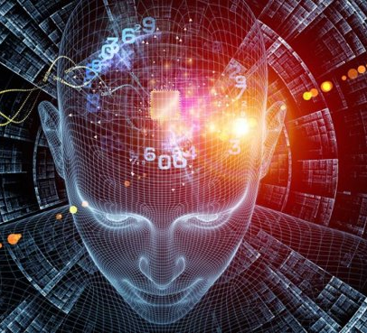
Agenda
Introduction ​
Objective
Methodology
Dataset​
Challenges Faced
Results and Analysis
Conclusion
Reference

Slide 3
introduction
Neural Machine Translation (NMT) has revolutionized the field of automated translation by providing more accurate and context-aware translations compared to traditional rule-based and statistical methods.
Advancing machine translation for Dravidian languages.​
Novel methodologies in neural machine translation (NMT).​
The development of multilingual models like the MT5, a variant of the T5 (Text-to-Text Transfer Transformer) model designed to handle multiple languages, has further expanded the potential of NMT systems.
Focus on low-resource language translation​
This introduction explores the application of the MT5 model for translating English into Dravidian languages—a group of languages primarily spoken in South India, including Tamil, Telugu, Kannada, and Malayalam.

Slide 4
objective
The key objectives of the paper as identified from the document:
Address Limited Resources: Tackle the challenge of developing robust bilingual machine translation systems, particularly under limited resource constraints which are common with low-resource languages like the Dravidian family .
Focus on Dravidian Languages: Specifically target the translation of English into other Dravidian languages such as Tamil, Telugu. This includes the development of machine translation systems tailored to these languages .
Experiment with Pre-trained and Fine tuning: Apply pre-trained model to finetuning techniques as a method of data augmentation to enrich training data, particularly for languages with limited monolingual data .
Evaluate with BLEU Scores: Use the BLEU score metric to evaluate the accuracy of the translation models, providing a quantitative measure of translation quality across different language pairs.

Slide 5
Neural Machine Translation
NMT is a type of machine translation that relies on artificial neural networks to predict the likelihood of a sequence of words, typically modeling entire sentences in a single integrated model.
NMT utilizes artificial neural networks to predict word sequences, offering an integrated model for entire sentences.
Compared to rule-based and statistical methods, NMT yields more fluent and accurate translations by capturing linguistic nuances.
While superior in output quality, NMT requires substantial data and computing power for training.
Significantly advances machine translation technology, underpinning many online translation services today.

Slide 6
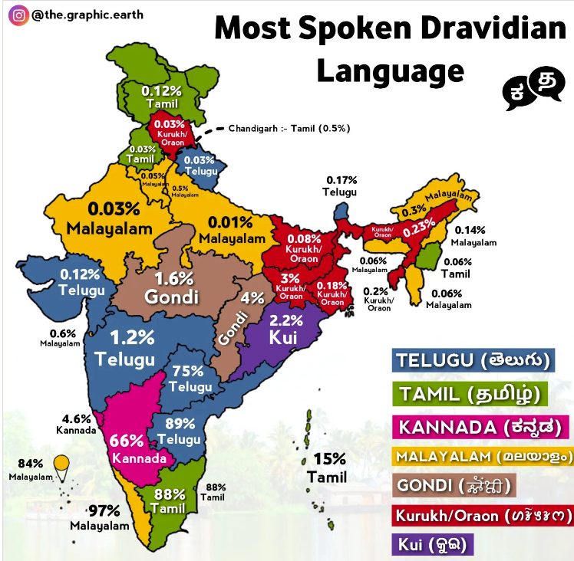
Importance of NMT for Dravidian languages
Facilitates seamless communication across Dravidian languages, vital for the linguistic diversity in South Asia.
Acts as a digital preservation tool for the literary and cultural heritage of these languages.
Ensures linguistic representation in the digital age, providing access to information and technology in native languages.

Slide 7
Challenges in NMT for low-resource languages
Some languages support Homograph words whose meaning changes with context.
E.g.: In Heart Attack and Dog attacks cat , attack is the homograph word.
Some languages have multiple scripts.
E.g.: Punjabi (Gurmukhi, Shahmukhi).
Grammatical variations between languages lead to ambiguity.
Judging of speakers intention is difficult. Meanings of sentences or words vary with the speakers intention (like sarcasm, sentiment, metaphor, etc.).
Code-Mixed language processing is challenging as user uses multiple languages in a sentence or an utterance.
E.g.: User tweet : “listening to Bombae Haelutaitae from Rajakumara”

Slide 8
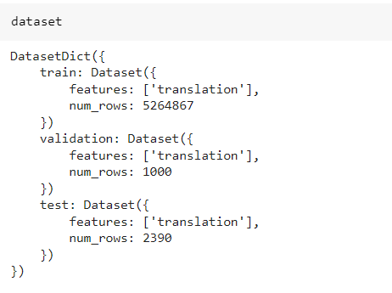
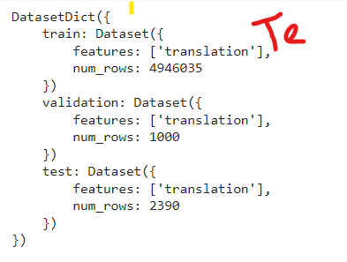
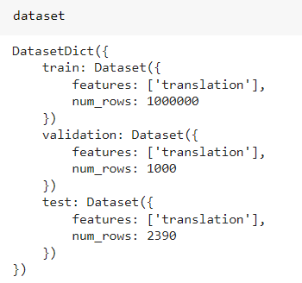
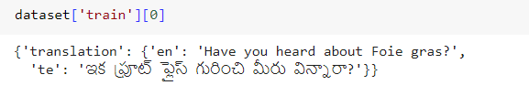
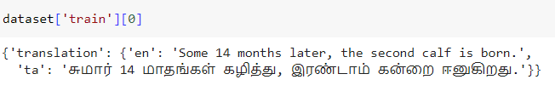
DATA SET

Slide 9
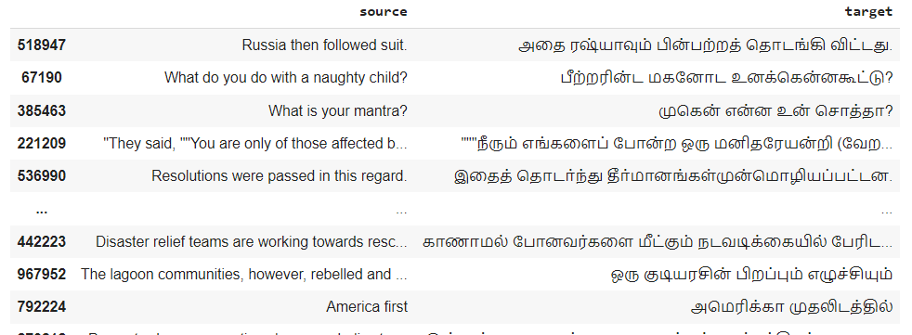

Slide 10
PROPOSED METHODOLOGY
Pre-Trained, Fine-Tuning

Slide 11
methodology
1. Environment Setup and Data Preparation
Installation of Necessary Libraries: The script begins by installing Python libraries such as transformers, sentencepiece, datasets, and sacrebleu that are essential for working with the MT5 model and handling language data.
Data Loading: Data files for training, validation, and testing are specified. Each file pair consists of parallel texts in English and Tamil. The script reads these files and creates a datasets.Dataset object for each set, ensuring the number of lines in English files matches those in Tamil to maintain accurate translation pairs.
2. Model and Tokenizer Initialization
MT5 Model Loading: The MT5 model and its corresponding tokenizer are loaded from Hugging Face's transformers library. This setup is critical for processing text in a format suitable for the model.
CUDA Configuration: If a GPU is available (checked via torch.cuda.is_available()), the model is configured to use it, enhancing the training speed and efficiency.

Slide 12
methodology
3. Data Encoding and Preparation
Text Encoding: The English and Tamil texts are tokenized using the MT5 tokenizer. The tokenized texts are then converted into tensors that the model can process. This step includes setting a maximum sequence length and ensuring the data fits this constraint by truncation or padding.
Data Batching: The tokenized data is divided into batches. This method improves the model's learning by not overwhelming it with too much data at once and helps in managing memory usage effectively.
4. Model Training
Optimization Setup: An AdamW optimizer and a learning rate scheduler are configured to update the model's weights efficiently during training.
Training Loop: The model undergoes training over multiple epochs, where it learns to translate from English to Tamil. Training involves feeding batches of data into the model, calculating the loss (how far the model's output is from the actual translation), and adjusting the model parameters to minimize this loss.
Loss Tracking and Evaluation: The script tracks the training loss to monitor the model’s performance. Periodically, the model's translation ability is evaluated using a validation set to ensure that it generalizes well to new data.

Slide 13
methodology
5. Model Saving and Loading
Saving the Model: After training, the model and tokenizer are saved to disk. This step allows the model to be reused later without retraining from scratch.
Loading the Model: The script includes functionality to reload the model and tokenizer from the saved files for further use or evaluation.
6. Evaluation and Translation
BLEU Score Calculation: The model's translation quality is quantitatively evaluated using the BLEU score, a common metric in machine translation that compares machine-generated text to one or more reference translations.
Translation Demonstration: The script showcases the model's translation capability by inputting English sentences and displaying the model-generated Tamil translations.
7. Visualization
Loss Visualization: Plots the training loss over time to visually assess how the model's performance improved during training.

Slide 14
Pre-Trained Model
What are the Model implemeted in the AI4Barath
Introduction to mT5:
Explain that mT5 is a multilingual extension of the T5 (Text-to-Text Transfer Transformer) model, developed by Google Research.
It is designed to handle tasks across multiple languages, capable of understanding and generating text in over 100 languages.
Model Architecture:
Describe the architecture of mT5, which follows the Transformer model framework with an encoder-decoder structure.
Highlight modifications made from the original T5 to better support multilingual capabilities.

Slide 15
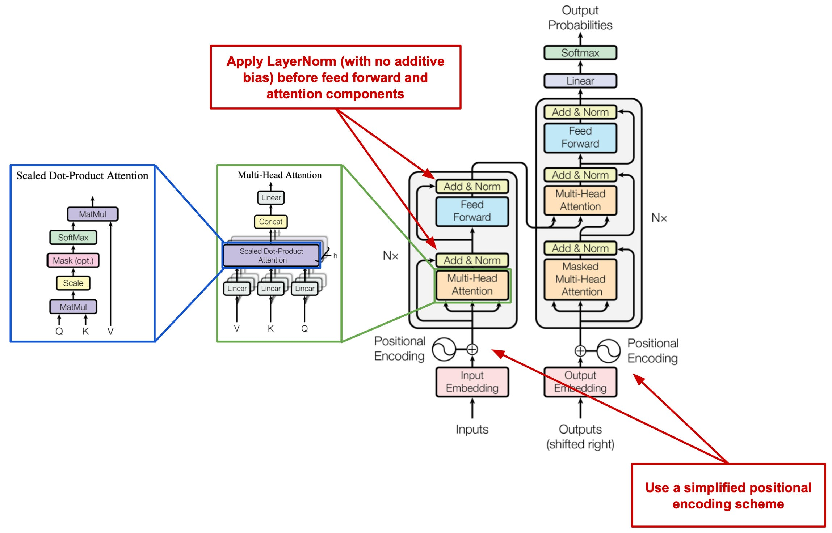
Pre-Trained Model

Slide 16
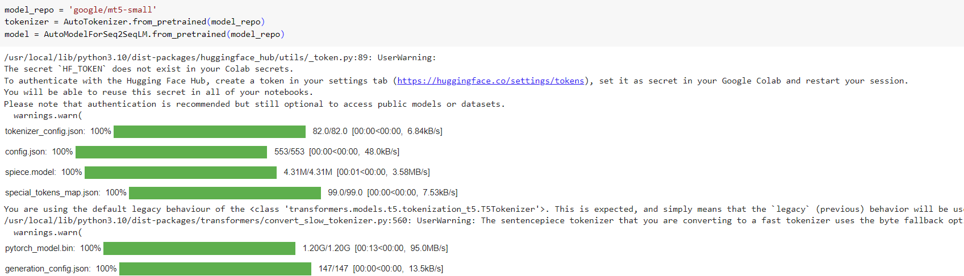

Slide 17
Attribute | T5 (Text-to-Text Transfer Transformer) | MT5 (Multilingual Text-to-Text Transfer Transformer)
Language Support | Primarily English, with potential adaptation to other languages. | Supports over 100 languages, inherently multilingual.
Training Data | C4 (Colossal Clean Crawled Corpus), predominantly English content. | mC4, a multilingual variant of C4, covering about 101 languages.
Task Flexibility | Versatile within English language tasks; requires fine-tuning for others. | Highly flexible across multiple languages without extensive retraining.
Use Cases | English text-based tasks such as summarization, question answering, text classification. | Multilingual tasks including translation, multilingual summarization, question answering across languages.
Model Complexity | Available in various sizes (small to XXL) tailored to computational needs and task requirements. | Similar variety in sizes, potentially higher resource requirements due to multilingual processing.
Ideal Environment | English-centric applications, academic research, single-language projects. | Global applications, multilingual environments, international businesses.

Slide 18
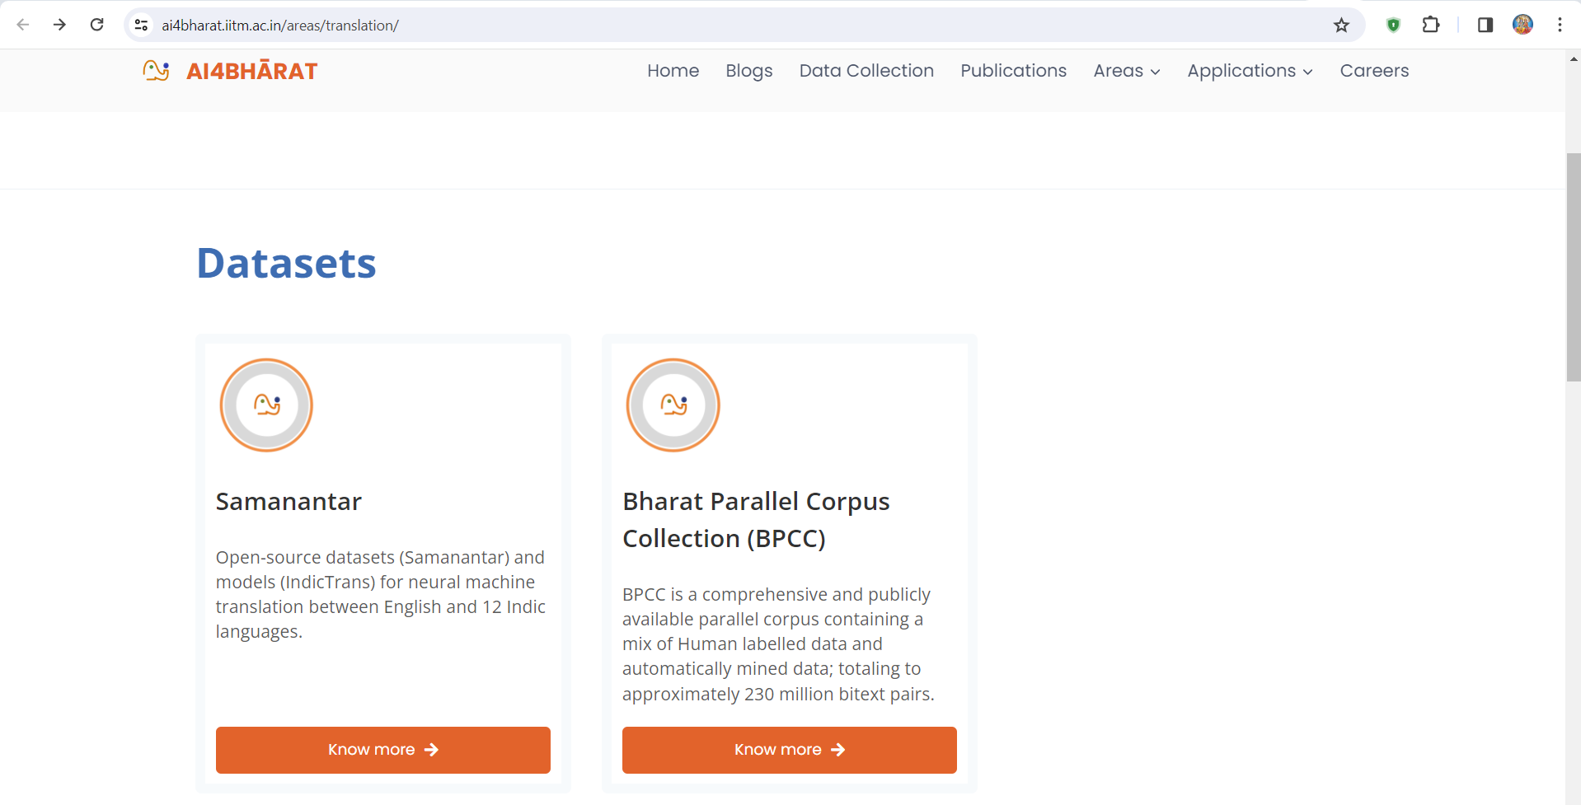
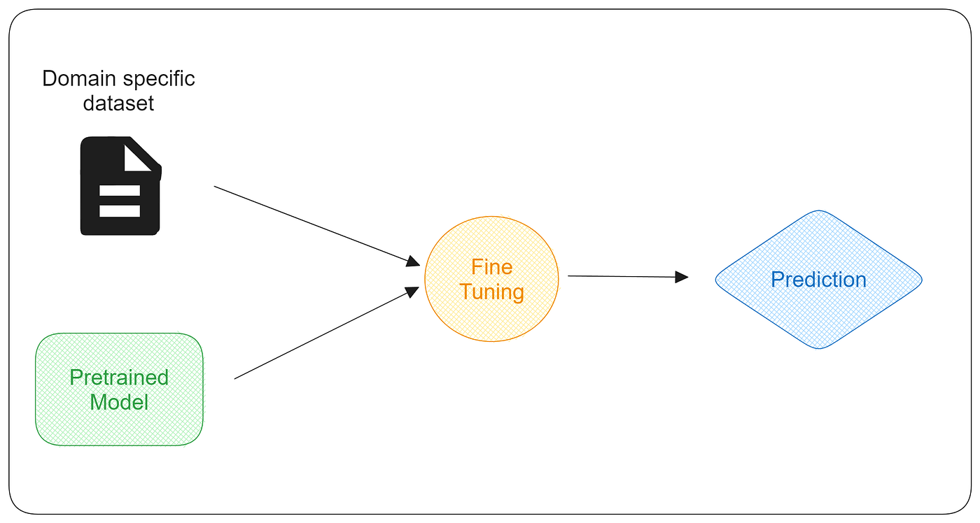
Fine Tuning
Fine-tuning was key to leveraging resources for high translation accuracy.
Adjusted hyperparameters, including learning rate, and used label smoothing to enhance model performance.

Slide 19
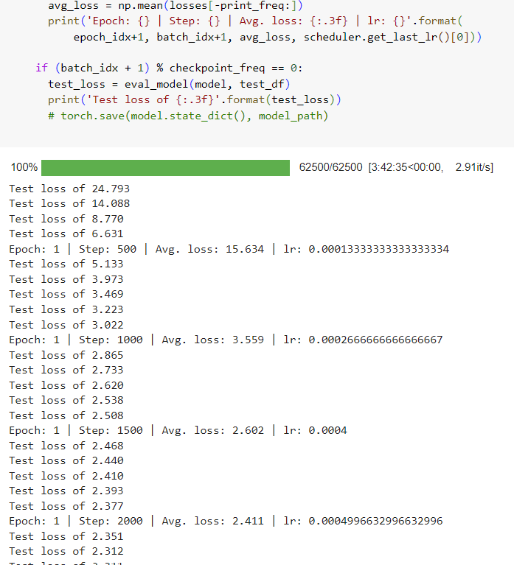

Slide 20
HYPER-Parameter
Model Selection
Model_repo = ‘google/mt5-small’
Tokenizer
Loss and Evaluation
Cross Entropy loss
Additonal parameter
Num_beams = 10
Max_length = 20
Optimizer and Scheduler
Optimizer = AdamW(model.parameters(), lr=lr)
Scheduler = get_linear_schedule_with_warmup(optimizer, n_warm_steps,total_steps)
Device Management
CUDA
Training parameter
N_epochs = 3
Batch_size = 16
Lr = 5e-4
N_warmup_steps = int(total_steps * 0.01)
Total_steps = n_epochs * n_batches
N_batches = int(ceil(len(train)/batch_size))

Slide 21
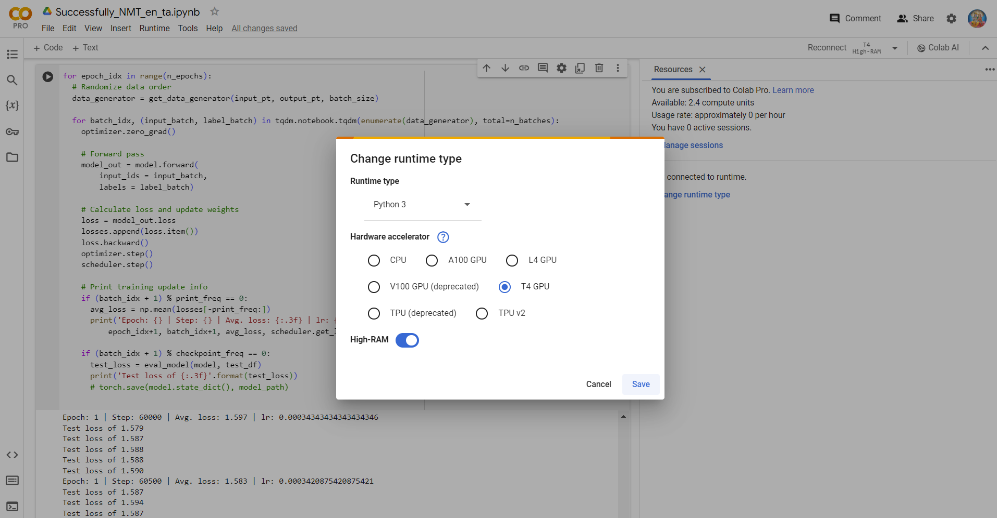
Requirements
Google Colab Pro
GPU Module (T4 GPU) or L4 GPU
Google Drive

Slide 22
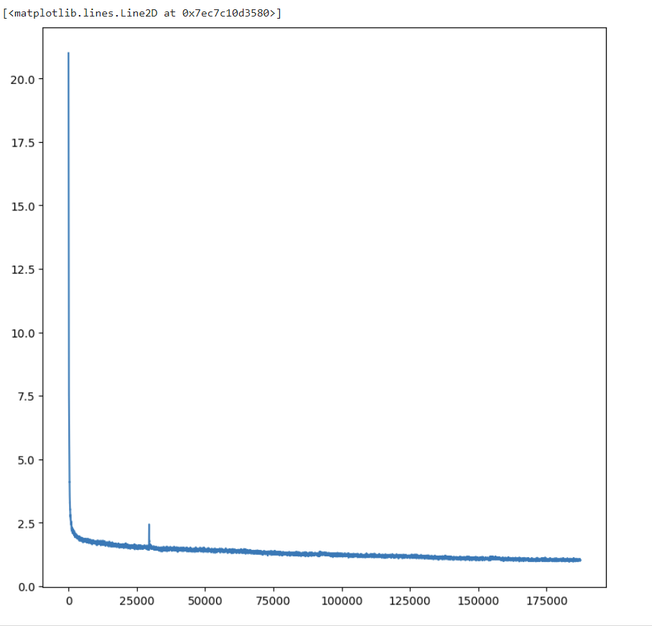
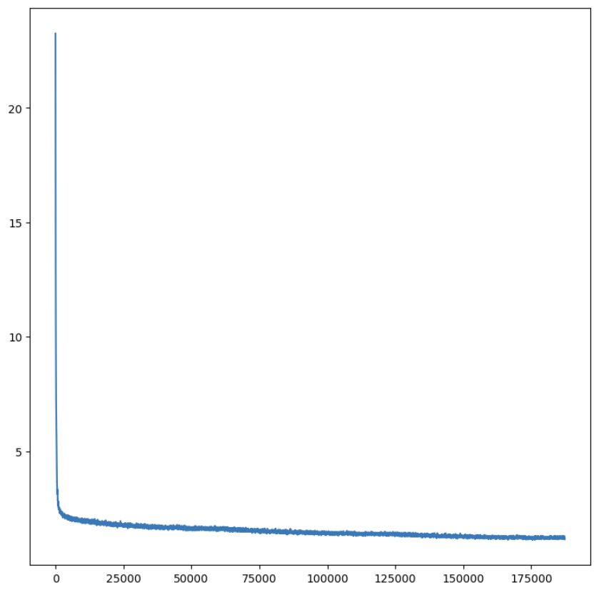
English – Telugu Losses
English – Tamil Losses

Slide 23
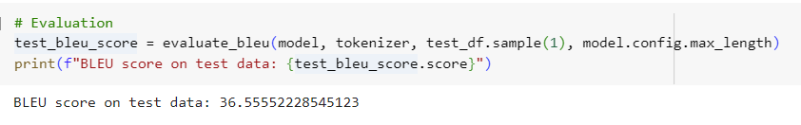
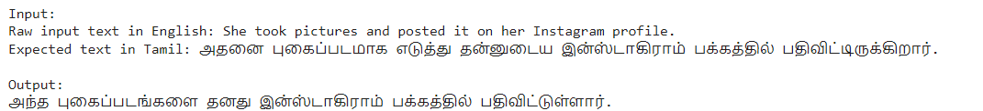
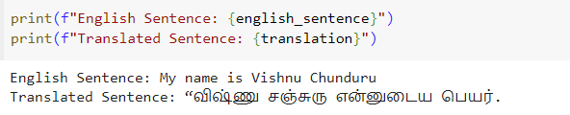
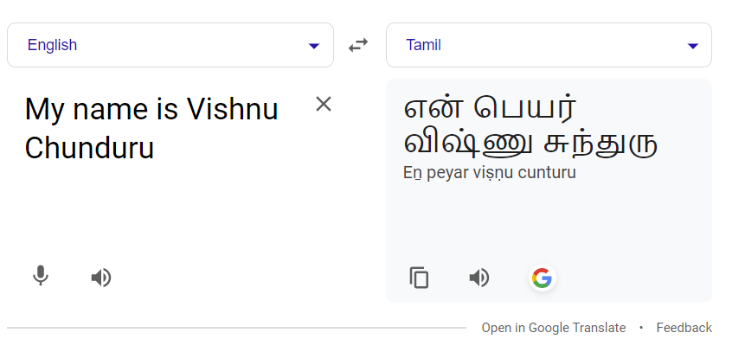
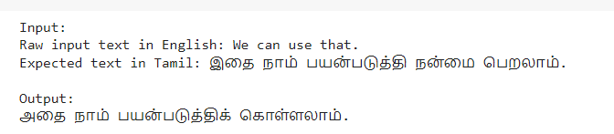
RESULTS
TAMIL

Slide 24
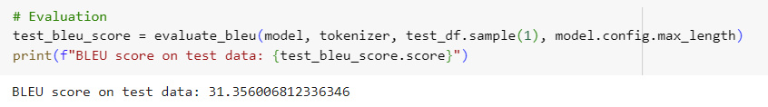
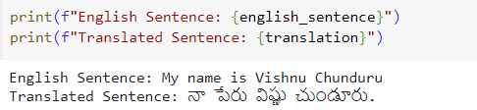
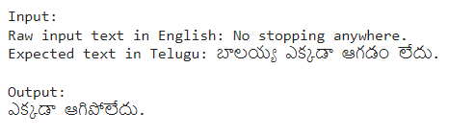
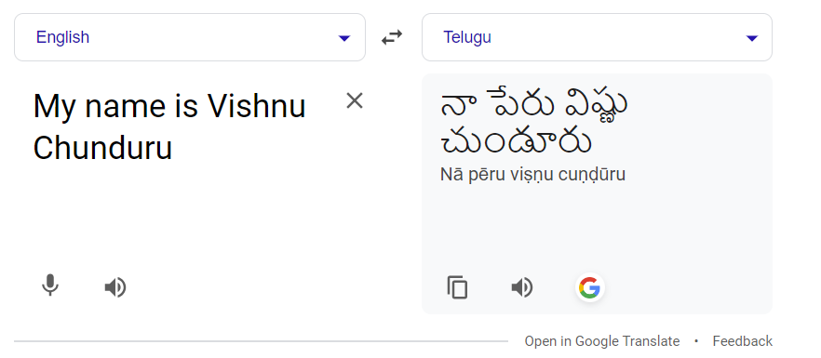
TELUGU

Slide 25
CONCLUSION
This project explored the application of the MT5 model in translating English into Dravidian languages, with a focus on Tamil and Telugu.
Our results demonstrated a notable difference in translation quality between the two languages.
The BLEU score for Tamil translations was 0.36, indicating a relatively higher translation accuracy compared to Telugu, which had a BLEU score of 0.31.
This disparity highlights the challenges and varying degrees of difficulty in machine translation across different languages within the Dravidian family.
The findings underscore the importance of continuous improvements and adaptations in machine translation models to enhance their effectiveness across diverse linguistic landscapes.

Slide 26
REFERENCE
PICT@DravidianLangTech-ACL2022: Neural Machine Translation On Dravidian Languages - Aditya Vyawahare, Rahul Tangsali, Aditya Mandke, Onkar Litake, Dipali Kadam
Vaswani, A., Shazeer, N., Parmar, N., et al. (2017). "Attention is All You Need." In Proceedings of the 31st Conference on Neural Information Processing Systems (NIPS 2017), Long Beach, CA, USA.
This paper introduces the Transformer model, which is the basis for many NMT systems, including MT5.
Raffel, C., Shazeer, N., Roberts, A., et al. (2020). "Exploring the Limits of Transfer Learning with a Unified Text-to-Text Transformer." Journal of Machine Learning Research, 21(140), 1-67.
Bharathi Raja Chakravarthi, Ruba Priyadharshini, Navya Jose, et al. (2020). "A Sentiment Analysis Dataset for Code-Mixed Malayalam-English." Proceedings of the 12th Language Resources and Evaluation Conference (LREC 2020), Marseille, France.
Although focused on sentiment analysis, this paper provides insights into handling code-mixed text in Dravidian languages, relevant to NMT for these languages.
Papineni, K., Roukos, S., Ward, T., et al. (2002). "BLEU: a Method for Automatic Evaluation of Machine Translation." Proceedings of the 40th Annual Meeting of the Association for Computational Linguistics (ACL), Philadelphia, PA, USA.
Introduces the BLEU score, a standard metric for evaluating machine translation quality.
J. Albert, V. Pandian (2019). "Neural Machine Translation of Dravidian Languages by Incorporating Linguistic Resources." Neural Computing and Applications.

Slide 27

Thank you
VISHNU CHOUNDUR
NARESH BOLISHETTY
VISHNU TEJA YERRAPRAGADA

