Slide 1

INF 212 ANALYSIS OF PROG. LANGS Type Systems
Instructors: Crista Lopes
Copyright © Instructors.

Slide 2
What is a Data Type?
A type is a collection of computational entities that share some common property
Programming languages are designed to help programmers organize computational constructs and use them correctly. Many programming languages organize data and computations into collections called types.
Some examples of types are:
the type Int of integers
the type (Int→Int) of functions from integers to integers

Slide 3
Why do we need them?
Consider “untyped” universes:
Bit string in computer memory
λ-expressions in λ calculus
Sets in set theory
“untyped” = there’s only 1 type
Types arise naturally to categorize objects according to patterns of use
E.g. all integer numbers have same set of applicable operations

Slide 4
Use of Types
Identifying and preventing meaningless errors in the program
Compile-time checking
Run-time checking
Program Organization and documentation
Separate types for separate concepts
Indicates intended use declared identifiers
Supports Optimization
Short integers require fewer bits
Access record component by known offset

Slide 5
Type Errors
A type error occurs when a computational entity, such as a function or a data value, is used in a manner that is inconsistent with the concept it represents
Languages represent values as sequences of bits. A "type error" occurs when a bit sequence written for one type is used as a bit sequence for another type
A simple example can be assigning a string to an integer or using addition to add an integer or a string
Notes:
hey!
ask her abt the different sub topics once..

Slide 6
Type Systems
A tractable syntactic framework for classifying phrases according to the kinds of values they compute
By examining the flow of these values, a type system
attempts to prove that no type errors can occur
Seeks to guarantee that operations expecting a certain kind of value are not used with values for which that operation does not make sense

Slide 7
Type Safety
A programming language is type safe if no program is allowed to violate its type distinctions
Example of current languages:
Not Safe : C and C++
Type casts, pointer arithmetic
Almost Safe : Pascal
Explicit deallocation; dangling pointers
Safe : Lisp, Smalltalk, ML, Haskell, Java, Scala
Complete type checking
Notes:
hey!
ask her abt the different sub topics once..

Slide 8
Type Declarations
Two basic kinds of type declaration:
transparent
meaning an alternative name is given to a type that can also be expressed without this name
For example, in C, the statements,
typedef char byte;
typedef byte ten bytes[10];
the first, declaring a type byte that is equal to char and the second an array type ten bytes that is equal to arrays of 10 bytes
Notes:
hey!
ask her abt the different sub topics once..

Slide 9
Type Declarations
2. Opaque
Opaque, meaning a new type is introduced into the program that is not equal to any other type
Example in C,
typedef struct Node{
int val;
struct Node *left;
struct Node* right;
}N;

Slide 10
Type Checking - Compile Time
Check types at compile time, before a program is started
In these languages, a program that violates a type constraint is not compiled and cannot be executed
Expressiveness of the Compiler:
a) sound
If no programs with errors are considered correct
b) conservative
if some programs without errors are still considered
to have errors (especially in the case of type-safe languages )
Notes:
hey!
ask her abt the different sub topics once..

Slide 11
Type Checking - Run Time
The compiler generates the code
When an operation is performed, the code checks to make sure that the operands have the correct type
Combining the Compile and Run time
Most programming languages use some combination of compile-time and run-time type checking
In Java, for example, static type checking is used to distinguish arrays from integers, but array bounds errors are checked at run time.
Notes:
hey!
ask her abt the different sub topics once..

Slide 12
A Comparison – Compile vs. Run Time
Form of Type Checking | Advantages | Disadvantages
Compile - Time |  | May restrict programming because tests are conservative
Run - Time | Prevents type errors Need not be conservative | Slows Program Execution
Prevents type errors
Eliminates run-time tests
Finds type errors before execution and run-time tests
Notes:
hey!
ask her abt the different sub topics once..

Slide 13
Type Inference
Process of identifying the type of the expressions based on the type of the symbols that appear in them
Similar to the concept of compile type checking
All information is not specified
Some degree of logical inference required
Some languages that include Type Inference are Visual Basic (starting with version 9.0), C# (starting with version 3.0), Clean, Haskell, ML, OCaml, Scala
This feature is also being planned and introduced for C++0x and Perl6
Notes:
hey!
ask her abt the different sub topics once..

Slide 14
Type Inference
Example: Compile Time checking:
For language, C:
int addone(int x) { int result; /*declare integer result (C language)*/
result = x+1;
return result;
}
Lets look at the following example, addone(x) {
val result; /*inferred-type result */
result = x+1;
return result;
}
Notes:
hey!
ask her abt the different sub topics once..

Slide 15
Haskell Type Inference Algorithm
There are three steps:
Assign a type to the expression and each subexpression.
Generate a set of constraints on types, using the parse tree of the expression.
Solve these constraints by means of uniﬁcation, which is a substitution-base algorithm for solving systems of equations.
Notes:
hey!
ask her abt the different sub topics once..

Slide 16
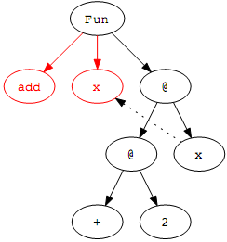
Explanation of the Algorithm
Consider an example function:
add x = 2 + x
add :: Int → Int
Step 0:
Construct a parse tree.
Node 'Fun' represents function declaration.
Children of Node 'Fun' are name of the
function 'add', its argument and function body.
The nodes labeled ‘@’ denote function applications, in which the left child is applied to the right child.
Constant expressions like '+', '3' and variables also have their own node.
Notes:
hey!
ask her abt the different sub topics once..

Slide 17
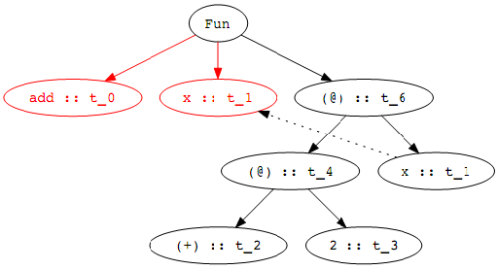
Explanation of the Algorithm
Step 1:
Assign a type variable to the expression and each subexpression.
Each of the types, written t_i for some integer i,is a type variable, representing the eventual type of the associated expression.
Notes:
hey!
ask her abt the different sub topics once..

Slide 18
Explanation of the Algorithm
Step 2:
Generate a set of constraints on types, using the parse tree of the expression.
Constant Expression: we add a constraint equating the type variable of the node with the known type of the constant
Variable will not introduce any type constraints
Function Application (@ nodes): If the type of 'f' is t_f, the type of 'a' is t_a, and the type of 'f a' is t_r,then we must have t_f = t_a -> t_ r
Function Deﬁnition: If 'f' is a function with argument 'x' and body 'b',then if 'f' has type 't_f', 'x' has type t_x, and 'b' has type 't_b', then these types must satisfy the constraint t_f=t_x -> t_b
Notes:
hey!
ask her abt the different sub topics once..

Slide 19
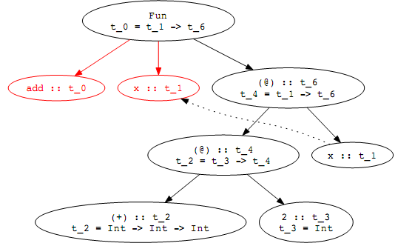
Explanation of the Algorithm
Set of Constraints generated:
t_0 = t_1 -> t_6
t_4 = t_1 -> t_6
t_2 = t_3 -> t_4
t_2 = Int -> (Int -> Int)
t_3 = Int
Notes:
hey!
ask her abt the different sub topics once..

Slide 20
Explanation of the Algorithm
Step 3:
Solve the generated constraints using unification
For Equations (3) and (4) to be true, it must be the case that
t_3 -> t_4 = Int -> (Int -> Int), which implies that
6. t_3 = Int
7. t_4 = Int -> Int
Equations (2) and (7) imply that
8. t_1 = Int
9. t_6 = Int
Notes:
hey!
ask her abt the different sub topics once..

Slide 21
Result of the Algorithm
Thus the system of equations that satisfy the assignment of all the variables:
t_0 = Int -> Int
t_1 = Int
t_2 = Int -> Int -> Int
t_3 = Int
t _4 = Int -> Int
t _6 = Int
Notes:
hey!
ask her abt the different sub topics once..

Slide 22
Polymorphism

Slide 23
Polymorphism
Constructs that can take different forms
poly = many morph = shape

Slide 24
Types of Polymorphism
Ad-hoc polymorphism similar function implementations for different types (method overloading, but not only)
Subtype (inclusion) polymorphism instances of different classes related by common super class
Parametric polymorphism functions that work for different types of data
class A {...}
class B extends A {...}; class C extends A {...}
def plus(x, y):
return x + y

Slide 25
Ad-hoc Polymorphism
int plus(int x, int y) {
return x + y;
}
string plus(string x, string y)
{
return x + y; }
float plusfloat(float x, float y)
{
return x + y; }

Slide 26
Subtype Polymorphism
First introduced in the 60s with Simula
Usually associated with OOP (in some circles, polymorphism = subtyping)
Principle of safe substitution (Liskov substitution principle) Note that this is behavioral subtyping, stronger than simple functional subtyping.
“if S is a subtype of T, then objects of type T may be
replaced with objects of type S without altering any
of the desirable properties of the program.”

Slide 27
Behavioral Subtyping Requirements
Contravariance of method arguments in subtype (from narrower to wider, e.g. Triangle to Shape)
Covariance of return types in subtype (from wider to narrower, e.g. Shape to Triangle)
Preconditions cannot be strengthened in subtype
Postcondition cannot be weakened in subtype
History constraint: state changes in subtype not possible in supertype are not allowed (Liskov’s constraint)

Slide 28
LSP Violations?
class Thing {...}
class Shape extends Thing {
Shape m1(Shape a) {...}
}
class Triangle extends Shape {
@Override
Triangle m1(Shape a) {...}
}
class Square extends Shape {
@Override
Thing m1(Shape a) {...}
}
Java does not support contravariance
of method arguments

Slide 29
LSP Violations?
class Thing {...}
class Shape extends Thing {
Shape m1(Shape a) {
assert(Shape.color == Color.Red);
...
}
}
class Triangle extends Shape {
@Override
Triangle m1(Shape a) {
assert(Shape.color == Color.Red);
assert(Shape.nsizes == 3);
...
}
}

Slide 30
Parametric Polymorphism
Parametric polymorphism functions that work for different types of data
def plus(x, y):
return x + y
How to do this in statically-typed languages?
int plus(int x, int y):
return x + y
???

Slide 31
Parametric Polymorphism
Parametric polymorphism for statically-typed languages introduced in ML in the 70s
aka “generic functions”
C++: templates
Java: generics
C#, Haskell: parametric types

Slide 32
Parametric Polymorphism
Explicit Parametric Polymorphism
C++ implements explicit polymorphism, in which explicit instantiation or type application to indicate how type variables are replaced with speciﬁc types in the use of a polymorphic value.
Example:
template <typename T>
T lessthan(T& x, T& y){
if( x < y) return x;
else
return y;
}
We define a template function with T as a parameter which can take any type as a parameter to the function.

Slide 33
Parametric Polymorphism
Explicit Parametric Polymorphism
Java example:
/**
* Generic version of the Box class.
* @param <T> the type of value being boxed
*/
public class Box<T> {
// T stands for "Type"
private T t;
public void add(T t) {
this.t = t;
}
public T get() {
return t;
}
}
Box<Integer> integerBox;
...
void m(Box<Foo> fbox) {...}

Slide 34
Parametric Polymorphism
Implicit parametric polymorphism
Haskell uses polymorphic functions that do not need to contain types
The inference algorithm computes when a function is polymorphic and computes the instantiation of type variables as needed
Example:
template <type t>
insert(less :: (t, t) -> Bool, x :: t, [] :: [t]) = [x]
insert(less, x, y:ys) = if less(x,y) then x:y:ys
else y:insert(less,x,ys)
Type Inference Algorithm can be simply considered as preprocessor that converts expression without type information into expression in intermediate language with templates
Notes:
hey!
ask her abt the different sub topics once..

Slide 35
Video
The structure of a compiler

