Slide 1

Seasonal Agriculture Performance Analysis
Student Name: Vinit Chaurasia
College Name: [Your College Name]
AICTE STU ID: [Your AICTE Student ID]
Major Data Analytics Project | VOIS Internship Program

Slide 2

PROBLEM STATEMENT
• Agricultural Context: Agricultural productivity in India is governed by distinct seasons (Kharif, Rabi, Zaid), resulting in dramatic variations in rainfall, temperature, humidity, and soil moisture.
• Core Industry Challenge: Raw agricultural data does not clearly explain how farm management practices, resource usage (water, fertilizers, pesticides), and economic outcomes interact across seasonal cycles.
• Primary Objective: Analyze 4,000 farm records across 8 states to investigate seasonal performance disparities, identify key yield drivers, assess water efficiency, and map disease/pest vulnerabilities.
• Key Questions Addressed: Which season offers the highest return on investment? How do specific crops perform across seasons? Are observed differences across seasons statistically significant?

Slide 3
Project Description
Dataset Granularity:
Evaluates 4,000 farm records across 8 Indian States (Maharashtra, Karnataka, Andhra Pradesh, Gujarat, Punjab, Tamil Nadu, Telangana, Madhya Pradesh) spanning 28 physical, operational, and financial features.
Three-Season Analytical Framework:
• Kharif (Monsoon): High precipitation (avg 849 mm), peak moisture (31.1%), dominant output (5.63 t/ha), elevated pest risk (54.5%).
• Rabi (Winter): Favorable cool climate (avg 23.5°C), stable productivity (5.04 t/ha), dependable cash margins.
• Zaid (Summer): Extreme heat (avg 31.0°C), low rainfall (305 mm), peak water usage (6,420 m³), net deficits.
End-to-End Analytics Workflow:
Data Quality Auditing -> Median Imputation -> 1.5xIQR Outlier Assessment -> Univariate/Bivariate/Multivariate EDA -> Non-Parametric Hypothesis Testing (Kruskal-Wallis, Chi-Square, Spearman) -> Decision Recommendations.

Slide 4

WHO ARE THE END USERS?
1. Farmers & Farmer Producer Organizations (FPOs): Enables data-driven seasonal crop selection to maximize profit margins (e.g. Chilli/Sugarcane) and avoids water-intensive cereal crops during water-deficit Zaid months.
2. Agricultural Extension Officers & Agronomists: Provides empirical evidence to advocate for precision micro-irrigation (Drip/Sprinkler) and proactive pest control before monsoon humidity surges.
3. Policy Makers & Ministry of Agriculture: Directs targeted irrigation and power subsidies to water-stressed regions, and informs MSP procurement planning based on seasonal supply forecasts.
4. Agri-Fintech, Banks & Crop Insurance Providers: Improves agricultural credit scoring, loan risk calibration, and premium pricing based on seasonal farm profitability dynamics.

Slide 5

Technology Used
  • Programming Language: Python 3.10 (High performance numerical execution & data science ecosystem)
• Data Manipulation & Profiling: Pandas & NumPy (DataFrames, GroupBy aggregations, missing value median imputation, IQR boundary modeling)
• Exploratory Data Visualization: Matplotlib & Seaborn (Statistical heatmaps, grouped bar charts, KDE histograms, boxplots, pairplots)
• Inferential & Hypothesis Testing: SciPy.stats (Kruskal-Wallis non-parametric H-tests, Chi-Square contingency analysis, Spearman rank correlation)
• Environment & Version Control: Google Colab, Jupyter Notebooks, Git & GitHub for reproducible open-source research

Slide 6
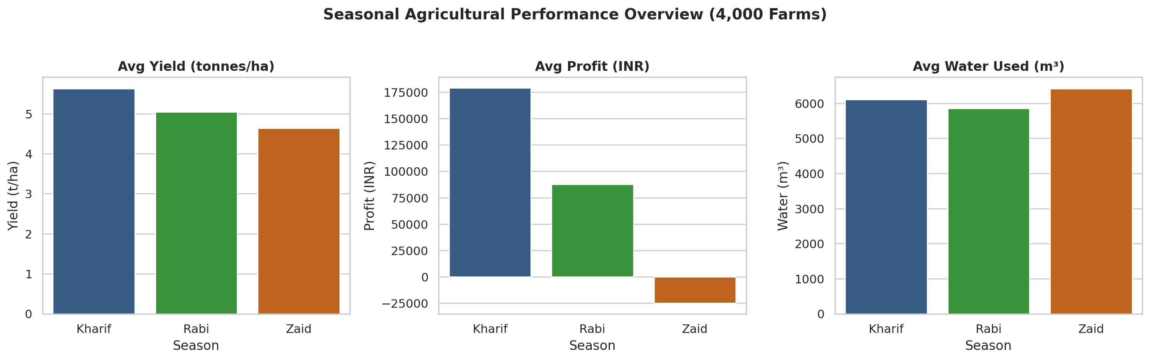
RESULTS: Executive Summary & Seasonal Dynamics
• Kharif (Peak Output): Generates highest average yield (5.63 t/ha) and net profits (INR 178,914/farm; 51.5% profitable farms) supported by 849.2 mm monsoon rainfall.
• Rabi (Seasonal Stability): Steady productivity (5.04 t/ha) and positive margins (INR 87,689/farm) driven by controlled 23.5°C winter climate and reliable soil moisture.
• Zaid (Deficit Period): Financial stress phase (-INR 24,804/farm) with highest water consumption (6,419.9 m³) due to severe heat (31.0°C) and low rainfall (304.7 mm).
• Water Efficiency: Natural precipitation boosts Kharif water efficiency (5.89 t/1,000 m³), whereas Zaid yields lower output per unit volume of water.

Slide 7
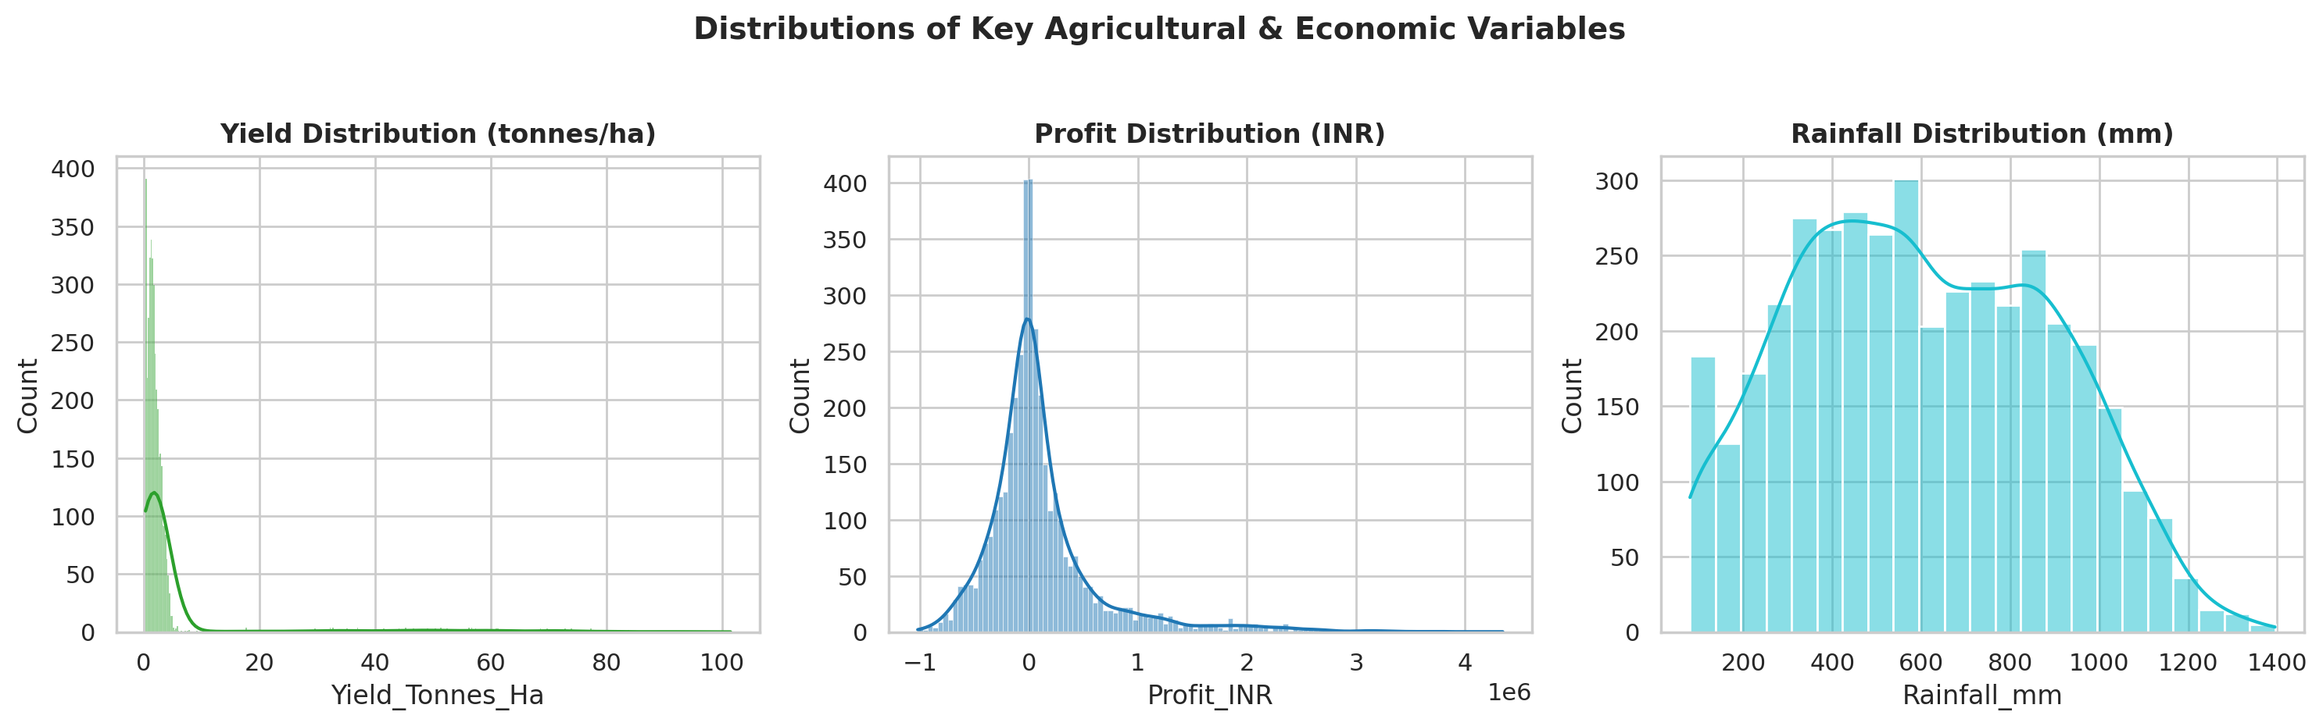
RESULTS: Exploratory Data Analysis & Distributions
• Data Quality & Cleaning: Missingness in Rainfall (1.2%), Soil Moisture (1.0%), and Yield (0.8%) successfully resolved via median imputation. Zero duplicates detected across 4,000 rows.
• Skewed Yield Profile: Agricultural yield is right-skewed (median: 1.74 t/ha vs mean: 5.24 t/ha) due to massive biomass production in Sugarcane (up to 101.4 t/ha).
• Profit Distribution: Farm profit ranges from -INR 1.02M to +INR 4.35M (median: INR 3,673), demonstrating wide economic variance across crop types and seasonal windows.
• Environmental Consistency: Rainfall shows multi-modal distribution aligned with monsoon patterns, while Temperature and Humidity are normally distributed.

Slide 8
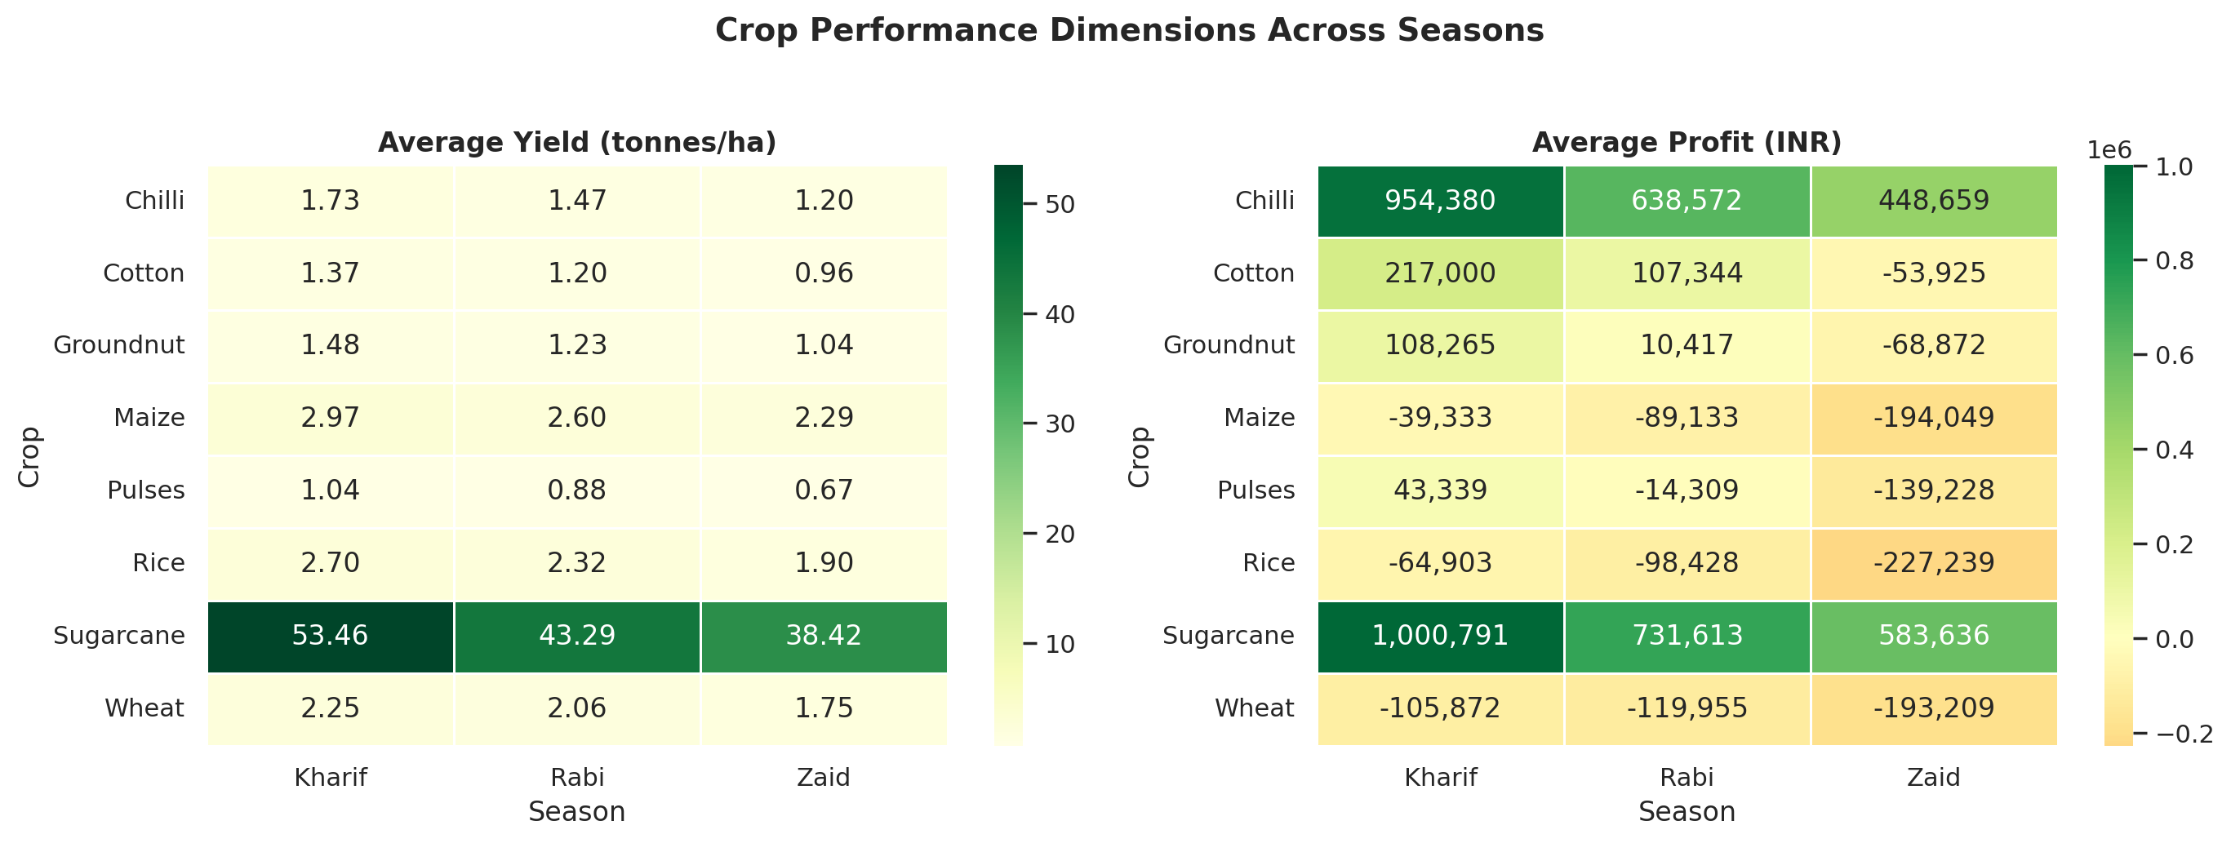
RESULTS: Crop-Season Interactions & Heatmaps
• Sugarcane Dominance: Achieves highest physical tonnage across all seasons (Kharif: 53.46 t/ha, Rabi: 43.29 t/ha, Zaid: 38.42 t/ha) and net profits exceeding INR 1.0M.
• High-Margin Chilli: Commands superior farm profit (Kharif: INR 954k, Rabi: INR 638k, Zaid: INR 448k) despite modest yield (~1.5 t/ha), benefiting from premium market price (>INR 90,000/tonne).
• Cereal Deficits (Rice & Wheat): Both staple crops suffer negative net profits across multiple seasons (-INR 64k to -INR 227k) due to high input costs relative to market realizations.
• Water Efficiency Matrix: Sugarcane achieves peak physical efficiency (36.0 t/1,000 m³ in Kharif), whereas Rice requires substantial water volumes for modest physical output.

Slide 9
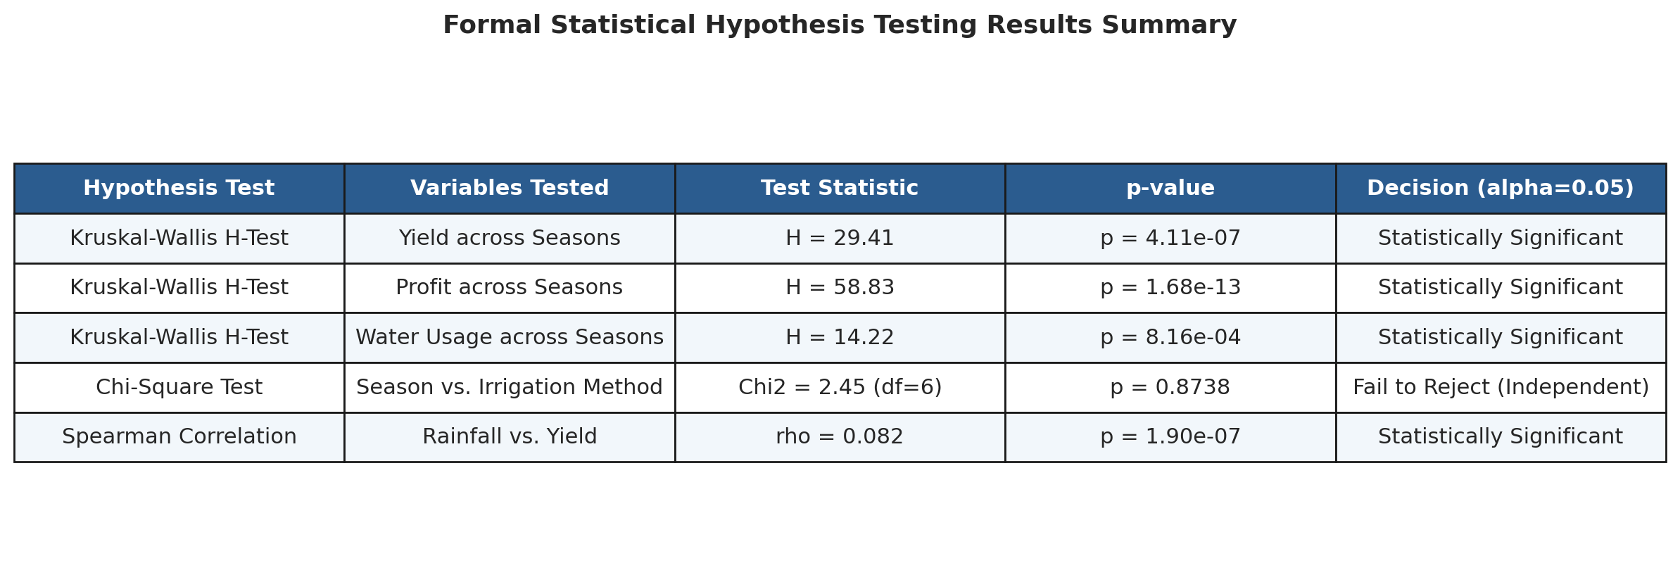
RESULTS: Statistical Hypothesis Testing
Rigorous non-parametric statistical tests were executed to validate that seasonal differences are genuine and statistically significant:
• Yield across Seasons (Kruskal-Wallis): H = 29.41, p = 4.11e-07 -> Statistically Significant. Yield distributions differ significantly across Kharif, Rabi, and Zaid.
• Profit across Seasons (Kruskal-Wallis): H = 58.83, p = 1.68e-13 -> Highly Significant. Farm profit is strongly season-dependent.
• Irrigation Method Independence (Chi-Square): Chi2 = 2.45, p = 0.8738 -> Fail to Reject. Current irrigation method choices do not vary by season, indicating clear modernization opportunities.

Slide 10
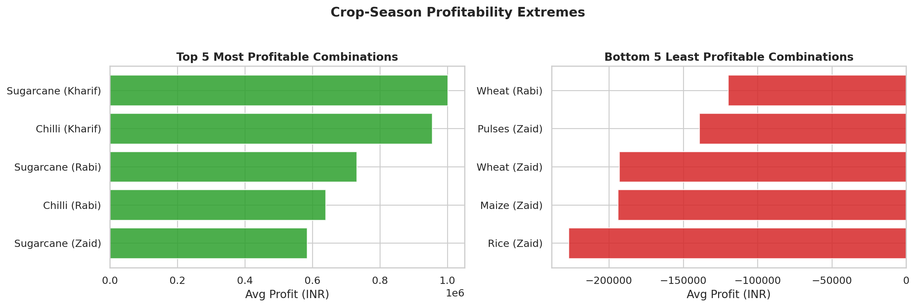
RESULTS: Profitability Extremes & Risk Assessment
• Top 5 Profitable Combinations: Sugarcane (Kharif: INR 1.00M), Chilli (Kharif: INR 954k), Sugarcane (Rabi: INR 732k), Chilli (Rabi: INR 639k), Sugarcane (Zaid: INR 584k).
• Bottom 5 Deficit Combinations: Rice (Zaid: -INR 227k), Maize (Zaid: -INR 194k), Wheat (Zaid: -INR 193k), Pulses (Zaid: -INR 139k), Wheat (Rabi: -INR 120k).
• Disease & Pest Vulnerability: Pest risk is highest during Kharif (54.5%) due to monsoon humidity (71.8%) and elevated soil moisture (31.1%), dropping to 38.2% in Zaid.
• Cost vs Revenue Trade-Off: Average costs remain high (~INR 513k to 544k) across all seasons, but Kharif revenues (INR 711k) vastly surpass Zaid revenues (INR 519k).

Slide 11
Future Scope
1. Predictive Machine Learning Modeling:
Develop supervised machine learning pipelines (Random Forest, XGBoost, CatBoost) to forecast crop yields and compute profit probabilities before the sowing window.
2. IoT Sensor Integration & Precision Agriculture:
Deploy field IoT sensor networks to continuously monitor soil moisture, micro-climates, and N-P-K nutrient depletion for automated, precision drip irrigation scheduling.
3. Satellite Remote Sensing & NDVI Tracking:
Integrate multi-spectral satellite imagery (Sentinel-2 / Landsat) to track vegetation indices (NDVI/EVI), detecting crop stress, drought severity, and pest hotspots in real-time.
4. Dynamic Digital Advisory & Market Platform (DSS):
Build a bilingual mobile-first decision support application offering localized sowing recommendations, weather risk alerts, and real-time mandi market price trends to eliminate intermediary exploitation.

Slide 12
GitHub Repository
Repository Link:
https://github.com/AswiniKumar55/-Seasonal-Agriculture-Performance-Analysis-.git
Repository Contents:
• Seasonal_Agriculture_Performance_Data_Analytics.ipynb (Complete, clean Colab/Jupyter Notebook)
• seasonal_agriculture_performance_dataset.csv (Cleaned & imputed 4,000-record dataset)
• High-resolution visualization exports, correlation matrices & statistical testing scripts
• Comprehensive project documentation, methodology reports, and rubric compliance verification

Slide 13
VOIS Course Completion Certificate
Course Name: Data Visualization
[ Insert your VOIS Data Visualization Course Completion Certificate Image Here ]
(Right-click -> Change Picture -> Choose your certificate file)

Slide 14
Thank You!
Seasonal Agriculture Performance Analysis
Major Data Analytics Project | VOIS Internship Program
Open for Questions & Discussion

