Slide 1

PHOTON
A Dynamically Reconfigurable Hybrid
Nano-photonic-Electric Network-on-Chip Shirish Bahirat Sudeep Pasricha
{shirish.bahirat@colostate.edu} {sudeep@colostate.edu}
Colorado State University

Slide 2
Chip Multi Processors (CMPs)
Single Core
Multi-Core
Networks On Chip
IP
IP
IP
IP
IP
IP
IP
IP
R
R
R
R
IP
IP
IP
IP
Bus
Memory
R
R
R
R
I/O
IP
IP
IP
IP
Memory
I/O
R
R
R
R
Hard Disk
IP
IP
IP
IP
Hard Disk
R
R
R
R
Increasing application complexity
Parallel processing
Bus based architecture does not scale
High Latency, Low Bandwidth, Low Predictability
Networks-on-chip (NoCs) enable multi-core systems
Better Bandwidth, Scalability and reliability

Slide 3
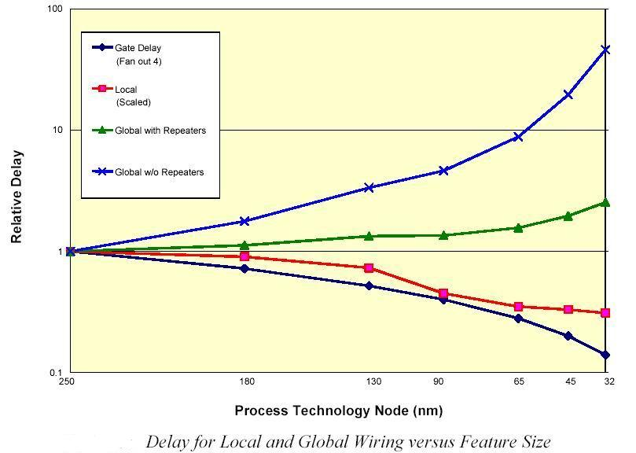
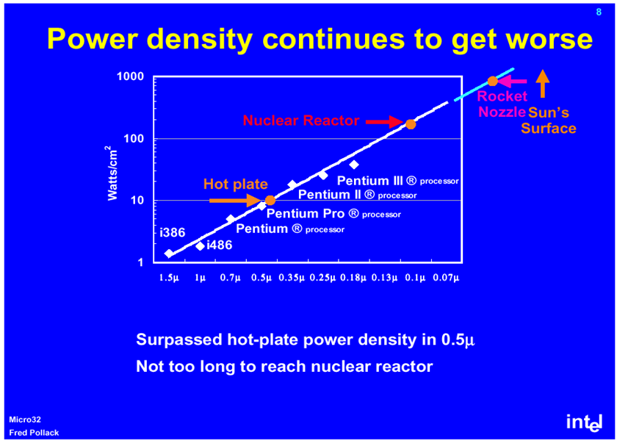
On Chip Interconnect Challenges
key challenge: Communication
Scalability
Performance
Power
NoC helps! However
High latency
High Power Dissipation
~40% of overall power in MIT RAW
~30% of overall power in Intel 80 core teraflop chip
Temperature, chip reliability etc

Slide 4
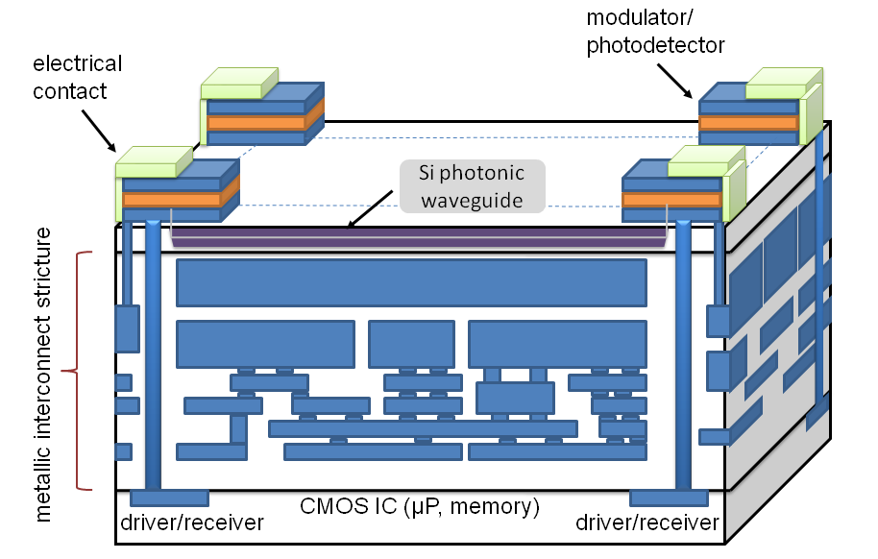
Contribution
Propose novel hybrid nanophotonic-electric architecture called PHOTON
Low Latency, High Bandwidth, Low Power
Photonic ring interfaced with 2D electrical mesh
Key enabler: CMOS ICs with 3D integration
Separate photonic and logic layers

Slide 5
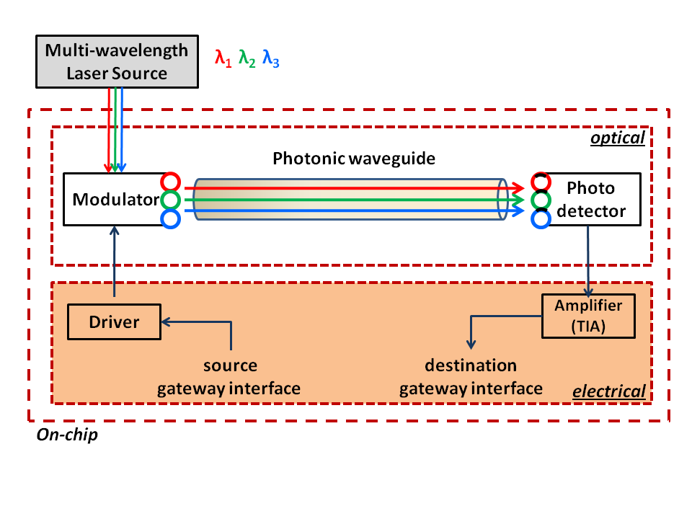
Components Photonic Interconnect
Laser light source: multi-wavelength mode-locked
Modulator: microring-resonator structure
Detector: SiGe photodetector w/ microring resonator filters
Waveguide: high refractive index Silicon On Insulator (SOI)
WDM: Wave Length Division Multiplexing
n interfacing cores having exclusive access to λ/n wavelengths

Slide 6
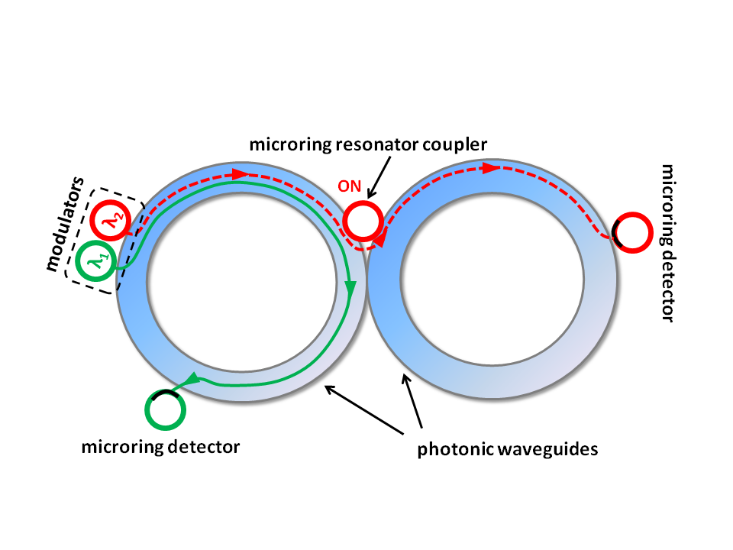
Components of Photonic Ring
Microring resonators as couplers
Destructive overlap with older messages in ring
Attenuators before each modulator
Sink for corresponding wavelength if signal goes full circle

Slide 7
Photonic Region of Influence (PRI)
Number of cores around gateway utilizing photonic path
PRI SIZE = 4
PRI SIZE = 1
IP
IP
IP
IP
IP
IP
G
R
R
R
R
R
G
R
IP
IP
IP
IP
IP
IP
R
R
R
R
R
R
IP
IP
IP
IP
IP
IP
R
R
R
R
R
R
IP
IP
IP
IP
IP
IP
R
R
R
R
R
R
IP
IP
IP
IP
IP
IP
G
R
R
R
R
R
R
G
IP
IP
IP
IP
IP
IP
R
R
R
R
R
R
PRI SIZE = 6
PRI SIZE = 3

Slide 8
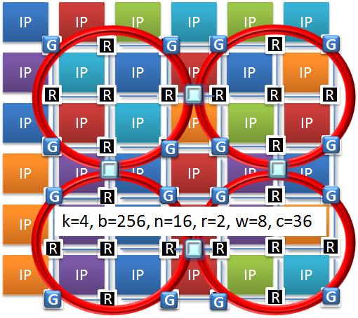
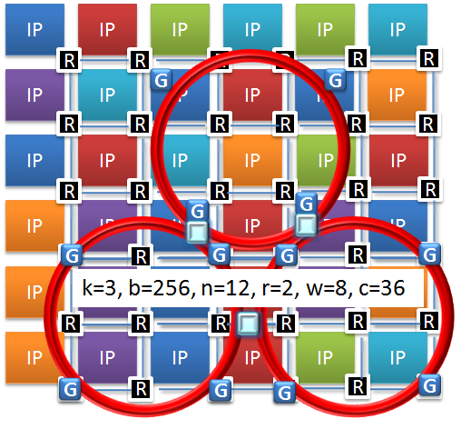
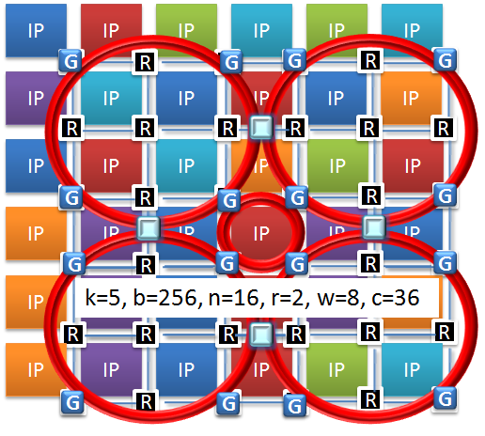
PHOTON Multi Ring Topology
6-tuple <k,b,n,r,w,c> Paramerization
k: Number of photonic rings
b: Bitwidth of the waveguides
n: Number of gateway interfaces
r: PRI size
w: Number of WDM channels
c: Number of cores in the CMP
k=4,b=256, n=16,r=2,w=16,c=36
k=3,b=256, n=12,r=2,w=16,c=36
k=5,b=256, n=16,r=2,w=16,c=36

Slide 9
System Level Architecture
Electrical Mesh
Wormhole switching
Flit width of 256
Regular 2D electrical mesh topology
Input queued crossbar, with 4-flit buffer at ports
Enhanced XY dimension order routing
Photonic ring
Parallel waveguides = flit width = 256
Gateway interface routers enable inter-layer transfers
Reduces router overhead
ACK/NACK flow control
If multiple requests contend for access to the photonic waveguide at a gateway interface, then the request with the furthest distance given priority

Slide 10
PRI Aware X-Y Router
Timeout Monitor
Region Validation
Routing and Switch Allocation
Arbitration
Data
Data
N
6x6 Crossbar
Switch
N
Flow Ctrl
Flow Ctrl
W
W
E
E
S
S
Local
Local
Optical
Optical
Input Ports
Output Ports
WDM Control
Photonic layer
n-k regular routers w/ region validation, timeout monitor
Enhanced gateway interface
add < 1% area overhead (minimal)

Slide 11
PRI Aware X-Y Routing
PRI SIZE = 4
PRI SIZE = 1
Intra PRI transfers
IP
IP
IP
IP
IP
IP
G
R
R
R
R
R
G
R
IP
IP
IP
IP
IP
IP
R
R
R
R
R
R
Non PRI transfers
IP
IP
IP
IP
IP
IP
R
R
R
R
R
R
IP
IP
IP
IP
IP
IP
R
R
R
R
R
R
IP
IP
IP
IP
IP
IP
G
R
R
R
R
R
R
Inter PRI transfers
G
IP
IP
IP
IP
IP
IP
R
R
R
R
R
R
PRI SIZE = 6
PRI SIZE = 3

Slide 12
Dynamic Reconfiguration
PRI:
Small PRI promotes transfer over electrical NoC
Large PRI promotes transfers over photonic rings
WDM:
Dissipated power in the modulators and receivers
Reducing number of WDM channels can save power
DVS/DFS:
Dynamic supply and voltage clock scaling is one of the most widely used runtime optimization
Performance requirements can lead to almost quadratic reduction in power

Slide 13
Experimental SetUp
Goal:
Analyze power, latency and performance tradeoffs as compared
Traditional NoC architectures
Non reconfigurable hybrid photonic NoC
Other hybrid photonic NoCs proposed in recent literature
Simulation parameters:
CMP/NoC Sizes: 6x6, 10x10
Benchmarks: Splash 2
Runtime Dynamic Configuration
Simulation methodology:
SystemC: Allows hardware and software components
Cycle accurate model

Slide 14
Assumptions
Power
Data Traffic Dependent Energy Modulator and Receiver | 20 fJ/bit
Static Energy (clock, leakage) | 5 fJ/bit
Thermal tuning energy (20K Temperature range) 1 heater per micro ring resonator | 16 fJ/bit/heater
Bitwidth of the waveguides | 256
Electrical laser power | 3.3 W with 30% η
CMOS | 32 nm
Loss
Coupler/Splitter Optical Loss | 1.2 dB
Non Linearity Optical Loss | 1 dB at 30 mW
Waveguide Crossing Loss | 0.05 dB
Ring modulator loss | 1 dB
Receiver Filter Loss | 1.5 dB
Photo detector Loss | 0.1 dB
SOI Waveguide Loss | 3 dB/cm
Delay
Electrical delay | 42 ps/mm
Electrical laser power | 3.3 W with 30% η
Modulator Driver Delay | 9.5 ps
Modulator Delay | 3.1 ps
Waveguide Delay | 15.4 ps/mm
Photo Detector Delay | 0.22 ps
Receiver Delay | 24.0 ps
Based on real world Data and ITRS projections

Slide 15
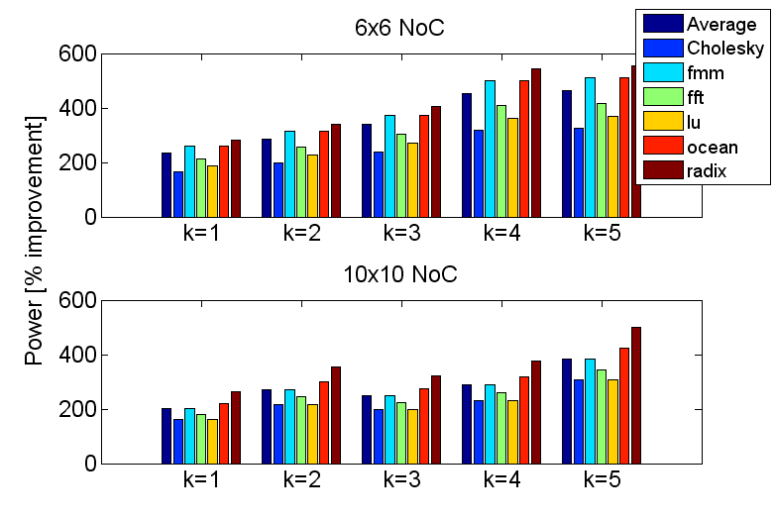
Dynamic Reconfiguration Improvement
Improvement compared non dynamic
Greater number of photonic rings: more opportunities for fine tuning traffic distribution

Slide 16
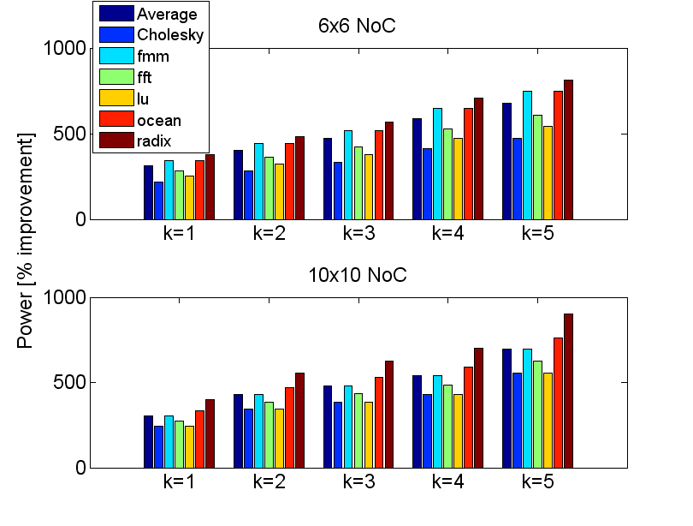
Improvement compared to Electrical Mesh
Power Improvement
Significant improvement for relatively smaller complexity

Slide 17
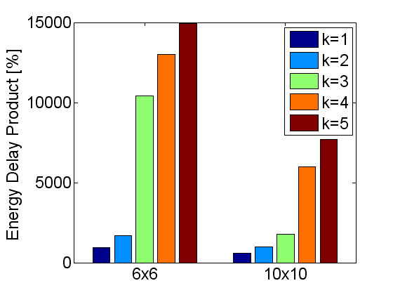
Improvement Compared to Electrical Mesh
PHOTON energy-delay improvements relative to the electrical mesh
150× energy-delay product improvement for medium sized (36 core) NoCs.
74× improvement for large sized (100 core) NoCs

Slide 18
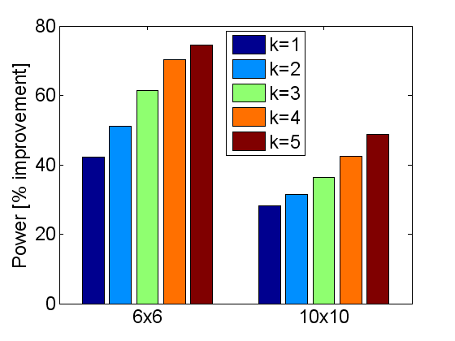
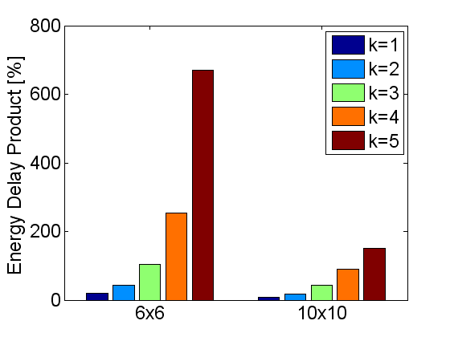
Improvement compared to Photonic Torus
PHOTON has significant advantage over more complex hybrid photonic torus architecture
Fewer power hungry photonic components
Aggressive power savings with runtime reconfiguration

Slide 19
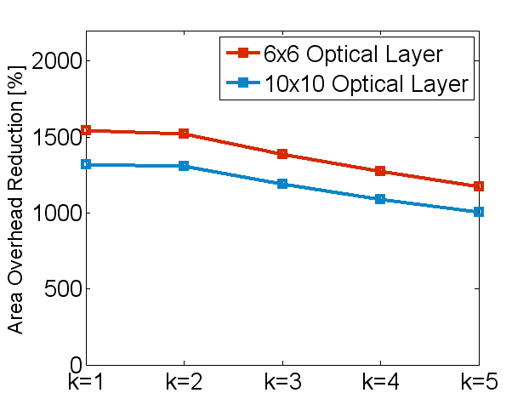
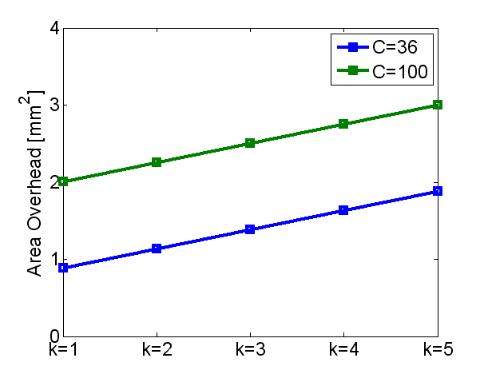
Area Overhead
Optical Layer area improvement
Silicon layer overhead
Hybrid photonic torus has 10-15× more photonic layer area
About 1.5-2× electrical layer area overhead
Electrical layer overhead for PHOTON is minimal

Slide 20
Conclusion
Future CMPs with hundreds of cores
Require a scalable communication fabric
Reducing power consumption is essential
High performance per watt
2D electrical NoCs unable to meet these requirements
Proposed novel PHOTON shows significant promise
Simpler and scalable architecture
Lower area overhead
Significant power and performance gains

Slide 21
Thank You
.
Questions
Discussion

