Slide 1
Modeling Ion Channel Kinetics with High-Performance Computation
Allison Gehrke
Dept. of Computer Science and Engineering
University of Colorado Denver

Slide 2
Agenda
Introduction
Application Characterization, Profile, and Optimization
Computing Framework
Experimental Results and Analysis
Conclusions
Future Research

Slide 3
Introduction
Target application – Kingen
Simulates ion channel activity (kinetics)
Optimizes kinetic model rate constants to biological data
Ion Channel Kinetics
Transition states
Reaction rates

Slide 4
Computational Complexity

Slide 5
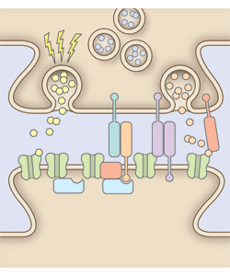
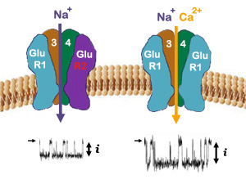
AMPA Receptors

Slide 6
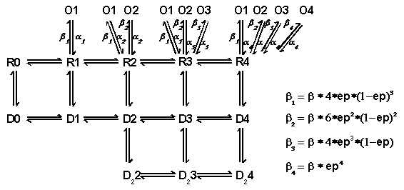
Kinetic Scheme

Slide 7
Introduction: Why study ion channel kinetics?
Protein function
Implement accurate mathematical models
Neurodevelopment
Sensory processing
Learning/memory
Pathological states

Slide 8
Modeling Ion Channel Kinetics with High-Performance Computation
Introduction
Application Characterization, Profile, and Optimization
Computing Framework
Experimental Results and Analysis
Conclusions
Future Research

Slide 9
Adapting Scientific Applications to Parallel Architectures
System-Level
Intel Vtune
Intel Pin
Application-Level
Profiling
Optimization
Parallel Architectures
CPU
GPU
Multicore
Intel Compiler & SSE2
Intel
TBB
NVIDIA
CUDA

Slide 10
System Level – Thread Profile
Fully utilized 93%
Under utilized 4.8%
Serial: 1.65%

Slide 11
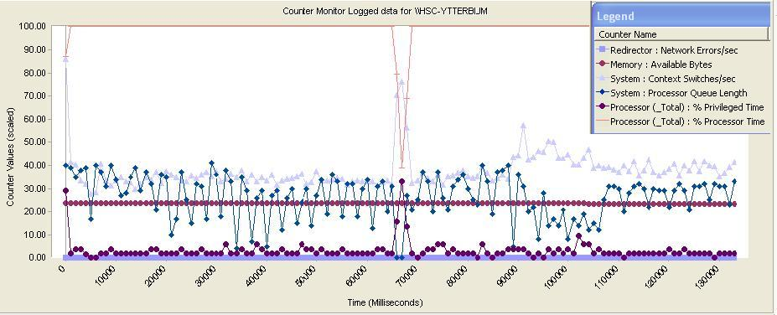
Hardware Performance Monitors
Processor utilization drops
Constant available memory
Context switches/sec increases
Privileged time increases

Slide 12
Adapting Scientific Applications to Parallel Architectures
System-Level
Intel Vtune
Intel Pin
Application-Level
Profiling
Optimization
Parallel Architectures
CPU
GPU
Multicore
Intel Compiler & SSE2
Intel
TBB
NVIDIA
CUDA

Slide 13
Application Level Analysis
Hotspots
CPI
FP Operations

Slide 14
Hotspots
 | 10.1 | 11.1
calc_funcs_ampa | 59.51% | 30.45%
runAmpaLoop | 40.04% | 40.99%
calc_glut_conc | 0.45% | 2.16%
operator[] | 0% | 25.92%
get_delta | 0% | 0.48%

Slide 15
FP Impacting Metrics
 | CPI | FP Assist | FP Instructions Ratio
v 10.1 | 3.464 | .85 | .13
v 11.1 | 0.536 | 0.0011 | 0.0028
CPI
.75 good
4 poor - indicates instructions require more cycles to execute than they should
Upgrade → ~9.4x speedup
FP assist
0.2 low
1 high

Slide 16
Post compiler Upgrade
Improved CPI and FP operations
Hotspot analysis
Same three functions still “hot”
FP operations in AMPA function optimized with SIMD
STL vector operator
get function from a class object
Redundant calculations in hotspot region

Slide 17
Manual Tuning
Reduced function overhead
Used arrays instead of STL vectors
Reduced redundancies
Eliminated get function
Eliminated STL vector operator[ ]
~2x speedup

Slide 18
Application Analysis Conclusions
runAmpaLoop | 91.83 %
calc_glut_conc | 4.4 %
ge | 0.02 %
libm_sse2_exp | 0.02 %
All others | 3.73 %

Slide 19
Observations
System-Level
Intel Vtune
Intel Pin
Application-Level
Profiling
Optimization
Parallel Architectures
CPU
GPU
Multicore
Intel Compiler & SSE2
Intel
TBB
NVIDIA
CUDA

Slide 20
Computer Architecture Analysis
DTLB Miss Ratios
L1 cache miss rate
L1 Data cache miss performance impact
L2 cache miss rate
L2 modified lines eviction rate
Instruction Mix

Slide 22
Computer Architecture Analysis Results
FP instructions dominate
Small instruction footprint fits in L1 cache
L2 handling typical workloads
Strong GPU potential

Slide 23
Modeling Ion Channel Kinetics with High-Performance Computation
Introduction
Application Characterization, Profile, and Optimization
Computing Framework
Experimental Results and Analysis
Conclusions
Future Research

Slide 24
Computing Framework
Multicore coarse-grain TBB implementation
GPU acceleration in progress
Distributed multicore in progress (192 core cluster)

Slide 25
TBB Implementation
Template library that extends C++
Includes algorithms for common parallel patterns and parallel interfaces
Abstracts CPU resources

Slide 26
tbb:parallel_for
Template function
Loop iterations must be independent
Iteration space broken into chunks
TBB runs each chunk on a separate thread

Slide 27
tbb:parallel_for
for (int i = 0; i < GeneticAlgo::NUM_CHROMOS; i++){
call ampa macro 11 times
calculate error on the chromosome (rate constant set)
}
parallel_for(
blocked_range<int>(0,GeneticAlgo::NUM_CHROMOS),
ParallelChromosomeLoop(tauError, ec50PeakError, ec50SteadyError, desensError, DRecoverError, ar, thetaArray),
auto_partitioner()
);

Slide 28
tbb::parallel_for: The Body Object
Need member fields for all local variables defined outside the original loop but used inside it
Usually constructor for the body object initializes member fields
Copy constructor invoked to create a separate copy for each worker thread
Body operator() should not modify the body so it must be declared as const
Recommend local copies in operator()

Slide 29
Ampa Macro
calc_bg_ampa – defines differential equations that describe ampa kinetics based on rate constant set
GA to solve the system of equations
runAmpaLoop → Runge-Kutta method

Slide 30
Ampa Macro
calc_bg_ampa – defines differential equations that describe ampa kinetics based on rate constant set
GA to solve the system of equations
runAmpaLoop → Runge-Kutta method

Slide 31
Initialize Chromosomes
Coarse-grained parallelism
Gen
0
Chromo 0
Chromo 1 + r
Chromo N
…
…
Ampa Macro
Calc Error
Genetic Algo → population has better fit on average
Serial Execution
.
.
.
Gen 1
Chromo 0
Chromo 1 + r
Chromo N
…
…
Ampa Macro
Calc Error
Gen N
Convergence

Slide 32
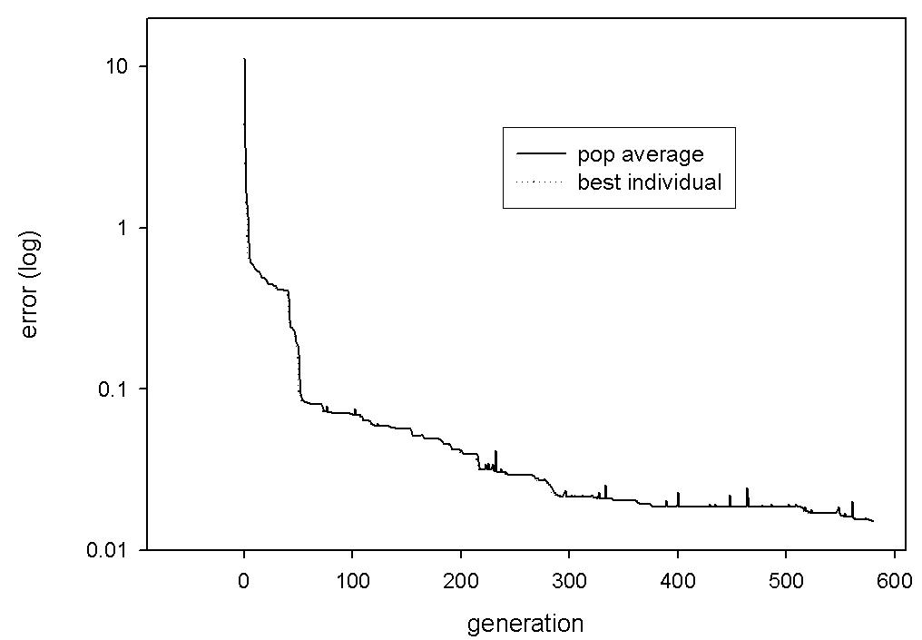
Genetic Algorithm Convergence

Slide 33
Runge-Kutta 4th Order Method (RK4)
runAmpaLoop: numerical integration of differential equations describing our kinetic scheme
RK4 Formulas:
x(t + h) = x(t) + 1/6(F₁+ 2F₂ +2F₃ + F₄)
where
F₁ = hf(t, x)
F₂ = hf(t + ½ h, x + ½ F₁)
F₃ = hf(t + ½ h, x + ½ F₂)
F₄ = hf(t + h, x + F₃)

Slide 34
RK4
Hotspot is the function that computes RK4
Need finer-grained parallelism to alleviate hotspot bottleneck
How to parallelize RK4?

Slide 35
Modeling Ion Channel Kinetics with High-Performance Computation
Introduction
Application Characterization, Profile, and Optimization
Computing Framework
Experimental Results and Analysis
Conclusions
Future Research

Slide 36
Experimental Results and Analysis
Hardware and software set-up
Domain specific metrics?
Parallel speed-up
Verification

Slide 37
Configuration
CPU | Intel® Xeon™ CPU X5355 @ 2.66 GHz | Intel ® Core™ 2 Quad CPU Q6600 @ 2.40 GHz | Intel ® Core™ 2 Quad CPU Q6600 @ 2.40 GHz
Cores | 8 | 4 | 4
Memory | 3 GB | 3 GB | 8 GB
OS | Windows XP Pro | Windows XP Pro | Fedora
Compiler | Intel C++ Compiler (11.1, 10.1) | Intel C++ Compiler (11.1, 10.1) | Intel C++ Compiler (11.1)
Intel TBB | Version 2.1 | Version 2.1 | Version 2.1

Slide 38
Computational Complexity

Slide 39
Parallel Speedup
Baseline: 2 generations, after compiler upgrade, prior to manual tuning
Generation number magnifies any performance improvement

Slide 40
Verification
MKL and custom Gaussian elimination routine get different results (sometimes)
Small variation in a given parameter changed error significantly
Non-deterministic

Slide 41
Conclusions
Process that uncovers key characteristics is important
Kingen needs cores/threads – lots of them
Need ability automatically (semi-?) identify opportunities for parallelism in code
Better validation methods

Slide 42
Future Research
192-core cluster
GPU acceleration
Programmer-led optimization
Verification
Model validation
Techniques to simplify porting to massively parallel architectures

