Slide 1
ZDDs for Dynamic Trace Analysis Graham Price Manish Vachharajani John Giacomoni John Michalakes Sreyasi Vinjamuri
Notes:
Intro

Slide 2
Motivation
Chip Multiprocessor (CMP) solutions are becoming more prevalent
Dynamic program analysis can aid location of parallelism in sequential programs
BDDs are useful
But they take days to create!
Notes:
Note that most research has been in static program analysis, but dynamic program analysis has a lot of potential

Slide 3
DIN vs. Ready Time
DIN
Instruction
Mem Addr
DIN
Ready Time
…
14
14
mov r3,r4
14
13
13
st 0(r1),r5
0xbee4
13
12
12
add r5,r3,r4
12
11
11
bnz r2, loop
11
10
10
addi r1,r1,4
10
9
9
addi r2,r2,-1
9
8
8
mov r4,r5
8
7
7
mov r3,r4
7
6
6
st 0(r1),r5
0xbee0
6
5
5
add r5,r3,r4
5
4
4
mov r3, 1
4
3
3
mov r4, 1
3
2
2
mov r2, 8
2
1
1
li r1, &fibarr
1
1
2
3
4
5
6
7
8
9
10
11
12
13
14
Notes:
The core of our technique is the DIN Rdy

Slide 4
Video
http://www.youtube.com/watch?v=KdeRtDrPEY4
Details: Price, Giacomoni, and Vachharajani PACT 2008

Slide 5
The BDD Data Structure
False Arc
Inverting
False Arc
True Arc
F(X,Y,Z) = x’y + xy’ + z
X
X
Y
Y
Y
Y
Z
Z
Z
Z
Z
0
1
1
1
1
1
0
1
1

Slide 6
Trace BDD Construction
X
X
X
X
Y
Y
Y
Y
Y
0
+
W
=
0
W
W
W
W
Z
I_{trace} = 0
Z
Z
Z
1
1
1
1
I_{t} = (X * Y * Z * W)
I_{trace} = (X * Y * Z * W)
I_{t} = (X’ * Y’ * Z’ * W’)
I_{trace} = (X * Y * Z * W) + (X’ * Y’ * Z’ * W’)

Slide 7
Trace BDD Construction
X
X
X
Y
Y
Y
Y
=
+
W
W
W
W
Z
Z
Z
1
1
1
I_{trace} = (X * Y * Z * W) + (X’ * Y’ * Z’ * W’)
I_{t} = (X * Y * Z * W)
I_{t} = (X’ * Y’ * Z’ * W’)
Notes:
Talk about strong canonisity

Slide 8
Trace BDD Construction Cont..
Garbage Problem
X
X
X
Y
Y
Y
Y
W
W
W
W
Z
Z
Z
1
1
1

Slide 9
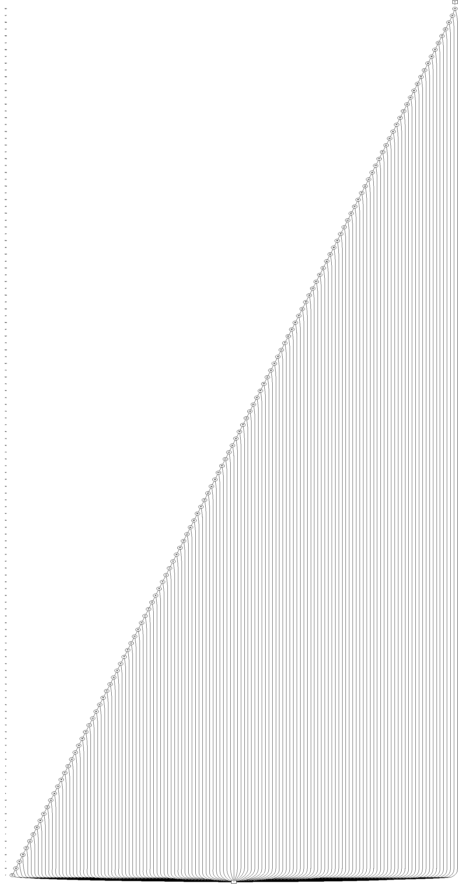
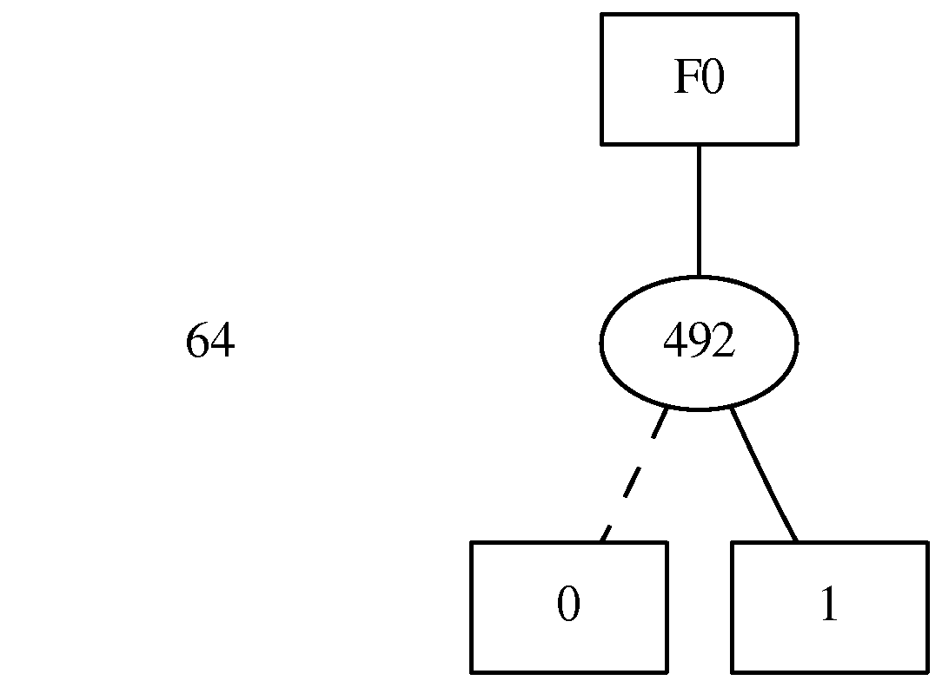
ZDDs
BDDs
Remove isomorpic graphs
Skip and remove nodes whose pointers point to the same child
ZDDs
Remove isomorpic graphs
Remove “1” nodes whose pointers point to “0”

Slide 10
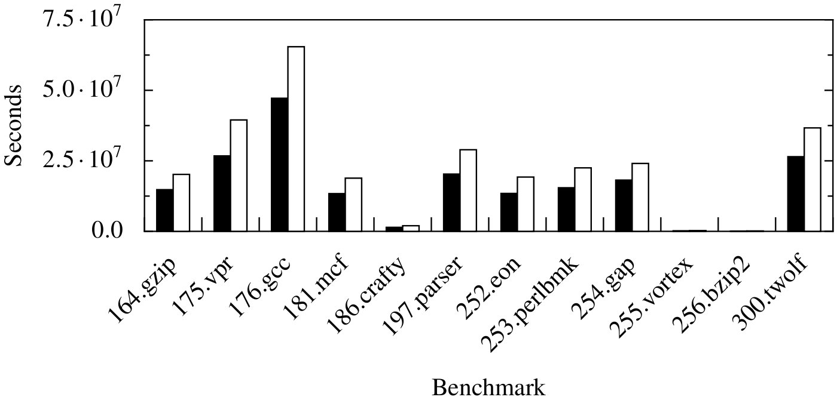
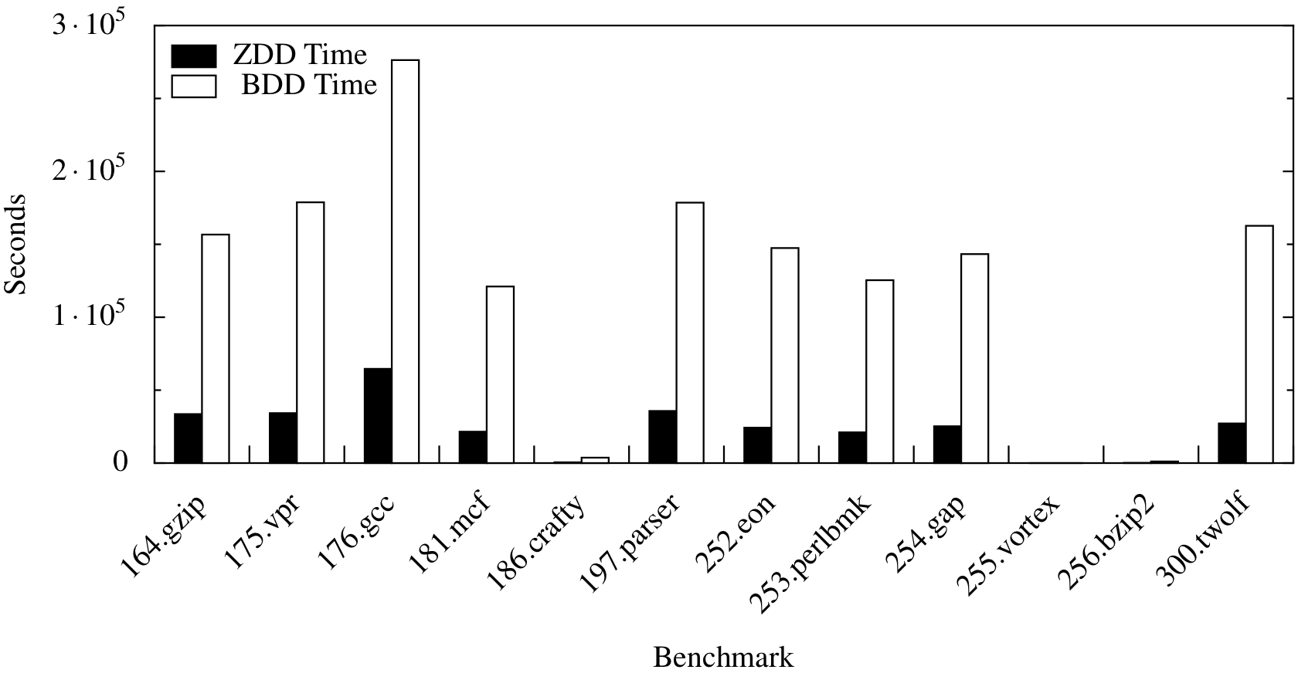
ZDD vs. BDD Size
I_{t} = (X’ * Y’ * Z’ * W’)
I_{t} = (X * Y * Z * W) + (X’ * Y * Z * W)
~ 20% Reduction
Notes:
Does dynamic trace information

Slide 11
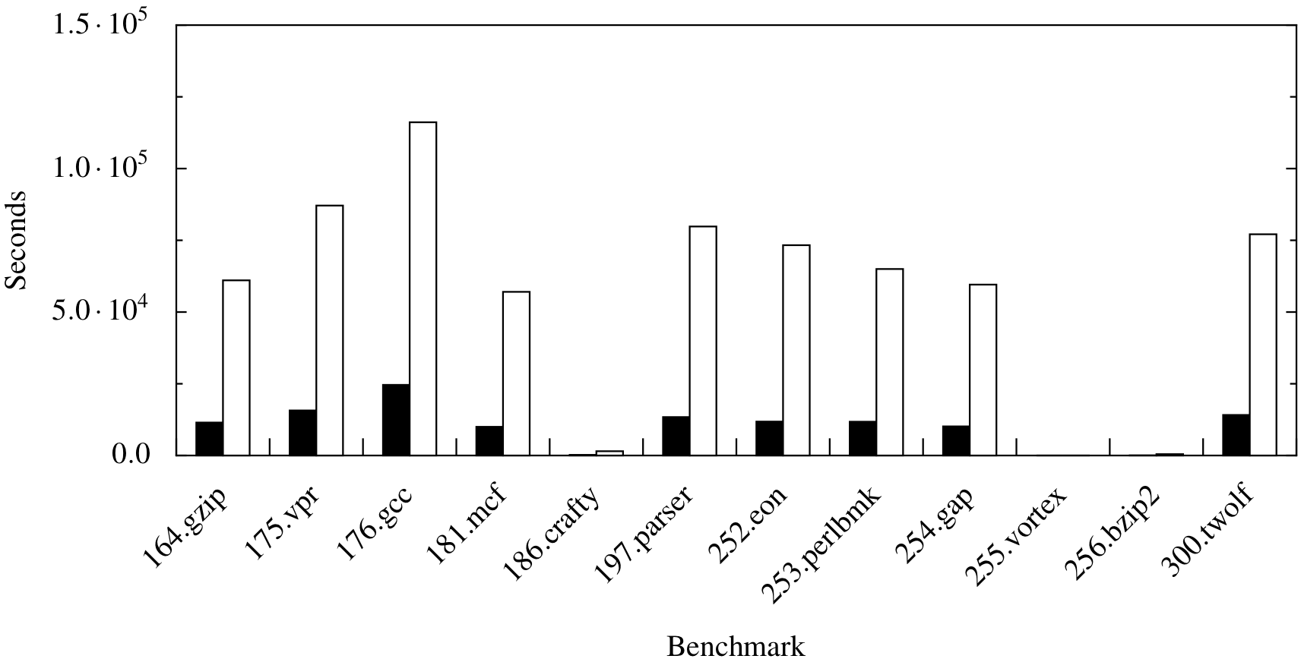
DD Creation Time
DIN x RDY Tuples
Over 9 times faster!

Slide 12
ZDD Construction
X
X
X
Y
Y
Y
0
+
W
=
0
W
W
Z
I_{trace} = 0
Z
Z
1
1
1
1
I_{t} = (X * Y * Z * W)
I_{trace} = (X * Y * Z * W)
I_{t} = (X’ * Y’ * Z’ * W’)
I_{trace} = (X * Y * Z * W) + (X’ * Y’ * Z’ * W’)
Notes:
The construction seems similar…

Slide 13
Where BDDs Compress
X
X
X
Y
Y
Y
Y
=
+
W
W
W
W
Z
Z
Z
1
1
1
Compression
No Compression
No Compression

Slide 14
Where ZDDs Compress
X
X
Y
Y
=
+
W
W
Z
Z
1
1
1
Little/No Compression
Compression
Compression
Details: Price and Vachharajani, to appear CGO 2010

Slide 15
Questions?

