Slide 1
Large-scale Learning with SVM and Convolutional Nets
for Generic Object Categorization
113-1_DMVL_Paper_Implementation
Presenter: 資科所二_周雲明
Student ID: 7112095015

Slide 2
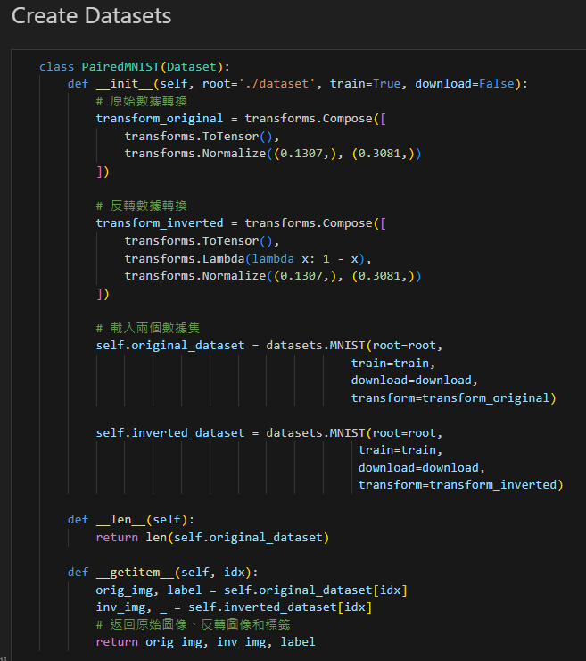
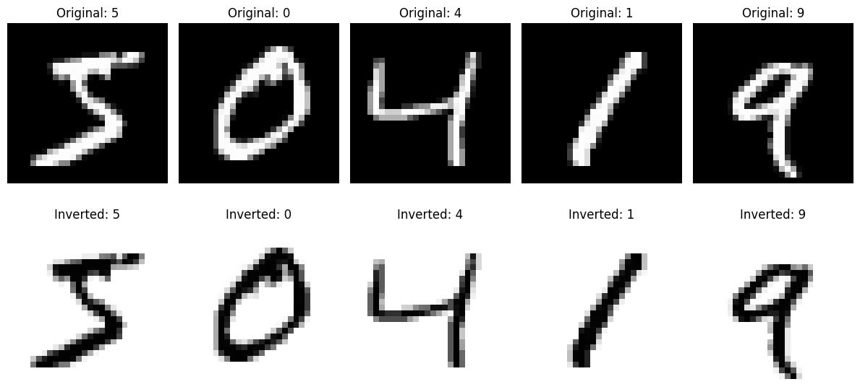
Dataset (MNIST)

Slide 3
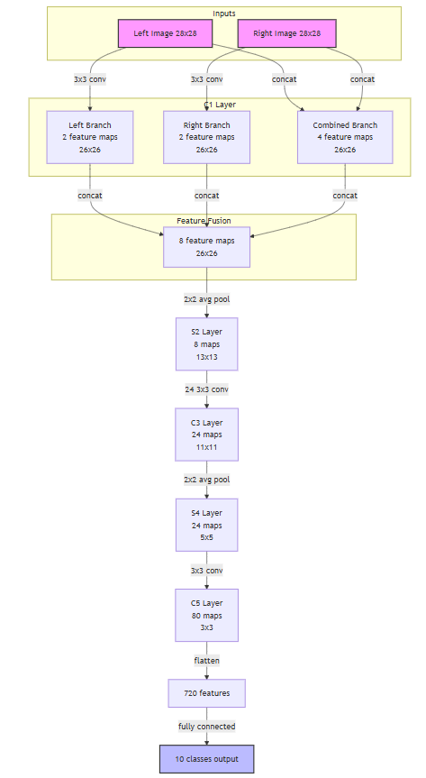
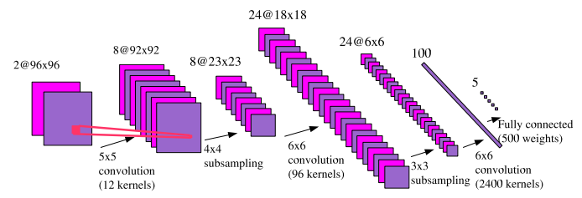
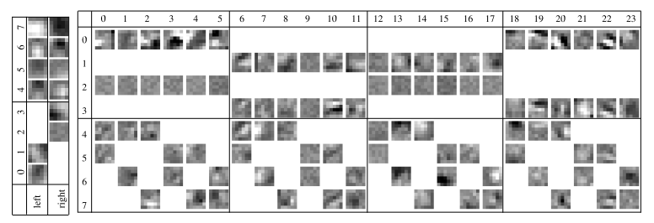
CNN Architecture
Implementation (MNIST)
Paper (NORB)

Slide 4
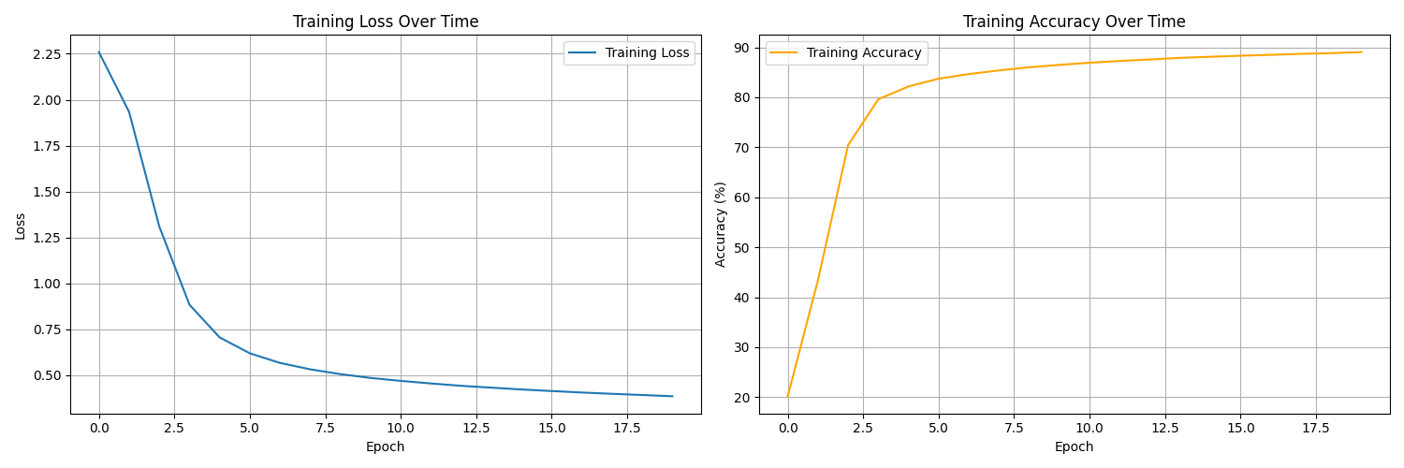
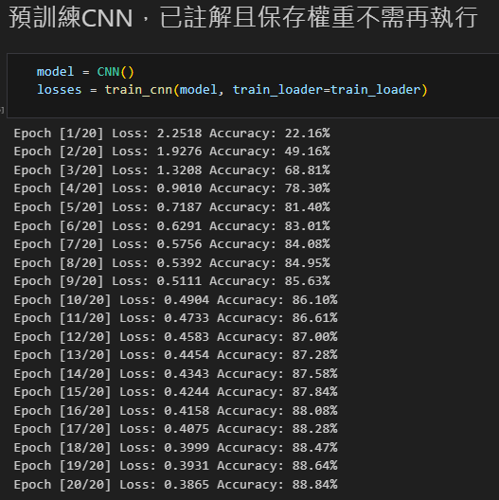
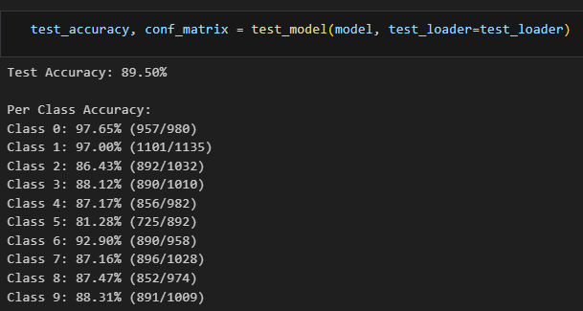
Pretrain CNN (Training and Testing)

Slide 5
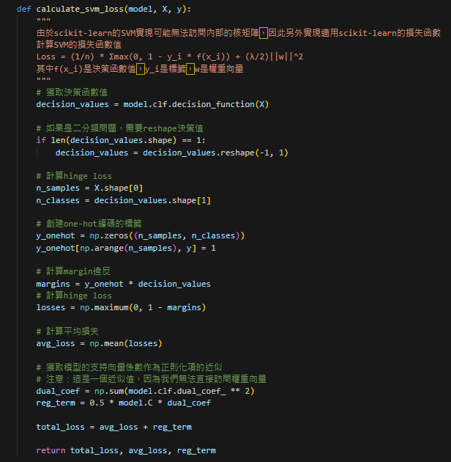
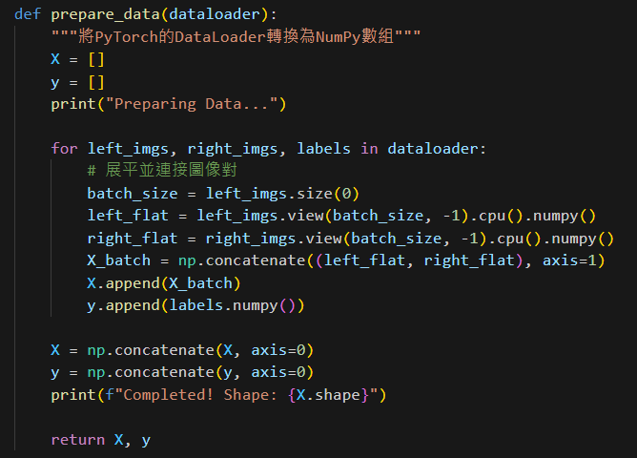
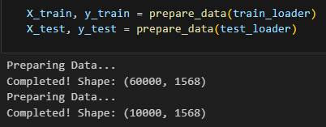
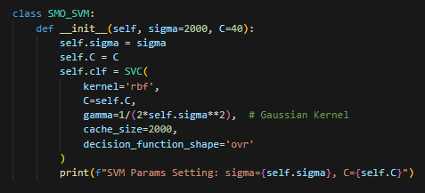
Create SVM Classifier

Slide 6
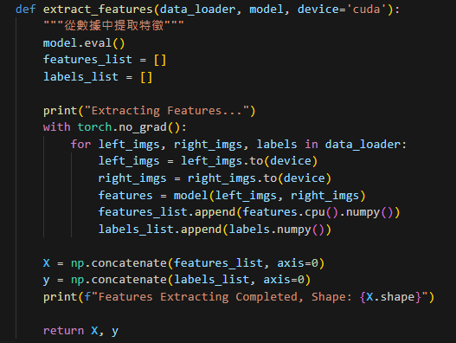
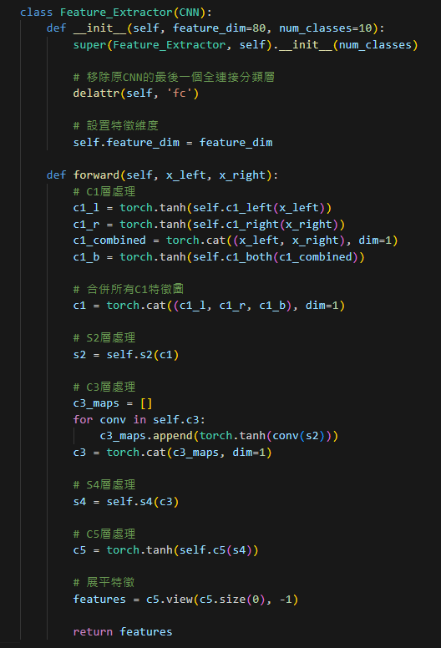
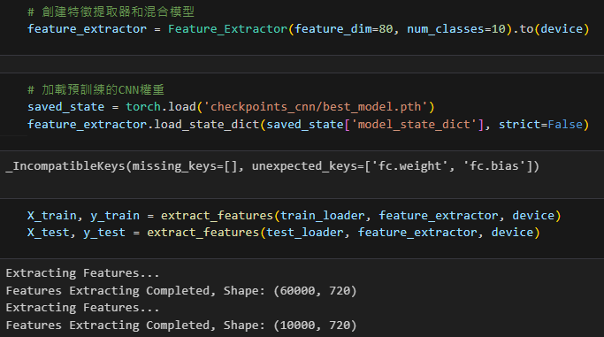
Create SVM_CNN Model (Feature Extractor)

Slide 7

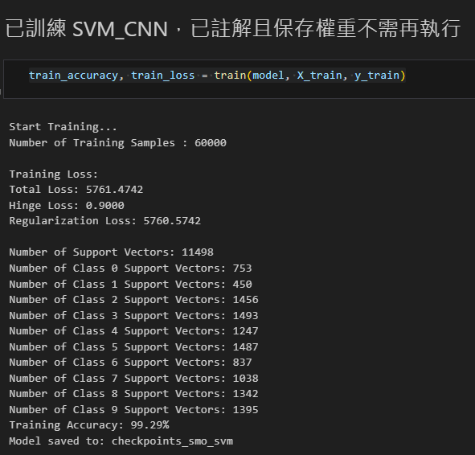
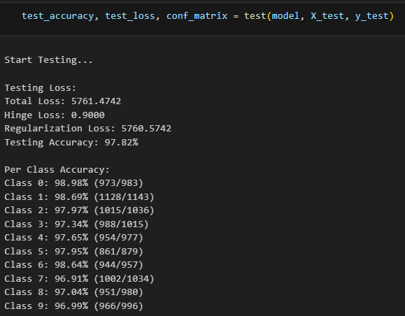
SVM_CNN (Training and Testing)

Slide 8
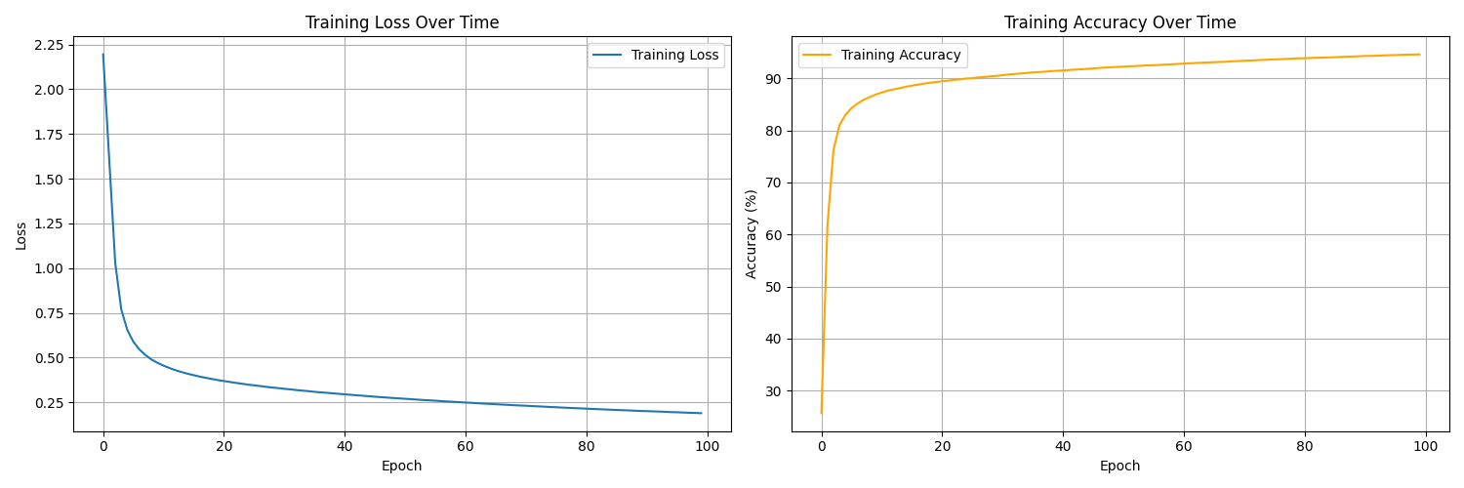
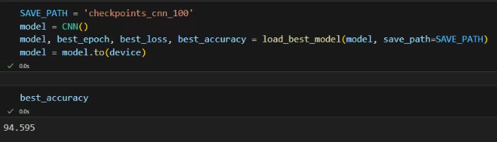
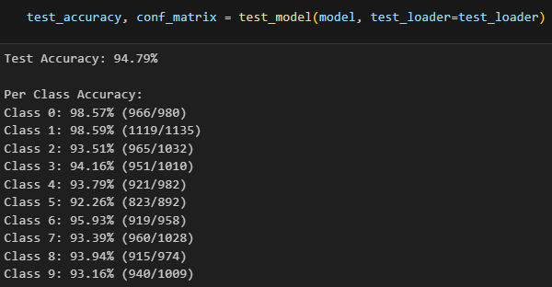
CNN for 100 Epochs (Training and Testing)

Slide 9
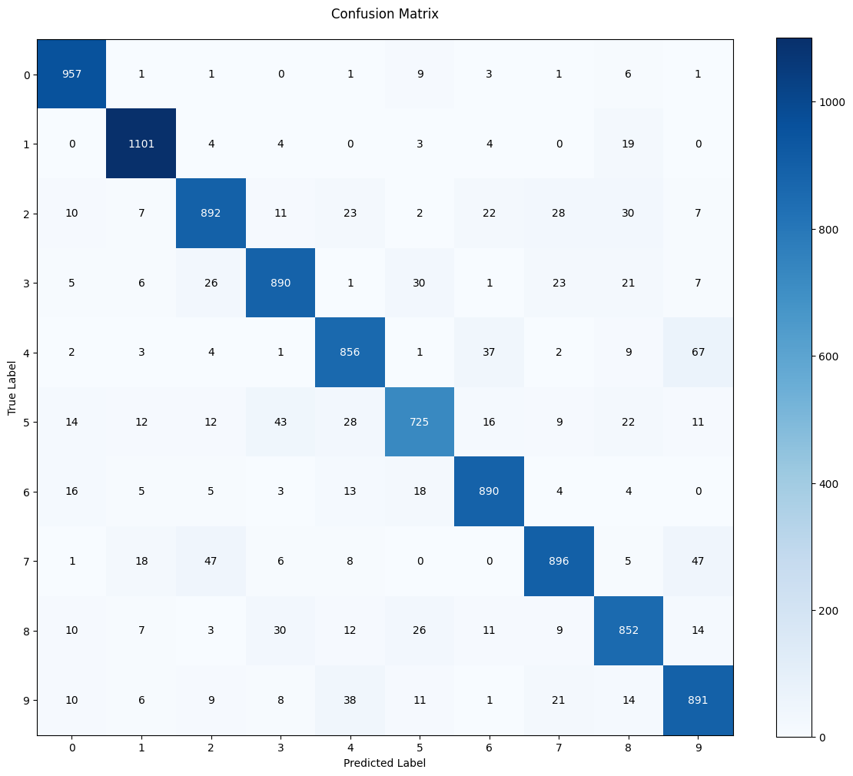
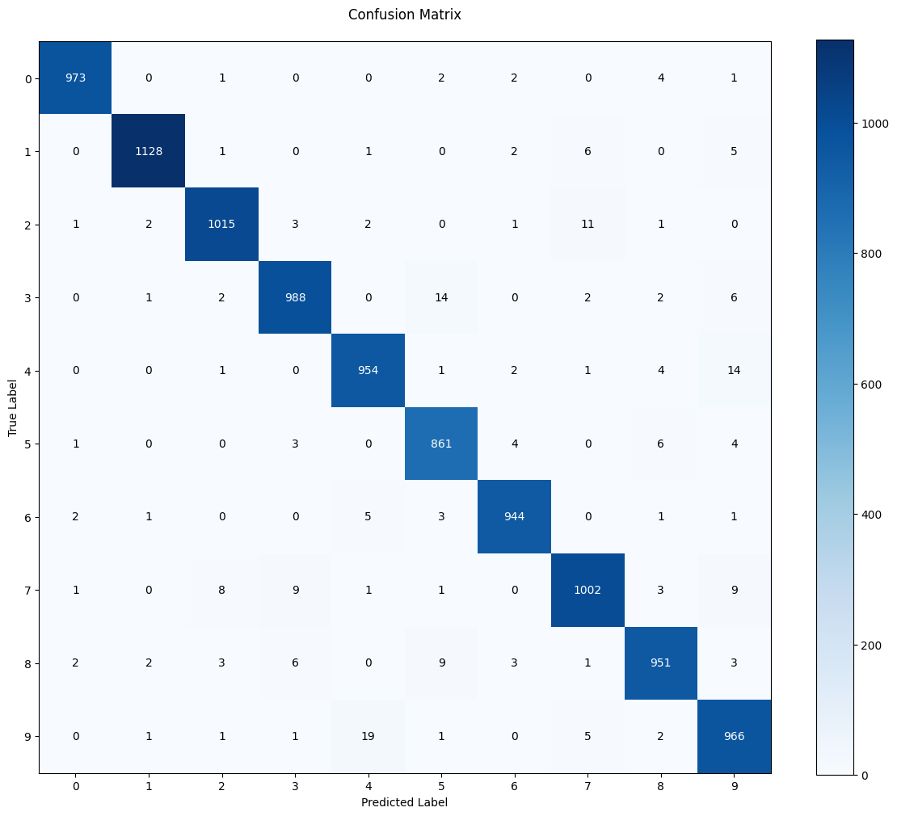
Result and Comparison
SVM_CNN
(CNN Pretrained 20 Epochs )
CNN 20 Epochs

Slide 10

Result and Comparison
SVM_CNN
(CNN Pretrained 20 Epochs )
CNN 100 Epochs

Slide 11
Result and Comparison
SVM_CNN
(CNN Pretrained 20 Epochs )
CNN 20 Epochs
CNN 100 Epochs

Slide 12
END

