Slide 1
FPGA HDMI Display Divider
DigiPen Institute of Technology
Fall 2014
ECE 310L
Presented by Cassandra Chow

Slide 2
Project Goals
Learning FPGA architecture and application
HDMI Protocol
Mission Statement:
To create a device that enables the user to divide their HDMI display into separate parts and delegate to these parts their own dedicated displays.

Slide 3
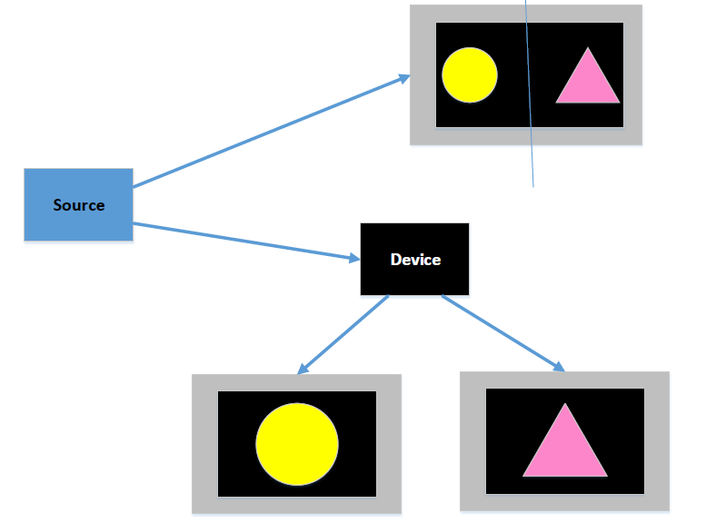
High Concept
Split-screen display
Two dedicated displays

Slide 4
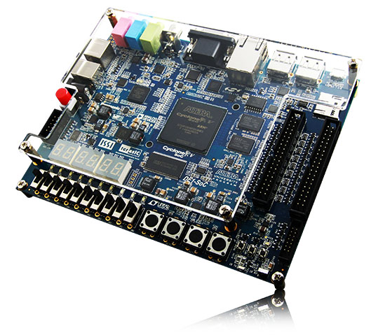
FPGA Platform
High speed video processing
A little processing on a lot of data
Requires building of analog components from scratch.

Slide 5
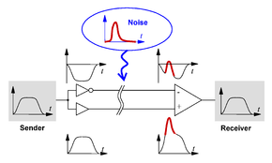
HDMI Differential Signaling

Slide 6
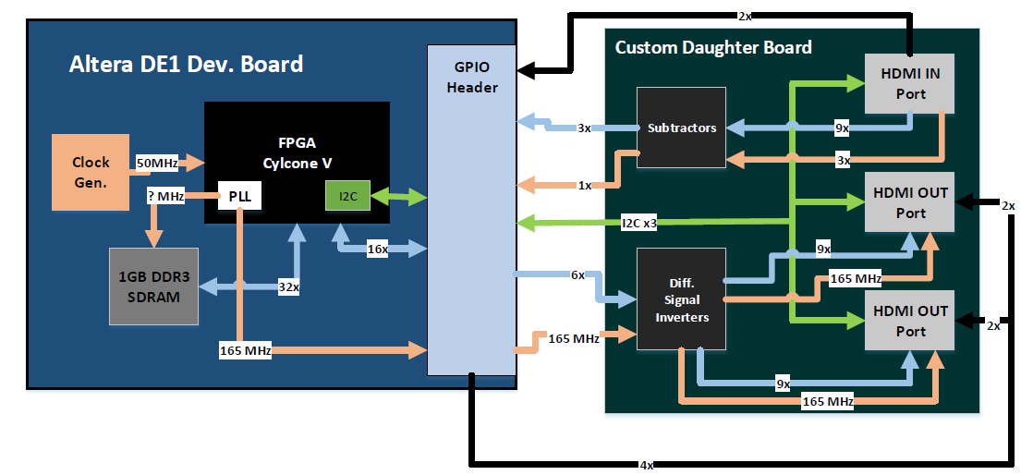
Device Design

Slide 7
Time Line (13 weeks)
PLL & DDR3 SDRAM firmware (2 weeks)
HDMI output prototype & firmware (2 weeks)
  > Debugging & Testing (1 week)
HDMI input prototype & firmware (2 weeks)
  > Debugging & Testing (2 weeks)
PCB design & fabrication (2 weeks)
Final Report & Polish ( 2 weeks)

Slide 8
Questions?

