Slide 1
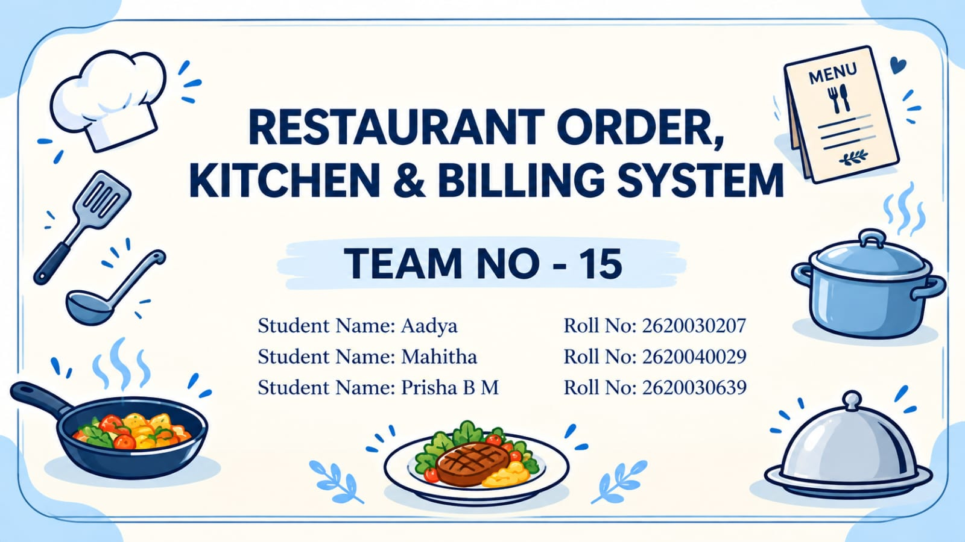
RESTAURANT ORDER, KITCHEN & BILLING SYSTEM
TEAM NO - 15
Student Name: Aadya Roll No: 2620030207
Student Name: Mahitha Roll No: 2620040029
Student Name: Prisha B M Roll No: 2620030639

Slide 2
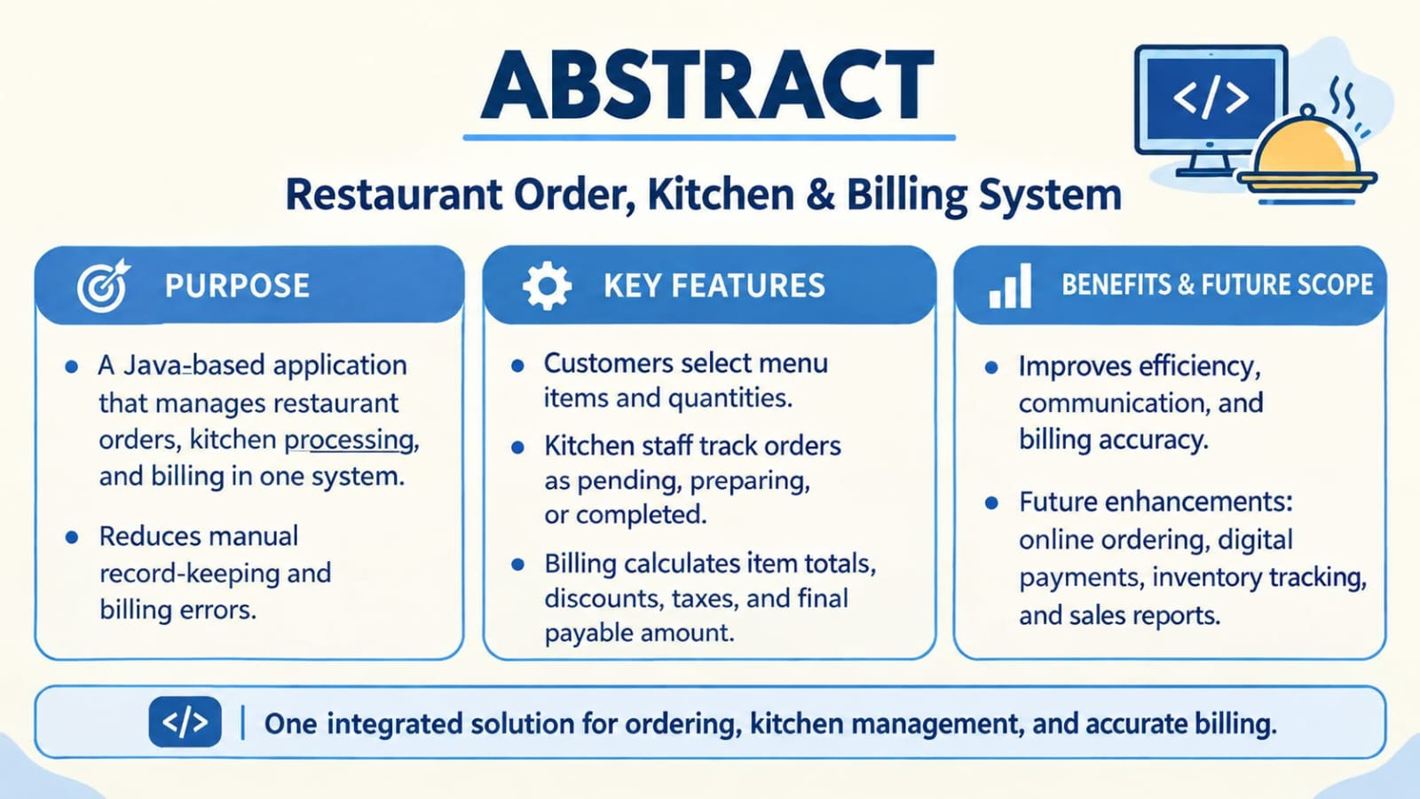
ABSTRACT
Restaurant Order, Kitchen & Billing System
The Restaurant Order, Kitchen & Billing System is a software-based application developed to simplify and manage the major activities involved in restaurant operations. The system provides an organized platform for handling customer orders, communicating order details to the kitchen, tracking food preparation, and generating bills accurately. It reduces the need for manual record-keeping and helps minimize errors in order processing and billing.
The system allows restaurant staff to view the available menu items, select items according to customer requirements, enter quantities, and place orders efficiently. Once an order is placed, the details can be made available to the kitchen staff, allowing them to prepare the required food items in an organized manner. The kitchen can update the status of each order, such as pending, preparing, or completed. This helps serving staff monitor orders and provide timely service to customers.
The billing module calculates the cost of ordered items based on their prices and quantities. It can also include applicable taxes, discounts, and the final payable amount. The system maintains order and billing information, making it easier to retrieve records when required.
Overall, the Restaurant Order, Kitchen & Billing System improves operational efficiency, reduces communication gaps, saves time, and increases billing accuracy. By integrating ordering, kitchen management, and billing into one system, it provides a convenient and reliable solution for modern restaurants. The system can also be enhanced in the future with features such as online ordering, digital payments, customer management, inventory tracking, and sales reports.

Slide 3
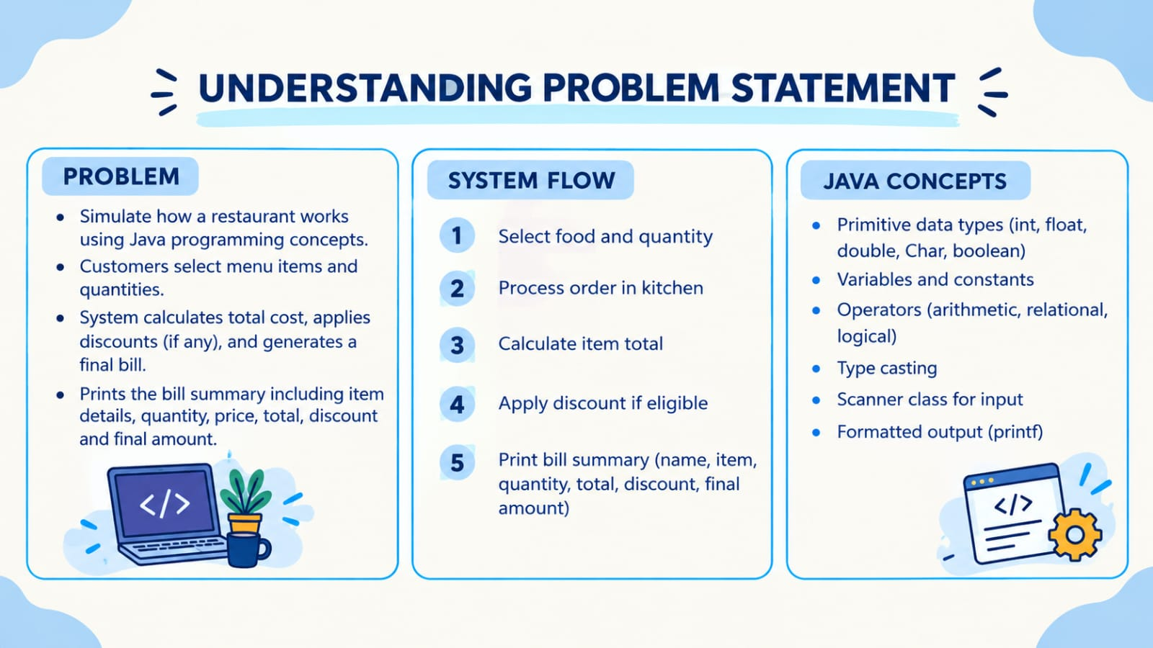
UNDERSTANDING PROBLEM STATEMENT
The Restaurant Order, Kitchen & Billing System problem statement is about simulating how a restaurant works using Java programming concepts. The system begins with a menu where customers can select food items and specify the quantity they want. Once the order is placed, the kitchen section of the program processes it by displaying a message that the food is being prepared. After that, the billing system calculates the total cost by multiplying the price of the item with the quantity, applies discounts if the bill crosses a certain limit, and then generates a final payable amount. Finally, the program prints a neat bill summary that includes the customer’s name, the item ordered, the quantity, the total amount, any discount applied, and the final bill. In short, this problem statement combines ordering, kitchen processing, and billing into one flow, making it a practical example of how control flow, methods, recursion, and arrays can be applied in real-life scenarios.

Slide 4
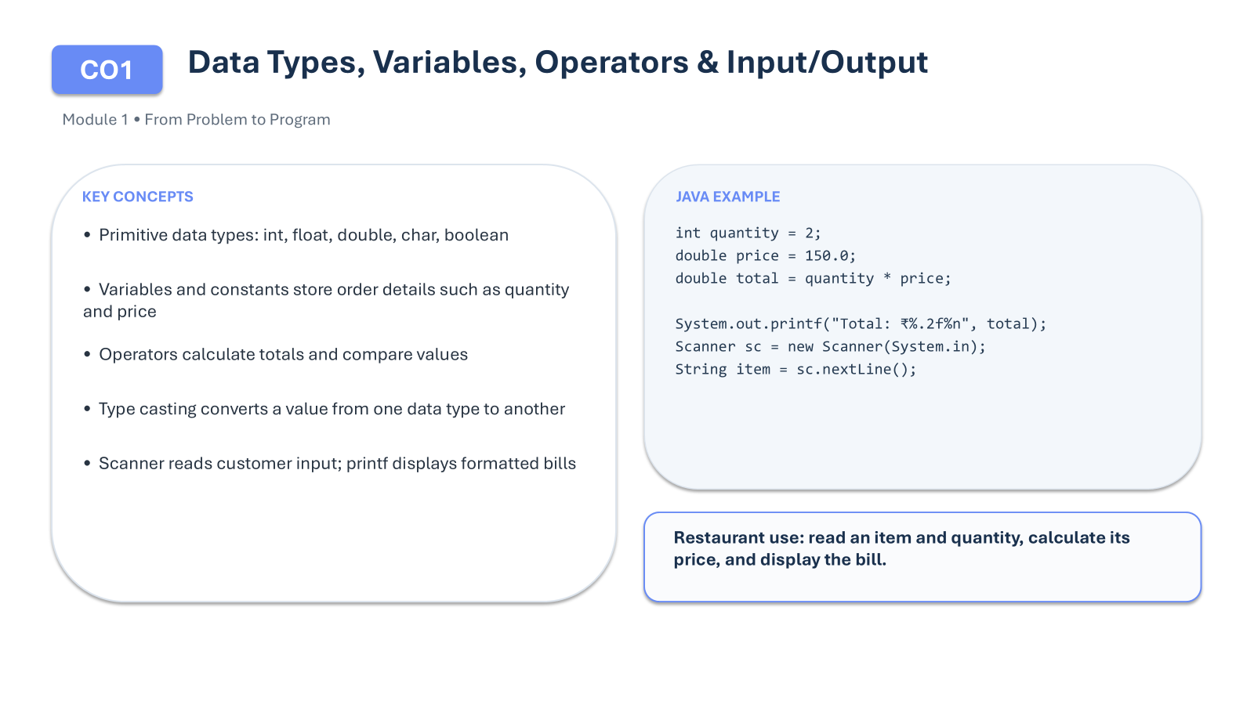

CO 1 Topics

Slide 5
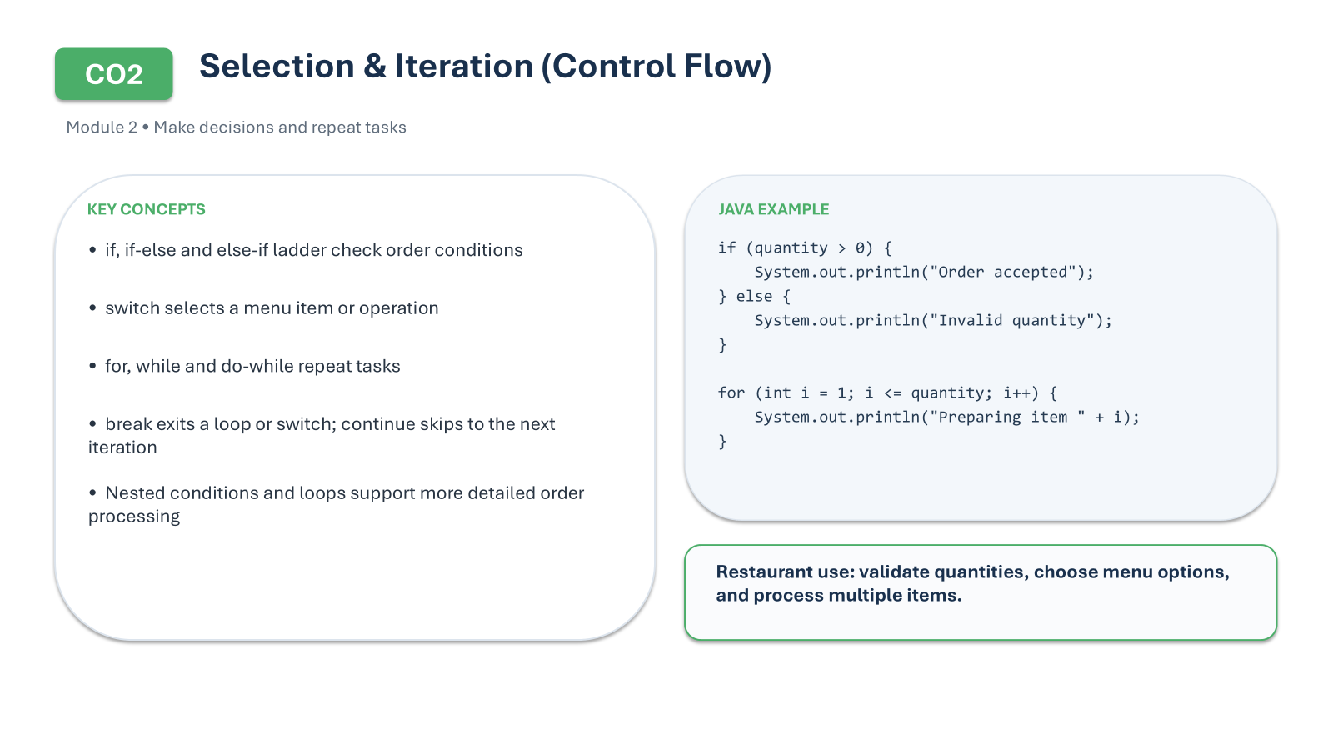
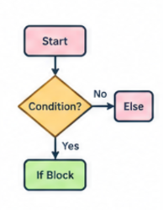
Co 2 TOPICS

Slide 6
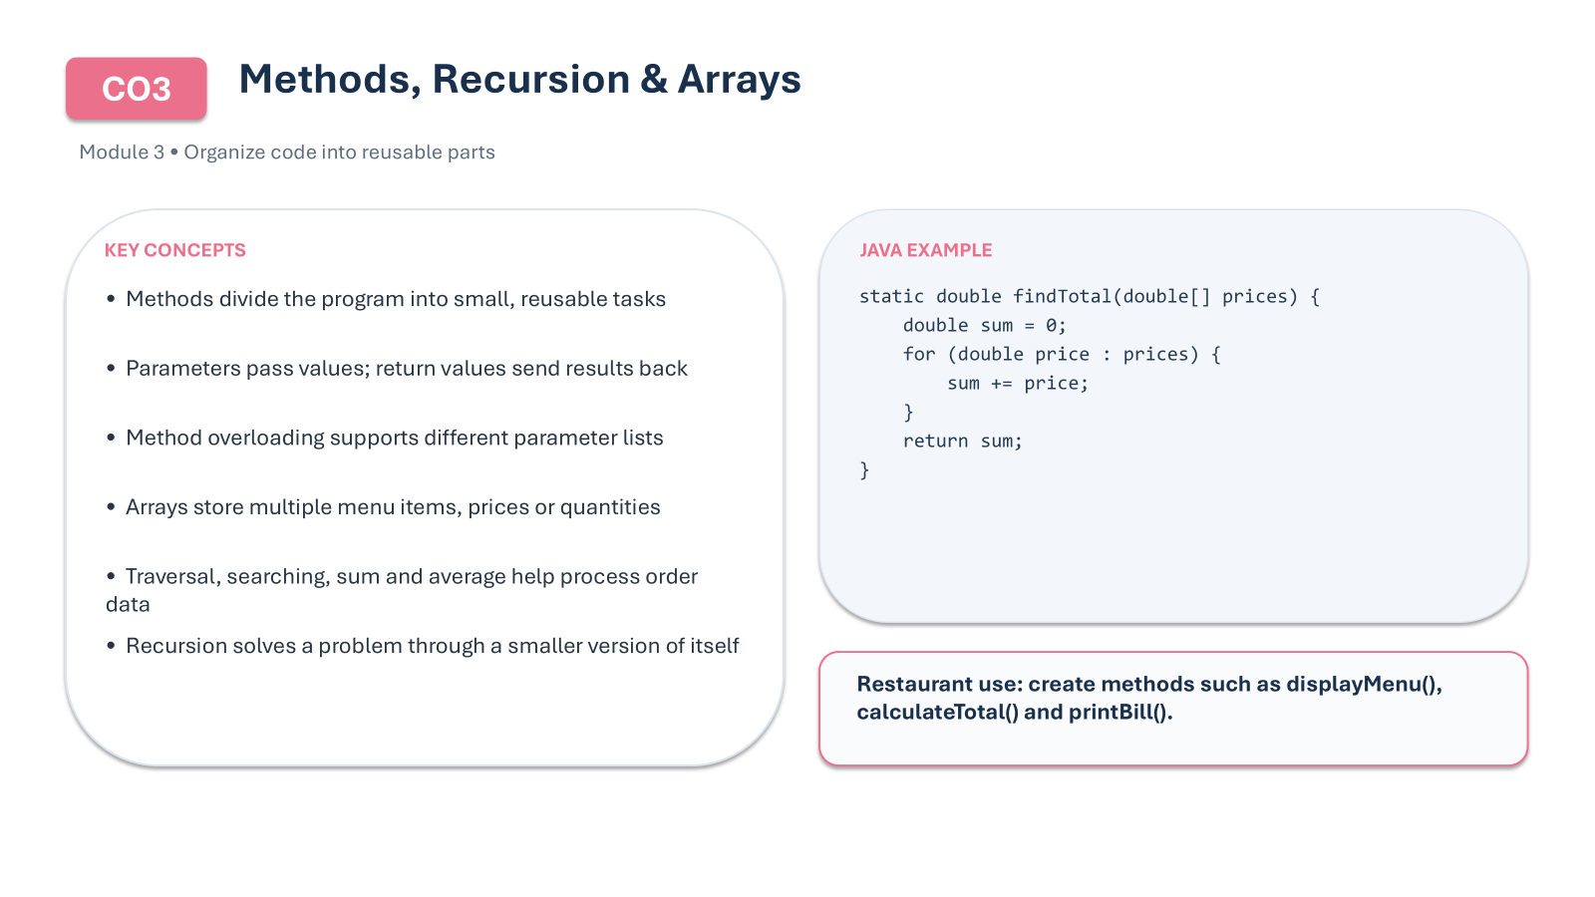

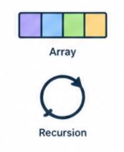

Slide 7
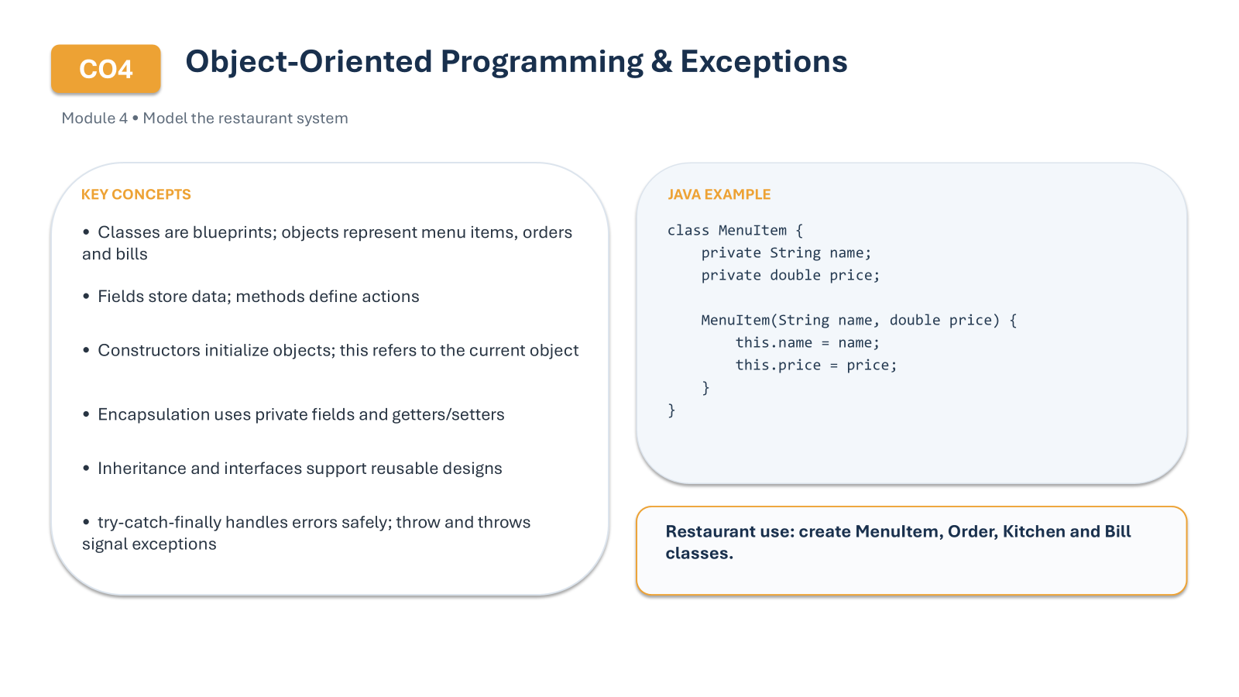
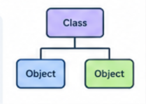

Slide 8
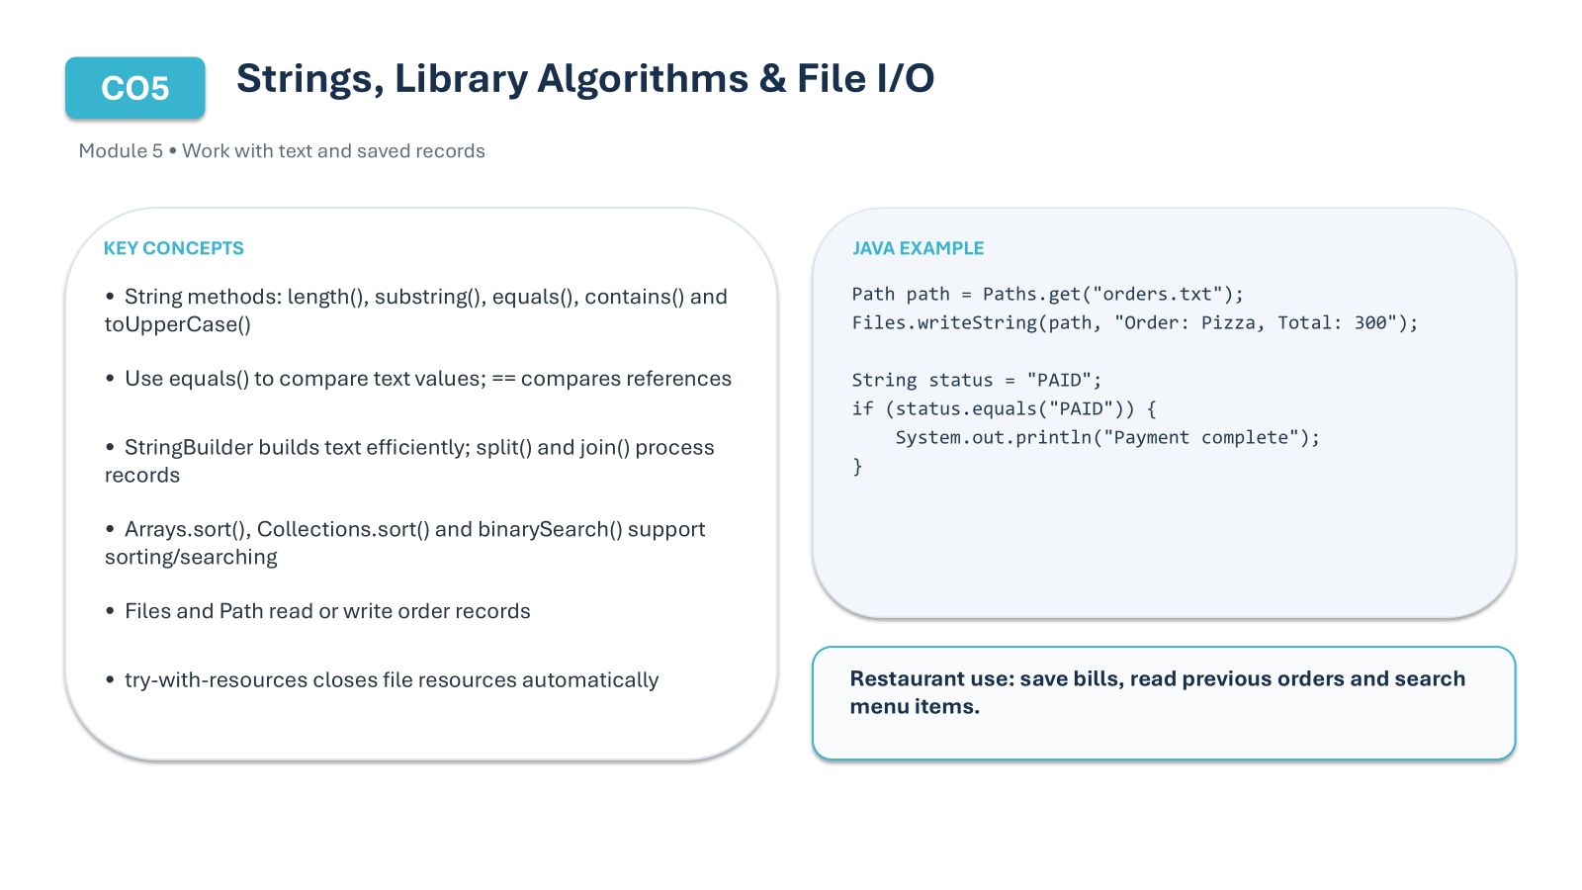

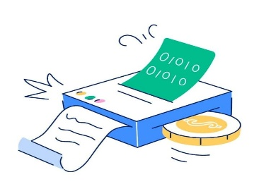
CO 3 Topics

Slide 9

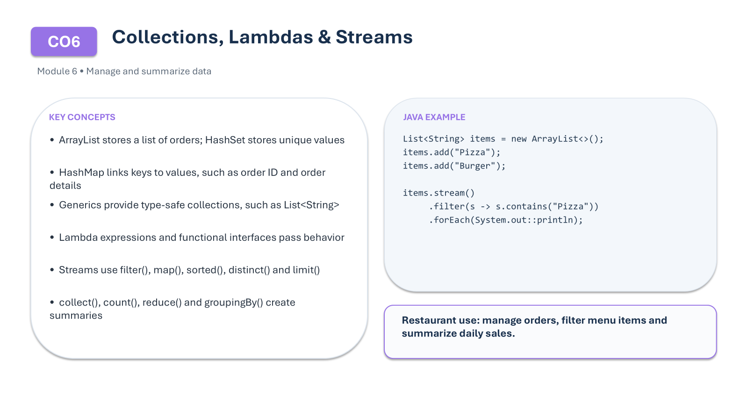
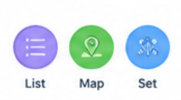
CO 6

Slide 10
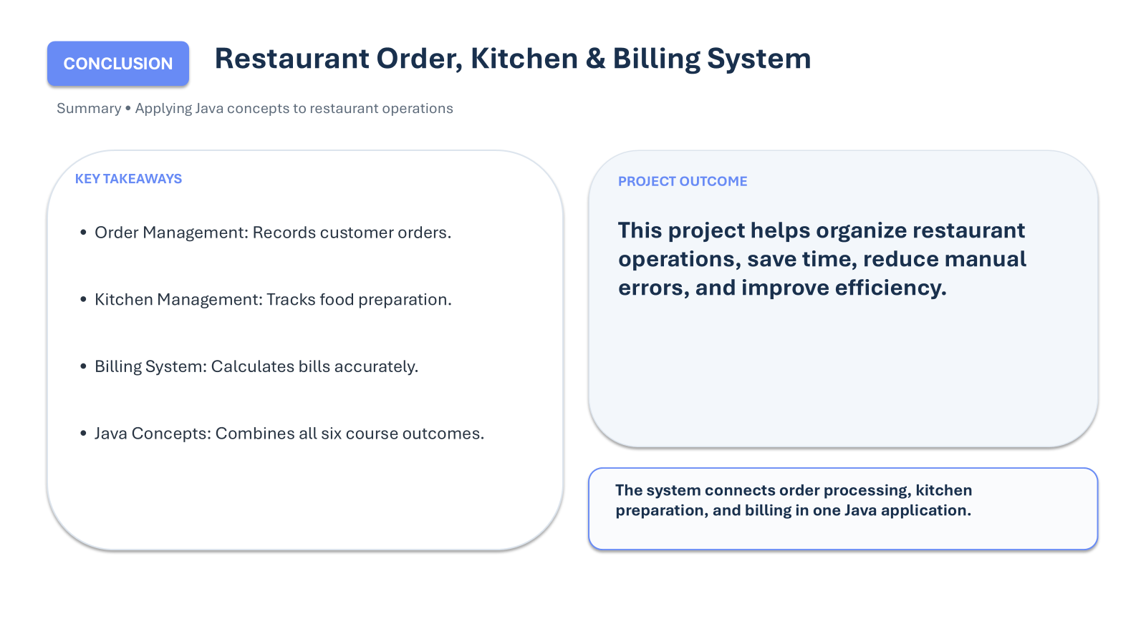
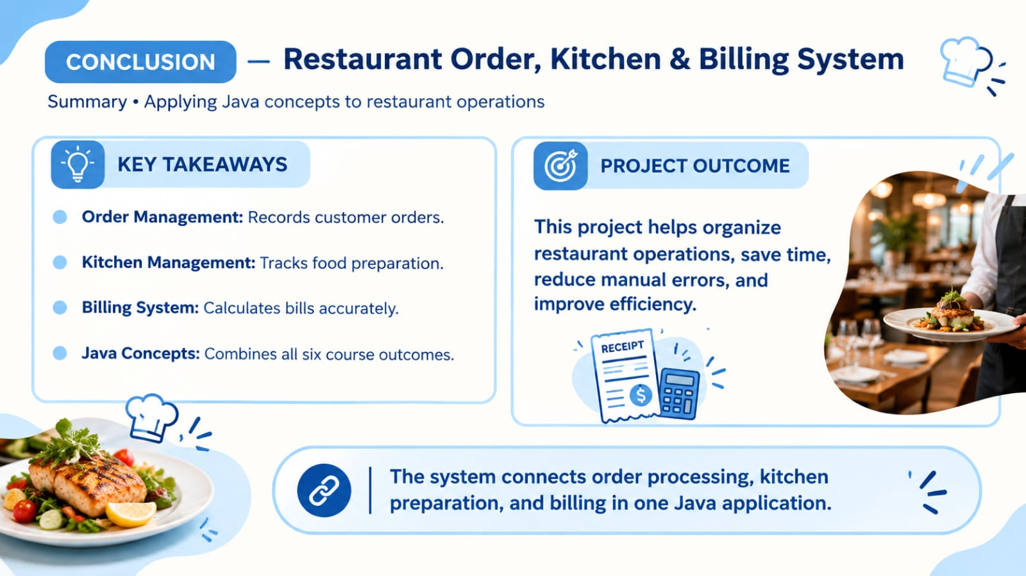
Conclusion

Slide 11

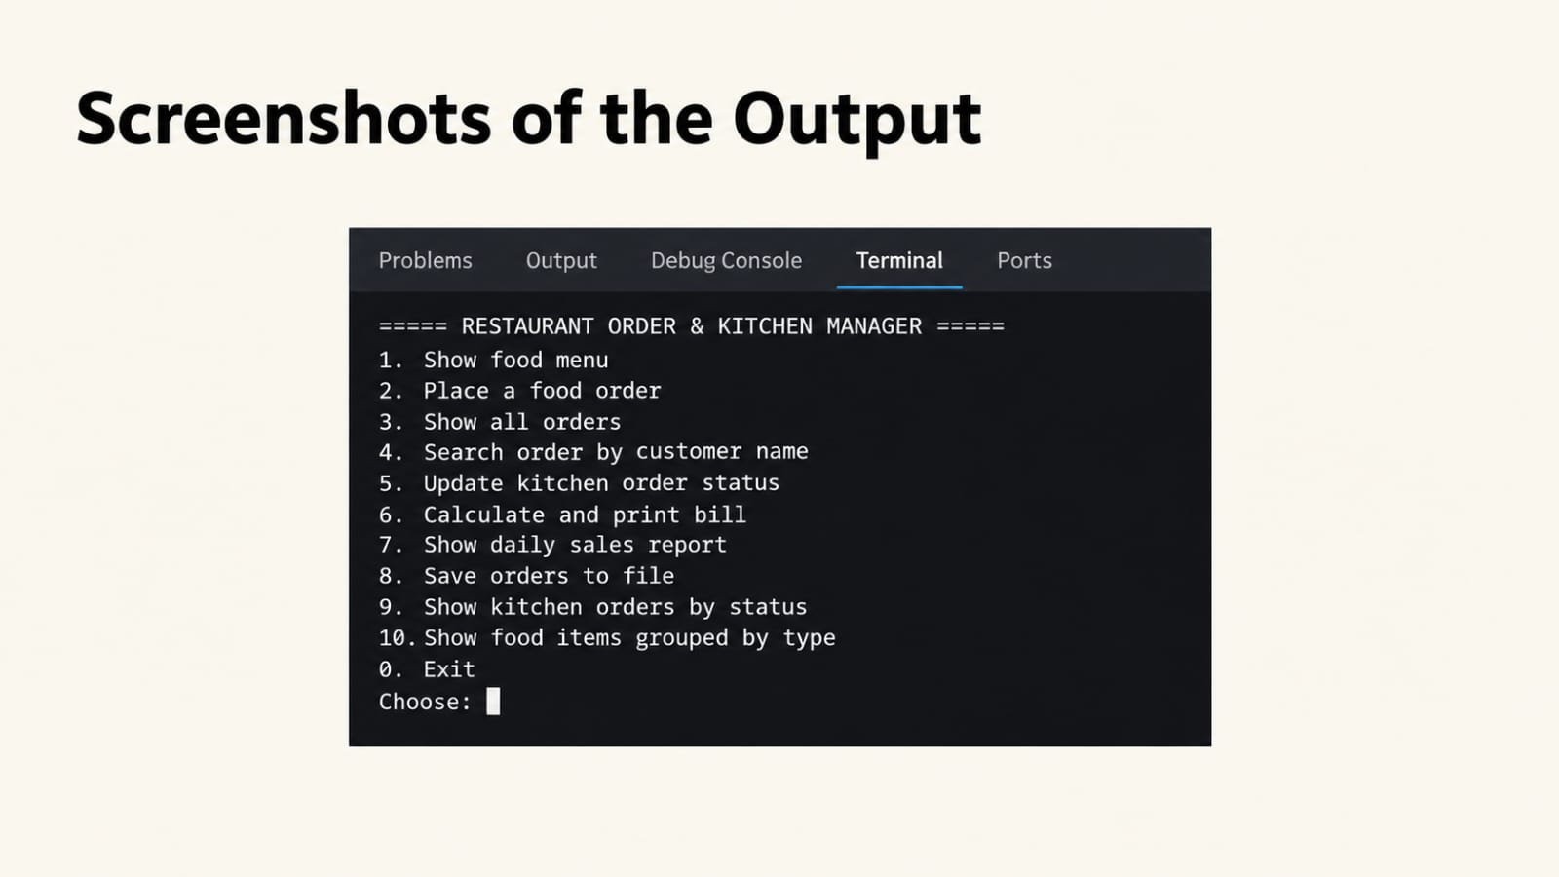
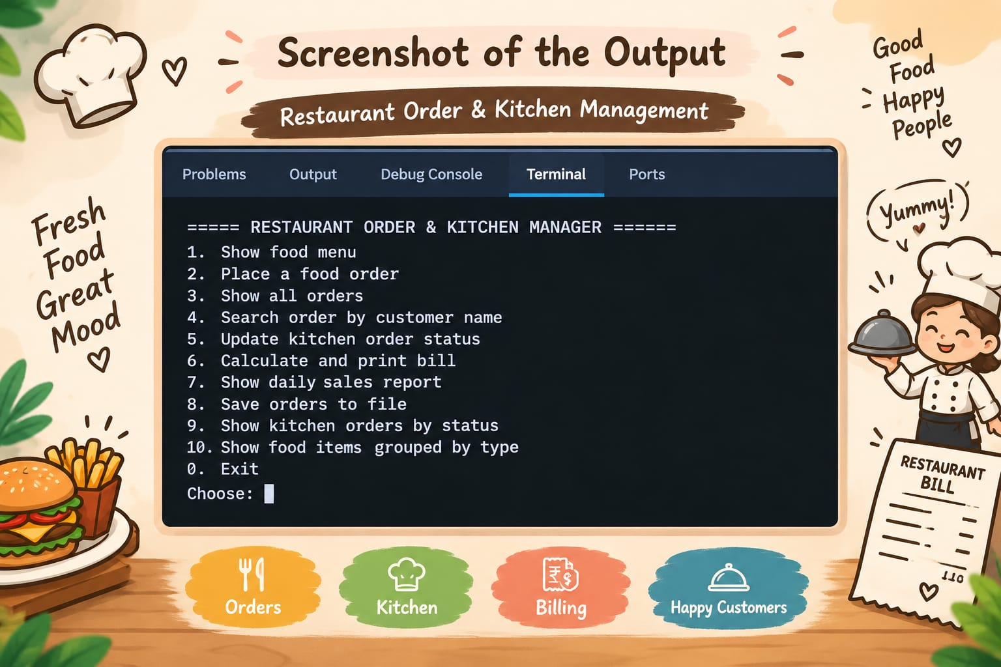

Screen Shots

Slide 12
Geo Tag Photo and git hub link
GEO TAG PHOTO & GITHUB LINK
GITHUB LINKS:
https://github.com/AadyaParuchuri9
https://github.com/chowdarymahi793-maker
https://github.com/Prishamyra

