Slide 1
Multi-Horizon Hazard Models for Battery Failure Prediction
Within-Dataset Reliability and Cross-Chemistry Transferability [Author Name] · [Affiliation]

Slide 2
1
Motivation
The original framework demonstrated feasibility — but several critical questions remain unanswered
Shikdar & Laaksonen (2026): multi-horizon hazard classification on NASA 18650 using HGB — AUC 0.87–0.90
Limited to one model class, one chemistry, no cross-dataset validation
Two open questions:
1. How sensitive are results to model choice (XGBoost, LightGBM, RF) and calibration method?
2. Do models trained on one chemistry (LCO) transfer to another (LFP)?

Slide 3
2
The Composite Failure Label
Failure = SOH drop OR voltage sag. Both must cross a per-cell baseline.
Two independent failure criteria — either triggers a positive label:
• State-of-Health (SOH) ≤ 0.80 of initial capacity
• Average voltage sag < 94% of early-life baseline (first 10 cycles)
Once triggered, label remains positive for all subsequent cycles
Voltage sag catches impedance-driven failures that precede capacity fade
LFP cells: no useful voltage sag (flat plateau at 2.7 V cutoff)

Slide 4
3
Datasets & Models
Dataset | Cells | Chemistry | Total Cycles | Cycles/Cell | Profile
NASA 18650 | 37 | LCO | ~1,000 | ~300 | Random walk, accelerated
CALCE LCO/CX2 | 7 | LCO | 8,733 | 775–1,952 | 1C/1C, slow degradation
Oxford LFP | 5 | LFP | ~1,500 | ~300 | 1C/1C, very stable
Models: XGBoost (depth=4, 300 trees, lr=0.05) · LightGBM (depth=4, 300 trees, lr=0.05) · Random Forest (depth=6, 300 trees)
Features: cycle, avg/min voltage, avg current, avg temp, duration, SOH
All hyperparameters matched to original study

Slide 5
4
Evaluation Protocol
Two parallel experiments: within-dataset reliability + cross-chemistry transfer
Within-dataset: 5-fold GroupKFold by cell — no cell leaks across folds
Horizons: H ∈ {10, 20, 30, 50} — label positive if failure within [t, t+H)
Calibration: isotonic vs Platt (sigmoid) — best method selected per dataset
Metrics: AUC (discrimination) + Brier score (calibration + discrimination)
Cross-chemistry: train on all LCO, test on all LFP — 3 variants (NASA, CALCE, ALL)
Feature ablation: with SOH vs without SOH — to isolate SOH contribution

Slide 6
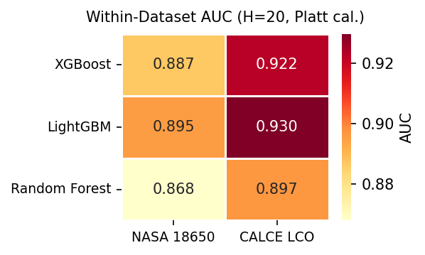
5
Finding 1: Within-Dataset AUC (H=20)

Slide 7
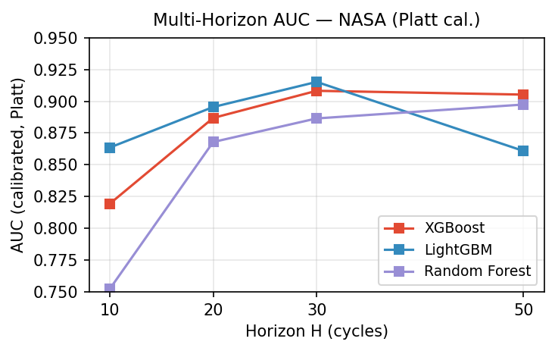
6
Finding 2: Multi-Horizon Performance (NASA)

Slide 8
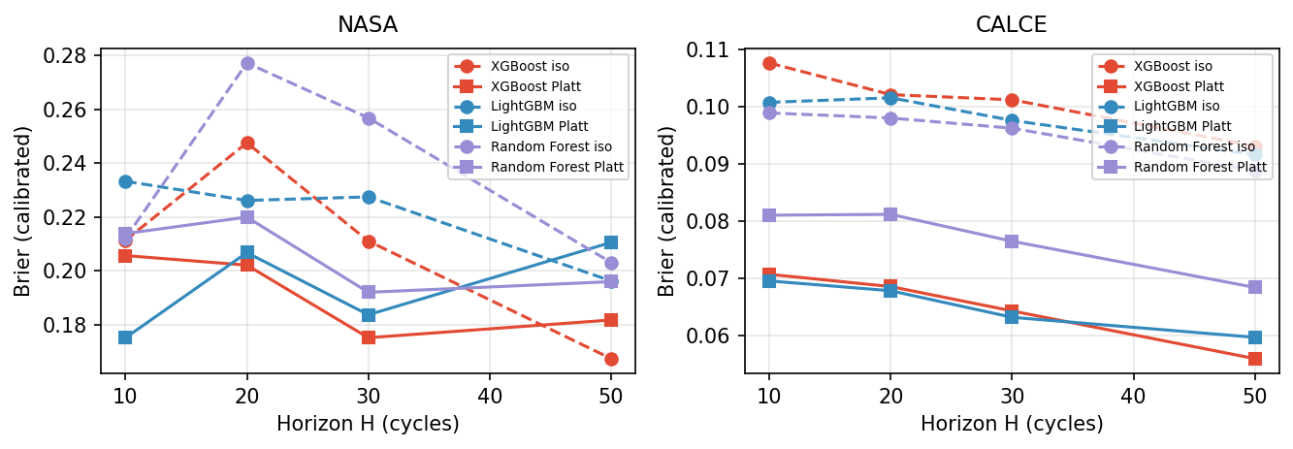
7
Finding 3: Platt vs Isotonic — NASA
NASA (left panel of Fig 2):
Platt Brier: 0.197 vs Isotonic: 0.222
11% reduction — consistent across all
models and horizons
Improvement is real but modest. NASA's
smaller per-cell cycle count limits
the calibration gap.
XGBoost Platt Brier: 0.191

Slide 9
8
Finding 3: Platt vs Isotonic — CALCE
CALCE (right panel of Fig 2):
Platt Brier: 0.069 vs Isotonic: 0.098
30% reduction — the headline result
Isotonic step function overcorrects on
CALCE's long-tailed SOH distribution
(8733 cycles, very slow degradation).
Platt's sigmoid is more robust to
class imbalance and distribution skew.
Per-model Brier (Platt):
XGB: 0.065 | LGBM: 0.065 | RF: 0.077

Slide 10
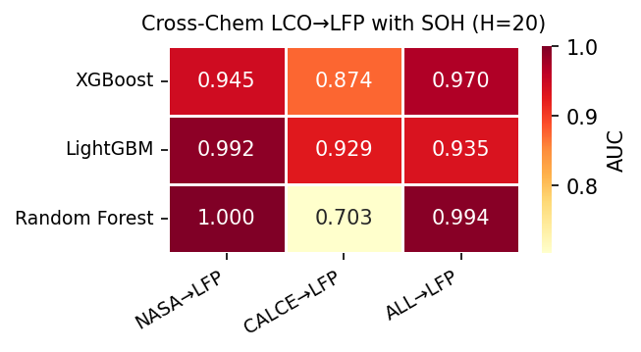
9
Finding 4a: Cross-Chemistry Transfer — With SOH
AUC 0.87–1.00
Looks like strong generalization
NASA→LFP:
0.95–1.00 (best)
CALCE→LFP:
0.70–0.93 (weakest)
ALL→LFP:
0.94–0.99
BUT — this is misleading
See next slide for the real story

Slide 11
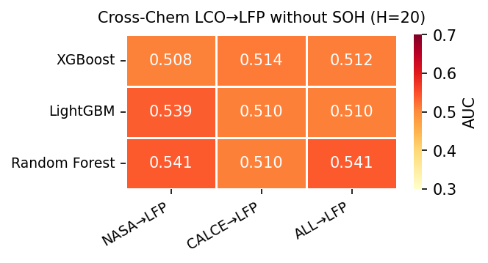
10
Finding 4b: Cross-Chemistry Transfer — Without SOH
AUC 0.51–0.54
Near-random across all 9 combinations
NASA→LFP:
0.508–0.541
CALCE→LFP:
0.510–0.514
ALL→LFP:
0.510–0.512
The SOH feature alone was driving
all apparent cross-chemistry transfer

Slide 12
11
Why? The SOH-as-Lookup-Table Mechanism
When SOH is available as a feature: • Model learns: SOH=0.85 means ~50 cycles to failure from LCO training data • LFP cells traverse similar SOH trajectories • Model applies the same learned mapping — predictions correlate with SOH, not with LFP-specific degradation • Result: high AUC, but no actual chemistry transfer When SOH is removed: voltage/current/temperature patterns alone carry no transferable signal LCO→LFP
SOH is not a transferable feature — it is a chemistry-specific capacity-to-RUL lookup table

Slide 13
12
Key Takeaway
Cross-chemistry transfer of hazard-based battery failure prediction remains an open problem.
Within-dataset reliability is strong (AUC ≥ 0.85). But practitioners should not expect LCO-trained hazard models to generalize to LFP without chemistry-specific retraining or domain adaptation.

Slide 14
13
Limitations
Oxford LFP: only 5 cells — insufficient for within-dataset evaluation (AUC ≈ 1.0 trivially)
Cross-chemistry: unidirectional only (LCO→LFP); may not generalize to LCO→NMC, NMC→LFP
Model scope: tree-based only — deep learning may capture more transferable features
Brier gap with published paper: published Brier 0.032 vs reproducible 0.17–0.26 (noted in discrepancy note)
Voltage sag feature dead for LFP: always at 2.7 V cutoff — no useful signal

Slide 15
14
Next Steps
Train on larger multi-chemistry datasets with balanced cell counts across chemistries
Develop learned feature representations designed explicitly for chemistry invariance (e.g., domain-adversarial training)
Bidirectional transfer evaluation: LCO↔NMC, NMC↔LFP, LCO↔LFP
Deep learning approaches (LSTM, transformers) with learned health indices
Reproduce and close the Brier gap with the published paper

