Slide 1
Multi-Horizon Hazard Models for Battery Failure Prediction
Can we predict battery failure across different chemistries? [Author Name] · [Affiliation]

Slide 2
The Problem
Batteries fail over time — we want to predict failure before it happens
This helps EVs, phones, and grid storage operate safely
Previous work tested only ONE battery type (LCO laptop batteries)
Question 1: Do different AI models give different results?
Question 2: Can we train on one chemistry and predict on another?

Slide 3
What Does "Failure" Mean?
We check two vital signs, like a doctor checking health:
1. State-of-Health (SOH) — battery capacity dropped below 80%
2. Voltage Sag — power drops suddenly before capacity fades
Either one triggered = "failure" label
Once triggered, stays triggered — batteries don't heal

Slide 4
The Batteries We Tested
NASA 18650: 37 LCO cells (laptop chemistry), ~300 cycles each
CALCE LCO/CX2: 7 LCO cells, 775–1952 cycles each
Oxford LFP: 5 LFP cells (EV chemistry), ~300 cycles each
LCO → test. LFP → test. Train on LCO, predict LFP? That's the key question.

Slide 5
How We Tested
Three AI models: XGBoost, LightGBM, Random Forest
Four prediction windows: 10, 20, 30, 50 cycles ahead
Two calibration methods: isotonic (freehand) vs Platt (smooth curve)
⚠ Critical: test with SOH feature AND without it

Slide 6
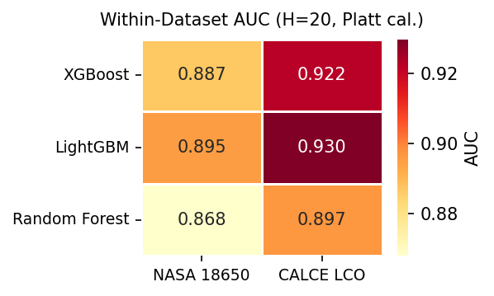
Finding 1: Works on Known Batteries
All three models score AUC ≥ 0.85 on NASA and CALCE — the framework is reliable on familiar chemistries

Slide 7
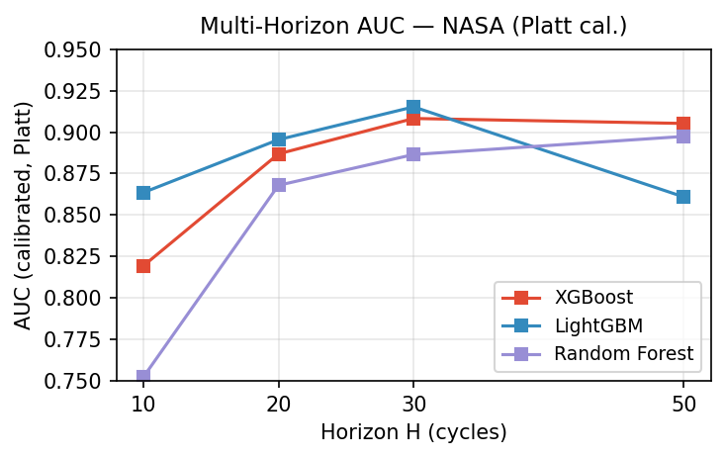
Finding 2: Longer Windows = Easier
Predicting 50 cycles ahead is easier than 10 — more time gives more data to work with

Slide 8
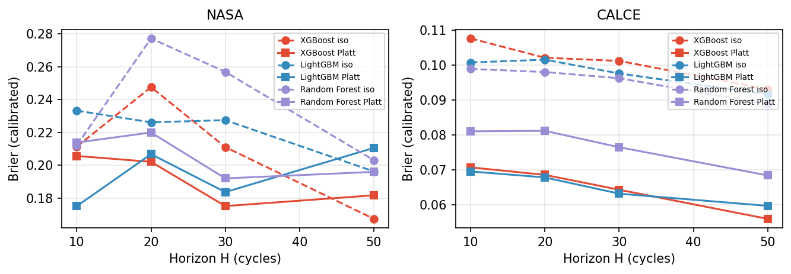
Finding 3: Getting Probabilities Right
Platt calibration (solid lines) always beats isotonic (dashed). Especially important for CALCE.

Slide 9
Why Platt Calibration is Better
Think of isotonic as drawing a freehand squiggle to fit the data:
• Follows every bump — works fine on small, clean datasets
• But overfits on messy, long-tailed data (like CALCE's 8733 cycles)
Platt uses a smooth S-curve instead:
• Like taking a step back and seeing the big picture
• More robust — it doesn't chase noise
CALCE Brier: isotonic 0.098 → Platt 0.069 (30% improvement)

Slide 10
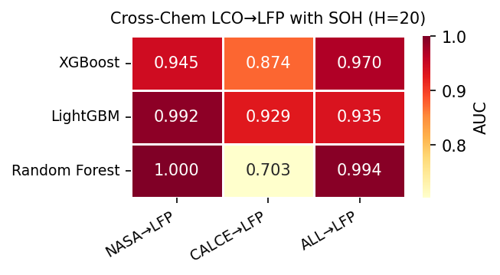
Finding 4a: Looks Like It Works...
With SOH, AUC hits 0.87–1.00 — looks like the model transfers perfectly from LCO to LFP

Slide 11
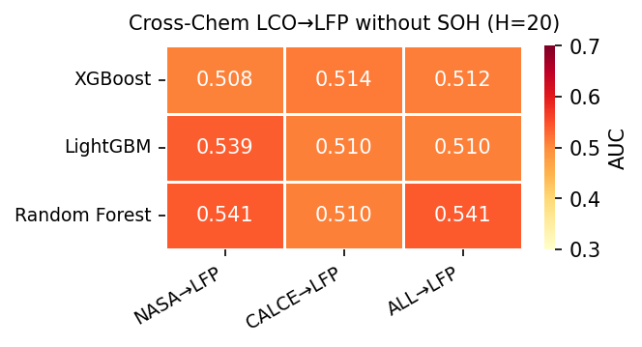
Finding 4b: ...But It's a Trick
Without SOH, AUC collapses to 0.51–0.54 — the model was 'cheating' using SOH as a shortcut

Slide 12
The "SOH Lookup Table"
When the model has SOH, it learns this rule:
"SOH = 85% → about 50 more cycles before failure"
It memorizes this from LCO training data
LFP batteries happen to have similar SOH values...
...so the model applies the same wrong rule to LFP
Result: predictions look good (high AUC)
But: the model learned nothing about LFP itself — just reused a lookup table

Slide 13
What This Means
The hazard framework works reliably within the same battery chemistry (AUC ≥ 0.85).
But cross-chemistry transfer is an unsolved problem. You cannot train on LCO and deploy on LFP without good features that actually transfer.

Slide 14
Caveats
Oxford LFP: only 5 cells — small sample
Tested one direction only (LCO → LFP)
Tree-based models only — deep learning might do better
Voltage sag useless for LFP (flat voltage plateau)
Published Brier scores could not be reproduced (code mismatch)

Slide 15
Next Steps
Test on larger datasets with more battery types
Design features that are "chemistry-agnostic"
Try deep learning (LSTM, transformers)
Test both directions: LCO→LFP AND LFP→LCO

