Slide 1
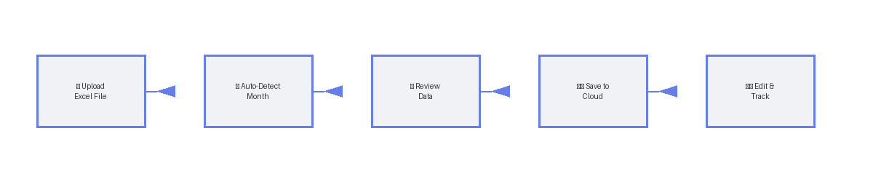
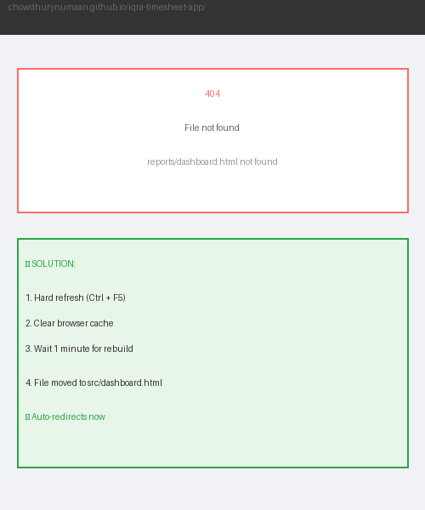
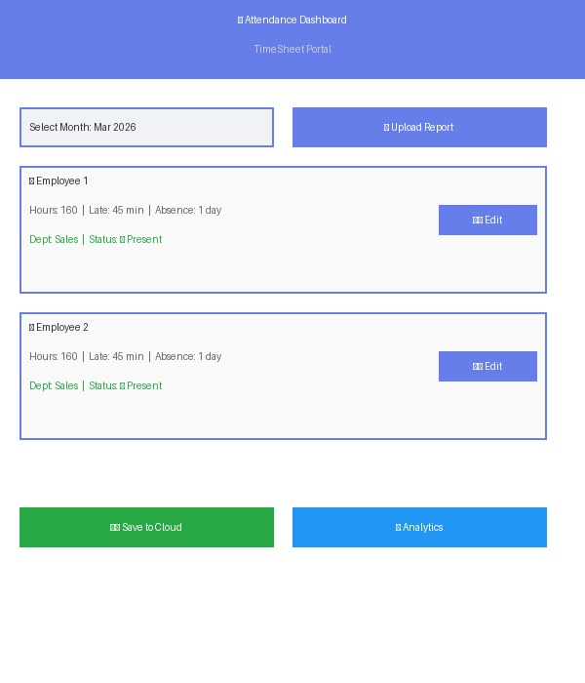
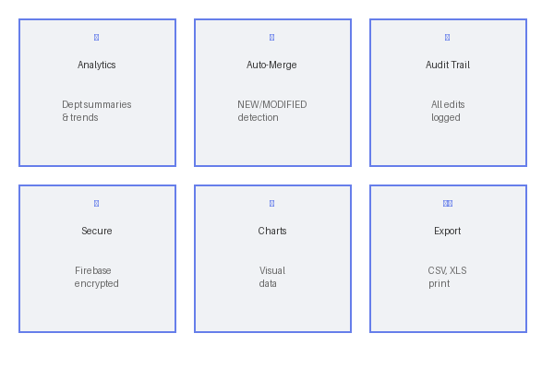
📊 TimeSheet Dashboard - Visual User Guide
⬆️ 5-STEP WORKFLOW - Follow arrows from left to right
🔗 https://chowdhurynumaan.github.io/iqra-timesheet-app/ | 💾 All data saved to cloud with audit trail | ✅ Works: Chrome, Firefox, Safari, Edge

