Slide 1

Fast, Interactive, Language-Integrated Cluster Computing

Slide 2
MapReduce is falling behind
MapReduce spends more than 90% of the time doing HDFS read-write operations.
Data sharing is slow due to: replication, serialization, and disk IO.

Slide 3
Motivation behind Spark
Most current cluster programming models are based on acyclic data flow from stable storage to stable storage
Map
Reduce
Benefits of data flow: runtime can decide where to run tasks and can automatically recover from failures
Input
Map
Output
Reduce
Map

Slide 4
Why Spark?
To extend MapReduce model to better support two common classes of analytics classes:
Iterative algorithms
Interactive data mining
Spark is not a modified version of Hadoop

Slide 5
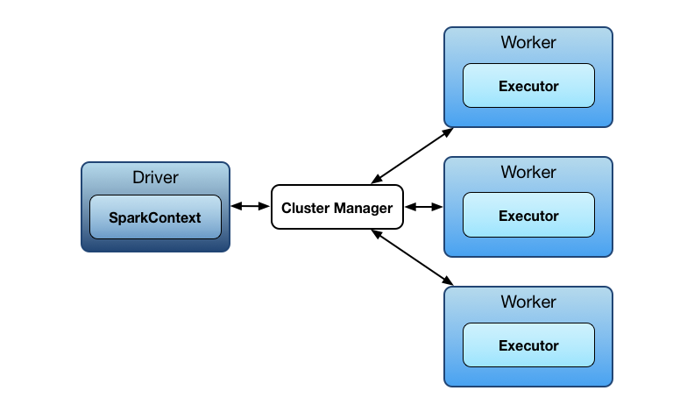
Spark Architecture

Slide 6
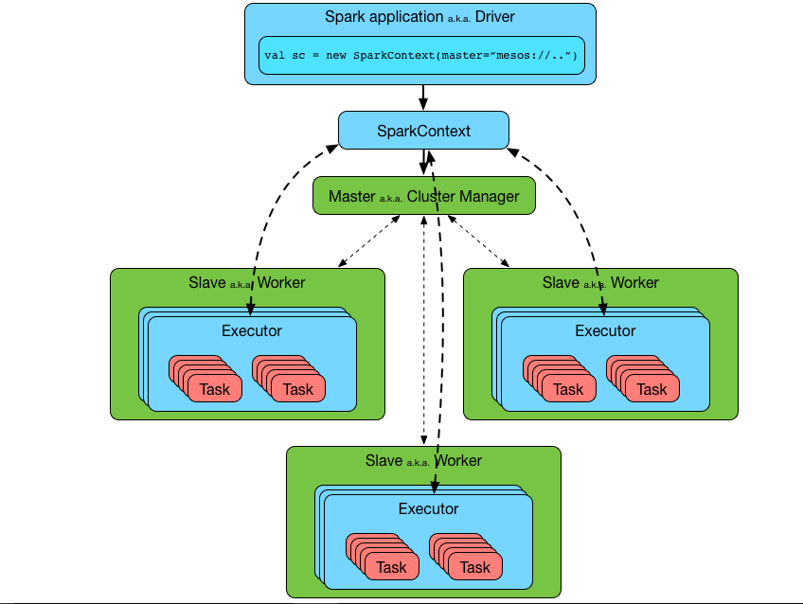
Spark Architecture in details

Slide 7
Introduction continues…
Spark uses Hadoop in two ways – one is storage and second is processing.
The main feature of Spark is its in-memory cluster computing.
There are three ways of Spark deployment
Standalone: Spark occupies the place on top of and space is allocated for HDFS, explicitly. Here, Spark and MapReduce will run side by side to cover all spark jobs on cluster.
Hadoop Yarn − Hadoop Yarn deployment means, simply, spark runs on Yarn without any pre-installation or root access required. It helps to integrate Spark into Hadoop ecosystem or Hadoop stack. It allows other components to run on top of stack.
Spark in MapReduce (SIMR) − Spark in MapReduce is used to launch spark job in addition to standalone deployment. With SIMR, user can start Spark and uses its shell without any administrative access.

Slide 8
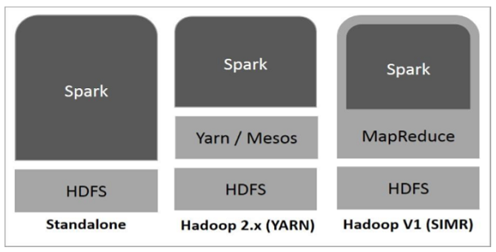
Hadoop Stack with Spark

Slide 9
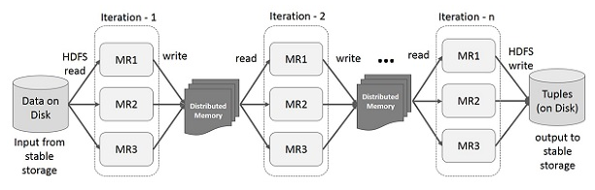
Iterative Operations on Spark
Spark stores intermediate results in a distributed memory instead of Stable storage (Disk) and make the system faster. If the Distributed memory (RAM) is not sufficient to store intermediate results (State of the JOB), then it will store those results on the disk.

Slide 10
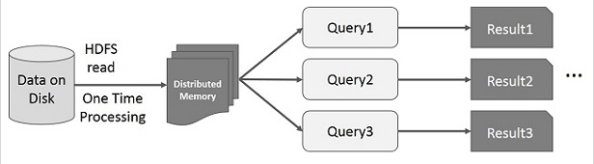
Interactive Operations on Spark
If different queries are run on the same set of data repeatedly, this particular data can be kept in memory for better execution times.

Slide 11
Resilient Distributed Datasets (RDDs)
Allow apps to keep working sets in memory for efficient reuse
Retain the attractive properties of MapReduce
Fault tolerance, data locality, scalability
Immutable
Partitioned collections of objects
Created through parallel transformations (map, filter, groupBy, join, …) on data in stable storage
Can be cached for efficient reuse
Actions on RDDs: Count, reduce, collect, save, …

Slide 12
RDD continues..
Each dataset in RDD is divided into logical partitions, which may be computed on different nodes of the cluster.
There are two ways to create RDDs
Parallelizing an existing collection.
Referencing a dataset in an external storage system
The key idea of spark is Resilient Distributed Datasets (RDD); it supports in-memory processing computation. This means, it stores the state of memory as an object across the jobs and the object is sharable between those jobs.

Slide 13
RDD Fault Tolerance
RDDs maintain lineage information that can be used to reconstruct lost partitions
Ex:
messages = textFile(...).filter(_.startsWith(“ERROR”))
.map(_.split(‘\t’)(2))
HDFS File
Filtered RDD
Mapped RDD
filter (func = _.contains(...))
map (func = _.split(...))

Slide 14
Logistic Regression Performance
127 s / iteration
first iteration 174 s
further iterations 6 s

Slide 15
Spark Applications
In-memory data mining on Hive data (Conviva)
Predictive analytics (Quantifind)
City traffic prediction (Mobile Millennium)
Twitter spam classification (Monarch)
Collaborative filtering via matrix factorization
…

Slide 16


Frameworks Built on Spark
Pregel on Spark (Bagel)
Google message passing model for graph computation
200 lines of code
Hive on Spark (Shark)
3000 lines of code
Compatible with Apache Hive
ML operators in Scala

Slide 17
Implementation
Runs on Apache Mesos to share resources with Hadoop & other apps
Can read from any Hadoop input source (e.g. HDFS)
Spark
Hadoop
MPI
…
Mesos
Node
Node
Node
Node

Slide 18
Spark Scheduler
Dryad-like DAGs
Pipelines functions within a stage
Cache-aware work reuse & locality
Partitioning-aware to avoid shuffles
B:
A:
G:
Stage 1
groupBy
C:
D:
F:
map
E:
join
Stage 2
union
Stage 3

Slide 19
Interactive Spark
Modified Scala interpreter to allow Spark to be used interactively from the command line
Required two changes:
Modified wrapper code generation so that each line typed has references to objects for its dependencies
Distribute generated classes over the network

Slide 20
Behavior with Not Enough RAM

Slide 21
Fault Recovery Results

Slide 22
Spark Operations
Transformations (define a new RDD) | map filter sample groupByKey reduceByKey sortByKey | flatMap union join cogroup cross mapValues
Actions (return a result to driver program) | collect reduce count save lookupKey

Slide 23
Resources
https://jaceklaskowski.gitbooks.io/mastering-apache-spark/content/spark-executor-ExecutorSource.html
http://spark.apache.org/

