Slide 1
Ames house price prediction

Slide 2
EDA:
A. Outlier and NA values B. Collinear features and identity feature C. Exploratory Visualizations: Continuous Variables D. Exploratory Visualizations: Categorical Variables
Preprocessing
A. Feature engineering
B. One-hot encode categorical variables C. Train/test split data D. Scale data
Modeling
A. Baseline Linear regression B. Fit RidgeCV and Lasso CV with default parameters C. Residual Plot
Conclusion and Recommendation

Slide 3
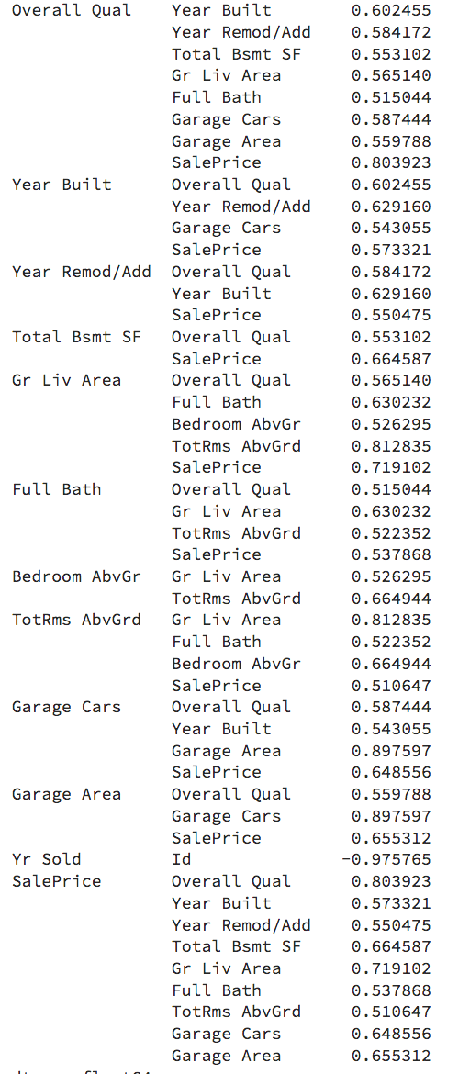
Continuous variables

Slide 4
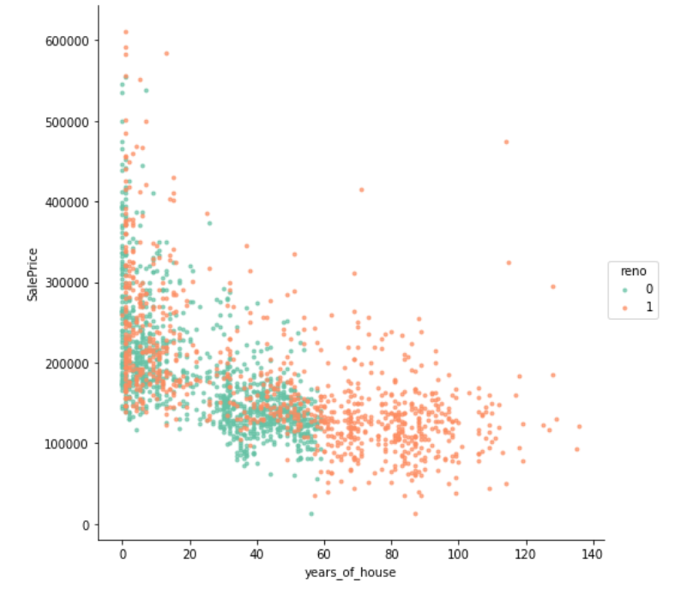
Continuous variables
Years of house vs Price
older the house
cheaper its price

Slide 5
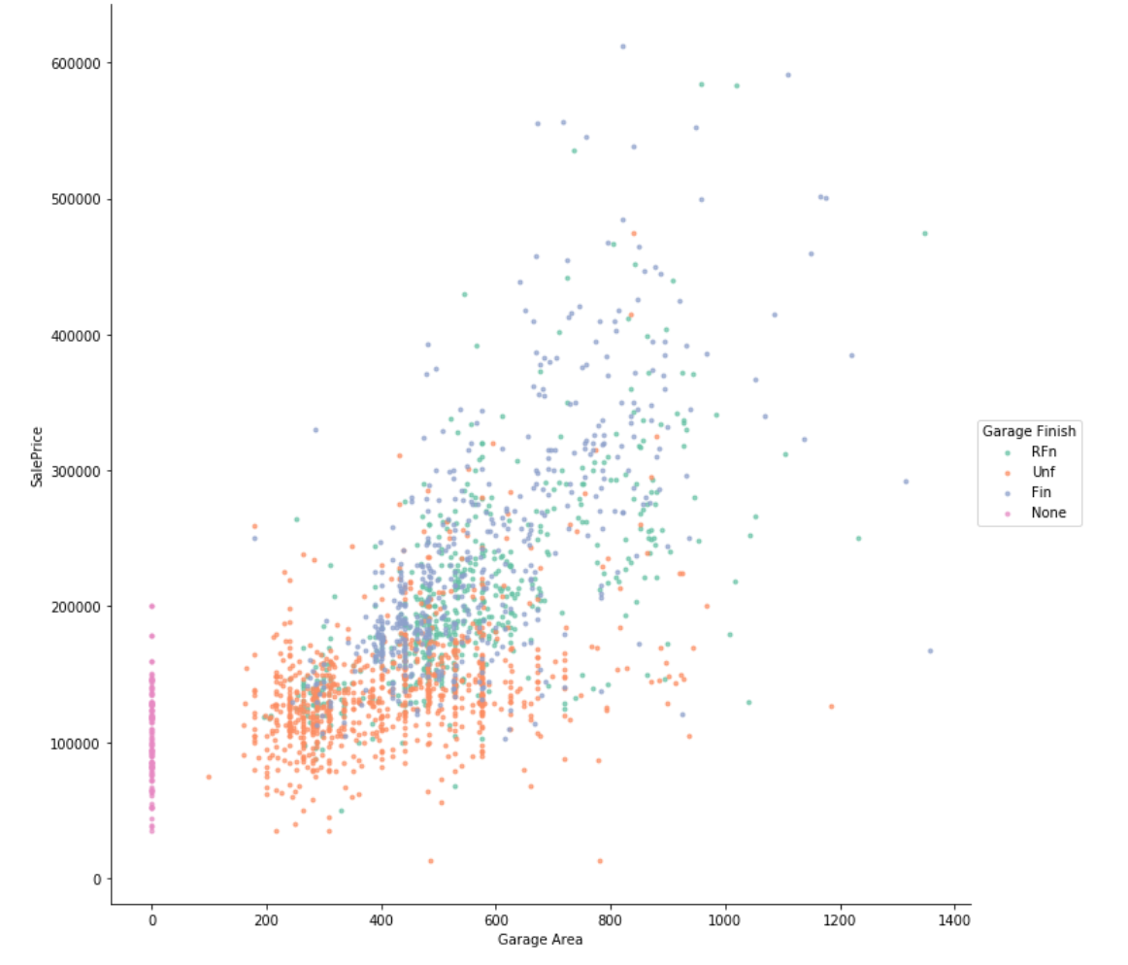
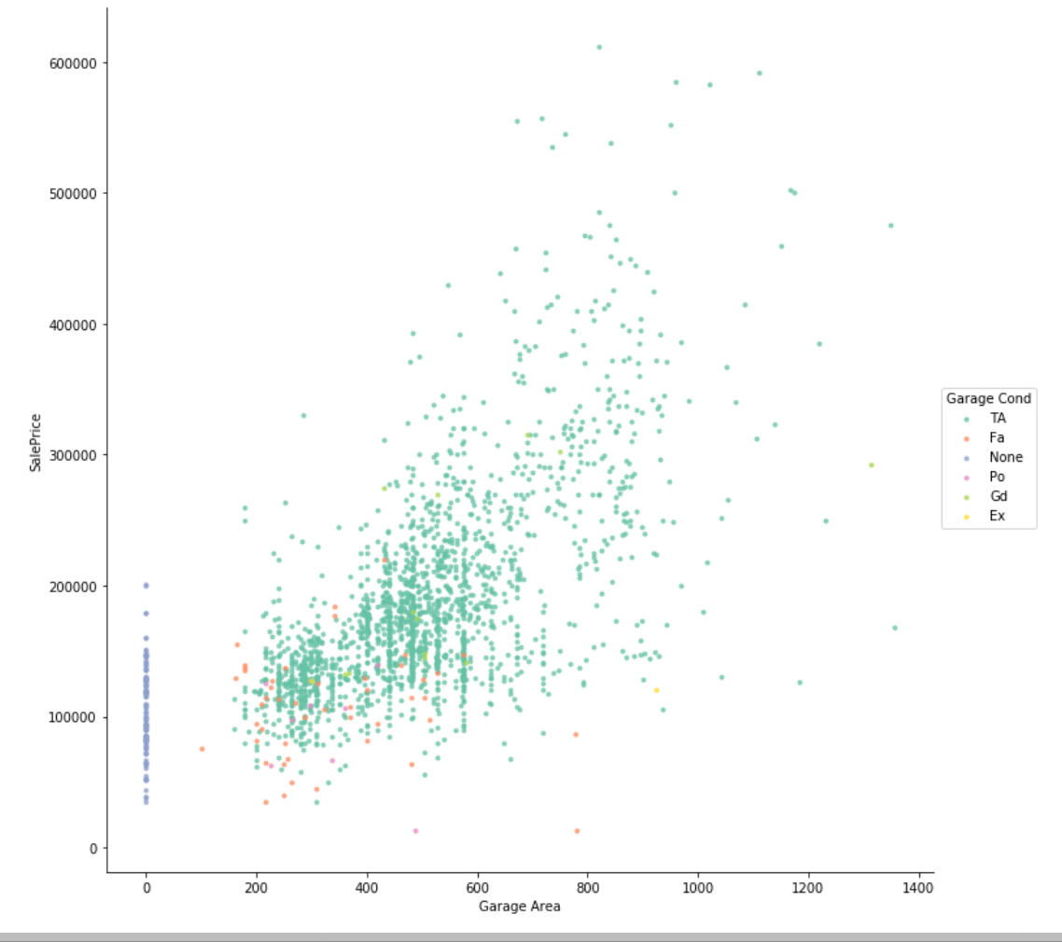
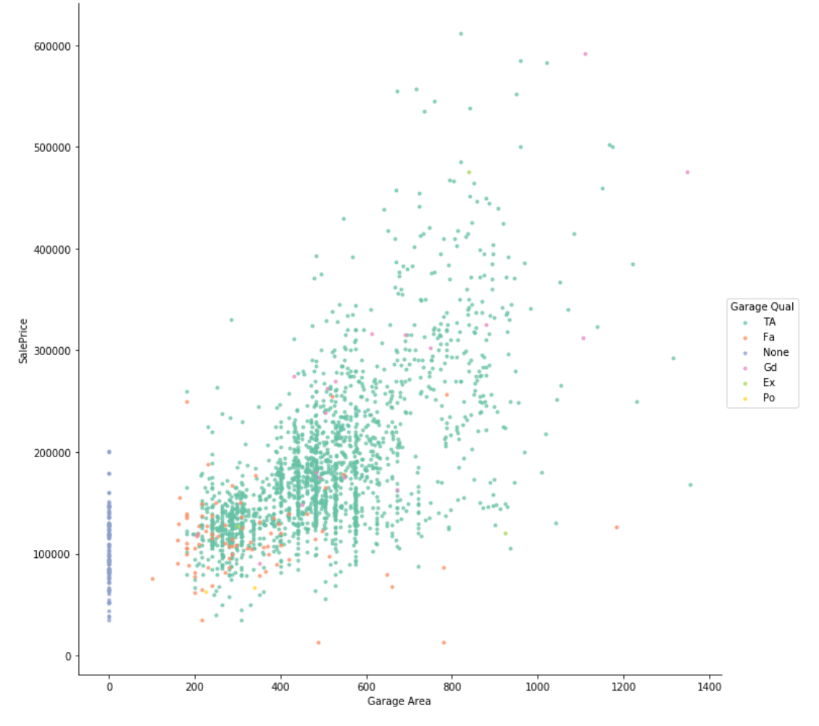
Continuous variables
Garage area vs Price
with different garage features
Do the same for
Basement feature
Gr Liv area feature

Slide 6
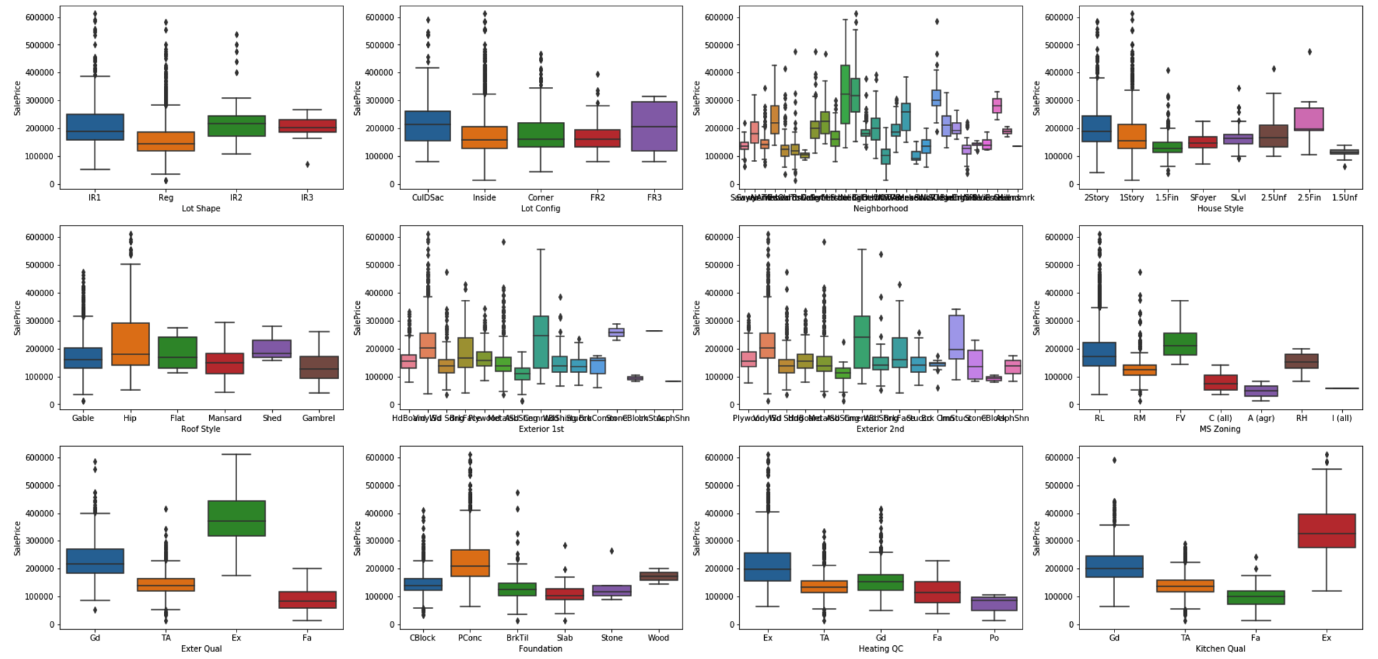
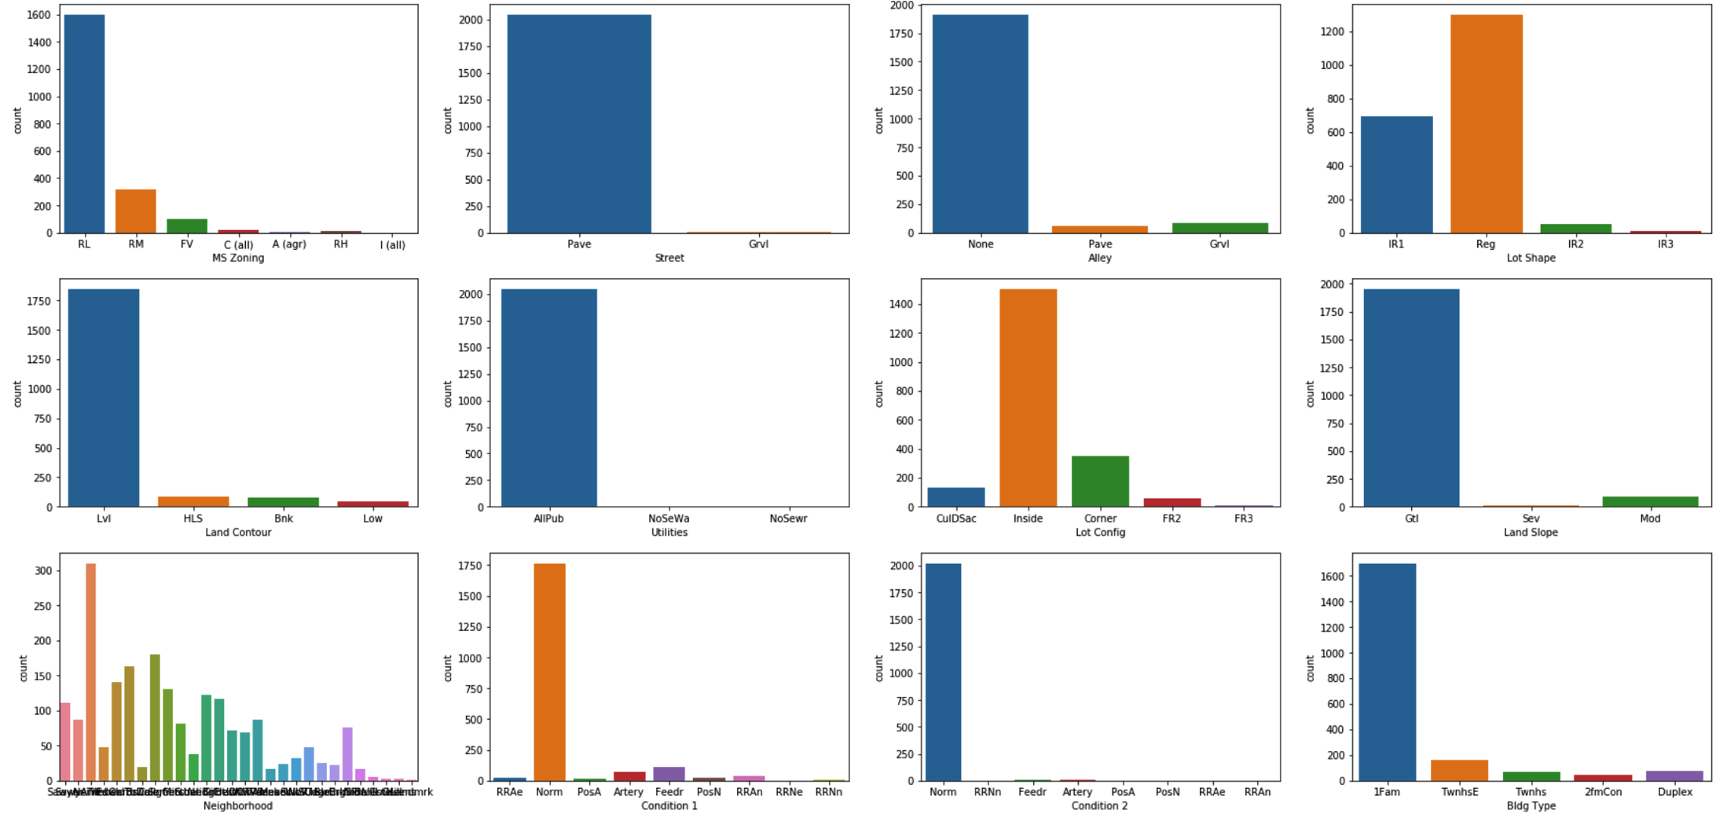
categorical variables
Countplot: eliminate feature with a variable that is high % compared other
Boxplot: compare the price different

Slide 7
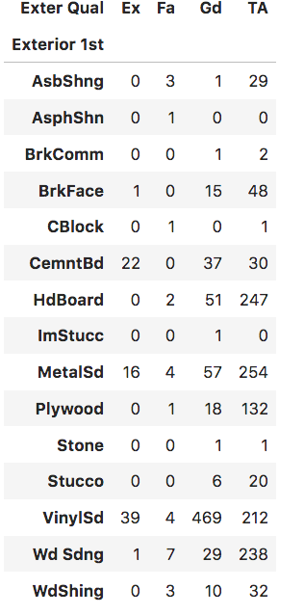
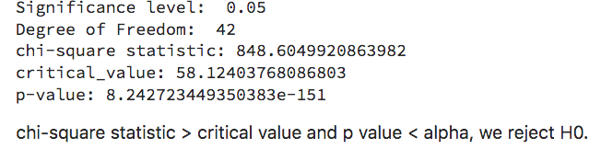
categorical variables
Exter Qual and Exterior 1st/2nd
- Chi-squared test to examine their relationship
- Chi-square test relies on the difference between observed and expected values
- Our hypothesis:
H0 = Exter Qual and Exterior 1st/2nd are independent to each other<br>
H1 = Exter Qual are Exterior 1st/2nd are dependent to each other.

Slide 8
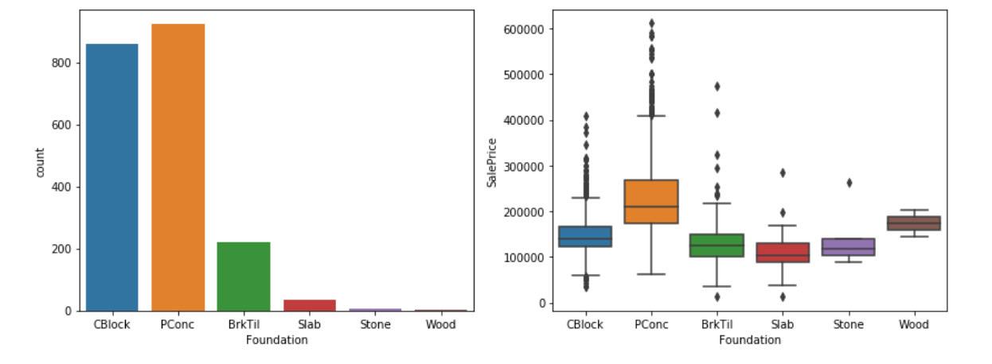
One hot encoded
'PConc’ has highest impact on 'SalePrice’
The rest of the materials have a comparable 'SalePrice' with 'CBlock’
Create a new column to check is 'PConc' the material for foudation
Do the same for
Number of fireplace
Garage finish

Slide 9
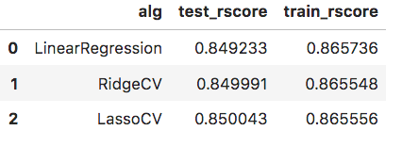
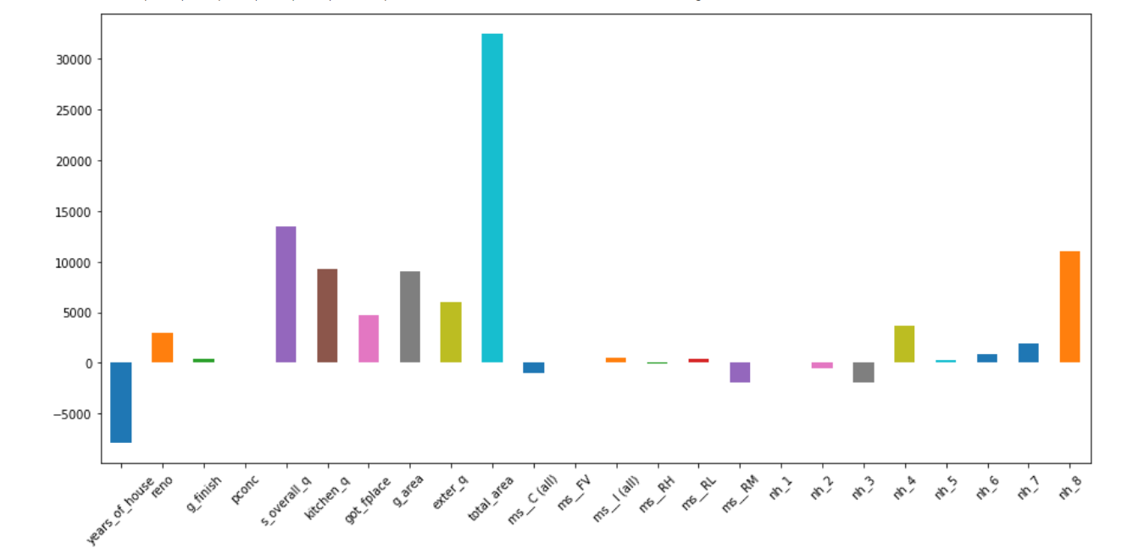
Model fitting
Use lassoCV because
reduce number of features
performs slightly better in test data

Slide 10
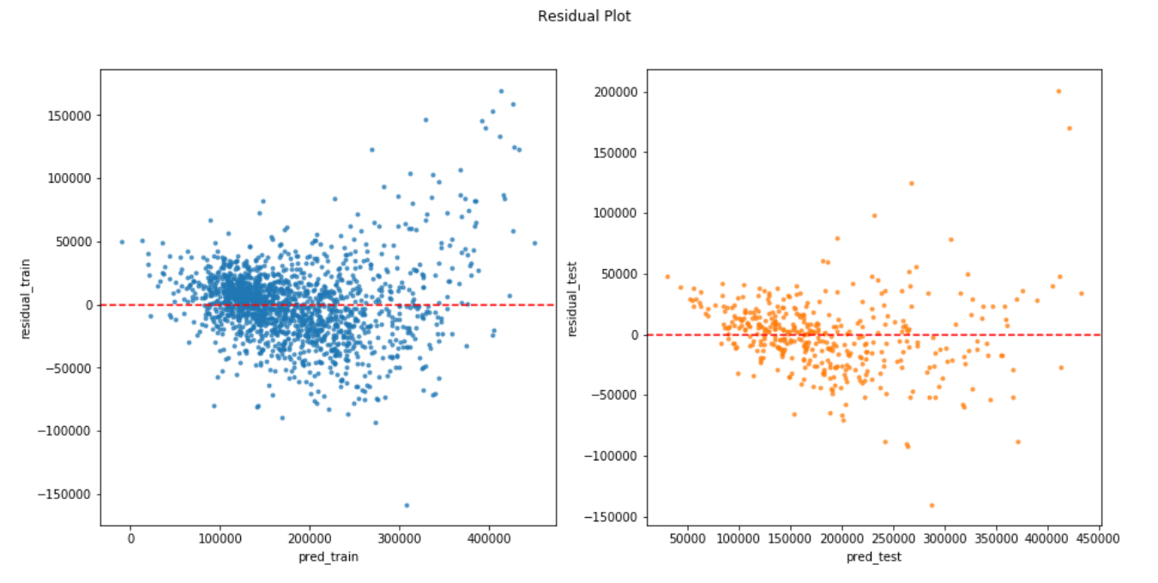
Residual plot
pretty symmetrically distributed
the residuals appear to behave randomly
most of the points are cluster around zero,
There are a few outliers

Slide 11
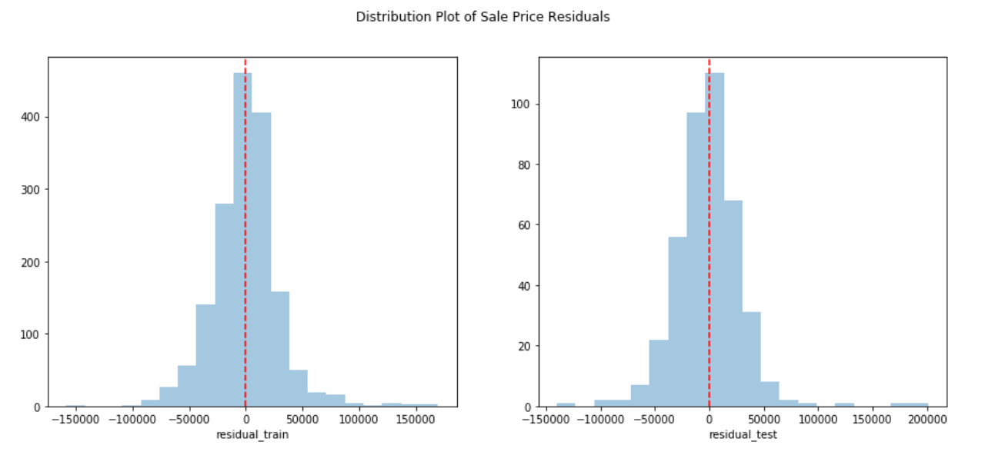
Residual plot
Normally distributed
Both of the plots show that the data is well fit with the model

Slide 12
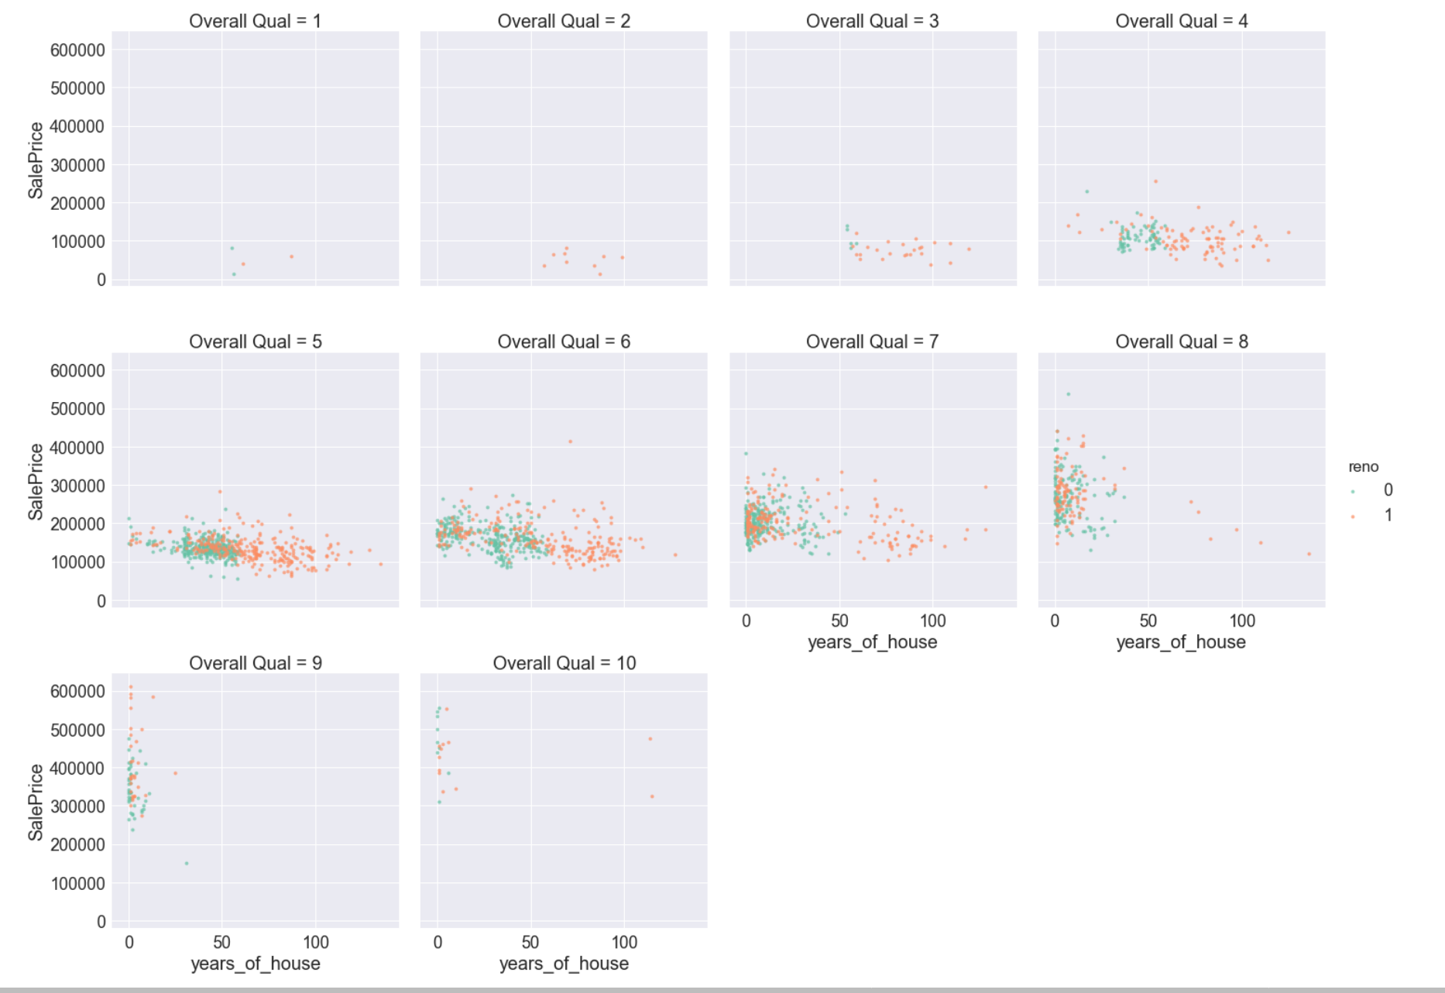
Recommendation
Renovation improve house quality
Need to consider the balance between cost of renovation and sale price

Slide 13
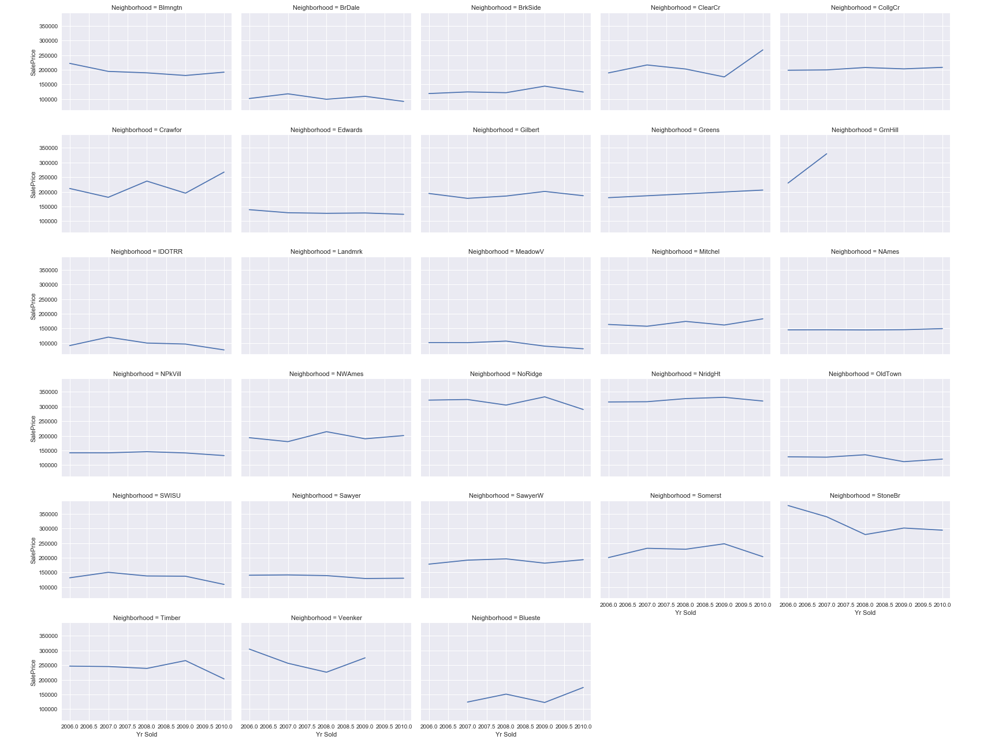
We can observe some neighborhood with increase/decrease sale price over the year

