Slide 1

Project 3: Web APIs & Classification

Slide 2
Problem Statements¶ Reddit posts are extremely large, it is near to impossible to sort all the posts manually.

Slide 3

A. API Scrapping
Scrap the desired reddit posts using api
Save the scrapped posts
Extract the needed data
X = title + selftext
y = subreddit

Slide 4
B. Data Cleaning
Basic data cleaning:
Drop duplicate
Handle NA
Convert subreddit to 1 and 0
‘Clean’ the feature(text)
Remove anything other than alphabets
Covert to lowercase
Remove stops words ['\n', 'www', 'reddit', 'com', 'comment', 'http']
Lemmatized the words

Slide 5
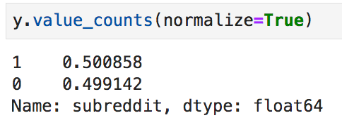
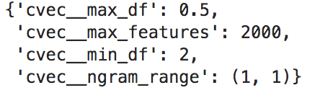
C. Modeling
Get the baseline
1st model: CountVectorizer + LogisticRegression
2nd model: CountVectorizer + MultinomialNB
*use GridsearchCV for hyperparameter tuning

Slide 6
D. Model Evaluation
Confusion table
LogisticR | Pred Marvel | Pred DC
Act Marvel | 192 (TP) | 21
Act DC | 9 | 216 (TN)
LogisticRegression has lower number of FP and FN
NB | Pred Marvel | Pred DC
Act Marvel | 205 (TP) | 8
Act DC | 32 | 193 (TN)

Slide 7
D. Model Evaluation
Classification Report
LogisticR | Precision | Recall | F1-score
0(DC) | 0.96 | 0.90 | 0.93
1(Marvel) | 0.91 | 0.96 | 0.94
LogisticRegression scores higher in recall and precision
NB | Precision | Recall | F1-score
0(DC) | 0.86 | 0.96 | 0.91
1(Marvel) | 0.96 | 0.86 | 0.91

Slide 8
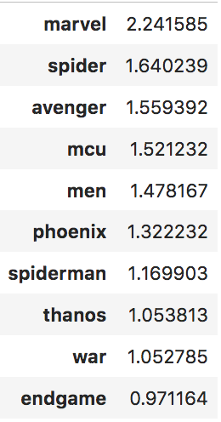
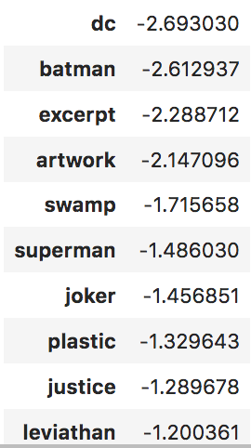
D. Model Evaluation
Word(s) with the highest weight
one unit increase in 'marvel', probability of a reddit post being an 'Marvel' subreddit increases by 2.24 times
one unit increase in the world 'dc', the probability of a reddit post being an 'Marvel' subreddit decreases by 2.69 times

Slide 9
D. Conclusion & Recommendation
Some of the posts has comparable less words, harder to predict the outcome accurately.
The model performs better under LogisticRegression with the average accuracy of 0.93 and average precision of 0.93. It is performs far more better from the baseline.
In future, we could use pic posted in a post as a feature to classify a subreddit.

