Slide 1

Deep Learning for Audio Classification:
An Overview and Analysis Gaetano Salvatore Falco Kuerxi Gulisidan
1

Slide 2
Table of Content
Architecture Description
Dataset Description
Model Training
Model Optimization
Model Inference
MQTT and Redis Protocol
Description of REST Architecture
Conclusion
2

Slide 3
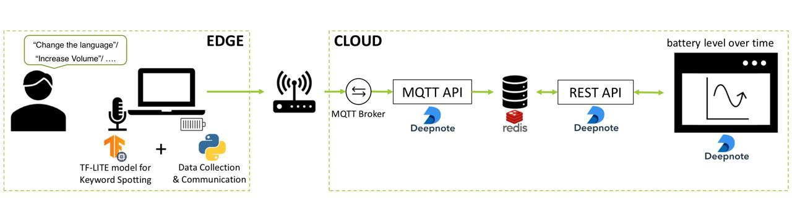
System Architecture
2

Slide 4
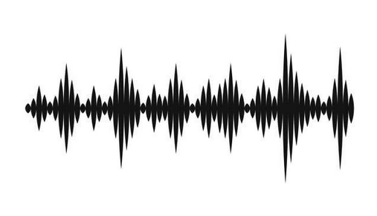
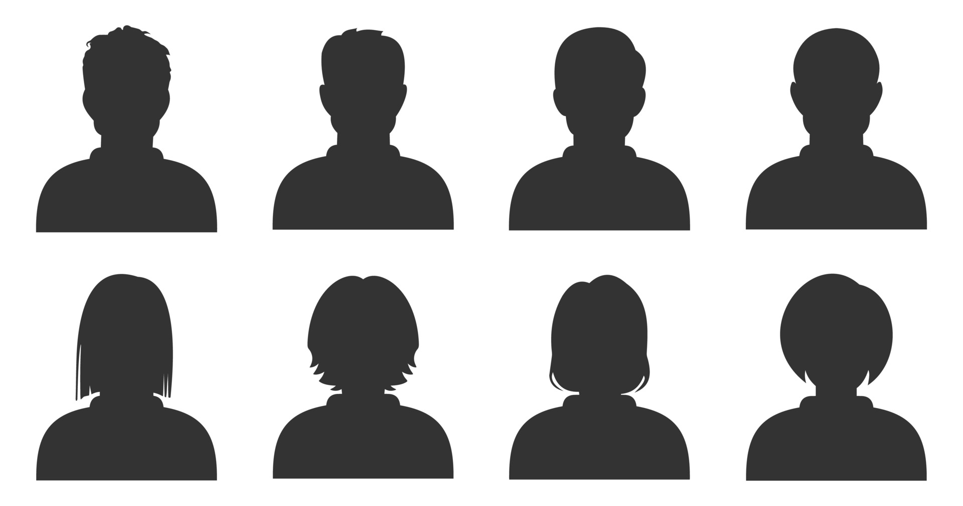
Dataset
Audio File :
11,309 WAV format audio
97 speakers
2

Slide 5
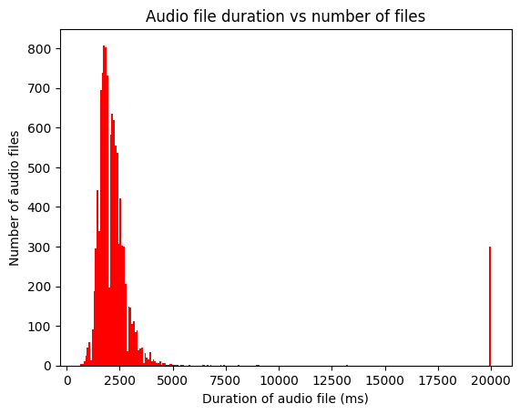
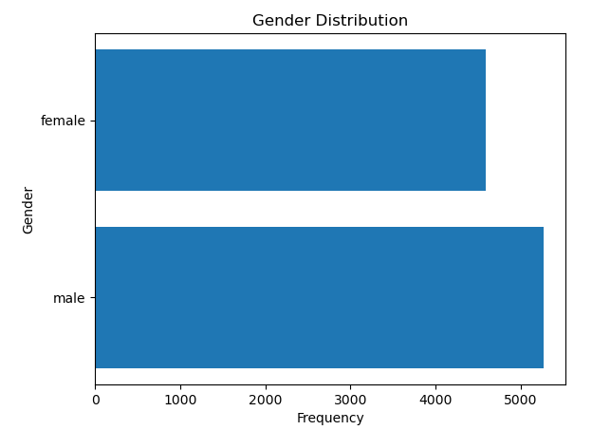
Dataset Exploration
After some data exploration, we found out that the provided dataset is composed of audio files with different lengths
2

Slide 6
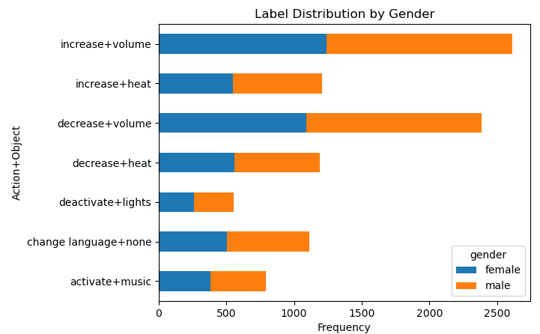
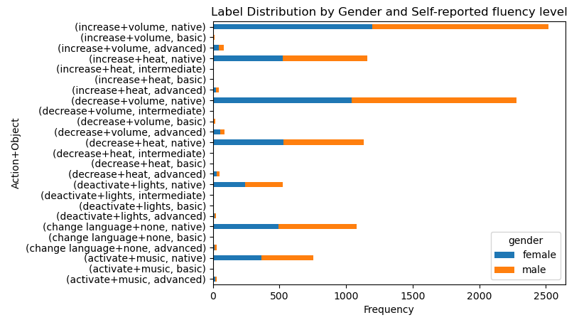
Dataset Exploration
2

Slide 7
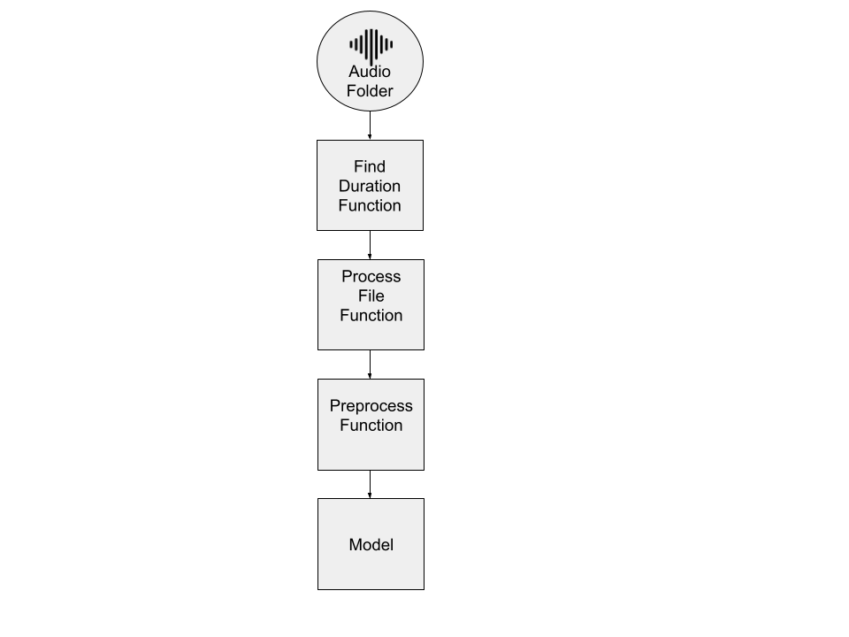
Model Training and Pre-processing
Imbalanced classes
Find optimal audio duration
Crop to optimal duration and sample to 8.000 Hz
MFCCs Extraction
Model Ingestion
2

Slide 8
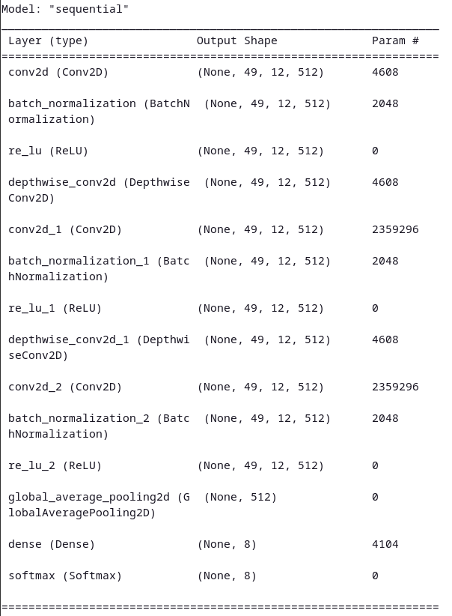
Model Training and Pre-processing
The model expands the one that we build in class with the papers of Palanisamy et al. [1] and Peter Mølgaard
Sørensen et al. [2]
[1] Kamalesh Palanisamy, Dipika Singhania, Angela Yao, ”Rethinking CNN Models for Audio Classification” in arXiv 2020 (https://arxiv.org/pdf/ 2007.11154.pdf)
[2] Sørensen, P.M., Epp, B. & May, T. ”A depthwise separable convolutional neural network for keyword spotting on an embedded system.” J AUDIO SPEECH MUSIC PROC. 2020, 10 (2020). (https://doi.org/10.1186/ s13636-020-00176-2)
2

Slide 9
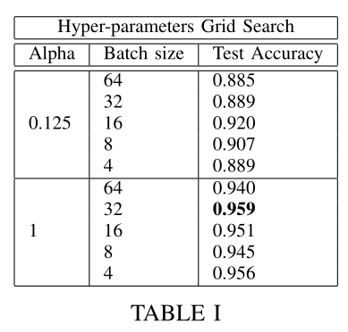
Model Optimization
Pruning the model reduces the trainable parameters and thus the model size by over 62 times while still able to achieve over 92% accuracy
2

Slide 10
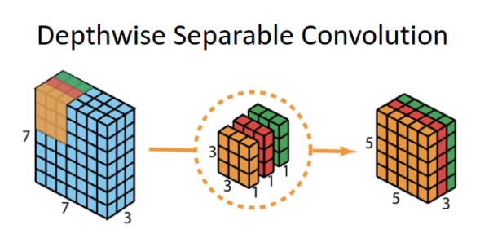
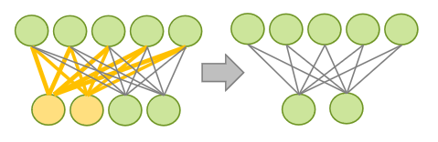
Model Optimizations and Conversion to TFLite
Width Scaling for reducing model complexity and thus reducing time required for training
Neural network that uses DS convolutional layers
2

Slide 11
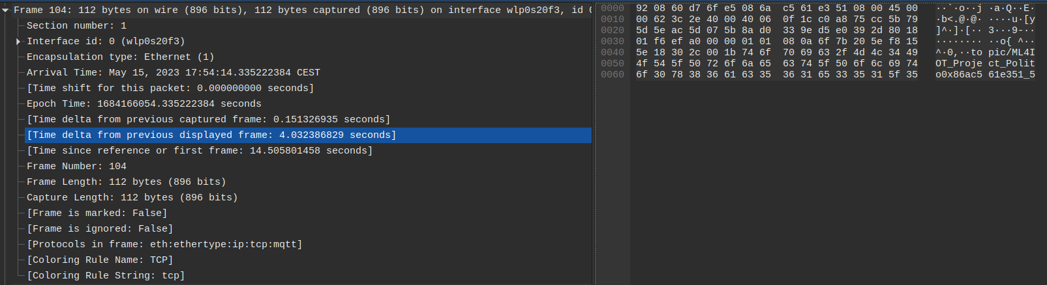
MQTT Protocol
Edge-Cloud communication using MQTT Protocol, with an additional overhead for sending the packages of 0.032s between packages. The package message is 44 bytes, with 27 bytes corresponding to the Topic and could be further optimized.
2

Slide 12
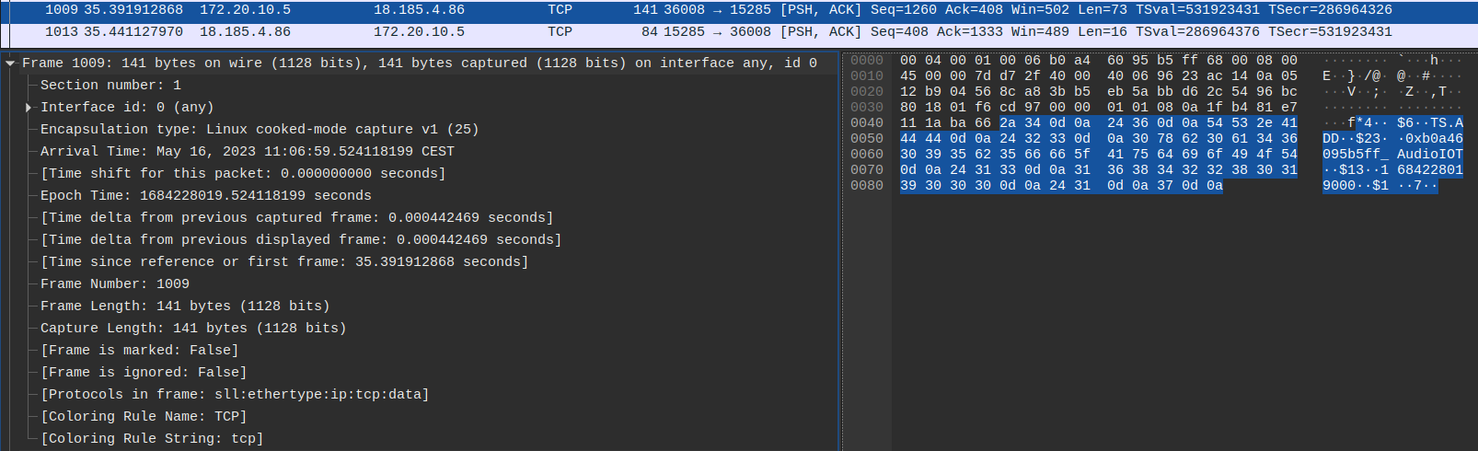
Redis Protocol
Package for adding an element to the timeseries on a redis server, most of the communication cannot be optimized and it runs on a TCP protocol, thus requiring the redis server to send an aknowledge and adding additional timing.
2

Slide 13
REST Server Structure
Root
Devices
Device
2

Slide 14
THANKS FOR YOUR ATTENTION! Gaetano Salvatore Falco Kuerxi Gulisidan
11

