Slide 1

Deep Learning for Audio Classification:
An Overview and Analysis Gaetano Salvatore Falco Kuerxi Gulisidan
1

Slide 2
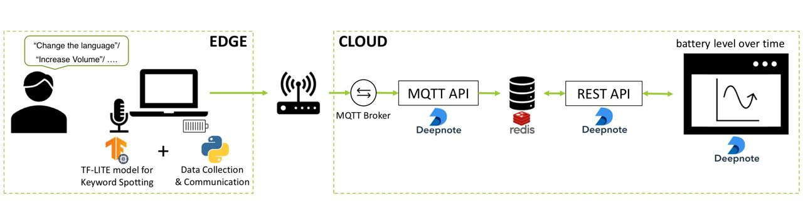
System Architecture
2

Slide 3
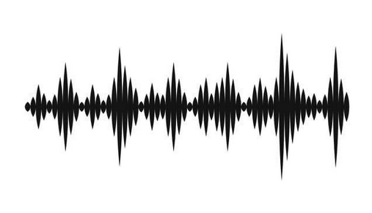
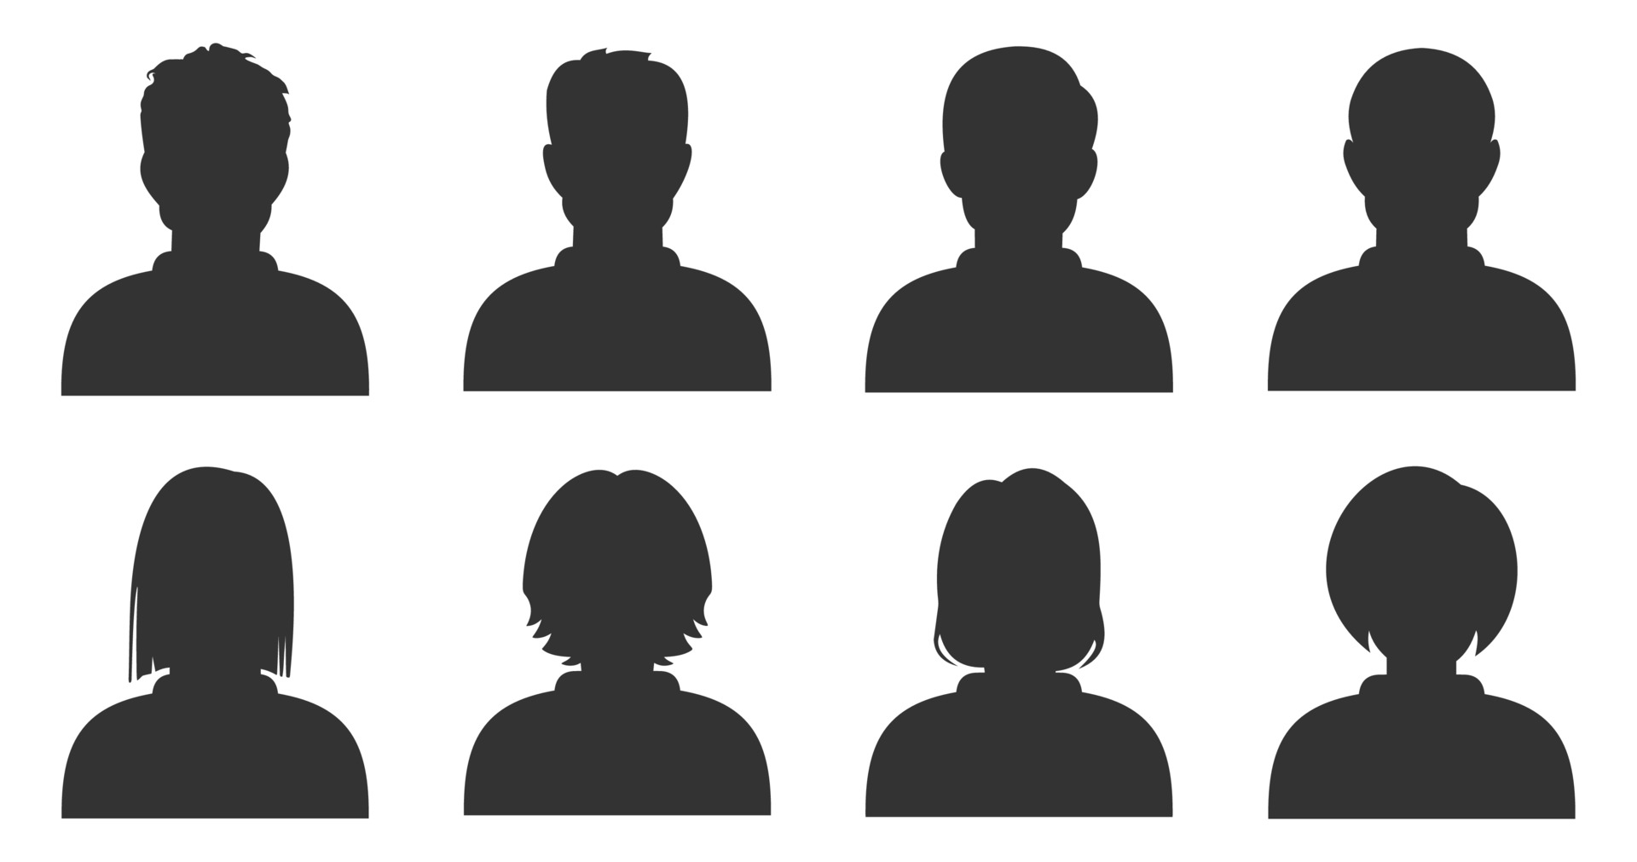
Dataset
Audio File :
11,309 WAV format audio
97 speakers
2

Slide 4
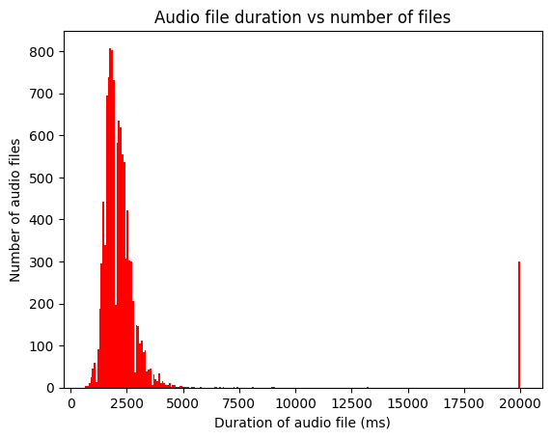
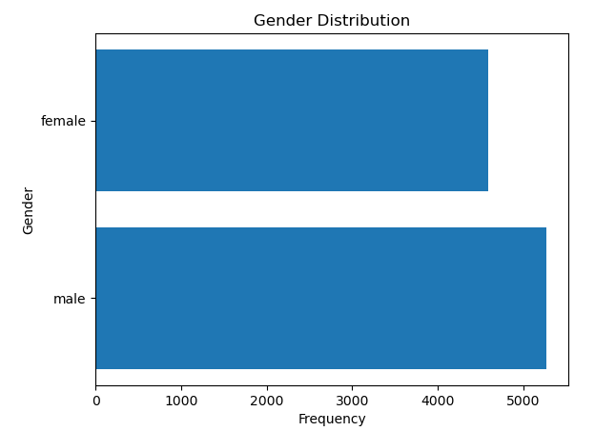
Dataset Exploration
After some data exploration, we found out that the provided dataset is composed of audio files with different lengths
2

Slide 5
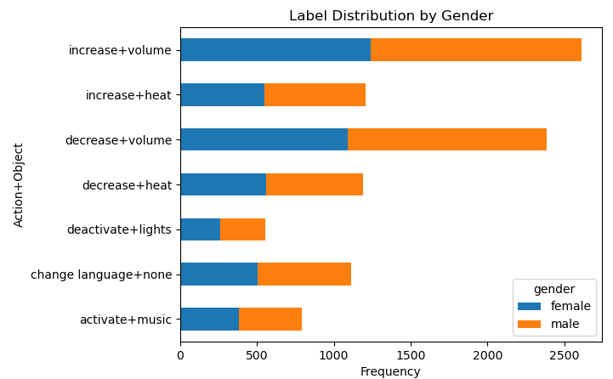
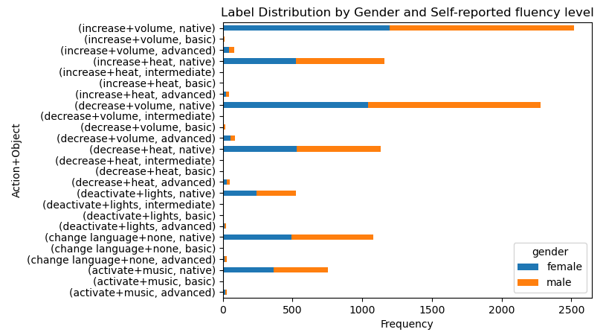
Dataset Exploration
2

Slide 6
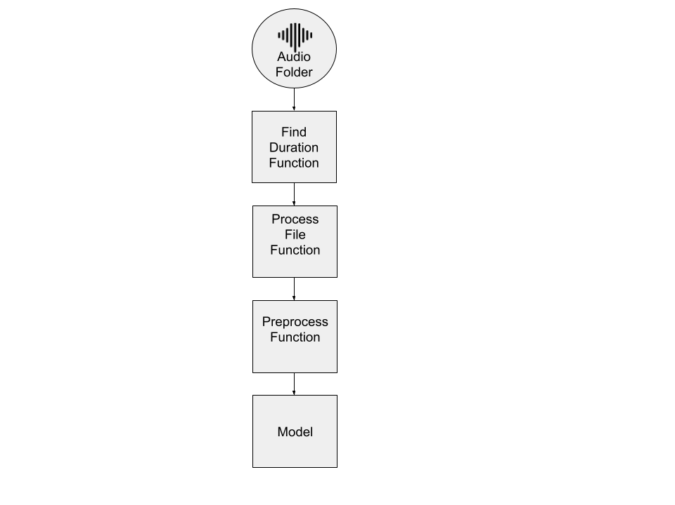
Model Training and Pre-processing
Imbalanced classes
Find optimal audio duration
Crop to optimal duration and sample to 8.000 Hz
MFCCs Extraction
Model Ingestion
2

Slide 7
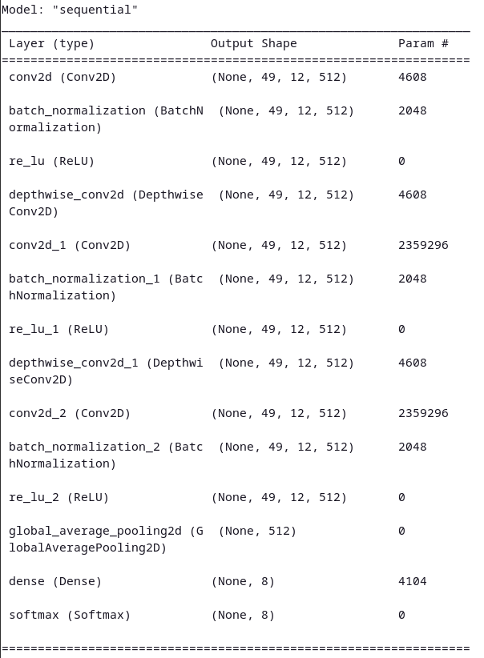
Model Training and Pre-processing
The model expands the one that we build in class with the papers of [¹] and [2]
2

Slide 8
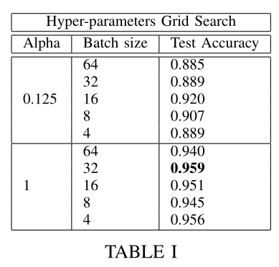
Model Optimization
Pruning the model reduces the trainable parameters and thus the model size by over 62 times while still able to achieve over 92%
accuracy
2

Slide 9
Model Optimizations and Conversion to TFLite
2

Slide 10
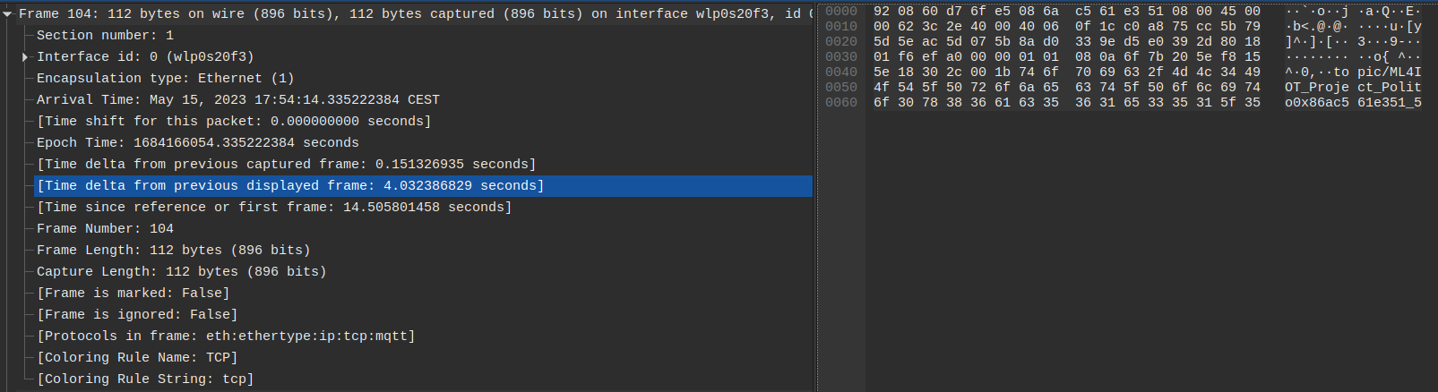
MQTT Protocol
Edge-Cloud communication using MQTT Protocol, with an additional overhead for sending the packages of 0.032s between packages. The package message is 44 bytes, with 27 bytes corresponding to the Topic.
2

Slide 11
Redis Protocol
Edge-Cloud communication using MQTT Protocol, with an additional overhead for sending the packages of 0.032s between packages. The package message is 44 bytes, with 27 bytes corresponding to the Topic.
2

Slide 12
REST Server Structure
Edge-Cloud communication using MQTT Protocol, with an additional overhead for sending the packages of 0.032s between packages. The package message is 44 bytes, with 27 bytes corresponding to the Topic.
2

Slide 13
THANKS FOR YOUR ATTENTION! Gaetano Salvatore Falco Kuerxi Gulisidan
11

