Slide 1
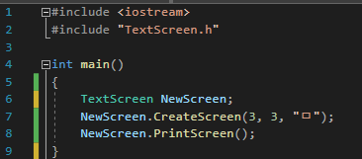
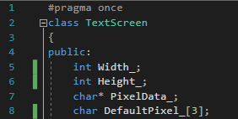
ConsoleScreen.cpp
TextScreen.h
Heap
Stack
main()
TextScreen
Width_ Height_ PixelData_ DefaultPixel_

Slide 2
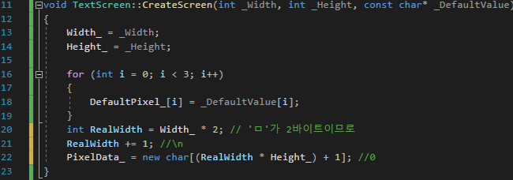
ConsoleScreen.cpp
TextScreen.cpp
Heap
Stack
main()
CreateScreen
22 (7*3+1)
RealWidth = 7
i = 2
i = 1
_DefaultValue ㅁ
i = 0
_Height = 3
_Width = 3
TextScreen
ㅁ
0
Width_ Height_ PixelData_ DefaultPixel_

Slide 3
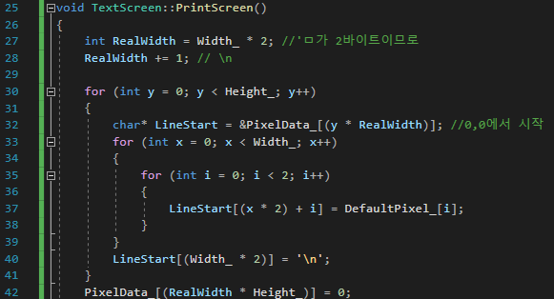
ConsoleScreen.cpp
TextScreen.cpp
y=0 y=1 y=3
Heap
Stack
[ | ] | [ | ] | [ | ] | \n | [ | ] | [ | ] | [ | ] | \n | [ | ] | [ | ] | [ | ] | \n | 0
PrintScreen
main()
x = 2 y = 2
x = 1 i = 1 y = 1
x = 0 i = 0 y = 0
LineStart = &PixelData
RealWidth = 7
TextScreen
Width_ Height_ PixelData_ DefaultPixel_

Slide 4
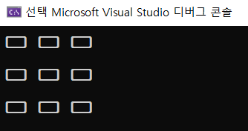
Result
출력 후 소멸 순서
PrintScreen() ↓ Main() ↓ Stack ↓ Heap ↓ Data ↓ Code

