Slide 1
When Should an Alert Threshold Learn?
Admission-separated recalibration as a decision-time action for time-series anomaly alerting
Nakul Somani (2023UCS1592) · Aman Pandey (2023UCS1595) · Pratyush Chaudhary (2023UCS1616)

Slide 2
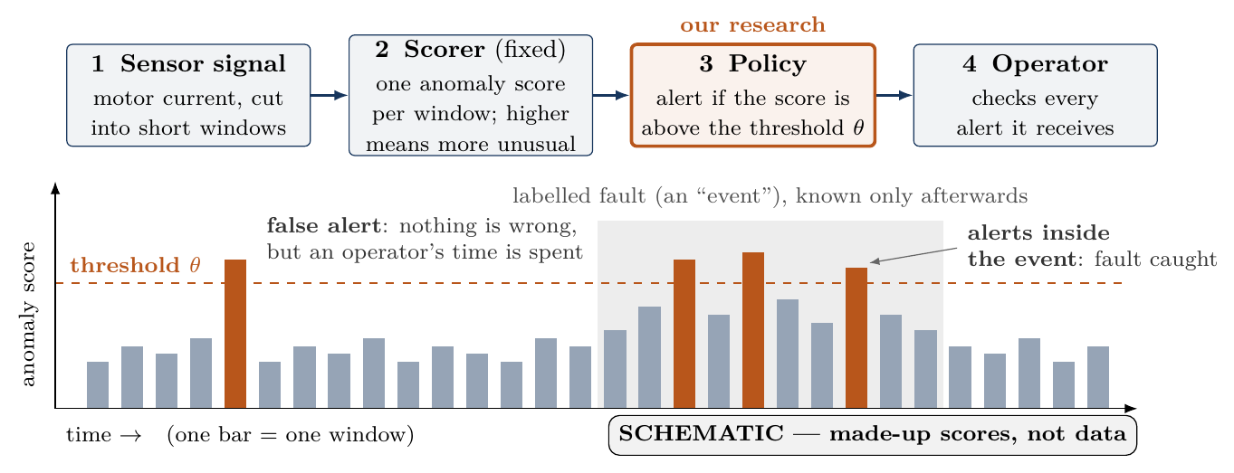
How alerting works: a score per window, a threshold, an operator
Our data: SKAB, a public benchmark recorded on a laboratory water-circulation rig. We use one sensor, the current drawn by its electric motor. Two ways to fail: miss a real fault, or raise false alerts. Each false alert costs an operator’s time; too many, and people stop trusting the alerts.
Notes:
First, the setting, in half a minute. A machine carries sensors. We use one: the current drawn by the electric motor of a water-circulation rig, from SKAB, a public laboratory benchmark. The signal is cut into short windows. A fixed scorer, which is not our contribution, gives each window an anomaly score: higher means more unusual. A policy turns each score into a decision; the simplest one alerts when the score is above a threshold. An operator then checks every alert. So the system can fail in two ways: it can miss a real fault, or it can raise false alerts, and each false alert spends someone’s time. Our research is about the policy, box three.

Slide 3
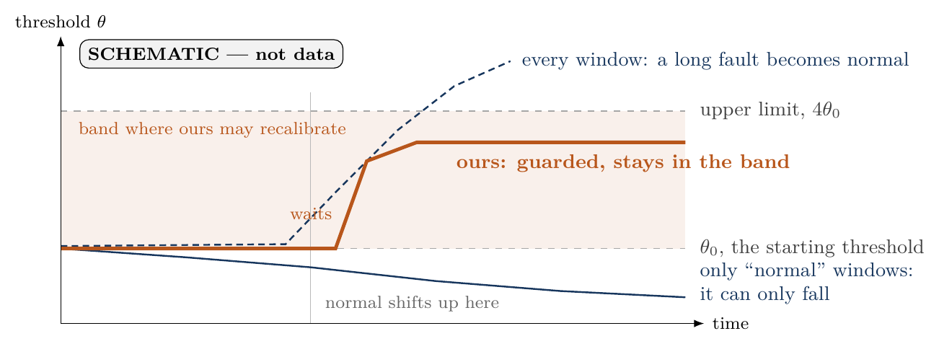
Normal drifts, so thresholds learn, but from which windows?
When normal shifts up (a repair, a new load), a fixed threshold floods the operator with false alerts, so systems recalibrate: they re-set the threshold from recent scores. Which windows should it learn from? The two obvious answers both fail.
Notes:
The threshold starts at theta-zero, set once on early data. But normal drifts. After a repair or under a new load the whole signal can sit higher, and a fixed threshold then alerts all the time. So real systems let the threshold learn from recent scores; this is called recalibration. The question is what it should learn from. If it learns only from windows it already called normal, it can only move down: the solid blue line. If it learns from every window, a long fault pulls it up until the fault looks normal: the dashed line. Ours is the orange line: it waits while a rise is unconfirmed, then learns only as a guarded decision and stays inside the shaded band. The next slide shows the first failure with six numbers.

Slide 4
A threshold that learns only from “normal” windows can only fall
Step | Score | Judged against | Decision | Threshold after
1 | 9 | 10 | normal, admitted | 9
2 | 12 | 9 | alert, rejected | 9
3 | 8 | 9 | normal, admitted | 9
4 | 7 | 9 | normal, admitted | 9
5 | 6 | 9 | normal, admitted | 8
6 | 9 | 8 | alert, rejected | 8
A threshold keeps its last 3 admitted scores, sets itself to their maximum, and admits a new score only if it judged that score normal. Score 9 is normal at step 1 and an alert at step 6: the alerts come from the threshold, not the signal.
Notes:
Here is the first failure, worked by hand. This threshold learns only from scores it already called normal, and sets itself to the largest of its last three. Every score it admits is at or below it, so it can only stay the same or fall. Score 9 is normal at step one and an alert at step six, though nothing about the signal changed: the alert comes from the threshold. Run that for a long time and ordinary scores become alerts.

Slide 5
Our direction: recalibration as a guarded, auditable action
Evidence | What we claim
[PROVED] | C1: learning only from “normal” windows means the threshold never rises
[MEASURED] | C2: on SKAB that costs 16.2× and 3.9× the alert windows
[MEASURED] | C3: the scorer, not the policy, limits detection
[IMPLEMENTED] | C4: a four-action controller, recalibration bounded to $[θ_{0},4θ_{0}]$
[MEASURED] | C5: identical to fixed on SKAB, so no harm and no benefit
[MEASURED] | C6: under stress it works on a step and fails on a ramp
[PROPOSED] | C7: a benefit on real regime changes, decided by a kill test
Recalibrate only as a deliberate decision, from data chosen neither by the threshold itself nor unconditionally, and judge every policy on identical scores. Tags: PROVED = theorem · MEASURED = saved, recomputed result · IMPLEMENTED = tested code · PROPOSED = not yet tested.
Notes:
This is our direction in one sentence: treat recalibration as a deliberate decision, learn from data the threshold did not choose for itself, and compare every policy on exactly the same scores, so a difference can only come from the policy. Read the tags as a strength scale, from a theorem down to an untested proposal. We have one proof, several measurements, a working controller, and an honest gap: we have not yet shown a benefit on real data.

Slide 6
Isn’t this just X? Each ingredient exists; the combination does not
Closest work | Already does | Ours differs
FITNESS (ICML 2022) | Shows dropping self-flagged anomalies fails | We claim only the ratchet proof
Sun et al. (ICML 2024) | Abstains with guarantees | Re-implemented and measured
Perini & Davis | Rejects on a fixed stability threshold | Defer is charged to coverage
DDADE, ADAPTS, CDDIA | Retrain the model on drift | Scorer frozen; only actions change
Hu (in press) | Evaluates alerts by workload | Same frame, plus a controller
SEAD, Dynamic-XY | New score; suppression from alert history | One score trace, explicit actions
Open in the nine papers checked: action policies compared on one frozen score trace. A bounded search, not proof of absence.
Notes:
Every examiner question of the form “isn’t this just X” is answered by this table. FITNESS already names the failure, so we do not claim it; we claim a proof for quantile thresholds. Sun et al. already abstain, so we re-implemented their method and measured it on our scores. Drift methods retrain the model; we freeze it. Hu already evaluates by workload; we borrow that. What we did not find, in nine papers, is policies compared on one fixed score trace. We say “not found”, never “does not exist”.

Slide 7
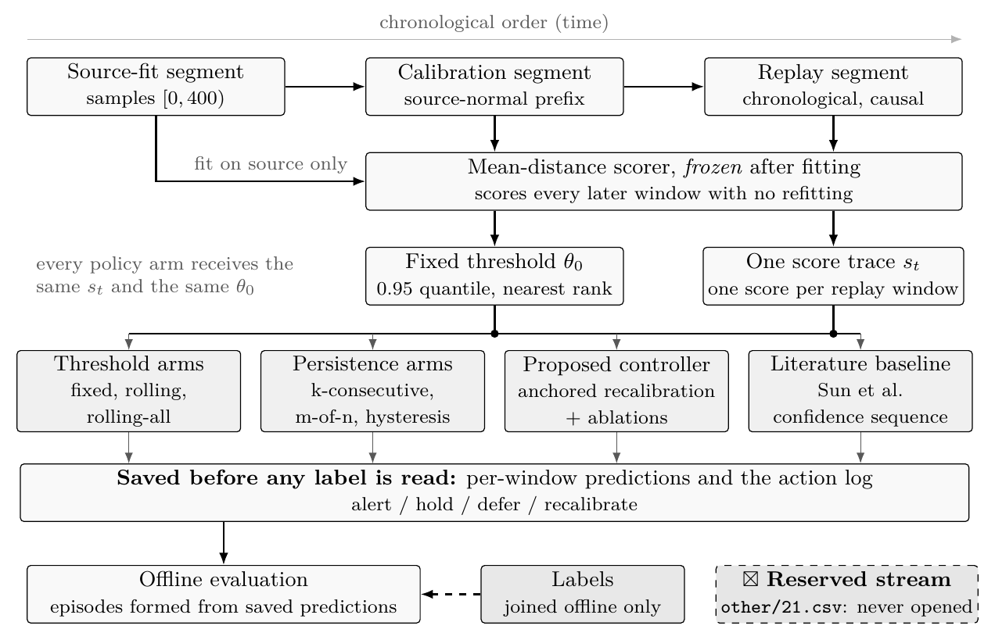
Every policy sees identical scores; labels arrive only afterwards
Notes:
This is the pipeline, and it is mostly discipline. Each stream is cut in time into a fitting part, a calibration part and a replay part. The scorer is fit once and frozen. One score trace goes to every policy, like setting every student the same exam, so any difference we report comes from the policy, never from the scorer. Predictions are saved before labels are read, so no policy can peek at the answers. The reserved stream in the manifest was never opened.

Slide 8
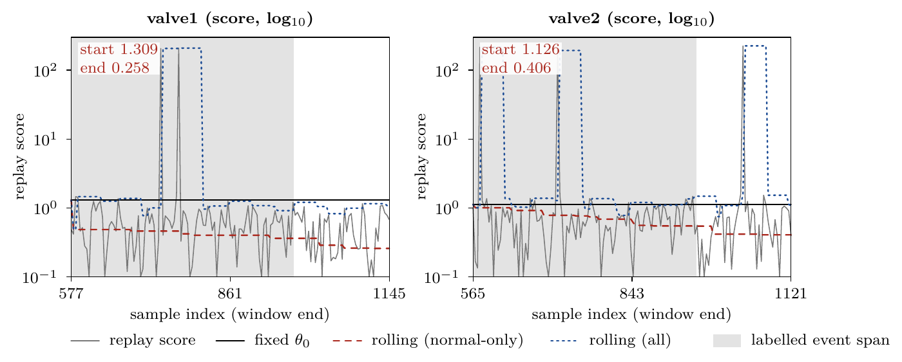
Proved, then observed: the self-referential threshold only falls
[PROVED] Proposition 1. Admit $s$ only if $s≤θ$ and set $θ$ to the buffer’s nearest-rank quantile; then $θ_{t+1}≤θ_{t}$ for every score sequence. [MEASURED] 0 increases in 143 and 140 steps; valve1 1.309 → 0.258, valve2 1.126 → 0.406.
Notes:
The one thing we prove: if a threshold admits only what it called normal and sets itself to a quantile of that buffer, it can never go up, for any data. The proof is a short rank argument. The saved SKAB traces agree: zero increases, and the threshold slides from 1.3 to 0.26 on valve1 and from 1.13 to 0.41 on valve2, below the typical score. That sinking line is why the rolling baseline alerts so often.

Slide 9
Same single event, up to 16× the alerts; our controller equals fixed
Policy (valve1 / valve2) | Alert windows | False-alert time | Recall | Coverage
Fixed threshold | 6 / 18 | 0 / 20 | 1/1 | full
Rolling, normal-only | 97 / 70 | 109 / 104 | 1/1 | full
Rolling, admit-all | 10 / 13 | 10 / 12 | 1/1 | full
k-consecutive | 0 / 0 | 0 / 0 | 0/1 | full
Our controller | 6 / 18 | 0 / 20 | 1/1 | full
Sun et al. | 3 / 2 | 0 / 4 | 1/1 | 54/143 · 57/140
[MEASURED] 97 vs 6 (16.2×) and 70 vs 18 (3.9×) alert windows for the same event. Our controller: 0 deferrals, 0 recalibrations, no harm and no evidence of benefit. False-alert time = alerted samples outside the event · recall = events caught · coverage = windows decided rather than deferred.
Notes:
The SKAB table, read narrowly. Every policy that alerts finds the one event per stream. What separates them is workload. The normal-only rolling policy needs 16 times the alert windows on valve1 and nearly 4 times on valve2 for the same event: the ratchet’s cost. Our controller is identical to fixed, because its guard never fires on this data. That is a no-harm check, not a win. Sun et al. look quiet only because they decide on about 40 percent of windows.

Slide 10
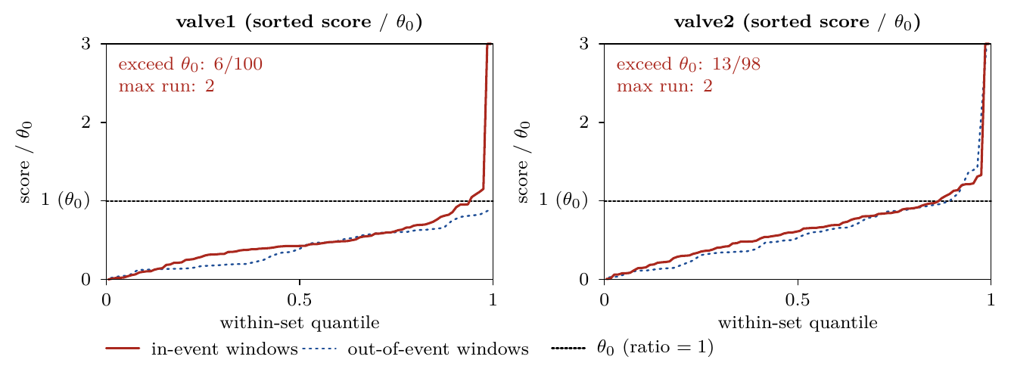
The scorer, not the policy, limits detection on SKAB
[MEASURED] Only 6/100 (valve1) and 13/98 (valve2) in-event windows exceed $θ_{0}$, never more than 2 in a row, so rules needing 3 miss the events. Each event spans about 70% of replay, so recall 1/1 says little. A policy can move alerts in time; it cannot create separation the scorer lacks.
Notes:
Why do the persistence rules miss the events? Because of the scorer. Inside the event only 6 of 100 windows on valve1 and 13 of 98 on valve2 even cross the threshold, and never more than two in a row. A rule that waits for three in a row has nothing to fire on. And since each event covers most of the replay, one alert anywhere scores full recall, so on SKAB we read workload and false episodes, not recall.

Slide 11
The controller: four actions, recalibration only inside a bounded band
At a window end | Action
No sustained rise | hold, or alert if $s>θ$
Sustained rise that is stable and at most $4θ_{0}$ | recalibrate up to it
Sustained rise, guard fails | defer, at most 10 in a row
Still failing after 10 deferrals | escalate: alert-capable, no recalibration
Rise over | recalibrate back toward $θ_{0}$
[IMPLEMENTED] AnchoredRecalibrationPolicy. Its buffer holds the last 10 scores of every window, so what it learns from never depends on its own decisions. Nothing was tuned: 10 and 0.95 are the rolling baseline’s values; the cap 4 and the stability bound 2 are declared operating assumptions.
Notes:
The controller in one table. With no sustained rise it behaves like a fixed threshold. When the recent median rises and the rise is stable and inside four times the calibration threshold, it recalibrates. If the rise is unstable it defers, up to ten times, then escalates and keeps alerting without learning. When the rise ends it returns toward the anchor. The parameters come from the existing baseline or are declared assumptions; none was chosen by looking at results.

Slide 12
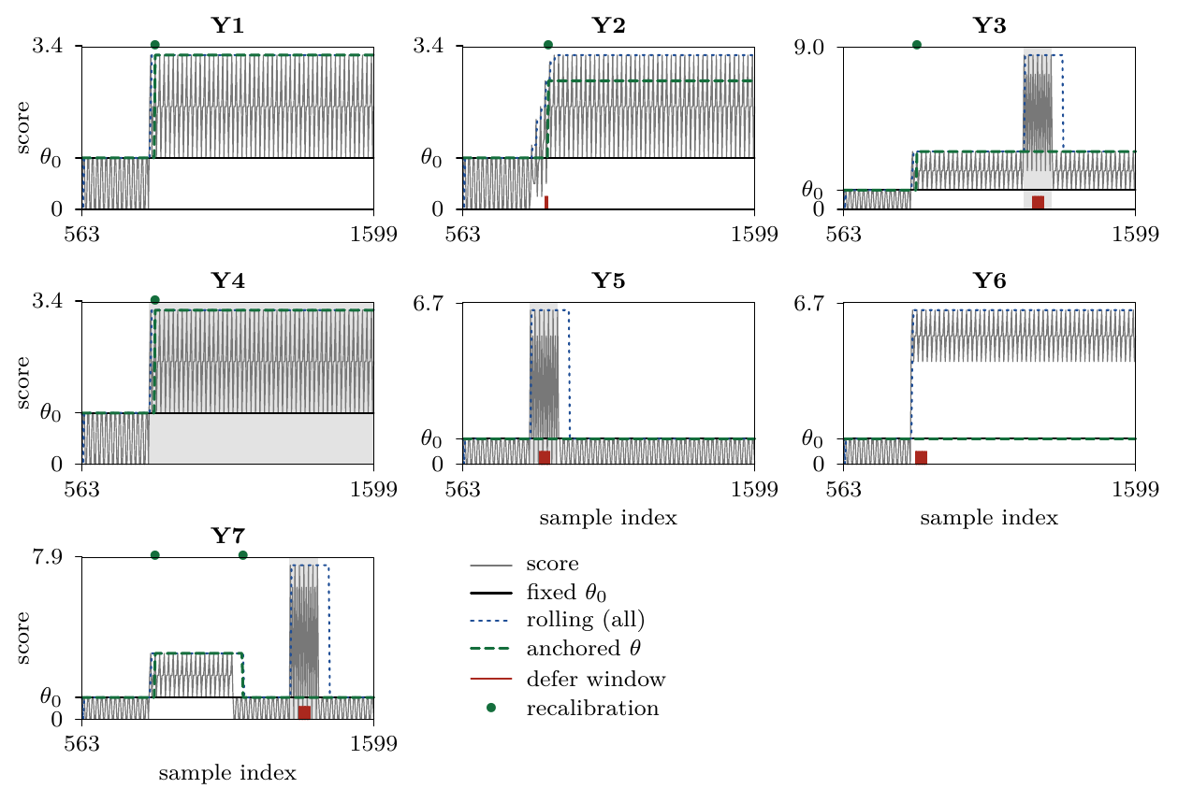
Under stress: adapts to a step, fails on a ramp and a step-shaped fault
[MEASURED] Seven deterministic cases:
Works, Y1 step: false-alert time 16 vs fixed 597, coverage 260/260
Still detects, Y3 and Y7: later faults caught, recall 1/1
Fails, Y2 ramp: locks into alerts, 204 over 50 episodes
Fails as declared, Y4: a fault shaped like a step is absorbed, 0.020 vs fixed 0.746
Notes:
These engineered cases show the mechanism and its failures. On a clean benign step it adapts and cuts false-alert time from 597 to 16 while deciding on every window. After adapting it still catches later faults. On a slow ramp it locks into repeated alerts, a real failure we report. And a fault shaped exactly like a benign step is absorbed; we declared that limit in advance, because no label-free rule can tell the two apart.

Slide 13
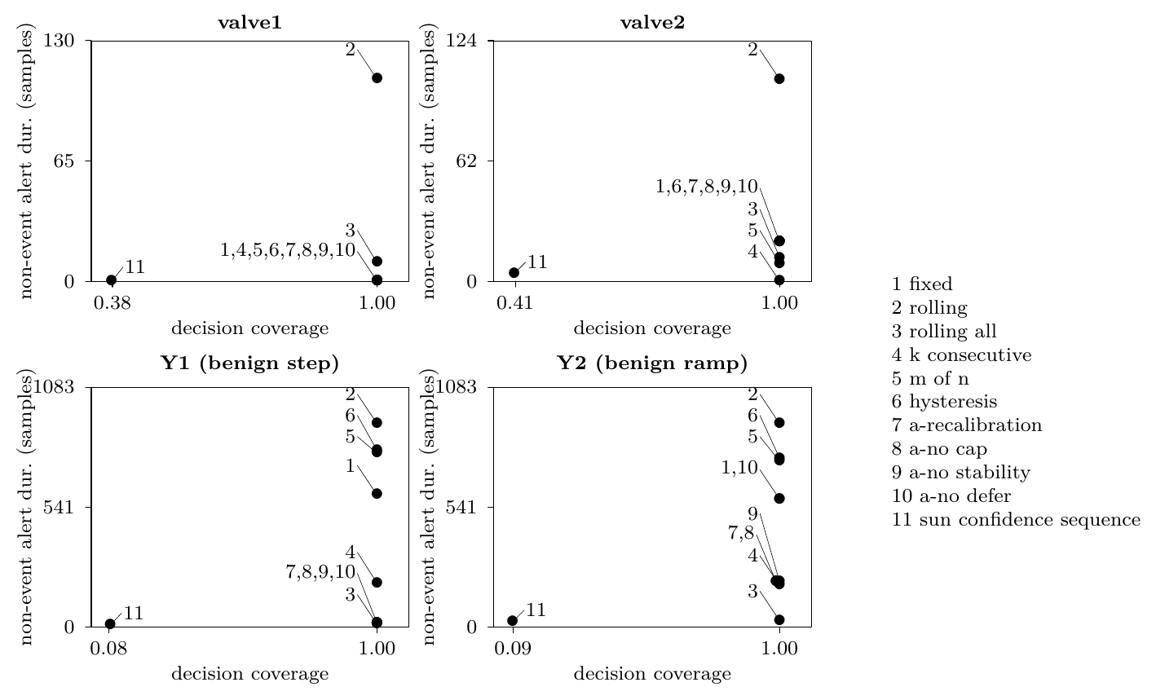
Quiet has two routes: adapt while deciding, or stop deciding
How to read it: one marker per policy; further right decides on more windows, lower means less false-alert time.
[MEASURED] On Y1 our controller reaches 16 while deciding on 260/260 windows.
Sun et al. are quiet because they decide on only 22/260.
Notes:
Each marker is one policy: to the right means it decided on more windows, lower means less false-alert time. On SKAB nearly every policy decides on every window. On the benign step our controller is quiet while still deciding everywhere, whereas Sun et al. are quiet by abstaining. That is why we always report coverage beside workload.

Slide 14
The strongest case against us: a simpler rule is quieter
These results do not establish a useful controller.
Admit-all is quieter on benign shifts: false-alert time 12 vs our 16 on Y1, and 28 vs our 204 on Y2.
Our only edge is keeping faults visible: on Y3 it alerts 0.29 of the fault against admit-all’s 0.04, both at recall 1/1.
SKAB gives no evidence either way: our rows are identical to fixed.
Abstention buys quiet with coverage: Sun et al. decide on 54/143 and 57/140 windows.
What we claim instead: a proved mechanism, an honest negative-to-inconclusive development finding, and a test that can refute the direction.
Notes:
This is the slide we most want to be honest on. On the benign cases the simplest rule, learning from every window, is quieter than ours: 12 against 16, and 28 against 204. Our only argument is that we keep faults visible: 0.29 of the Y3 fault against 0.04. On SKAB we are identical to fixed, so it proves nothing either way. We therefore claim a mechanism and a finding, not a winner.

Slide 15
Not yet shown, and the experiment designed to kill the idea
Not shown: any benefit on real benign regime changes; any held-out or generalisation result. Limits: one event per stream, one channel (Current), dataset licence not independently verified; other/21.csv reserved and never opened.
[PROPOSED] Replay all policies on common traces over every other SKAB valve1 and valve2 file, admitted by a label-independent rule, plus one public family with labelled benign regime changes. The direction is refuted if any one holds:
Where the elevation test fires, it does not cut false-alert time versus fixed at equal recall.
It loses an event that fixed detects.
Sun et al.’s abstention matches it at equal coverage.
A refutation becomes the reported result.
Notes:
To close, what we have not shown and how we will find out. We have no real-world benefit and no held-out result, the data has one event per stream on one channel, and we make no claim about the reserved stream. The next experiment is committed in advance, so we cannot move the goalposts: every policy is replayed on the other SKAB valve files, chosen without looking at labels, plus a dataset with genuine benign shifts. Any one of three outcomes kills the direction, and then that becomes our result. Thank you; we are happy to take questions.

