Slide 1
Air-Conditioning Mannagement System
One platform , All services
Powered by
D.I.S Technology Co,. Ltd

Slide 2
Table of contents
01
02
03
04
05
06
Objectives
Project Scope
Customer Flow
Technician Flow
Admin FLow
Conclusion

Slide 3
01
Objectives

Slide 4
Objectives
The main goal of this system is to provide a simple and user-friendly platform where customers can easily request Air-Con services.
Technicians can manage jobs efficiently and complete work faster.
Administrators can monitor and control all operations from one centralized system.

Slide 5
02
Project Scope

Slide 6
Project Scope
Customer login using phone + OTP
Service request (Normal & Urgent)
Appointment scheduling
Automatic technician assignment
Service tracking & warranty checking
Cash payment recording
Maintenance scheduling & reminders
Admin reports and management

Slide 7
03
Customer Flow

Slide 8
Customer Flow
Login with phone + OTP
Choose service type (Normal/Urgent)
Schedule appointment (if needed)
System finds nearest technician
Customer confirms request
Track service status & warranty

Slide 9
04
Technician Flow

Slide 10
Technician Flow
View assigned service requests
Accept or reject
Perform service at customer location
Update status (Pending/Completed)
Receive cash payment

Slide 11
05
Admin Flow

Slide 12
Admin Flow
Manage customers, technicians, and user roles
Register Air Con units and warranties
Assign technicians to service requests
Set service fees (Normal & Urgent)
Schedule maintenance and send reminders
View reports for payments, services, warranties, and maintenance

Slide 13
06
Conclusion

Slide 14
Conclusion
The system simplifies service from request to completion.
Customers can request services easily and track progress.
Technicians and admins can manage work efficiently.
The system is user-friendly and fast for everyone.

Slide 15
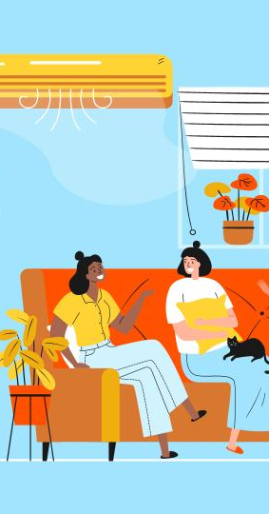
Thank You!
Do you have any questions?😊

