Slide 1
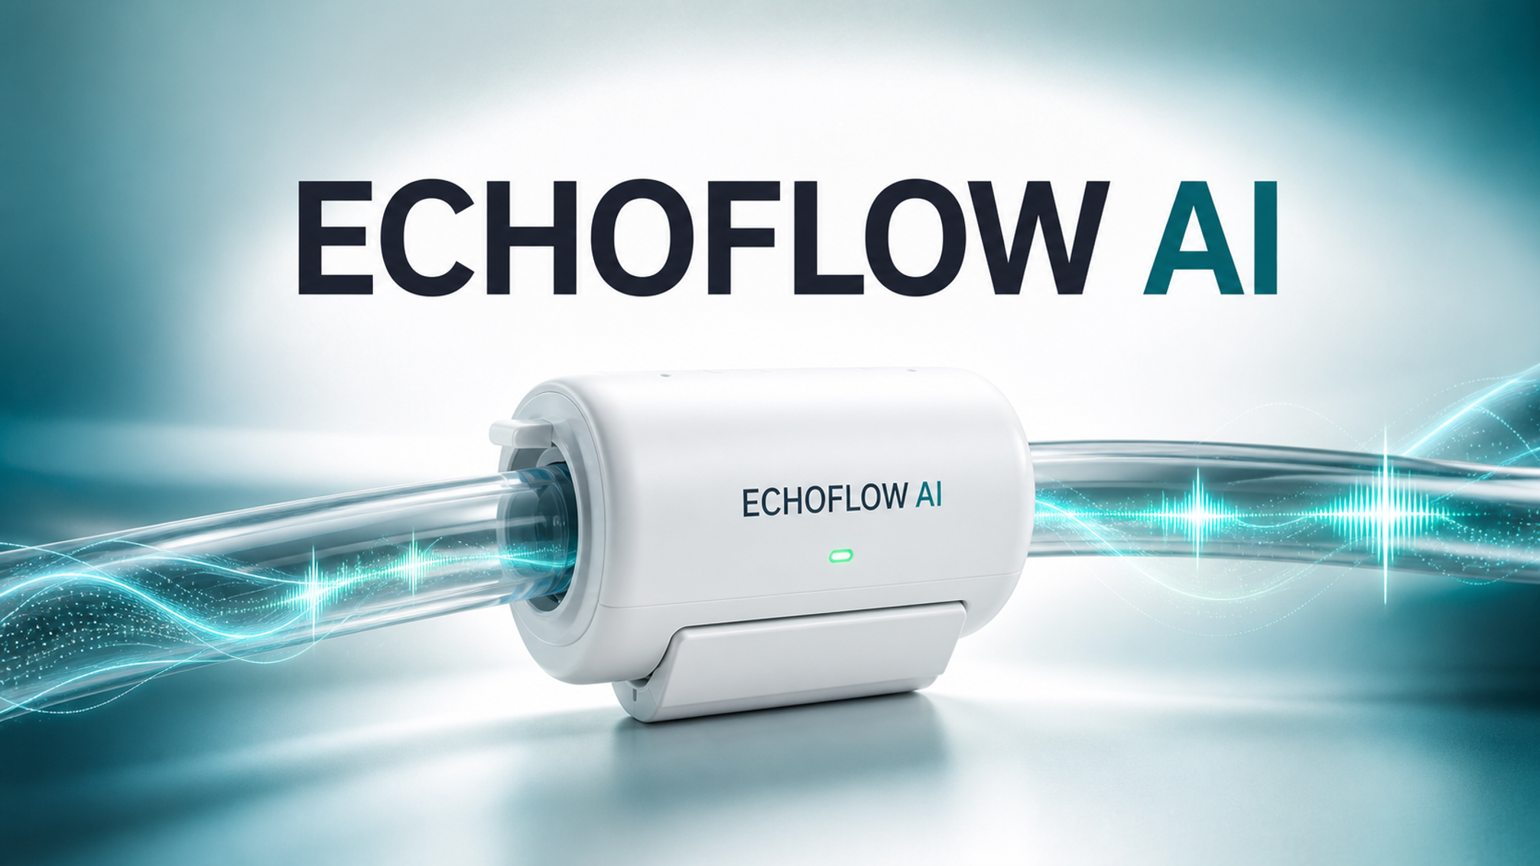

Passive listening. Earlier warning.
Safer dialysis
Notes:
Hello, we are Team EchoFlow.

Slide 2
01 — THE PROBLEM
EXISTING MANUAL PERITONEAL DIALYSIS (PD) HAS A
FLOW-FEEDBACK GAP
Without continuous flow feedback, complications may go unnoticed until treatment is disrupted.
1
2
3
Undetected Flow Abnormalities
No real-time monitoring
Care becomes reactive
Partial restrictions or near-stopped flow may go unnoticed
The patient relies on visual observations rather than continuous flow feedback
Action may begin only after the exchange is disrupted
THE CHALLENGE
Can a non-invasive external sensor provide useful flow-state feedback during manual PD?
Scope: flow-state monitoring concept, not catheter-obstruction diagnosis or dialysis-adequacy assessment.
ECHOFLOW AI 01 / 08
Notes:
What if an abnormal flow during manual peritoneal dialysis, or PD, went unnoticed?
Today, patients rely on visual observation, so flow abnormalities may go unnoticed until treatment is disrupted.

Slide 3
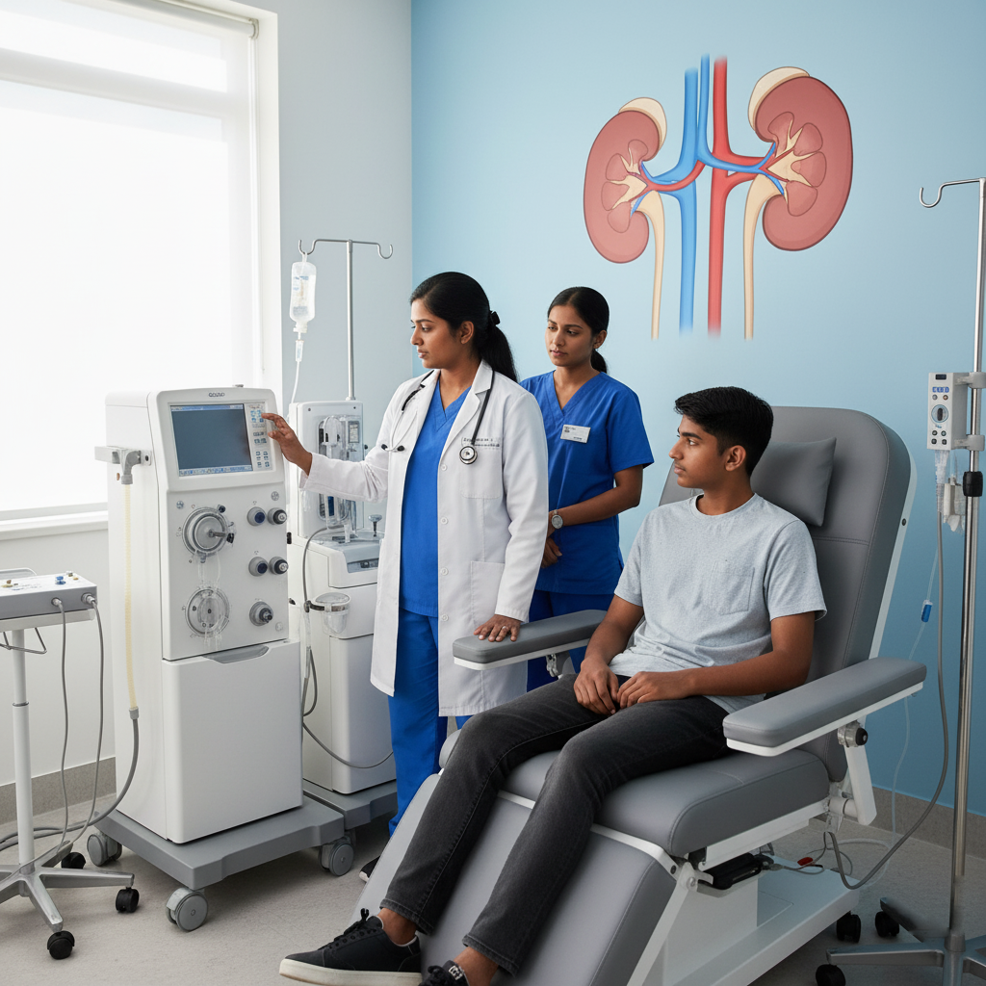

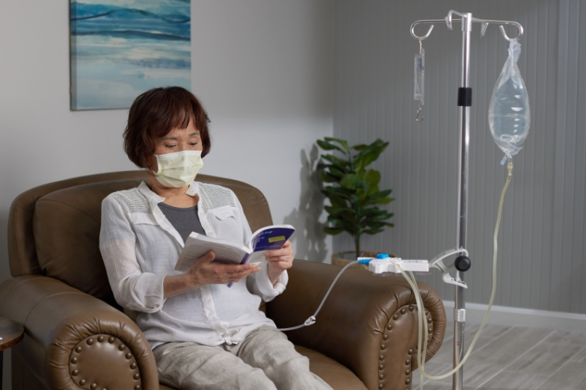
02 — OPPORTUNITY & USERS
FOCUSED ON MANUAL PERITONEAL DIALYSIS
Helping home PD patients and clinicians detect flow abnormalities earlier.
400,000+
1
2
3
People worldwide rely on peritoneal dialysis.
Many of whom perform manual exchanges at home without continuous flow monitoring.¹
UP TO 11.2%
experience PD catheter-related flow problems.²
New England Journal of Medicine review on peritoneal dialysis.
,
2. https://pmc.ncbi.nlm.nih.gov/articles/PMC11168815/
(2024 review of PD mechanical complications)
PRIMARY USER
HEALTHCARE CUSTOMER
SCALE PARTNER
People performing manual peritoneal-dialysis exchanges at home.
PD providers and nephrology services responsible for safe home care.
Dialysis-device manufacturers that can integrate a reusable sensing layer.
THE COMMERCIAL QUESTION TO VALIDATE
Will patients and PD services value earlier flow-state feedback enough to adopt an external retrofit?
Source for broad kidney-disease context: International Society of Nephrology. PD-specific market sizing remains a validation task.
ECHOFLOW AI 02 / 08
Notes:
We chose to focus on manual PD.
More than 400,000 people worldwide rely on PD, and many perform manual exchanges at home without continuous flow monitoring.
Our users are home manual PD patients, supported by PD providers.

Slide 4
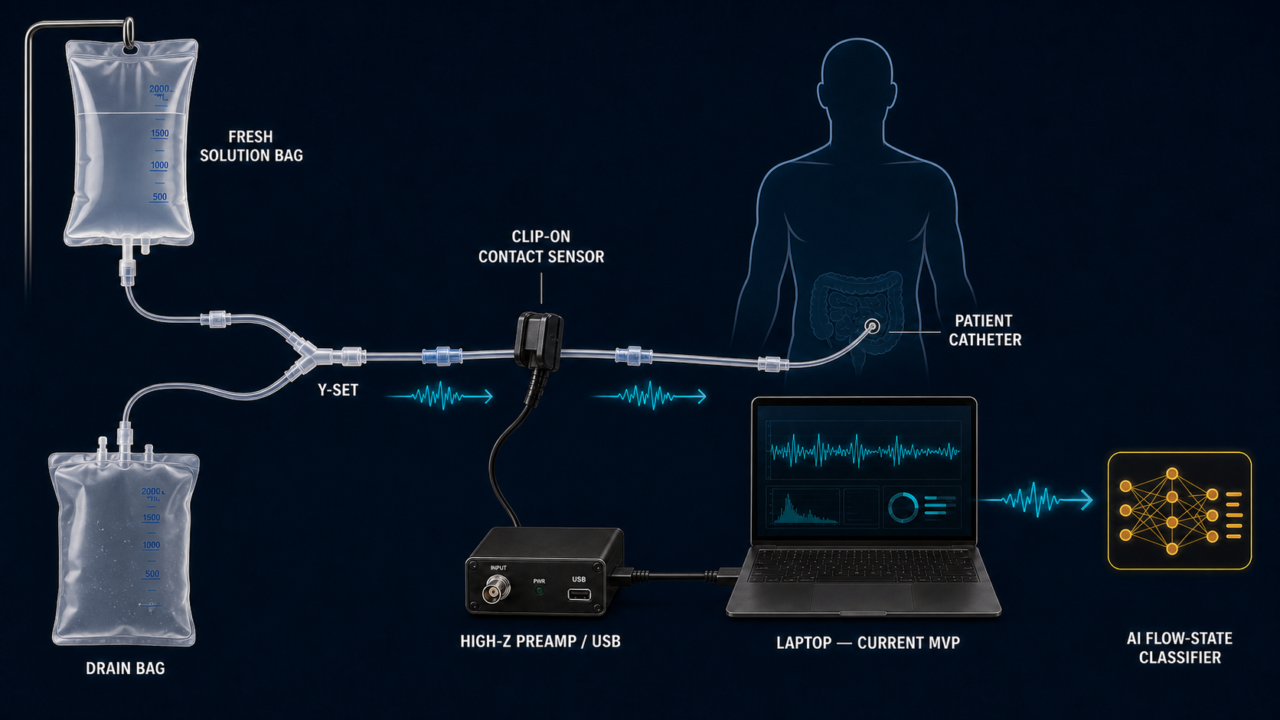
03 — YOUR SOLUTION
ECHO FLOW ADDS A SENSING LAYER OUTSIDE THE TUBING
Retrofits existing manual PD without changing the sterile fluid pathway.
1
CLIP ON
A contact sensor captures tube-wall vibration.
2
CLASSIFY (Current MVP)
Local AI analyses acoustic signals and estimates the flow state.
3
GUIDE ACTION
Displays the estimated flow state for patient and clinician awareness
EXTERNAL AND REUSABLE
LOCAL / OFFLINE-CAPABLE
NO FLUID-PATH MODIFICATION
Current MVP runs on a laptop; embedded edge processing is a later engineering stage.
ECHOFLOW AI 03 / 08
Notes:
To address this, we’ve developed EchoFlow.
EchoFlow adds a sensing layer outside the tubing.
A clip-on contact sensor captures tube-wall vibration, while local AI estimates the flow state and provides feedback.
The system retrofits existing manual PD equipment without modifying the sterile fluid pathway.

Slide 5
04 — WHY ECHOFLOW
THE RETROFIT GAP: MANUAL CHECKS VS AUTOMATED CYCLERS
EchoFlow is designed specifically around manual home exchanges.
Existing Option
Limitation
Manual observation
No continuous feedback
Automated cycler
Not designed for manual CAPD
Echoflow
Continuous monitoring without replacing existing equipment
DIFFERENTIATION
Passive contact-vibration sensing + flow-state classification + manual-PD workflow fit
ECHOFLOW AI 04 / 08
Notes:
So, why EchoFlow?
Existing solutions either rely on manual observation or require automated cyclers.
EchoFlow provides continuous flow-state monitoring while fitting seamlessly into the existing manual PD workflow.

Slide 6
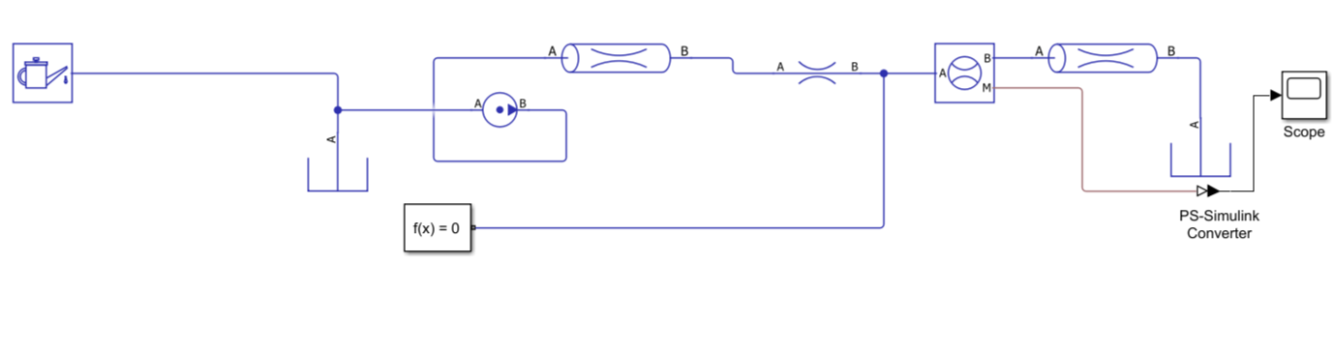


05 — PROTOTYPE DEMO
FROM FLOW MODEL TO CLASSIFICATION (MVP)
Proof-of-concept demonstrating AI classification of 4 simulated flow states.
1 SIMSCAPE FLOW MODEL
2 ACOUSTIC PROXY SIGNALS
3 RANDOM FOREST
NORMAL
UNSEEN TEST RECORDING
→
Noise
0%
REDUCED FLOW
Normal
14%
Pressure-driven tubing under controlled restrictions
Reduced flow
84%
Stopped
2%
REDUCED FLOW
84% confidence
✅ End-to-end pipeline completed
Physics-informed synthetic data → AI Classifier
Validated on synthetic data generated from a physics-informed flow model
NEXT Milestone: validation using physical tubing experiments
ECHOFLOW AI 05 / 08
Notes:
To test feasibility, we built an end-to-end MVP.
We created a physics-informed flow model, generated synthetic acoustic signals, and trained a Random Forest classifier to distinguish different flow states.
In this example, the model identifies reduced flow with 84% confidence.
This proof of concept demonstrates the pipeline, with real tubing validation as the next milestone.

Slide 7
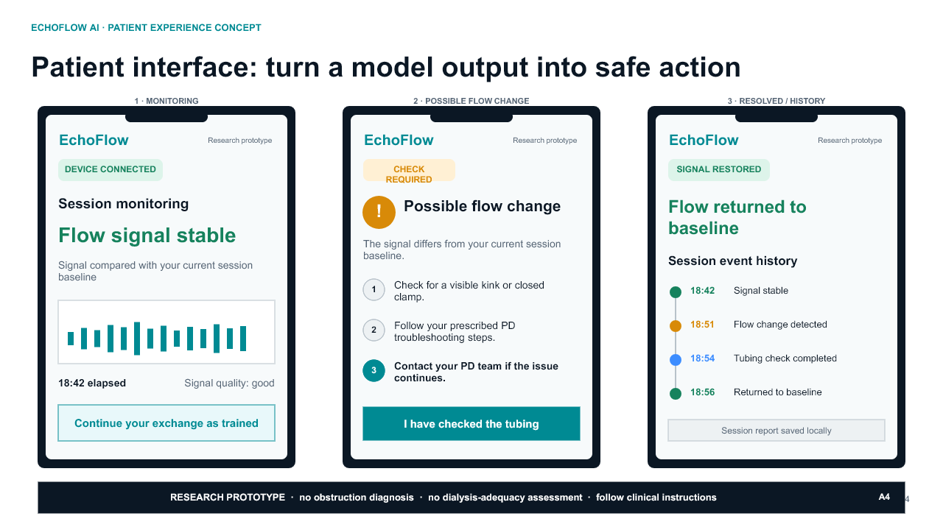
06 — VALIDATION & IMPACT
THE NEXT STEP: TURNING A PROTOTYPE TO CLINICAL IMPACT
Our MVP demonstrates technical feasibility. The next milestone is real-world validation.
1
CURRENT MVP
Synthetic four-state classifier
2
BENCH VALIDATION
Repeated generic-tubing trials with held-out recordings
3
CLINICAL VALIDATION
PD-specific data, user research and clinical study
4
REGULATORY READINESS
Privacy and security, safety and performance, and regulatory approval
IMPACT HYPOTHESIS
Earlier detection | Earlier action | Better patient outcomes
These are intended outcomes, not results demonstrated by the synthetic MVP.
ECHOFLOW AI 06 / 08
Notes:
Our MVP demonstrates technical feasibility, but real-world validation is the next step.
Our roadmap includes bench testing, PD-specific validation and clinical studies.
Our goal is earlier detection, earlier action and better patient outcomes.

Slide 8
07 — BUSINESS & NEXT STEPS
A 12-MONTH PLAN TURNS THE CONCEPT INTO EVIDENCE
A reusable device model creates value only if technical and workflow validation succeed.
BUSINESS MODEL
NEXT 12 MONTHS
INDICATIVE ASK
CUSTOMER
0-3
Build the sensor interface and repeated tubing protocol
GBP 75k
PD providers and dialysis- device manufacturers
3-6
Test held-out recordings and refine the classifier
12-month pre-clinical validation programme
OFFER
Reusable sensor + software + implementation support
6-9
Interview patients and PD professionals; map escalation workflow
Prototype + instrumentation
Technical validation
User and clinician research
Quality and governance planning
VALUE
Earlier flow-state awareness using existing manual PD equipment
9-12
Prepare a PD-specific feasibility, privacy, and governance study
DECISION GATE
Proceed only if real, unseen recordings remain distinguishable and users value the feedback.
Funding figure is an indicative planning estimate, not a supplier quote.
ECHOFLOW AI 07 / 08
Notes:
Our initial customers are PD providers, with dialysis-device manufacturers as future partners.
Over the next 12 months, we’ll refine the hardware, validate it with real tubing recordings and prepare for clinical studies.

Slide 9
08 — THE TEAM
WHY WE’RE THE RIGHT TEAM
5 students combining engineering, bioengineering, design, health sciences, and entrepreneurship to validate a new approach to manual peritoneal dialysis
Joel (ICL)
Aymen (ICL)
Duaa (ICL)
Rabiatu (Uni of Ghana)
Roland (Uni of Ghana)
Signal processing,
Physics modelling,
ML Prototype
Biomedical engineering,
Device concept,
Clinical feasibility
User-centered design,
Behaviour insigts,
Pitch & communication
Patient perspective, healthcare context,
User needs
Entrepreneurship,
Business validation,
Market thinking
Together, we combine engineering, healthcare, design and entrepreneurship to turn a promising concept into validated evidence!
ECHO FLOW
Listen outside the tubing. Build evidence before expanding the claim.
ECHOFLOW AI 08 / 08
Notes:
Finally, we’re a multidisciplinary team combining engineering, design, health sciences and entrepreneurship.
Together, we’re building the evidence to bring EchoFlow into clinical practice.

Slide 10

Notes:
This concludes our presentation. Thank you.

