Slide 1
Meeting Planner
Mercury
4
5
Jupiter
5
2
Venus
52%
30
150
Team: LOCH
50
+56%

Slide 2
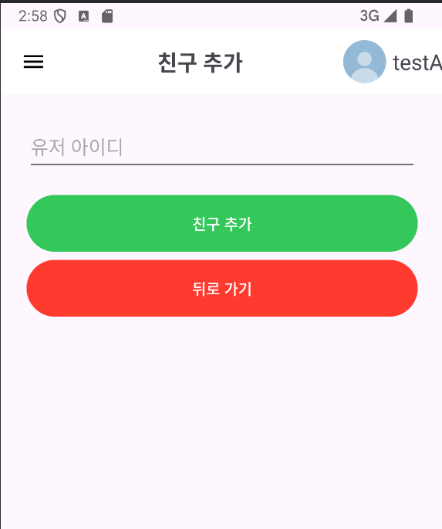
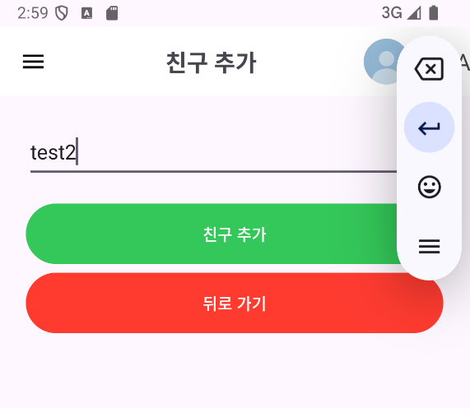
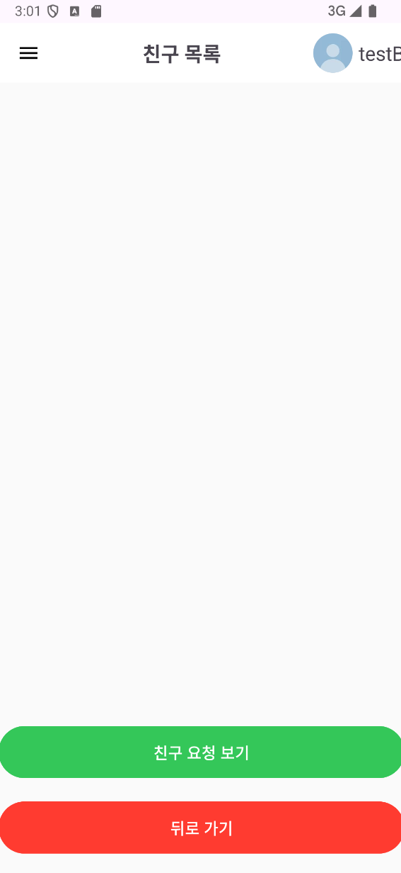
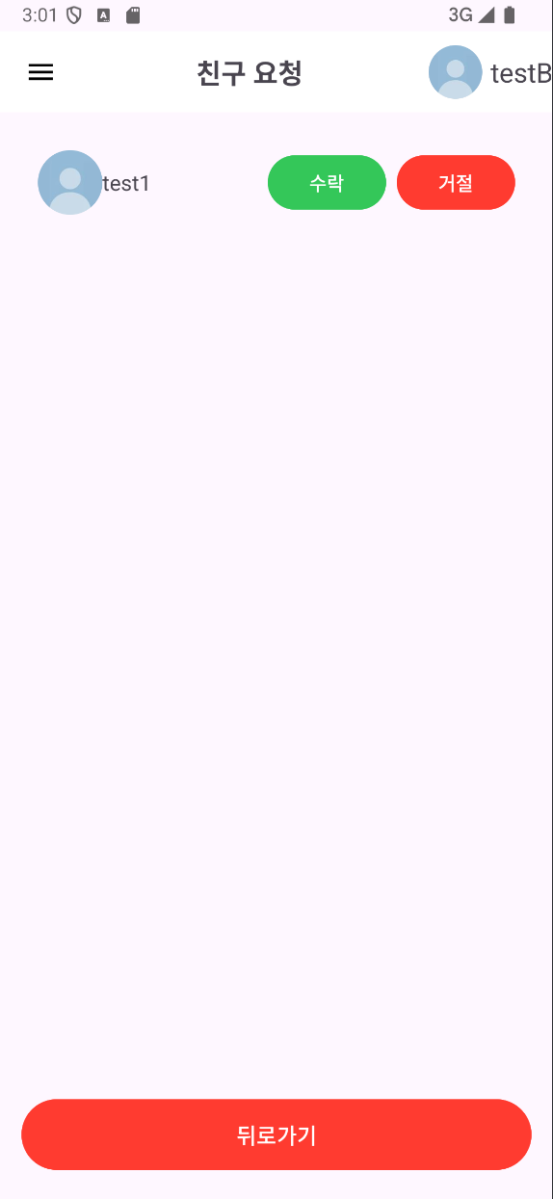
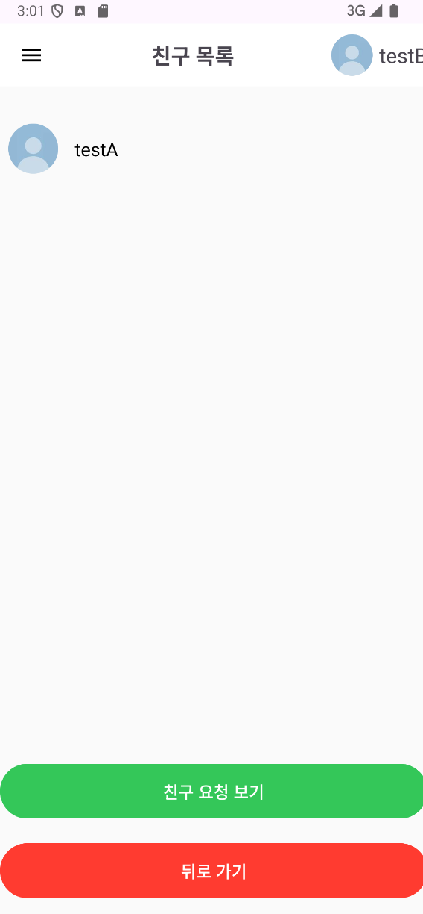

Slide 3
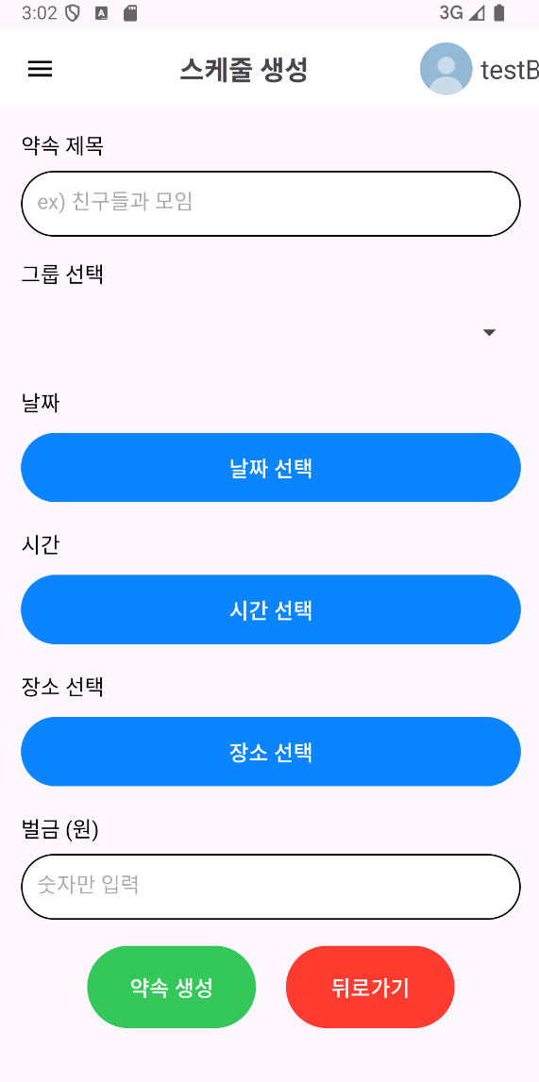
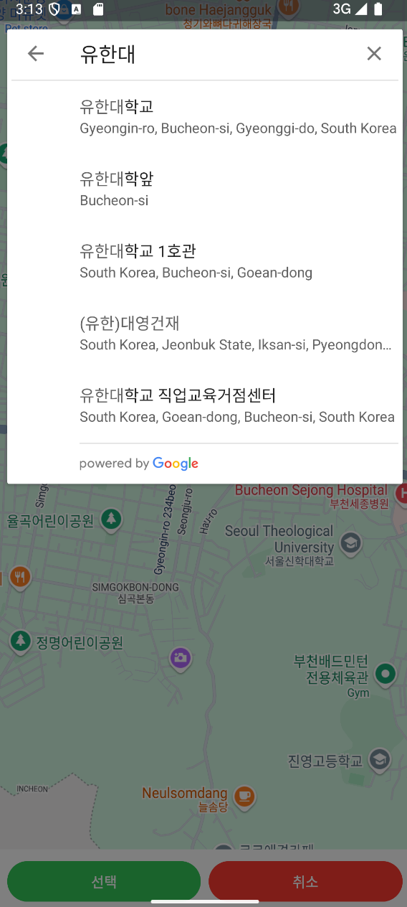
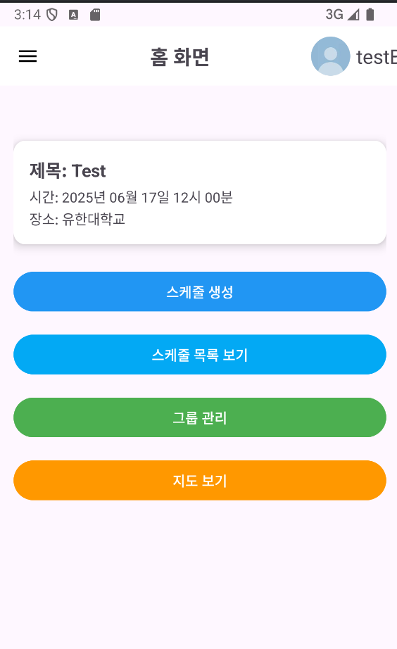
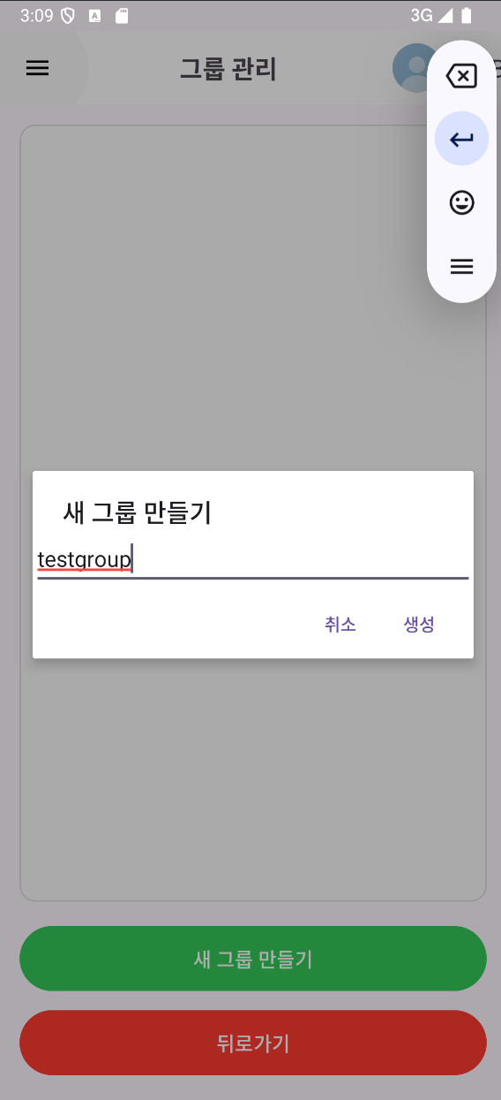
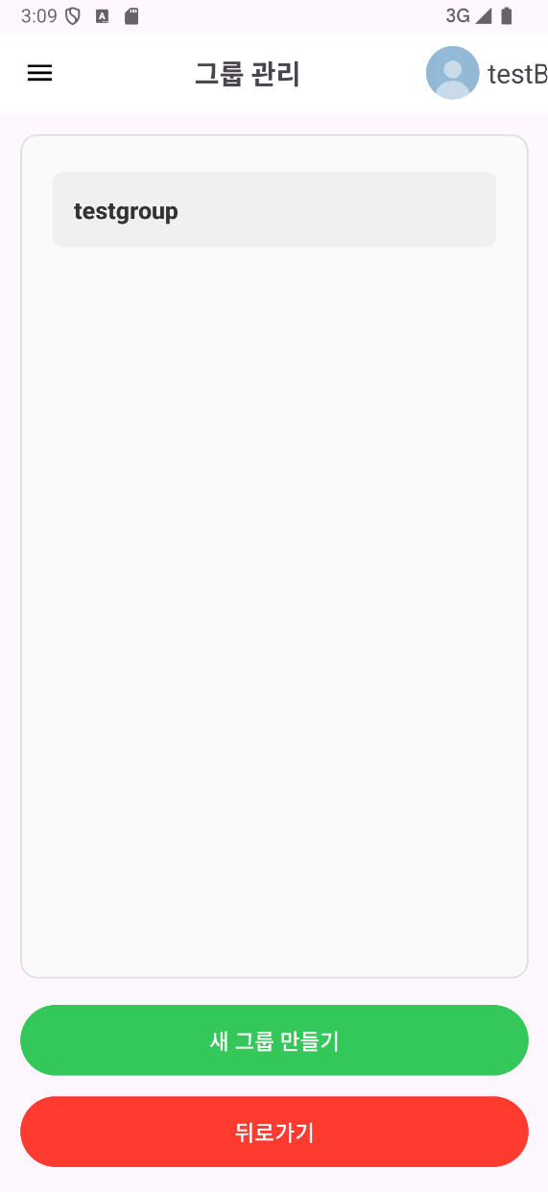
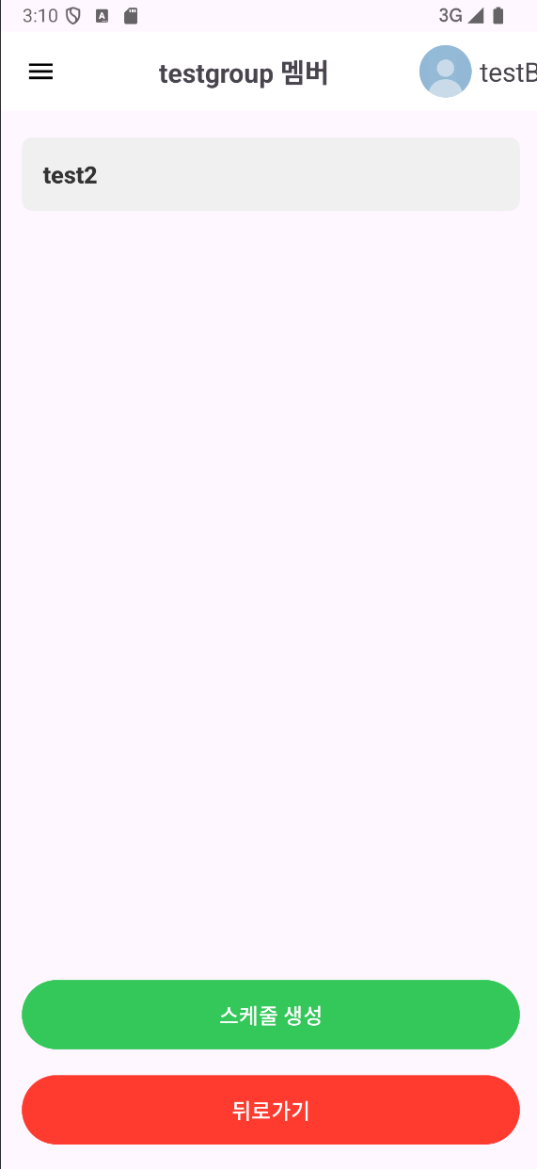
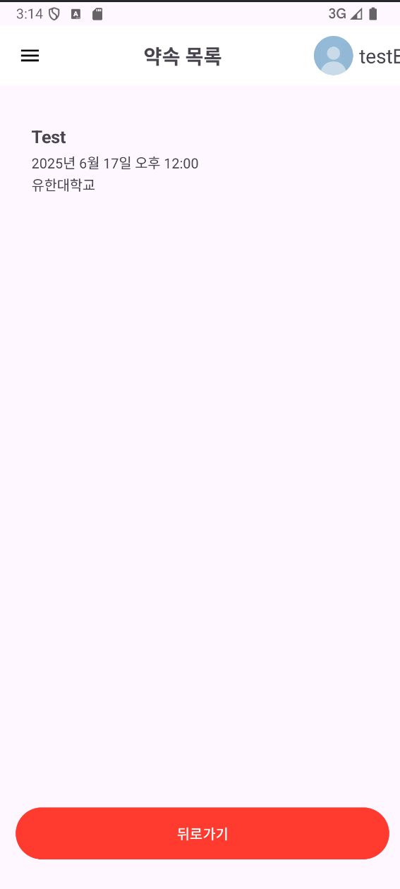
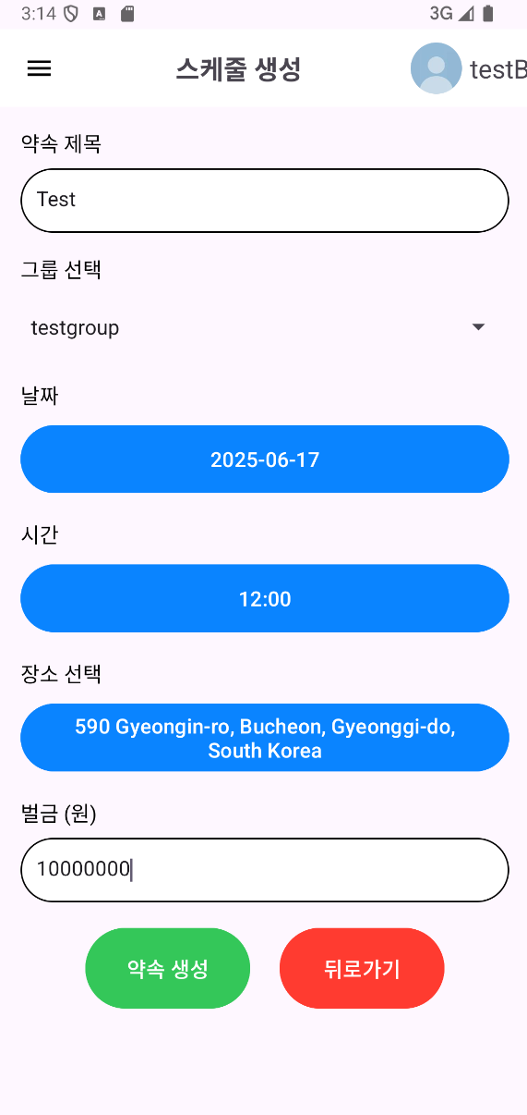
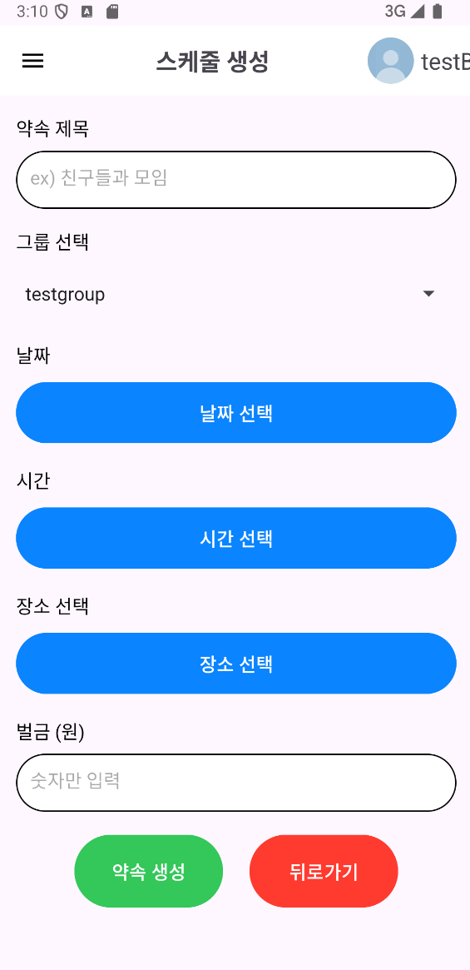
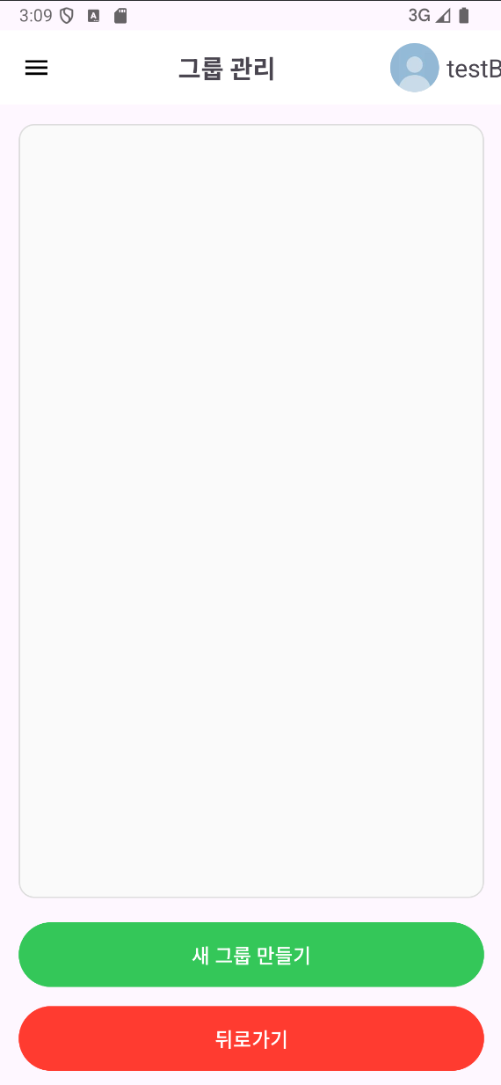
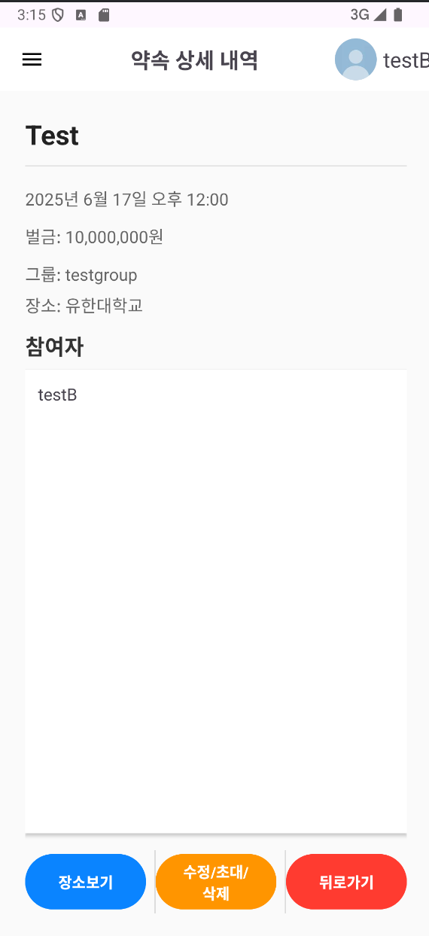

Slide 4
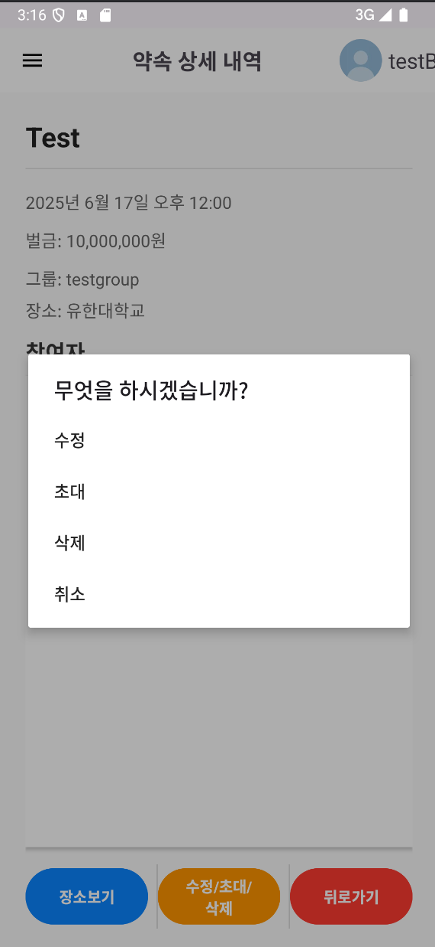
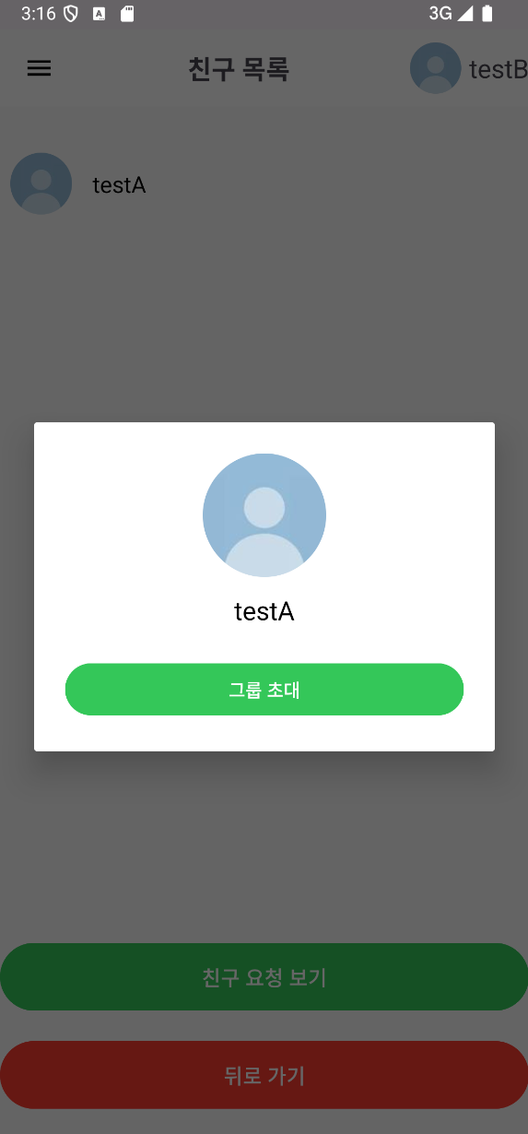
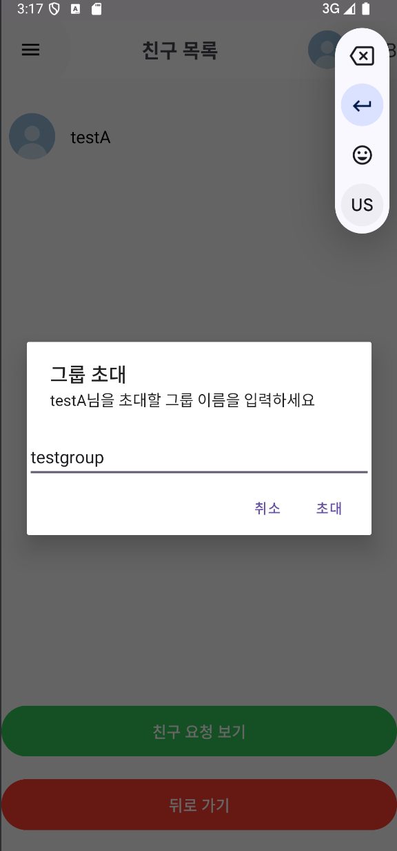
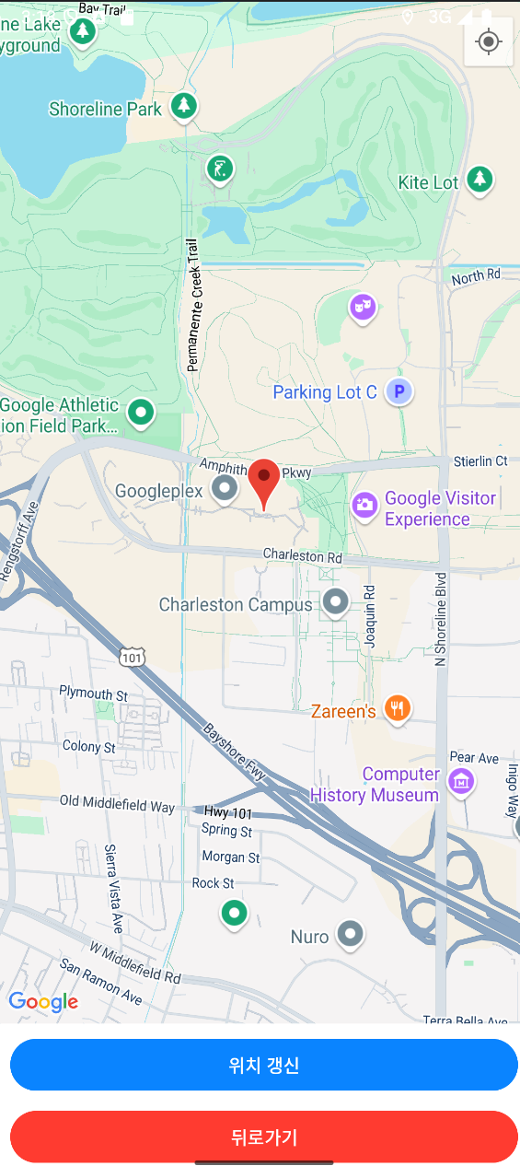
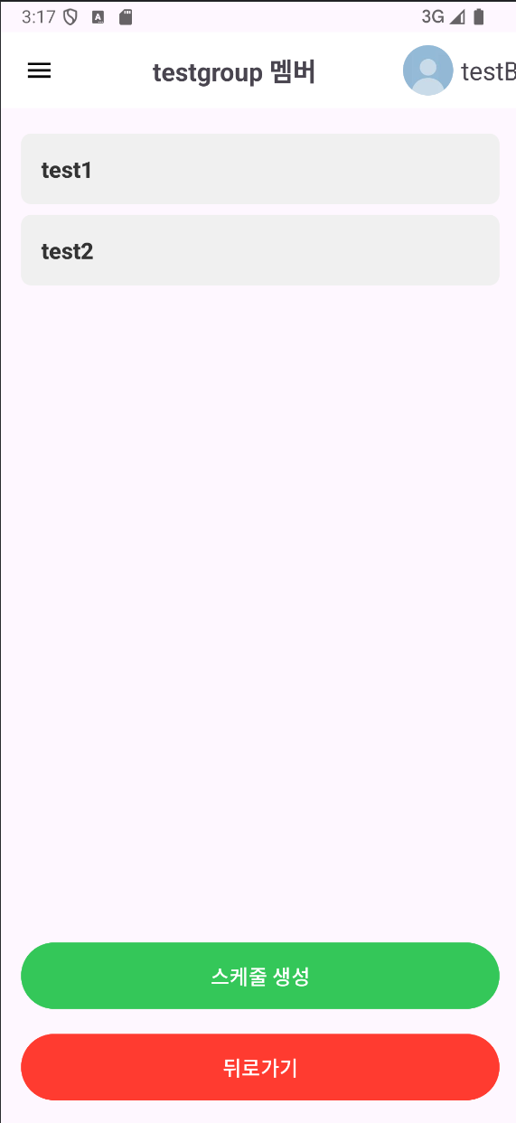
지도이미지는 학교에서 같이 테스트하고
이미지 삽입

Slide 5
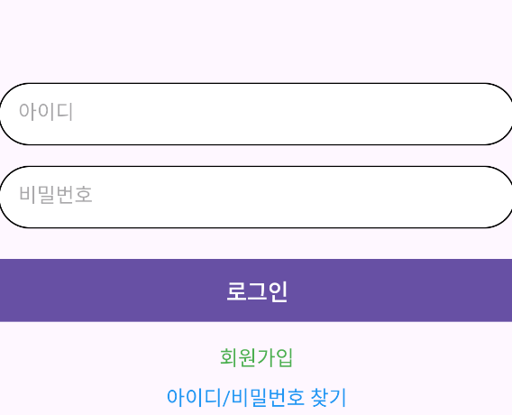
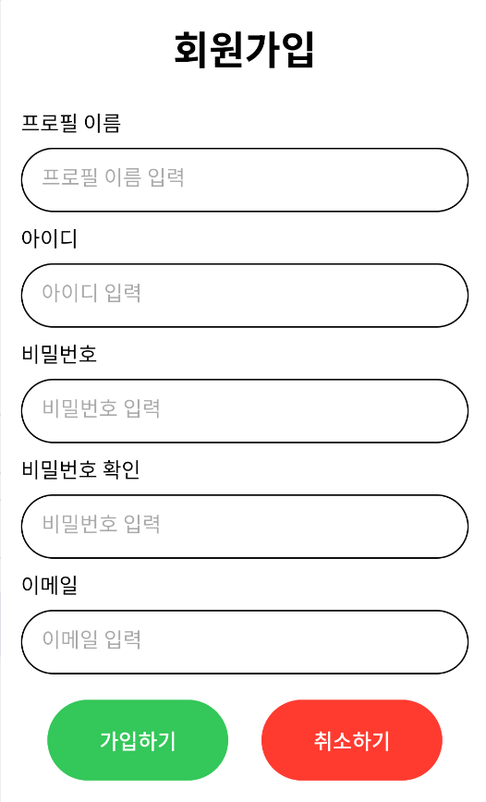
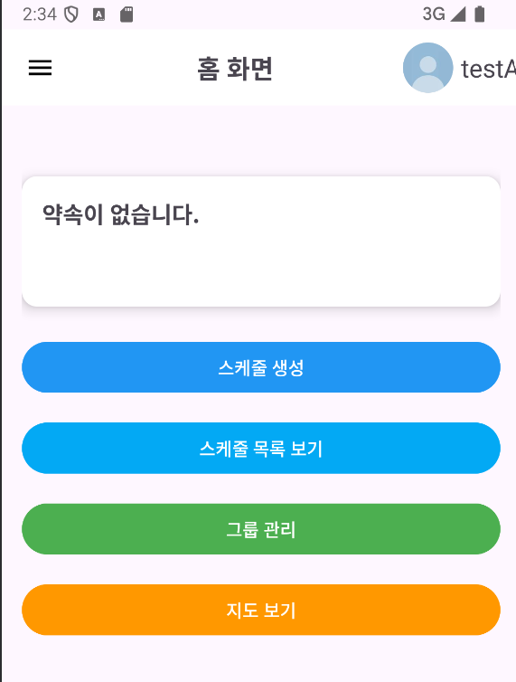
회원가입/로그인
처음화면
회원가입
로그인 후 화면

Slide 6
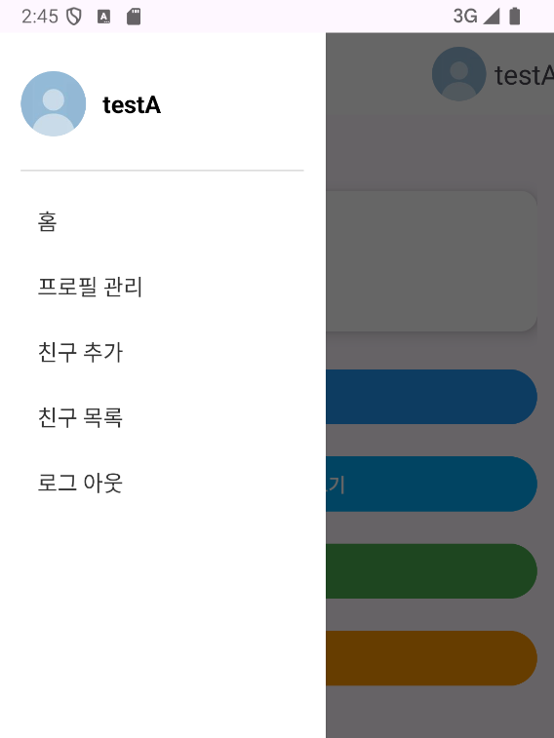
메뉴화면
메뉴화면에는 각 기능들이 포함되어있습니다.
홈: 홈 화면으로 돌아가는 기능입니다.
프로필 관리: 사진에 보이는 이름과 프로필 사진등을 변경할 수 있습니다.
친구 추가: 친구를 추가할 수 있습니다.
친구 목록: 친구를 확인할 수 있습니다.
로그아웃: 로그아웃 기능입니다.

Slide 7
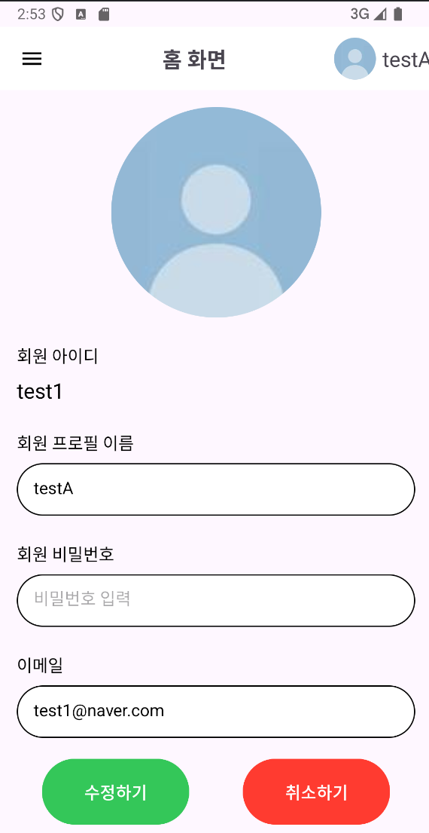
프로필 수정 기능 화면

Slide 8
Mobile App Dashboard Infographics
Jupiter
Mercury
Mercury is the closest planet to the Sun and the smallest one in the Solar System
Mercury
52%
Mercury is the closest planet to the Sun and the smallest one in the Solar System
Venus
+56%
30
150
50

Slide 9
Mobile App Dashboard Infographics
150 605
985 056
Mercury
Jupiter
Saturn
M
Tu
W
Th
F
Sa
Su
Jupiter
Mercury
1
2
3
4
5
6
7
Saturn has several rings
8
9
10
11
12
13
14
10
50%
85%
15
16
17
18
19
20
21
25
Jupiter is the biggest planet
22
23
24
25
26
27
28
29
30
31
Jupiter
30
Neptune is very far away
Jupiter
6
Jupiter is the biggest planet
Saturn
20
15
25
32
25
Venus has a beautiful name
16
Mars
Venus

Slide 10
Mobile App Dashboard Infographics
Venus
15:45
Mercury
Venus has a beautiful name
11
Jupiter is the biggest planet
15
10
Venus has a beautiful name
5
Mars
Venus
Pluto is an icy dwarf planet
M
T
W
T
Mars
Venus
Saturn
Mars
Neptune is very far away
$3
1W
1M
3M
All
60
79
Earth is the third planet
$9

Slide 11
Mobile App Dashboard Infographics
Mars
Mercury
Venus
50%
70%
70%
Jupiter is the biggest planet
Neptune is very far away
Mercury
30
10
20
30
25
10%
0
Venus
4.3
Neptune
70
10
Venus has a beautiful name
Neptune is very far away
60
Earth
20
Saturn
50
30
Neptune
Saturn
40

Slide 12
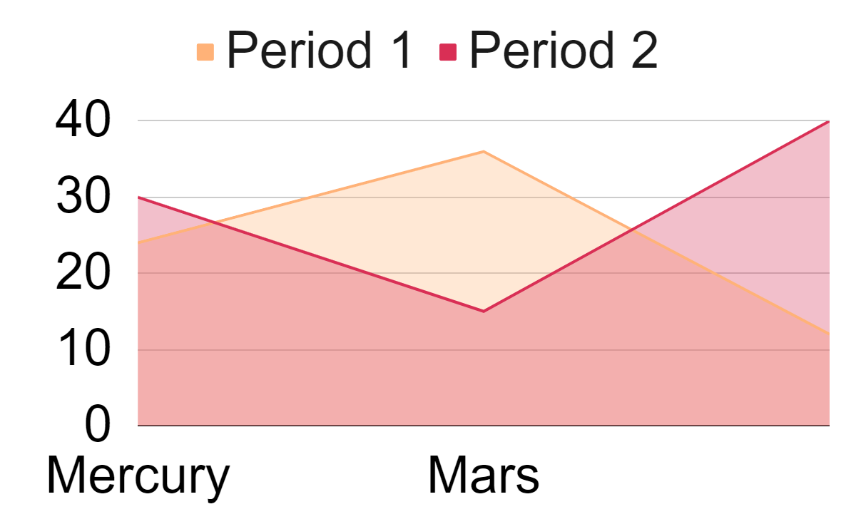
Mobile App Dashboard Infographics
Mercury
Mars
Mercury
Neptune
65
40
45
50
Mars
11 km
123 Kcal
Mars is actually a cold place
Neptune
73
20 km
264 Kcal
Saturn
Venus
Mars
Pluto
Saturn
11
12
13
14
14
W
T
F
S
S
5
15
15
20
To modify this graph, click on it, follow the link, change the data and paste the new graph here
$15 235

Slide 13
Mobile App Dashboard Infographics
Mercury
Mercury
M
T
W
T
F
S
S
Saturn
12
1
2
3
4
5
6
7
Mercury
123
15 km
8
9
10
11
12
13
14
Venus
45
15
16
17
18
19
20
21
Mars
896
22
23
24
25
26
27
28
Saturn
60
Jupiter is the biggest planet
29
30
31
Saturn
Neptune
20
12
Saturn has several rings
Jupiter
90
Neptune
13
Neptune is very far away
10 k
5 k
15 k
01
02
03
Saturn
Venus
Mars

Slide 14
Mobile App Dashboard Infographics
Mercury
Mars
Mercury
40%
4
Mars
3
65%
50%
70%
2
Venus
1
90%
Earth
1
2
3
4
5
6
Saturn
Mars
Venus
Step 2
Step 4
Mars
Saturn
Mars
351
896
60
79
Step 1
Step 3
152
454

Slide 15
Mobile App Dashboard Infographics
Jupiter
Mercury
Jupiter is the biggest planet
50%
80%
11
12
13
14
14
W
T
F
S
S
Mars
Mercury
Mercury
Saturn has several rings
Mars
Jupiter
250
Saturn
Neptune is very far away
Saturn

Slide 16
Mobile App Dashboard Infographics
Jupiter
Mercury
Jupiter is the biggest planet
156 563
15
16
17
18
1
Neptune is very far away
3,546
m
Mars
Mercury
Venus
523
kcal
10.03
15.03
20.03
489.1
points
523
489.1
Saturn
kcal
points
54
Mars
min
64
kg
Saturn
Mercury

Slide 17
Mobile App Dashboard Infographics
Jupiter
Mercury
60%
40%
Mercury
Mercury is the closest planet to the Sun and the smallest one in the Solar System
Venus
Earth
Mars
60%
40%
25%
20.05
Saturn
Mars
10
15
25
15
Venus
Venus

Slide 18
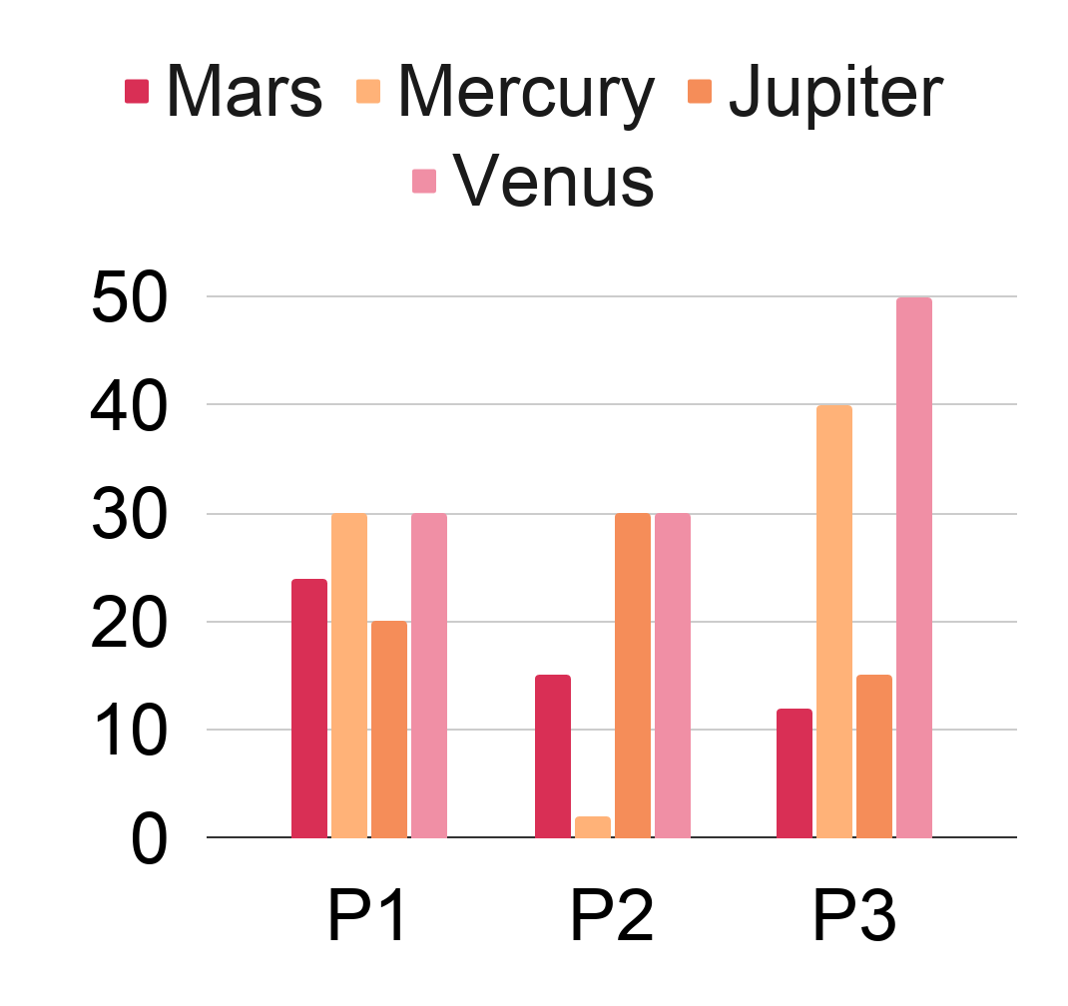
Mobile App Dashboard Infographics
Mercury
Saturn
Jupiter
Mars
Venus
Venus
75%
Mars is actually a cold place
120
Earth
50%
01
Earth
Mercury
Mars
30%
02
Mars
Earth
Venus
78%
03
Jupiter
To modify this graph, click on it, follow the link, change the data and paste the new graph here

Slide 19
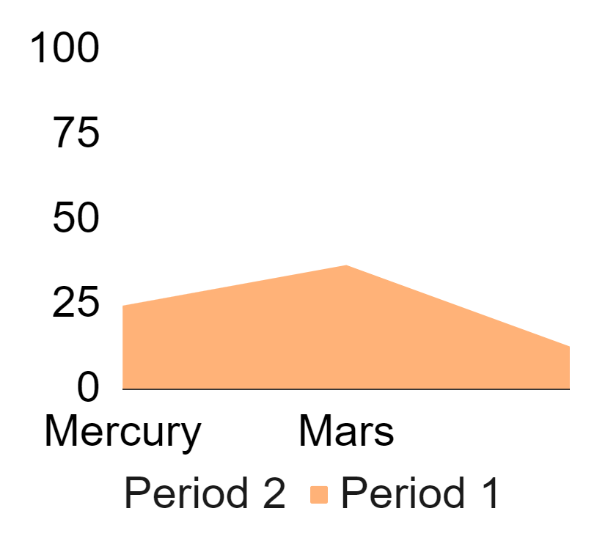
Mobile App Dashboard Infographics
35
Mercury
23
Mercury
32
Venus
Mars
Earth
Jupiter is the biggest planet
Mars
Mercury
Jupiter
75%
80%
30%
Saturn
Mercury
11
12
13
14
W
T
F
S
Mars
Mars is actually a cold place
Jupiter
Venus
To modify this graph, click on it, follow the link, change the data and paste the new graph here
70

Slide 20
Mobile App Dashboard Infographics
Venus
Mercury
Mercury
M
T
W
T
F
S
S
Saturn
Jupiter
Jupiter
Jupiter is the biggest planet
60%
Jupiter
09:40
Jupiter is the biggest planet
Mercury
08:25
Mars
Mars
Saturn
Venus
07:10
Jupiter
10:30
Venus
Earth
16:35
Mercury
11:40
Saturn
15:30
Jupiter
Neptune
15:15
Saturn

Slide 21
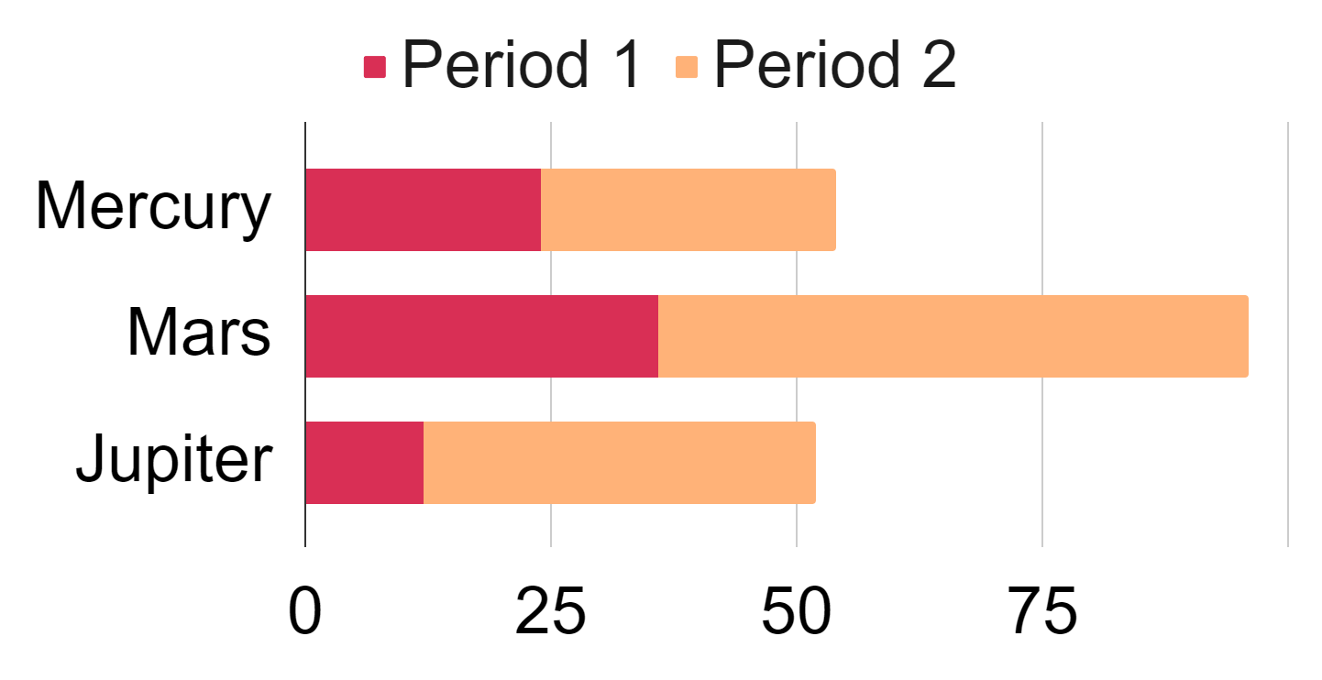
Mobile App Dashboard Infographics
Mercury
Mars
Venus
15
Saturn
Saturn has several rings
Venus
90%
05:10
Venus
50%
75%
Mars
50%
Venus
Mars
07:25
Mercury
Saturn
90%
09:50
Saturn
25%
10%
Venus
Saturn
Mercury
20:25
Mars
Venus has a beautiful name
To modify this graph, click on it, follow the link, change the data and paste the new graph here

Slide 22
Mobile App Dashboard Infographics
Venus
Saturn
102
105
Mars
75%
2
1
Earth
Venus
Mars
Mercury
25%
50%
75%
Saturn
50%
1
Saturn
Saturn has several rings
25%
Mars
30%
00:20:45
2
Neptune
Neptune is very far away
0.25
0.54
0.89
Venus

Slide 23
Mobile App Dashboard Infographics
Saturn
Jupiter
1 560
520
Jupiter
M
Tu
W
Th
F
Sa
Su
Mars
Jupiter
1
2
3
4
5
6
7
8
9
10
11
12
13
14
15
16
17
18
19
20
21
75%
50%
20
15
17
12
23
22
23
24
25
26
27
28
29
30
31
Saturn
Mars
Venus
Earth
10
Earth
Saturn
20
15
25
15
12
Mercury
563

Slide 24
Mobile App Dashboard Infographics
Venus
Mars
15
10
156
652
5
Mercury
75%
01
02
03
04
659
256
Mars
Venus
Venus
Neptune
348
147
Neptune
20 min
30 min
Neptune
Saturn
Neptune
Neptune is very far away

Slide 25
Mobile App Dashboard Infographics
Mercury
Jupiter
Venus
Jupiter is the biggest planet
Mercury
Mars
Step 1
Step 3
Mercury is the smallest planet
Venus has a beautiful name
Saturn
Venus
Step 2
Step 4
Jupiter
Saturn
Mercury
Saturn
50%
125
Jupiter
Mars
15 km
100
80%
Jupiter
60

Slide 26
Mobile App Dashboard Infographics
Neptune
Jupiter
Neptune is very far away
Jupiter
Earth
Mars
10:30
10
11
12
13
Mercury
12:50
Mars
Mon
13
50
Neptune
Neptune
Mercury
Mercury
Venus
Neptune
Mars
Earth
Mars

Slide 27
Mobile App Dashboard Infographics
Mon
Mars
Venus
1.7
Tue
Venus
Venus has a beautiful name
Mercury
Mercury is the closest planet to the Sun and the smallest one in the Solar System
Wed
Jupiter
75%
50%
Saturn
Mars
Mercury
Mars
60
79

Slide 28
Mobile App Dashboard Infographics
Mars
15
Mercury
Venus
Mars
Saturn
01
02
03
10
Saturn has several rings
Mars
Venus
Venus
25%
50%
Neptune
Neptune is very far away
Saturn
Mercury
Mercury
50%
Earth
Mars
Mars
Jupiter

Slide 29
Mobile App Dashboard Infographics
Saturn
Neptune is very far away
$5
Neptune
65%
Mercury
35%
Mercury
450 056
Mercury is the closest planet to the Sun and the smallest one in the Solar System
Neptune is very far away
Venus
50%
Jupiter
30%
Mars
Venus
20
15
17
12
23

Slide 30
Mobile App Dashboard Infographics
Saturn
Mars
Earth
Neptune
523
489.1
Mars
Venus
50%
70%
Mercury
Mars
Saturn
156
652
Mercury
01
02
03
50%
Venus
156 238
00:15:20
Mercury is the smallest planet
Saturn
563

Slide 31
Mobile App Dashboard Infographics
M
Tu
W
Th
F
Sa
Su
Jupiter
1
2
3
4
5
6
7
Saturn
8
9
10
11
12
13
14
15
16
17
18
19
20
21
22
23
24
25
26
27
28
20
15
25
15
29
30
31
Mercury
Mars
Earth
Venus
Jupiter
15
16
17
18
17
Jupiter is the biggest planet
60%
40%
25%
Mercury is the smallest planet
Mercury
Mercury is the closest planet to the Sun and the smallest one in the Solar System
Neptune is very far away

Slide 32
Mobile App Dashboard Infographics
Mars
Venus
Mercury
+10
+15
Venus
Mars
Venus
Mars
Venus
Venus has a beautiful name
25%
5
7
4
12
9
5
Mercury
+5
Mars
Mars
-2
Mars is actually a cold place
Mercury
Jupiter
-6
Saturn
60%
Neptune
+10

Slide 33
Mobile App Dashboard Infographics
142
Mars
Venus
20%
Venus
123 056
45 236
Mars
Venus
20
Mars
25
Mercury
Mercury
70
Mercury
123
10
Venus
45
2
4
6
2
4
5
2
Jupiter
65
Mars
Venus
Mars
896

Slide 34
Instructions for use (free users)
In order to use this template, you must credit Slidesgo by keeping the Thanks slide.
You are allowed to:
Modify this template.
Use it for both personal and commercial purposes.
You are not allowed to:
Sublicense, sell or rent any of Slidesgo Content (or a modified version of Slidesgo Content).
Distribute this Slidesgo Template (or a modified version of this Slidesgo Template) or include it in a database or in any other product or service that offers downloadable images, icons or presentations that may be subject to distribution or resale.
Use any of the elements that are part of this Slidesgo Template in an isolated and separated way from this Template.
Delete the “Thanks” or “Credits” slide.
Register any of the elements that are part of this template as a trademark or logo, or register it as a work in an intellectual property registry or similar.
For more information about editing slides, please read our FAQs or visit Slidesgo School:
https://slidesgo.com/faqs and https://slidesgo.com/slidesgo-school

Slide 35
Instructions for use (premium users)
In order to use this template, you must be a Premium user on Slidesgo.
You are allowed to:
Modify this template.
Use it for both personal and commercial purposes.
Hide or delete the “Thanks” slide and the mention to Slidesgo in the credits.
Share this template in an editable format with people who are not part of your team.
You are not allowed to:
Sublicense, sell or rent this Slidesgo Template (or a modified version of this Slidesgo Template).
Distribute this Slidesgo Template (or a modified version of this Slidesgo Template) or include it in a database or in any other product or service that offers downloadable images, icons or presentations that may be subject to distribution or resale.
Use any of the elements that are part of this Slidesgo Template in an isolated and separated way from this Template.
Register any of the elements that are part of this template as a trademark or logo, or register it as a work in an intellectual property registry or similar.
For more information about editing slides, please read our FAQs or visit Slidesgo School:
https://slidesgo.com/faqs and https://slidesgo.com/slidesgo-school

Slide 36
Infographics
You can add and edit some infographics to your presentation to present your data in a visual way.
Choose your favourite infographic and insert it in your presentation using Ctrl C + Ctrl V or Cmd C + Cmd V in Mac.
Select one of the parts and ungroup it by right-clicking and choosing “Ungroup”.
Change the color by clicking on the paint bucket.
Then resize the element by clicking and dragging one of the square-shaped points of its bounding box (the cursor should look like a double-headed arrow). Remember to hold Shift while dragging to keep the proportions.
Group the elements again by selecting them, right-clicking and choosing “Group”.
Repeat the steps above with the other parts and when you’re done editing, copy the end result and paste it into your presentation.
Remember to choose the “Keep source formatting” option so that it keeps the design. For more info, please visit Slidesgo School.

