Slide 1

CYPRESS TESTING
CLOUDING
Carlos Cavalcante

Slide 2
What is cloud ?
Cloud computing is on-demand access, via the internet, to computing resources - applications, servers ( physical and virtual ), data storage, development tools, networking capabilities, and more—hosted at a remote data center managed by a cloud services provider.

Slide 3
Cypress overview
View past test results from your CI environment.
Analyze and diagnose test health.
Reduce test time and save money by smartly orchestrating future runs across multiple machines.
Integrate with your favorite developer tools to help streamline your workflows.
View CI runs and test health directly from the Cypress app.

Slide 4
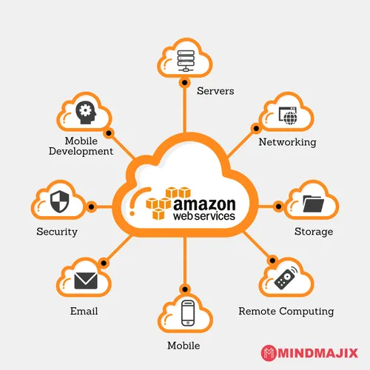
cloud overview
Amazon Web Services (AWS) is a platform that offers flexible, reliable, scalable, easy-to-use, and cost-effective cloud computing solutions.

Slide 5
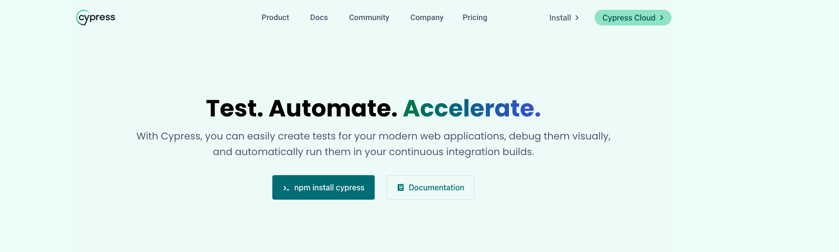
Steps to use cypress into cloud Cypress dashboard

Slide 6
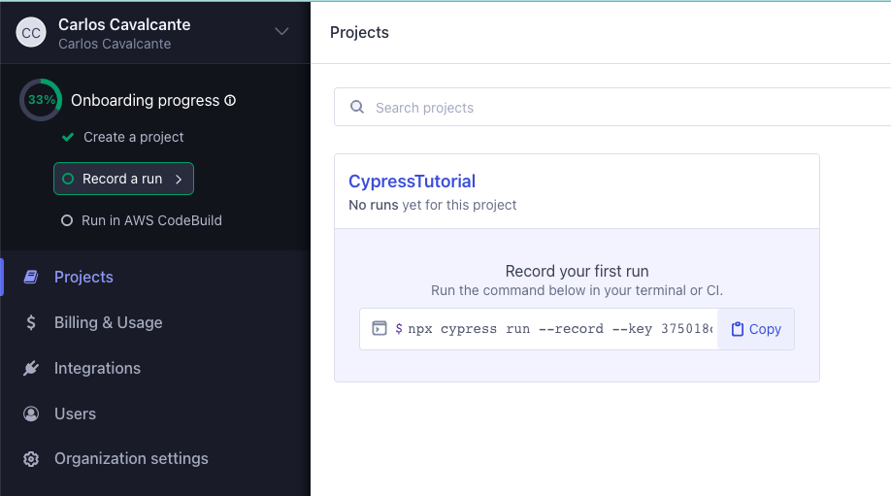
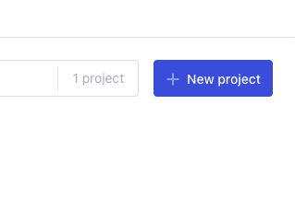
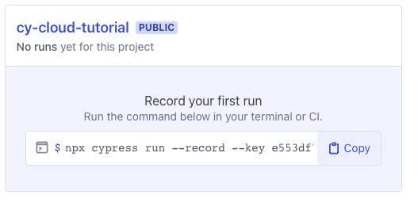
Create project & run

Slide 7
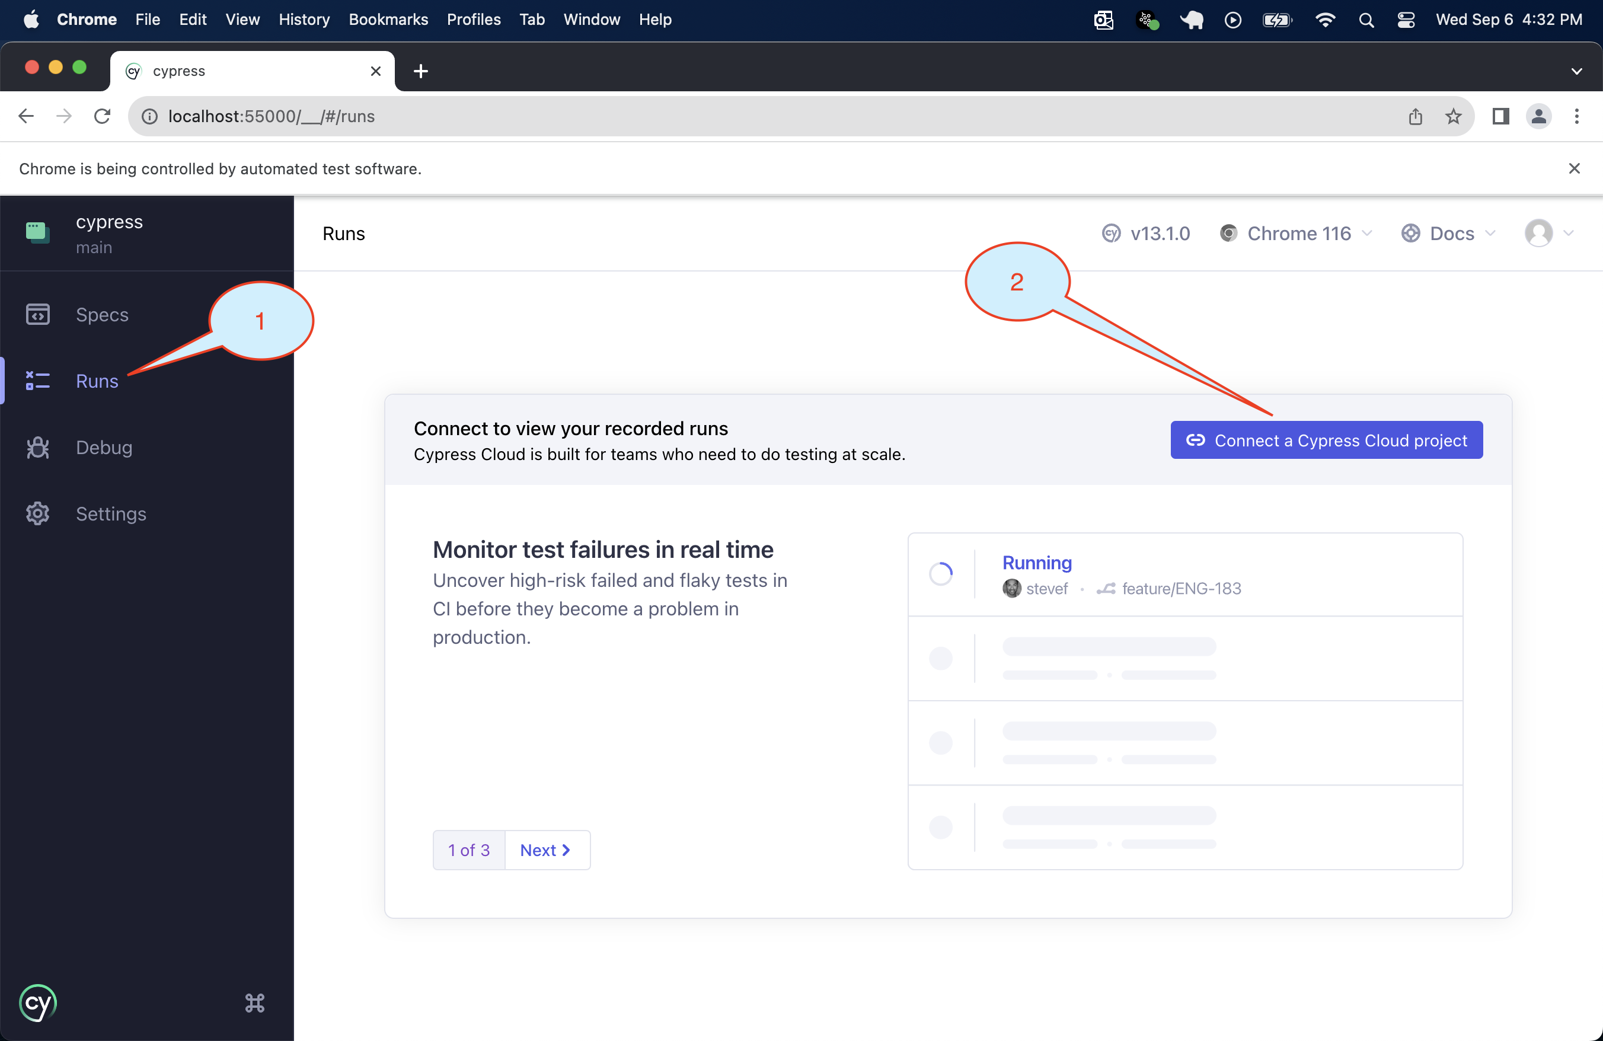
Dashboard & browser

Slide 8
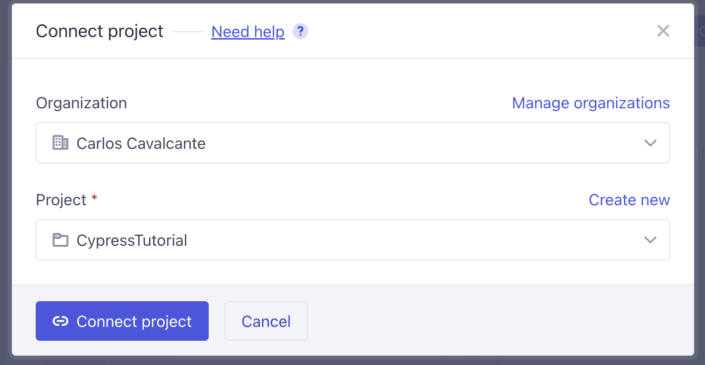
Connect cypress cloud

Slide 9
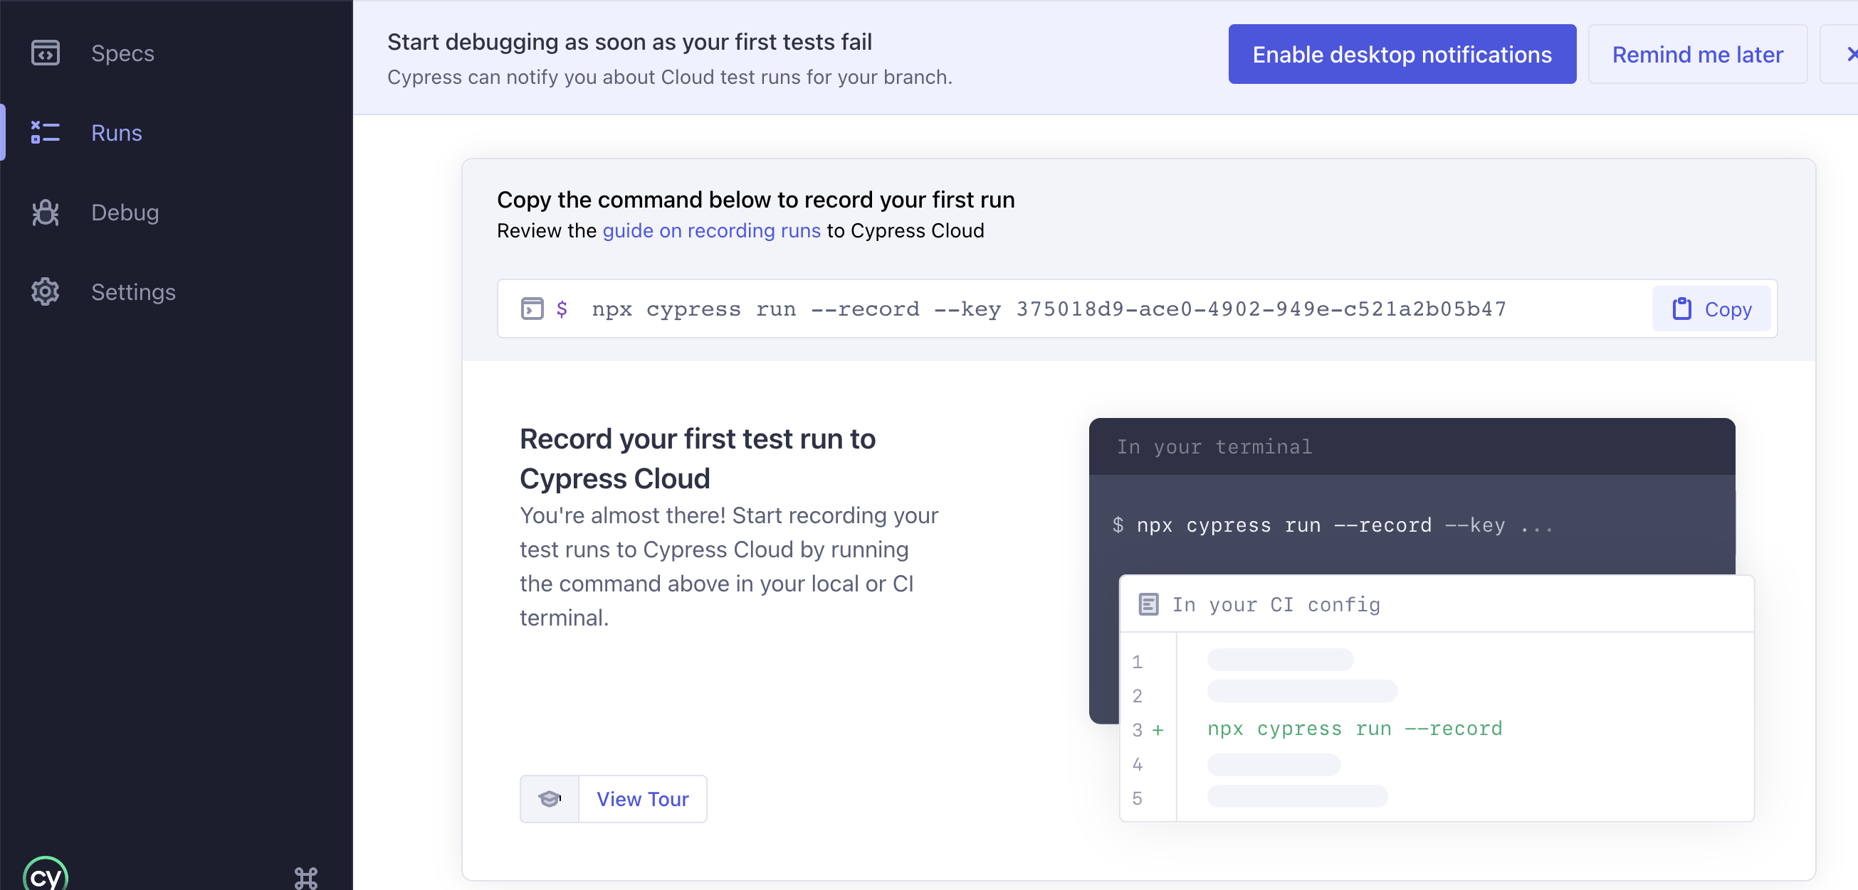
Get a key to run on aws

Slide 10
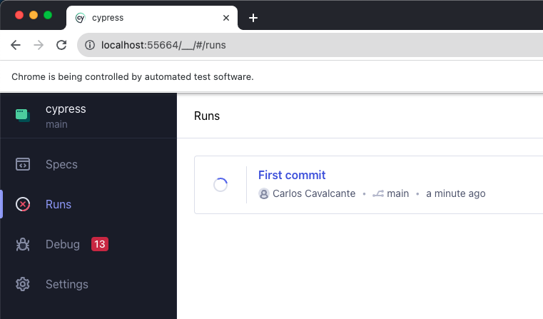
run

Slide 11
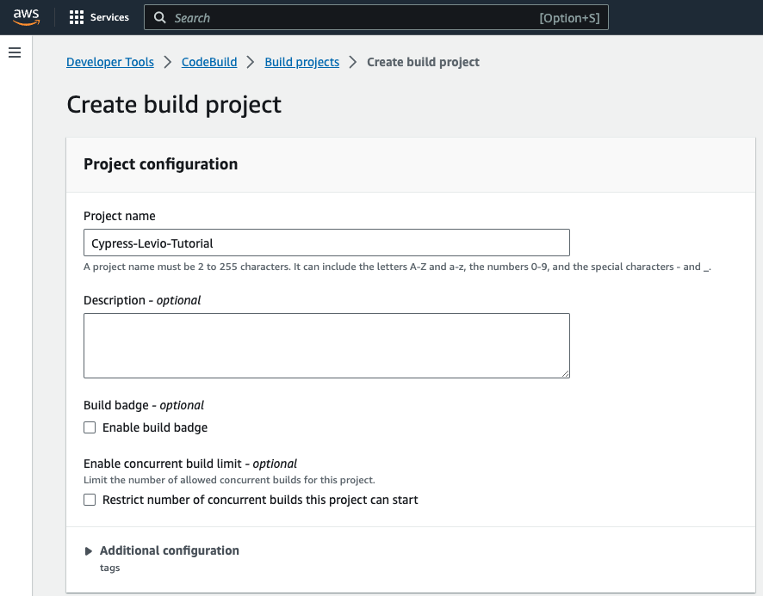
Aws build project

Slide 12
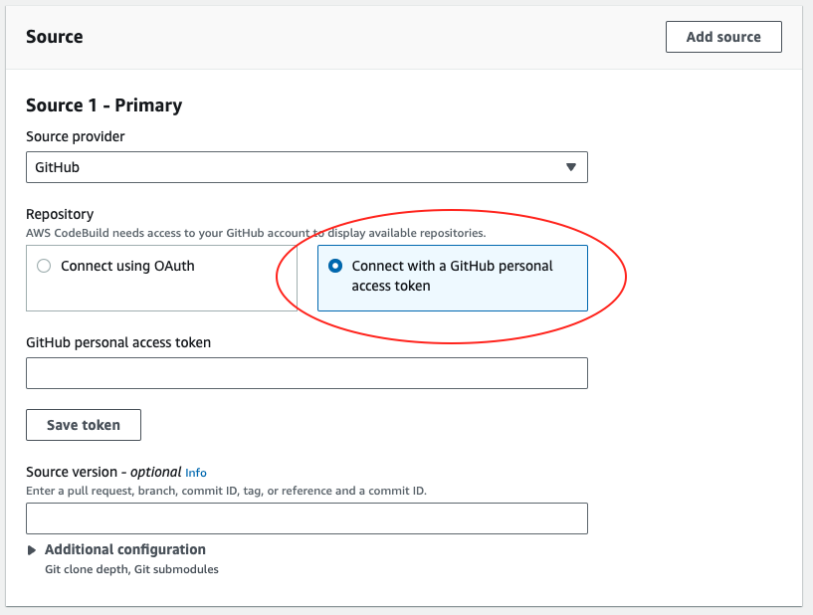
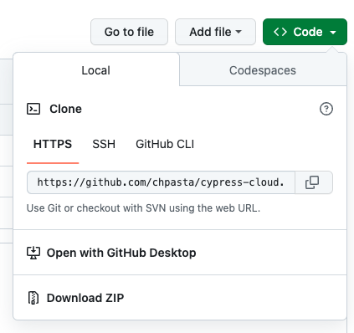
Cypress overview

Slide 13
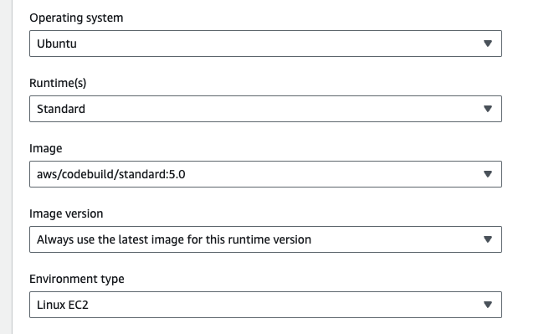
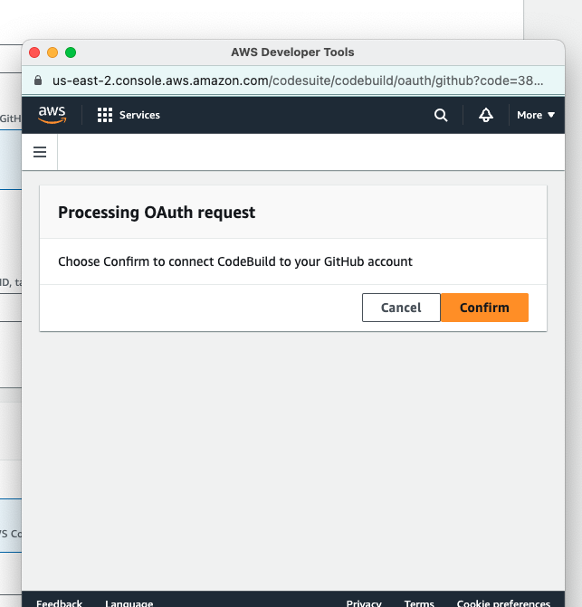
Cypress overview

Slide 14
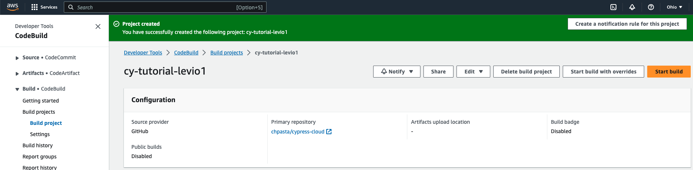
Cypress overview

Slide 15
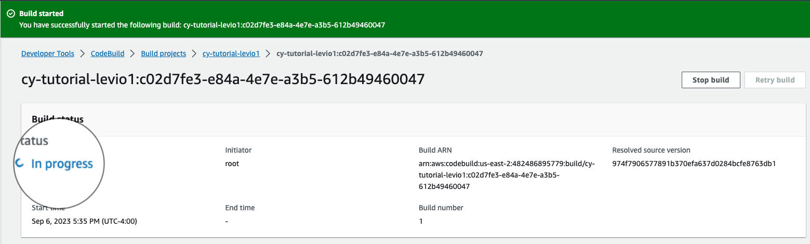
Cypress overview

Slide 16
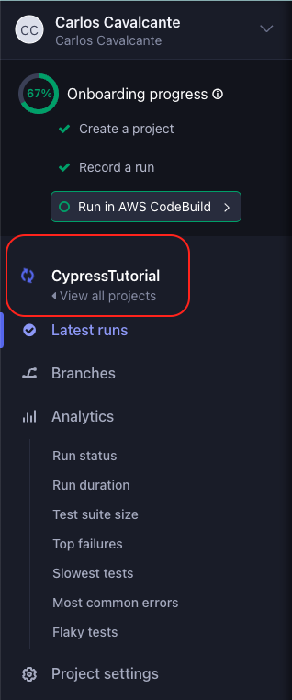
Cypress overview

Slide 17
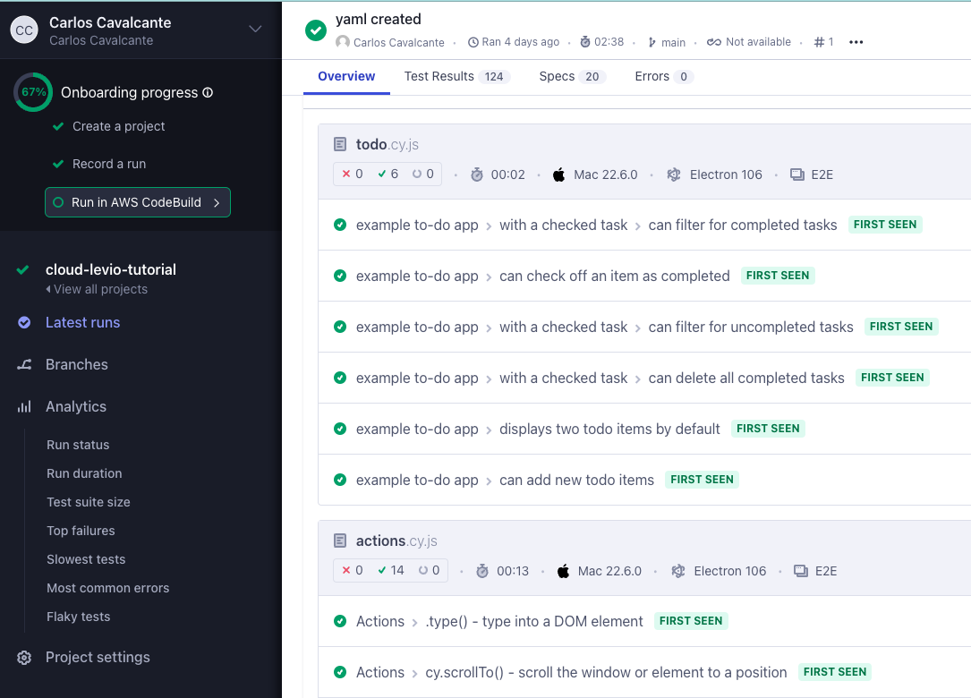
Cypress test results

Slide 18
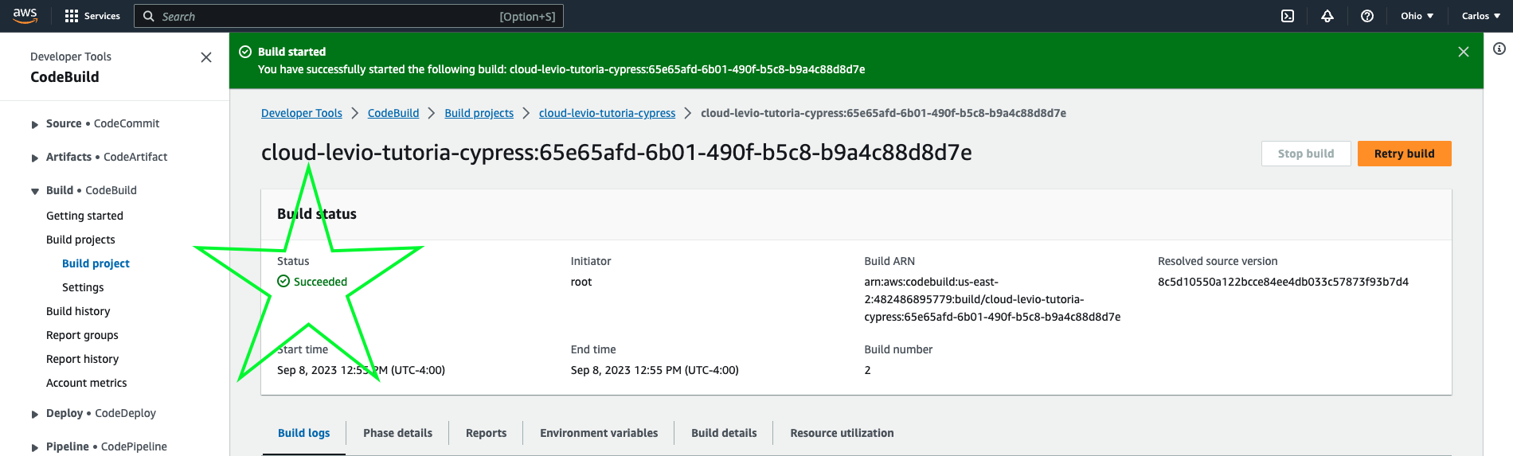
Cypress + github + aws successful result

Slide 19
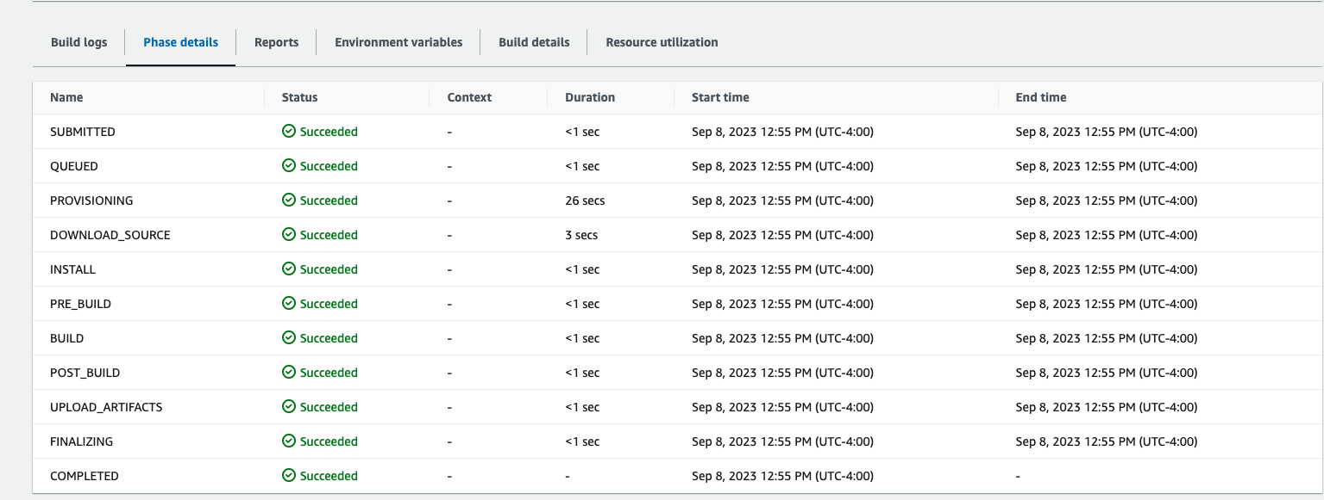
Phase details

Slide 20
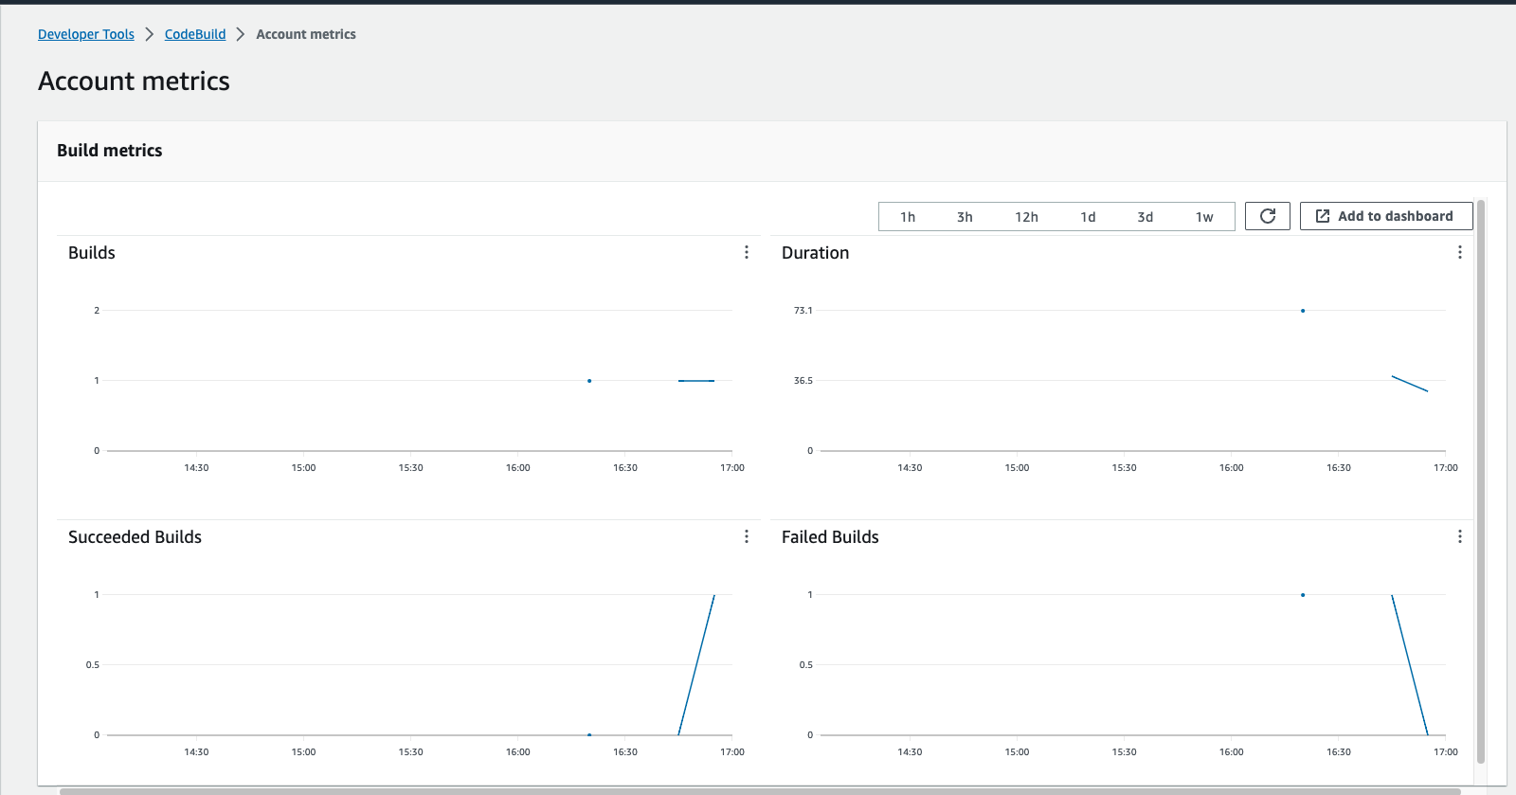
AWS Metrics

Slide 21
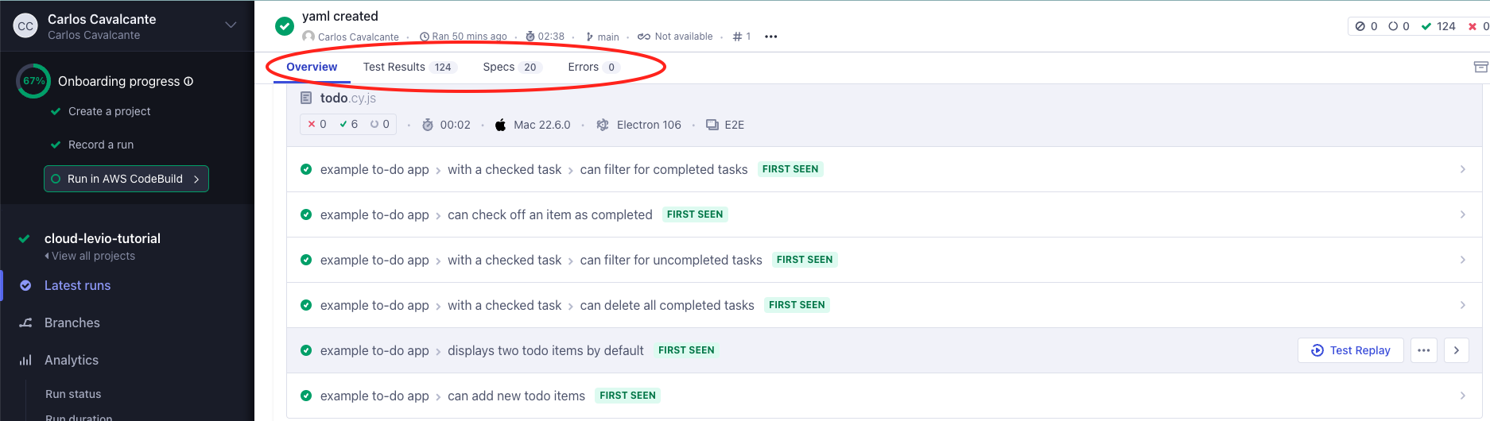
Cypress Dashboard

Slide 22
conclusion
Clouding is the future!
Cloud storage enables you to make data available anywhere, anytime, as long as you have an internet connection.
Cost Savings – “Pay as you go”
Security.
Mobility.
Increased Collaboration.
Disaster Recovery.
Availability – Scalability - Elasticity

Slide 23
resources
Cypress cloud documentation: https://docs.cypress.io/guides/cloud/getting-started
Repository: Github AWS: https://aws.amazon.com/

Slide 24

Questions ?
Thank you!

