Slide 1


Cypress
QA Levio Team
Tutorial Beginner

Slide 2
Why Cypress

Slide 3
Get started Install Cypress
cd /your/project/path
npm install cypress --save-dev
The recommended approach is to install Cypress with npm because:

Slide 4
Open Cypress
Command Line
npx cypress open
Or
yarn run cypress open

Slide 5
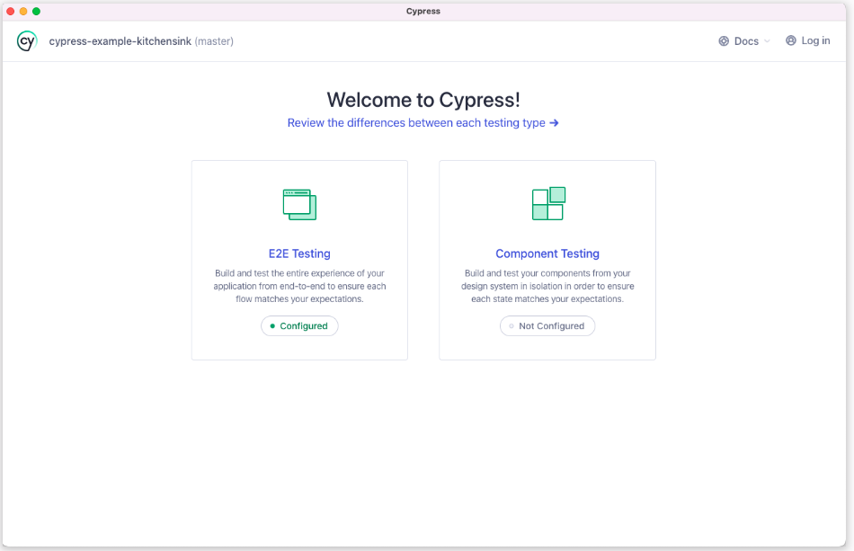
Cypress Launchpad

Slide 6
Open Cypress
Choosing a Testing Type
Launching a Browser
Writing Your First E2E Test
Add a test file
Write your first test

Slide 7
Write test in Cypress
1. Write your first passing test.
describe('My First Test', () => { it('Does not do much!', () => { expect(true).to.equal(true) }) })
2. Watch Cypress reload in real time.

Slide 8
Write test in Cypress
Query for an element

Slide 9
Writing Your First E2E Test
describe('My First Test', () => {
it('finds the content "type"', () => {
cy.visit('https://example.cypress.io')
cy.contains('type')
})
})

Slide 10
Writing Your First E2E Test
describe('My First Test', () => {
it('finds the content "type"', () => {
cy.visit('https://example.cypress.io')
cy.contains('type')
})
})

Slide 11
Writing Your First E2E Test
describe('My First Test', () => {
it('finds the content "type"', () => {
cy.visit('https://example.cypress.io')
cy.contains('type')
})
})

Slide 12
Writing Your First E2E Test
describe('My First Test', () => {
it('finds the content "type"', () => {
cy.visit('https://example.cypress.io')
cy.contains('type')
})
})

Slide 13
Last Slide: suggestions and sources
Cypress Documents: https://docs.cypress.io/guides/overview/why-cypress
Suggestions:
Tutorial youtube: https://www.youtube.com/playlist?list=PLhW3qG5bs-L9LTfxZ5LEBiM1WFfvX3dJo
Udemy: https://www.udemy.com/courses/search/?src=ukw&q=cypress
Github: project tutorial: https://github.com/cypress-io/cypress-example-conduit-app
Advanced Project: https://example.cypress.io/todo

