Slide 1


Cypress
QA Levio Team
Tutorial Beginner
By Julie Humbert and Carlos Cavalcante

Slide 2
Why Cypress
Cypress is JavaScript-based front-end testing tool
Built for the modern web
It aims to address the pain points developers or QA engineers face while testing an application
Developer-friendly tool that uses a unique DOM manipulation technique Operates directly in the browser
Provides a unique interactive test runner in which it executes all commands.

Slide 3
Get started Install Cypress
cd /your/project/path
npm install cypress --save-dev

Slide 4
Open Cypress
Command Line
npx cypress open
Or
yarn run cypress open

Slide 5
Open Cypress
Choosing a Testing Type
Launching a Browser
Writing Your First E2E Test
Add a test file
Write your first test

Slide 6
Write test in Cypress
Query for an element
That’s a funny part. Just click on aim tool and choose the component to be tested. Copy its id or className and paste on the code add an event like click. Save it and check the component being clicked.

Slide 7
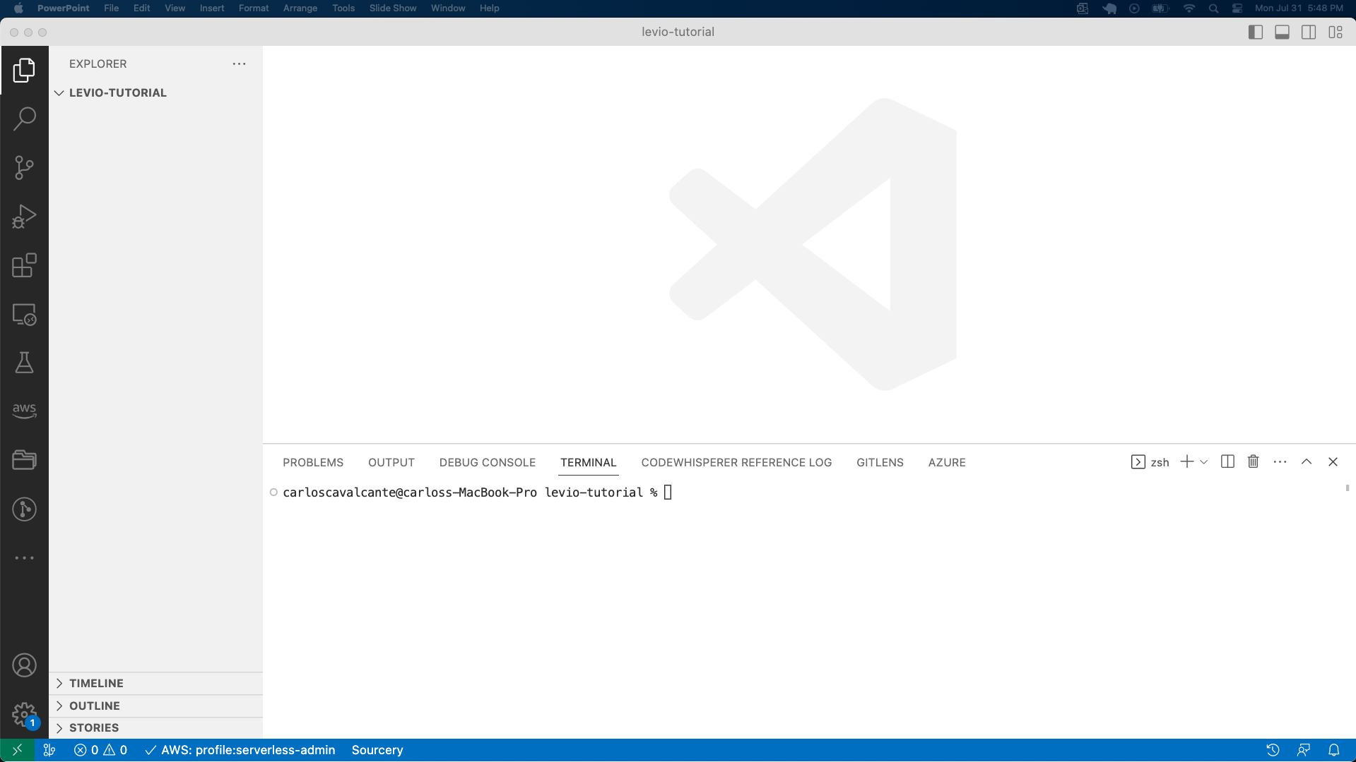
Cypress - Demo File and path

Slide 8
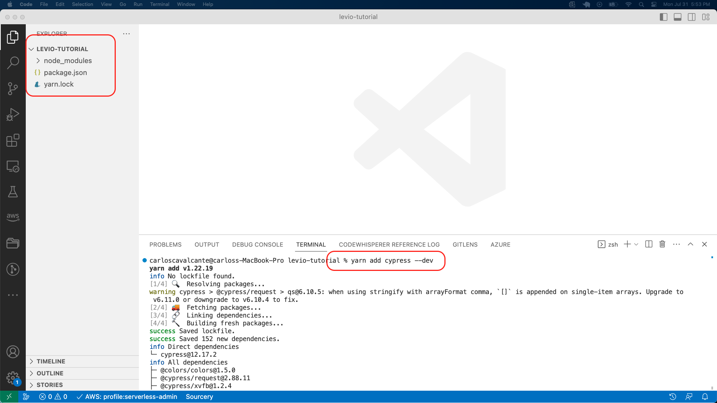
Write test in Cypress yarn add cypress --dev

Slide 9
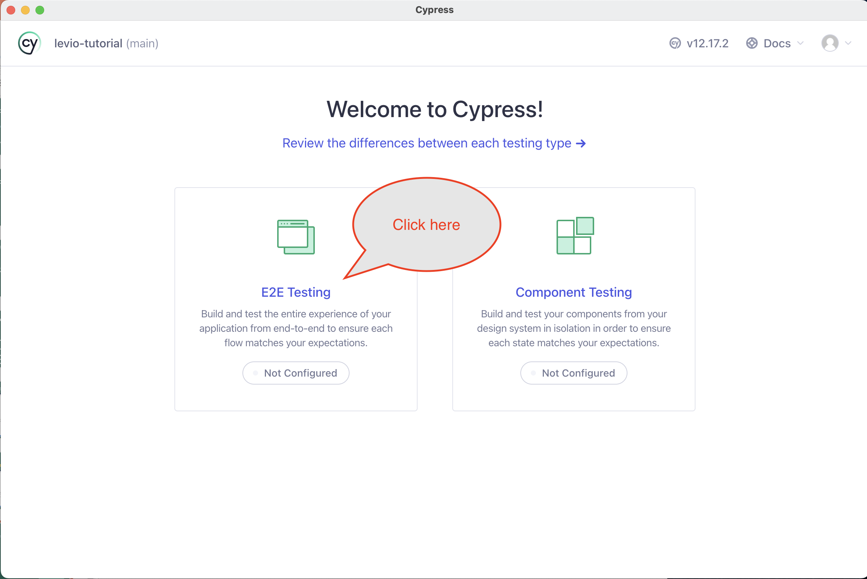
Choosing type

Slide 10
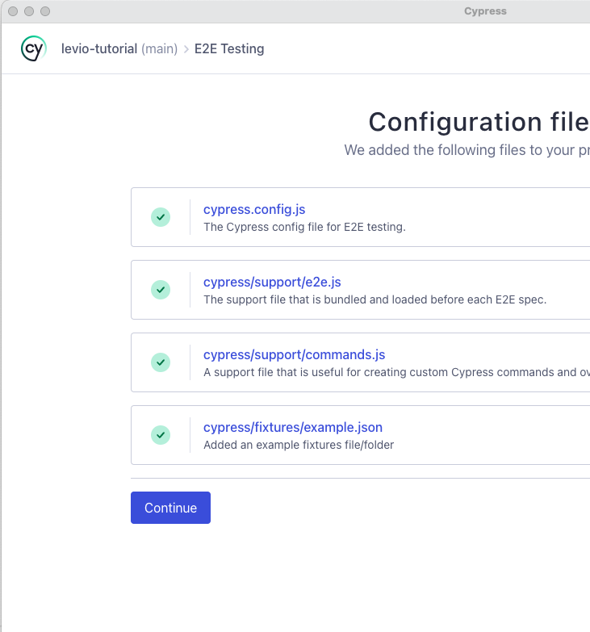
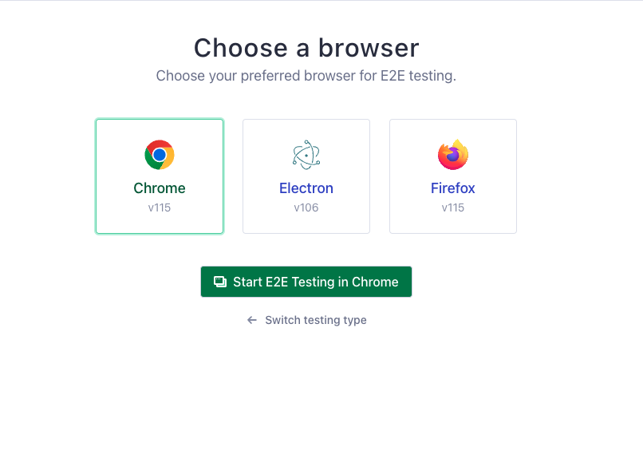
Cypress Open Launching a Browser

Slide 11
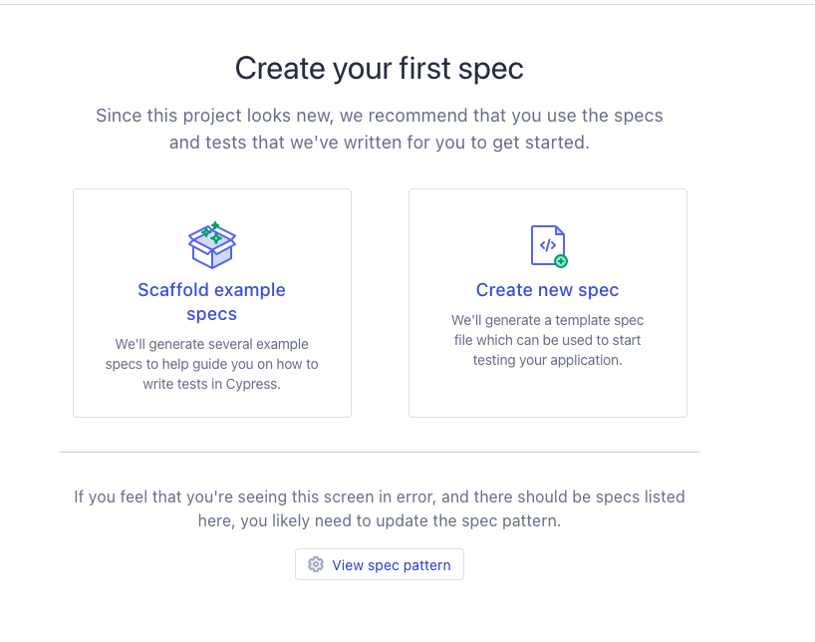
Cypress Open Creating a spec

Slide 12
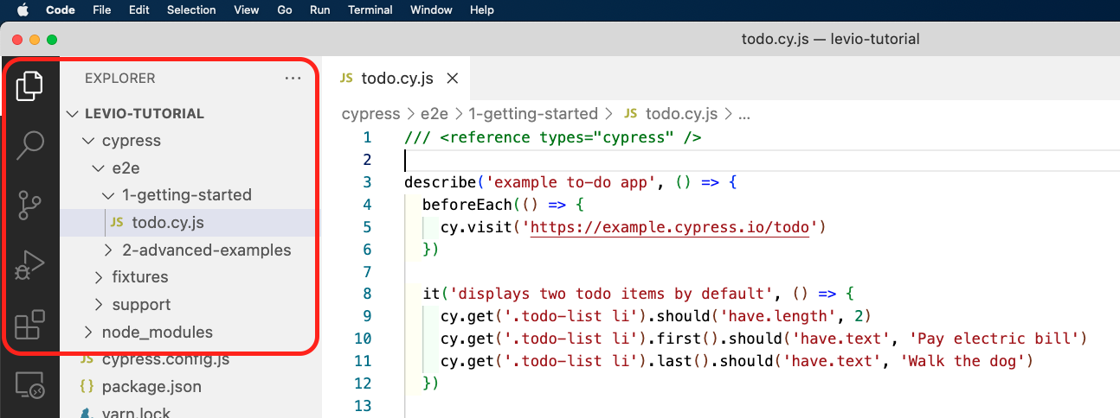
Opening the App Code

Slide 13
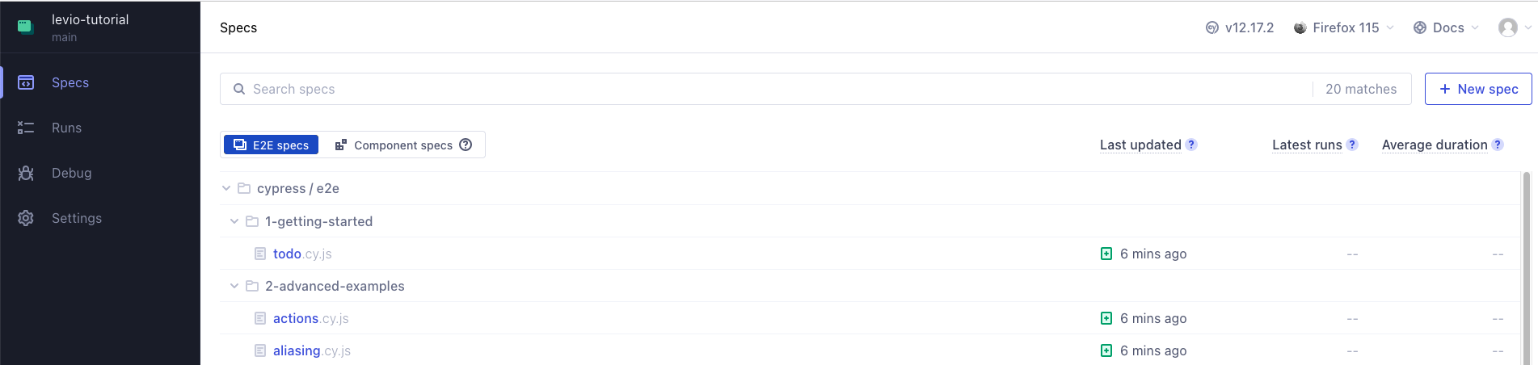
Cypress testing

Slide 14
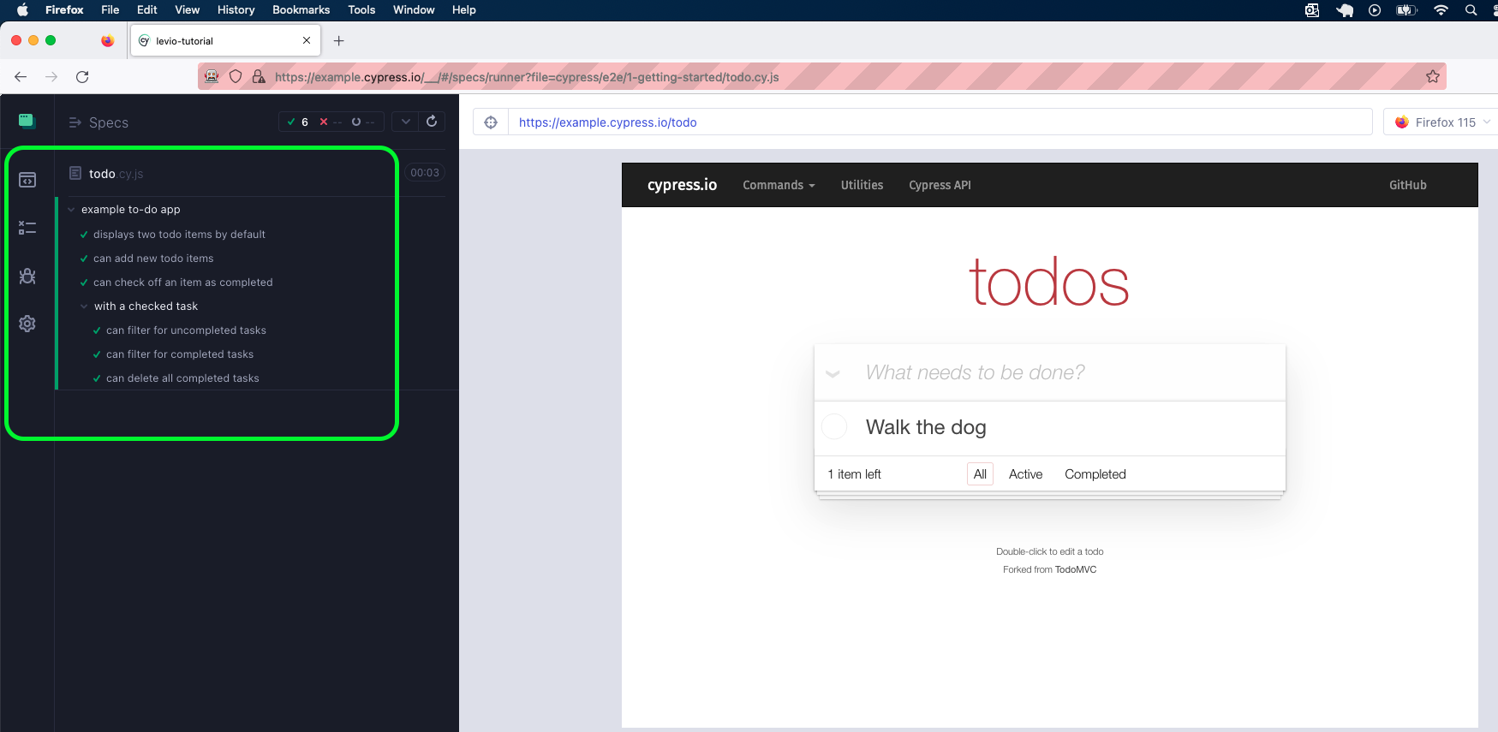
Cypress running

Slide 15
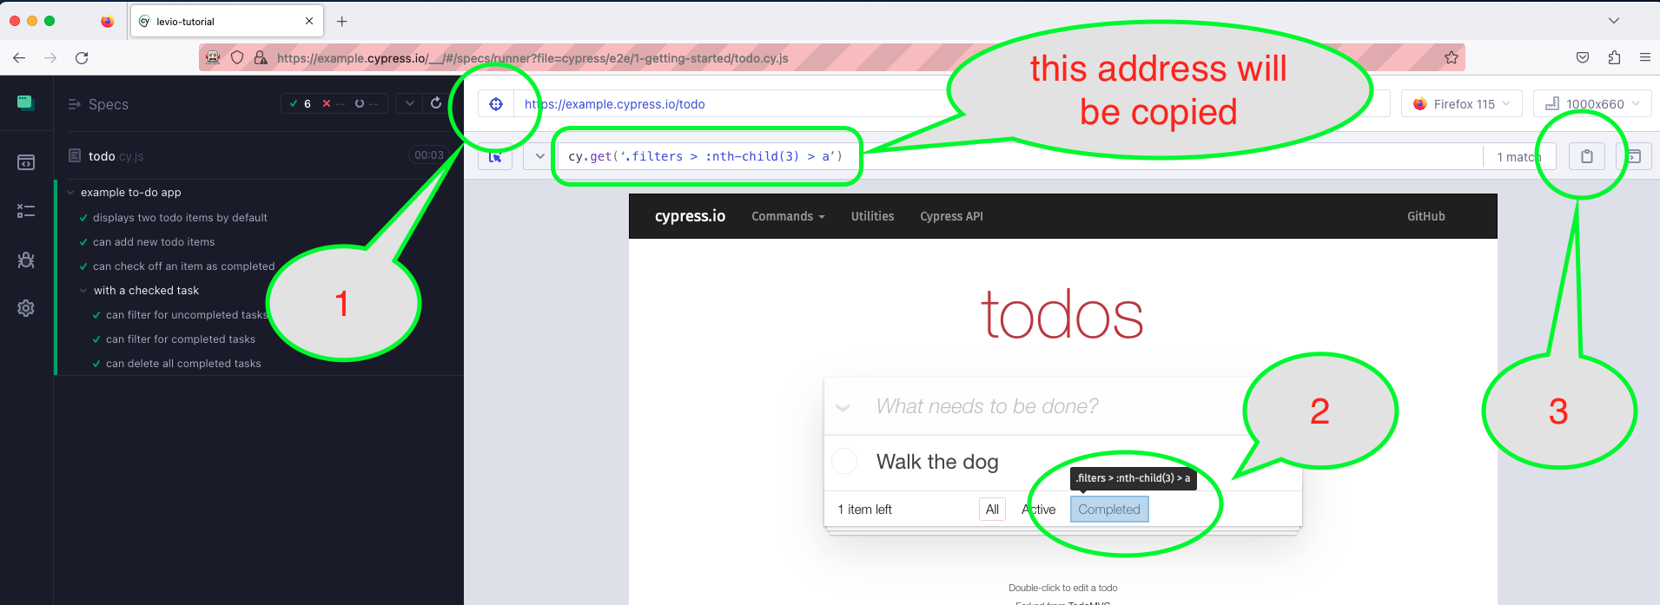
Testing

Slide 16
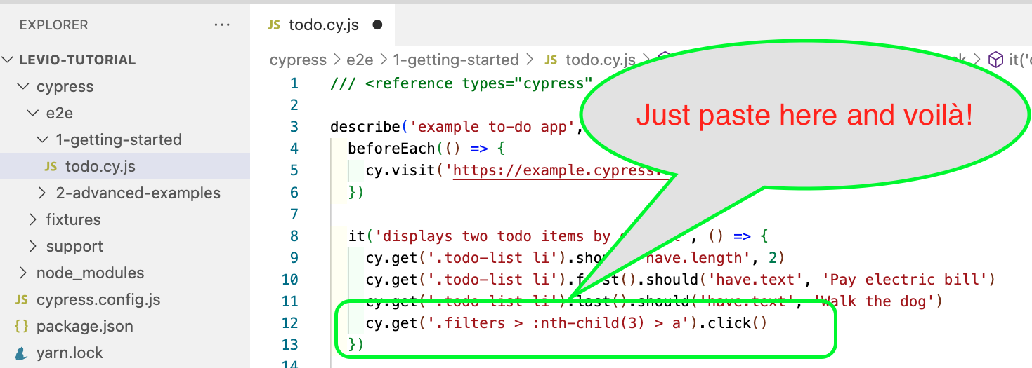
Testing

Slide 17
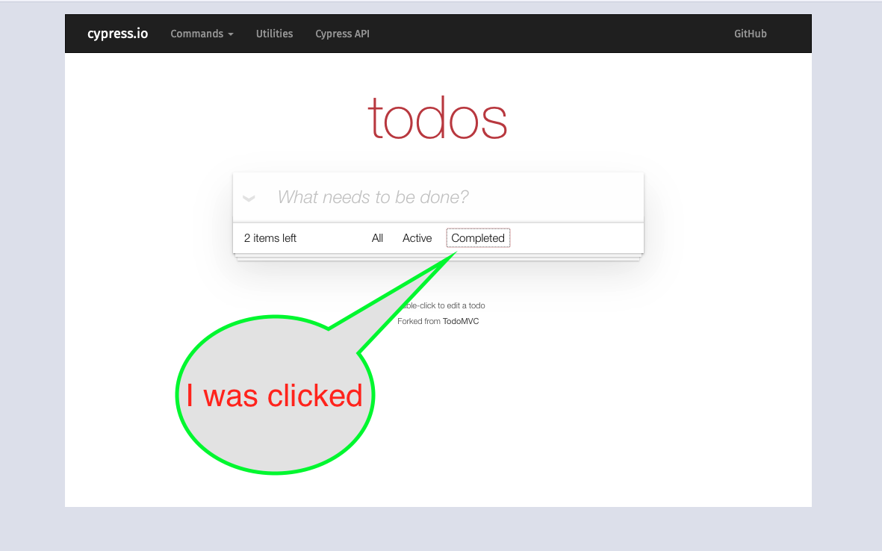
Save and see the results

Slide 18
Last Slide: suggestions and sources
Cypress Documents: https://docs.cypress.io/guides/overview/why-cypress
Suggestions:
Tutorial youtube: https://www.youtube.com/playlist?list=PLhW3qG5bs-L9LTfxZ5LEBiM1WFfvX3dJo
Udemy: https://www.udemy.com/courses/search/?src=ukw&q=cypress
Github: project tutorial: https://github.com/cypress-io/cypress-example-conduit-app
Advanced Project: https://example.cypress.io/todo

Slide 19
Cypress Thanks Questions?

