Slide 1
GlycoSeq

Slide 2
Index
From ChuanYih
2015-08-14 2015-07-21 2015-07-17 2015-04-20
From TTU
2015-07-28 2015-04-20

Slide 3
From Chuan-Yih

Slide 4
2015-08-14
From Chuan-Yih

Slide 5
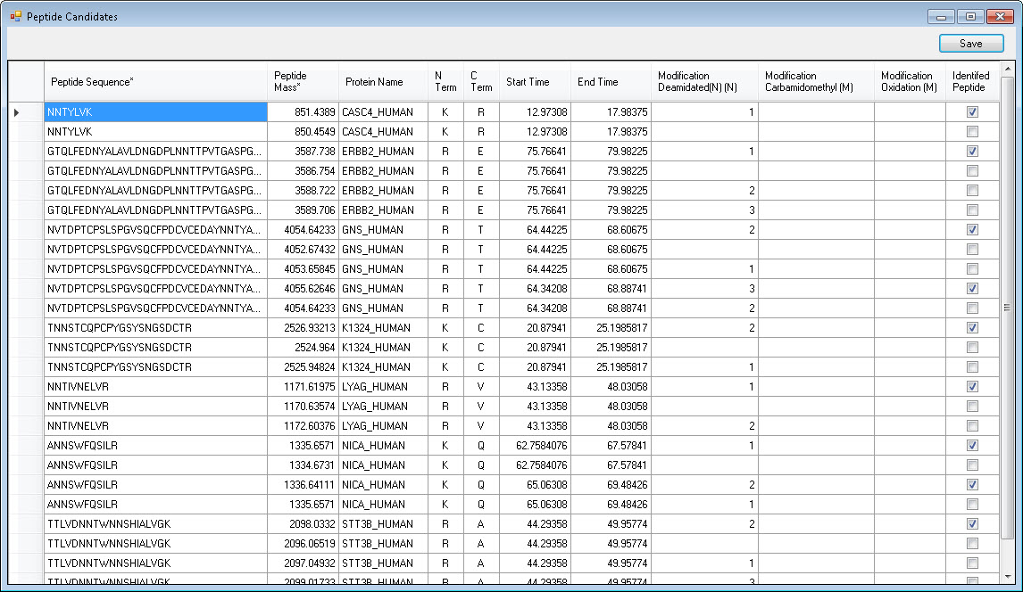
Candidate list can be sorted by peptide modification
Candidate list add extra column to label peptides from Mascot search

Slide 6
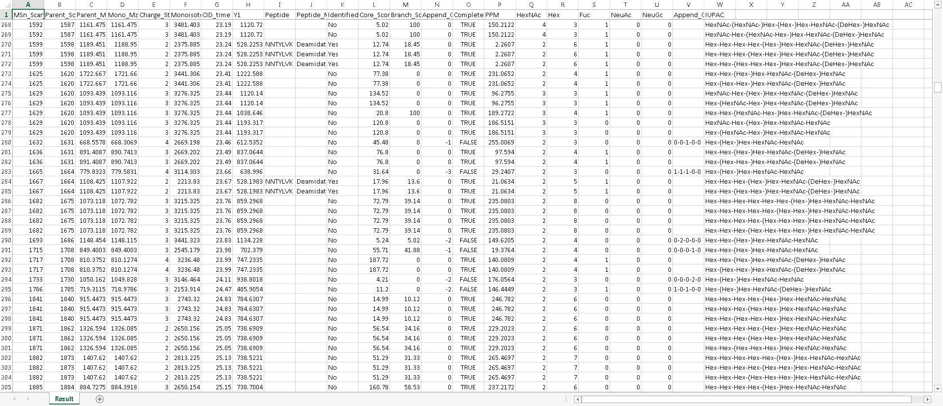
Export result contain modification in column J
Mascot identified peptides show in column K

Slide 7
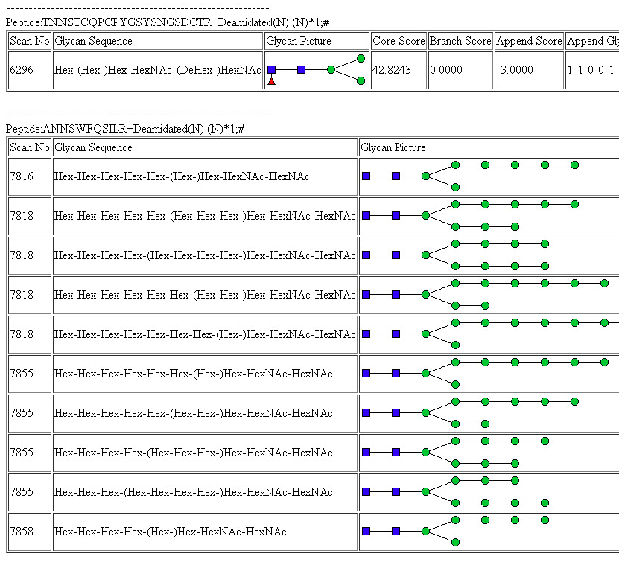
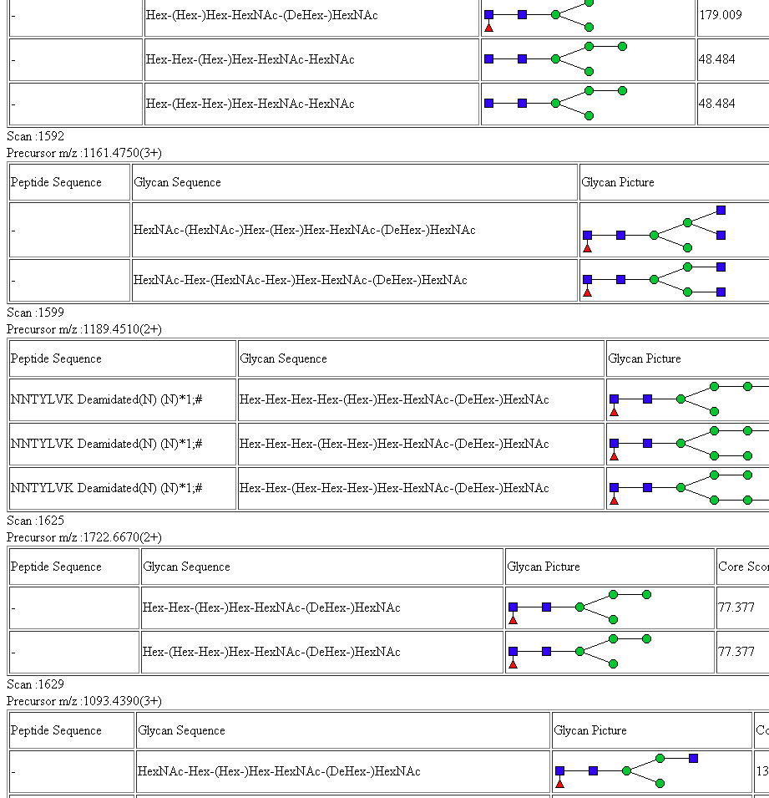
Sort by Scan
Sort by Peptide
Export result contain modification
Peptides from Mascot will have a # tag after sequence in HTML export

Slide 8
2015-07-21
From Chuan-Yih

Slide 9
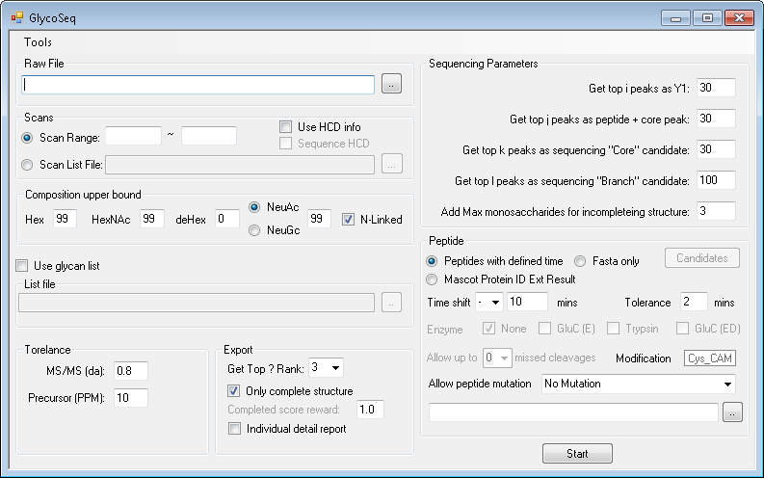
New GlycoSeq
1. Select file type
Note: “Mascot Protein ID Ext” option only accept export file by MascotProteinIDExtractor 1.1
Download Link: https://iu.box.com/s/cp258sftzoapzyymdrt0gejnetrjkorx

Slide 10
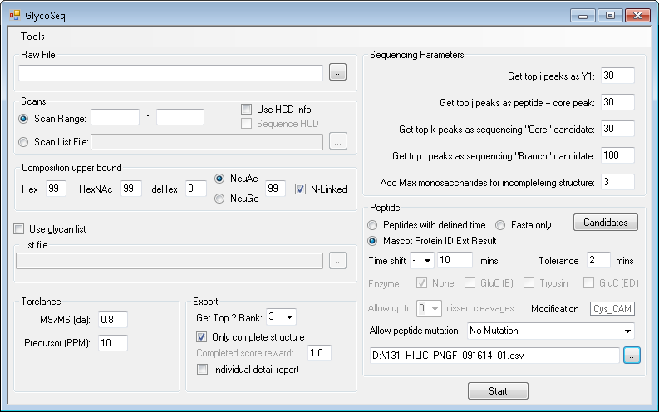
2. Select file

Slide 11
3. View candidates

Slide 12
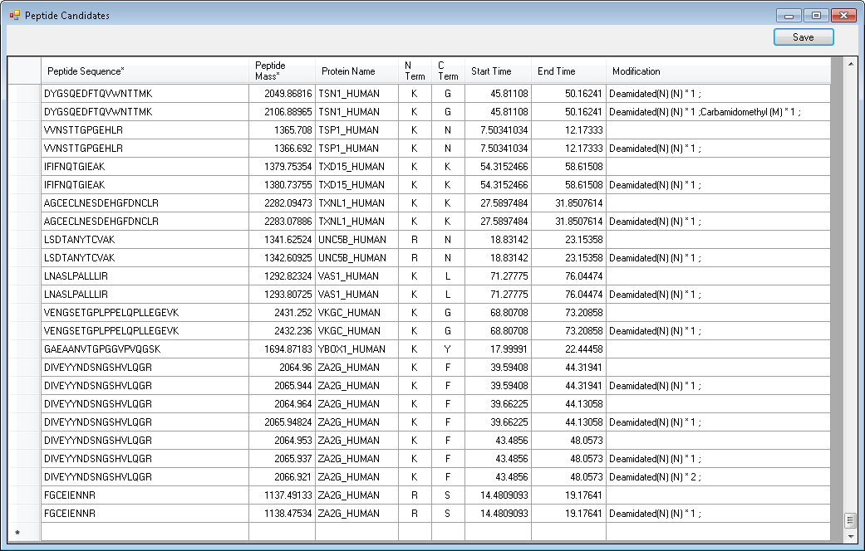
Peptide candidates
Save list
Click here and press “delete” to delete
Double click empty cell to add new candidate (sequence and mass is required)

Slide 13
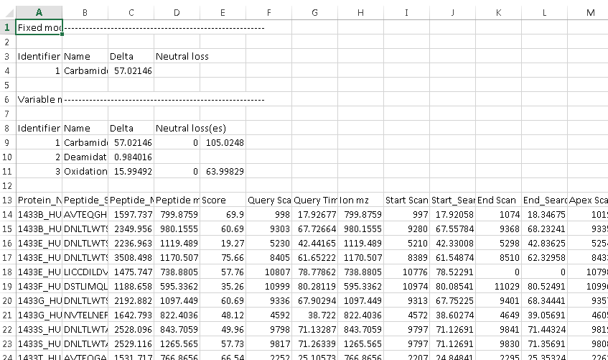
MascotProteinIDExtractor 1.1
Add modification table in export file
Download Link: https://iu.box.com/s/i3ogm247bajt29aku7v5yweegqtgb78h

Slide 14
2015-07-17
From Chuan-Yih

Slide 15
Will the same type of Variable Modifications partial loss
Peptide Sequence
Modifications
TMIGEPMNFVHLTHIGSGEMGAGDGLAMTGAVQEQMR
1:Carbamidomethyl (M);6:Carbamidomethyl (M);
7:Deamidated(N) (N);19:Carbamidomethyl (M);
27:Carbamidomethyl (M);35:Carbamidomethyl (M)
Modified peptide:
Completed modified peptide: TMIGEPMNFVHLTHIGSGEMGAGDGLAMTGAVQEQMR
Partial modified peptide:
1 Carbamidomethyl and No Deamidated
TMIGEPMNFVHLTHIGSGEMGAGDGLAMTGAVQEQMR
TMIGEPMNFVHLTHIGSGEMGAGDGLAMTGAVQEQMR
TMIGEPMNFVHLTHIGSGEMGAGDGLAMTGAVQEQMR
TMIGEPMNFVHLTHIGSGEMGAGDGLAMTGAVQEQMR
TMIGEPMNFVHLTHIGSGEMGAGDGLAMTGAVQEQMR
1 Carbamidomethyl and Deamidated
TMIGEPMNFVHLTHIGSGEMGAGDGLAMTGAVQEQMR
TMIGEPMNFVHLTHIGSGEMGAGDGLAMTGAVQEQMR
…

Slide 16
Should we consider all different combinations?
In this case
2⁶ = 64 peptide?
Or just 2 different type of partial modification
1. With Carbamidomethyl No Deamidated
TMIGEPMNFVHLTHIGSGEMGAGDGLAMTGAVQEQMR
2. No Carbamidomethyl With Deamidated
TMIGEPMNFVHLTHIGSGEMGAGDGLAMTGAVQEQMR

Slide 17
2015-04-20

Slide 18
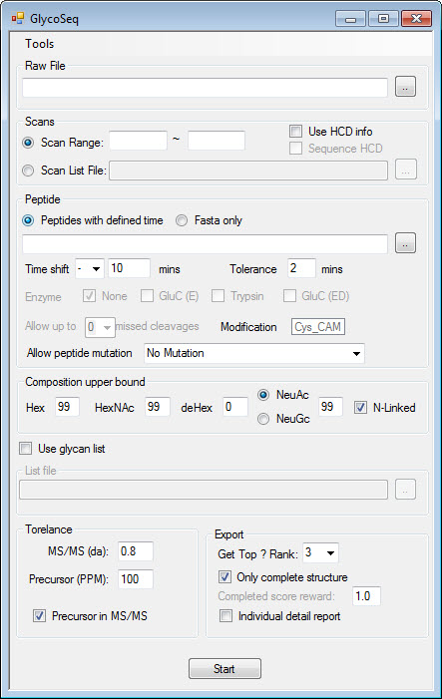
Suggestion setting are shown in the picture
Raw File: Thermo Raw or mzXML
Use HCD Info: if your raw file contain HCD scan, this can help guide CID sequencing
Sequence HCD: sometimes HCD contains glycosidic bond fragments, and can be used for sequencing.
Peptide with defined time: CSV format contain peptide search time information (Page 3) Use “Mascot Protein ID result extractor”
Time shift: plus/minus the time that in CSV defined time file
Tolerance: extend defined search time window
Fasta Only: input protein/peptide sequence in fasta format
Enzyme, missed cleavage: for protein sequence
For peptide fasta choose None and 0
Peptide mutation: generate and add mutated peptides

Slide 19
Composition upper bound: limit the number of glycan in the structure. eg. high mannose sample can be set as the picture shown
Use glycan list: check this bix if you have csv format glycan list
Precursor in MS/MS: if CID contains precursor, it can help for sequencing
Get top: export top n results
Only complete structure: export completed structure
Generate detail report: generate report for each scan (caution : lots of files, and long time)

Slide 20
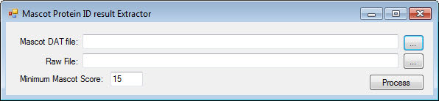
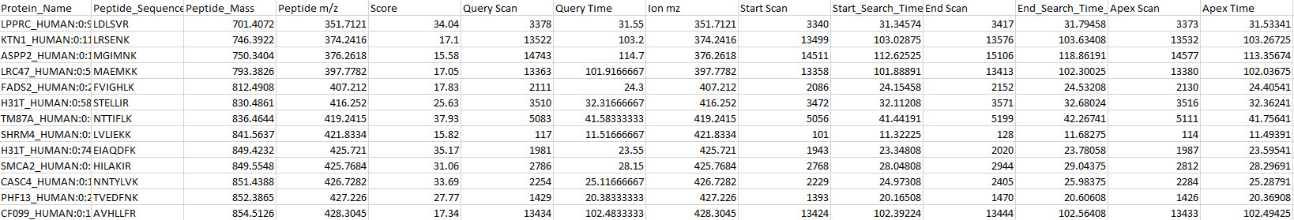
Peptide with defined time
Mascot dat file from mascot server
Raw file that use for Mascot search
This file is needed to construct elution profile for precursor.
Support Thermo RAW only
Export example

Slide 21
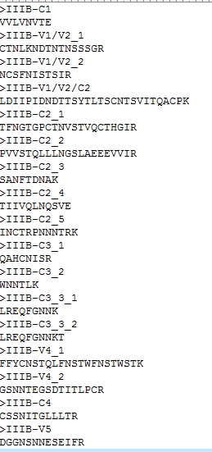
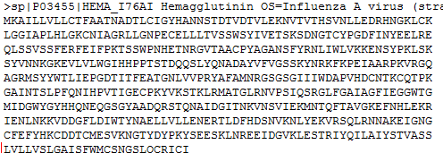
Protein/peptide fasta
Peptide format
Protein format

Slide 22
From TTU

Slide 23
2015-07-28

Slide 24
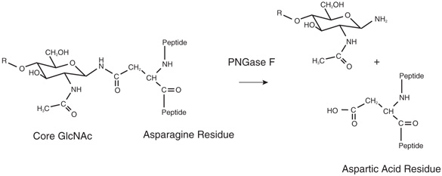
Deamidation of Asparaginec
In general, when Asparagine residue is deamidated, the amine group (-NH2) of Asparagine residue is replaced by a hydeoxyl group (-OH). Therefore, the deamidation process results in a +0.9840 mass shift.
In our samples, there are two ways to have a deamidation modification on Asparagine residue. One is due to the PNGase F digestion, another is a natural process which could occur in the sample preparation. Both of them will result in a +0.9840 mass shift on N. However, PNGase F will only modify the N when it is linked with a N-glycan. In other words, PNGase F will only modify the N in the NXS/T motif.

Slide 25
MASCOT Search of Deamidation of Asparagine
In MASCOT search, we can not distinguish the two type of deamidation. We only search for +0.9840 mass shift on N residues. Therefore, it will create a problem with the glycopeptide mass calculation.
In general, the glycopeptide mass = peptide mass + glycan mass – H2O (18.0105).
For example, the mono isotopic mass of glycopeptide NLTK+2500 =
474.2802 (peptide mass) + 2*203.0794 +5*162.0528 +18.0105(glycan mass) – 18.0105 = 1690.7030
However, in the PNGase F sample, since all the N-linked glycosylation site was deamidated, all the occupied NXS/T motifs are changed to DXS/T. Therefore, the MASCOT result of calculated peptide mass is off by 0.9840.
For example, the mass of SLVTQYLNATGNR is 1435.7419. When you calculate the glycopeptide mass of this peptide backbone, you should use 1435.7419 as your peptide backbone mass. However, in the MASCOT search file, the mass is 1436.7259 (1435.7419+0.9840). If you use 1436.7259 as the peptide mass, the result will be off by 0.9840.
pep_calc_mr | pep_res_before | pep_seq | pep_res_after | pep_var_mod | pep_var_mod_pos
1436.726 | K | SLVTQYLNATGNR | W | Deamidated(N) (N) | 0.0000000200000.0

Slide 26
If the deamidation is not caused by PNGase F, then you will take the +0.9840 in you calculation of glycopeptides.
For example, peptide TVTISDHGTVTYN(1)GSICGDDQN(2)GPK has 2 Ns. N(1) is a glycosylation site, N(2) is not. In the MASCOT result, two forms of deamidation are detected. One is only N(1) deamidation, the other is both site deamidation.
pep_calc_mr | pep_res_before | pep_seq | pep_res_after | pep_var_mod | pep_var_mod_pos
2636.166 | K | TVTISDHGTVTYNGSICGDDQNGPK | I | Deamidated(N) (N) | 0.0000000000002000000000000.0
2637.15 | K | TVTISDHGTVTYNGSICGDDQNGPK | I | 2 Deamidated(N) (N) | 0.0000000000002000000002000.0
In this case, N(1) deamidation is due to PNGase F digestion, while N(2) deamidation is a random natural process.
Therefore, when you calculate the glycopeptide mass, for the N(1) deamidation form, the peptide backbone mass is 2635.1820 (2636.166-0.9840).
For the N(1)&N(2) deamidation form, you do NOT substract 2*0.9840, because the N(2) deamidation is not caused by PNGase F. The mass of the second peptide backbone is 2636.166 (2637.15-0.9840).

Slide 27
Extra Rule
Since the PNGase F will digest the N-glycan from the N residue and change it to D through deamidation (+0.9840). We consider this reaction is 100% complete. Therefore, for any peptide has the motif NXS/T, if the N in the motif is not deamidation in the PNGase F sample, we will consider this glycosylation site is not occupied. Therefore, this peptide could be eliminate from the candidate list.
In addition, since the N deamidation could occur during sample preparation, we would like N deamidation to be a variable modification.

Slide 28
Summary
For any peptide from the MASCOT result,
AAAAAN(1)XS/TAAAAAN(2)AMAACAAK,
For N residue,
i. If N(1) is not detected to be deamidated, then exclude this peptide from candidate list.
ii. If N(1) is deamidated, no matter the N(2) deamidated or not, then take the mass from “pep_calc_mr” column and substract 0.9840 as the peptide back bone mass.
iii. If there are multiple N(1)s (glycosylation sites) detected, x of the N(1)s are deamidated, then take the mass from “pep_calc_mr” column and substract x *0.9840 as the peptide back bone mass.
iv. For N(2) deamidation, please treat it as a variable modification. (If only deamidated N(2) is detected, then create an native one (-0.9840). If only native N(2) is detected, then create a deamidated one(+0.9840))
For M residue,
i. If M is detected as native M, then create a variable modification of O (+15.9949).
ii. If M is detected as oxidation form, then create a variable modification of native form (-15.9949).
iii. If M is detected as Carbamidomethylated M, then create the native form (-57.0215) and the oxidated form
(-57.0215+15.9949).
For C residue,
Always keep Carbamidomethylated C as a fixed modification.

Slide 29
2015-04-20

Slide 30
MS/MS spectra peak list
Next i
Take top i th intense peak as Y1
Next i
No
No
Look for Y1 + 1 HexNac + 3 Hex
In top j intense peak list
Look for Y1 + 1 HexNac + 3 Hex + Fuc
In top j intense peak list
Yes
Yes
Build Structure from Y1 to Y1 + 1 HexNac + 3Hex or
From Y1 toY1 + 1 HexNac + 3 Hex + Fuc
Accept peaks in top k intense peak list
Score 1
Build Structure from pep + core strcutrue to precursor mass
Accept peaks in top l intense peak list
Score 2
Complete structure
Incomplete structure
Calculate theoretical peptide mass using [precursor mass – glycan mass] (10ppm tol)
Calculate missing structure using [x= precursor mass – the largest assigned incomplete structure ] (0.8 Da tol)
Match x with 1~ m monosaccharides (0.8 Da tol)
Look for peptide in the preloaded list (10ppm tol)
Yes
Score 3
No
Treat the spectra as
“Complete structure”
Yes
No
Output result with score as:
Pep + glycan + score
Output result with score as:
UnkownPep + glycan + score
Calculate theoretical peptide mass using [precursor mass – glycan mass] (10ppm tol)
Look for peptide in the preloaded list (10ppm tol)
Yes
No
Output result with score as:
Pep + glycan (incomplete) + score
Output result with score as:
UnkownPep + glycan (incomplete) + score

Slide 31
Parameter i, j, k, l, m is better to be an input parameter, so we can change it to test the best setting.
Score 1: score based on fragment peaks between Y1 and pep+core
Score 2: score based on fragment peaks between pep+core and precusor
Score 3: a negative score, the more monosaccharides needed to match x the lower the score is.
Score 1, 2, 3 are independent output.

