Slide 1
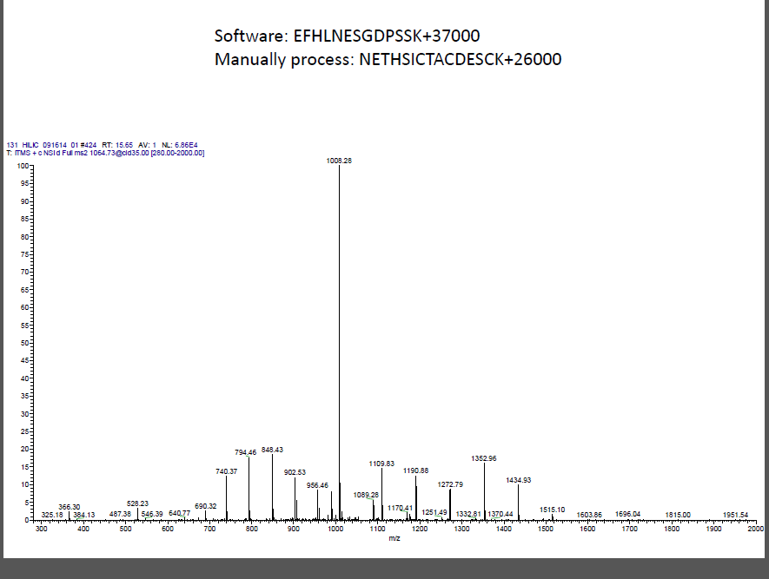

Slide 2
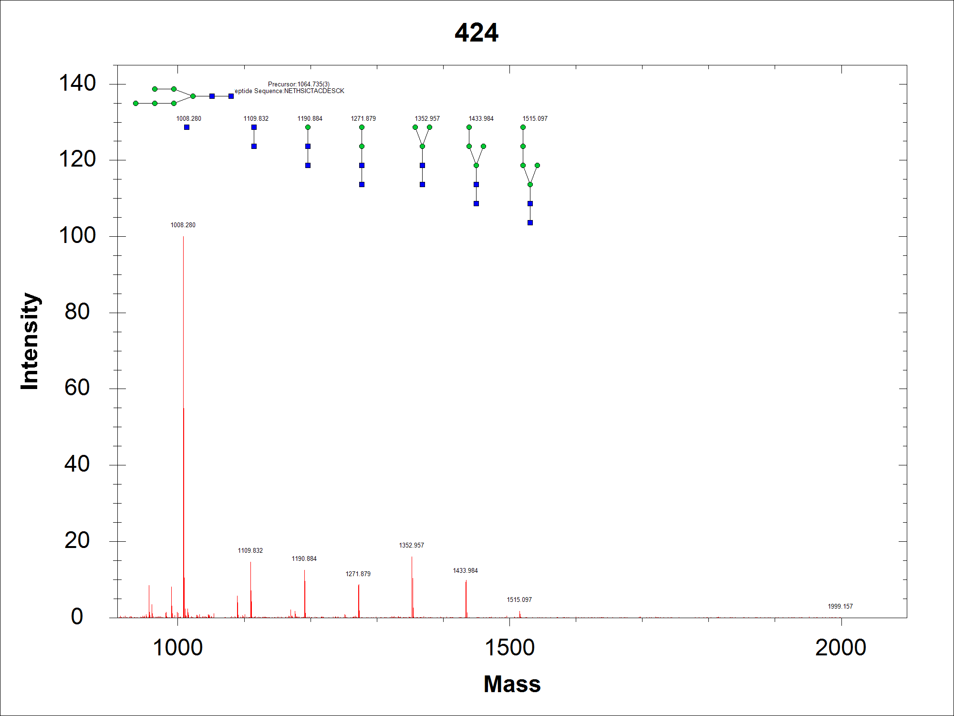
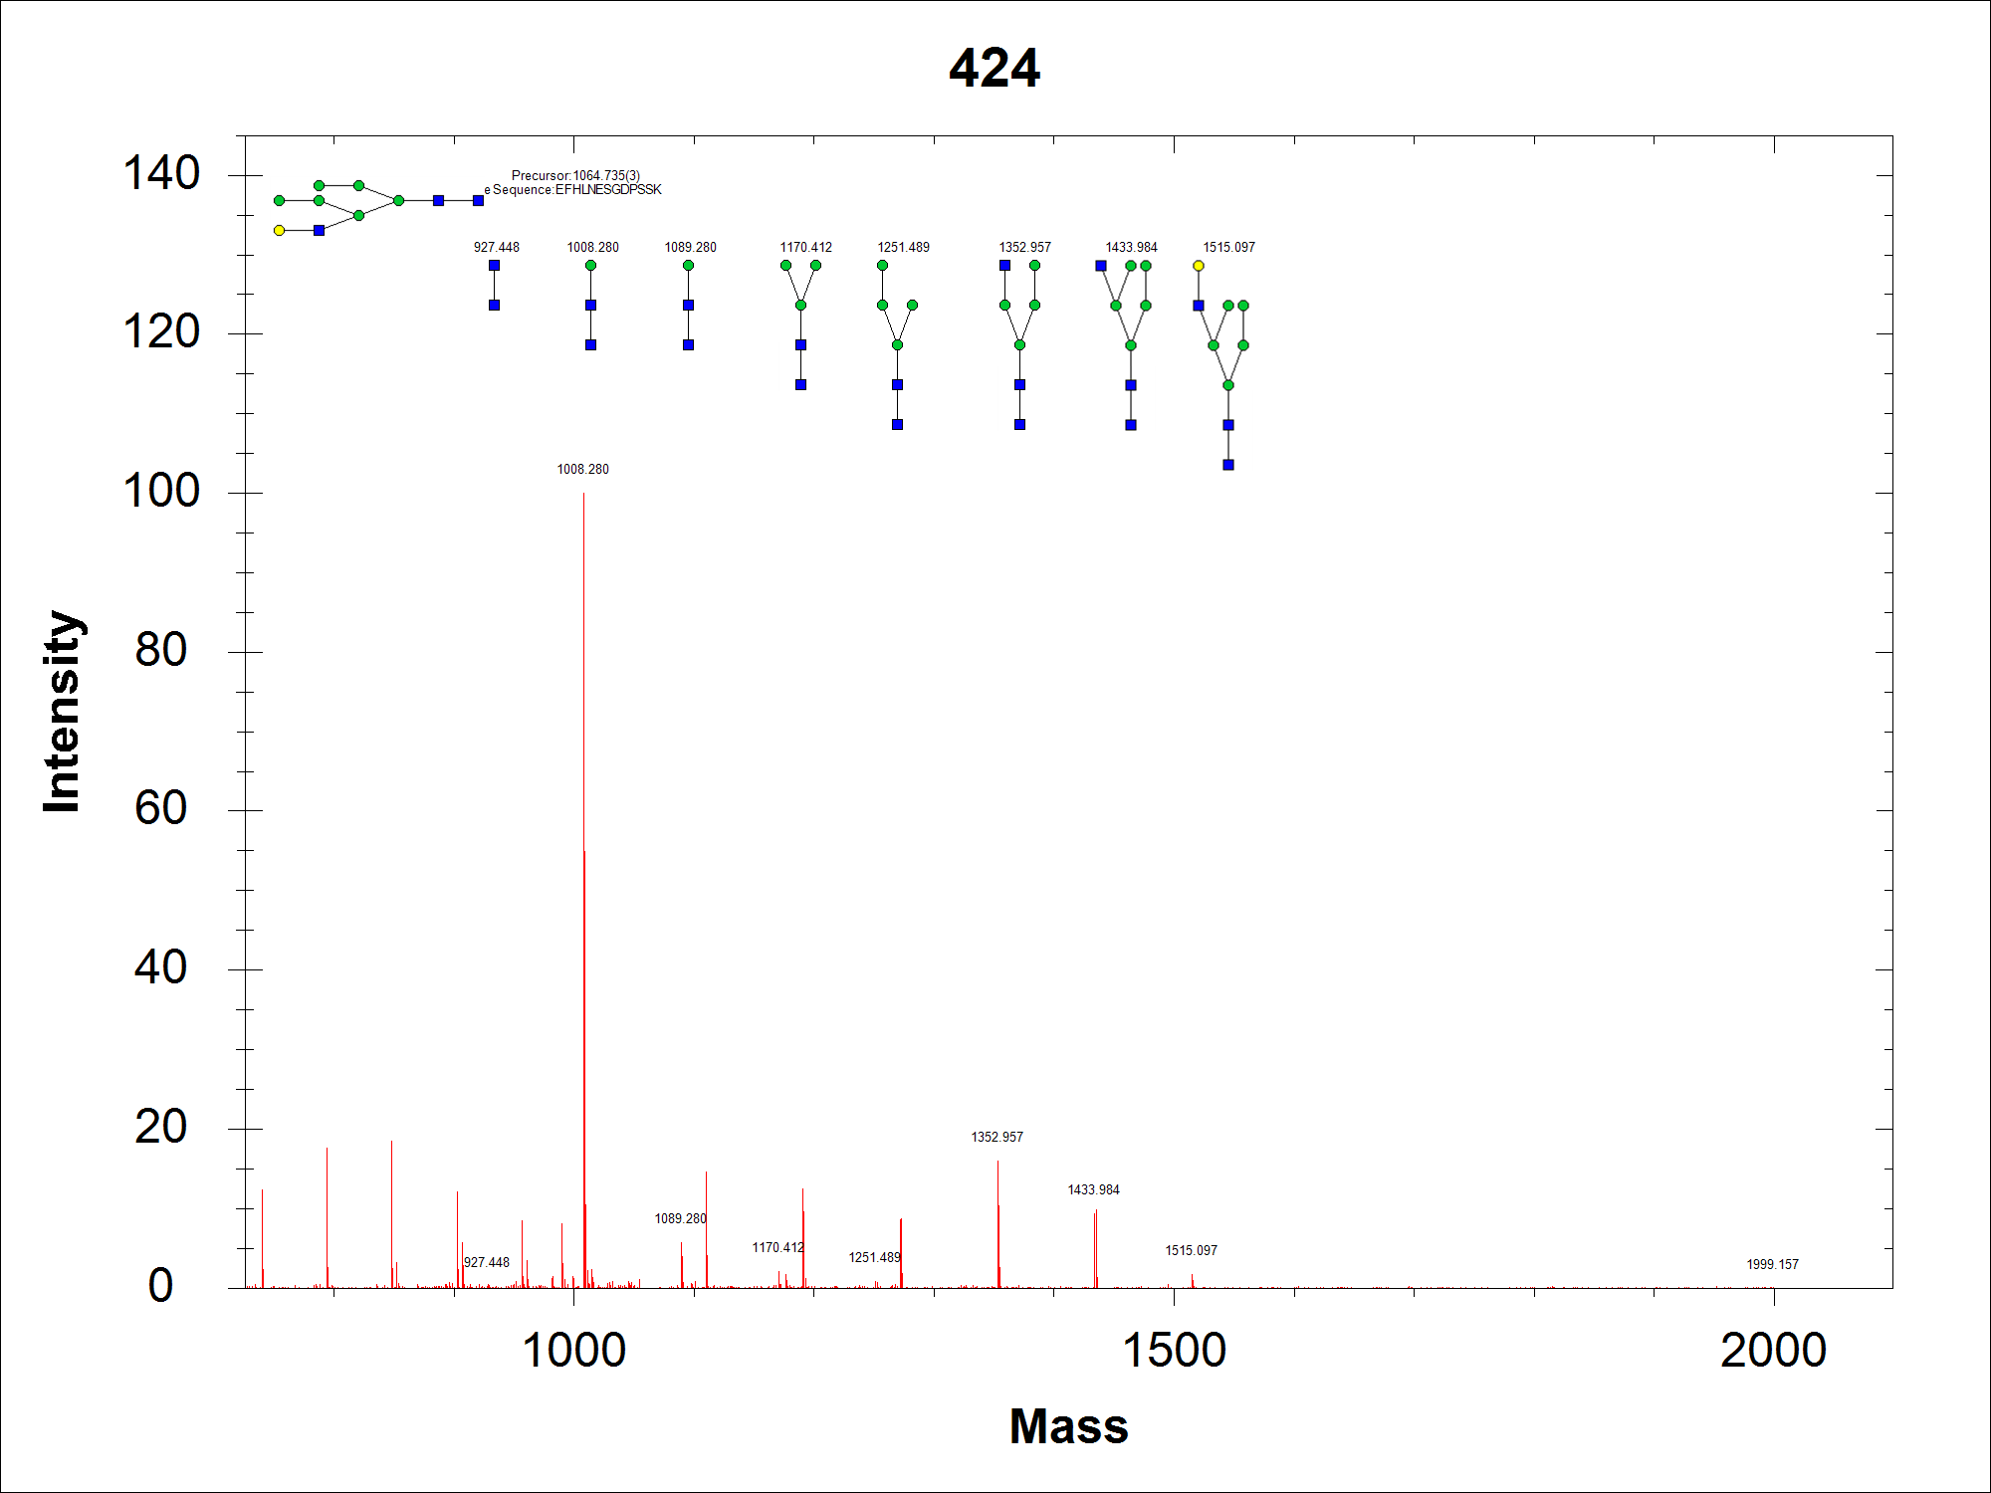
NETHSICTACDESCK + 26000 Score:16.59
This peptide has Mascot score 14, so didn’t include in csv file. If I include this peptide, the sequencing result is correct.
EFHLNESGDPSSK+37000 Score:11.14
Both glycopeptides are completed.

Slide 3
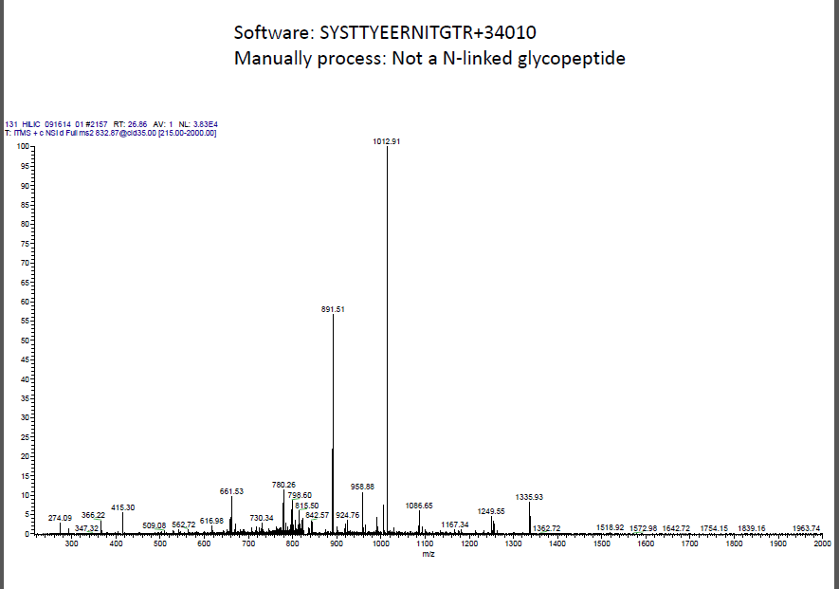

Slide 4
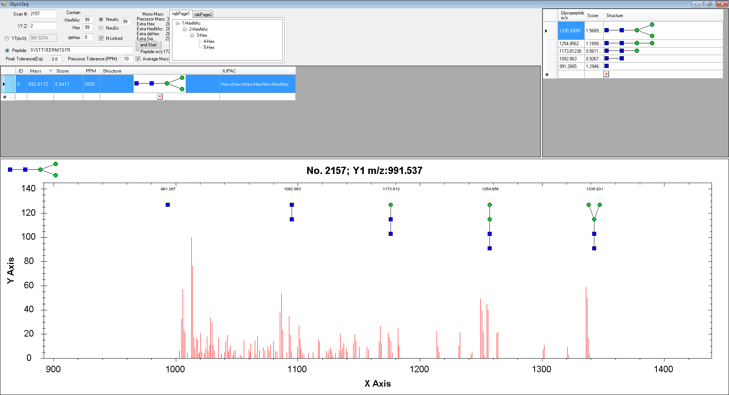
I can’t find the result that you refer.
SYSTTYEERNITGTR+34010

Slide 5
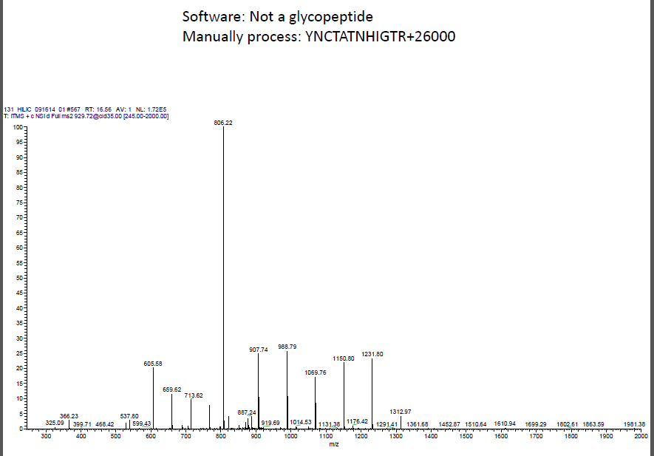

Slide 6
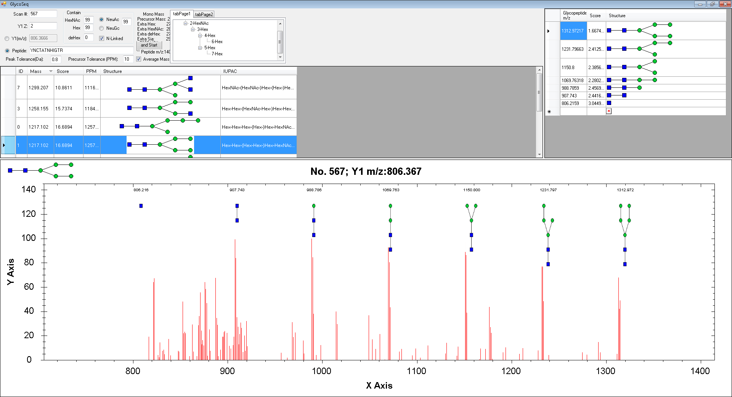
I can’t get completed sequencing for this one, so if you check “completed only” it won’t show in result.
This one has very high sequencing score 16.7.

