Slide 1
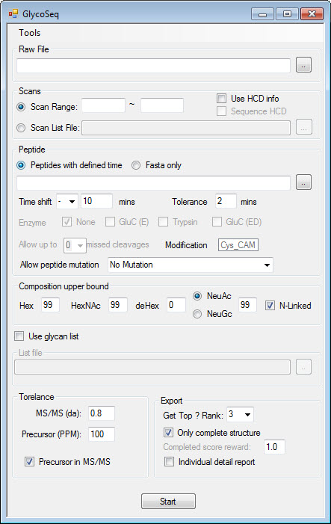
Suggestion setting are shown in the picture
Raw File: Thermo Raw or mzXML
Use HCD Info: if your raw file contain HCD scan, this can help guide CID sequencing
Sequence HCD: sometimes HCD contains glycosidic bond fragments, and can be used for sequencing.
Peptide with defined time: CSV format contain peptide search time information (Page 3) Use “Mascot Protein ID result extractor”
Time shift: plus/minus the time that in CSV defined time file
Tolerance: extend defined search time window
Fasta Only: input protein/peptide sequence in fasta format
Enzyme, missed cleavage: for protein sequence
For peptide fasta choose None and 0
Peptide mutation: generate and add mutated peptides

Slide 2
Composition upper bound: limit the number of glycan in the structure. eg. high mannose sample can be set as the picture shown
Use glycan list: check this bix if you have csv format glycan list
Precursor in MS/MS: if CID contains precursor, it can help for sequencing
Get top: export top n results
Only complete structure: export completed structure
Generate detail report: generate report for each scan (caution : lots of files, and long time)

Slide 3
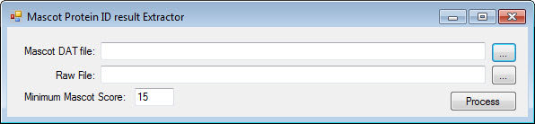
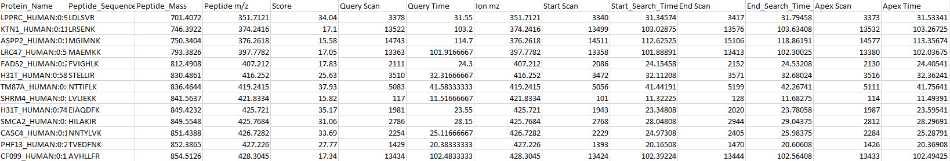
Peptide with defined time
Mascot dat file from mascot server
Raw file that use for Mascot search
This file is needed to construct elution profile for precursor.
Support Thermo RAW only
Export example

Slide 4
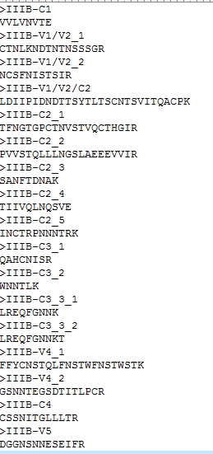
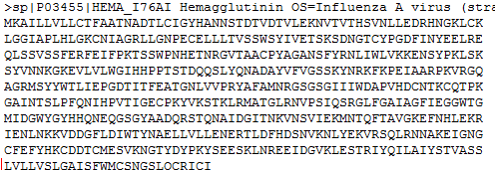
Protein/peptide fasta
Peptide format
Protein format

