Slide 1
Multiglycan

Slide 2
Index
From Chuan-Yih
2015-08-14 2015-07-23 2015-05-02 2015-05-01 2015-04-03 2015-03-25
From TTU
2015-07-16 2015-04-03 2015-03-31

Slide 3
From Chuan-Yih

Slide 4
2015-08-14

Slide 5
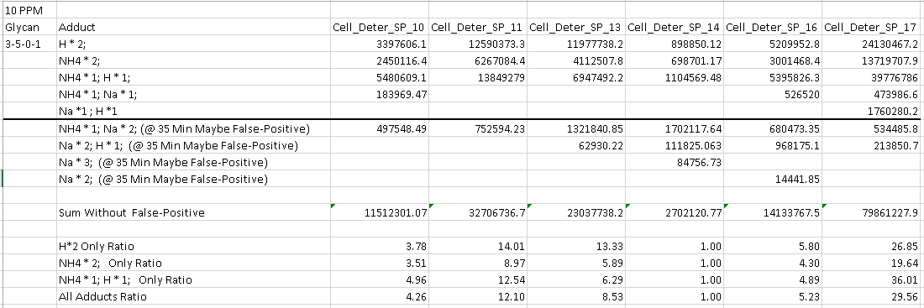
Response to: 2015-07-16

Slide 6
2015-07-23

Slide 7
Batch mode issue
I was able to finish 54 raw files on a 4 GB (3GB available) Windows 7 32 bits computer.
All graphs are generated
Can not replicate issues in your end
Advice: change another pc or re-install OS to run

Slide 8
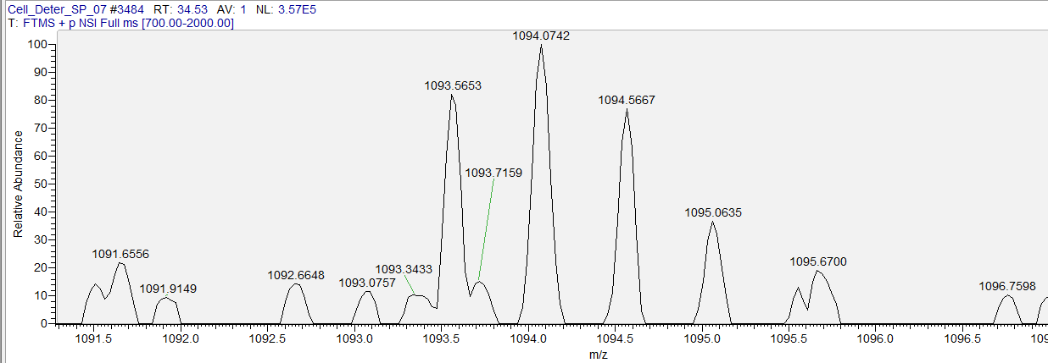
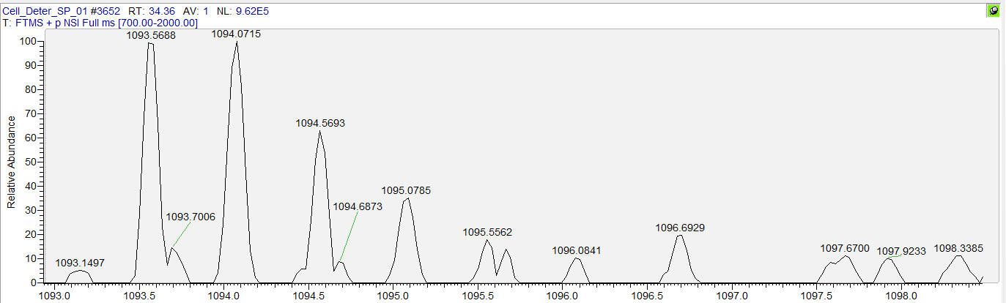
Peak picking problem ~ Missing peak
☒ Can’t find Peak
1093.5653 + 0.5 = 1094.0653 (expect 2nd mono)
1094.0742 - 1094.0653 =~ 8.14 PPM > 6 PPM (Peak picking threshold)
☑ Found Peak
1093.5688 + 0.5 = 1094.0688 (expect 2nd mono)
1094.0715 - 1094.0688 =~ 2.46 PPM < 6 PPM (Peak picking threshold)

Slide 9
Peak picking problem ~ Missing peak
6 PPM is suggested by Shiyue
Some PPM between expected 2nd/3rd isotope peak and observed peak can greater than 10 PPM
The ways to solve this problem are
Give a wider threshold
Match mono only (no isotope pattern matching)
This also could result in quantitation inaccuracy.

Slide 10
2015-05-02

Slide 11
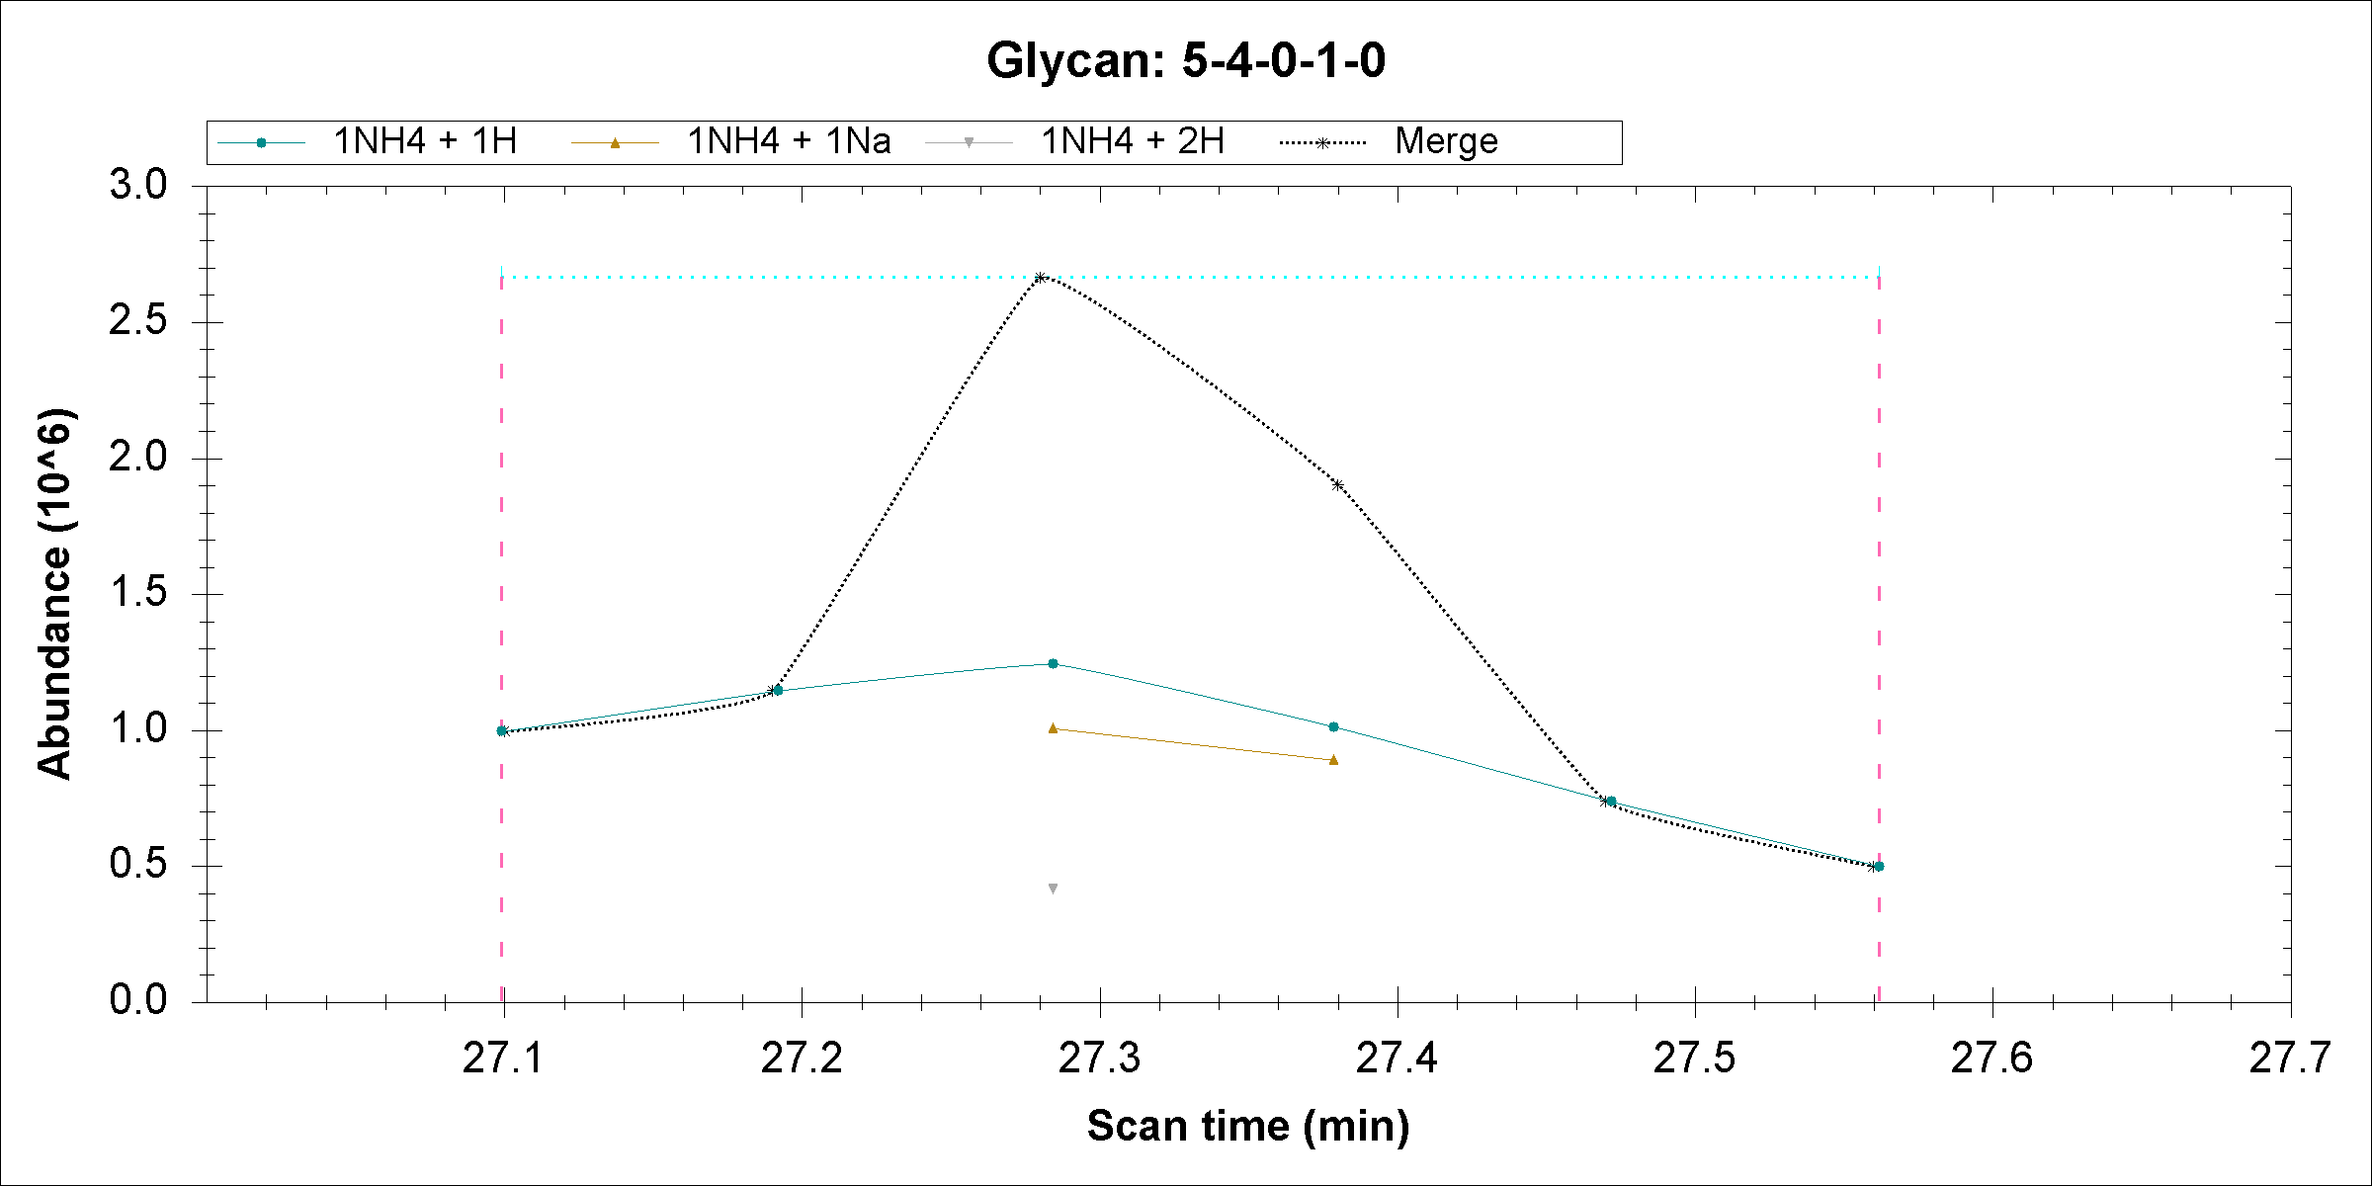

Slide 12
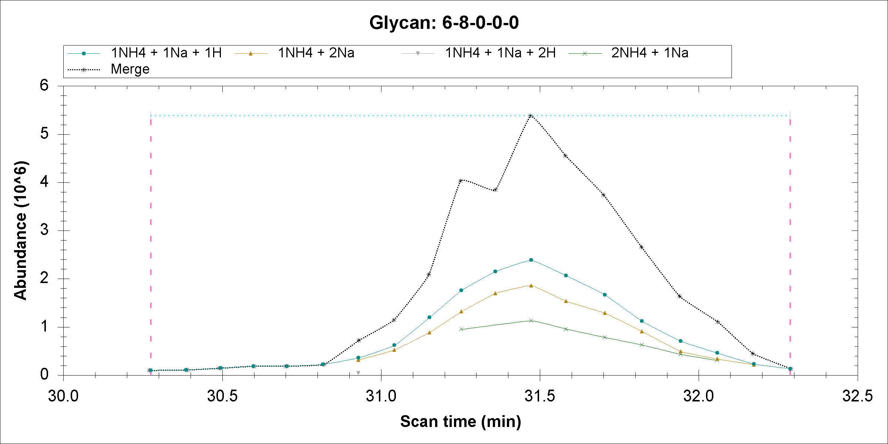

Slide 13
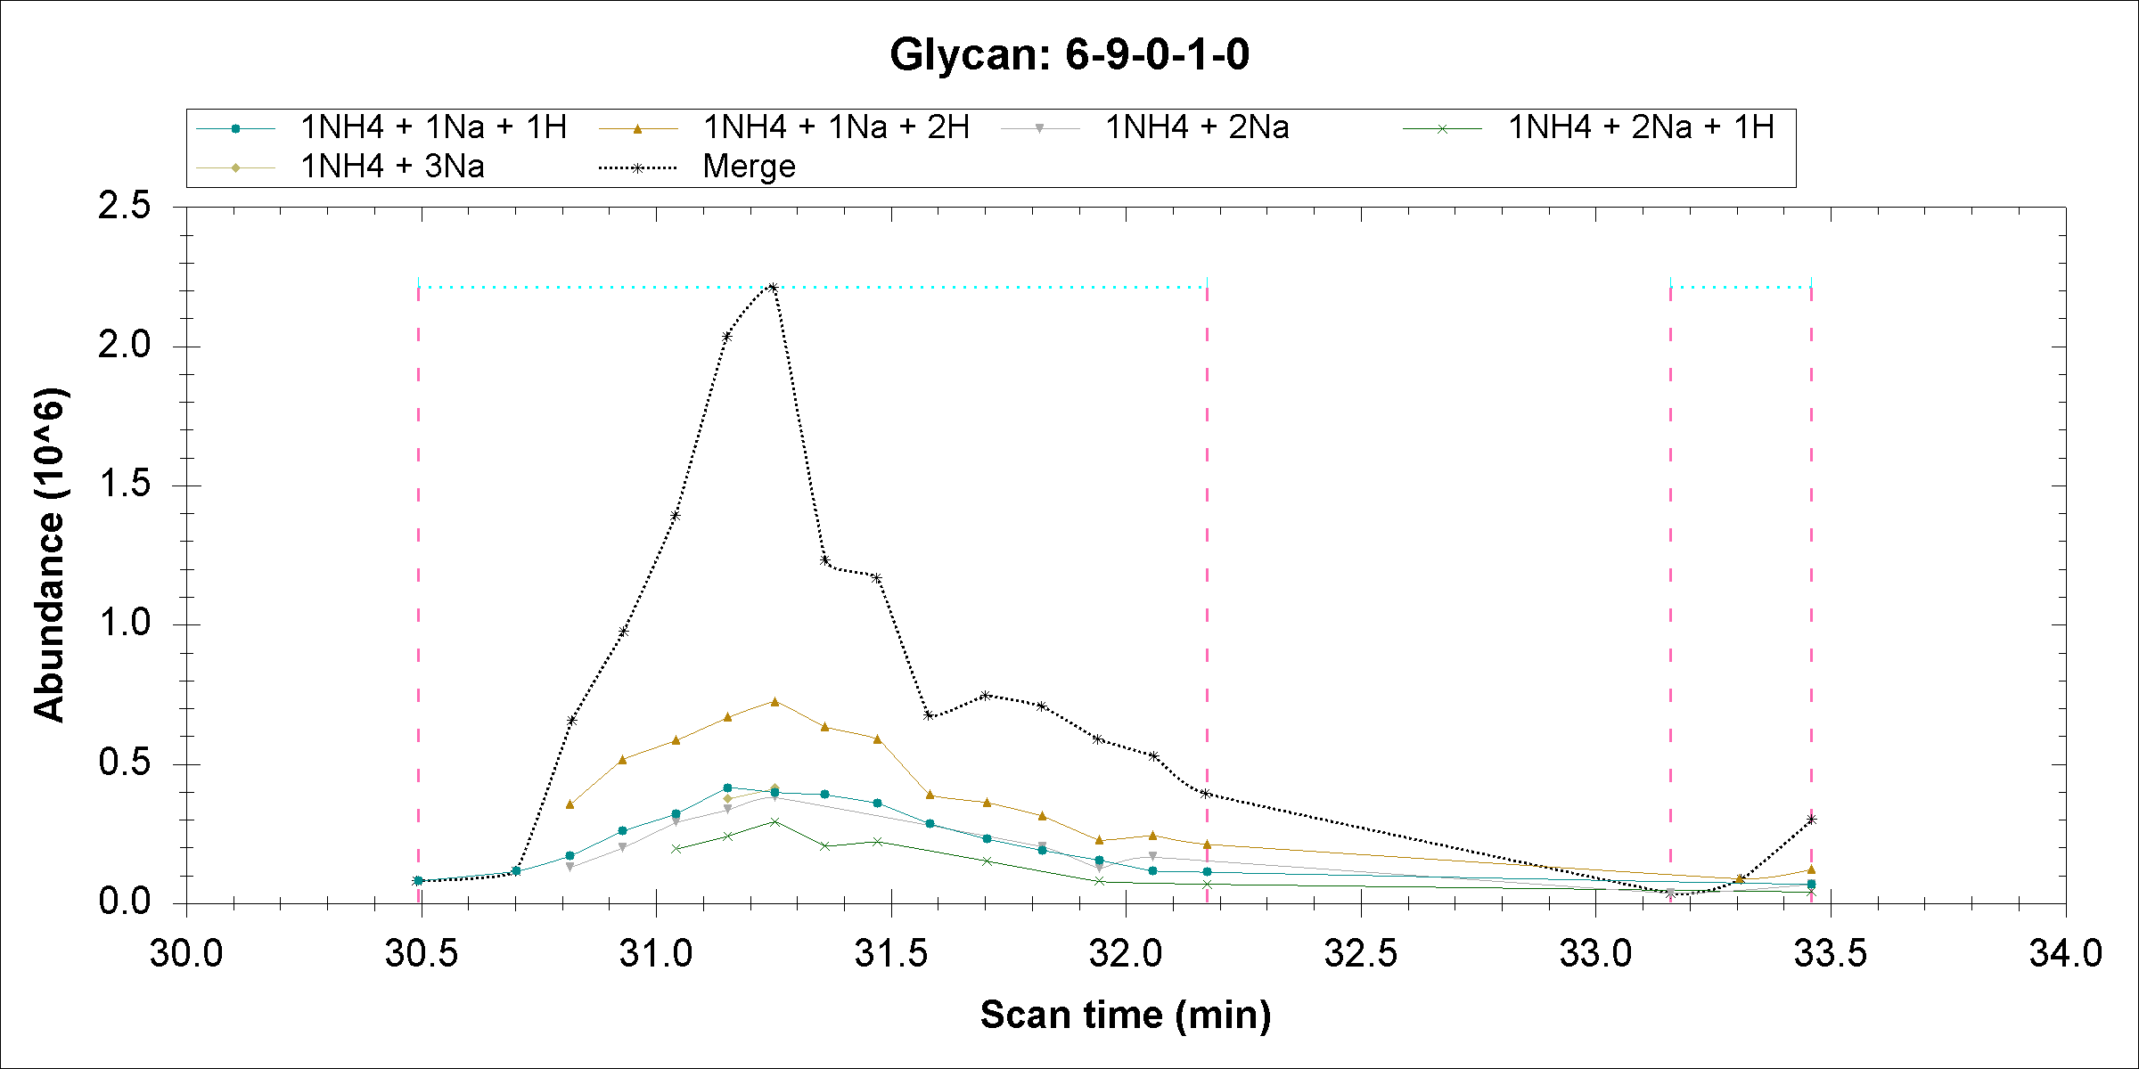

Slide 14

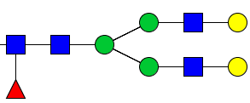

Close mass due to adducts
+ =378.1890
+ NH3 =378.2002
Mass difference=0.0112, if permethylated glycan mass is ~3000 Da, then the difference is ~3.7ppm, which can not be resolved by our MS method.
For example
V.S.
[M+2H]2+
1119.5905
[M+H+NH4]2+
1119.5961

Slide 15
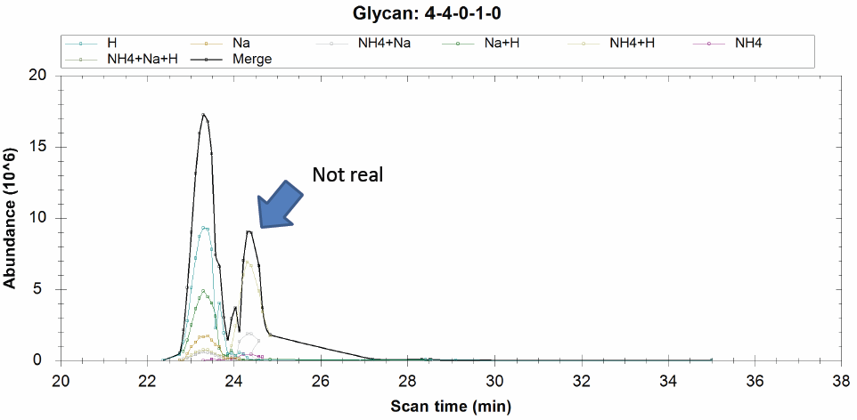

Since this is from glycan: 4-5-1-0-0, this glycan has the retention time as 24.3

Slide 16
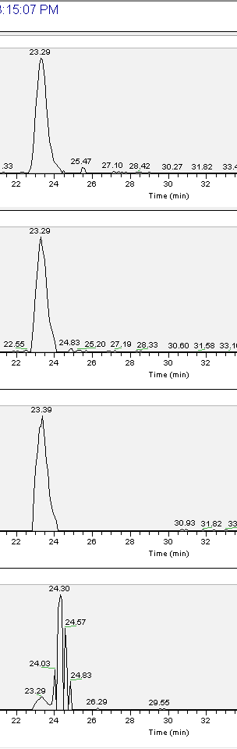
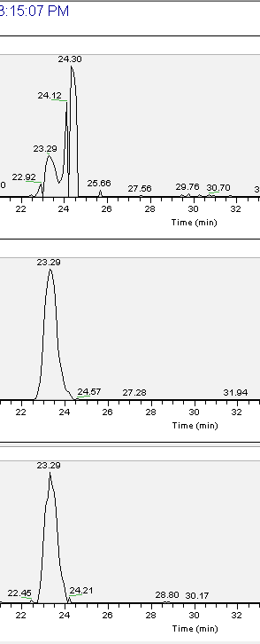
1111.08 H*2 ;
1130.585 NH4*1 ;Na*1 ;
[M+H+Na]2+
1122.072 Na*1 ;H*1 ;
741.056 H*3 ;
1133.063 Na*2 ;
748.3835 Na*1 ;H*2 ;
1119.594 NH4*1 ;H*1 ;
[M+2H]2+

Slide 17
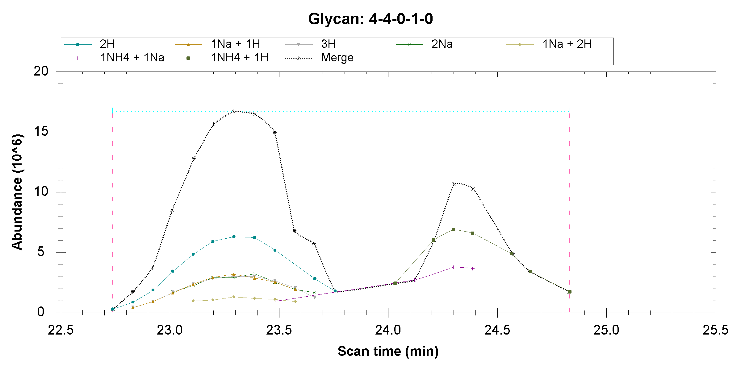
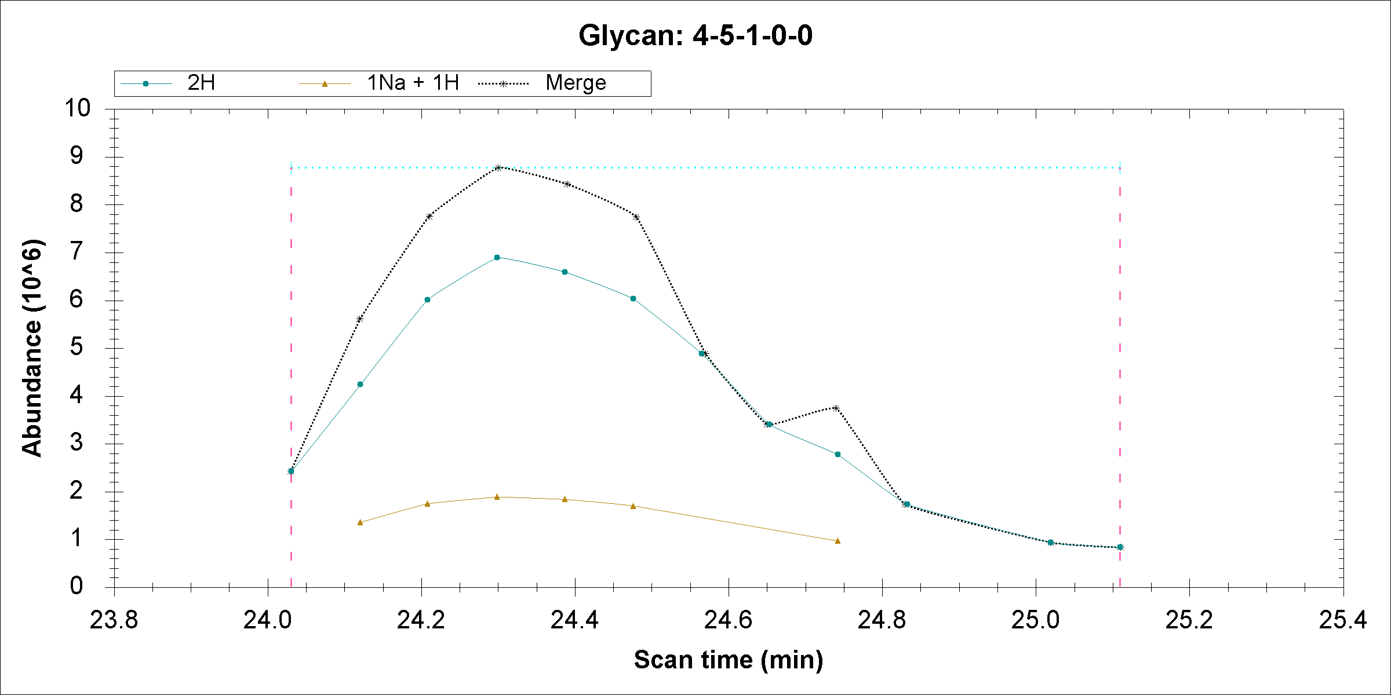
Observed m/z | 4-4-0-1 |  | 4-5-1-0-0
1119.589 | NH4*1,H*1 | 1119.594 (Δ=0.005 PPM 4.4) | H*2 | 1119.588 (Δ=0.001 PPM 0.89)
1130.57959 | NH4*1 ;Na*1 | 1130.5851 (Δ=0.00551 PPM 4.9) | Na*1 ;H*1 | 1130.579 (Δ=0.00059 PPM 0.52)
Indeed, these m/z can be matched to two different glycans, however 4-5-1-0 has smallest delta and more reasonable elution time. Currently my program report these two glycans and merge them into different glycan. So the peaks are counted twice. I will modify my program to solve this problem.

Slide 18
2015-05-01

Slide 19
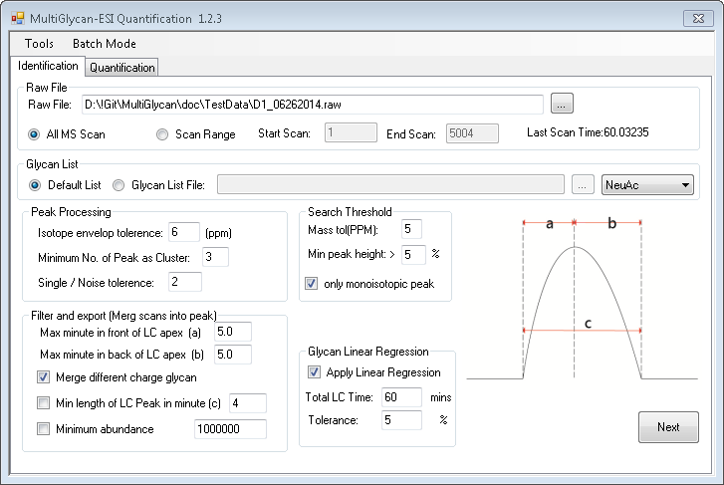
New updated
Only use relative abundance above this value

Slide 20
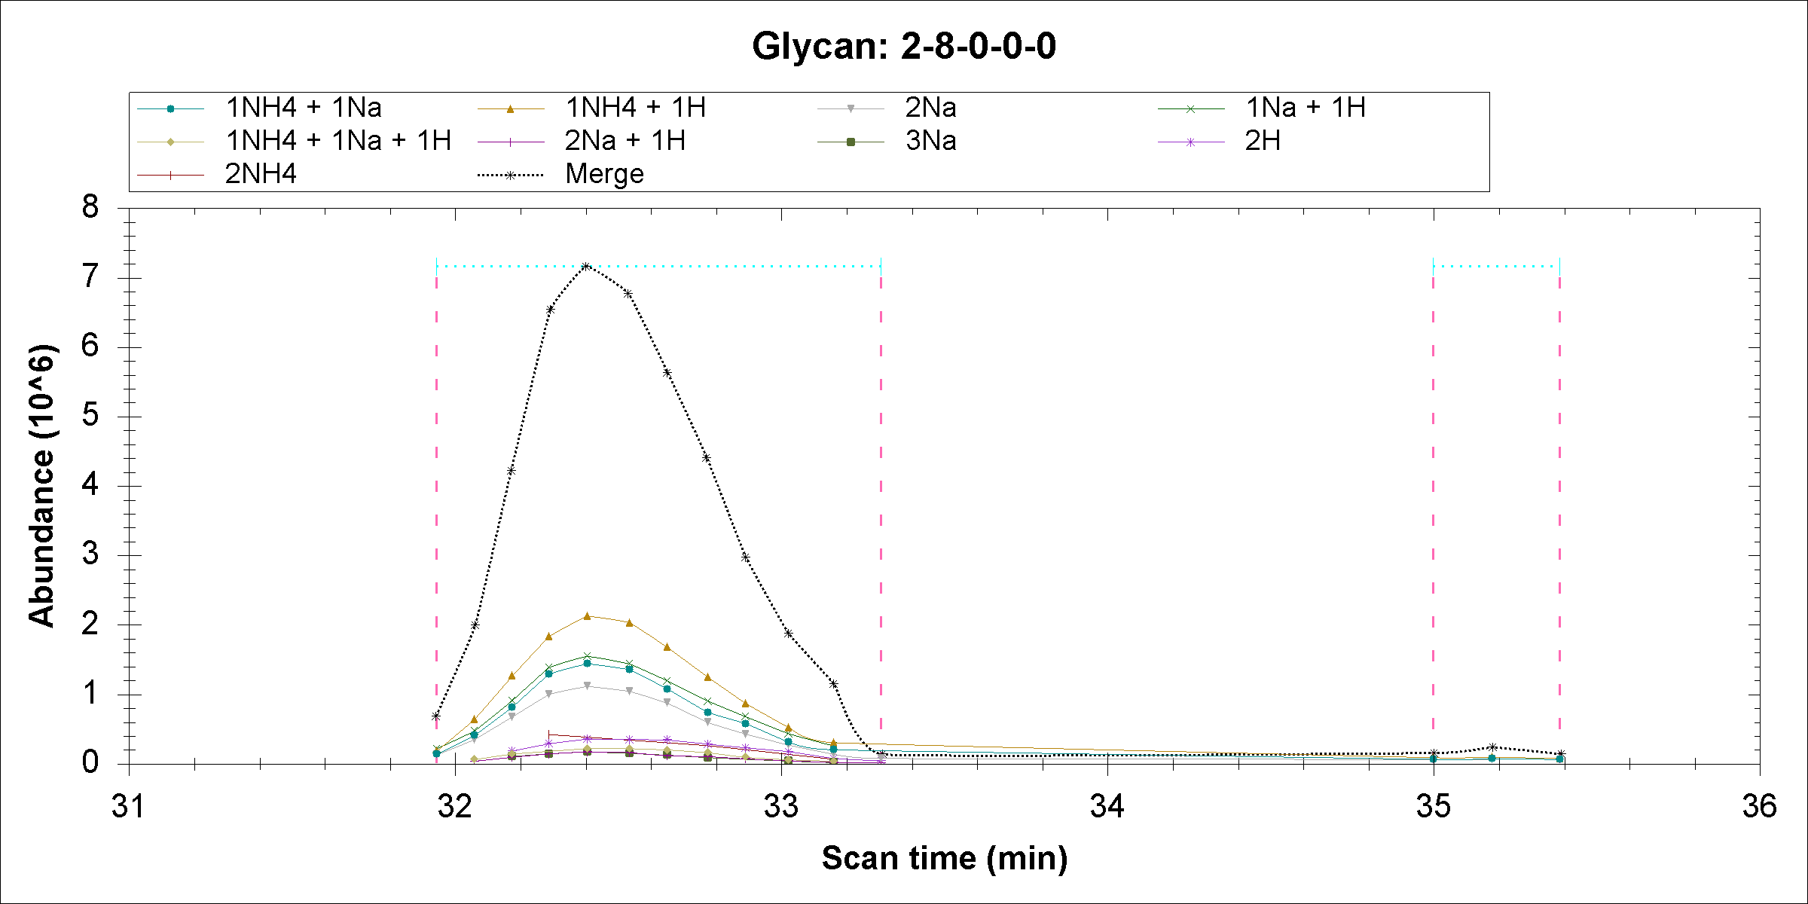
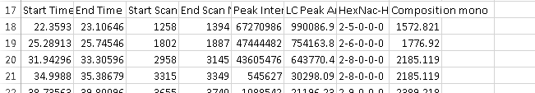
Illustrate peak range

Slide 21
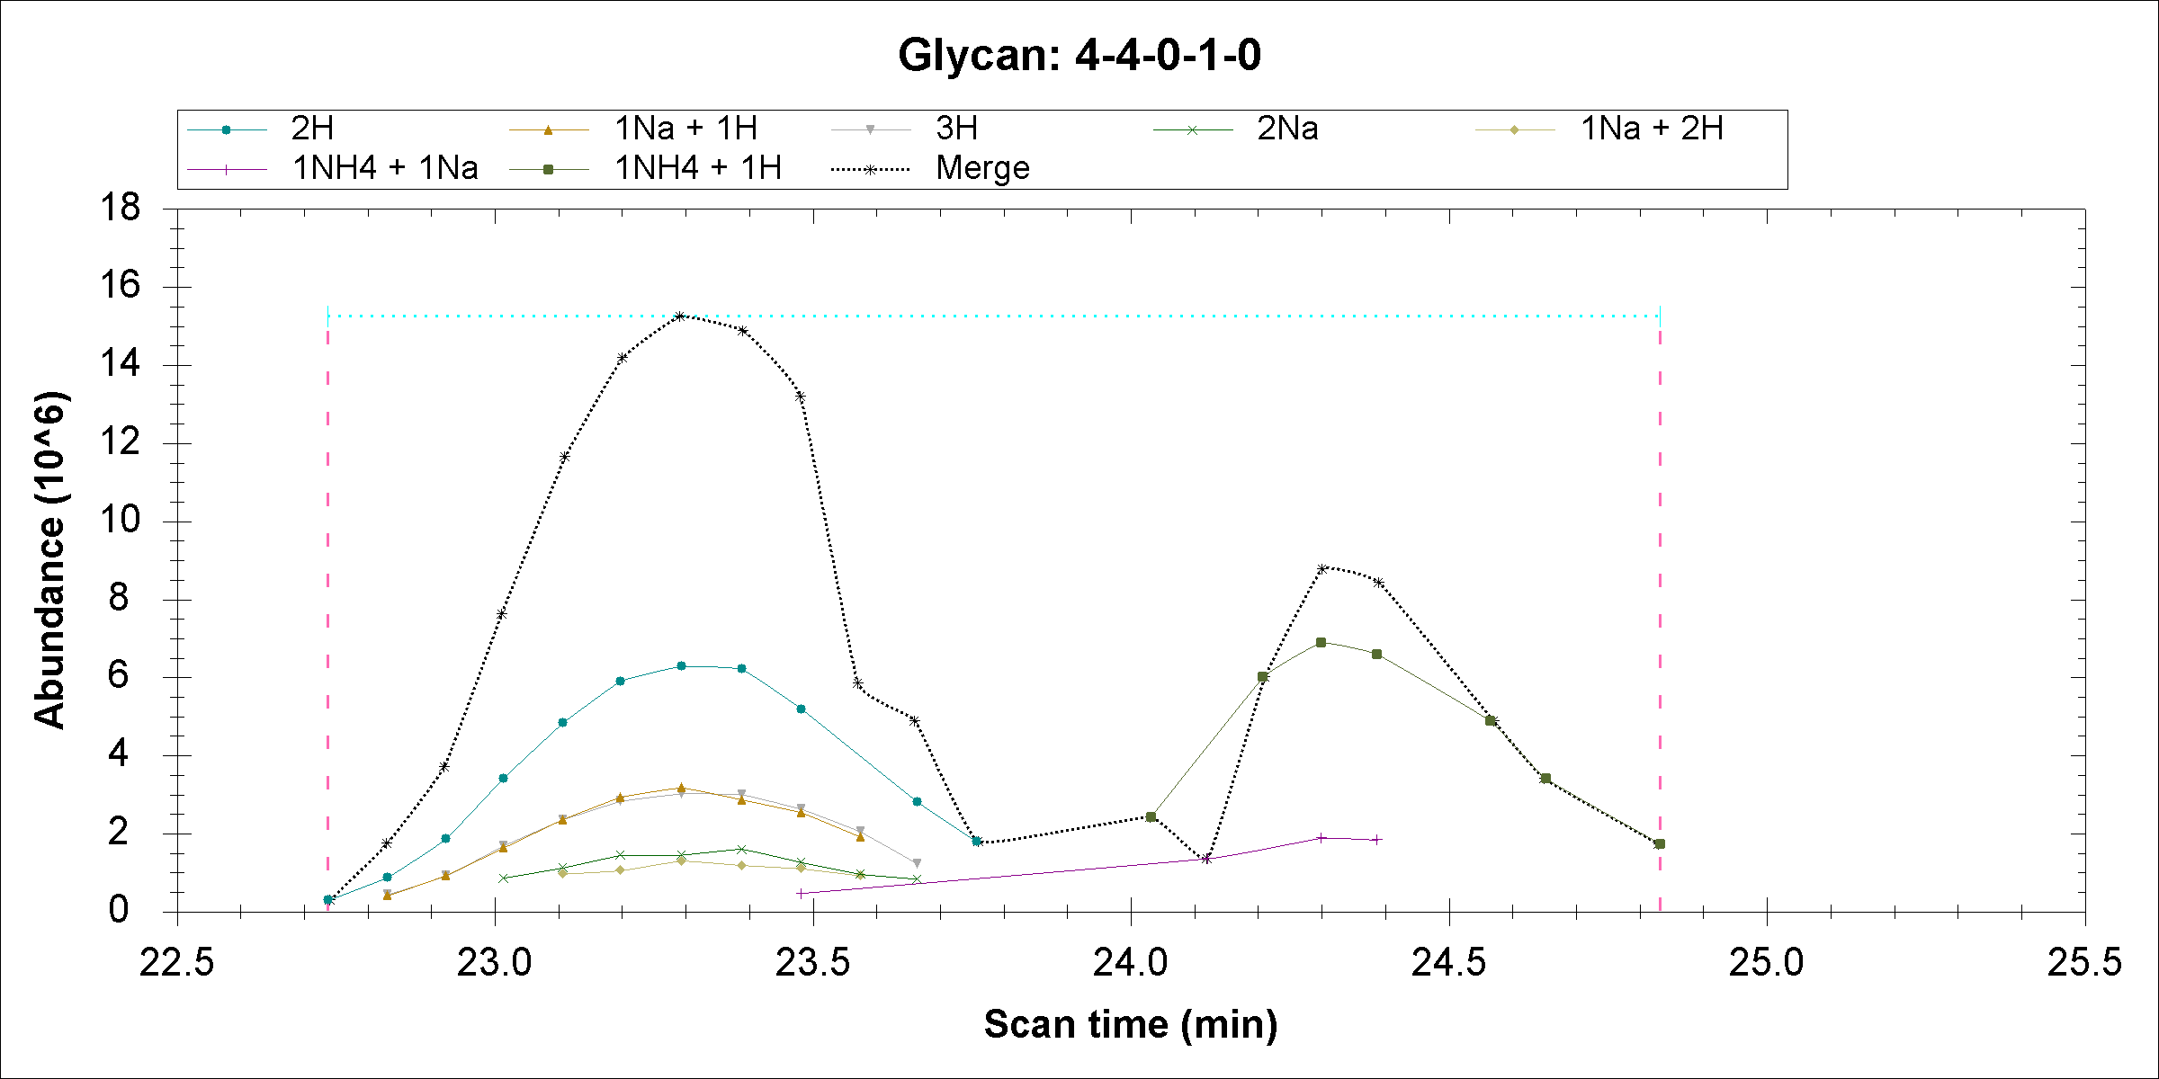
 |  |  | PPM
1111.074 | 6-7-0-4-0 | NH4*2 ;H*2 ; | 5.400151204
1111.08 | 4-4-0-1-0 | H*2 ; | 0
1111.098 | 10-8-1-0-0 | K*2 ;Na*2 ; | 16.20045361
1122.066 | 6-7-0-4-0 | NH4*2 ;Na*2 ; | 5.347250444
1122.072 | 4-4-0-1-0 | Na*1 ;H*1 ; | 0
1122.109 | 8-9-1-1-0 | K*1 ;NH4*3 ; | 32.97471107
1133.013 | 9-9-0-4-0 | K*2 ;NH4*2 ;H*1 ; | 44.12817293
1133.063 | 4-4-0-1-0 | Na*2 ; | 0
1133.084 | 7-9-1-2-0 | NH4*1 ;H*3 ; | 18.53383263
1119.588 | 4-5-1-0-0 | H*2 ; | 5.359085526
1119.594 | 4-4-0-1-0 | NH4*1 ;H*1 ; | 0
1119.595 | 9-8-1-1-0 | K*1 ;H*3 ; | 0.893180921
1130.579 | 4-5-1-0-0 | Na*1 ;H*1 ; | 5.306987091
1130.585 | 4-4-0-1-0 | NH4*1 ;Na*1 ; | 0
1130.587 | 9-8-1-1-0 | K*1 ;Na*2 ;H*1 ; | 1.768995697
741.0153 | 7-7-0-1-0 | K*2 ;NH4*2 ;Na*1 ; | 54.92162536
741.056 | 4-4-0-1-0 | H*3 ; | 0
741.1596 | 5-7-1-2-0 | Na*4 ;H*1 ; | 139.8005009
748.3738 | 6-6-1-2-0 | NH4*1 ;Na*3 ;H*1 ; | 12.96126919
748.3835 | 4-4-0-1-0 | Na*1 ;H*2 ; | 0
748.3867 | 4-6-0-2-0 | H*4 ; | 4.275882619

Slide 22
1111.08 H*2 ;
1130.585 NH4*1 ;Na*1 ;
1122.072 Na*1 ;H*1 ;
741.056 H*3 ;
1133.063 Na*2 ;
748.3835 Na*1 ;H*2 ;
1119.594 NH4*1 ;H*1 ;

Slide 23
2015-04-03

Slide 24
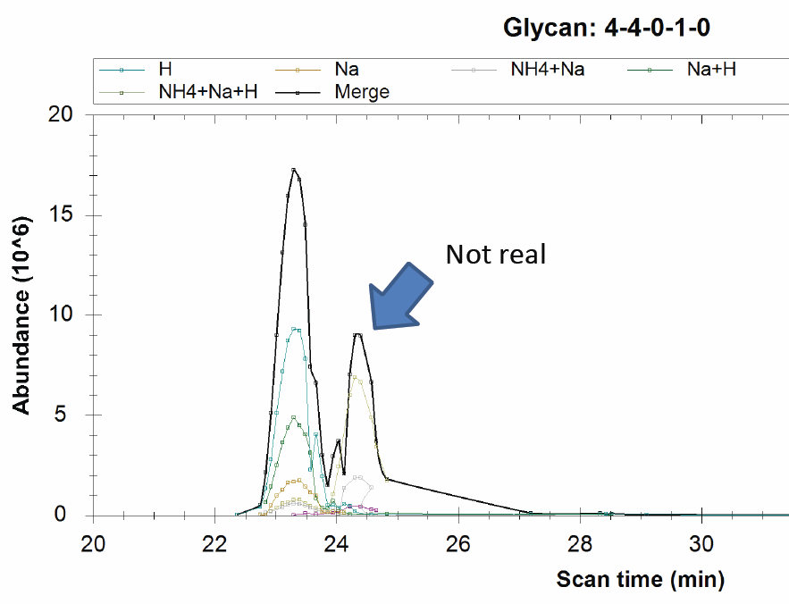

Slide 25
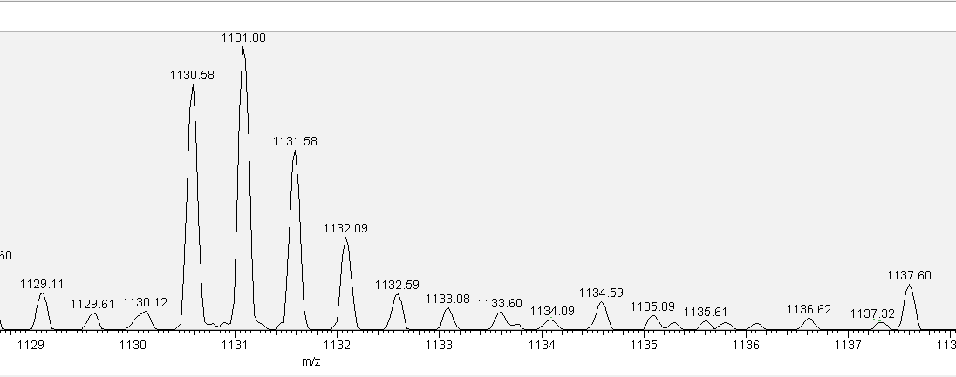
1130.581, 4-4-0-1-0, NH4 * 1; Na * 1;

Slide 26
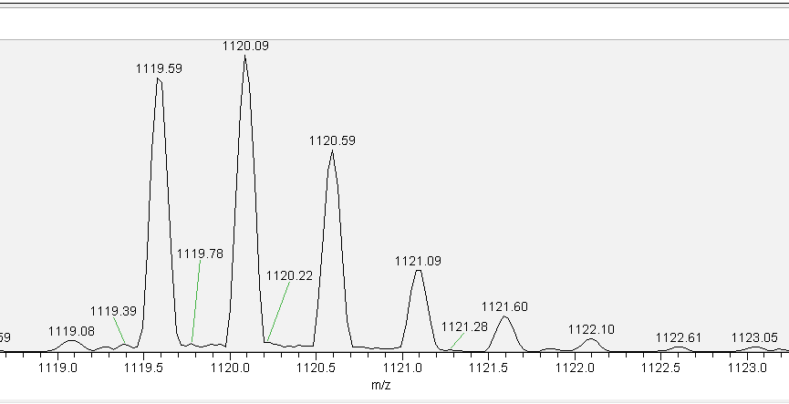
1119.59, 4-4-0-1-0, NH4 * 1; H * 1;

Slide 27
2015-03-25

Slide 28
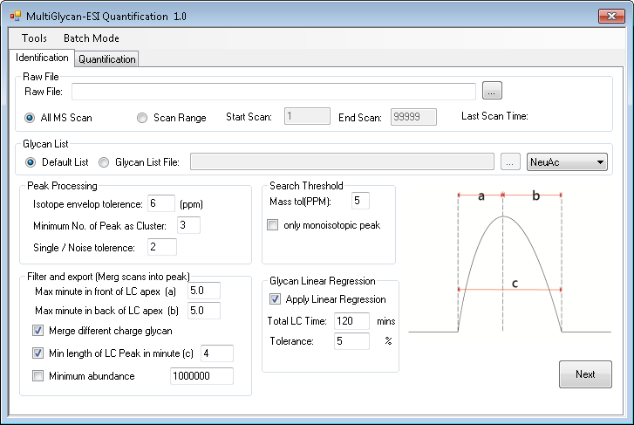

Slide 29
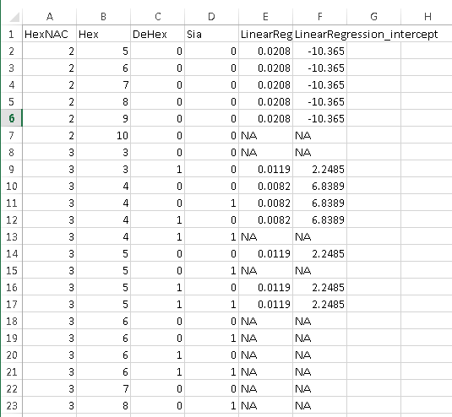
Two new columns in Glycan files
LinearRegression_Slope
LinearRegression_intercept

Slide 30
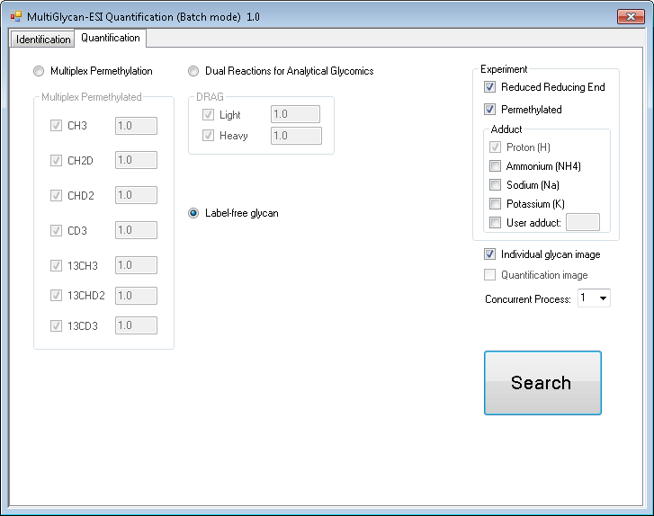
Choose concurrent file

Slide 31
From TTU

Slide 32
2015-07-16

Slide 33
Batch Mode Issue
The batch mode is not able to handle more than 15 raw files simultaneously. As you can see in the “MergeResult.csv”, we tried to process 18 raw files together, the last file shows “N/A” for all glycans. (Some times last two or three samples are all “N/A”. In other cases, Multiglycan crushed with >15 files loading.)
The “pic” folders do not contain all the peak construction information, when batch mode is used. (Most of time, only several of the “pic” folders are empty. The ones we uploaded is the worst case, only “Cell_Deter_SP_01” has 3 pictures.)

Slide 34
Quantitation Issue
There are two issues with the newest version of Multiglycan.
1. Some peaks are not picked.
2. Some quantitation results agreed with Xcalibur while some quantitation results did not.
Examples are shown in the following slides.

Slide 35
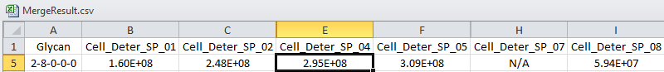
Issue Type 1
EICs of [28000+2H]2+
Clear Peak

Slide 36
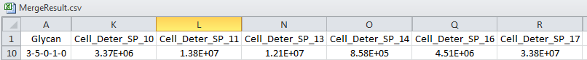
Issue Type 2: quantitation of same glycan in different files (Multiglycan and Xcarlibur gives different ratio)
3.92
16.08
14.01
1
5.25
39.39
2.56
4.78
5.08
1
2.73
9.68

Slide 37
2.61
5.04
4.21
1
2.80
8.15

Slide 38
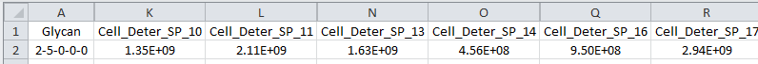
Issue Type 2: quantitation of same glycan in different files (Multiglycan and Xcarlibur gives similar ratio)
2.96
4.62
3.57
1
2.08
6.44
2.48
3.82
3.06
1
1.68
4.66

Slide 39
2015-04-03

Slide 40
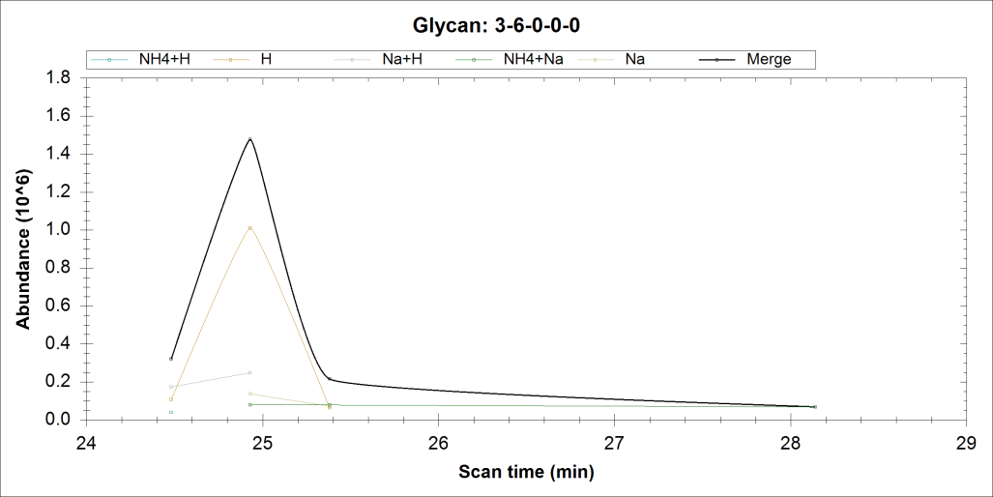

Slide 41
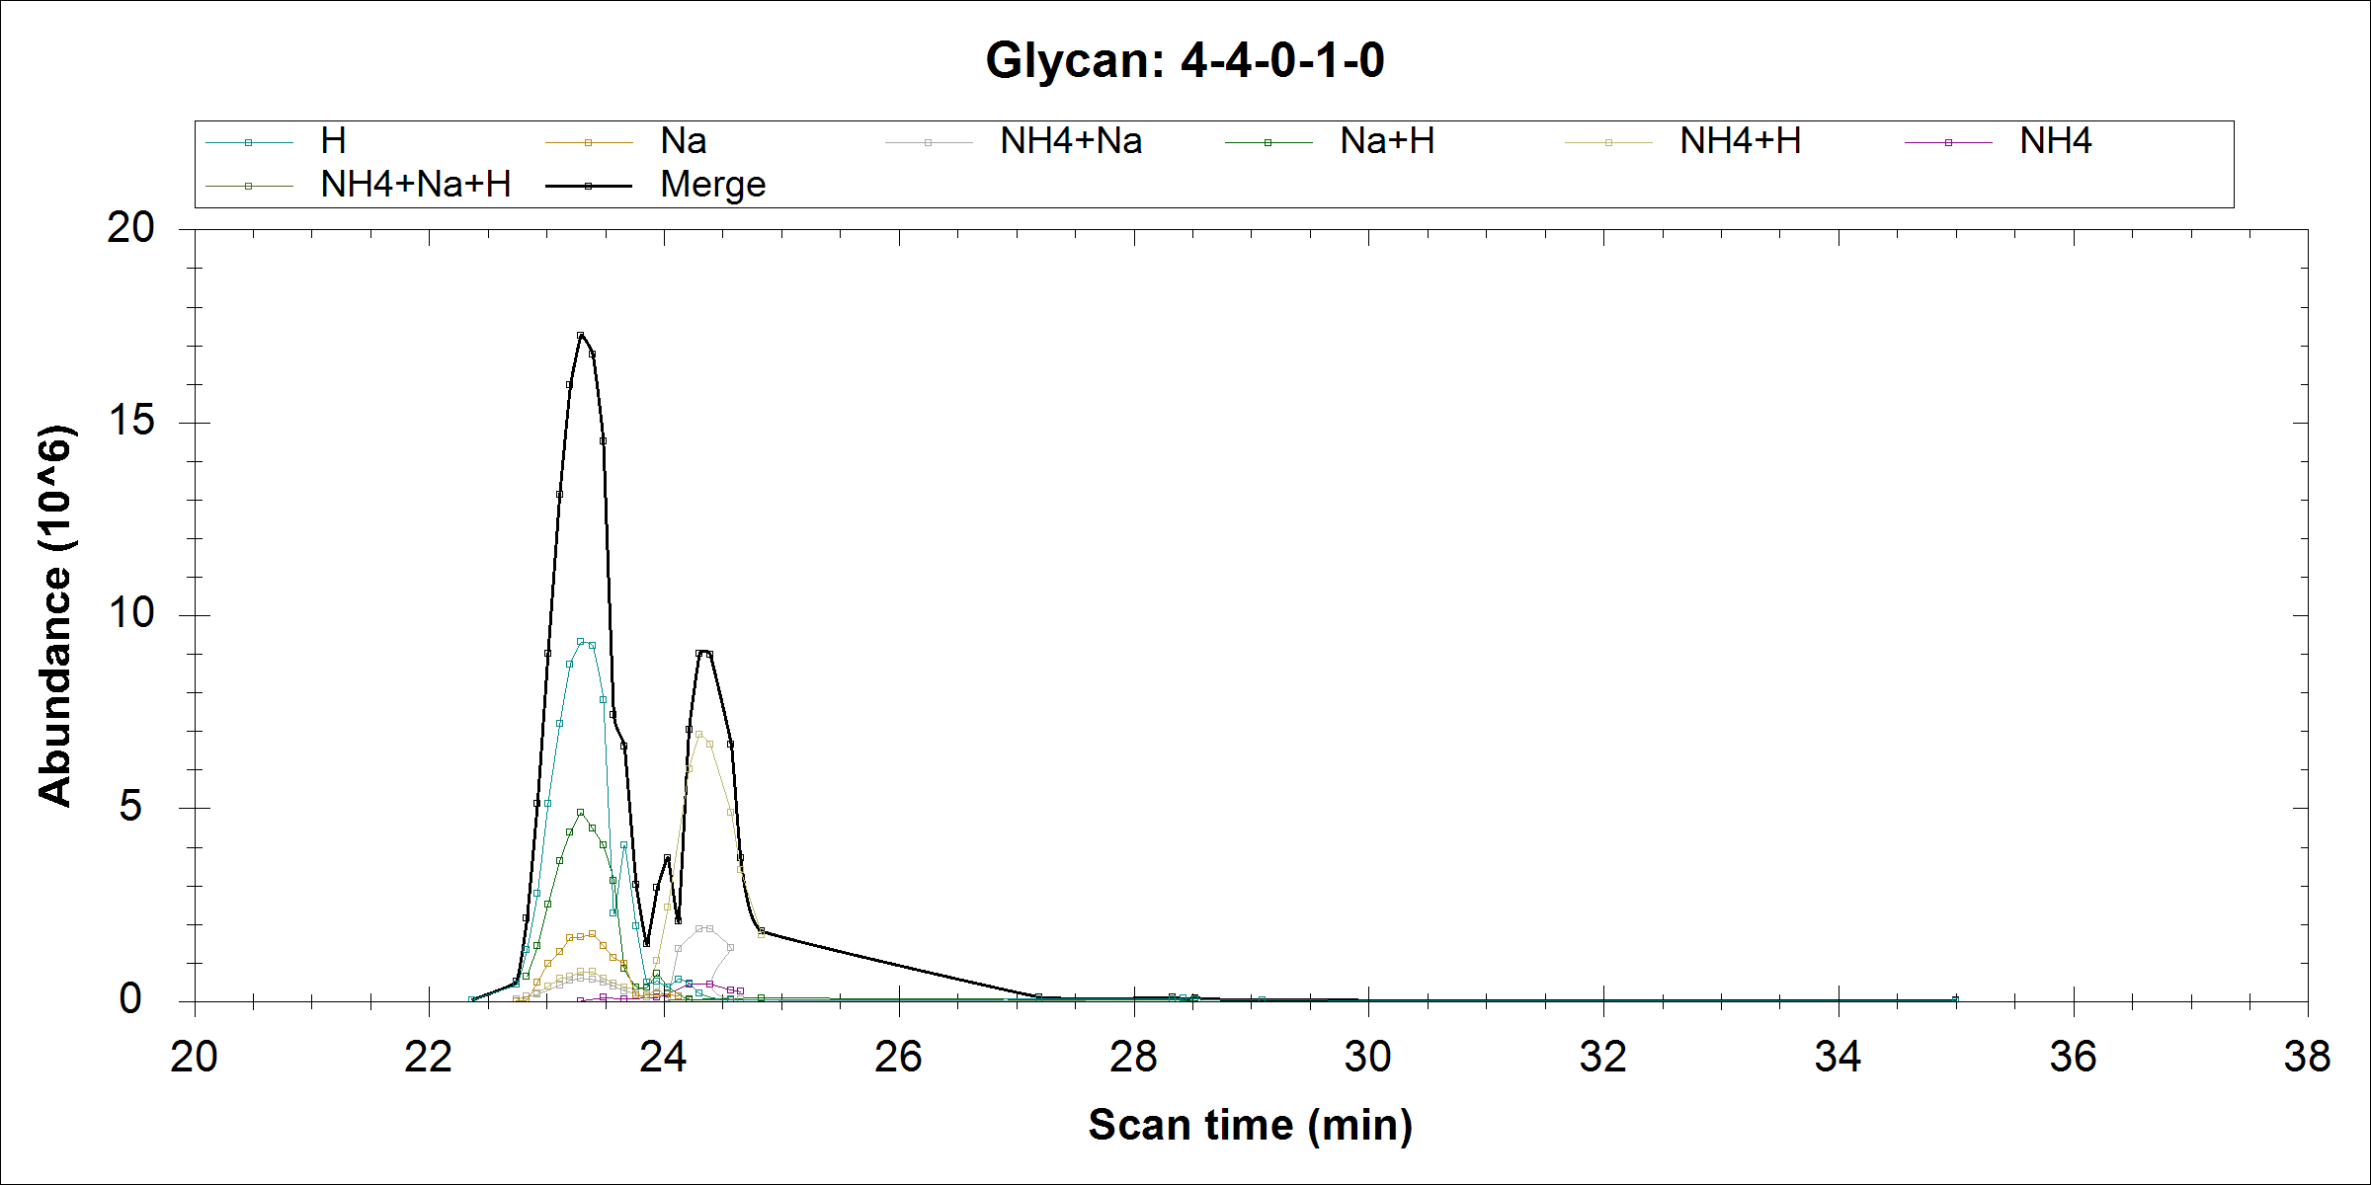
Not real

Slide 42
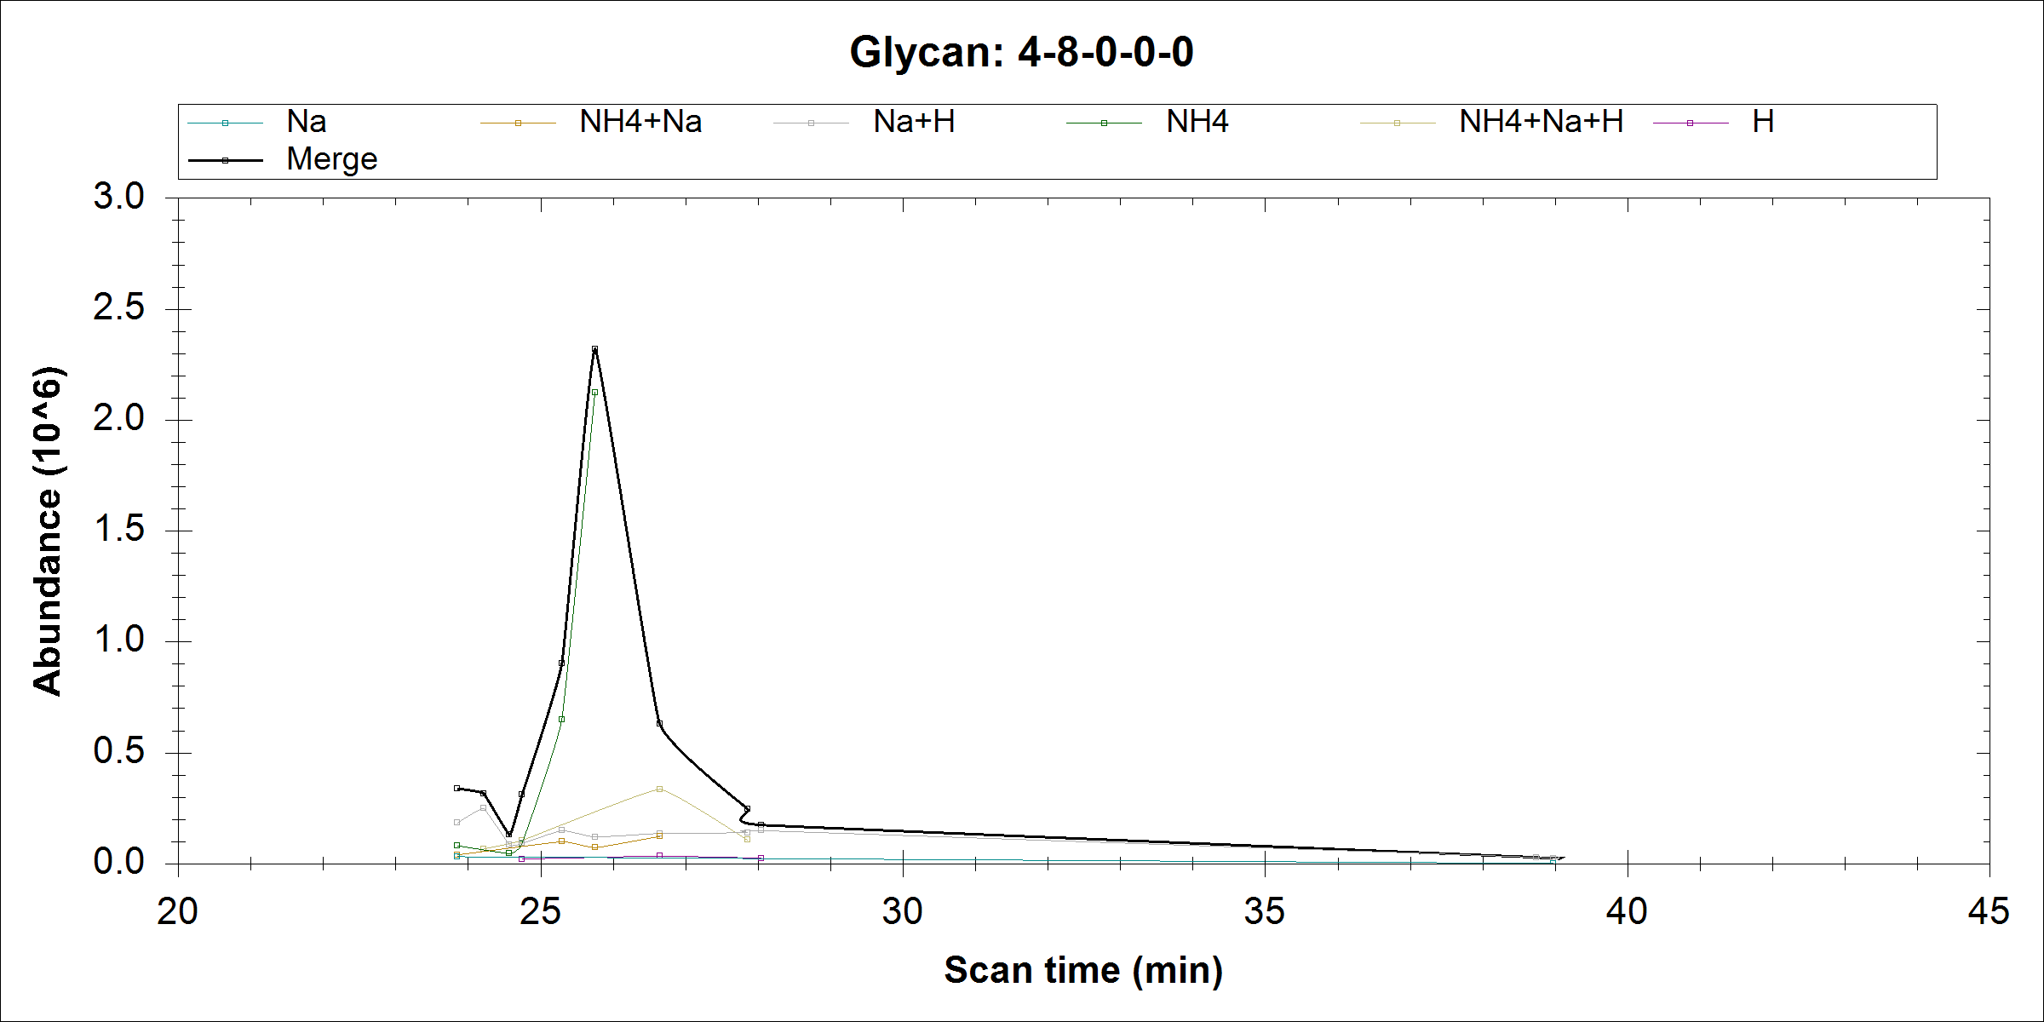
Wrong charge state

Slide 43
2015-03-31

Slide 44
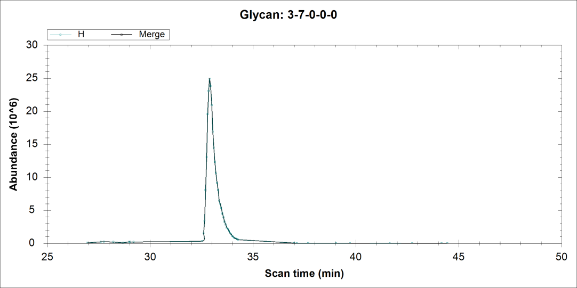
Dropbox\Chuan-Yih\Raw file and old results\R4_150319124400.raw
m/z=1114.0832
Wrong Peak since it’s not first mono
Similar issue exists in several other structures e.g. 3-5-0-0-0, 3-4-0-0-0

Slide 45
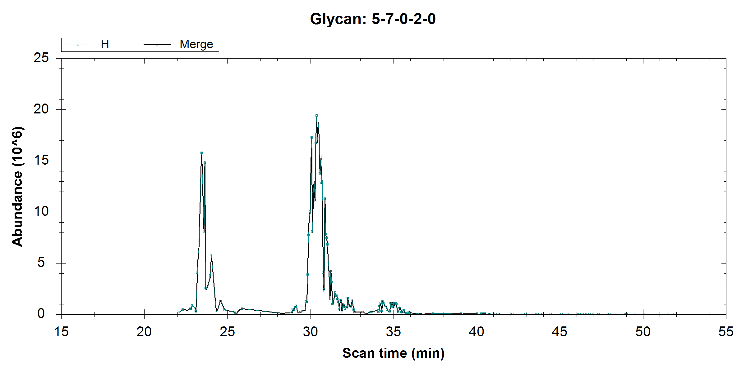
Could not be found in Xcalibur using EIC

Slide 46
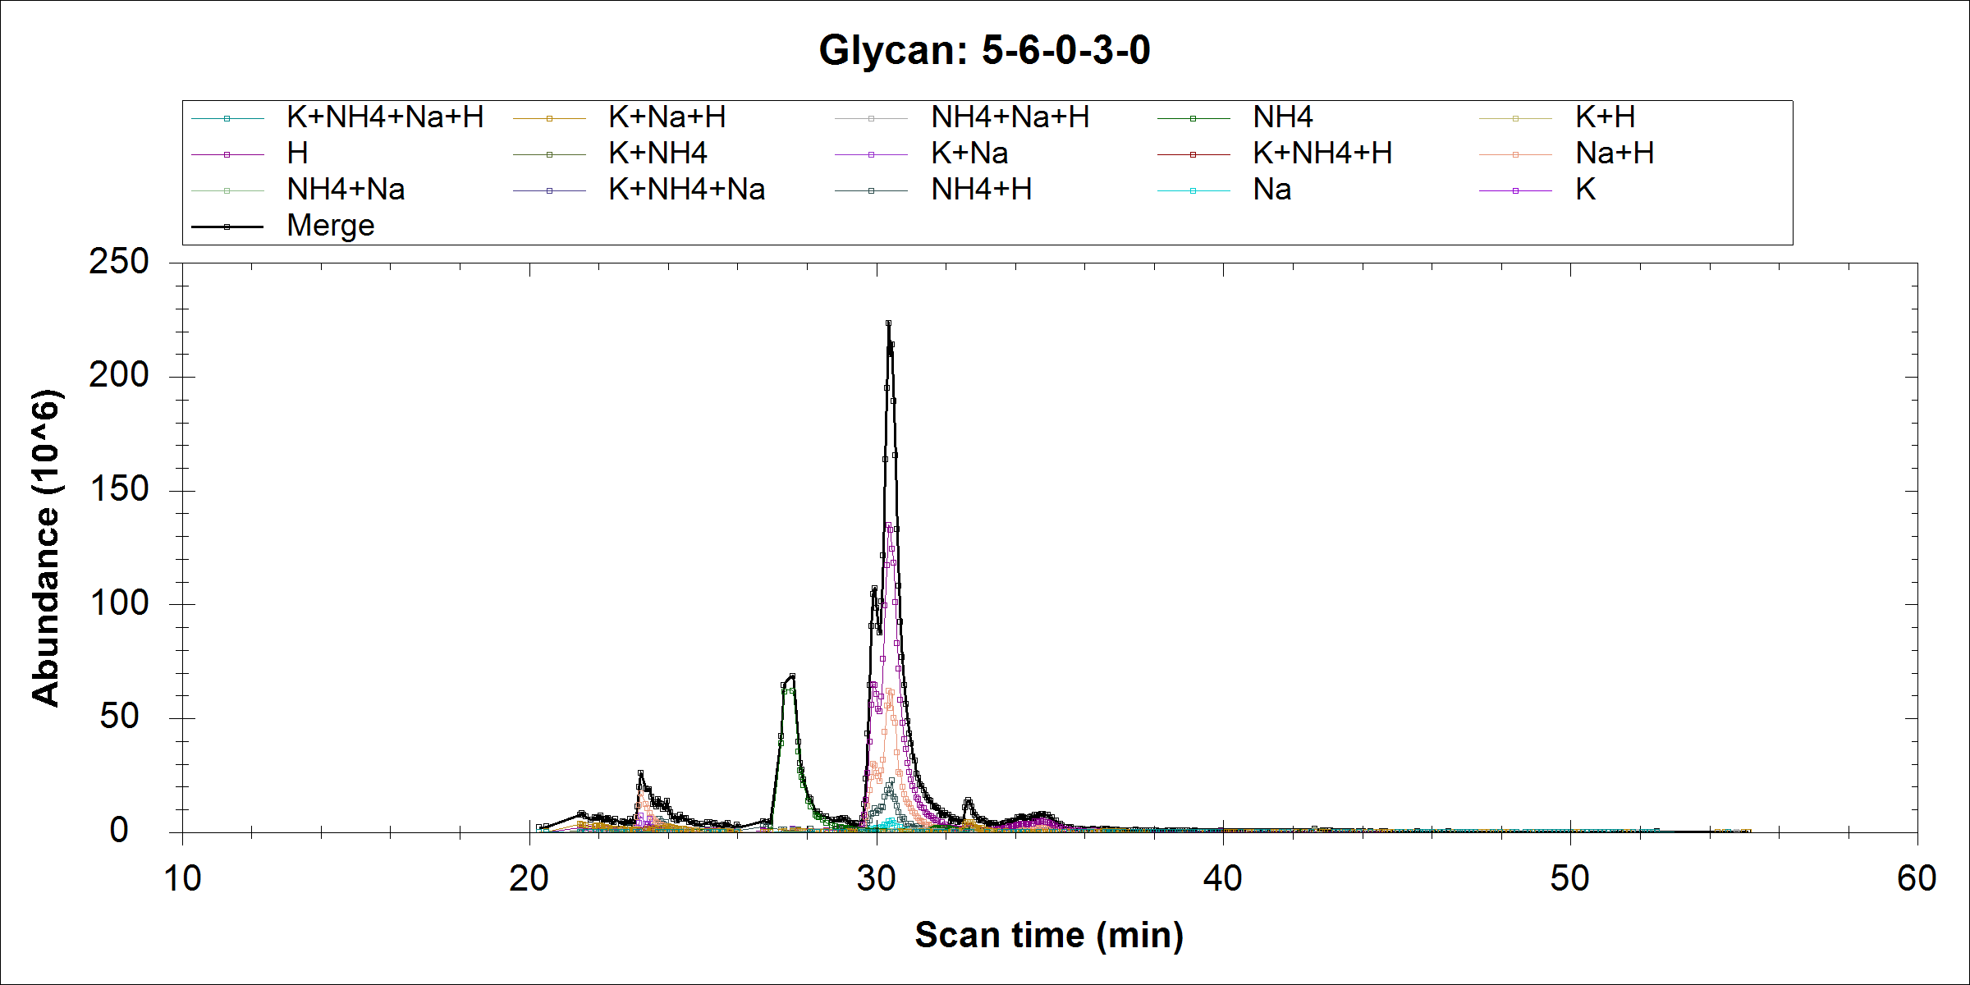
Not real peak
Real

Slide 47
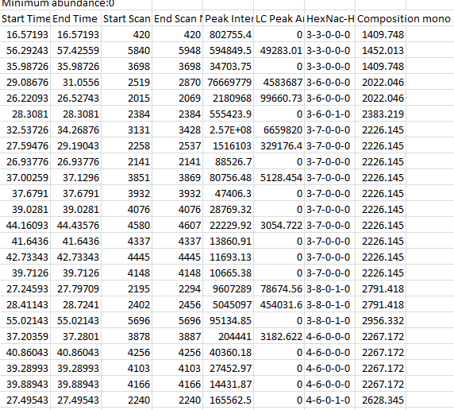
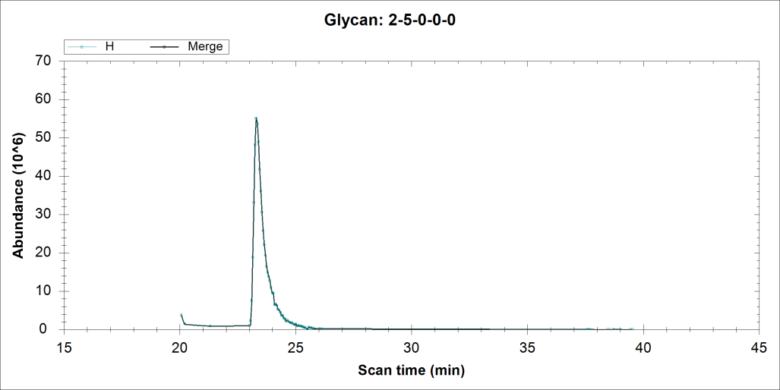
High mannose is excluded in the exported xls file in the latest version of software, they were picked in the PIC file. I have uploaded the raw file and the processed results in dropbox

