Slide 1
MultiGlycan
2015.03.25

Slide 2
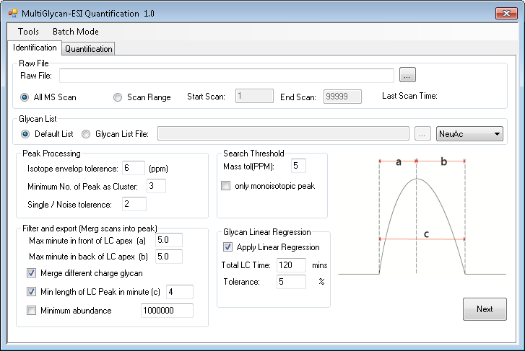

Slide 3
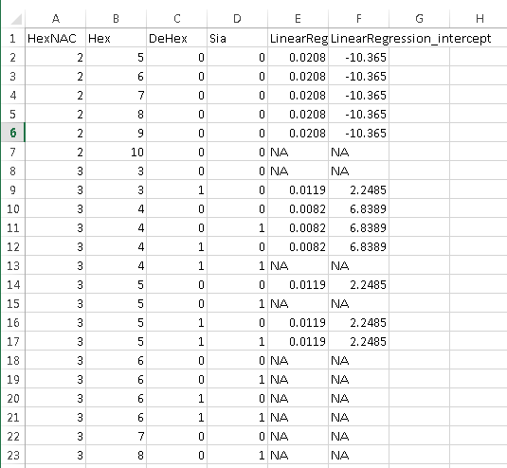
Two new columns in Glycan files
LinearRegression_Slope
LinearRegression_intercept

Slide 4
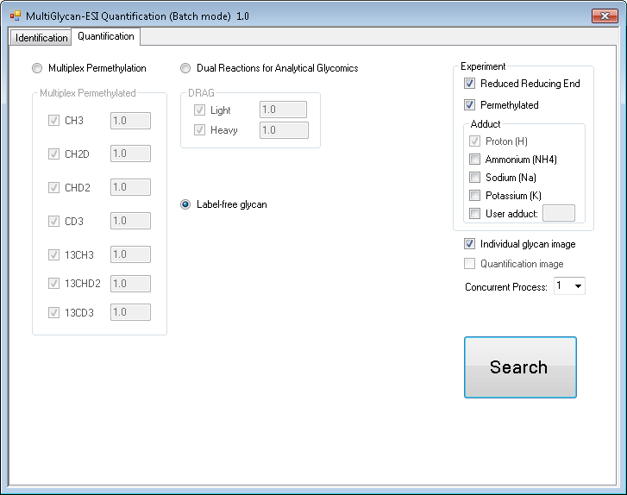
Choose concurrent file

