Slide 1
2015/05/01
MultiGlycan

Slide 2
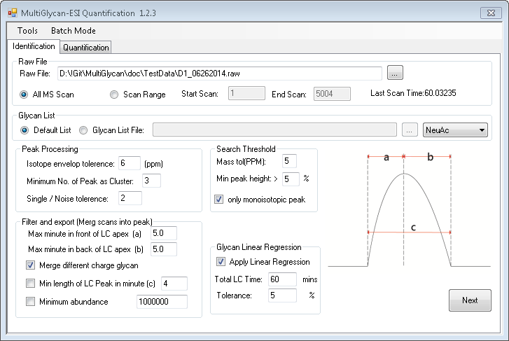
New updated
Only use relative abundance above this value

Slide 3
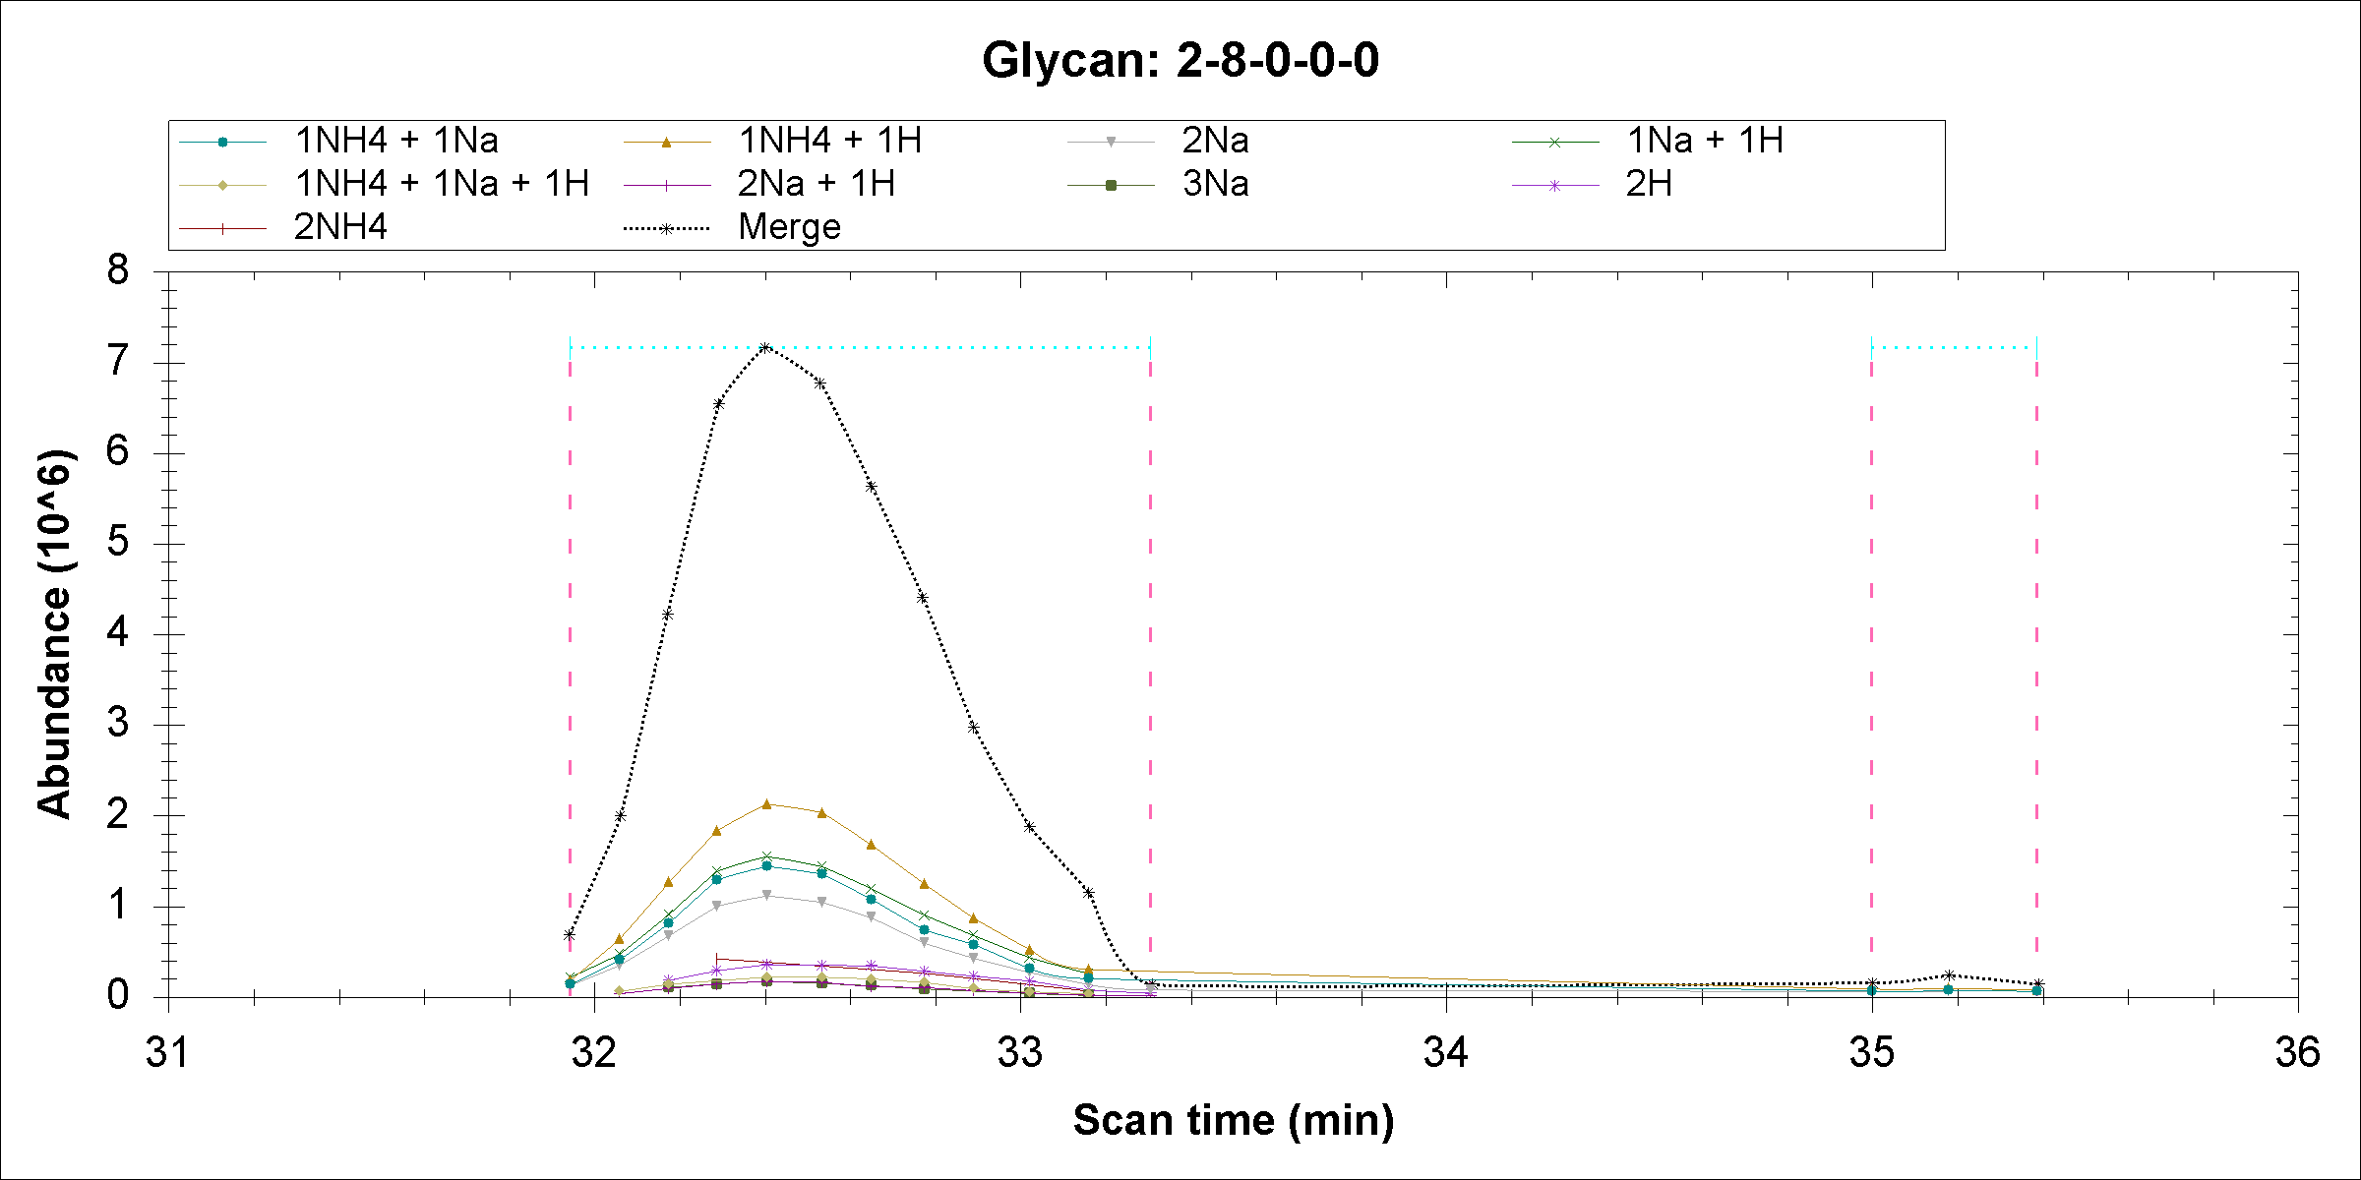
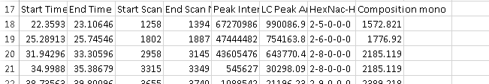
Illustrate peak range

Slide 4
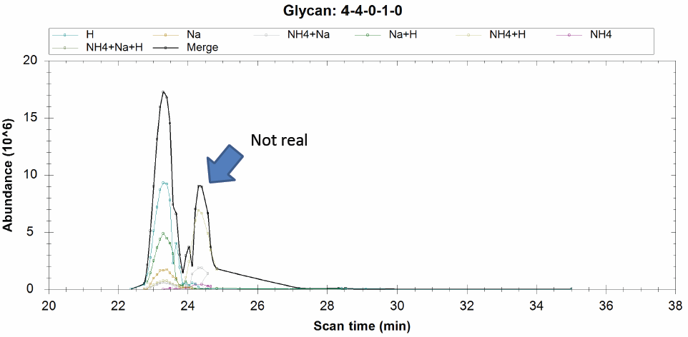
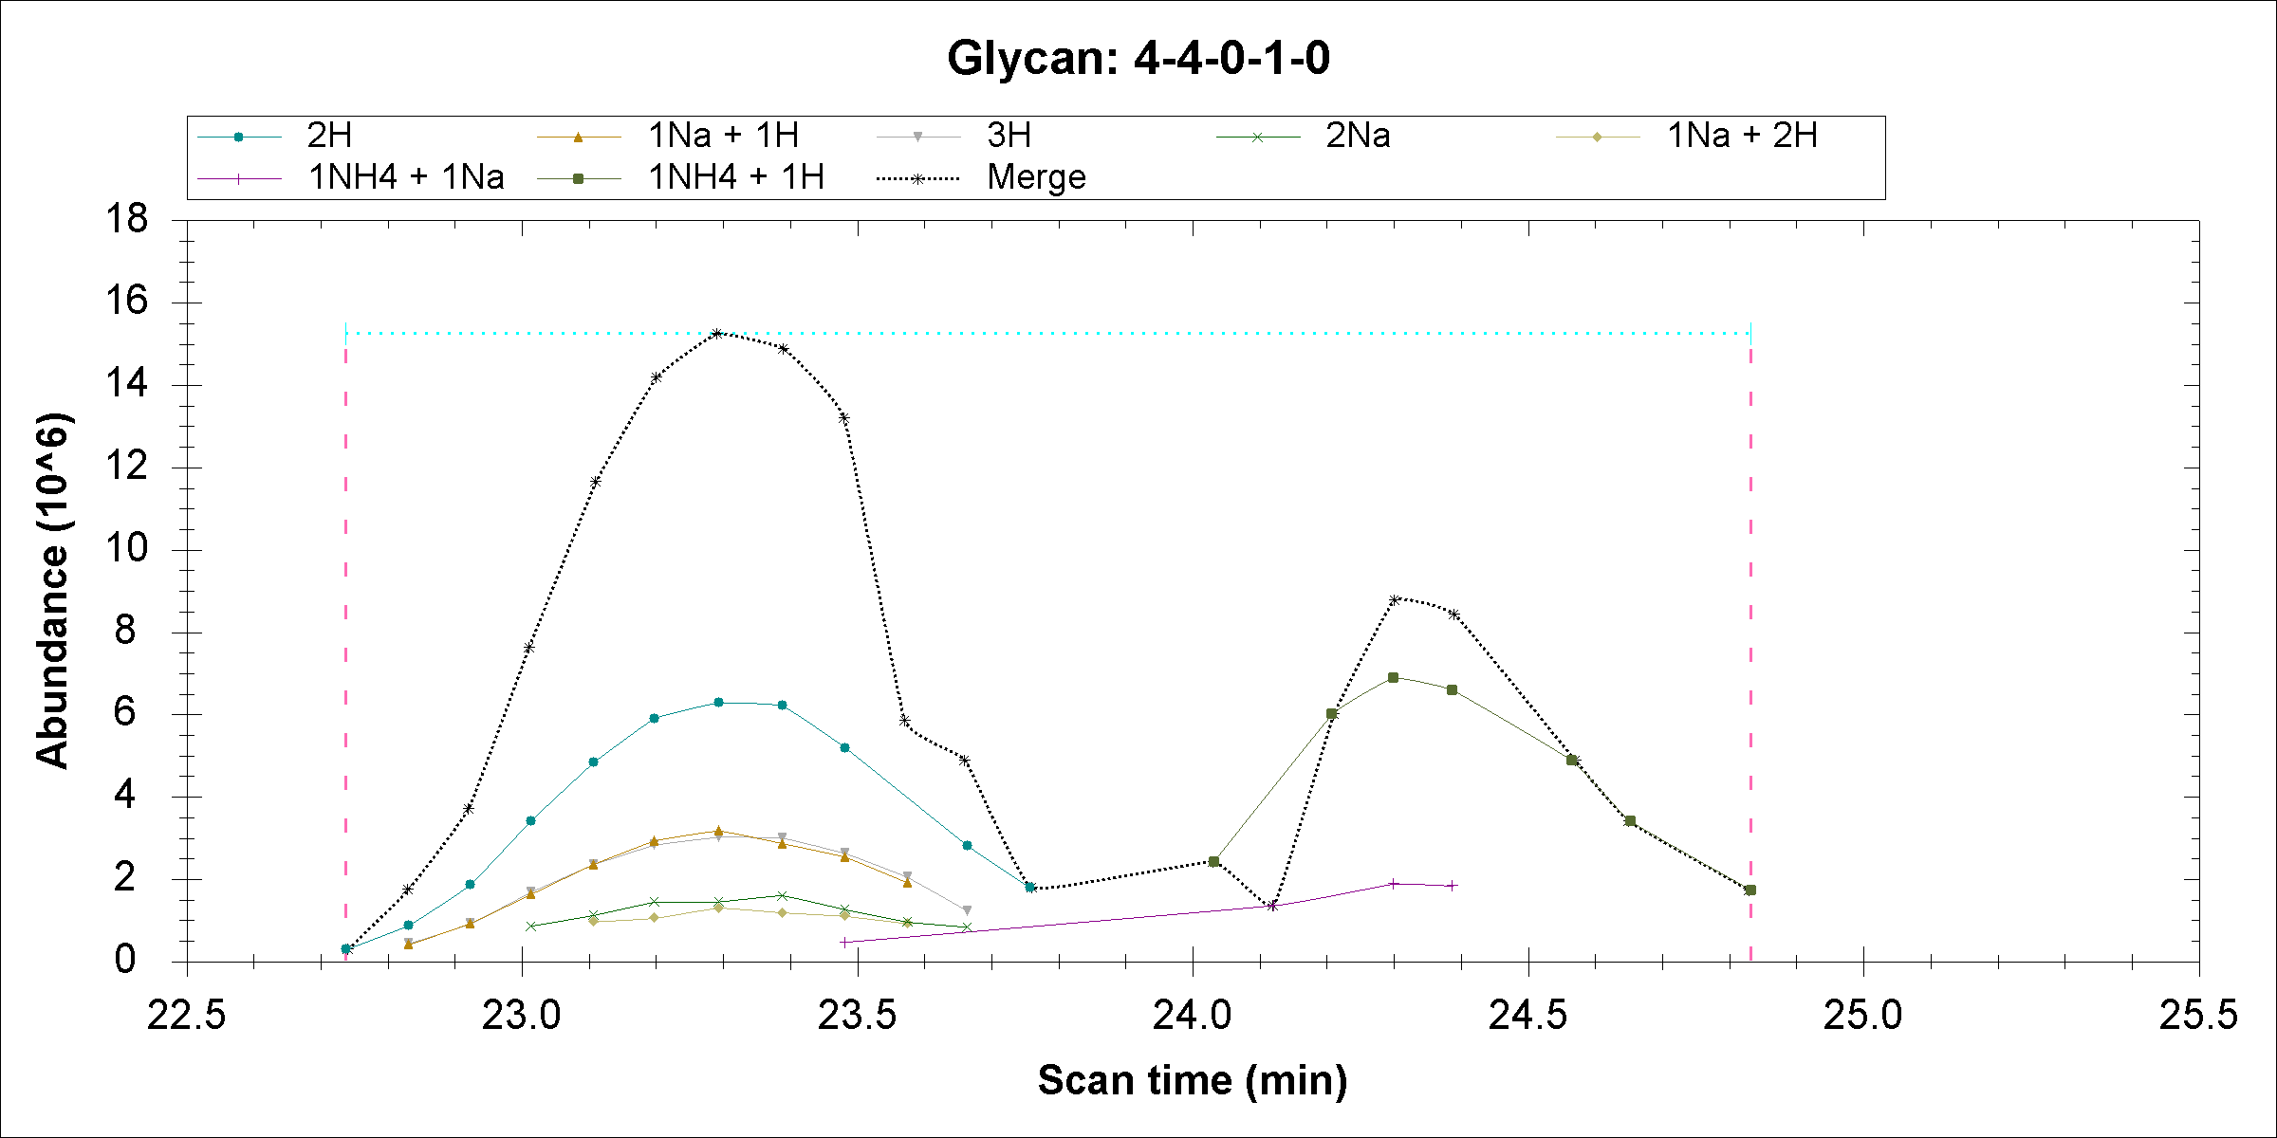
 |  |  | PPM
1111.074 | 6-7-0-4-0 | NH4*2 ;H*2 ; | 5.400151204
1111.08 | 4-4-0-1-0 | H*2 ; | 0
1111.098 | 10-8-1-0-0 | K*2 ;Na*2 ; | 16.20045361
1122.066 | 6-7-0-4-0 | NH4*2 ;Na*2 ; | 5.347250444
1122.072 | 4-4-0-1-0 | Na*1 ;H*1 ; | 0
1122.109 | 8-9-1-1-0 | K*1 ;NH4*3 ; | 32.97471107
1133.013 | 9-9-0-4-0 | K*2 ;NH4*2 ;H*1 ; | 44.12817293
1133.063 | 4-4-0-1-0 | Na*2 ; | 0
1133.084 | 7-9-1-2-0 | NH4*1 ;H*3 ; | 18.53383263
1119.588 | 4-5-1-0-0 | H*2 ; | 5.359085526
1119.594 | 4-4-0-1-0 | NH4*1 ;H*1 ; | 0
1119.595 | 9-8-1-1-0 | K*1 ;H*3 ; | 0.893180921
1130.579 | 4-5-1-0-0 | Na*1 ;H*1 ; | 5.306987091
1130.585 | 4-4-0-1-0 | NH4*1 ;Na*1 ; | 0
1130.587 | 9-8-1-1-0 | K*1 ;Na*2 ;H*1 ; | 1.768995697
741.0153 | 7-7-0-1-0 | K*2 ;NH4*2 ;Na*1 ; | 54.92162536
741.056 | 4-4-0-1-0 | H*3 ; | 0
741.1596 | 5-7-1-2-0 | Na*4 ;H*1 ; | 139.8005009
748.3738 | 6-6-1-2-0 | NH4*1 ;Na*3 ;H*1 ; | 12.96126919
748.3835 | 4-4-0-1-0 | Na*1 ;H*2 ; | 0
748.3867 | 4-6-0-2-0 | H*4 ; | 4.275882619

Slide 5
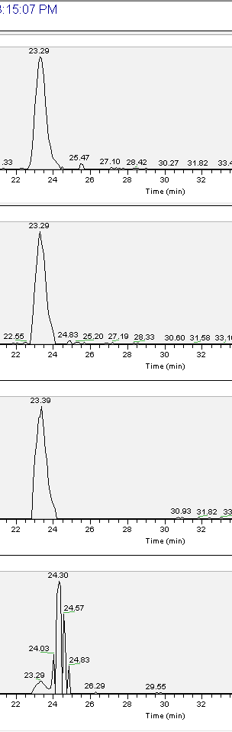
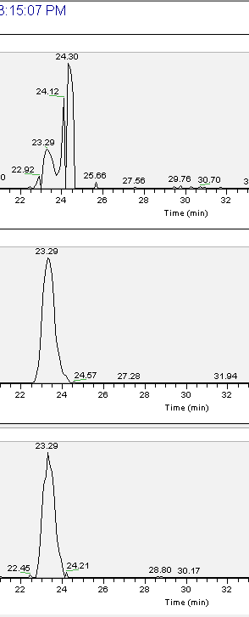
1111.08 H*2 ;
1130.585 NH4*1 ;Na*1 ;
1122.072 Na*1 ;H*1 ;
741.056 H*3 ;
1133.063 Na*2 ;
748.3835 Na*1 ;H*2 ;
1119.594 NH4*1 ;H*1 ;

