Slide 1
Glycan peak without protonated and multiple matched glycans

Slide 2
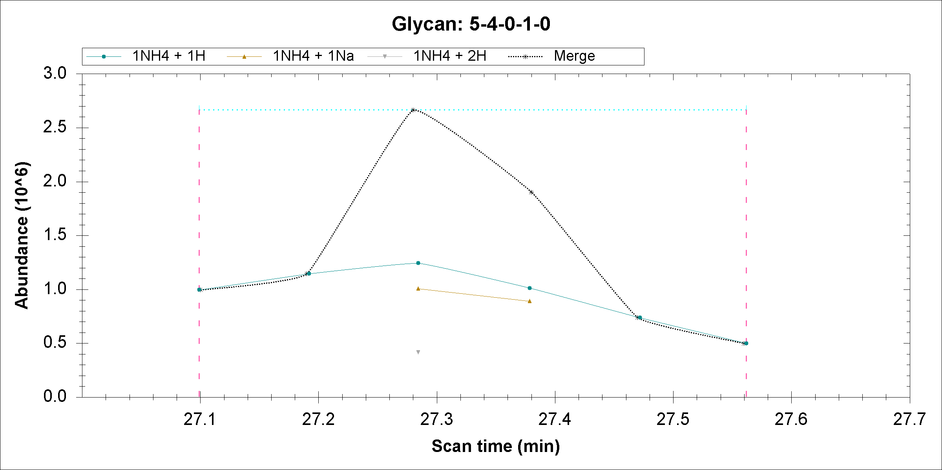

Slide 3
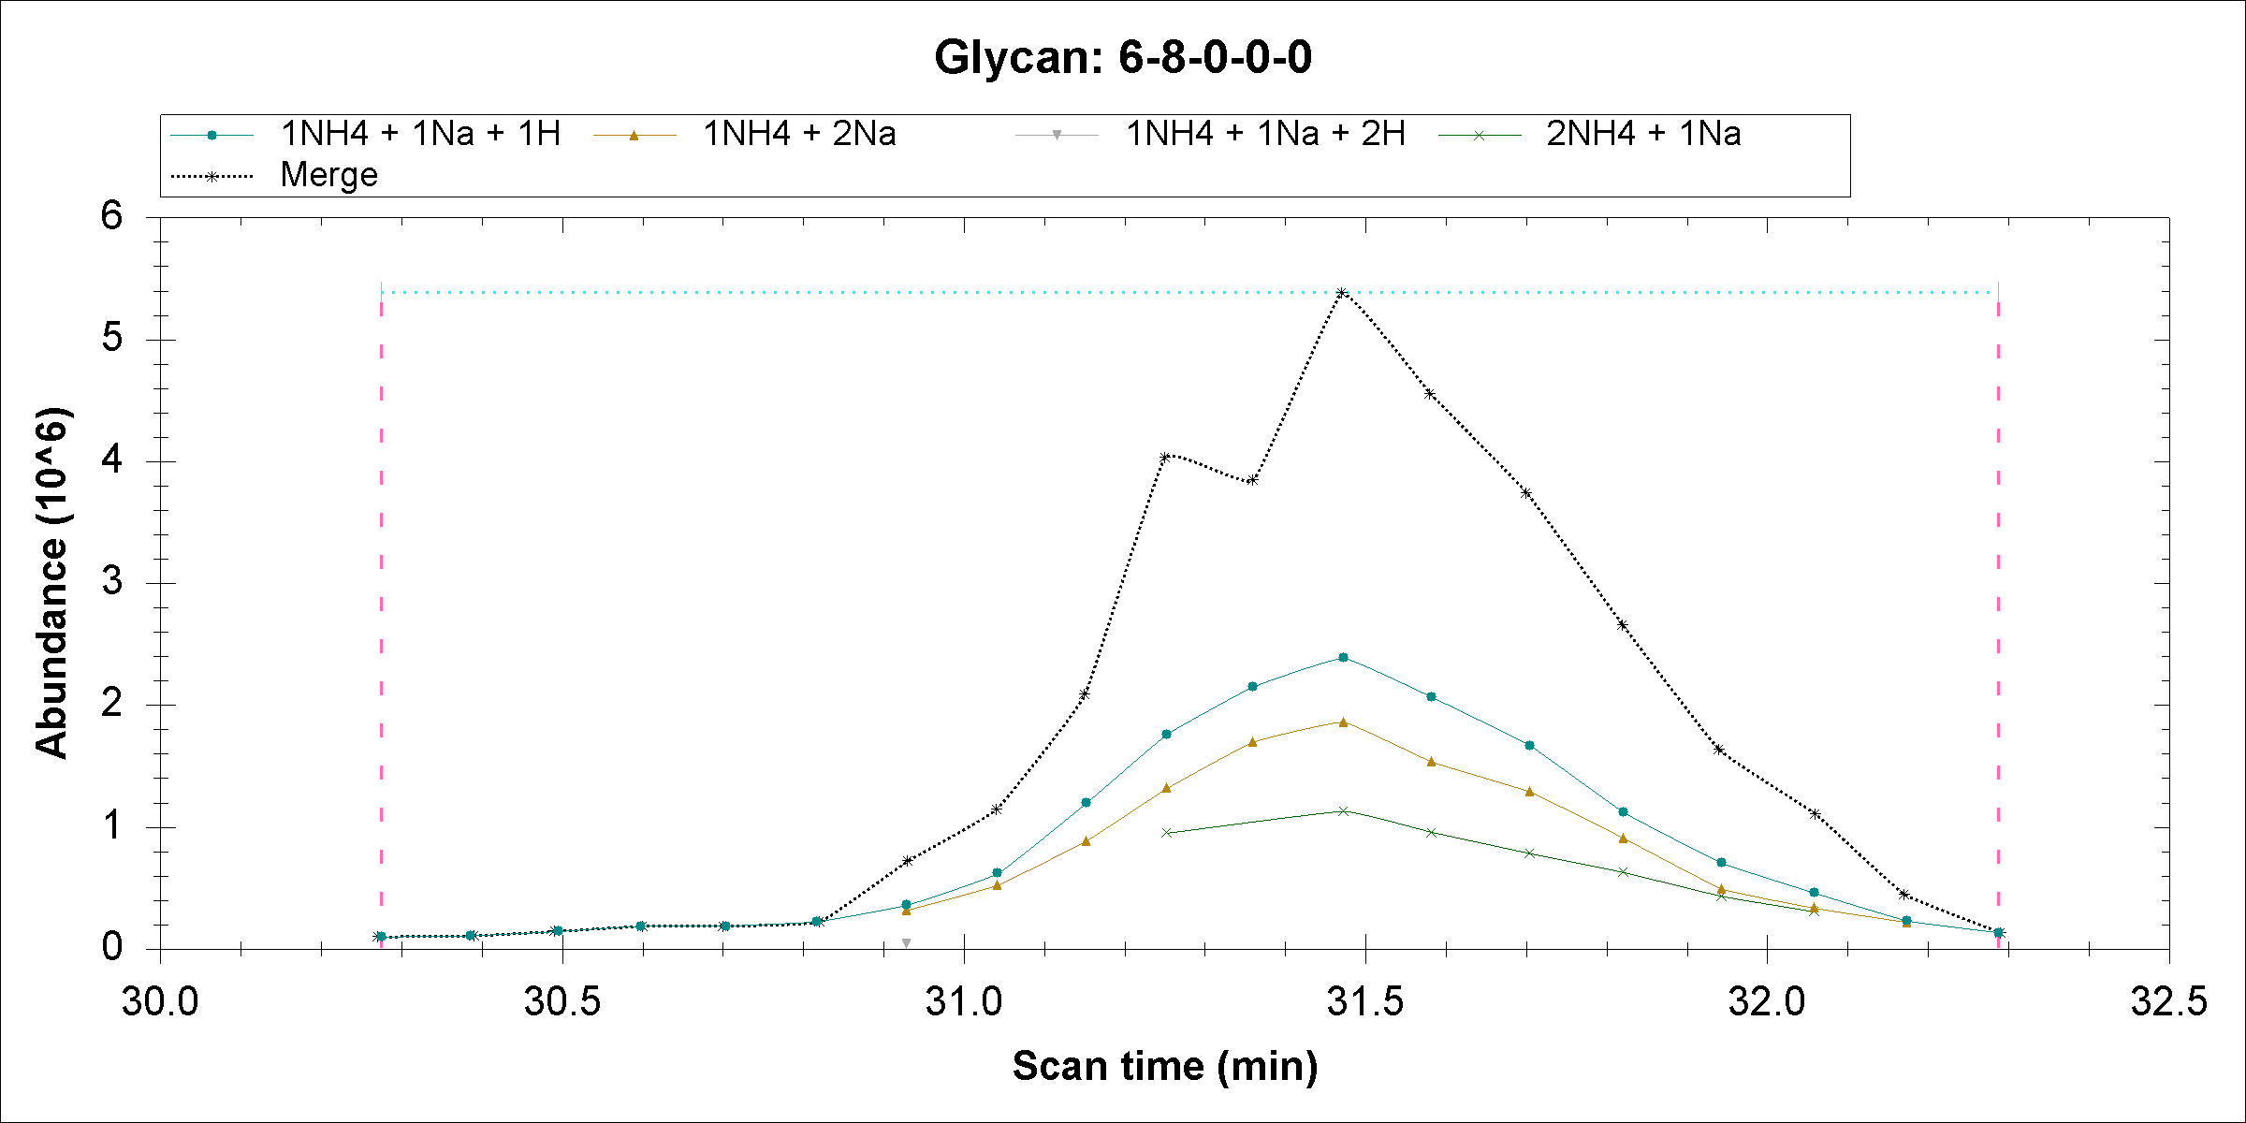

Slide 4
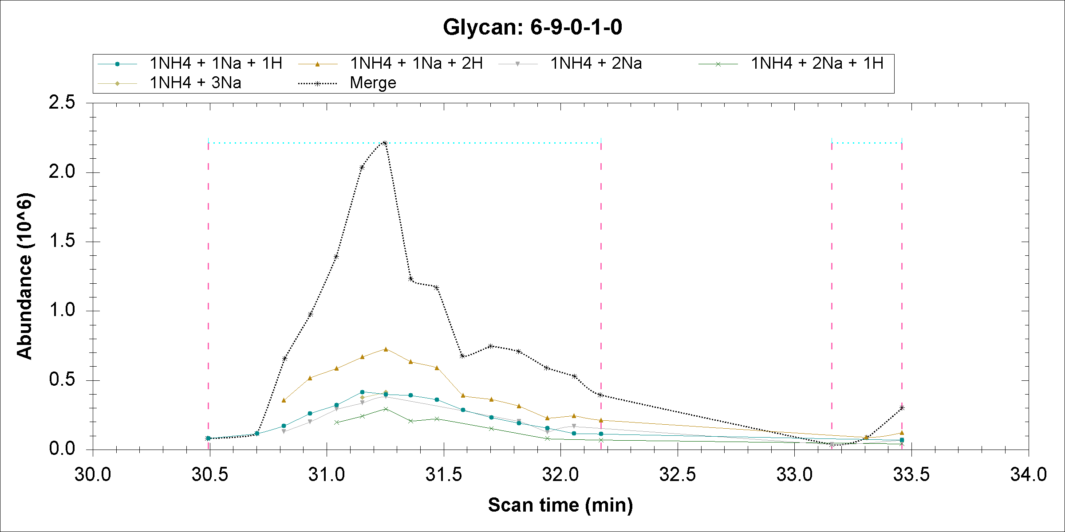

Slide 5

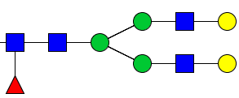

Close mass due to adducts
+ =378.1890
+ NH3 =378.2002
Mass difference=0.0112, if permethylated glycan mass is ~3000 Da, then the difference is ~3.7ppm, which can not be resolved by our MS method.
For example
V.S.
[M+2H]2+
1119.5905
[M+H+NH4]2+
1119.5961

Slide 6
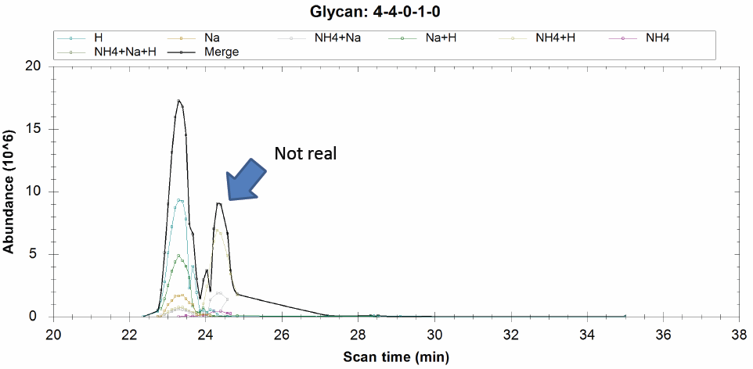

Since this is from glycan: 4-5-1-0-0, this glycan has the retention time as 24.3

Slide 7
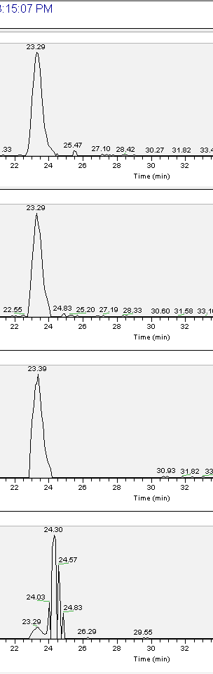
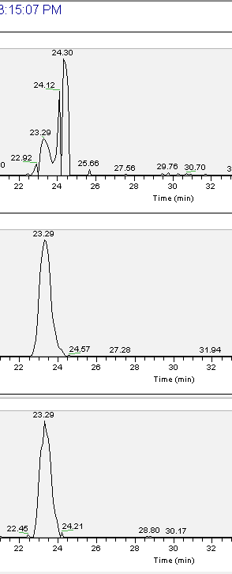
1111.08 H*2 ;
1130.585 NH4*1 ;Na*1 ;
[M+H+Na]2+
1122.072 Na*1 ;H*1 ;
741.056 H*3 ;
1133.063 Na*2 ;
748.3835 Na*1 ;H*2 ;
1119.594 NH4*1 ;H*1 ;
[M+2H]2+

Slide 8
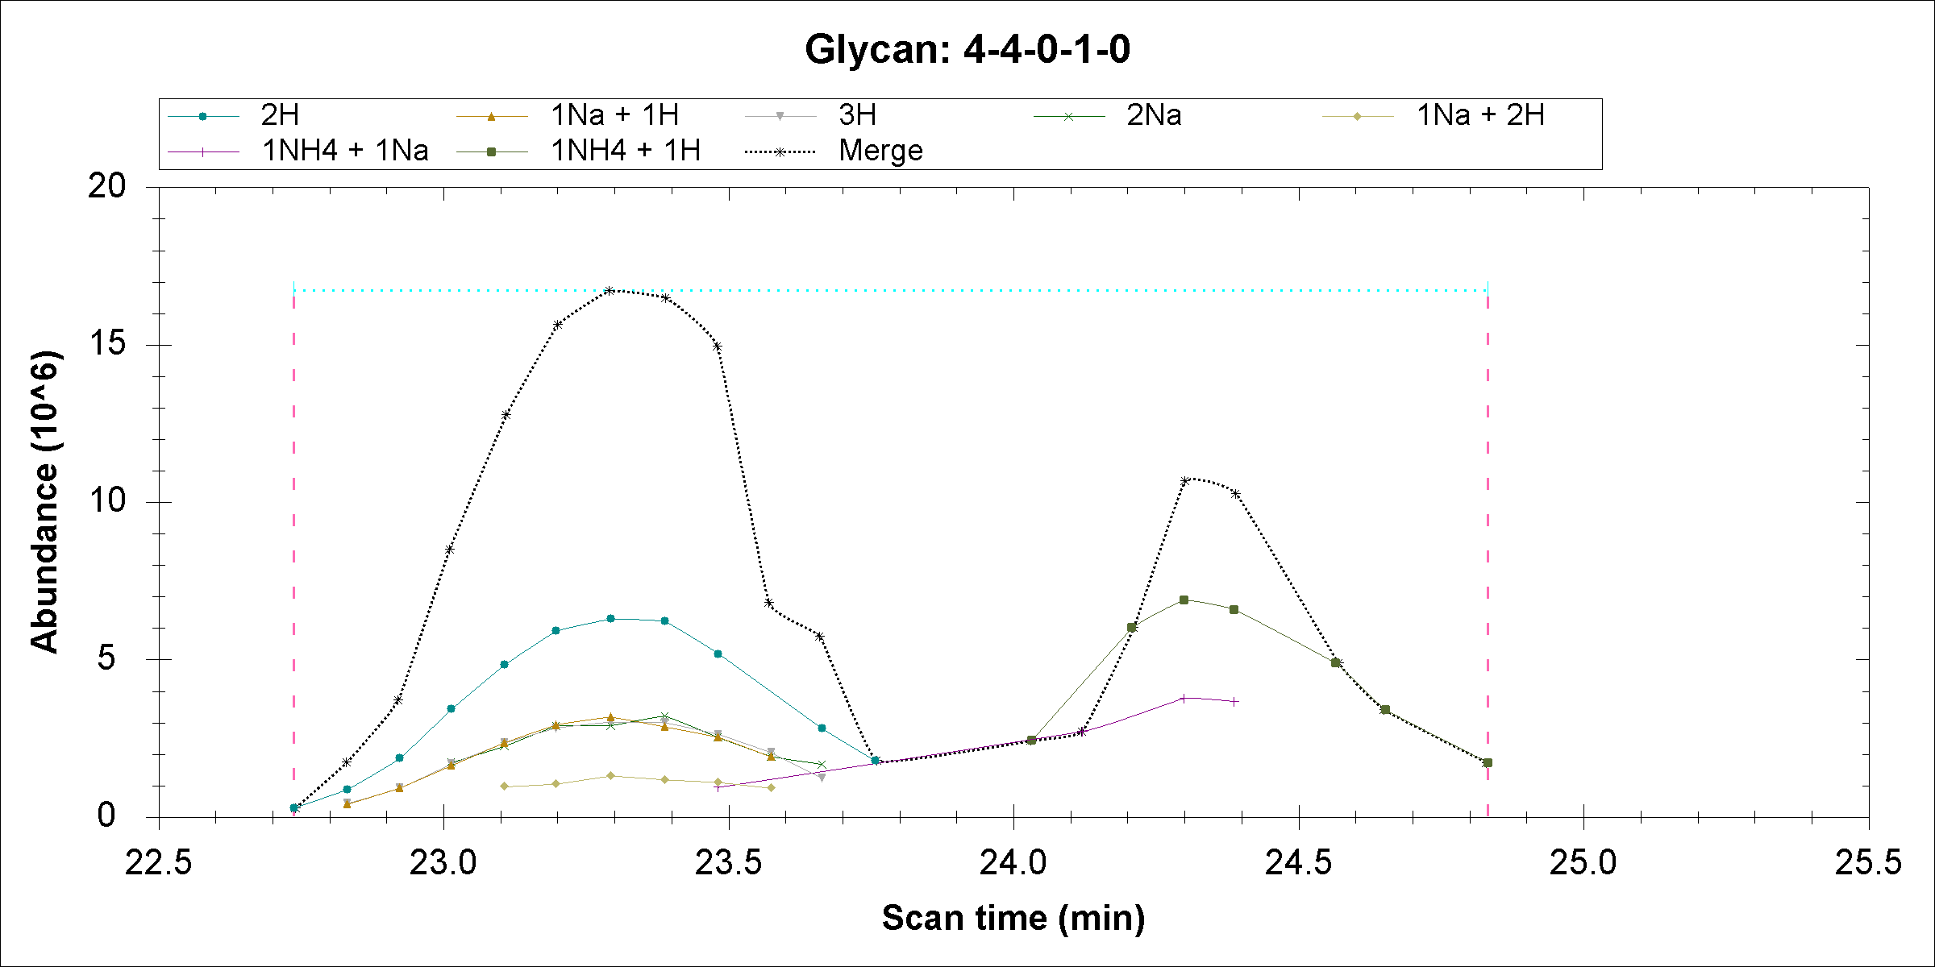
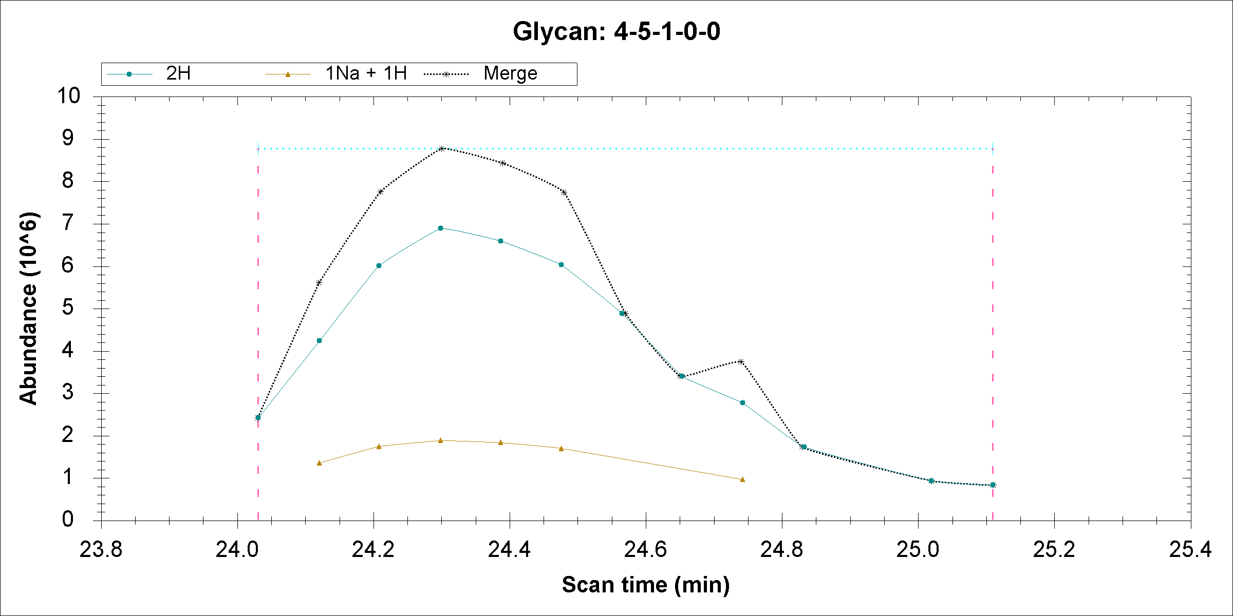
Observed m/z | 4-4-0-1 |  | 4-5-1-0-0
1119.589 | NH4*1,H*1 | 1119.594 (Δ=0.005 PPM 4.4) | H*2 | 1119.588 (Δ=0.001 PPM 0.89)
1130.57959 | NH4*1 ;Na*1 | 1130.5851 (Δ=0.00551 PPM 4.9) | Na*1 ;H*1 | 1130.579 (Δ=0.00059 PPM 0.52)
Indeed, these m/z can be matched to two different glycans, however 4-5-1-0 has smallest delta and more reasonable elution time. Currently my program report these two glycans and merge them into different glycan. So the peaks are counted twice. I will modify my program to solve this problem.

