Slide 1
MultiGlycan
Peak picking
2015.07.23

Slide 2
Batch mode issue
I was able to finish 54 raw files on a 4 GB (3GB available) Windows 7 32 bits computer.
All graphs are generated
Can not replicate issues in your end
Advice: change another pc or re-install OS to run

Slide 3
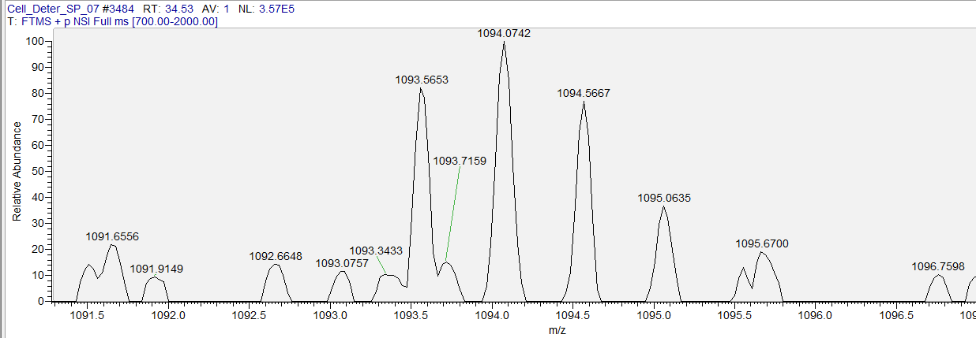
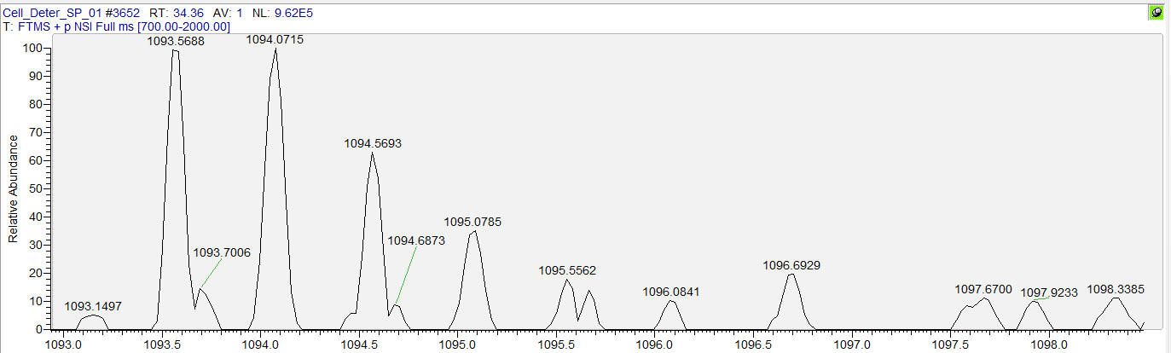
Peak picking problem ~ Missing peak
☒ Can’t find Peak
1093.5653 + 0.5 = 1094.0653 (expect 2nd mono)
1094.0742 - 1094.0653 =~ 8.14 PPM > 6 PPM (Peak picking threshold)
☑ Found Peak
1093.5688 + 0.5 = 1094.0688 (expect 2nd mono)
1094.0715 - 1094.0688 =~ 2.46 PPM < 6 PPM (Peak picking threshold)

Slide 4
Peak picking problem ~ Missing peak
6 PPM is suggested by Shiyue
Some PPM between expected 2nd/3rd isotope peak and observed peak can greater than 10 PPM
The ways to solve this problem are
Give a wider threshold
Match mono only (no isotope pattern matching)
This also could result in quantitation inaccuracy.

