Slide 1
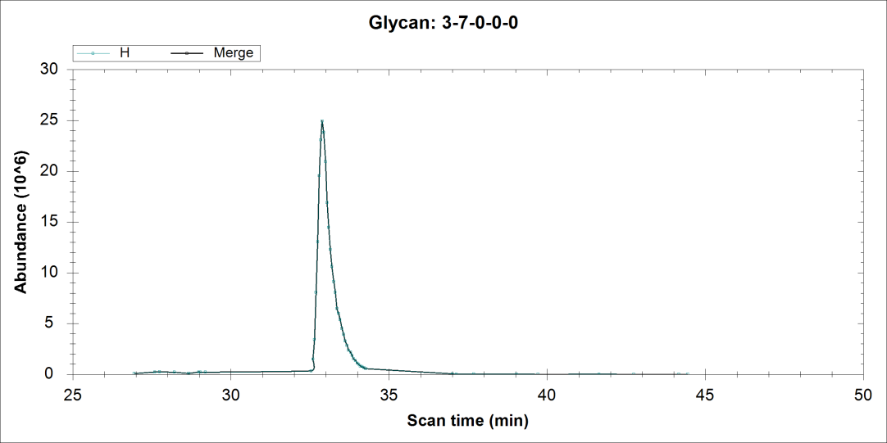
Dropbox\Chuan-Yih\Raw file and old results\R4_150319124400.raw
m/z=1114.0832
Wrong Peak since it’s not first mono
Similar issue exists in several other structures e.g. 3-5-0-0-0, 3-4-0-0-0

Slide 2
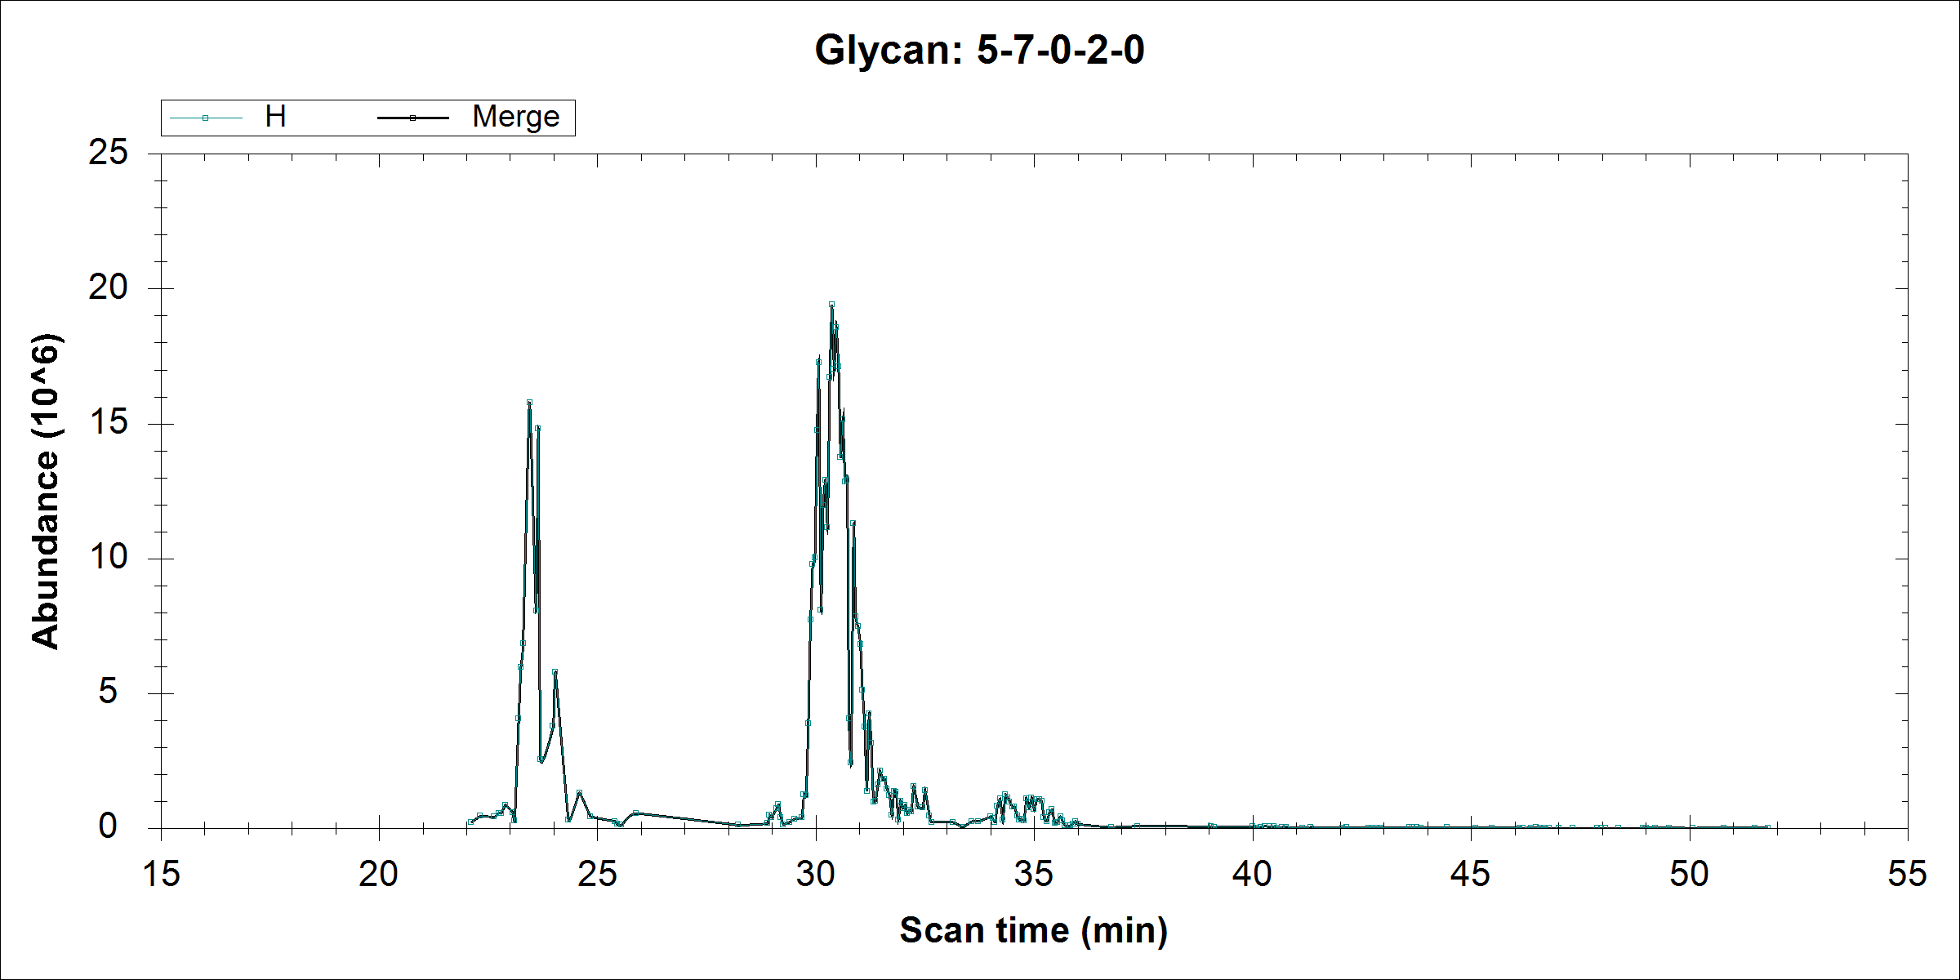
Could not be found in Xcalibur using EIC

Slide 3
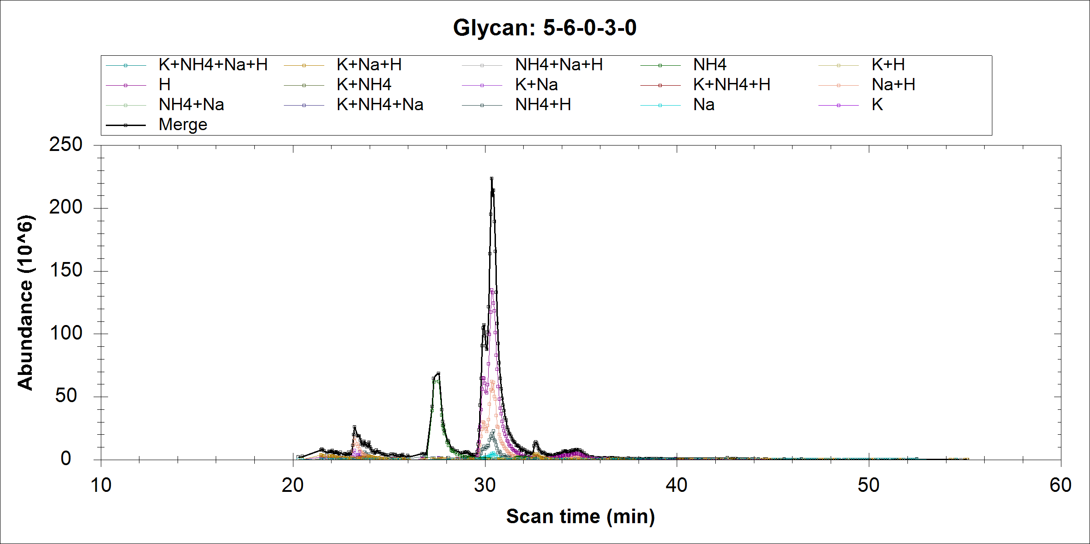
Not real peak
Real

Slide 4
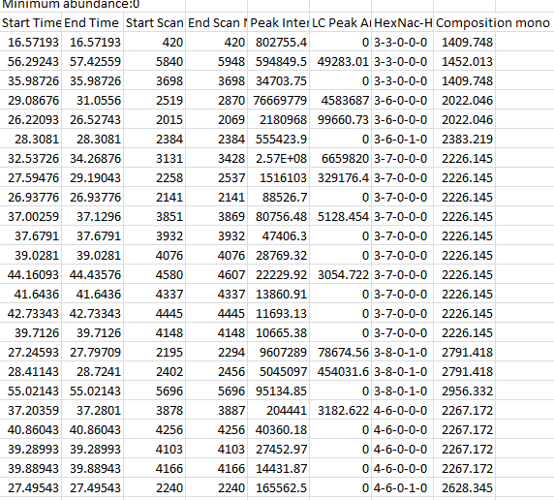
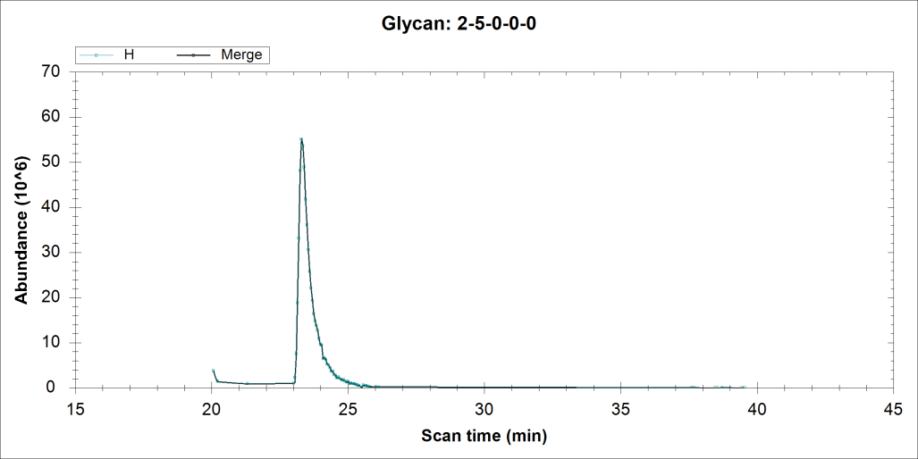
High mannose is excluded in the exported xls file in the latest version of software, they were picked in the PIC file. I have uploaded the raw file and the processed results in dropbox

