Slide 1
Introduction to Parallel Computing
Martin Čuma
Center for High Performance Computing University of Utah
m.cuma@utah.edu
https://git.io/CHPC-Intro-to-Parallel-Computing
Slide <number>
Notes:
http://www.chpc.utah.edu

Slide 2
Overview
Types of parallel computers.
Parallel programming options.
OpenMP, OpenACC, MPI
Higher level languages
Debugging, profiling and libraries
Summary, further learning.
https://git.io/CHPC-Intro-to-Parallel-Computing
Slide <number>
Notes:
http://www.chpc.utah.edu

Slide 3
How to compute faster
Faster CPU clock speed
  Higher voltage = more heat – not sustainable
Work distribution
  Vectorization – process more than one value at a time
  Parallelization – spread work over multiple processing elements
  Specialization – application specific processors (ASIC), programmable logic (FPGA)
https://git.io/CHPC-Intro-to-Parallel-Computing
Slide <number>
Notes:
http://www.chpc.utah.edu
ASIC - Application-specific integrated circuit

Slide 4
Computer architectures
Single processor:
SISD – single instruction single data.
Multiple processors:
SIMD - single instruction multiple data.
MIMD – multiple instruction multiple data.
  Shared Memory
  Distributed Memory
Current processors combine SIMD and MIMD
  Multi-core CPUs w/ SIMD instructions (AVX, SSE)
  GPUs with many cores and SIMT
https://git.io/CHPC-Intro-to-Parallel-Computing
Slide <number>
Notes:
http://www.chpc.utah.edu
SISD – one instruction queue, one processing unit
SIMD – one queue but more processing at the time – specialized CPUs, often a lot of small (4,7,16) bit processing units
MIMD – full SISD CPUs aligned along in parallel – the choice now – can use cheap comodity CPUs

Slide 5
Shared memory
Dual quad-core node
All processors have access to local memory
Simpler programming
Concurrent memory access
More specialized hardware
Representatives:
Linux clusters nodes 8-32 core GPU nodes
CPU
BUS
Memory
CPU
Memory
Many-CPU node (e.g. SGI)
CPU
BUS
Memory
CPU
Memory
CPU
Memory
CPU
Memory
https://git.io/CHPC-Intro-to-Parallel-Computing
Slide <number>
Notes:
http://www.chpc.utah.edu
Local memory – either through a bus – but bus gets saturated with more CPUs – adding cache helps decrease traffic on the bus
- or via a switch – fast switches are very expensive
= often a compromise, smaller switch on a top of the bus
Simpler programming – all processes share memory – don’t have to worry about data synchronization
Concurrent MA + memory synchronization when have cache – this can slow down execution as processes have to wait if the memory is being accessed by other process.
Inca – bus based
Raptor – distributed memory banks on node boards that include 2 CPUs and memory, but connected via fast bus, max. 128 CPUs

Slide 6
Distributed memory
Process has access only to its local memory
Data between processes must be communicated
More complex programming
Cheap commodity hardware
Representatives:
Linux clusters
CPU
BUS
Memory
CPU
Memory
Node
Network
Node
Node
Node
Node
Node
Node
Node
8 node cluster (64 cores)
https://git.io/CHPC-Intro-to-Parallel-Computing
Slide <number>
Notes:
http://www.chpc.utah.edu
no idea on what’s going on on the other process
Programmer must be aware of this and design the program to send the needed data from one process to another
Advantage – just a simple SISD machine connected by a network – cheap. More expensive alternatives speed up the node network connection – faster switches, different network protocols, …
Linux cluster – the cheapest supercomputer.

Slide 7
Ways of program execution
Process (task)
  Entity that executes a program – has its own memory space, execution sequence, is independent from other processes
Thread
  Has own execution sequence but shares memory space with the original process - a process may have many threads
F
O
R
K
J
O
I
N
Process
Threads
https://git.io/CHPC-Intro-to-Parallel-Computing
Slide <number>
Notes:
http://www.chpc.utah.edu
Shared memory
Threaded – pthreads – simple multitasking library (can run also in SISD computers), not suitable for complex parallel programming
OpenMP – first standard in sh. mem. supported by major vendors (Intel, Sun, SGI, IBM, Compaq, Fujitsu)
mess. Pasing – works here too, and is generally faster than on dist. mem, but there is overhead (message creation, reception)
Tests on sh. mem. multiprocessors show that MPI and OpenMP timings are similar, but OpenMP is easier to code.
BUT – since it’s a younger development, there are many unresolved issues (mixed Fortran-C applications, easy to write incorrect programs that work – shared, private variables – compared to implicit variable declaration in Fortran – easy to write but only if code correctly)
Distributed memory
old times – vendor specific – n.p. = a lot of effort needed to be spent to get the code running on different comp. Platform.
Now – last 10 yrs. - portable libraries, PVM – first, MPI, latest (last 5-6 yrs.)

Slide 8
Parallel programming options
Shared Memory
Threads
  POSIX Pthreads, OpenMP (CPU, MIC), OpenACC, CUDA (GPU)
Processes
  message passing, independent processes
Distributed Memory
Independent processes
Message passing libraries
  General – MPI, PVM, language extensions (Co-array Fortran, UPC. …)
Higher level programming languages (Python, R, Matlab) do a combination of these approaches under the hood.
https://git.io/CHPC-Intro-to-Parallel-Computing
Slide <number>
Notes:
http://www.chpc.utah.edu
Shared memory
Threaded – pthreads – simple multitasking library (can run also in SISD computers), not suitable for complex parallel programming
OpenMP – first standard in sh. mem. supported by major vendors (Intel, Sun, SGI, IBM, Compaq, Fujitsu)
mess. Pasing – works here too, and is generally faster than on dist. mem, but there is overhead (message creation, reception)
Tests on sh. mem. multiprocessors show that MPI and OpenMP timings are similar, but OpenMP is easier to code.
BUT – since it’s a younger development, there are many unresolved issues (mixed Fortran-C applications, easy to write incorrect programs that work – shared, private variables – compared to implicit variable declaration in Fortran – easy to write but only if code correctly)
Distributed memory
old times – vendor specific – n.p. = a lot of effort needed to be spent to get the code running on different comp. Platform.
Now – last 10 yrs. - portable libraries, PVM – first, MPI, latest (last 5-6 yrs.)

Slide 9
Parallel programming options hierarchy
Instruction level (ILP)
  Instruction pipelining, speculative execution, branch prediction, …
Vector (SIMD)
Multi-core/Multi-socket SMP
Accelerators (GPU, MIC)
FPGA, ASIC
Distributed clusters
Compiler (not your problem)
OpenMP
OpenACC
Very specialized
MPI
https://git.io/CHPC-Intro-to-Parallel-Computing
Slide <number>
Notes:
http://www.chpc.utah.edu
SISD – one instruction queue, one processing unit
SIMD – one queue but more processing at the time – specialized CPUs, often a lot of small (4,7,16) bit processing units
MIMD – full SISD CPUs aligned along in parallel – the choice now – can use cheap comodity CPUs

Slide 10
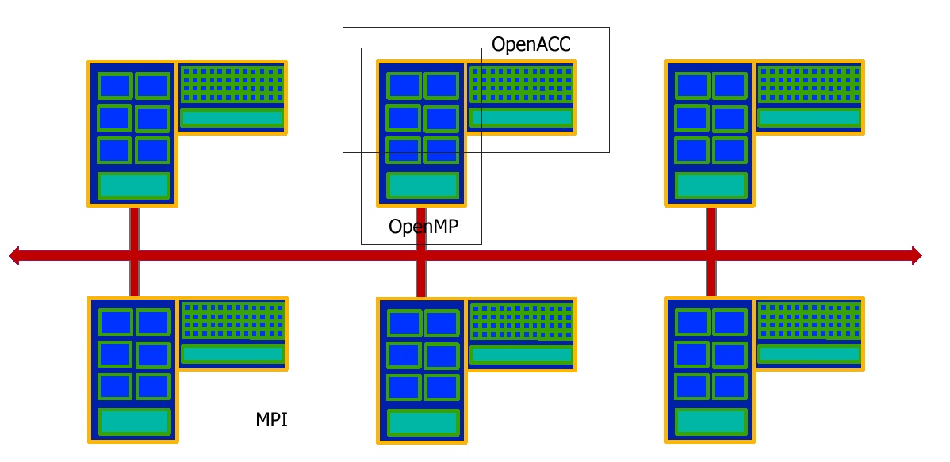
Mapping programming options to the hardware
Compute cluster
CPU
cores
GPU cores
Memory
Compute
node
Memory
Network
https://git.io/CHPC-Intro-to-Parallel-Computing
Slide <number>
Notes:
http://www.chpc.utah.edu
SISD – one instruction queue, one processing unit
SIMD – one queue but more processing at the time – specialized CPUs, often a lot of small (4,7,16) bit processing units
MIMD – full SISD CPUs aligned along in parallel – the choice now – can use cheap comodity CPUs

Slide 11
OpenMP basics
Compiler directives to parallelize (CPU or GPU)
Fortran – source code comments
!$omp parallel/!$omp end parallel
C/C++ - #pragmas
#pragma omp parallel
Small set of subroutines
Degree of parallelism specification
OMP_NUM_THREADS or omp_set_num_threads(INTEGER n)
https://git.io/CHPC-Intro-to-Parallel-Computing
Slide <number>
Notes:
http://www.chpc.utah.edu
OpenMP – not a new language
comp. Directives – specific format for Fortran and C – need a special compiler
Subroutines – small library to query and set no. of nodes, process node number,…

Slide 12
OpenACC Basics
Compiler directives to offload to GPU
Fortran – source code comments
!$acc kernels/!$acc end kernels
C/C++ - #pragmas
#pragma acc kernels
Small set of subroutines
Degree of parallelism specification
OMP_NUM_THREADS or omp_set_num_threads(INTEGER n)
https://git.io/CHPC-Intro-to-Parallel-Computing
Slide <number>
Notes:
http://www.chpc.utah.edu
OpenMP – not a new language
comp. Directives – specific format for Fortran and C – need a special compiler
Subroutines – small library to query and set no. of nodes, process node number,…

Slide 13
MPI Basics
Communication library
Language bindings:
C/C++ - int MPI_Init(int argv, char* argc[])
Fortran - MPI_Init(INTEGER ierr)
Quite complex (100+ subroutines)
but only small number used frequently
User defined parallel distribution
https://git.io/CHPC-Intro-to-Parallel-Computing
Slide <number>
Notes:
http://www.chpc.utah.edu
In which data are communicated from one process to another – either point-to-point or collective (more procs. involved)
Since it is a library, don’t need special compiler, the mpif90,… commands some user may be familiar with are just scripts that specify locations of the MPI libraries, … and they call standard compilers.
But can write simple program with a handful of subroutines
= can not change number of nodes used by the code on the fly (but can create a sub-communicator that can take only a fraction of the allocated nodes)

Slide 14
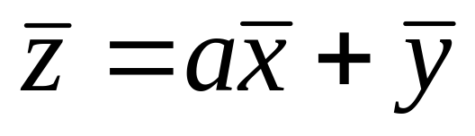
Program example
saxpy – vector addition:
simple loop, no cross-dependence, easy to parallelize
subroutine saxpy_serial(z, a, x, y, n)
integer i, n
real z(n), a, x(n), y(n)
do i=1, n
z(i) = a*x(i) + y(i)
enddo
return
https://git.io/CHPC-Intro-to-Parallel-Computing
Slide <number>
Notes:
http://www.chpc.utah.edu
Just loop through all the vector dimension, calculate the product and store in z(i)

Slide 15
OpenMP program example
subroutine saxpy_parallel_omp(z, a, x, y, n)
integer i, n
real z(n), a, x(n), y(n)
!$omp parallel do
do i=1, n
z(i) = a*x(i) + y(i)
enddo
return
$ gcc –fopenmp saxpy.f
$ export OMP_NUM_THREADS=16
$ ./a.out
FORK
JOIN
https://git.io/CHPC-Intro-to-Parallel-Computing
Slide <number>
Notes:
http://www.chpc.utah.edu
Just one extra directive to parallelize the loop
Automatic load balance (although there are options to modify this)
Set the number of nodes via OMP_NUM_NODES
Won’t say more about OpenMP, but its syntax is relatively simple – less than 10 directives, about the same amount of functions, ca 15 options that control data sharing, thread execution order,…

Slide 16
OpenMP caveats
Data dependencies
  Private (thread-local) variables
  Flow dependence – rearrangement
  Reduction (sum over threads)
Scheduling
  What runs on what thread – schedule, task,…
Advanced features
  Thread affinity (to CPU core)
  Vectorization
  Accelerator offload
x = a(i)
b(i) = c + x
a(i) = a(i+1) + x
x += a(i)
https://git.io/CHPC-Intro-to-Parallel-Computing
Slide <number>
Notes:
http://www.chpc.utah.edu
Just one extra directive to parallelize the loop
Automatic load balance (although there are options to modify this)
Set the number of nodes via OMP_NUM_NODES
Won’t say more about OpenMP, but its syntax is relatively simple – less than 10 directives, about the same amount of functions, ca 15 options that control data sharing, thread execution order,…

Slide 17
OpenACC program example
subroutine saxpy_parallel_oacc(z, a, x, y, n)
integer i, n
real z(n), a, x(n), y(n)
!$acc kernels datain(x,y) dataout(z)
do i=1, n
z(i) = a*x(i) + y(i)
enddo
return
$ pgcc –acc –Minfo=accel saxpy.f
$ pgaccelinfo
$ ./a.out
Offload to GPU
Return from GPU
To verify that GPU is available
https://git.io/CHPC-Intro-to-Parallel-Computing
Slide <number>
Notes:
http://www.chpc.utah.edu
Just one extra directive to parallelize the loop
Automatic load balance (although there are options to modify this)
Set the number of nodes via OMP_NUM_NODES
Won’t say more about OpenMP, but its syntax is relatively simple – less than 10 directives, about the same amount of functions, ca 15 options that control data sharing, thread execution order,…

Slide 18
OpenACC caveats
Data dependencies (Like in OpenMP)
Data locality
  Transfers from host to GPU and back take time – need to minimize them
  #pragma acc data [copyin, copyout, create,...]
Parallel regions
  More explicit execution control (warps, threads)
  #pragma acc parallel
Procedure calls
  If procedure is executed on the GPU
  #pragma acc routine
https://git.io/CHPC-Intro-to-Parallel-Computing
Slide <number>
Notes:
http://www.chpc.utah.edu
Just one extra directive to parallelize the loop
Automatic load balance (although there are options to modify this)
Set the number of nodes via OMP_NUM_NODES
Won’t say more about OpenMP, but its syntax is relatively simple – less than 10 directives, about the same amount of functions, ca 15 options that control data sharing, thread execution order,…

Slide 19
MPI program example
subroutine saxpy_parallel_mpi(z, a, x, y, n)
integer i, n, ierr, my_rank, nodes, i_st, i_end
real z(n), a, x(n), y(n)
call MPI_Init(ierr)
call MPI_Comm_rank(MPI_COMM_WORLD,my_rank,ierr)
call MPI_Comm_size(MPI_COMM_WORLD,nodes,ierr)
i_st = n/nodes*my_rank+1
i_end = n/nodes*(my_rank+1)
do i=i_st, i_end
z(i) = a*x(i) + y(i)
enddo
call MPI_Finalize(ierr)
return
P0
P1
P2
P3
z(i) operation on 4 processes (tasks)
z(1
… n/4)
z(n/4+1
… 2*n/4)
z(2*n/4+1
… 3*n/4)
z(3*n/4+1
… n)
https://git.io/CHPC-Intro-to-Parallel-Computing
Slide <number>
Notes:
http://www.chpc.utah.edu
must initialize and finalize MPI
The vectors are distributed on the CPUs (or x(i) is full on all CPUs)
Must calculate starting and finishing vector index for each node
Final vector z(i) is distributed on the nodes (would have to send the data the node does not own from the other nodes)

Slide 20
MPI program example
Result on the first CPU
include "mpif.h"
integer status(MPI_STATUS_SIZE)
if (my_rank .eq. 0 ) then
do j = 1, nodes-1
do i= n/nodes*j+1, n/nodes*(j+1)
call MPI_Recv(z(i),1,MPI_REAL,j,0,MPI_COMM_WORLD,
& status,ierr)
enddo
enddo
else
do i=i_st, i_end
call MPI_Send(z(i),1,MPI_REAL,0,0,MPI_COMM_WORLD,ierr)
enddo
endif
P3
P2
P1
P0
Sender
Data
Count
Recipient
https://git.io/CHPC-Intro-to-Parallel-Computing
Slide <number>
Notes:
http://www.chpc.utah.edu
Here comes an actual message passing
All the processes apart from no. 0 send their results to process 0
Very inefficient – send one real at the time. Can speed this up by setting count to n/nodes, but then would have to take care of the receiving buffer – will show a better solution on the next slide.
Also, MPI provides various functions to optimize the communication count via so called derived datatypes.
Look at the syntax of the Send/Recv calls, most of the communication subroutines have similar syntax:
Communicated data, their count and type, sender/receiver, tag and communicator. Tag and communicator serve to differentiate between various kinds of messages that can be in transport at given time.

Slide 21
MPI program example
zi(i)
Process 0
Collective communication
real zi(n)
j = 1
do i=i_st, i_end
zi(j) = a*x(i) + y(i)
j = j +1
enddo
call MPI_Gather(zi,n/nodes,MPI_REAL,z,n/nodes,MPI_REAL,
& 0,MPI_COMM_WORLD,ierr)
Result on all nodes
call MPI_AllGather(zi,n/nodes,MPI_REAL,z,n/nodes,
& MPI_REAL,MPI_COMM_WORLD,ierr)
zi(i)
Process 1
zi(i)
Process 2
zi(i)
Process 3
z(i)
Send data
Receive data
Root process
No root process
https://git.io/CHPC-Intro-to-Parallel-Computing
Slide <number>
Notes:
http://www.chpc.utah.edu
To give a feel of MPI complexity:
Collective communication involves all the nodes at given time – don’t have to split using if statements
Gather – sends data from all processes to root process (here 0)

Slide 22
MPI caveats
Explicit task based parallelism
  manual work distribution
  task communication and synchronization
Communication patterns
  due to different data distribution
Many advanced features
  blocking vs. non-blocking communication
  derived data types
  topologies
  …
broadcast
reduction
gather/scatter
…
https://git.io/CHPC-Intro-to-Parallel-Computing
Slide <number>
Notes:
http://www.chpc.utah.edu
Just one extra directive to parallelize the loop
Automatic load balance (although there are options to modify this)
Set the number of nodes via OMP_NUM_NODES
Won’t say more about OpenMP, but its syntax is relatively simple – less than 10 directives, about the same amount of functions, ca 15 options that control data sharing, thread execution order,…

Slide 23
MPI distributions
Different networks
  Ethernet
  InfiniBand
  Intel OmniPath
  most MPI distributions now come with multiple networks support
Several distributions follow the MPI standard
  MPICH, MVAPICH2
  Intel MPI, Cray MPI,…
  OpenMPI
  Ensure that build and run is done with the same distribution (ABI compatibility)
https://git.io/CHPC-Intro-to-Parallel-Computing
Slide <number>
Notes:
http://www.chpc.utah.edu
Interactive batch – use reasonable time limits, mostly used for debugging
Batch – production runs – check the right syntax on SP and IB

Slide 24
But wait, my program is not in C or Fortran
Interpreted languages are popular
Matlab, Python, R
Each has some sort of parallel support, but most likely it will not perform as well as using OpenMP or MPI with C/Fortran.
Try to parallelize (and optimize ) your Matlab/Python/R code and if it’s still not enough consider rewriting in C++ or Fortran.
https://git.io/CHPC-Intro-to-Parallel-Computing
Slide <number>
Notes:
http://www.chpc.utah.edu
Shared memory
Threaded – pthreads – simple multitasking library (can run also in SISD computers), not suitable for complex parallel programming
OpenMP – first standard in sh. mem. supported by major vendors (Intel, Sun, SGI, IBM, Compaq, Fujitsu)
mess. Pasing – works here too, and is generally faster than on dist. mem, but there is overhead (message creation, reception)
Tests on sh. mem. multiprocessors show that MPI and OpenMP timings are similar, but OpenMP is easier to code.
BUT – since it’s a younger development, there are many unresolved issues (mixed Fortran-C applications, easy to write incorrect programs that work – shared, private variables – compared to implicit variable declaration in Fortran – easy to write but only if code correctly)
Distributed memory
old times – vendor specific – n.p. = a lot of effort needed to be spent to get the code running on different comp. Platform.
Now – last 10 yrs. - portable libraries, PVM – first, MPI, latest (last 5-6 yrs.)

Slide 25
Cluster running options for Matlab, Python, R
Using parallelization in the program run through interactive or batch job
  multi-threading and/or multi-processing packages (parfor, mpi4py, R parallel, Rmpi, …)
Using built in job submission
  Matlab Parallel Server, rslurm, python Dask, snakemake
Independent calculations in parallel
  launching concurrent calculations in a job
https://git.io/CHPC-Intro-to-Parallel-Computing
Slide <number>
Notes:
http://www.chpc.utah.edu
Shared memory
Threaded – pthreads – simple multitasking library (can run also in SISD computers), not suitable for complex parallel programming
OpenMP – first standard in sh. mem. supported by major vendors (Intel, Sun, SGI, IBM, Compaq, Fujitsu)
mess. Pasing – works here too, and is generally faster than on dist. mem, but there is overhead (message creation, reception)
Tests on sh. mem. multiprocessors show that MPI and OpenMP timings are similar, but OpenMP is easier to code.
BUT – since it’s a younger development, there are many unresolved issues (mixed Fortran-C applications, easy to write incorrect programs that work – shared, private variables – compared to implicit variable declaration in Fortran – easy to write but only if code correctly)
Distributed memory
old times – vendor specific – n.p. = a lot of effort needed to be spent to get the code running on different comp. Platform.
Now – last 10 yrs. - portable libraries, PVM – first, MPI, latest (last 5-6 yrs.)

Slide 26
Matlab
Threads
Built in Matlab functions. Vector/matrix operations threaded (and vectorized) through Intel MKL library, many other functions also threaded
Tasks (processes)
Parallel Computing Toolbox allows for task based parallelism
Parallel Server can distribute tasks to multiple nodes
Great for independent calculations, when communication is needed uses MPI under the hood
https://www.chpc.utah.edu/documentation/software/matlab.php
https://git.io/CHPC-Intro-to-Parallel-Computing
Slide <number>
Notes:
http://www.chpc.utah.edu
Shared memory
Threaded – pthreads – simple multitasking library (can run also in SISD computers), not suitable for complex parallel programming
OpenMP – first standard in sh. mem. supported by major vendors (Intel, Sun, SGI, IBM, Compaq, Fujitsu)
mess. Pasing – works here too, and is generally faster than on dist. mem, but there is overhead (message creation, reception)
Tests on sh. mem. multiprocessors show that MPI and OpenMP timings are similar, but OpenMP is easier to code.
BUT – since it’s a younger development, there are many unresolved issues (mixed Fortran-C applications, easy to write incorrect programs that work – shared, private variables – compared to implicit variable declaration in Fortran – easy to write but only if code correctly)
Distributed memory
old times – vendor specific – n.p. = a lot of effort needed to be spent to get the code running on different comp. Platform.
Now – last 10 yrs. - portable libraries, PVM – first, MPI, latest (last 5-6 yrs.)

Slide 27
Matlab tasks
Parallel program
function t = parallel_example
parfor idx = 1:16
A(idx) = idx;
end
Parallel worker pool on a single machine
poolobj=parpool('local',8);
parallel_example;
delete(poolobj);
Parallel pool on a cluster
c = parcluster;
c.AdditionalProperties.QueueName = 'kingspeak';
...
j = c.batch(@parallel_example, 1, {}, 'Pool', 4); j.State
j.fetchOutputs{:}
Will launch loop iterations on multiple workers
Starts multiple workers pool
Submits cluster job
https://git.io/CHPC-Intro-to-Parallel-Computing
Slide <number>
Notes:
http://www.chpc.utah.edu
Shared memory
Threaded – pthreads – simple multitasking library (can run also in SISD computers), not suitable for complex parallel programming
OpenMP – first standard in sh. mem. supported by major vendors (Intel, Sun, SGI, IBM, Compaq, Fujitsu)
mess. Pasing – works here too, and is generally faster than on dist. mem, but there is overhead (message creation, reception)
Tests on sh. mem. multiprocessors show that MPI and OpenMP timings are similar, but OpenMP is easier to code.
BUT – since it’s a younger development, there are many unresolved issues (mixed Fortran-C applications, easy to write incorrect programs that work – shared, private variables – compared to implicit variable declaration in Fortran – easy to write but only if code correctly)
Distributed memory
old times – vendor specific – n.p. = a lot of effort needed to be spent to get the code running on different comp. Platform.
Now – last 10 yrs. - portable libraries, PVM – first, MPI, latest (last 5-6 yrs.)

Slide 28
Matlab examples
Parallel worker pool on a single node
  best run from a SLURM job
  loop_parallel_onenode.m, run_matlab_onenode.m, run_matlab_onenode.slr
  https://git.io/CHPC-Intro-to-Parallel-Computing-Matlab
  sbatch run_matlab_onenode.slr
Parallel worker pool on a multiple nodes
  must run from inside of Matlab
  start Matlab on interactive node inside of a FastX session
  ml matlab
  matlab &
  loop_parallel.m, parallel_multinode.m
  parallel_multinode
https://git.io/CHPC-Intro-to-Parallel-Computing
Slide <number>
Notes:
http://www.chpc.utah.edu
Shared memory
Threaded – pthreads – simple multitasking library (can run also in SISD computers), not suitable for complex parallel programming
OpenMP – first standard in sh. mem. supported by major vendors (Intel, Sun, SGI, IBM, Compaq, Fujitsu)
mess. Pasing – works here too, and is generally faster than on dist. mem, but there is overhead (message creation, reception)
Tests on sh. mem. multiprocessors show that MPI and OpenMP timings are similar, but OpenMP is easier to code.
BUT – since it’s a younger development, there are many unresolved issues (mixed Fortran-C applications, easy to write incorrect programs that work – shared, private variables – compared to implicit variable declaration in Fortran – easy to write but only if code correctly)
Distributed memory
old times – vendor specific – n.p. = a lot of effort needed to be spent to get the code running on different comp. Platform.
Now – last 10 yrs. - portable libraries, PVM – first, MPI, latest (last 5-6 yrs.)

Slide 29
R
Threads
Under the hood threading with specially built (or Microsoft) R for vector/matrix operations using MKL
parallel R library
Tasks (processes)
parallel R library (uses multicore for shared and snow for distributed parallelism)
Parallelized *apply functions, e.g. mclapply
Rmpi library provides MPI like functionality
Many people run multiple independent R instances in parallel
https://www.chpc.utah.edu/documentation/software/r-language.php
https://git.io/CHPC-Intro-to-Parallel-Computing
Slide <number>
Notes:
http://www.chpc.utah.edu
Shared memory
Threaded – pthreads – simple multitasking library (can run also in SISD computers), not suitable for complex parallel programming
OpenMP – first standard in sh. mem. supported by major vendors (Intel, Sun, SGI, IBM, Compaq, Fujitsu)
mess. Pasing – works here too, and is generally faster than on dist. mem, but there is overhead (message creation, reception)
Tests on sh. mem. multiprocessors show that MPI and OpenMP timings are similar, but OpenMP is easier to code.
BUT – since it’s a younger development, there are many unresolved issues (mixed Fortran-C applications, easy to write incorrect programs that work – shared, private variables – compared to implicit variable declaration in Fortran – easy to write but only if code correctly)
Distributed memory
old times – vendor specific – n.p. = a lot of effort needed to be spent to get the code running on different comp. Platform.
Now – last 10 yrs. - portable libraries, PVM – first, MPI, latest (last 5-6 yrs.)

Slide 30
Parallel R on a cluster
Load libraries
library(parallel)
library(foreach)
library(doParallel)
Start R cluster
hostlist <- paste(unlist(read.delim(file="hostlist.txt", header=F, sep =" ")))
cl <- makeCluster(hostlist)
registerDoParallel(cl)
clusterEvalQ(cl,.libPaths("/uufs/chpc.utah.edu/sys/installdir/RLibs/3.5.2i"))
Run parallel loop
r <- foreach(icount(trials), .combine=rbind) %dopar% {}
Stop R cluster
stopCluster(cl)
hostlist.txt comes from a job script
srun -n $SLURM_NTASKS > hostlist.txt
this is only needed if running on multiple nodes
https://git.io/CHPC-Intro-to-Parallel-Computing
Slide <number>
Notes:
http://www.chpc.utah.edu
Shared memory
Threaded – pthreads – simple multitasking library (can run also in SISD computers), not suitable for complex parallel programming
OpenMP – first standard in sh. mem. supported by major vendors (Intel, Sun, SGI, IBM, Compaq, Fujitsu)
mess. Pasing – works here too, and is generally faster than on dist. mem, but there is overhead (message creation, reception)
Tests on sh. mem. multiprocessors show that MPI and OpenMP timings are similar, but OpenMP is easier to code.
BUT – since it’s a younger development, there are many unresolved issues (mixed Fortran-C applications, easy to write incorrect programs that work – shared, private variables – compared to implicit variable declaration in Fortran – easy to write but only if code correctly)
Distributed memory
old times – vendor specific – n.p. = a lot of effort needed to be spent to get the code running on different comp. Platform.
Now – last 10 yrs. - portable libraries, PVM – first, MPI, latest (last 5-6 yrs.)

Slide 31
R examples
Parallel R on one node
  best run from a SLURM job
  parallel-onenode-iris.R, R-parallel-onenode-iris.slr
  https://git.io/CHPC-Intro-to-Parallel-Computing-R
  sbatch R-parallel-onenode-iris.slr
Parallel R multiple nodes
  must specify list of nodes where R workers run
  parallel-multinode-iris.R, R-parallel-multinode-iris.slr-
  sbatch R-parallel-onenode-iris.slr
Submit SLURM job directly from R - rslurm
  SLURM-aware apply function, some issues with results collection
  rslurm-example.R
https://git.io/CHPC-Intro-to-Parallel-Computing
Slide <number>
Notes:
http://www.chpc.utah.edu
Shared memory
Threaded – pthreads – simple multitasking library (can run also in SISD computers), not suitable for complex parallel programming
OpenMP – first standard in sh. mem. supported by major vendors (Intel, Sun, SGI, IBM, Compaq, Fujitsu)
mess. Pasing – works here too, and is generally faster than on dist. mem, but there is overhead (message creation, reception)
Tests on sh. mem. multiprocessors show that MPI and OpenMP timings are similar, but OpenMP is easier to code.
BUT – since it’s a younger development, there are many unresolved issues (mixed Fortran-C applications, easy to write incorrect programs that work – shared, private variables – compared to implicit variable declaration in Fortran – easy to write but only if code correctly)
Distributed memory
old times – vendor specific – n.p. = a lot of effort needed to be spent to get the code running on different comp. Platform.
Now – last 10 yrs. - portable libraries, PVM – first, MPI, latest (last 5-6 yrs.)

Slide 32
Python
Threads
No threads in Python code because of GIL (Global Intepreter Lock)
C/Fortran functions can be threaded (e.g. NumPy - Anaconda)
Tasks (processes)
Several libraries that use MPI under the hood, most popular is mpi4py
More-less MPI function compatibility, but slower communication because of the extra overhead
Also many other data-parallel libraries, e.g. Dask
https://www.chpc.utah.edu/documentation/software/python.php
https://git.io/CHPC-Intro-to-Parallel-Computing
Slide <number>
Notes:
http://www.chpc.utah.edu
Shared memory
Threaded – pthreads – simple multitasking library (can run also in SISD computers), not suitable for complex parallel programming
OpenMP – first standard in sh. mem. supported by major vendors (Intel, Sun, SGI, IBM, Compaq, Fujitsu)
mess. Pasing – works here too, and is generally faster than on dist. mem, but there is overhead (message creation, reception)
Tests on sh. mem. multiprocessors show that MPI and OpenMP timings are similar, but OpenMP is easier to code.
BUT – since it’s a younger development, there are many unresolved issues (mixed Fortran-C applications, easy to write incorrect programs that work – shared, private variables – compared to implicit variable declaration in Fortran – easy to write but only if code correctly)
Distributed memory
old times – vendor specific – n.p. = a lot of effort needed to be spent to get the code running on different comp. Platform.
Now – last 10 yrs. - portable libraries, PVM – first, MPI, latest (last 5-6 yrs.)

Slide 33
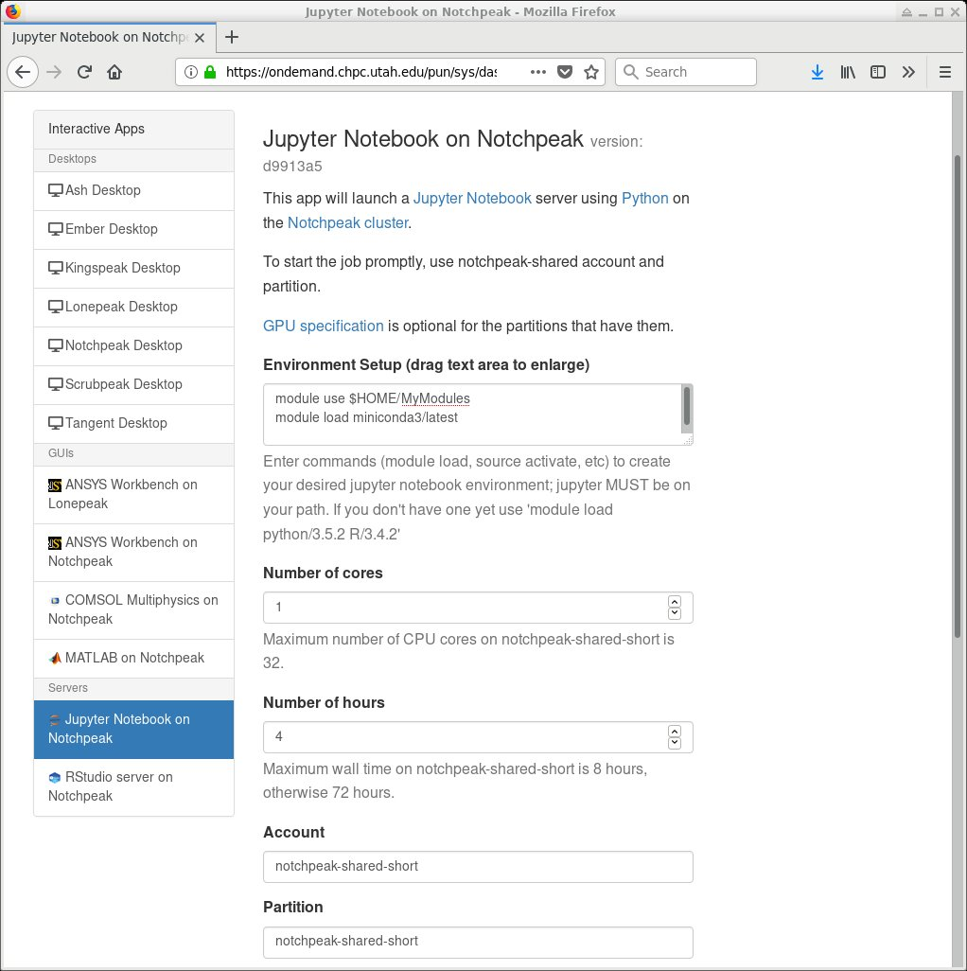
Python - Jupyter
Several options listed at https://www.chpc.utah.edu/documentation/software/jupyterhub.php
The easiest is to use Open OnDemand
https://git.io/CHPC-Intro-to-Parallel-Computing
Slide <number>
Notes:
http://www.chpc.utah.edu
Shared memory
Threaded – pthreads – simple multitasking library (can run also in SISD computers), not suitable for complex parallel programming
OpenMP – first standard in sh. mem. supported by major vendors (Intel, Sun, SGI, IBM, Compaq, Fujitsu)
mess. Pasing – works here too, and is generally faster than on dist. mem, but there is overhead (message creation, reception)
Tests on sh. mem. multiprocessors show that MPI and OpenMP timings are similar, but OpenMP is easier to code.
BUT – since it’s a younger development, there are many unresolved issues (mixed Fortran-C applications, easy to write incorrect programs that work – shared, private variables – compared to implicit variable declaration in Fortran – easy to write but only if code correctly)
Distributed memory
old times – vendor specific – n.p. = a lot of effort needed to be spent to get the code running on different comp. Platform.
Now – last 10 yrs. - portable libraries, PVM – first, MPI, latest (last 5-6 yrs.)

Slide 34
Python tasks
Our personal favorite is to ignore all the Python parallel efforts, divide the data into independent parts and run multiple Python processes on parts of the data concurrently
Only works if data can be split
Use various approaches for independent parallel calculations listed at https://www.chpc.utah.edu/documentation/software/serial-jobs.php
More on this later
https://git.io/CHPC-Intro-to-Parallel-Computing
Slide <number>
Notes:
http://www.chpc.utah.edu
Shared memory
Threaded – pthreads – simple multitasking library (can run also in SISD computers), not suitable for complex parallel programming
OpenMP – first standard in sh. mem. supported by major vendors (Intel, Sun, SGI, IBM, Compaq, Fujitsu)
mess. Pasing – works here too, and is generally faster than on dist. mem, but there is overhead (message creation, reception)
Tests on sh. mem. multiprocessors show that MPI and OpenMP timings are similar, but OpenMP is easier to code.
BUT – since it’s a younger development, there are many unresolved issues (mixed Fortran-C applications, easy to write incorrect programs that work – shared, private variables – compared to implicit variable declaration in Fortran – easy to write but only if code correctly)
Distributed memory
old times – vendor specific – n.p. = a lot of effort needed to be spent to get the code running on different comp. Platform.
Now – last 10 yrs. - portable libraries, PVM – first, MPI, latest (last 5-6 yrs.)

Slide 35
Python- Dask
With relatively small effort one can use Dask
Install Miniconda
wget https://repo.continuum.io/miniconda/Miniconda3-latest-Linux-x86_64.sh
bash ./Miniconda3-latest-Linux-x86_64.sh -b -p $HOME/software/pkg/miniconda3
mkdir -p $HOME/MyModules/miniconda3
cp /uufs/chpc.utah.edu/sys/installdir/python/modules/miniconda3/latest.lua $HOME/MyModules/miniconda3
Use own miniconda and install Jupyter and Dask
module use $HOME/MyModules
module load miniconda3/latest
conda install jupyter dask
Start Open OnDemand Jupyter notebook
  log into ondemand.chpc.utah.edu with CHPC credentials
https://git.io/CHPC-Intro-to-Parallel-Computing
Slide <number>
Notes:
http://www.chpc.utah.edu
Shared memory
Threaded – pthreads – simple multitasking library (can run also in SISD computers), not suitable for complex parallel programming
OpenMP – first standard in sh. mem. supported by major vendors (Intel, Sun, SGI, IBM, Compaq, Fujitsu)
mess. Pasing – works here too, and is generally faster than on dist. mem, but there is overhead (message creation, reception)
Tests on sh. mem. multiprocessors show that MPI and OpenMP timings are similar, but OpenMP is easier to code.
BUT – since it’s a younger development, there are many unresolved issues (mixed Fortran-C applications, easy to write incorrect programs that work – shared, private variables – compared to implicit variable declaration in Fortran – easy to write but only if code correctly)
Distributed memory
old times – vendor specific – n.p. = a lot of effort needed to be spent to get the code running on different comp. Platform.
Now – last 10 yrs. - portable libraries, PVM – first, MPI, latest (last 5-6 yrs.)

Slide 36
Python- Dask
Go to Interactive Apps - Jupyter Notebook on notchpeak
In the Environment Setup text box, put:
module use $HOME/MyModules
module load miniconda3/latest
Use notchpeak-shared-short for account and partition, and select your choice of CPU cores and walltime hours (within the listed limits). Then hit Launch to submit the job.
Once the job starts, hit the blue Connect to Jupyter button
Open one of the following notebooks:
dask_embarrass.ipynb, dask_slurmcluster.ipynb, dask_slurm_xarray.ipynb
DASK also allows to submit jobs to SLURM (last 2 examples)
https://git.io/CHPC-Intro-to-Parallel-Computing
Slide <number>
Notes:
http://www.chpc.utah.edu
Shared memory
Threaded – pthreads – simple multitasking library (can run also in SISD computers), not suitable for complex parallel programming
OpenMP – first standard in sh. mem. supported by major vendors (Intel, Sun, SGI, IBM, Compaq, Fujitsu)
mess. Pasing – works here too, and is generally faster than on dist. mem, but there is overhead (message creation, reception)
Tests on sh. mem. multiprocessors show that MPI and OpenMP timings are similar, but OpenMP is easier to code.
BUT – since it’s a younger development, there are many unresolved issues (mixed Fortran-C applications, easy to write incorrect programs that work – shared, private variables – compared to implicit variable declaration in Fortran – easy to write but only if code correctly)
Distributed memory
old times – vendor specific – n.p. = a lot of effort needed to be spent to get the code running on different comp. Platform.
Now – last 10 yrs. - portable libraries, PVM – first, MPI, latest (last 5-6 yrs.)

Slide 37
Independent calculations
Different approaches based on the nature of the calculations
  Runtime length, variability, number of calculations
Similar runtime, small calculation count
  Shell script in a SLURM job
  #!/bin/bash
  for (( i=0; i < $SLURM_NTASKS ; i++ )); do
  /path_to/myprogram $i &
  done
  wait
  srun –multi-prog
  srun --multi-prog my.conf
  cat my.conf
  0-11 ./example.sh %t
https://www.chpc.utah.edu/documentation/software/serial-jobs.php
https://git.io/CHPC-Intro-to-Parallel-Computing
Slide <number>
Notes:
http://www.chpc.utah.edu
Shared memory
Threaded – pthreads – simple multitasking library (can run also in SISD computers), not suitable for complex parallel programming
OpenMP – first standard in sh. mem. supported by major vendors (Intel, Sun, SGI, IBM, Compaq, Fujitsu)
mess. Pasing – works here too, and is generally faster than on dist. mem, but there is overhead (message creation, reception)
Tests on sh. mem. multiprocessors show that MPI and OpenMP timings are similar, but OpenMP is easier to code.
BUT – since it’s a younger development, there are many unresolved issues (mixed Fortran-C applications, easy to write incorrect programs that work – shared, private variables – compared to implicit variable declaration in Fortran – easy to write but only if code correctly)
Distributed memory
old times – vendor specific – n.p. = a lot of effort needed to be spent to get the code running on different comp. Platform.
Now – last 10 yrs. - portable libraries, PVM – first, MPI, latest (last 5-6 yrs.)

Slide 38
Variable runtime
Mini-scheduler inside of a job
  to launch calculations till all are done
  GNU Parallel - https://www.gnu.org/software/parallel/
  TACC Launcher - https://www.tacc.utexas.edu/research-development/tacc-software/the-launcher
  CHPC Submit - https://www.chpc.utah.edu/documentation/software/serial-jobs.php#submit
Workflow managers
  More on this later
  Makeflow, Swift, Snakemake, Pegasus
Distributed computing resources
  Open Science Grid - https://opensciencegrid.org/
https://git.io/CHPC-Intro-to-Parallel-Computing
Slide <number>
Notes:
http://www.chpc.utah.edu
Shared memory
Threaded – pthreads – simple multitasking library (can run also in SISD computers), not suitable for complex parallel programming
OpenMP – first standard in sh. mem. supported by major vendors (Intel, Sun, SGI, IBM, Compaq, Fujitsu)
mess. Pasing – works here too, and is generally faster than on dist. mem, but there is overhead (message creation, reception)
Tests on sh. mem. multiprocessors show that MPI and OpenMP timings are similar, but OpenMP is easier to code.
BUT – since it’s a younger development, there are many unresolved issues (mixed Fortran-C applications, easy to write incorrect programs that work – shared, private variables – compared to implicit variable declaration in Fortran – easy to write but only if code correctly)
Distributed memory
old times – vendor specific – n.p. = a lot of effort needed to be spent to get the code running on different comp. Platform.
Now – last 10 yrs. - portable libraries, PVM – first, MPI, latest (last 5-6 yrs.)

Slide 39
Debuggers
Useful for finding bugs in programs
Several free
  gdb – GNU, text based, limited parallel
  ddd – graphical frontend for gdb
Commercial that come with compilers
  pgdbg – PGI, graphical, parallel but not intuitive
  pathdb, idb – Pathscale, Intel, text based
Specialized commercial
  totalview – graphical, parallel, CHPC has a license
  ddt - Distributed Debugging Tool
  Intel Inspector XE – memory and threading error checker
How to use:
http://www.chpc.utah.edu/docs/manuals/software/par_devel.html
https://git.io/CHPC-Intro-to-Parallel-Computing
Slide <number>
Notes:
http://www.chpc.utah.edu
None of these is paricularly great (won’t catch many memory bugs, for example), apart from Insure, which is good but only for C/C++
Need to finish the webpage….

Slide 40
Debuggers - parallel
Parallel debugging more complex due to interaction between processes
DDT is the debugger of choice at CHPC
Expensive but academia get discount
How to run it:
  compile with –g flag
  run ddt command
  fill in information about executable, parallelism, …
Details:
https://www.chpc.utah.edu/documentation/software/debugging.php
Further information
https://www.allinea.com/products/ddt
https://git.io/CHPC-Intro-to-Parallel-Computing
Slide <number>
Notes:
http://www.chpc.utah.edu

Slide 41
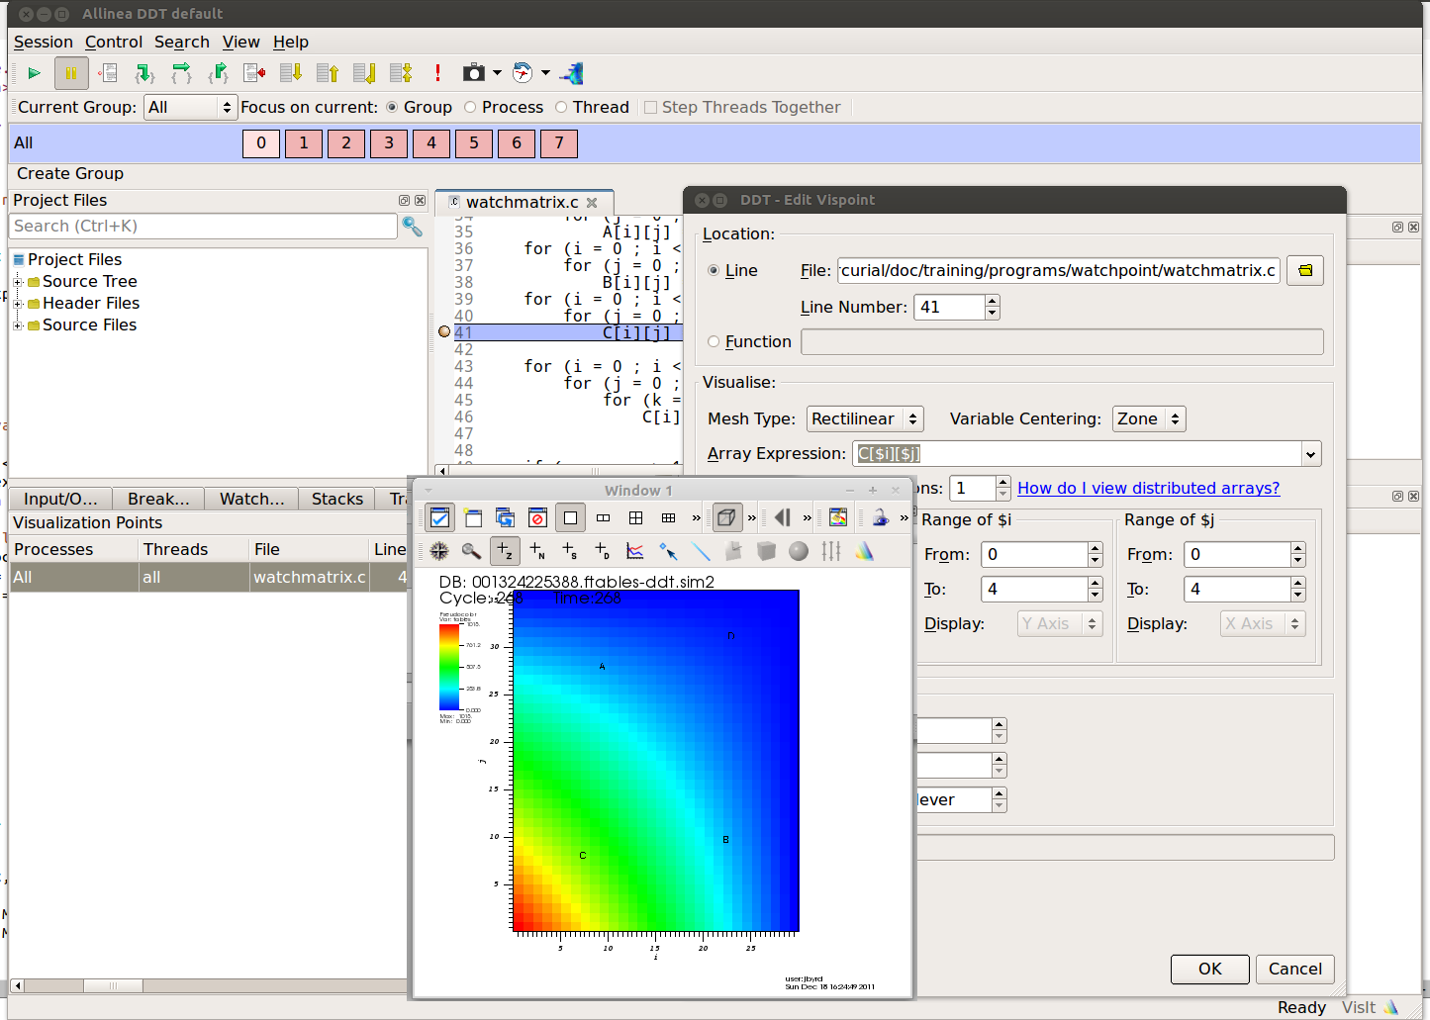
Debuggers – parallel
https://git.io/CHPC-Intro-to-Parallel-Computing
Slide <number>
Notes:
http://www.chpc.utah.edu
On the left side up, the window displays running processes (here 4)
On the right side is the debugger window
On the left side down is the variable inspection window.
To switch between the process debug views, double click the process in the process window, or push the arrow (up, down) in the main window.
Then describe the features on the main window.

Slide 42
Profilers
Measure performance of the code
Serial profiling
  discover inefficient programming
  computer architecture slowdowns
  compiler optimizations evaluation
  gprof, pgprof, pathopt2, Intel tools
Parallel profiling
  target is inefficient communication
  Intel Trace Collector and Analyzer, AdvisorXE, VTune
https://git.io/CHPC-Intro-to-Parallel-Computing
Slide <number>
Notes:
http://www.chpc.utah.edu
Speedshop – mostly serial, but has MPI routine time tracing capability
Xprofiler – probably similar to speedshop, now does not run since the MPI is not working fully correctly
Vampir – very good profiler designed specifically for MPI, records time spend in communication thus pointing to where the user should concentrate his effort to speed up the application

Slide 43
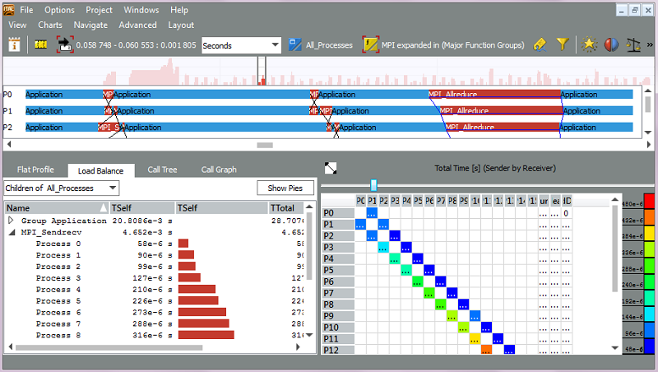
Profilers - parallel
https://git.io/CHPC-Intro-to-Parallel-Computing
Slide <number>
Notes:
http://www.chpc.utah.edu
Top window is the main menu part, through which can be open and customized the windows below
Global timeline shows execution profile of the program’s processes. It can be zoomed to particular region. Displays type of activity and messages direction and duration
Summary chart summarizes what time was spent where
Global activity chart does the same thing for each process
Parallelization shows distribution of the activity aligned with time, which shows what was run in parallel and what not.
All the windows have right click menus that enable to customize the views.
Overall, this profiler is very user friendly and easily customizable.
For this program we see that main part of the job is in the initial MPI_Bcast, which broadcasts initial data from process 0 to the rest. Here is the major area for the improvement.

Slide 44
Libraries
Use libraries for common operationsSerial
  BLAS, LAPACK – linear algebra routines
  MKL, ACML – hardware vendor libraries
Parallel
  ScaLAPACK, PETSc, FFTW
  MKL – dense and sparse matrices
Design a new code around existing library
  PETSc, Trilinos,…
https://git.io/CHPC-Intro-to-Parallel-Computing
Slide <number>
Notes:
http://www.chpc.utah.edu
Not everything needs to be programmed from the scratch. Most of the vendors and many independent organizations supply libraries that can be used for commonly used tasks.
One of them – numerical math.
Most of the stuff is on Raptor – SGI’s SCSL is parallelized linear algebra library similar to BLAS and LAPACK, PETSc is more for numerical solutions of PDEs, NAG contains many routines from linal, PEDs, Fourier transforms,… Should be callable from both C and Fortran
SP has IBM’s version of SCALAPACK – parallel LAPACK – PESSL
Icebox currently does not have anything installed, but can try for PBLAS, SCALAPACK or PETSc, which are public domain. If you are interested, send us e-mail.

Slide 45
Single executable across desktops and clusters
MPICH, MVAPICH2 and Intel MPI are cross-compatible using the same ABI
  Can e.g. compile with MPICH on a desktop, and then run on the cluster using MVAPICH2 and InfiniBand
Intel and PGI compilers allow to build "unified binary" with optimizations for different CPU platforms
  But in reality it only works well under Intel compilers
On a desktop
module load intel mpich
mpicc –axCORE-AVX512,CORE-AVX2,AVX program.c –o program.exe
mpirun –np 4 ./program.exe
On a cluster
srun –N 2 –n 24 ...
module load intel mvapich2
mpirun –np $SLURM_NTASKS ./program.exe
https://www.chpc.utah.edu/documentation/software/single-executable.php
https://git.io/CHPC-Intro-to-Parallel-Computing
Slide <number>
Notes:
http://www.chpc.utah.edu
Interactive batch – use reasonable time limits, mostly used for debugging
Batch – production runs – check the right syntax on SP and IB

Slide 46
Summary
Shared vs. Distributed memory parallelism
OpenMP, OpenACC and MPI for low level parallelism
Different approaches for higher level languages
Many ways to run independent calculations in parallel
There are tools for debugging, profiling
https://git.io/CHPC-Intro-to-Parallel-Computing
Slide <number>
Notes:
http://www.chpc.utah.edu
Difference between Sh and Dist M – shared – all processes have access to whole memory on the computer
Dist – local machines – process accesses only local memory – must communicate via network to exchange info
OpenMP – for shared M. (although efforts to put also on dist. m.) Main advantage – simple, but not as flexible
MPI – distributed mem. – processes communicate by passing messages

Slide 47
To learn more
CHPC lectures
  https://www.chpc.utah.edu/presentations/index.php
XSEDE HPC Summer Boot Camp
  OpenMP, OpenACC, MPI
  https://www.youtube.com/XSEDETraining
Petascale Computing Institute
  Wide range of parallel programming topics
  videos at https://bluewaters.ncsa.illinois.edu/bw-petascale-computing-2019/agenda
XSEDE online training
  https://www.xsede.org/web/xup/online-training
https://git.io/CHPC-Intro-to-Parallel-Computing
Slide <number>
Notes:
http://www.chpc.utah.edu
Some useful references:
MPI – MPI project main web site – links from here to manuals, tutorials,…
Books – many, but those two are quite good and explanatory
OpenMP – OMP project website
Book – just published – good overview
And our website contains info on the systems, software on CHPC

