Slide 1
Running Jobs at the CHPC with Slurm
Ashley Dederich & Emilie Parra
Research Consulting & Faculty Engagement
Center for High Performance Computing
ashley.dederich@utah.edu

Slide 2
Overview of Talk
Overview
Basics of a Slurm Script
Getting Started
Example Dataset
Hands On: Batch Scripting
#1: Submitting to Notchpeak Cluster
#2: Submitting to Owner Nodes
Hands On #3: Start an Interactive Job
Hands On #4: Open OnDemand’s Job Composer

Slide 3
Overview of Talk
Overview
Basics of a Slurm Script
Getting Started
Example Dataset
Hands On: Batch Scripting
#1: Submitting to Notchpeak Cluster
#2: Submitting to Owner Nodes
Hands On #3: Start an Interactive Job
Hands On #4: Open OnDemand’s Job Composer

Slide 4
Re-cap of Resources
CHPC resources:
HPC clusters:
General Environment: notchpeak, kingspeak, lonepeak
Protected Environment (PE): redwood
Others
VM (Windows, Linux)
Storage
Services
Condominium mode:
HPC Cluster = CHPC-owned nodes (general nodes) + PI-owned nodes (owner nodes)
All CHPC users have access to CHPC-owned resources for free. Some clusters (notchpeak) need allocations (peer-reviewed proposals)
Owners (PI group) have the highest priority using owner nodes
All CHPC users have access to owner nodes in Guest mode for free (jobs subject to preemption)

Slide 5

What is Slurm?
Formerly known as Simple Linux Utility for Resource Management
Open-source workload manager for supercomputers/clusters
Manage resources (nodes/cores/memory/interconnect/gpus)
Schedule jobs (queueing/prioritization)
Used by 60% of the TOP500 supercomputers¹
Fun fact: development team based in Lehi, UT
[1] https://en.wikipedia.org/wiki/Slurm_Workload_Manager (2023 Jun)

Slide 6
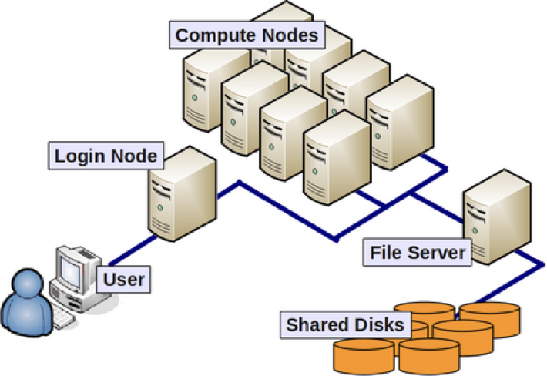
What is Slurm …and why use it?
Goal: you, the user, want to connect to the CHPC machines and analyze some data using R
You don’t want to analyze your data on the login node…
So, you connect to one of our clusters

Slide 7
The login node has limited resources
You could guess that, in this example, just a few people could overload the login node
Nobody could login, edit files, etc…

Slide 8
*Slurm allows users to request a compute job to run on compute nodes
Notes:
So, how do we go about asking SLURM to submit a job for us?

Slide 9
Overview of Talk
Overview
Basics of a Slurm Script
Getting Started
Example Dataset
Hands On: Batch Scripting
#1: Submitting to Notchpeak Cluster
#2: Submitting to Owner Nodes
Hands On #3: Start an Interactive Job
Hands On #4: Open OnDemand’s Job Composer

Slide 10
#!/bin/bash
#SBATCH --account=owner-guest
#SBATCH --partition=kingspeak-shared-guest
#SBATCH --time=02:00:00
#SBATCH --nodes=1
#SBATCH --ntasks=8
#SBATCH --mem=32G
#SBATCH -o slurmjob-%j.out-%N
#SBATCH -e slurmjob-%j.err-%N
#set up the temporary directory
SCRDIR=/scratch/general/vast/$USER/$SLURM_JOB_ID
mkdir -p $SCRDIR
#copy over input files
cp file.input $SCRDIR/.
cd $SCRDIR
#Set up whatever package we need to run with
module load <some-module>
#Run the program with our input
myprogram < file.input > file.output
#Move files out of working directory and clean up
cp file.output $HOME/.
cd $HOME
rm -rf $SCRDIR
#!/bin/tcsh
#SBATCH --account=owner-guest
#SBATCH --partition=kingspeak-shared-guest
#SBATCH --time=02:00:00
#SBATCH --nodes=1
#SBATCH --ntasks=8
#SBATCH --mem=32G
#SBATCH -o slurmjob-%j.out-%N
#SBATCH -e slurmjob-%j.err-%N
#set up the scratch directory
set SCRDIR /scratch/general/vast/$USER/$SLURM_JOB_ID
mkdir -p $SCRDIR
#move input files into scratch directory
cp file.input $SCRDIR/.
cd $SCRDIR
#Set up whatever package we need to run with
module load <some-module>
#Run the program with our input
myprogram < file.input > file.output
#Move files out of working directory and clean up
cp file.output $HOME/.
cd $HOME
rm -rf $SCRDIR
Notes:
This is what a slurm script looks like all together. It looks like a lot of information at first, but lets break it down piece by piece.

Slide 11
#!/bin/bash
#SBATCH --account=owner-guest
#SBATCH --partition=kingspeak-shared-guest
#SBATCH --time=02:00:00
#SBATCH --nodes=1
#SBATCH --ntasks=8
#SBATCH --mem=32G
#SBATCH -o slurmjob-%j.out-%N
#SBATCH -e slurmjob-%j.err-%N
#!/bin/tcsh
#SBATCH --account=owner-guest
#SBATCH --partition=kingspeak-shared-guest
#SBATCH --time=02:00:00
#SBATCH --nodes=1
#SBATCH --ntasks=8
#SBATCH --mem=32G
#SBATCH -o slurmjob-%j.out-%N
#SBATCH -e slurmjob-%j.err-%N
Notes:
The first thing you will need to fill out are the #SBATCH directives. Lets focus on the most important part – account and partition

Slide 12
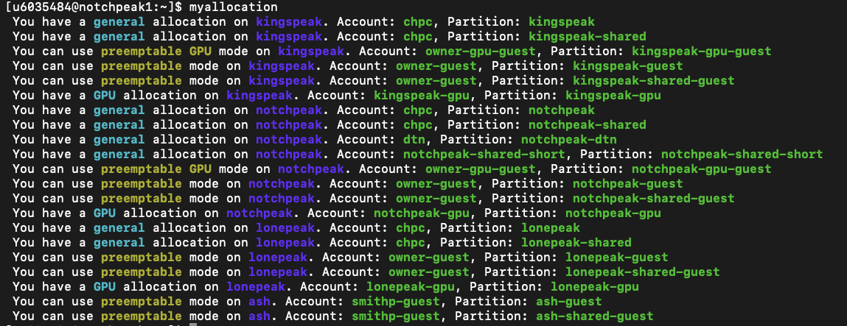
Preparing a SLURM Job
myallocation
Helpful command; shows what resources you have access to
Allocation state
cluster
account
partition
Notes:
Cluster, account, and partition are information you will need to submit a SLURM job.

Slide 13
#!/bin/bash
#SBATCH --account=owner-guest
#SBATCH --partition=kingspeak-shared-guest
#SBATCH --time=02:00:00
#SBATCH --nodes=1
#SBATCH --ntasks=8
#SBATCH --mem=32G
#SBATCH -o slurmjob-%j.out-%N
#SBATCH -e slurmjob-%j.err-%N
#!/bin/tcsh
#SBATCH --account=owner-guest
#SBATCH --partition=kingspeak-shared-guest
#SBATCH --time=02:00:00
#SBATCH --nodes=1
#SBATCH --ntasks=8
#SBATCH --mem=32G
#SBATCH -o slurmjob-%j.out-%N
#SBATCH -e slurmjob-%j.err-%N
#SBATCH --time=02:00:00 specifies wall time of a job in Hours:Minutes:Seconds
#SBATCH -t 02:00:00
also works

Slide 14
#!/bin/bash
#SBATCH --account=owner-guest
#SBATCH --partition=kingspeak-shared-guest
#SBATCH --time=02:00:00
#SBATCH --nodes=1
#SBATCH --ntasks=8
#SBATCH --mem=32G
#SBATCH -o slurmjob-%j.out-%N
#SBATCH -e slurmjob-%j.err-%N
#!/bin/tcsh
#SBATCH --account=owner-guest
#SBATCH --partition=kingspeak-shared-guest
#SBATCH --time=02:00:00
#SBATCH --nodes=1
#SBATCH --ntasks=8
#SBATCH --mem=32G
#SBATCH -o slurmjob-%j.out-%N
#SBATCH -e slurmjob-%j.err-%N
#SBATCH --nodes=1 specifies number of nodes
#SBATCH -N 1
also works

Slide 15
#!/bin/bash
#SBATCH --account=owner-guest
#SBATCH --partition=kingspeak-shared-guest
#SBATCH --time=02:00:00
#SBATCH --nodes=1
#SBATCH --ntasks=8
#SBATCH --mem=32G
#SBATCH -o slurmjob-%j.out-%N
#SBATCH -e slurmjob-%j.err-%N
#!/bin/tcsh
#SBATCH --account=owner-guest
#SBATCH --partition=kingspeak-shared-guest
#SBATCH --time=02:00:00
#SBATCH --nodes=1
#SBATCH --ntasks=8
#SBATCH --mem=32G
#SBATCH -o slurmjob-%j.out-%N
#SBATCH -e slurmjob-%j.err-%N
#SBATCH --ntasks=8 total number of tasks (cpu cores) (or -n)
#SBATCH -n 8
also works

Slide 16
#!/bin/bash
#SBATCH --account=owner-guest
#SBATCH --partition=kingspeak-shared-guest
#SBATCH --time=02:00:00
#SBATCH --nodes=1
#SBATCH --ntasks=8
#SBATCH --mem=32G
#SBATCH -o slurmjob-%j.out-%N
#SBATCH -e slurmjob-%j.err-%N
#!/bin/tcsh
#SBATCH --account=owner-guest
#SBATCH --partition=kingspeak-shared-guest
#SBATCH --time=02:00:00
#SBATCH --nodes=1
#SBATCH --ntasks=8
#SBATCH --mem=32G
#SBATCH -o slurmjob-%j.out-%N
#SBATCH -e slurmjob-%j.err-%N
#SBATCH --mem=32GB specifies total memory per node
#SBATCH --mem=0 gives you memory of whole node

Slide 17
#!/bin/bash
#SBATCH --account=owner-guest
#SBATCH --partition=kingspeak-shared-guest
#SBATCH --time=02:00:00
#SBATCH --nodes=1
#SBATCH --ntasks=8
#SBATCH --mem=32G
#SBATCH -o slurmjob-%j.out-%N
#SBATCH -e slurmjob-%j.err-%N
#!/bin/tcsh
#SBATCH --account=owner-guest
#SBATCH --partition=kingspeak-shared-guest
#SBATCH --time=02:00:00
#SBATCH --nodes=1
#SBATCH --ntasks=8
#SBATCH --mem=32G
#SBATCH -o slurmjob-%j.out-%N
#SBATCH -e slurmjob-%j.err-%N
#SBATCH -o outputs standard output in the form slurmjob-<JOBID>.out-<NODEID>
#SBATCH -e outputs error messages in the form slurmjob-<JOBID>.err-<NODEID>

Slide 18
#!/bin/bash
#SBATCH --account=owner-guest
#SBATCH --partition=kingspeak-shared-guest
#SBATCH --time=02:00:00
#SBATCH --nodes=1
#SBATCH --ntasks=8
#SBATCH --mem=32G
#SBATCH -o slurmjob-%j.out-%N
#SBATCH -e slurmjob-%j.err-%N
#SBATCH --constraints <CONSTRAINTS>
#!/bin/tcsh
#SBATCH --account=owner-guest
#SBATCH --partition=kingspeak-shared-guest
#SBATCH --time=02:00:00
#SBATCH --nodes=1
#SBATCH --ntasks=8
#SBATCH --mem=32G
#SBATCH -o slurmjob-%j.out-%N
#SBATCH -e slurmjob-%j.err-%N
#SBATCH --constraints <CONSTRAINTS>
Can also include constraints to target specific nodes
This can be memory avail, cpu count, specific owner nodes, etc

Slide 19
#!/bin/bash
#SBATCH --account=owner-guest
#SBATCH --partition=kingspeak-shared-guest
#SBATCH --time=02:00:00
#SBATCH --nodes=1
#SBATCH --ntasks=8
#SBATCH --mem=32G
#SBATCH -o slurmjob-%j.out-%N
#SBATCH -e slurmjob-%j.err-%N
#SBATCH --constraints “c40”
#!/bin/tcsh
#SBATCH --account=owner-guest
#SBATCH --partition=kingspeak-shared-guest
#SBATCH --time=02:00:00
#SBATCH --nodes=1
#SBATCH --ntasks=8
#SBATCH --mem=32G
#SBATCH -o slurmjob-%j.out-%N
#SBATCH -e slurmjob-%j.err-%N
#SBATCH --constraints “m768”
Can also include constraints to target specific nodes
This can be memory avail, cpu count, specific owner nodes, etc

Slide 20
#!/bin/bash
#SBATCH --account=owner-guest
#SBATCH --partition=kingspeak-shared-guest
#SBATCH --time=02:00:00
#SBATCH --nodes=1
#SBATCH --ntasks=8
#SBATCH --mem=32G
#SBATCH -o slurmjob-%j.out-%N
#SBATCH -e slurmjob-%j.err-%N
#SBATCH --constraints “c40&m768”
#!/bin/tcsh
#SBATCH --account=owner-guest
#SBATCH --partition=kingspeak-shared-guest
#SBATCH --time=02:00:00
#SBATCH --nodes=1
#SBATCH --ntasks=8
#SBATCH --mem=32G
#SBATCH -o slurmjob-%j.out-%N
#SBATCH -e slurmjob-%j.err-%N
#SBATCH --constraints “c40|c36”
Include c40 AND m768 nodes
Include c40 OR c36 nodes
Can also include constraints to target specific nodes
This can be memory avail, cpu count, specific owner nodes, etc

Slide 21
#!/bin/bash
#SBATCH --account=owner-guest
#SBATCH --partition=kingspeak-shared-guest
#SBATCH --time=02:00:00
#SBATCH --nodes=1
#SBATCH --ntasks=8
#SBATCH --mem=32G
#SBATCH -o slurmjob-%j.out-%N
#SBATCH -e slurmjob-%j.err-%N
#set up the temporary directory
SCRDIR=/scratch/general/vast/$USER/$SLURM_JOB_ID
mkdir -p $SCRDIR
#copy over input files
cp file.input $SCRDIR/.
cd $SCRDIR
#!/bin/tcsh
#SBATCH --account=owner-guest
#SBATCH --partition=kingspeak-shared-guest
#SBATCH --time=02:00:00
#SBATCH --nodes=1
#SBATCH --ntasks=8
#SBATCH --mem=32G
#SBATCH -o slurmjob-%j.out-%N
#SBATCH -e slurmjob-%j.err-%N
#set up the scratch directory
set SCRDIR /scratch/general/vast/$USER/$SLURM_JOB_ID
mkdir -p $SCRDIR
#move input files into scratch directory
cp file.input $SCRDIR/.
cd $SCRDIR
Points to your uNID
Points to your uNID
Create an environmental variable that points to scratch path
Notes:
Create environmental var
$USER
Notice $SLURM_JOB_ID – lets talk about this

Slide 22
SLURM Environment Variables
Some useful environment variables:
$SLURM_JOB_ID
$SLURM_SUBMIT_DIR
$SLURM_NNODES
$SLURM_NTASKS
Can get them for a given set of directives by using the env command inside a script (or in a srun session).
See: https://slurm.schedmd.com/sbatch.html#SECTION_OUTPUT-ENVIRONMENT-VARIABLES
Notes:
SLURM sets environmental variables for us that we can call in our script, including $SLURM_JOB_ID
There is a whole bunch of different vars that slurm sets, you can see a complete list at this link, available in the pdf of these slides.
Back to our regularly scheduled programming

Slide 23
#!/bin/bash
#SBATCH --account=owner-guest
#SBATCH --partition=kingspeak-shared-guest
#SBATCH --time=02:00:00
#SBATCH --nodes=1
#SBATCH --ntasks=8
#SBATCH --mem=32G
#SBATCH -o slurmjob-%j.out-%N
#SBATCH -e slurmjob-%j.err-%N
#set up the temporary directory
SCRDIR=/scratch/general/vast/$USER/$SLURM_JOB_ID
mkdir -p $SCRDIR
#copy over input files
cp file.input $SCRDIR/.
cd $SCRDIR
#!/bin/tcsh
#SBATCH --account=owner-guest
#SBATCH --partition=kingspeak-shared-guest
#SBATCH --time=02:00:00
#SBATCH --nodes=1
#SBATCH --ntasks=8
#SBATCH --mem=32G
#SBATCH -o slurmjob-%j.out-%N
#SBATCH -e slurmjob-%j.err-%N
#set up the scratch directory
set SCRDIR /scratch/general/vast/$USER/$SLURM_JOB_ID
mkdir -p $SCRDIR
#move input files into scratch directory
cp file.input $SCRDIR/.
cd $SCRDIR
Create the scratch directory
Notes:
Create environmental var
$USER
Notice $SLURM_JOB_ID – lets talk about this

Slide 24
#!/bin/bash
#SBATCH --account=owner-guest
#SBATCH --partition=kingspeak-shared-guest
#SBATCH --time=02:00:00
#SBATCH --nodes=1
#SBATCH --ntasks=8
#SBATCH --mem=32G
#SBATCH -o slurmjob-%j.out-%N
#SBATCH -e slurmjob-%j.err-%N
#set up the temporary directory
SCRDIR=/scratch/general/vast/$USER/$SLURM_JOB_ID
mkdir -p $SCRDIR
#copy over input files
cp file.input $SCRDIR/.
cd $SCRDIR
#!/bin/tcsh
#SBATCH --account=owner-guest
#SBATCH --partition=kingspeak-shared-guest
#SBATCH --time=02:00:00
#SBATCH --nodes=1
#SBATCH --ntasks=8
#SBATCH --mem=32G
#SBATCH -o slurmjob-%j.out-%N
#SBATCH -e slurmjob-%j.err-%N
#set up the scratch directory
set SCRDIR /scratch/general/vast/$USER/$SLURM_JOB_ID
mkdir -p $SCRDIR
#move input files into scratch directory
cp file.input $SCRDIR/.
cd $SCRDIR
Copy over input files and move on over to $SCRDIR

Slide 25
#!/bin/bash
#SBATCH --account=owner-guest
#SBATCH --partition=kingspeak-shared-guest
#SBATCH --time=02:00:00
#SBATCH --nodes=1
#SBATCH --ntasks=8
#SBATCH --mem=32G
#SBATCH -o slurmjob-%j.out-%N
#SBATCH -e slurmjob-%j.err-%N
#set up the temporary directory
SCRDIR=/scratch/general/vast/$USER/$SLURM_JOB_ID
mkdir -p $SCRDIR
#copy over input files
cp file.input $SCRDIR/.
cd $SCRDIR
#Set up whatever package we need to run with
module load <some-module>
#!/bin/tcsh
#SBATCH --account=owner-guest
#SBATCH --partition=kingspeak-shared-guest
#SBATCH --time=02:00:00
#SBATCH --nodes=1
#SBATCH --ntasks=8
#SBATCH --mem=32G
#SBATCH -o slurmjob-%j.out-%N
#SBATCH -e slurmjob-%j.err-%N
#set up the scratch directory
set SCRDIR /scratch/general/vast/$USER/$SLURM_JOB_ID
mkdir -p $SCRDIR
#move input files into scratch directory
cp file.input $SCRDIR/.
cd $SCRDIR
#Set up whatever package we need to run with
module load <some-module>
Load the desired modules
Notes:
Load the desired modules into your environment so that the computer can recognize the commands you are giving it

Slide 26
#!/bin/bash
#SBATCH --account=owner-guest
#SBATCH --partition=kingspeak-shared-guest
#SBATCH --time=02:00:00
#SBATCH --nodes=1
#SBATCH --ntasks=8
#SBATCH --mem=32G
#SBATCH -o slurmjob-%j.out-%N
#SBATCH -e slurmjob-%j.err-%N
#set up the temporary directory
SCRDIR=/scratch/general/vast/$USER/$SLURM_JOB_ID
mkdir -p $SCRDIR
#copy over input files
cp file.input $SCRDIR/.
cd $SCRDIR
#Set up whatever package we need to run with
module load <some-module>
#Run the program with our input
myprogram < file.input > file.output
#!/bin/tcsh
#SBATCH --account=owner-guest
#SBATCH --partition=kingspeak-shared-guest
#SBATCH --time=02:00:00
#SBATCH --nodes=1
#SBATCH --ntasks=8
#SBATCH --mem=32G
#SBATCH -o slurmjob-%j.out-%N
#SBATCH -e slurmjob-%j.err-%N
#set up the scratch directory
set SCRDIR /scratch/general/vast/$USER/$SLURM_JOB_ID
mkdir -p $SCRDIR
#move input files into scratch directory
cp file.input $SCRDIR/.
cd $SCRDIR
#Set up whatever package we need to run with
module load <some-module>
#Run the program with our input
myprogram < file.input > file.output
Run the program you need to
Notes:
This is what a slurm script looks like all together. It looks like a lot of information at first, but lets break it down piece by piece.

Slide 27
#!/bin/bash
#SBATCH --account=owner-guest
#SBATCH --partition=kingspeak-shared-guest
#SBATCH --time=02:00:00
#SBATCH --nodes=1
#SBATCH --ntasks=8
#SBATCH --mem=32G
#SBATCH -o slurmjob-%j.out-%N
#SBATCH -e slurmjob-%j.err-%N
#set up the temporary directory
SCRDIR=/scratch/general/vast/$USER/$SLURM_JOB_ID
mkdir -p $SCRDIR
#copy over input files
cp file.input $SCRDIR/.
cd $SCRDIR
#Set up whatever package we need to run with
module load <some-module>
#Run the program with our input
myprogram < file.input > file.output
#Move files out of working directory and clean up
cp file.output $HOME/.
cd $HOME
rm -rf $SCRDIR
#!/bin/tcsh
#SBATCH --account=owner-guest
#SBATCH --partition=kingspeak-shared-guest
#SBATCH --time=02:00:00
#SBATCH --nodes=1
#SBATCH --ntasks=8
#SBATCH --mem=32G
#SBATCH -o slurmjob-%j.out-%N
#SBATCH -e slurmjob-%j.err-%N
#set up the scratch directory
set SCRDIR /scratch/local/$USER/$SLURM_JOB_ID
mkdir -p $SCRDIR
#move input files into scratch directory
cp file.input $SCRDIR/.
cd $SCRDIR
#Set up whatever package we need to run with
module load <some-module>
#Run the program with our input
myprogram < file.input > file.output
#Move files out of working directory and clean up
cp file.output $HOME/.
cd $HOME
rm -rf $SCRDIR
Copy output to your $HOME
Copy output to your $HOME
Move back to $HOME
Move back to $HOME
Remove $SCRDIR
Remove $SCRDIR
Notes:
Finally, you clean up after yourself.
Removing $SCRDIR is the most important part, because the scratch directories (vast and nfs1) frequently fill up and we have to remind users to clean up those directories.

Slide 28
#!/bin/bash
#SBATCH --account=owner-guest
#SBATCH --partition=kingspeak-shared-guest
#SBATCH --time=02:00:00
#SBATCH --nodes=1
#SBATCH --ntasks=8
#SBATCH --mem=32G
#SBATCH -o slurmjob-%j.out-%N
#SBATCH -e slurmjob-%j.err-%N
#set up the temporary directory
SCRDIR=/scratch/general/vast/$USER/$SLURM_JOB_ID
mkdir -p $SCRDIR
#copy over input files
cp file.input $SCRDIR/.
cd $SCRDIR
#Set up whatever package we need to run with
module load <some-module>
#Run the program with our input
myprogram < file.input > file.output
#Move files out of working directory and clean up
cp file.output $HOME/.
cd $HOME
rm -rf $SCRDIR
#!/bin/tcsh
#SBATCH --account=owner-guest
#SBATCH --partition=kingspeak-shared-guest
#SBATCH --time=02:00:00
#SBATCH --nodes=1
#SBATCH --ntasks=8
#SBATCH --mem=32G
#SBATCH -o slurmjob-%j.out-%N
#SBATCH -e slurmjob-%j.err-%N
#set up the scratch directory
set SCRDIR /scratch/local/$USER/$SLURM_JOB_ID
mkdir -p $SCRDIR
#move input files into scratch directory
cp file.input $SCRDIR/.
cd $SCRDIR
#Set up whatever package we need to run with
module load <some-module>
#Run the program with our input
myprogram < file.input > file.output
#Move files out of working directory and clean up
cp file.output $HOME/.
cd $HOME
rm -rf $SCRDIR
Done! Let’s call this file
FirstSlurmScript.sbatch
Notes:
And there you have it! You have a whole SLURM script.

Slide 29
Basic SLURM commands
sbatch FirstSlurmScript.sbatch - launch a batch job
Job ID
Notes:
sbatch is the command to use. If your #SBATCH directives have no errors, you will see a message pop up that looks like this…
This is the SLURM job id

Slide 30
Basic SLURM commands
sbatch FirstSlurmScript.sbatch - launch a batch job
squeue - shows all jobs in queue
squeue --me - shows only your jobs
squeue -u <uNID> - shows only your jobs
mysqueue* - shows job queue per partition and associated accounts you have access to on the cluster
*CHPC developed programs. See CHPC Newsletter 2023 Summer
Notes:
Give demonstration

Slide 31
Basic SLURM commands
sbatch FirstSlurmScript.sbatch - launch a batch job
squeue - shows all jobs in queue
squeue --me - shows only your jobs
squeue -u <uNID> - shows only your jobs
mysqueue* - shows job queue per partition and associated accounts you have access to on the cluster
scancel <jobid> - cancel a job
*CHPC developed programs. See CHPC Newsletter 2023 Summer
scancel 13335248

Slide 32
Overview of Talk
Overview
Basics of a Slurm Script
Getting Started
Example Dataset
Hands On: Batch Scripting
#1: Submitting to Notchpeak Cluster
#2: Submitting to Owner Nodes
Hands On #3: Start an Interactive Job
Hands On #4: Open OnDemand’s Job Composer

Slide 33
Getting Started
Download github repo:
git clone https://github.com/chpc-uofu/slurm-lectures.git

Slide 34
Overview of Talk
Overview
Basics of a Slurm Script
Getting Started
Example Dataset
Hands On: Batch Scripting
#1: Submitting to Notchpeak Cluster
#2: Submitting to Owner Nodes
Hands On #3: Start an Interactive Job
Hands On #4: Open OnDemand’s Job Composer

Slide 35
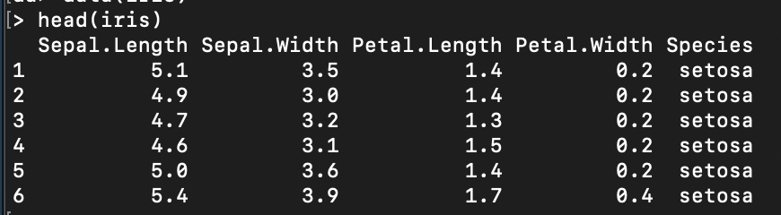
Example Dataset
R has built-in datasets
Using the iris dataset

Slide 36
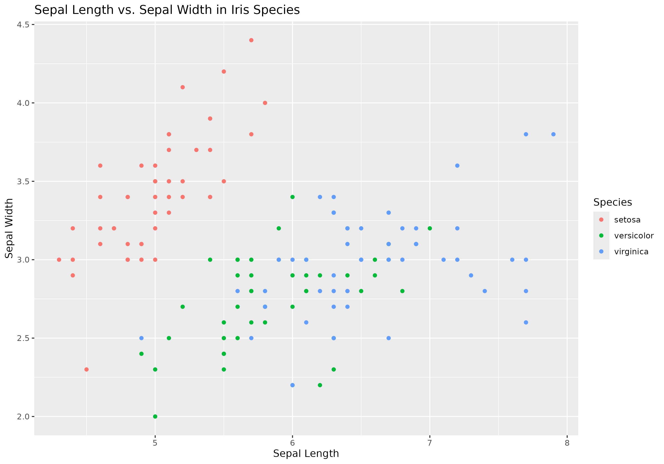
data_visualization.r
Script takes in iris.csv as a parameter
Plots sepal width vs. sepal length
Saves graph as IrisData.png

Slide 37
Overview of Talk
Overview
Basics of a Slurm Script
Getting Started
Example Dataset
Hands On: Batch Scripting
#1: Submitting to Notchpeak Cluster
#2: Submitting to Owner Nodes
Hands On #3: Start an Interactive Job
Hands On #4: Open OnDemand’s Job Composer

Slide 38
Overview of Talk
Overview
Basics of a Slurm Script
Getting Started
Example Dataset
Hands On: Batch Scripting
#1: Submitting to Notchpeak Cluster
#2: Submitting to Owner Nodes
Hands On #3: Start an Interactive Job
Hands On #4: Open OnDemand’s Job Composer

Slide 39
Hands On #1: Batch Scripting
Goal: Write a Slurm script that will copy the input data and R script over to a scratch directory and run the R script, meeting the following requirements:
Submit to Notchpeak’s shared-short partition
Request 1 CPU
Requests 25GB of memory
Runs for 5 minutes
Creates .out and .err files

Slide 40
Overview of Talk
Overview
Basics of a Slurm Script
Getting Started
Example Dataset
Hands On: Batch Scripting
#1: Submitting to Notchpeak Cluster
#2: Submitting to Owner Nodes
Hands On #3: Start an Interactive Job
Hands On #4: Open OnDemand’s Job Composer

Slide 41
Hands On #2: Batch Scripting
Goal: Write a Slurm script that will copy the input data and R script over to a scratch directory and run the R script, meeting the following requirements:
Submit to owner nodes on Notchpeak
Request 1 CPU
Requests 25GB of memory
Runs for 5 minutes
Creates .out and .err files

Slide 42
Hands On #2: Batch Scripting
Goal: Write a Slurm script that will copy the input data and R script over to a scratch directory and run the R script, meeting the following requirements:
Submit to owner nodes on Notchpeak
Request 1 CPU
Requests 25GB of memory
Runs for 5 minutes
Creates .out and .err files

Slide 43
Overview of Talk
Overview
Basics of a Slurm Script
Getting Started
Example Dataset
Hands On: Batch Scripting
#1: Submitting to Notchpeak Cluster
#2: Submitting to Owner Nodes
Hands On #3: Start an Interactive Job
Hands On #4: Open OnDemand’s Job Composer

Slide 44
Running interactive batch jobs
An interactive command is launched through the salloc command

Slide 45
Running interactive batch jobs
An interactive command is launched through the salloc command salloc --time=8:00:00 -–ntasks=4 --nodes=1 –-mem=16G --account=<account> --partition=kingspeak-shared

Slide 46
Hands On #3: Start an Interactive Job
Start an interactive session with salloc command and specify:
Notchpeak-shared-short partition and associated account
10 minutes time
Run the R script
Exit when R script has completed

Slide 47
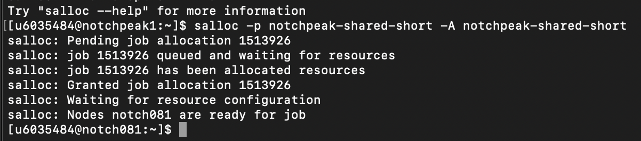
Hands On #3: Start an Interactive Job
After requesting interactive node with salloc, you saw:
Slurm grants job ID, no node granted yet
Node granted (notch081
Automatic ssh to node
- This gets around Arbiter if you have an interactive script
- This is a great way to open Rstudio sessions and other GUIs (through a FastX session).

Slide 48
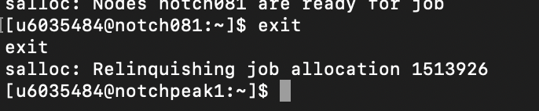
Hands On #3: Start an Interactive Job
After relinquishing the interactive node, you saw:
Job allocation revoked
Returned to login node

Slide 49
Overview of Talk
Overview
Basics of a Slurm Script
Getting Started
Example Dataset
Hands On: Batch Scripting
#1: Submitting to Notchpeak Cluster
#2: Submitting to Owner Nodes
Hands On #3: Start an Interactive Job
Hands On #4: Open OnDemand’s Job Composer

Slide 50
Open OnDemand
Open OnDemand has built-in tools available as a GUI
Great alternative for users who aren’t comfortable via command line
Notes:
Show them how this works in talk

Slide 51
Hands On #4: Open OnDemand
Navigate to ondemand.chpc.utah.edu
Go to the ‘Jobs’ menu item
Click ‘Job Composer’
Click ‘New Job’ -> ‘From Specified Path’
Input path that your Slurm script resides and submit job
Cancel the job

Slide 52
Hands On #4: Open OnDemand
Creating a job template
CHPC provides several job templates
You can create your own template
Only accessible to you
Select job that just ran
Click ‘create template’
Fill in fields
View your new Slurm template!

Slide 53
Hands On #4: Open OnDemand
Interested in learning more about Open OnDemand?
We give presentations on it every semester.
You can find slides and information here: https://www.chpc.utah.edu/presentations/OpenOnDemand.php

Slide 54
Slurm Documentation at CHPC
https://www.chpc.utah.edu/documentation/software/slurm.php
https://www.chpc.utah.edu/documentation/software/serial-jobs.php
https://www.chpc.utah.edu/documentation/software/node-sharing.php
https://www.chpc.utah.edu/usage/constraints/
https://www.chpc.utah.edu/documentation/guides/index.php#GenSlurm
Other good documentation sources
http://slurm.schedmd.com/documentation.html
http://slurm.schedmd.com/pdfs/summary.pdf
http://www.schedmd.com/slurmdocs/rosetta.pdf

Slide 55
Getting Help
CHPC website documentation
www.chpc.utah.edu
Getting started guide, cluster usage guides, software manual pages, CHPC policies
Email: helpdesk@chpc.utah.edu
Help Desk: 405 INSCC
We use chpc-hpc-users@lists.utah.edu for sending messages to users
Notes:
Will be changing to web maintenance.

