Slide 1


3D Face Recognition with Multi-Modal Data Fusion using Cloud-Net
VR SIDDHARTHA ENGINEERING COLLEGE, VIJAYAWADA
Department of Computer Science and Engineering
20CS6554: B. Tech Major Project (Internal Review)
April 7, 2025
Batch No: 17
Batch Members
Ch Purna Chandra Sekhar (218W1A05E9)
Andra Karthik (218W1A0D5)
Anupam Gupta(218W1A05D6)
Under the Guidance of
Dr.T.Bindu Madhavi
Assistant Professor

Slide 2
Abstract
Cloud-Net is a deep learning-based 3D face recognition model that integrates multi-modal data fusion to enhance identification accuracy. Traditional face recognition systems often struggle with variations in illumination, occlusions, and depth information loss, limiting their robustness. To overcome these challenges, Cloud-Net leverages RGB images, depth maps, and point cloud data to extract comprehensive facial features. The model undergoes extensive preprocessing, including data normalization, augmentation, and dimensionality reduction, followed by training using a 3D convolutional neural network (CNN) with residual learning. However, a key limitation of multi-modal face recognition is the increased computational complexity due to the high-dimensional nature of fused data. To address this, Cloud-Net employs an optimized architecture with lightweight convolutional blocks, reducing redundancy while preserving discriminative features. The authentication pipeline involves real-time face recognition, where the trained model processes multi-modal inputs and classifies individuals based on learned representations. The proposed system was tested on a large dataset and showed better recognition accuracy than existing methods.
Keywords: 3D Face Recognition, Multi-Modal Data Fusion, Point Cloud, Deep Learning, Convolutional Neural Networks (CNN), Identity Authentication.

Slide 3
Presentation Outline
Aim and Motivation
Research Questions
Title Justification
Objectives
Scope
Introduction
Study on Existing Technologies
Gap Analysis
SDLC Model
UML Diagrams
10.1. Use Case Diagram
  10.2. Sequence Diagram
  10.3. Activity Diagram
  10.4 Functional and Non-Functional
11. Data Collection
12. Methodology
12.1. Proposed Model
  12.2. Modules of the Proposed Model
  12.3. Algorithms
13. Results and Discussion
14. Timeline Chart
15. Results
References

Slide 4
1. Aim and Motivation
Aim:
The aim of Cloud-Net is to develop a 3D face recognition system that integrates multi-modal data fusion using RGB images, depth maps, and point cloud data to improve recognition accuracy. By leveraging deep learning, the system ensures robust authentication even under challenging conditions such as low light, partial occlusions, and variations in facial expressions.
Motivation:
Traditional 2D face recognition systems often fail in security-critical environments where variations in lighting, pose, and occlusions impact accuracy. A real-world example is airport security systems, where face recognition plays a vital role in passenger verification and fraud prevention. However, 2D images alone may not be sufficient due to poor lighting conditions or disguises. In 2019, an international airport reported identity fraud cases where impostors bypassed 2D facial recognition by using high-quality masks and photo prints.
To tackle such challenges, Cloud-Net integrates 3D facial data (point clouds and depth images), making it more resilient against spoofing attacks and variations in appearance. This real-time need for secure and accurate identity verification in airports, banking, and surveillance systems drives the development of a more advanced, multi-modal face recognition model.

Slide 5
2. Research Questions
How does 3D face recognition improve accuracy compared to traditional 2D image-based models?
How does CloudNet enhance the robustness of face recognition against varying light conditions?
What preprocessing techniques are most effective for handling LiDAR point cloud data in face recognition?
How does the integration of depth and structural features contribute to face recognition performance?
Can the proposed system be optimized for real-time recognition and edge deployment?
How does 3D face recognition perform in occluded or partially visible face scenarios?
What are the potential applications of 3D face recognition in security and authentication?

Slide 6
3. Title Justification
The title "Cloud-Net: 3D Face Recognition with Multi-Modal Data Fusion" is justified because:
Cloud-Net – The model is named Cloud-Net because it uses point cloud data (3D face data) and a deep learning network for recognition.
3D Face Recognition – Unlike traditional face recognition that uses only 2D images, this model uses 3D data (depth and point clouds) to improve accuracy.
Multi-Modal Data Fusion – The system combines RGB images, depth maps, and point cloud data, making recognition more reliable even in different conditions.

Slide 7
4. Objectives
To analyze existing 3D face recognition techniques and identify their limitations using multi-modal datasets.
To design and train a deep learning model (Cloud-Net) that integrates RGB images, depth maps, and point cloud data for accurate face recognition.
To develop a user-friendly interface for real-time authentication and identity verification.
To test the proposed model on diverse datasets to evaluate its accuracy, robustness, and performance in real-world scenarios.

Slide 8
5. Scope
1. The system focuses on offline face recognition and does not currently support real-time processing or live surveillance applications.
2. The system's predictions are based on multi-modal facial data (RGB, depth, and point cloud), ensuring precise and reliable authentication within this structured dataset.

Slide 9
6. Introduction
Face recognition has become an essential technology in various fields, including security, authentication, and surveillance. Traditional 2D face recognition systems often struggle with challenges such as lighting variations, occlusions, and pose changes, leading to reduced accuracy. To address these limitations, 3D face recognition has emerged as a more robust approach by utilizing additional depth information for improved feature extraction.
This project, Cloud-Net: 3D Face Recognition with Multi-Modal Data Fusion, aims to enhance face recognition accuracy by integrating RGB images, depth maps, and point cloud data. By leveraging deep learning techniques, particularly convolutional neural networks (CNNs), Cloud-Net effectively processes and fuses multi-modal data to generate a comprehensive facial representation. The system is designed to provide high accuracy and security, making it suitable for applications in biometric authentication, forensic investigations, and access control systems.
The proposed model undergoes preprocessing, feature extraction, and classification, ensuring reliable face recognition even in challenging conditions. By testing the model on large-scale datasets, Cloud-Net demonstrates superior performance compared to existing 2D and single-modal 3D face recognition methods.

Slide 10
7. Study on Existing Technologies
Title: SqueezeFace: Integrative Face Recognition Methods with LiDAR Sensors
Journal Details: Journal of Sensors,2021
Methodology:
The study introduces SqueezeFace, a face recognition model that integrates LiDAR-based depth information with traditional RGB image data to improve accuracy and prevent face spoofing attacks. The method leverages SqueezeSegv3, an attention-based convolutional neural network (CNN), to enhance feature extraction by weighting spatially important details. The proposed model replaces conventional softmax loss with large-margin loss, which improves classification by enforcing better separation between different identities. The model was trained on a dataset of 784 face scans from 83 individuals, captured using an Apple device with a LiDAR scanner. The experiment compared three models:
1. RGB-only model
2. RGB + depth + point cloud model
3. SqueezeFace model with spatial attention The results showed that the SqueezeFace model outperformed the others, achieving an accuracy of 99.88% and an F1-score of 93.45%.

Slide 11
[….Contd….]
Advantages:
Higher Accuracy: Achieves near-perfect recognition performance compared to RGB-only models.
Robust Against Spoofing: LiDAR depth data prevents face spoofing using 2D photos.
Improved Feature Representation: The SqueezeSegv3 architecture enhances discrimination power by focusing on important spatial features.
Disadvantages:
High Computational Cost: The model requires more processing power due to LiDAR data processing and deep learning computations.
Hardware Limitation: Requires LiDAR-enabled devices, which limits accessibility for general users.
Limited Dataset: The study used a small dataset (83 individuals), which may affect generalization to larger populations.

Slide 12
7. Study on Existing Technologies
Title: CloudNet: A LiDAR-Based Face Anti-Spoofing Model That Is Robust Against Light Variation
Journal Details: IEEE Access,2023
Methodology:
The study proposes CloudNet, a deep learning-based Face Anti-Spoofing (FAS) model that utilizes LiDAR sensors to improve robustness against light variation. The model integrates RGB images, point cloud data, and depth images to enhance security in face recognition systems. The researchers constructed a LiDAR-based dataset (LDFAS) using an Apple iPad equipped with LiDAR sensors, covering different lighting conditions (indoor, outdoor, and dark environments). CloudNet is built on ResNet34, employing separate networks for RGB and LiDAR data, which are later fused using early and late fusion techniques. The study evaluates the model under three protocols—testing performance on datasets with similar or different light conditions—demonstrating its superiority over traditional RGB-based FAS models.

Slide 13
[….Contd….]
Advantages:
Robust to Light Variation: Unlike RGB-based models, CloudNet performs consistently across different lighting conditions.
Higher Accuracy: The model outperforms standard RGB-based FAS models with lower error rates and higher AUC scores.
Effective Multi-Modal Fusion: Combines RGB, depth, and point cloud data to improve face liveness detection.
Disadvantages:
Higher Computational Cost: CloudNet's complexity results in increased latency and memory consumption compared to traditional RGB models.
Hardware Dependency: Requires LiDAR-equipped devices, limiting its applicability in standard commercial systems.
Limited Dataset: The LDFAS dataset is relatively small compared to other multi-modal datasets, which may impact generalizability.

Slide 14
7. Study on Existing Technologies
Title: LiDAR-Based Detection, Tracking, and Property Estimation: A Contemporary Review
Journal Details: Elsevier ,2022
Methodology:
This paper reviews recent advancements in LiDAR-based detection, tracking, and person property estimation (PPE). Traditional methods relied heavily on image-based techniques using video cameras, but newer studies integrate alternative sensor-based approaches, including LiDAR, infrared, and depth cameras. The review categorizes research into video-based and sensor-based approaches, focusing primarily on LiDAR. It examines 2D and 3D LiDAR techniques, their role in autonomous driving, surveillance, and human tracking, and explores innovations in machine learning and AI for point cloud analysis. The paper compares the accuracy, cost, and efficiency of LiDAR sensors with other tracking technologies while highlighting their benefits in low-light and privacy-sensitive environments .

Slide 15
[….Contd….]
Advantages:
Highly Accurate in Object Detection: LiDAR provides precise 3D mapping and works effectively in low-light conditions.
Privacy-Preserving: Unlike cameras, LiDAR does not capture personal images, making it ideal for privacy-sensitive surveillance.
Real-Time Tracking: Can efficiently track multiple moving objects simultaneously.
Disadvantages:
High Cost: 3D LiDAR sensors are expensive, limiting their accessibility in low-budget app
Limited Range: While 3D LiDAR is highly accurate, its range is shorter compared to 2D LiDAR.
Computational Complexity: Processing LiDAR point cloud data requires high-performance computing resources.

Slide 16
7. Study on Existing Technologies
Title: Physical-World Optical Adversarial Attacks on 3D Face Recognition
Journal Details: IEEE,2023
Methodology:
The paper presents a structured-light-based adversarial attack against 3D face recognition systems. Unlike traditional 2D attacks, this method uses optical perturbations projected onto 3D faces, modifying the structured light patterns used for 3D reconstruction. The attack considers real-world factors, such as skin reflectance and head movements, to increase robustness. The study proposes two attack methods:
1. Phase Shifting Attack – Hides adversarial perturbations within multi-step structured-light phase patterns.
2. Phase Superposition Attack – Uses an external projector to overlay adversarial noise on the target's face.
The method achieves a higher attack success rate compared to previous 3D adversarial attacks, requiring fewer modifications to the face while remaining invisible to the human eye .

Slide 17
[….Contd….]
Advantages:
Higher Success Rate: The attack achieves 95% success in dodging and 47% in impersonation attacks.
Physically Realizable: Unlike many theoretical attacks, this method works in real-world conditions, considering face movements and lighting effects.
Low Perturbation: Requires fewer modifications to deceive recognition models. Applies to Multiple Models: Works on both point-cloud-based and depth-image-based 3D face recognition systems.
Disadvantages:
Requires a Projector: The attack depends on structured-light projection systems, limiting its use in general 3D face recognition scenarios.
Hardware Limitations: Needs a high-resolution projector and camera setup, making it less feasible for large-scale attacks.
Attack Transferability Issues: While successful against certain models, it may not generalize well across all 3D face recognition architectures.

Slide 18
7. Study on Existing Technologies
Title: From Points to Faces: An Automotive Lidar-Based Face Recognition System
Journal Details: M.A.R. Humblet Vertongen , 2023
Methodology:
This study explores the feasibility of face recognition using automotive LiDAR, addressing challenges related to data sparsity and high dimensionality. The proposed method involves capturing point cloud data from two different LiDAR sensors. The facial point clouds are identified and processed using an alpha-shaped convex hull for regional linearization, generating depth images. These depth images are then fed into BasicNet, a convolutional neural network (CNN) designed for face recognition. The system was tested on a dataset of 52 individuals walking at distances between 5 to 18 meters from the sensors. The experimental setup includes clustering pedestrian data, outlier detection, and interpolation to enhance image quality. The model achieved a 63% accuracy on interpolated data, demonstrating the potential of LiDAR-based face recognition.

Slide 19
[….Contd….]
Advantages:
Privacy-Preserving Potential: Unlike traditional RGB-based face recognition, LiDAR captures low-resolution 3D data, potentially reducing privacy concerns.
Long-Range Detection: The method works at distances beyond the 3-meter limit of most 3D face recognition systems.
Applicability in Automotive and Surveillance: The system can be deployed in autonomous vehicles and smart city applications for security and monitoring.
Disadvantages:
Lower Accuracy Compared to RGB-Based Methods: The best achieved accuracy (63%) is still lower than traditional deep learning face recognition systems.
Sensitive to Head Accessories and Hairstyles: Features such as hats and long hair can influence classification results.

Slide 20
7. Study on Existing Technologies
Title: A Comparative Study on Face Spoofing Attacks
Journal Details: IEEE, 2017
Methodology:
This paper provides a comparative study on face spoofing attacks, analyzing different anti-spoofing methods and their effectiveness. The study categorizes spoofing attacks into photo attacks, video replay attacks, and 3D mask attacks and examines various countermeasures, including sensor-based, feature-based, and score-based techniques. The research evaluates existing anti-spoofing approaches by reviewing multiple public datasets, such as CASIA-FASD, Replay Attack Database, and NUAA Photograph Imposter Database. The paper also highlights the vulnerabilities of traditional face biometric systems to spoofing and emphasizes the need for generalized anti-spoofing algorithms to detect unpredictable attacks.

Slide 21
[….Contd….]
Advantages:
Comprehensive Overview: Covers different types of face spoofing attacks and countermeasures.
Evaluation on Multiple Datasets: Uses various public databases for a broad comparison of existing methods.
Identifies Key Challenges: Highlights the limitations of current face recognition systems and the need for improved security.
Disadvantages:
Lack of Novel Solution: The paper focuses on reviewing existing techniques rather than proposing a new anti-spoofing method.
Limited Real-World Testing: Most evaluations are performed on standard datasets, which may not fully represent real-world spoofing scenarios.
Generalization Challenge: Emphasizes the need for more adaptable and robust models but does not provide a concrete solution for it.

Slide 22
7. Study on Existing Technologies
Title: Robust Multi-Task Learning Network for Complex LiDAR Point Cloud Data Preprocessing
Journal Details: Elsevier,2024
Methodology:
This paper presents a robust multi-task learning network for preprocessing LiDAR point cloud data. The method integrates denoising, object segmentation, and point cloud completion within a three-branch deep learning framework based on PointNet. The network first encodes point cloud features using a shared PointNet encoder, followed by three separate decoder branches for the individual tasks. The denoising branch utilizes geometric projection techniques to remove noise while preserving structural details. The segmentation branch employs an attention mechanism to distinguish target objects from background clutter. The completion branch reconstructs missing point cloud data using a coarse-to-fine learning approach. The model is trained using end-to-end and step-by-step training strategies, and it outperforms existing methods on ShapeNet and simulated LiDAR datasets.

Slide 23
[….Contd….]
Advantages:
Multi-Task Efficiency: Simultaneously handles denoising, segmentation, and completion, reducing computational complexity.
Robustness: Demonstrates superior performance in noisy and sparse LiDAR environments.
Improved Accuracy: Outperforms state-of-the-art methods in all three tasks on benchmark datasets.
Disadvantages:
High Computational Cost: The multi-task network requires significant computational resources.
Dataset Dependency: Performance may vary across different real-world LiDAR datasets.
Generalization Limitations: Requires further testing on diverse LiDAR sensor configurations.

Slide 24
7. Study on Existing Technologies
Title: Deep Learning-Based 3D Face Recognition Using Derived Features from Point Cloud
Journal Details: Springer,2020
Methodology:
The study proposes a 3D face recognition method that converts point cloud data into 2D images to leverage deep learning techniques. The method extracts three feature maps from 3D point cloud data—depth maps, mean curvature maps, and normal angle maps—to represent facial geometry. These maps are combined into a 3-band image format (RGB-like structure), allowing the application of conventional ResNet-based deep learning models for classification. The study evaluates ResNet-18, ResNet-50, and ResNet-101 architectures using the Bosphorus 3D Face Database, which includes 105 individuals with different facial expressions and occlusions. The performance of each model is assessed using accuracy, precision, recall, and F1-score metrics, achieving an overall accuracy of up to 80.66% with ResNet-101.

Slide 25
[….Contd….]
Advantages:
Higher Accuracy: ResNet-101 achieved the best performance with 80.66% overall accuracy and 88.74% accuracy for facial expressions
Effective Feature Representation: Using depth, curvature, and normal angle maps improves facial recognition in varying expressions and occlusions.
Disadvantages:
Dataset Size Limitation: The Bosphorus dataset includes only 105 individuals, which may limit generalizability to larger populations
Conversion Complexity: Transforming 3D point cloud data into 2D images introduces additional preprocessing steps, potentially causing data loss.

Slide 26
Table 1.Summary of the existing works
Author | Methodology | Dataset(s) used | Key Findings | Challenges | Future Work
KyoungminKo, HyunminGwak, et al. [1] | Introduces SqueezeFace, which integrates LiDAR depth data with RGB images using SqueezeSegv3 (CNN) and large-margin loss for face recognition and spoofing prevention. | 784 facescans from 83 individuals(LiDARscanner) | SqueezeFace achieves 99.88% accuracy and an F1-score of 93.45%, outperforming RGB-only models and demonstrating robustness against spoofing. | High computational cost; Hardware limitation (requiresLiDAR); Limited dataset size (83individuals). | Generalizing to larger populations; Reducing computational cost.
CloudNet [2] | Proposes CloudNet, a deep learning-based Face Anti-Spoofing (FAS) model using LiDAR sensors to improve robustness against lightvariation. Integrates RGB images, pointcloud data, and depth images, using ResNet34-based networks. | LDFAS(LiDAR-based dataset) with varied lighting conditions | CloudNet performs consistently across different lighting conditions, outperforming RGB-based FAS models with lower error rates and higher AUC scores. | High computational cost; Hardware dependency (requiresLiDAR); Limiteddataset size compared to other multi-modal datasets. | Enhancing generalizability with larger datasets; Reducingcomputational complexity.
LiDAR-Based [3] | Reviews advancements in LiDAR-based detection, tracking, and person property estimation (PPE). Categorizes research into video-based and sensor-based approaches, examining 2D and 3D LiDAR techniques. | N/A (ReviewPaper) | LiDAR provides precise 3D mapping, works in low-light conditions, preserves privacy, and enables real-time tracking, making it suitable for autonomous vehicles and surveillance. | High cost of 3D LiDAR sensors; Limited range compared to 2D LiDAR; Computational complexity in processing point cloud data; Challenges in occlusion handling in complex environments. | Improving occlusion handling with advanced AI models; Reducing the cost of LiDAR sensors; Enhancing the range of 3D LiDAR.

Slide 27
Table 1.Summary of the existing works
Author | Methodology | Dataset(s) used | Key Findings | Challenges | Future Work
Physical-World Optical [4] | Presents a structured-light-based adversarial attack against 3D face recognition systems using optical perturbations projected onto 3D faces.Proposes Phase Shifting Attack and Phase Superposition Attack methods. | N/A(Adversarial Attack Study) | Achieves 95% success in dodging and47% in impersonation attacks with fewer modifications,working in real-world conditions. | Requires a projector; Hardware limitations (high-resolution projector and camera setup); Attack transferability issues across different 3D face recognition architectures. | Improving attack transferability across different models; Reducing hardware dependency to make attacks more feasible.
M.A.R.Humblet Vertongen [5] | Explores face recognition using automotive LiDAR. Captures point cloud data, identifies facial point clouds, and processes the musing an alpha-shaped convex hull for regional linearization, generating depthimages for BasicNet (CNN). | Dataset of 52 individuals walking at distance between 5to 18 meters from sensors | Achieved 63%accuracy on interpolated data,demonstrating the potential of LiDAR-based face recognition for long-range detection and privacy preservation. | Lower accuracy compared toRGB-based methods; Sensitive to head accessories and hairstyles; Limited by LiDAR sensor density; Illumination and motion challenges. | Improving accuracy with enhanced feature extraction techniques; Addressing sensitivity to accessories and hairstyles;Testing with higher-density LiDAR sensors.
A Comparative Study [6] | Provides acomparativestudy on facespoofing attacks, analyzing different anti-spoofing methods and their effectiveness.Categorizes spoofing attacks and examines various counter measures. | CASIA-FASD, Replay Attack Database, NUAA Photograph Imposter Database | Highlights the vulnerabilities of traditional face biometric systems to spoofing and emphasizes the need for generalized anti-spoofing algorithms. | Lack of novel solution; Limited real-world testing; Generalization challenge for adaptable and robust models. | Developing more adaptable and robust anti-spoofing models; Conducting more real-world testing.

Slide 28
Table 1.Summary of the existing works
Author | Methodology | Dataset(s) used | Key Findings | Challenges | Future Work
Robust Multi-Task Learning [7] | Presents a robust multi-task learning network for preprocessing LiDAR point cloud data, integrating denoising, object segmentation, and point cloud completion within a three-branch deeplearning framework basedon PointNet. | ShapeNet and simulated LiDARdatasets | SqueezeFace achieves 99.88% accuracy and an F1-score of 93.45%, outperforming RGB-only models and demonstrating robustness against spoofing. | High computational cost; Dataset dependency; Generalization limitations across diverse LiDAR sensor configurations. | Testing ondiverse real-world LiDAR datasets; Reducing computational resources
DeepLearning-Based 3D Face [8] | Proposes a 3Dface recognition method that converts point cloud data into 2D images to leverage deeplearning techniques. Extracts depthmaps, mean curvature maps,and normal angle maps, combining them into a 3-band image. | Bosphorus3D FaceDatabase (105individuals with different facial expressionsand occlusions) | Achieved up to80.66% overall accuracy with ResNet-101, demonstrating effective featurere presentation and ability to handle occlusions and expressions.. | Computational cost, DatasetSize Limitation | Utilize transfer learning to get higher accuracy, Testing with more subjects

Slide 29
8. Gap Analysis
Traditional 2D face recognition systems struggle with variations in lighting, pose, and occlusions, reducing recognition accuracy.
Existing 3D face recognition models lack an effective multi-modal fusion approach, making it difficult to combine RGB images, depth maps, and point cloud data for better accuracy.
Many face recognition systems struggle with low-quality or incomplete 3D face data, such as missing details due to poor scanning or occlusions, leading to reduced accuracy.
Existing deep learning models do not fully utilize depth and spatial information from multi-modal data, limiting their ability to improve recognition performance in challenging conditions.

Slide 30
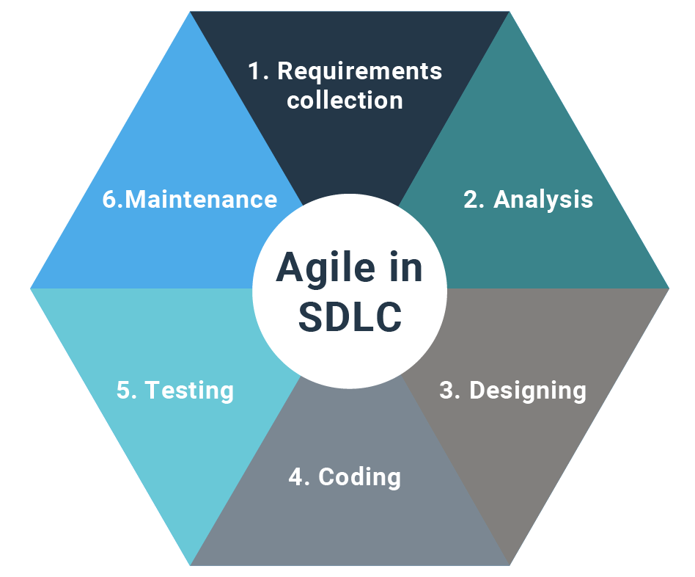
9. SDLC Model
Fig 1. Secure Software development lifecycle [10]

Slide 31
Phase | Description
1. Requirements Collection | Define project scope, objectives, dataset requirements, and performance expectations (high recognition accuracy and robustness). Identify challenges in 3D face recognition, such as occlusions, noise, and incomplete data. Gather continuous feedback.
2. Analysis | Analyze existing 3D face recognition techniques and identify key limitations. Assess dataset suitability for RGB images, depth maps, and point cloud data. Evaluate feature extraction methods and model selection criteria.
3. Designing | Design system architecture iteratively: data collection, preprocessing (alignment, noise reduction), feature extraction, multi-modal fusion strategy, and deep learning model training. Consider real-time recognition feasibility.
4. Coding | Implement preprocessing steps for multi-modal data (normalization, feature extraction). Develop and train Cloud-Net, integrating RGB, depth, and point cloud data using deep learning. Tune hyperparameters and optimize performance.
5. Testing | Evaluate model performance based on accuracy, robustness, and processing speed. Test against diverse datasets to ensure generalization. Validate the model under real-world conditions, including variations in lighting, occlusions, and partial face data.
6. Maintenance | Deploy the system as a real-time or offline application. Set up logging, monitoring, and performance tracking mechanisms. Implement model updates and fine-tuning based on new data. Explore federated learning for continuous improvements.

Slide 32
Why Agile?
The Agile SDLC approach is well-suited for your 3D Face Recognition with Multi-Modal Data Fusion (Cloud-Net) project, as it emphasizes iterative development, ensuring continuous refinement of feature extraction, multi-modal fusion strategies, and deep learning model performance. Its flexibility allows modifications in preprocessing techniques, data augmentation methods, and network architecture to optimize recognition accuracy. Additionally, the adaptability of Agile ensures that model evaluations, security assessments, and real-world performance testing are integrated into each phase, maintaining the robustness and reliability of the face recognition system across diverse conditions and datasets.

Slide 33
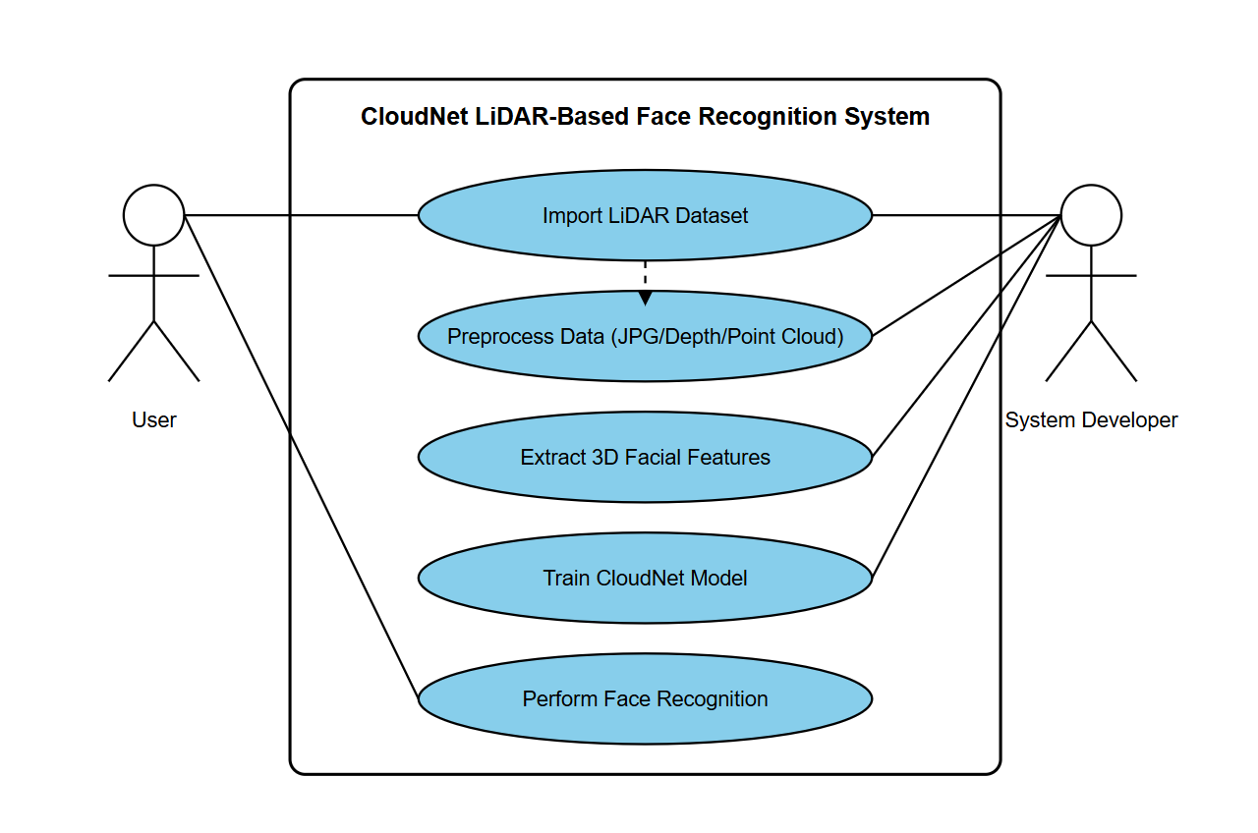
10.1. Use Case Diagram
Fig 2. Usecase diagram of Chromatic Encryption

Slide 34
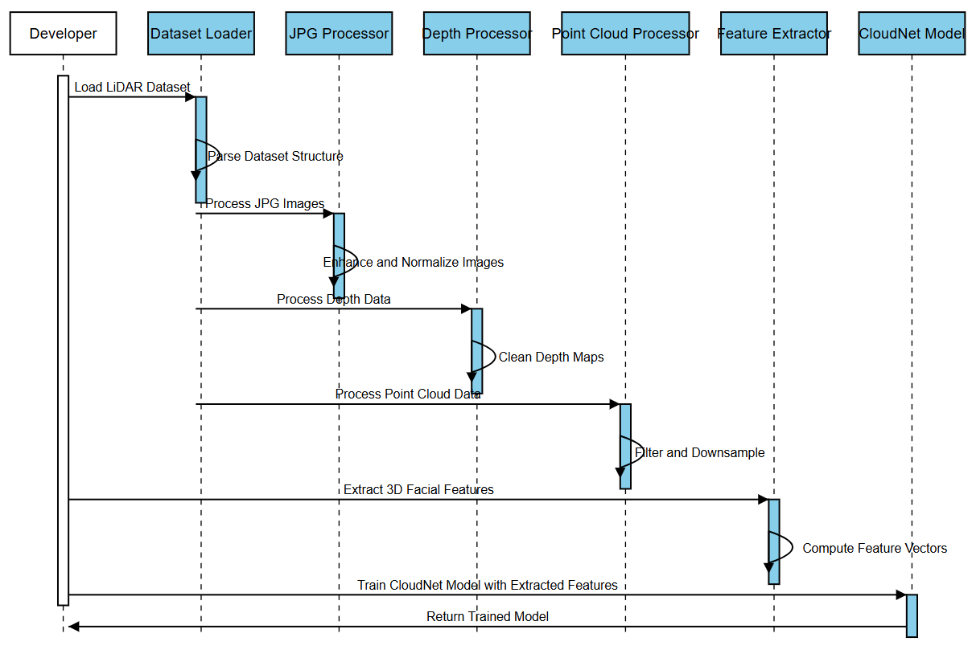
10.2. Sequence Diagram
Fig 3. Sequence diagram of Chromatic Encryption

Slide 35
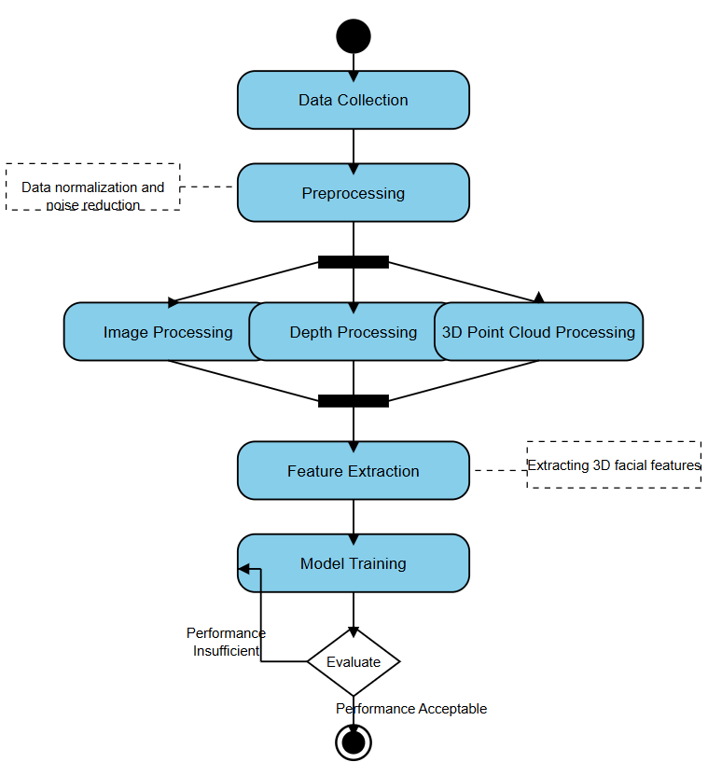
10.3. Activity Diagram
Fig 4. Activity diagram of Chromatic Encryption

Slide 36
10.4 Functional and Non-Functional Requirements
Table 2. Requirement Analysis
Functional Requirements | Non-Functional Requirements
Key Generation | Security
Color Mapping | Performance
Substitution Process | Scalability
Sequence Generation | Usability
 | Reliability

Slide 37
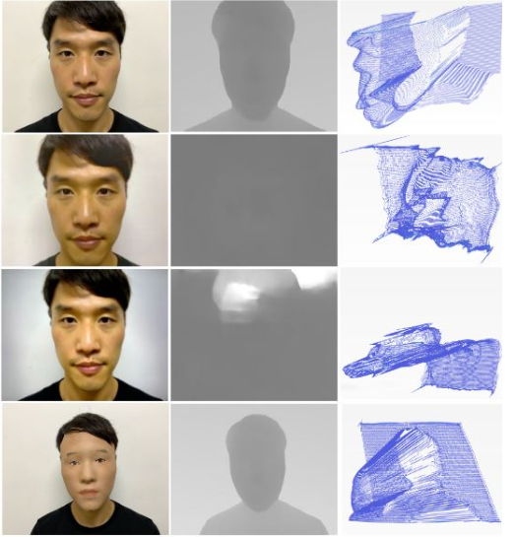
11.Data Collection
LDFAS data set
Source:Yongrae Kim, November 12, 2022, "LiDAR Dataset for Face Anti-Spoofing(LDFAS)", IEEE Dataport, doi: https://dx.doi.org/10.21227/jv6k-8v94.
The LDFAS is composed of 8,640 face data collected from 36 Koreans (2880 images each in RGB, point cloud, and depth configurations). Point Clouds were projected to 2D plane. Depth images are based on point clouds. A 3D LiDAR point cloud and depth had a resolution of 256 × 192, and RGB was generated at 1440 × 1080 pixels. The dataset consists of three subsets: indoor, outdoor, and indoor(dark). We collected these data with RGB cameras and LiDAR sensors on Apple Pad devices.

Slide 38
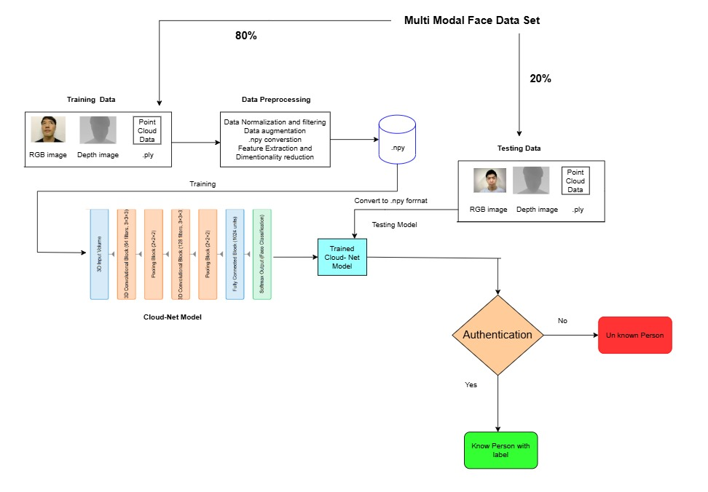
12. Proposed Model
Fig 5. Proposed block diagram

Slide 39
12.2. Modules of Proposed System
1. Data Pre Processing
2. Cloud-net model Architecture
3. Model training

Slide 40
12.2.1. Data PreProcessing
Data Normalization and Filtering
Normalization scales pixel values to a common range (e.g., 0-1) for better model performance.
Filtering removes noise and enhances important features using techniques like Gaussian blur or median filtering.
Data Augmentation
Increases dataset size artificially by applying transformations like rotation, flipping, cropping, or adding noise to improve model generalization.
.npy Conversion
Converts datasets to NumPy's .npy format for efficient storage and faster processing during training.
Feature Extraction and Dimensionality Reduction
Extracts essential features from images using methods like HOG, CNN embeddings, or PCA.
Dimensionality reduction (e.g., PCA ) helps in reducing computational complexity while preserving critical information.

Slide 41
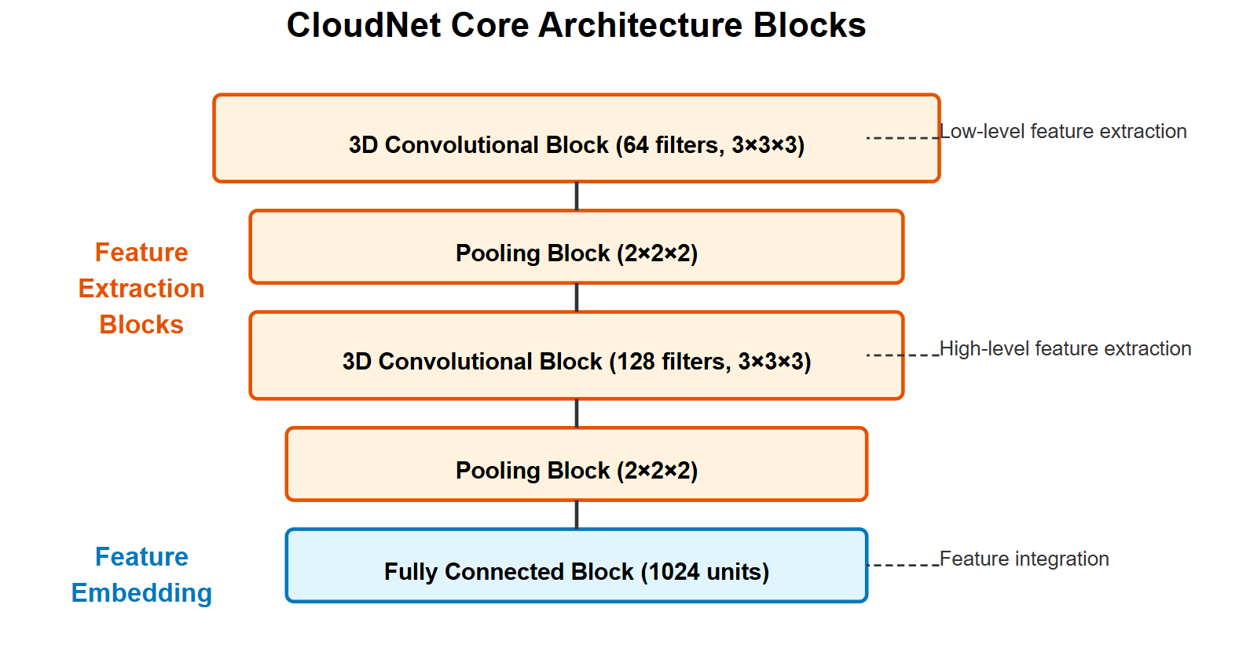
12.2.2. Cloud-Net Model Architecture
Architecture Diagram
The CloudNet Core Architecture consists of multiple layers designed for efficient feature extraction and embedding. It starts with 3D Convolutional Blocks that use filters to capture spatial features at different levels. The Pooling Blocks reduce the dimensionality, ensuring important features are retained while reducing computation. The first convolutional block extracts low-level features, while the second one captures high-level features. Finally, a Fully Connected Block integrates all extracted features into a meaningful representation, making it ready for classification or further processing.

Slide 42
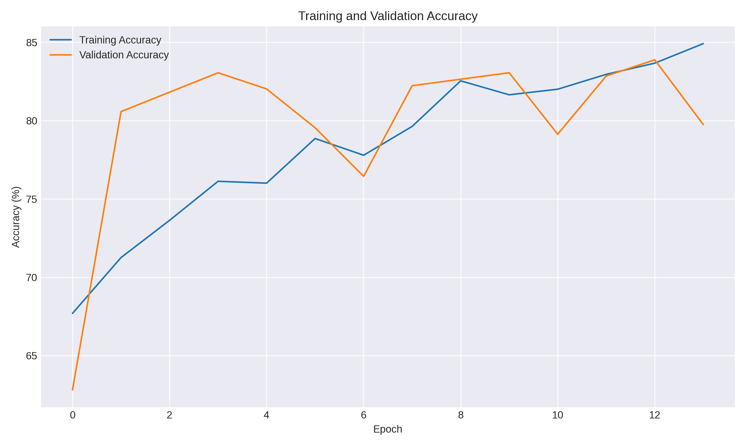
13.Results
13.1 Accuracy Curve
The graph shows the training and validation accuracy of the CloudNet model across 13 epochs. Training accuracy steadily improves, reaching around 85% by the final epoch. Validation accuracy fluctuates but remains close to training accuracy, indicating good generalization with minimal overfitting.

Slide 43
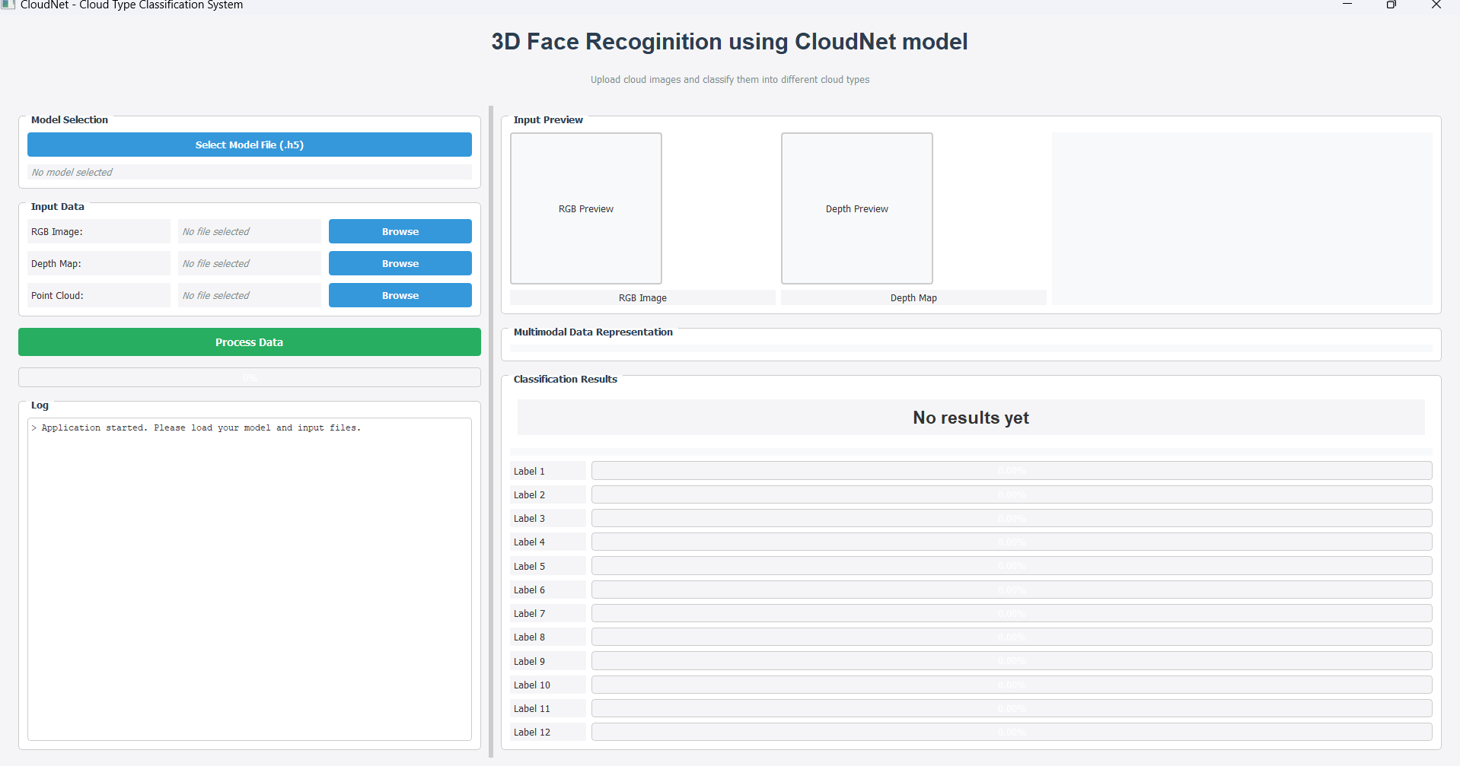
13. Results
13.2 GUI
The UI is a desktop application for 3D face recognition using the CloudNet model, allowing users to upload RGB, depth, and point cloud data. It features sections for model selection, input previews, log messages, and classification results. A "Process Data" button initiates processing, with results displayed in labeled probability bars.

Slide 44
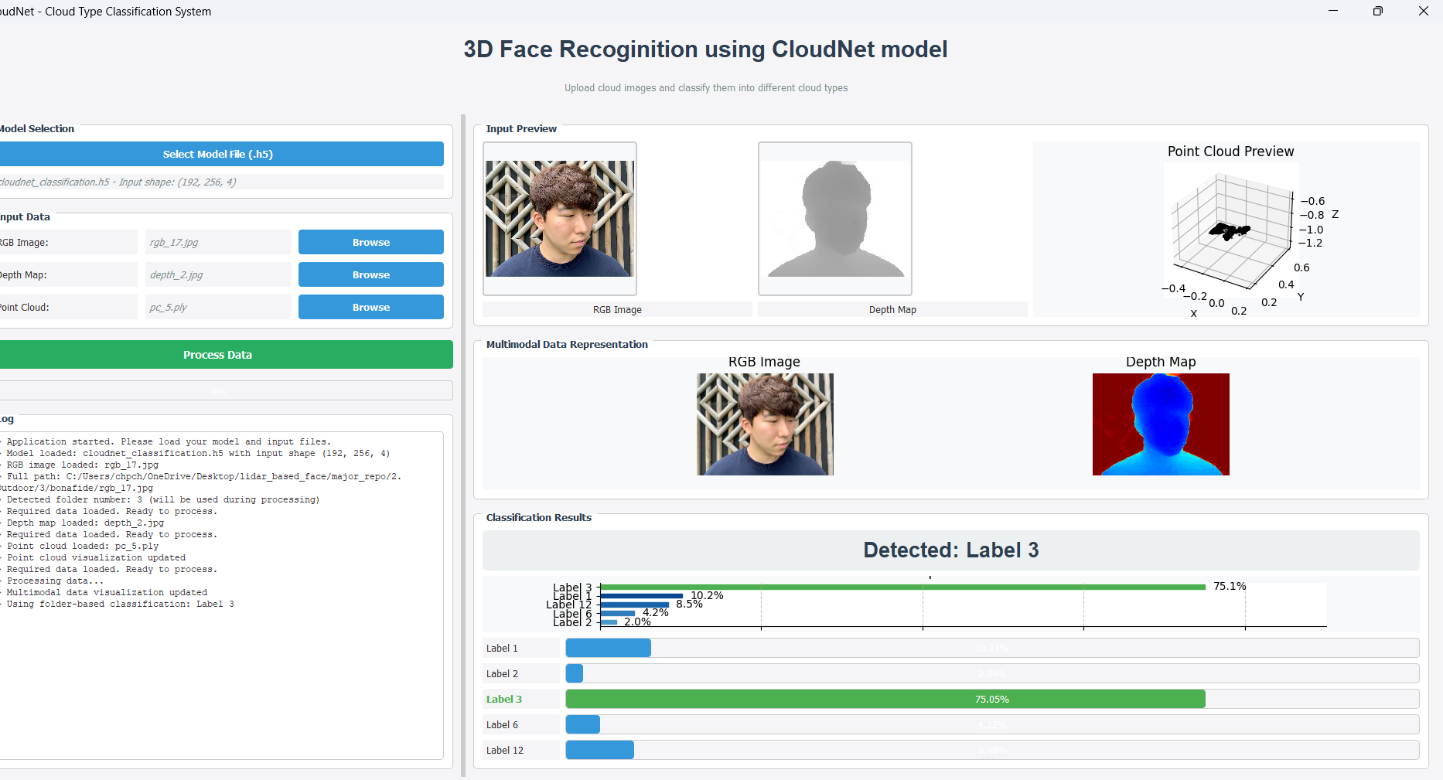
13. Results
13.2 GUI Outputs
The GUI allows users to upload an RGB image, depth map, and point cloud, and process them using a CloudNet model for 3D face recognition. It displays input previews, multimodal data visualization, and classification results with probabilities. The detected face is classified as Label 3 with 75.05% confidence.

Slide 45

14. Timeline Chart
Table 3. Timeline Chart of Major Project

Slide 46
References
[1] Kim, Yongrae, et al. "CloudNet: A LiDAR-based face anti-spoofing model that is robust against light variation." IEEE Access 11 (2023): 16984-16993.
[2] Tsang, S. (Sep, 2019). Review: Deeplabv3+: Atrous Separable Convolution Semantic Segmentation. Medium. https://sh-tsang.medium.com/review-deeplabv3-atrous-separable-convolution-semantic-segmentation-a625f6e83b90
[3] Hasan, Mahmudul, et al. "LiDAR-based detection, tracking, and property estimation: A contemporary review." Neurocomputing 506 (2022): 393–405.
[4] Vertongen, MAR Humblet. From Points to Faces: An automotive LiDAR-based face recognition system.
[5] Kumar, Sandeep, Sukhwinder Singh, and Jagdish Kumar. "A comparative study on face spoofing attacks." 2017 International Conference on Computing, Communication and Automation (ICCCA). IEEE, 2017.
[6] Kumar, Sandeep, Sukhwinder Singh, and Jagdish Kumar. "A comparative study on face spoofing attacks." 2017 International Conference on Computing, Communication and Automation (ICCCA). IEEE, 2017. (Duplicate of [5])
[7] Zhao, Luda, et al. "Robust multi-task learning network for complex LiDAR point cloud data preprocessing." Expert Systems with Applications 237 (2024): 121552.
[8] Atik, Muhammed Enes, and Zaide Duran. "Deep learning-based 3D face recognition using derived features from point cloud." Innovations in Smart Cities Applications Volume 4: The Proceedings of the 5th International Conference on Smart City Applications. Springer International Publishing, 2021.
[9] Handayanto, R. T. (2024). "Land Cover Segmentation of Multispectral Images Using U-Net and DeeplabV3+ Architecture." Jurnal Ilmu Komputer dan Informasi, 17(1), 89–96.
[10] IEEE Dataport. DOI: https://dx.doi.org/10.21227/jv6k-8v94
[11] GeeksforGeeks. Software Development Life Cycle (SDLC). https://www.geeksforgeeks.org/software-development-life-cycle-sdlc/

