Slide 1




VisPer – a person centered visualisation of the estates of the Vienna City Library
Katharina Prager, Evelyne Luef, Christiane Fritze
Workshop on Information Vizualization in the (Digital) Humanities, 27th-28th of October 2022, University of Graz

Slide 2

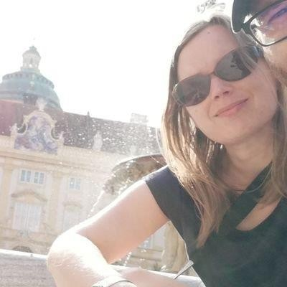
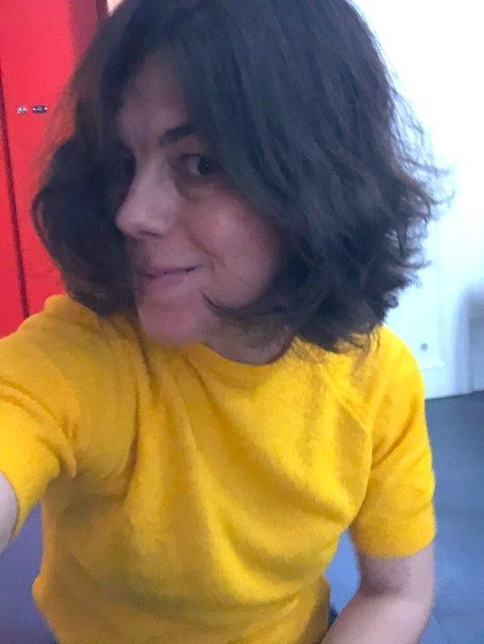
Evelyne Luef
Katharina Prager
Workshop on Information Vizualization in the (Digital) Humanities, 27th-28th of October 2022, University of Graz

Slide 3



Overview
Who we are
Introduction to the estates
Status Quo
What we want the users see
Workshop on Information Vizualization in the (Digital) Humanities, 27th-28th of October 2022, University of Graz

Slide 4
Vienna City Library
Main focus is on research into and the documentation of the history and culture of Vienna
Music and Manuscript Department (250.000 catalogued autographs and 100.000 music manuscripts)
Poster Department (350.000 posters)
Printed Work Department (650.000 volumes)
Digital Library
Participation initiatives
Crowdsourcing letters 1914-1919
Vienna History Wiki
Workshop on Information Vizualization in the (Digital) Humanities, 27th-28th of October 2022, University of Graz

Slide 5
Estate, remains, bequests
Material that is of interest to the posterity of the person with
reference to his work and activity
Cataloguing rules for estates (RNAB, 2019, v1.1 2022, „Resource
indexing with norm data in archives and libraries for personal,
family, corporate archives and collections”)
https://d-nb.info/1250862868/34
Preliminary inventory, partial inventory, splinter inventory, crypto
inventory
Different traditions of inventory the estates, even within one
institution
We follow the provenance principle
Every acquisition as closed entity
Workshop on Information Vizualization in the (Digital) Humanities, 27th-28th of October 2022, University of Graz

Slide 6
Estate, remains, bequests
We collect
Person- or family archives
Archives of corporations (companies, publishing houses, theatre)
Collections to specific persons,
Initiated by collectors, by the institution or within an estate
Workshop on Information Vizualization in the (Digital) Humanities, 27th-28th of October 2022, University of Graz

Slide 7
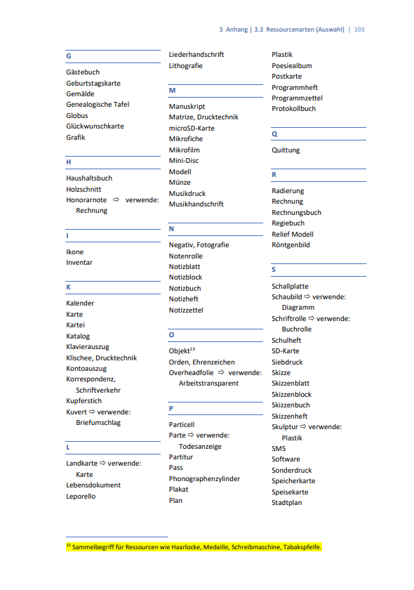
Estate, remains, bequests
The cataloguing of the estate follows an order scheme
Works
Correspondences
Living documents
Objects
Archives of person or families may contain:
letters, prints, photos, objects, manuscripts, notes, posters, postcards, travel documents, passes, certificates, sketches and drafts to literary, scientific or other works, diaries, audio and video documents, presentations, newspaper clippings…
Workshop on Information Vizualization in the (Digital) Humanities, 27th-28th of October 2022, University of Graz

Slide 8
Estates at the Vienna City Library
About 1400 estates of a wide variety of personalities from the cultural and intellectual life of Vienna
All estates have an record in the library catalogue
Most of the 1400 people are rather unknown
The collection’s bias is not immediately apparent in several respects.
Workshop on Information Vizualization in the (Digital) Humanities, 27th-28th of October 2022, University of Graz

Slide 9
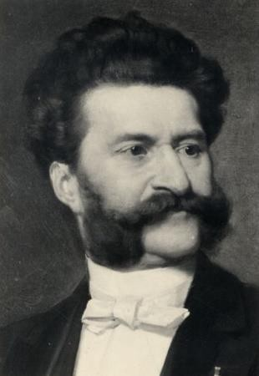
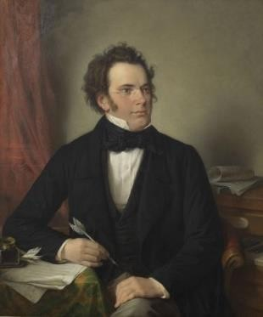
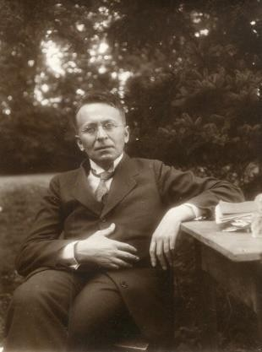
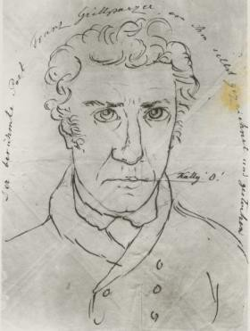
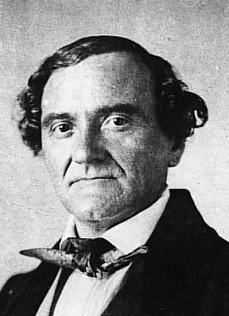
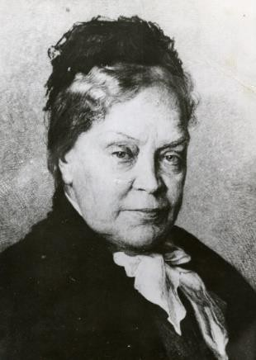
The big Five
Family Johann Strauß (composer)
Franz Schubert (composer)
Karl Kraus (publicist, satirist, writer)
Franz Grillparzer (writer)
Johann Nestroy (actor)
Marie von Ebner-Eschenbach (poet)
Workshop on Information Vizualization in the (Digital) Humanities, 27th-28th of October 2022, University of Graz

Slide 10
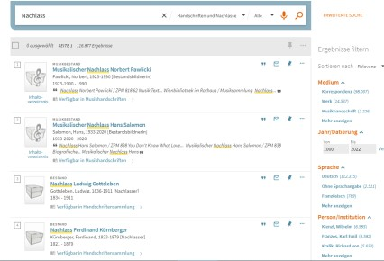

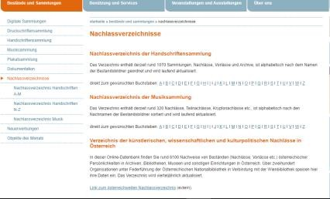
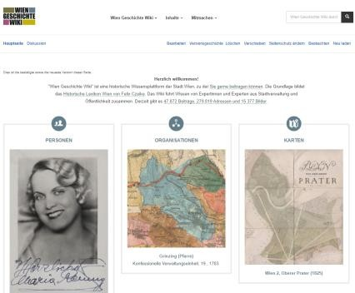
What we have
A library catalogue
Lookup and click through the record metadata
A digital library
Lookup and click, turn the digital facsimile pages and read
A list of estates
Scroll down the list on the website letter by letter and get a
link to the catalogue and to the Vienna History Wiki
A Wiki about the history of Vienna
Search for, inter alea, encyclopaedic articles about the most
important peoples of Vienna in history
Workshop on Information Vizualization in the (Digital) Humanities, 27th-28th of October 2022, University of Graz

Slide 11
What is the catch?
The library catalogue
you can only search what you expect to find
The list of estates
is incomplete
The digital library
We are far away from having digitised every single document of all
estates
The Vienna History Wiki
Not every person in the wiki we have an estate from has a reference to the catalogue entry
Not all persons we preserve an estate from have even a wiki entry
Workshop on Information Vizualization in the (Digital) Humanities, 27th-28th of October 2022, University of Graz

Slide 12
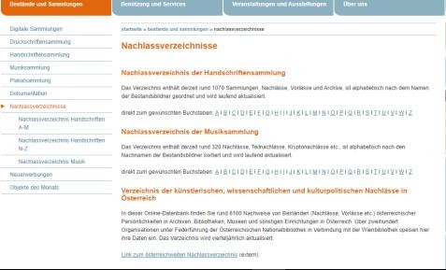
The list of estates
This is currently THE tool to guide our users to the estates
In German only
Up to date for only for the manuscript section (1.120 holdings)
Different information depending on the department
Name (Bestandsbildner, Nachlasser, Sammelschwerpunkt) Title of the estate Collation Content Status of indexing Subject field Floruit time | Name (Bestandsbildner) Title of the estate Status of indexing Date of birth and death Year of acquisition Content
Workshop on Information Vizualization in the (Digital) Humanities, 27th-28th of October 2022, University of Graz

Slide 13


The Vienna History Wiki
Media wiki with semantic media wiki extension
Form with fields
name, alternative names, title, sex, GND, Wikidata ID, date and place of birth and death, all about burial, profession, relations, addresses, party membership, religion, functions, awards, estates
Encyclopaedic article
Images
References
587 persons with information about estate at the VCL
Workshop on Information Vizualization in the (Digital) Humanities, 27th-28th of October 2022, University of Graz

Slide 14
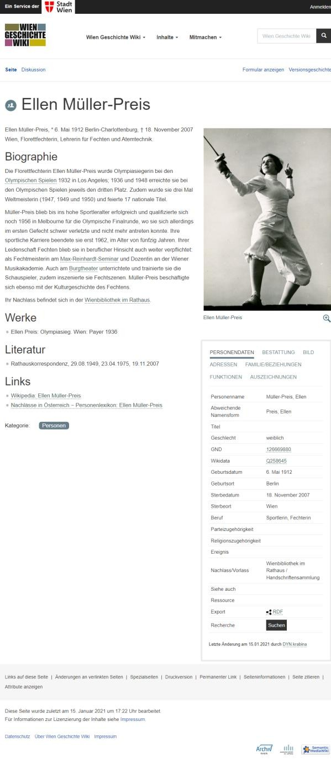
Ellen Müller-Preis ZPH 1626
Call Number: ZPH 1620
Catalogue Record: https://permalink.obvsg.at/wbr/AC15842649
Estate inventory: http://media.obvsg.at/AC15842649-1001
Wiki: https://www.geschichtewiki.wien.gv.at/Ellen_ Müller-Preis
Workshop on Information Vizualization in the (Digital) Humanities, 27th-28th of October 2022, University of Graz

Slide 15
Why Visper
As an institution, we would like to see a visualisation of our estate holdings
that invites researchers to engage with our holdings,
that stimulates possible topics and research questions,
that acts as a link between the library catalogue, the Vienna History Wiki and the digital library
In line with the FAIR principles, the underlying data should be available for further re-use.
Workshop on Information Vizualization in the (Digital) Humanities, 27th-28th of October 2022, University of Graz

Slide 16
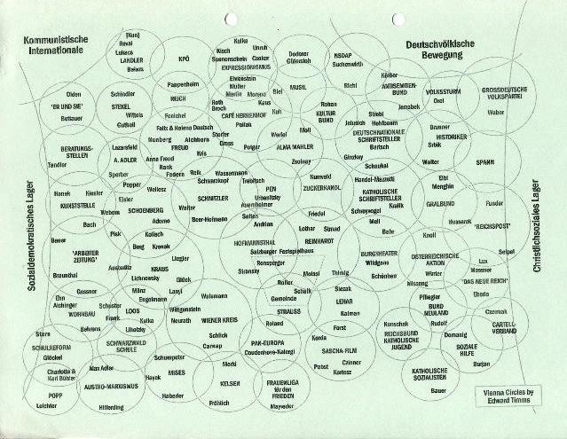
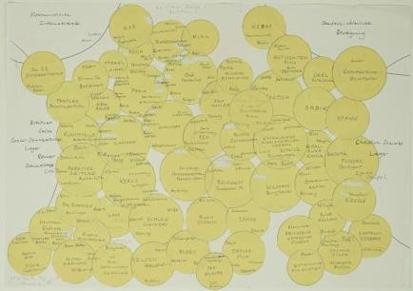
Inspiration
Starting point: The circles of Edward Timms
Let the user arrange clusters of people again and again according to their needs based on different categories
Person centration:
break of the provenance principle with multiple acquisitions of material to one person
Disassemble virtually family archive to make every singe member of
the family visible
The Vienna Circles in the 1920/30Th according to
Timms. Dynamik der Kreise, Resonanz der Räume. Die schöpferischen Impulse der Wiener Moderne,
Wien 2013, 14.
Workshop on Information Vizualization in the (Digital) Humanities, 27th-28th of October 2022, University of Graz

Slide 17
What we want the user to see
Main target group:
Students
University lecturer
Journalists
Anticipated use cases: “I want to see …
… the different subject areas of the estates to dive deeper into specific subjects.”
… how many estates the library has for a specific time period.”
… who was in what kind of relationship with whom?”
… the size of the different estates in comparison to each other.”
Workshop on Information Vizualization in the (Digital) Humanities, 27th-28th of October 2022, University of Graz

Slide 18

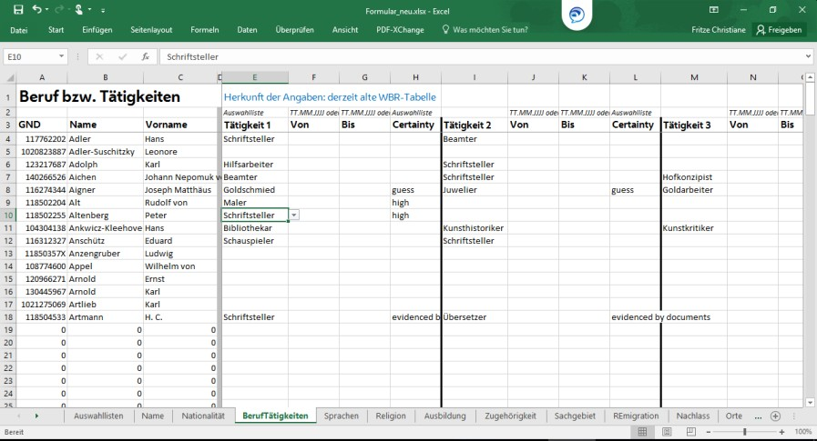
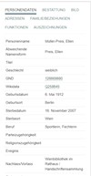
Mock-ups only
Available information collected from the estate lists of the website
Structured data extracted from the semantic Vienna History Wiki
Merged into Excel file for further data collection
+
→
Workshop on Information Vizualization in the (Digital) Humanities, 27th-28th of October 2022, University of Graz

Slide 19
Workflow
Collecting data by domain experts in excel (ONLY OFFICE)
Enriching data via OpenRefine with GND and Wikidata by
library staff
Transforming the excel data via python by a third party into
JSON as base format for the visualisation
XML for sharing and reuse
Creation of the visualisations by a third party in close
cooperation with the library staff
Permanent data enhancement by domain experts
Archiving and maintaining to be determined
Workshop on Information Vizualization in the (Digital) Humanities, 27th-28th of October 2022, University of Graz

Slide 20
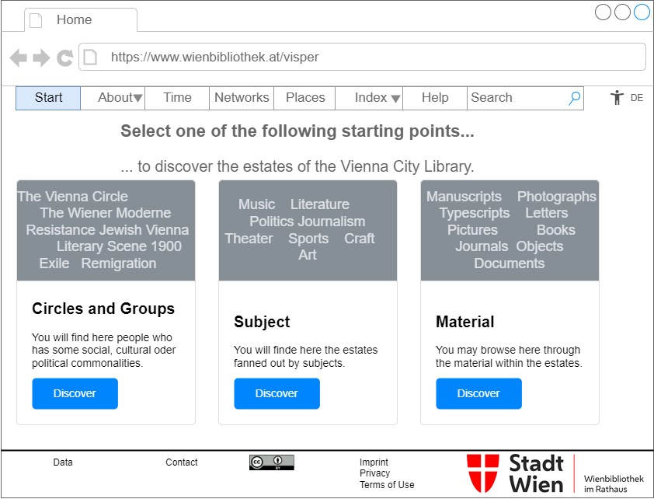
Workshop on Information Vizualization in the (Digital) Humanities, 27th-28th of October 2022, University of Graz 20

Slide 21
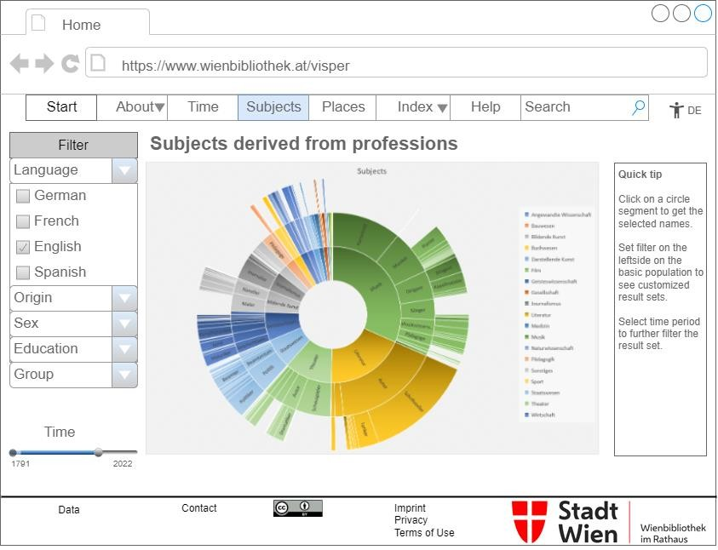
Workshop on Information Vizualization in the (Digital) Humanities, 27th-28th of October 2022, University of Graz 21

Slide 22
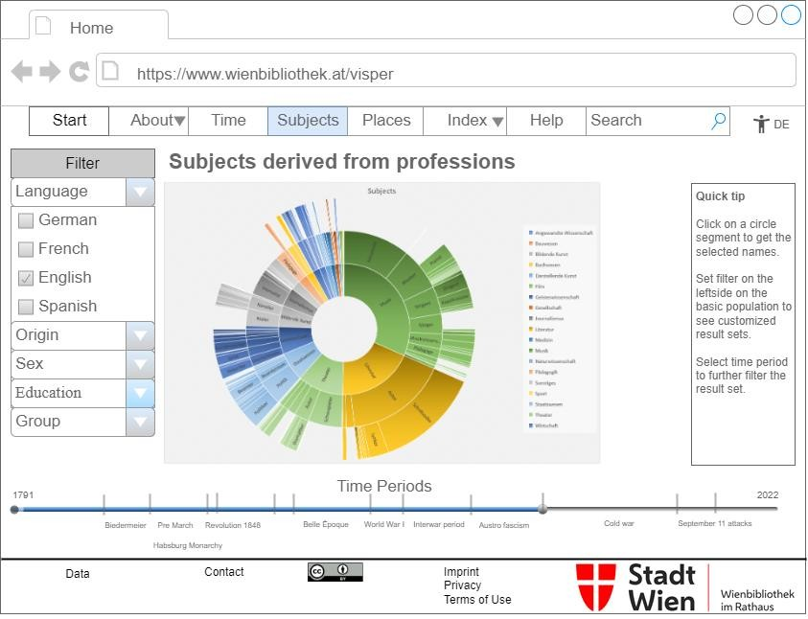
Workshop on Information Vizualization in the (Digital) Humanities, 27th-28th of October 2022, University of Graz 22

Slide 23
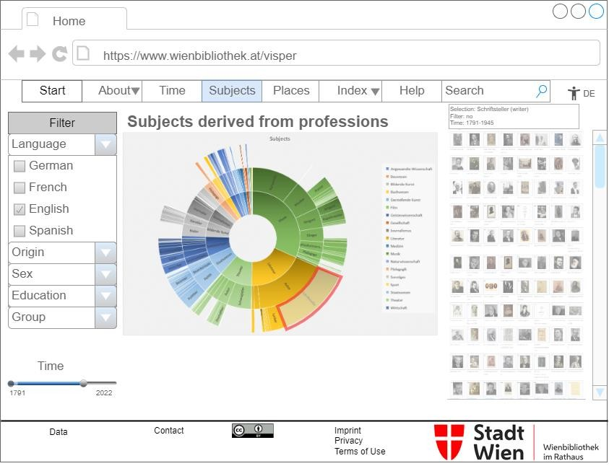
Workshop on Information Vizualization in the (Digital) Humanities, 27th-28th of October 2022, University of Graz 23

Slide 24
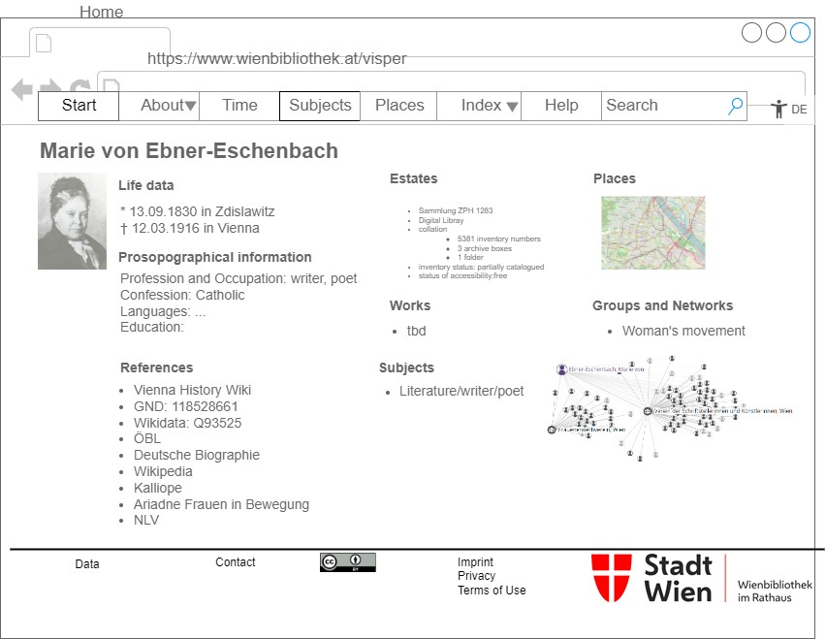
Workshop on Information Vizualization in the (Digital) Humanities, 27th-28th of October 2022, University of Graz 24

Slide 25
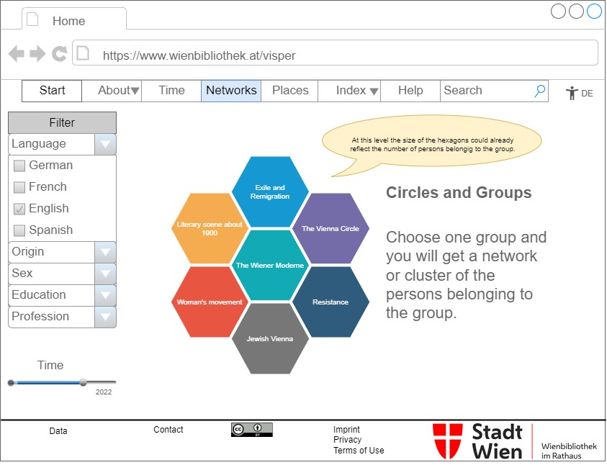
Workshop on Information Vizualization in the (Digital) Humanities, 27th-28th of October 2022, University of Graz 25

Slide 26
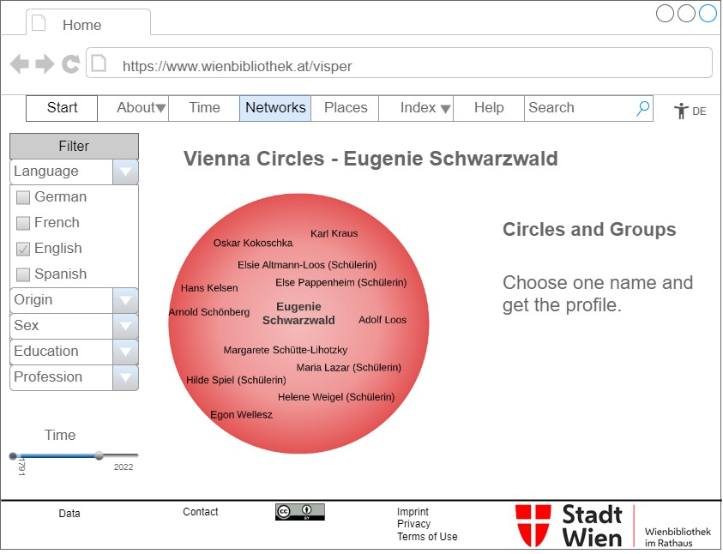
Workshop on Information Vizualization in the (Digital) Humanities, 27th-28th of October 2022, University of Graz 26

Slide 27
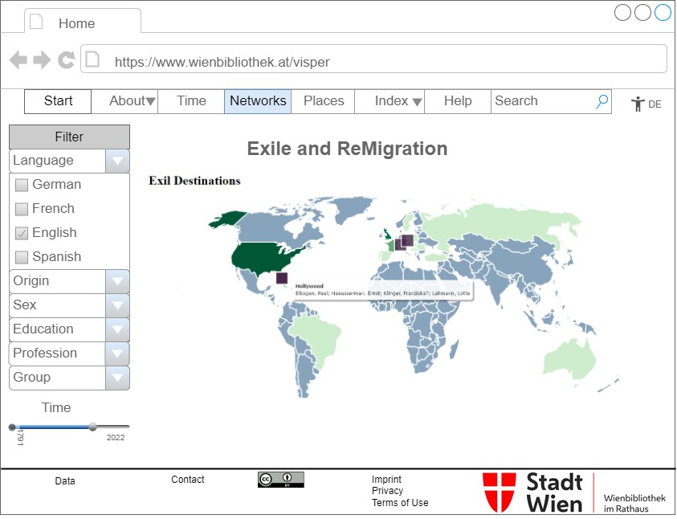
Workshop on Information Vizualization in the (Digital) Humanities, 27th-28th of October 2022, University of Graz 27

Slide 28
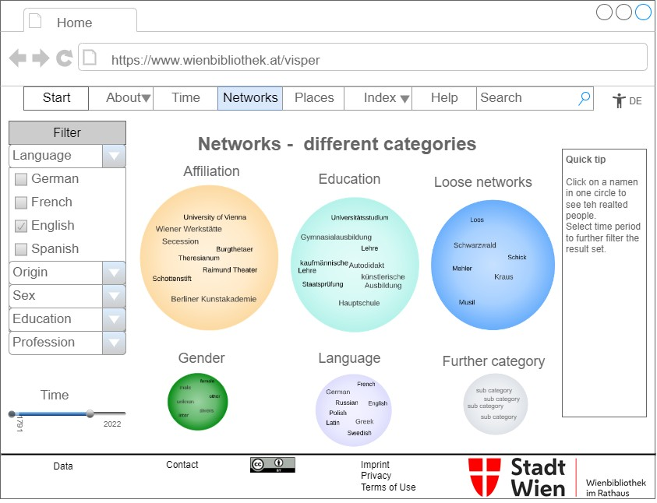
Workshop on Information Vizualization in the (Digital) Humanities, 27th-28th of October 2022, University of Graz 28

Slide 29
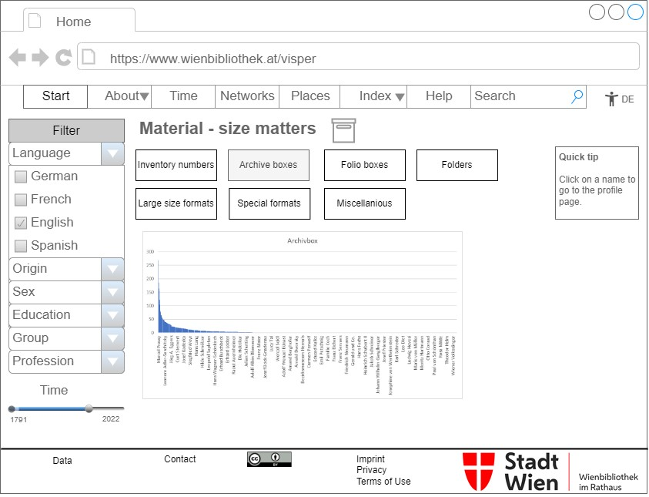
Workshop on Information Vizualization in the (Digital) Humanities, 27th-28th of October 2022, University of Graz 29

Slide 30
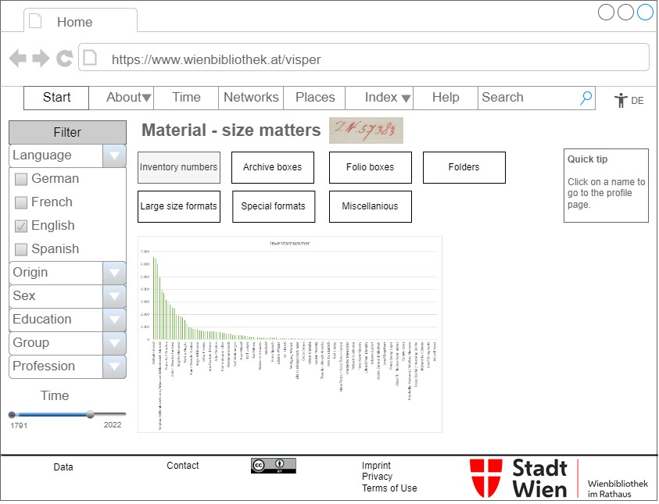
Workshop on Information Vizualization in the (Digital) Humanities, 27th-28th of October 2022, University of Graz 30

Slide 31
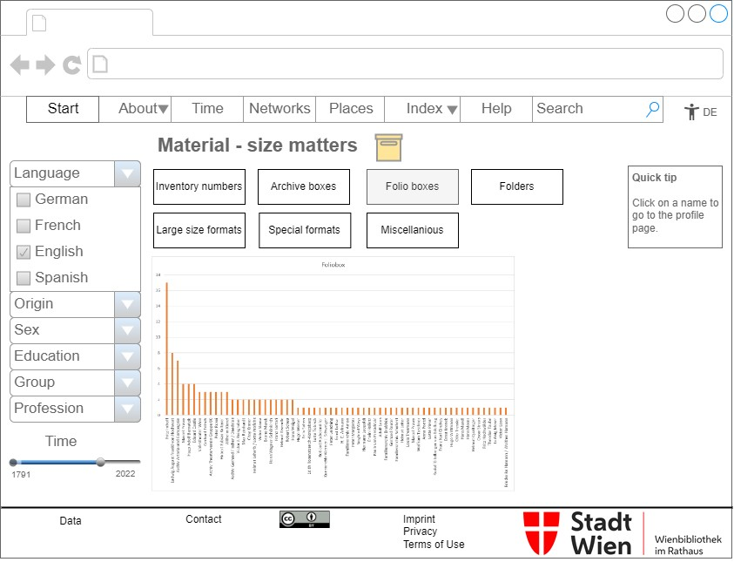
Workshop on Information Vizualization in the (Digital) Humanities, 27th-28th of October 2022, University of Graz 31

Slide 32
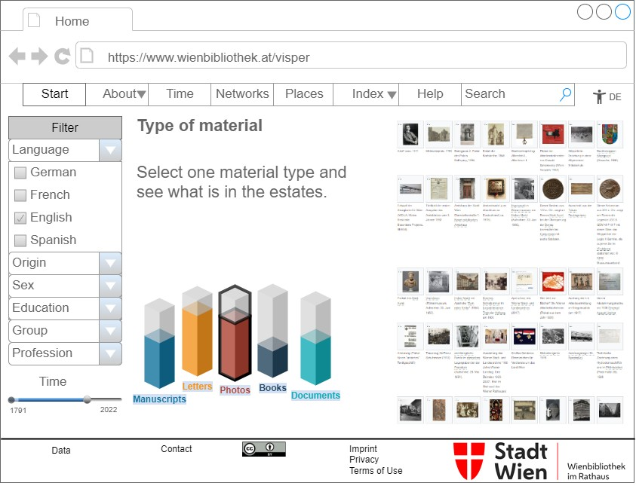
Workshop on Information Vizualization in the (Digital) Humanities, 27th-28th of October 2022, University of Graz 32

Slide 33
Questions
How to make clear and visible different kinds of uncertainty?
How to deal with political difficult wordings for instance for the grouping of cultural circles?
What about the filters?
Can the visualisations fulfil the accessibility criteria?
Workshop on Information Vizualization in the (Digital) Humanities, 27th-28th of October 2022, University of Graz
34

Slide 34
Thank you.
Twitter: @wienbibliothek
Katharina.Prager@wienbibliothek.at
Evelyne.Luef@wienbibliothek.at
Christiane.Fritze@wienbibliothek.at
https://www.wienbibliothek.at/bestaende- sammlungen/nachlassverzeichnisse
Workshop on Information Vizualization in the (Digital) Humanities, 27th-28th of October 2022, University of Graz
34

