Slide 1
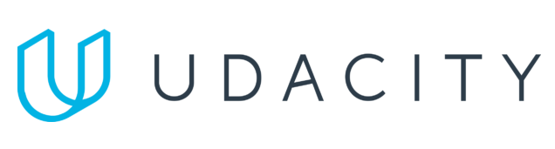
Data Lake Value Proposition
Medical Data Processing Company
Chrysanthi Polyzoni
Udacity IPS Version 1.0

Slide 2
Agenda
What is a Data Lake
Components of a Data Lake
Data Lake vs Data Warehouse
Business Value of Data Lake Solution
Proposed Data Lake Architecture for Medical Data Processing system
Udacity IPS Ver. 1 2/2020

Slide 3
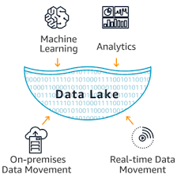
What is a Data Lake
Executive summary
A data lake is a centralized repository that allows you to store all your structured and unstructured data at any scale. You can store your data as-is, without having to first structure the data, and run different types of analytics—from dashboards and visualizations to big data processing, real-time analytics, and machine learning to guide better decisions.

Slide 4
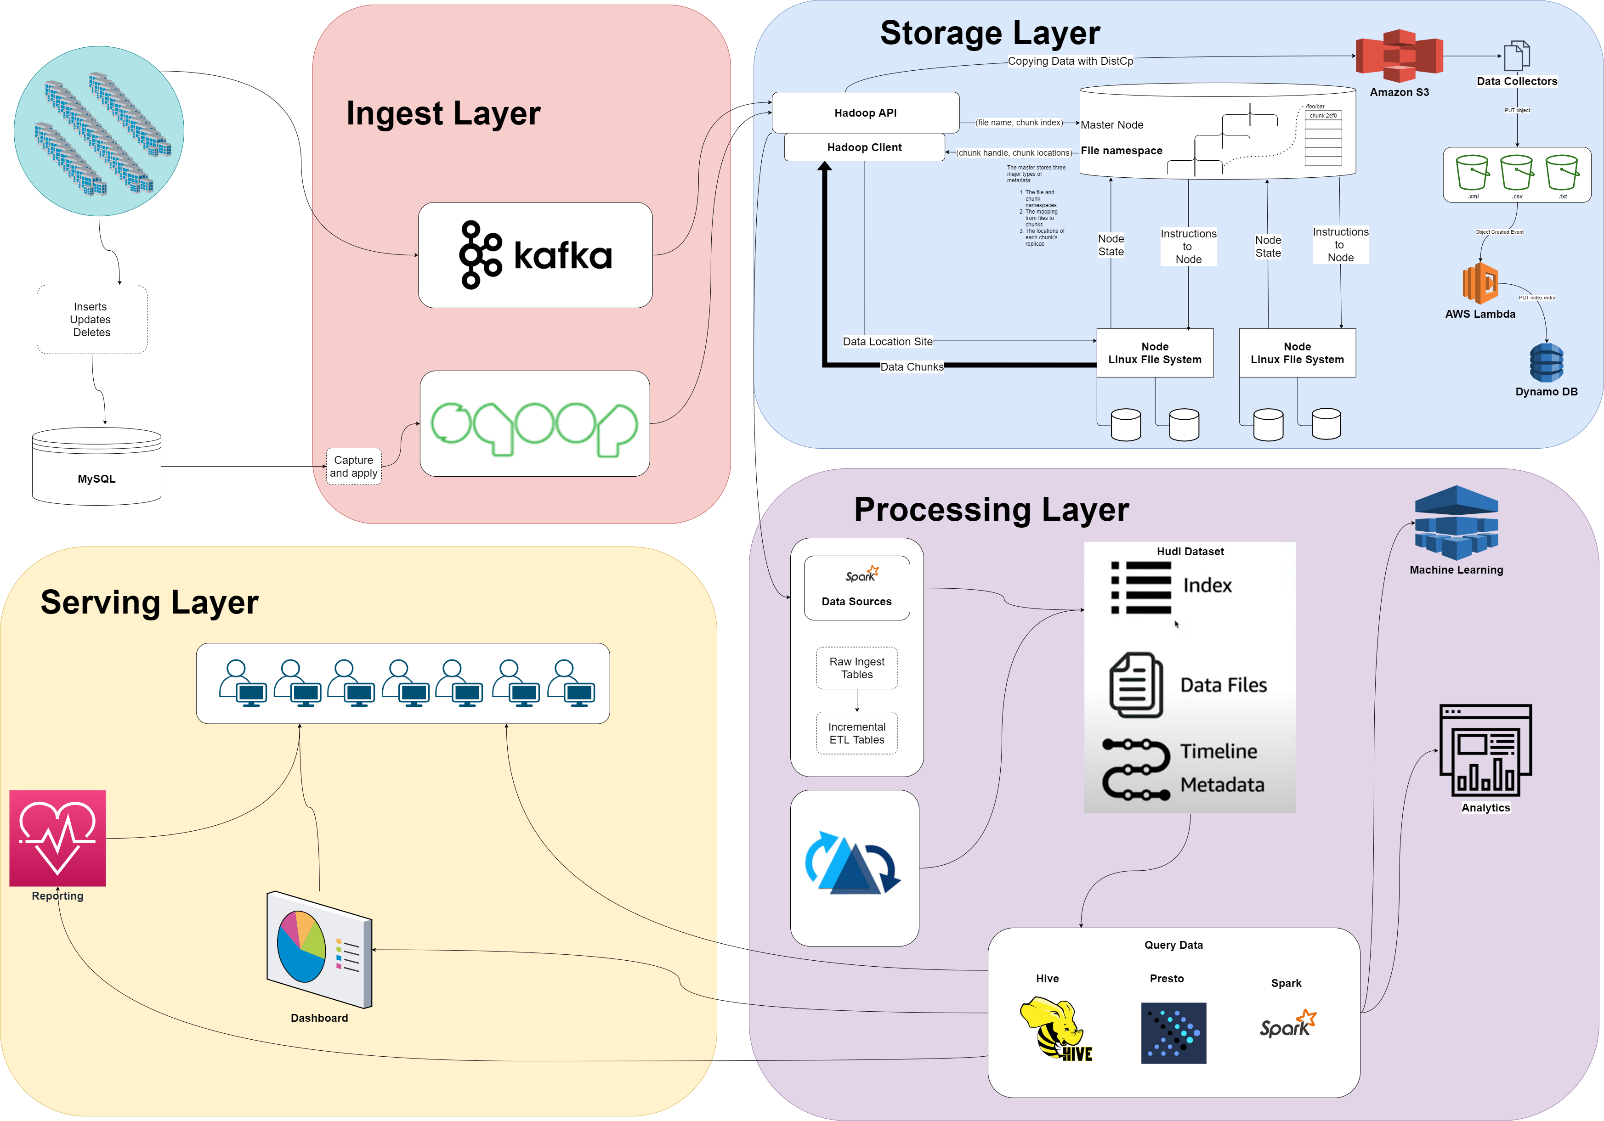
Components of Data Lake
Ingestion Layer (Sqoop and Kafka)
Storage Layer (HDFS, S3)
Processing Layer (Advanced Analytics and Machine Learning)
Serving Layer (Reporting and Dashboard)

Slide 5
Data Lake vs Data Warehouse
A data warehouse is a blend of technologies and components which allows the strategic use of data. It is a technique for collecting and managing data from varied sources to provide meaningful business insights.
A Data Lake is a storage repository that can store large amount of structured, semi-structured, and unstructured data. It is a place to store every type of data in its native format with no fixed limits on account size or file. It offers high data quantity to increase analytic performance and native integration.

Slide 6
Data Warehouse
Data Lake
Stuctured data
Storing data in Data warehouse is costlier and time-consuming.
Data warehouses offer insights into pre-defined questions for pre-defined data types. So, any changes to the data warehouse needed more time.
Schema on Write
Stuctured, Semi Structured, Unstructured data. It empowers users to access data prior the process of transformed, cleansed and structured.
Data storing in big data technologies are relatively inexpensive than storing data in a data warehouse.
Data lakes empower users to access data before it has been transformed, cleansed and structured. Thus, it allows users to get to their result more quickly compares to the traditional data warehouse.
Schema on Read
Udacity IPS Ver. 1 2/2020

Slide 7
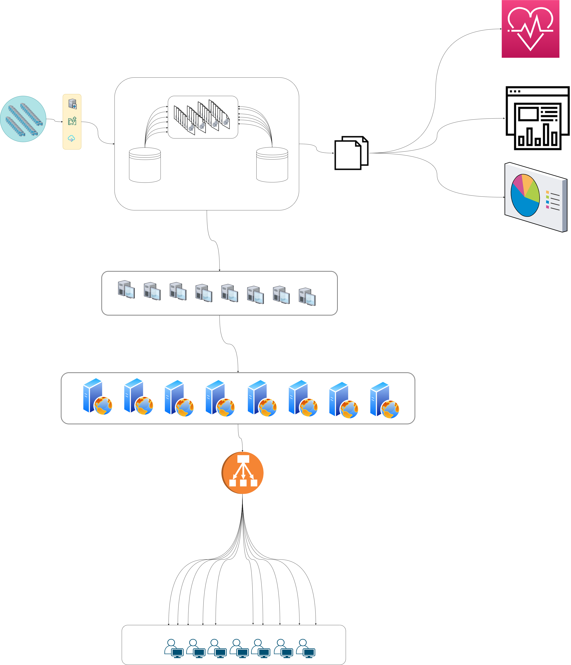
State of the Art – Data Warehouse

Slide 8
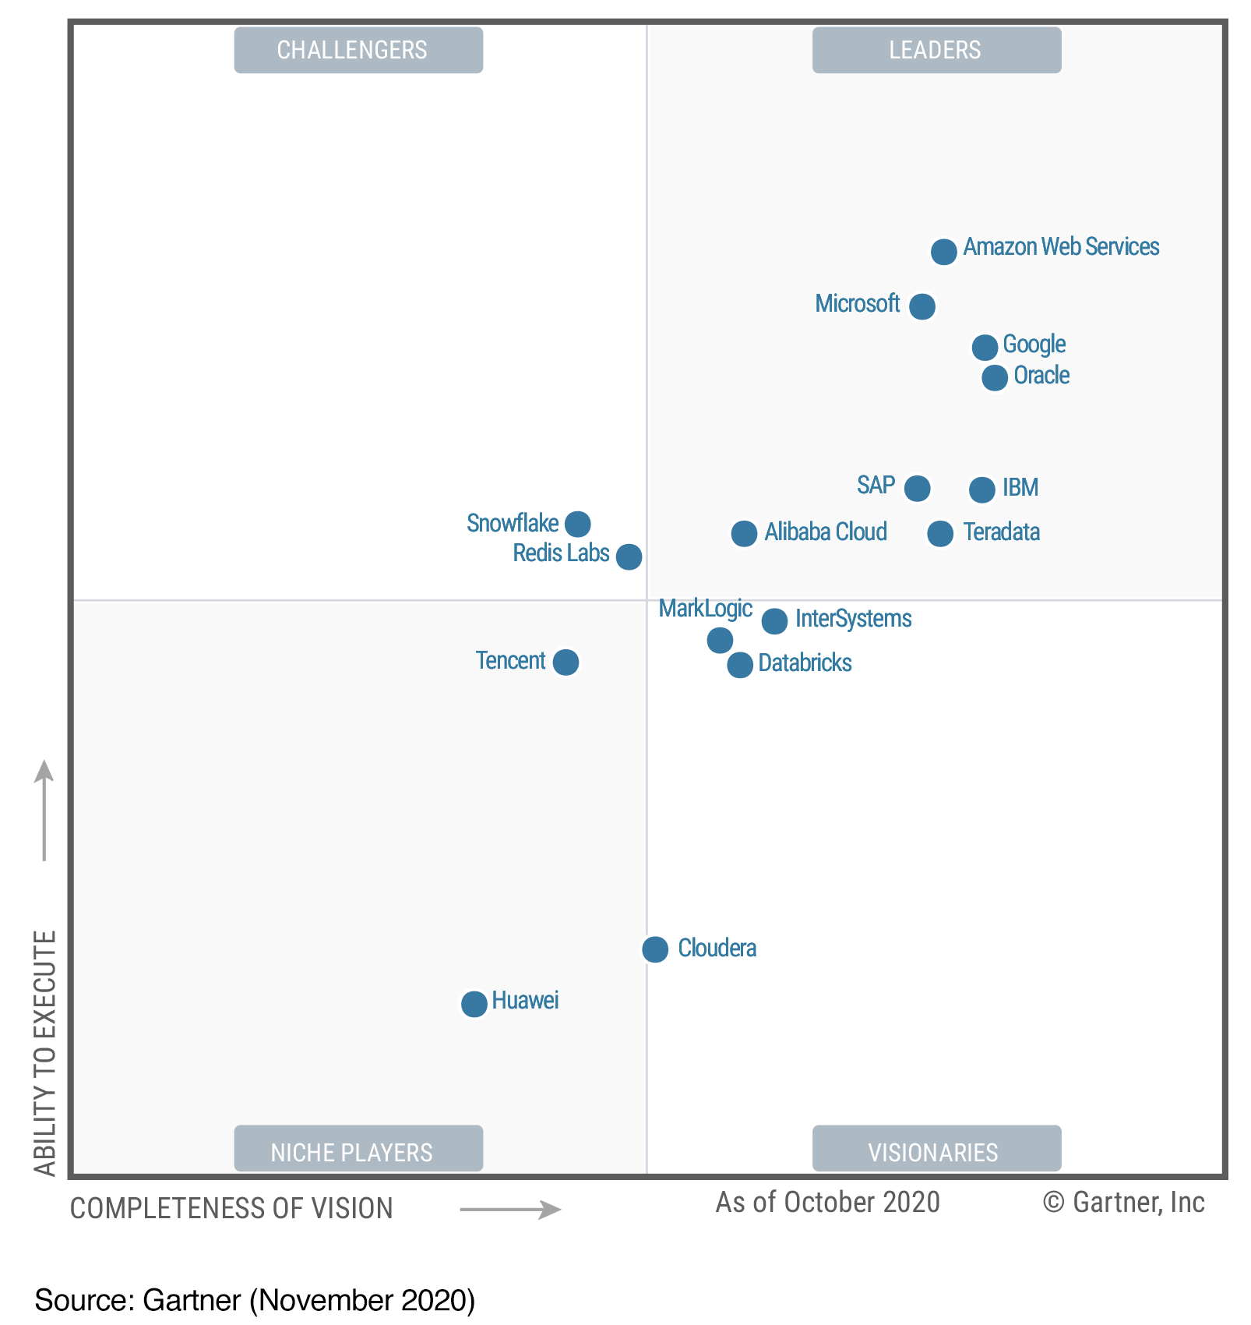
Cloud DataBase Management Systems

Slide 9
Data Lake Architecture

Slide 10
Business Value of Data Lake
Create a resilient system to collect different types of data
Capable to grow and change in time
Provide fast and immediate insights
Align different teams on the same vision
Align Finance and Operations teams to mitigate a future disaster
Analyze business models and decide which ones to expand and what to explore because of data availability

Slide 11
THANK YOU
Udacity IPS Version 1.0

