Slide 1


Data Governance @ SneakerPark
Prepared by:
Submitted on:

Slide 2
Background
SneakerPark is an online shoe reseller that allows people to buy and sell used and new shoes. Buyers can bid for shoes or buy them outright, and sellers can set a price or sell to the highest bidder.
Each buyer and seller must have an active account in order to sell, bid, or purchase sneakers using SneakerPark’s website.
SneakerPark authenticates the shoes before shipping them to the buyer, so before listing an item, the seller must ship it to SneakerPark’s warehouse. Upon receipt, SneakerPark assigns an item number to each pair of sneakers and notifies the seller that they are now free to list their item. If the item is not listed within 45 days, SneakerPark returns it to the seller and sends an invoice to the seller for the shipping cost.
If the item is found to be inauthentic or in an unacceptable condition, it is also returned back to the seller in a similar fashion.
When the item sells, the buyer’s account is credited with the purchase price minus the SneakerPark service fee and shipping fees to deliver the item to the buyer.
Currently, SneakerPark only supports sales within the United States.

Slide 3
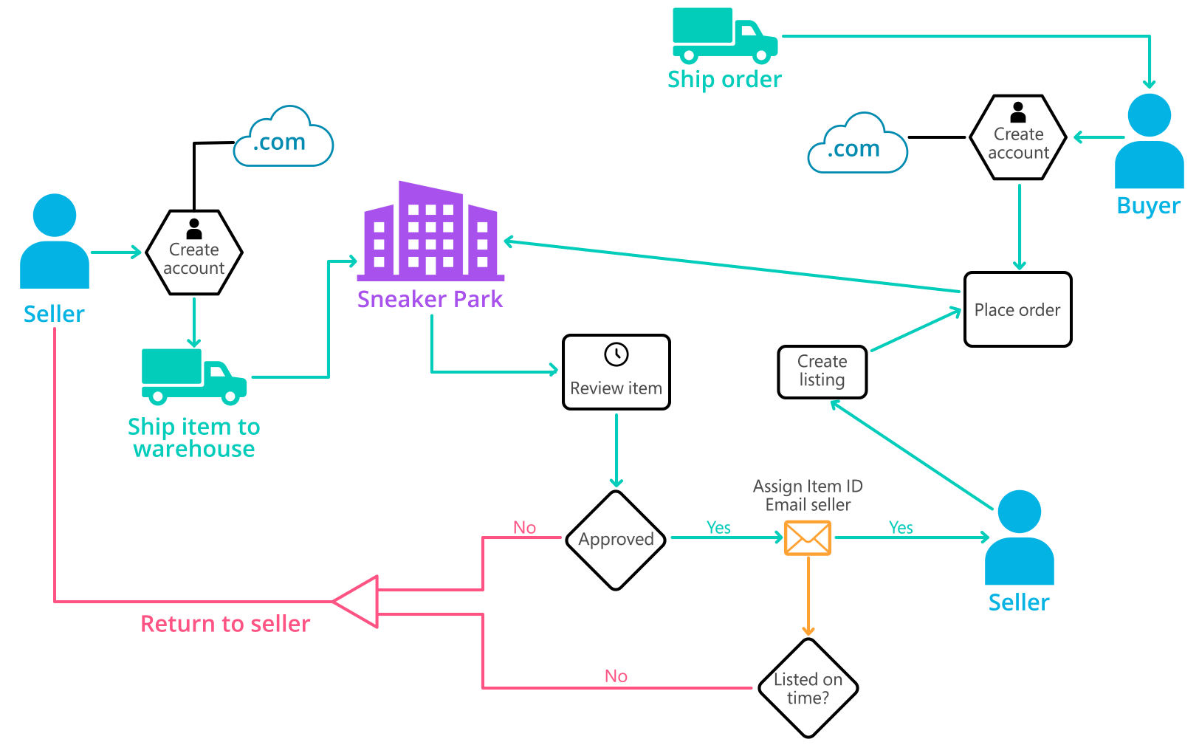
Background
(continued)
Initial Diagram Provided By the company

Slide 4
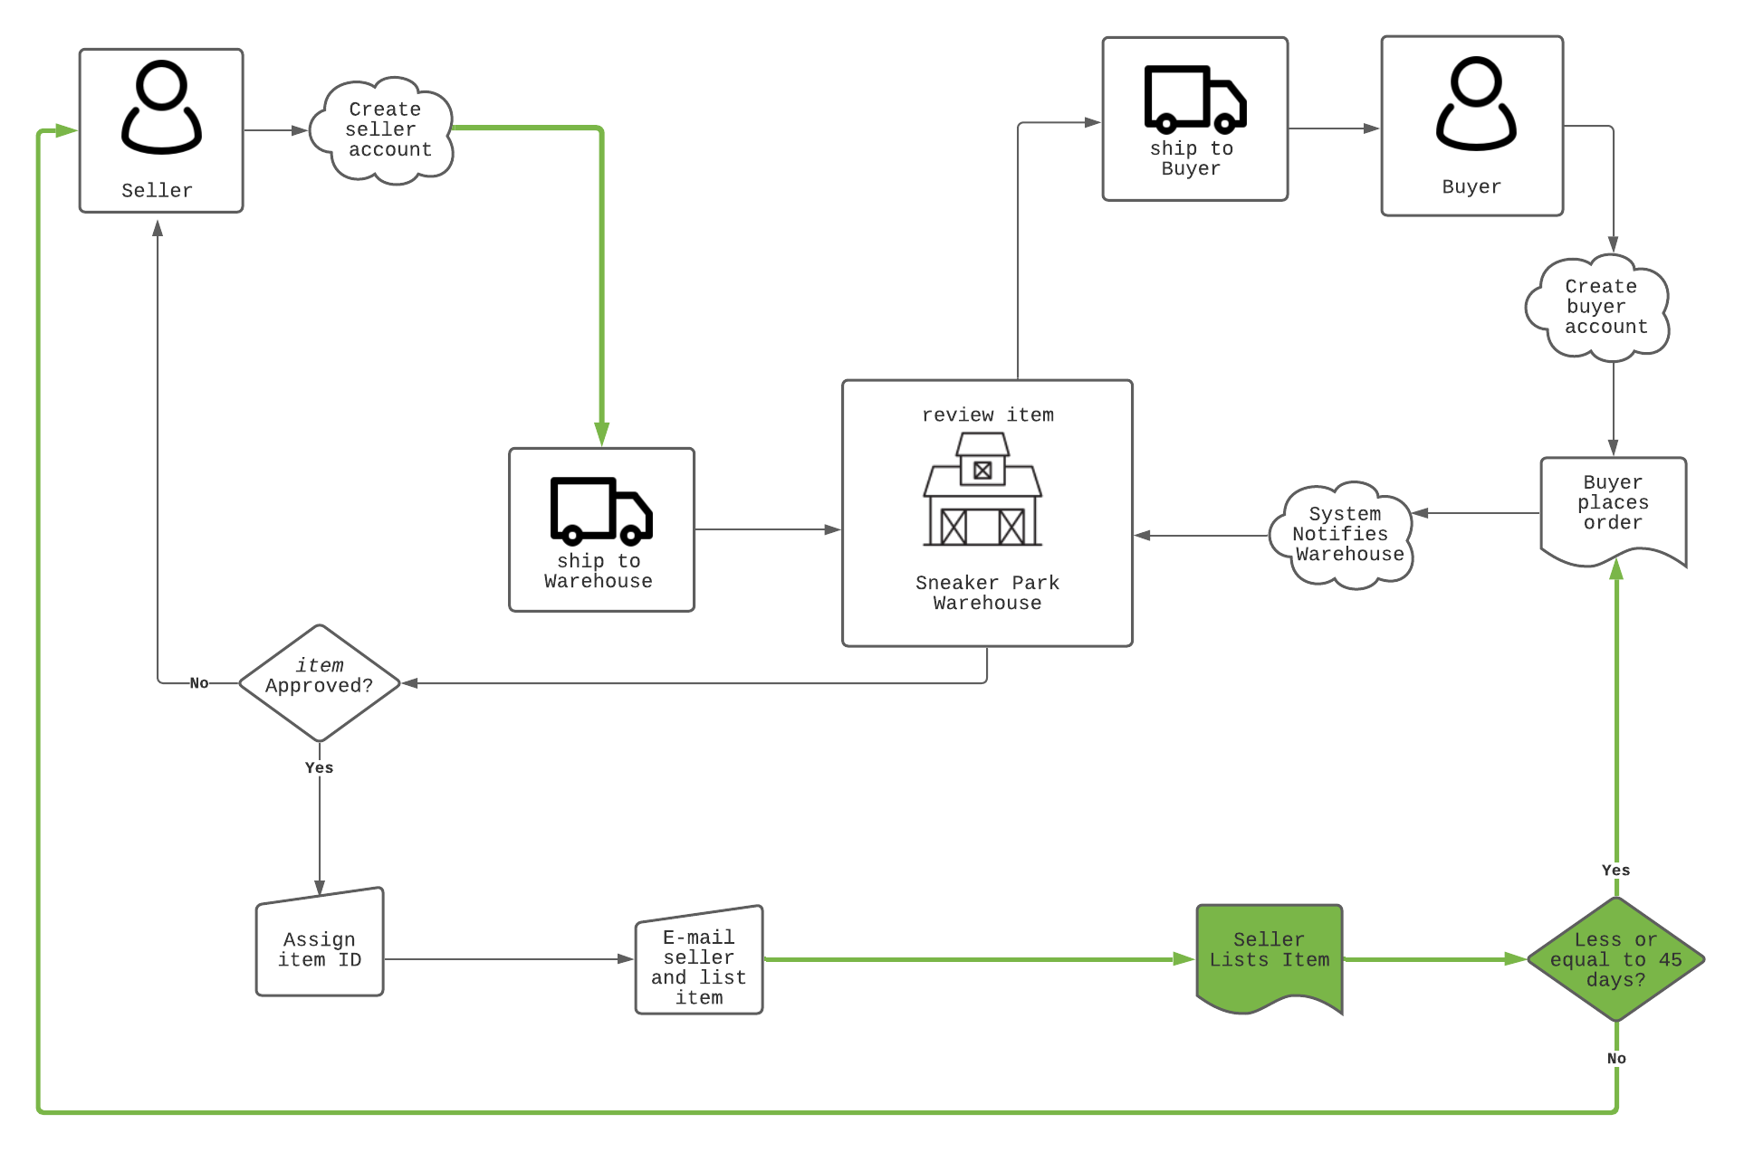
Background
(continued)
Revisited Diagram
Questions:
Why Having all frows in Green?
Why having sent a pair of shoes that will not be traded in the platform?
This adds unnecessary operational costs. Moving is not working.
https://www.graphicproducts.com/articles/value-added-vs-non-value-added-activities/

Slide 5
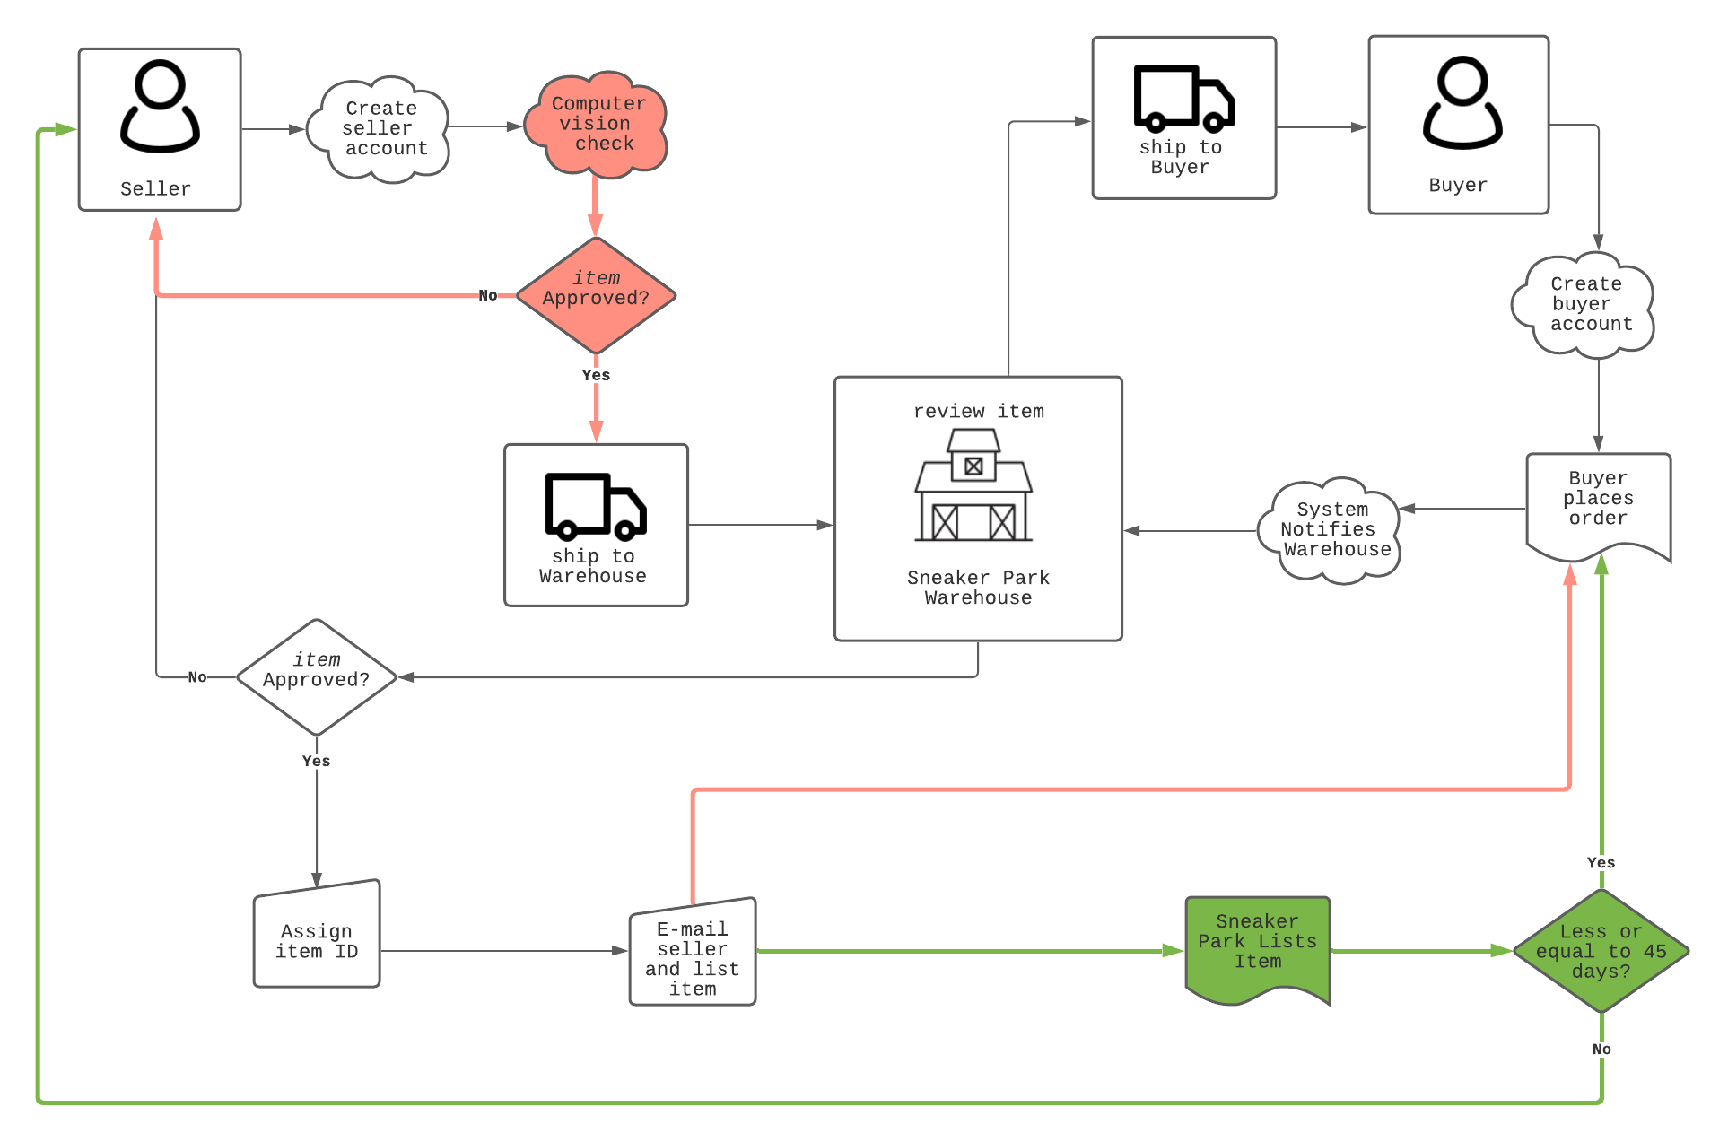
Background
(continued)
Revisited Diagram
Why not to try this?

Slide 6
Step 1
Enterprise Data Catalog Part 1: Enterprise Data Model

Slide 7
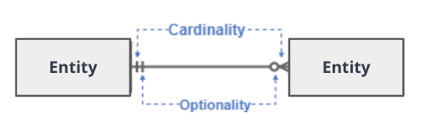
Create a conceptual data model that will provide SneakerPark with a holistic view of its data systems and help you grasp the organization's important entities and relationships, which will be instrumental as you move further in the project. You can use Lucidchart or any other diagramming tool of your choice, but please use the Crow’s Foot/IE Notation and please be sure to indicate both cardinality (the type of a relationship such as 1:N or N:N) and optionality (whether the relationship is optional or mandatory).

Slide 8
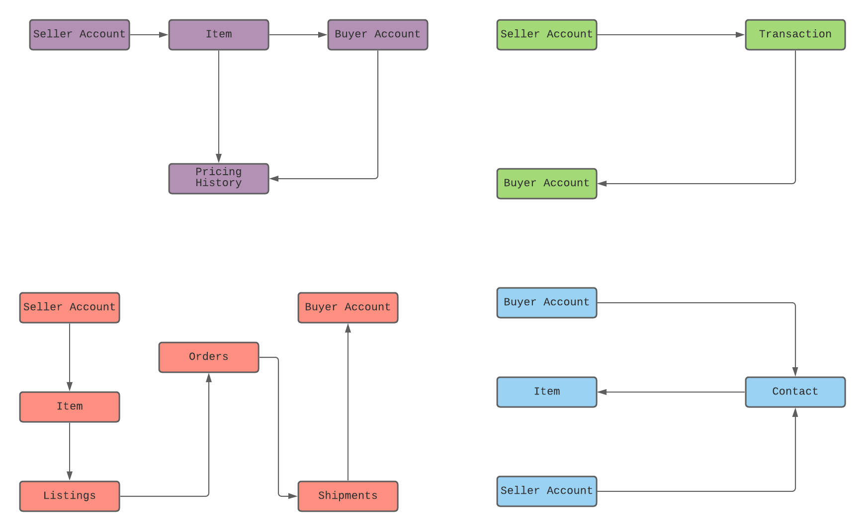
Different Systems

Slide 9
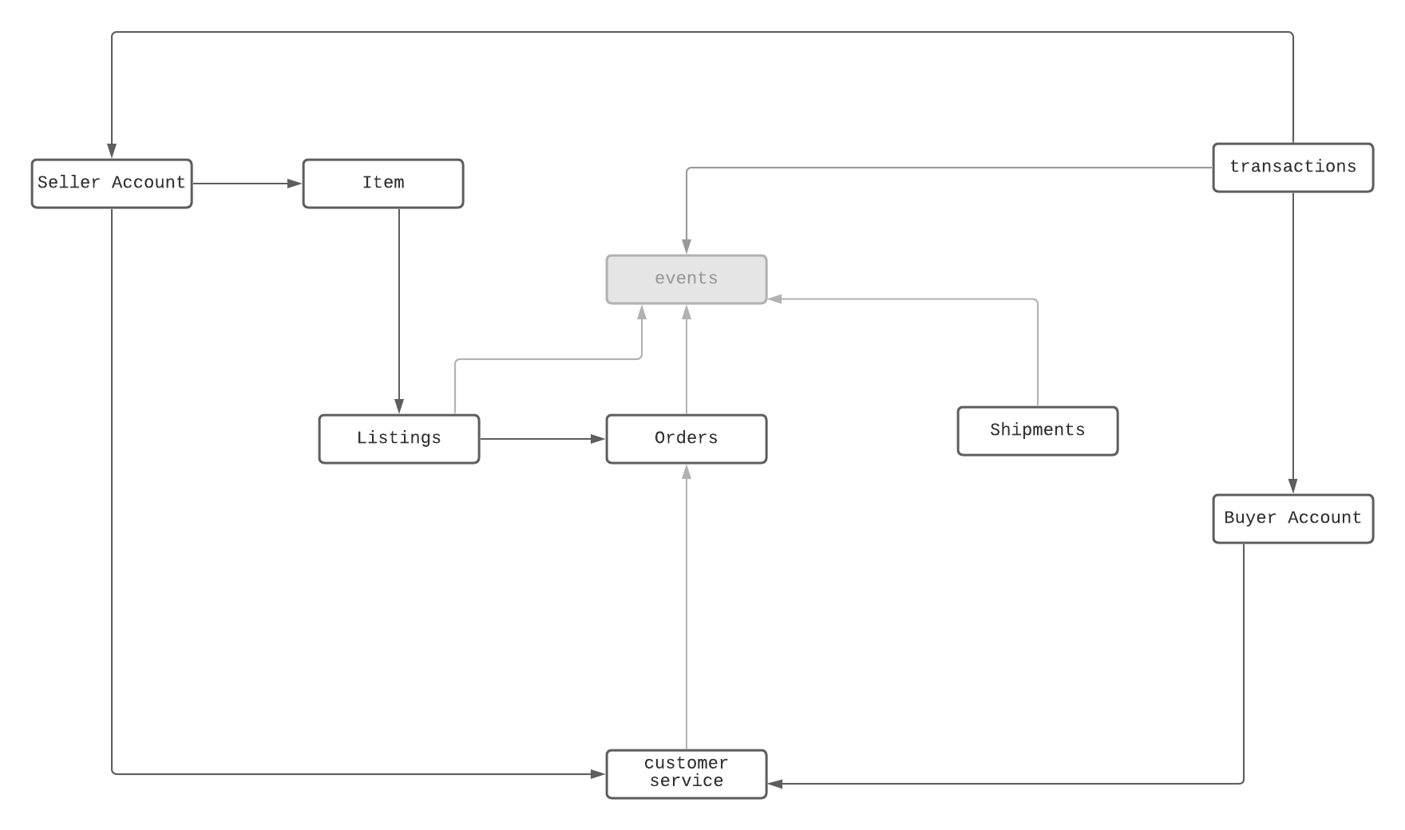
Different Systems interacting

Slide 10
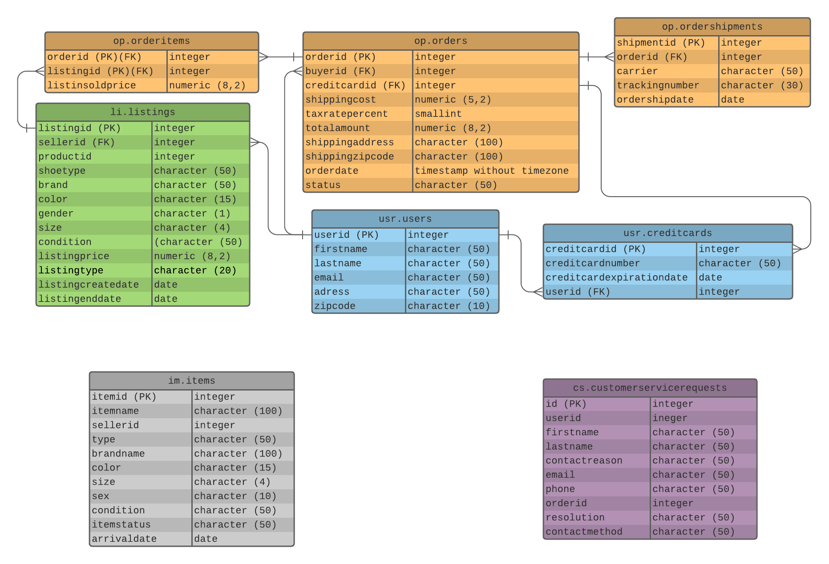
Initial Logical Enterprise Data Model

Slide 11
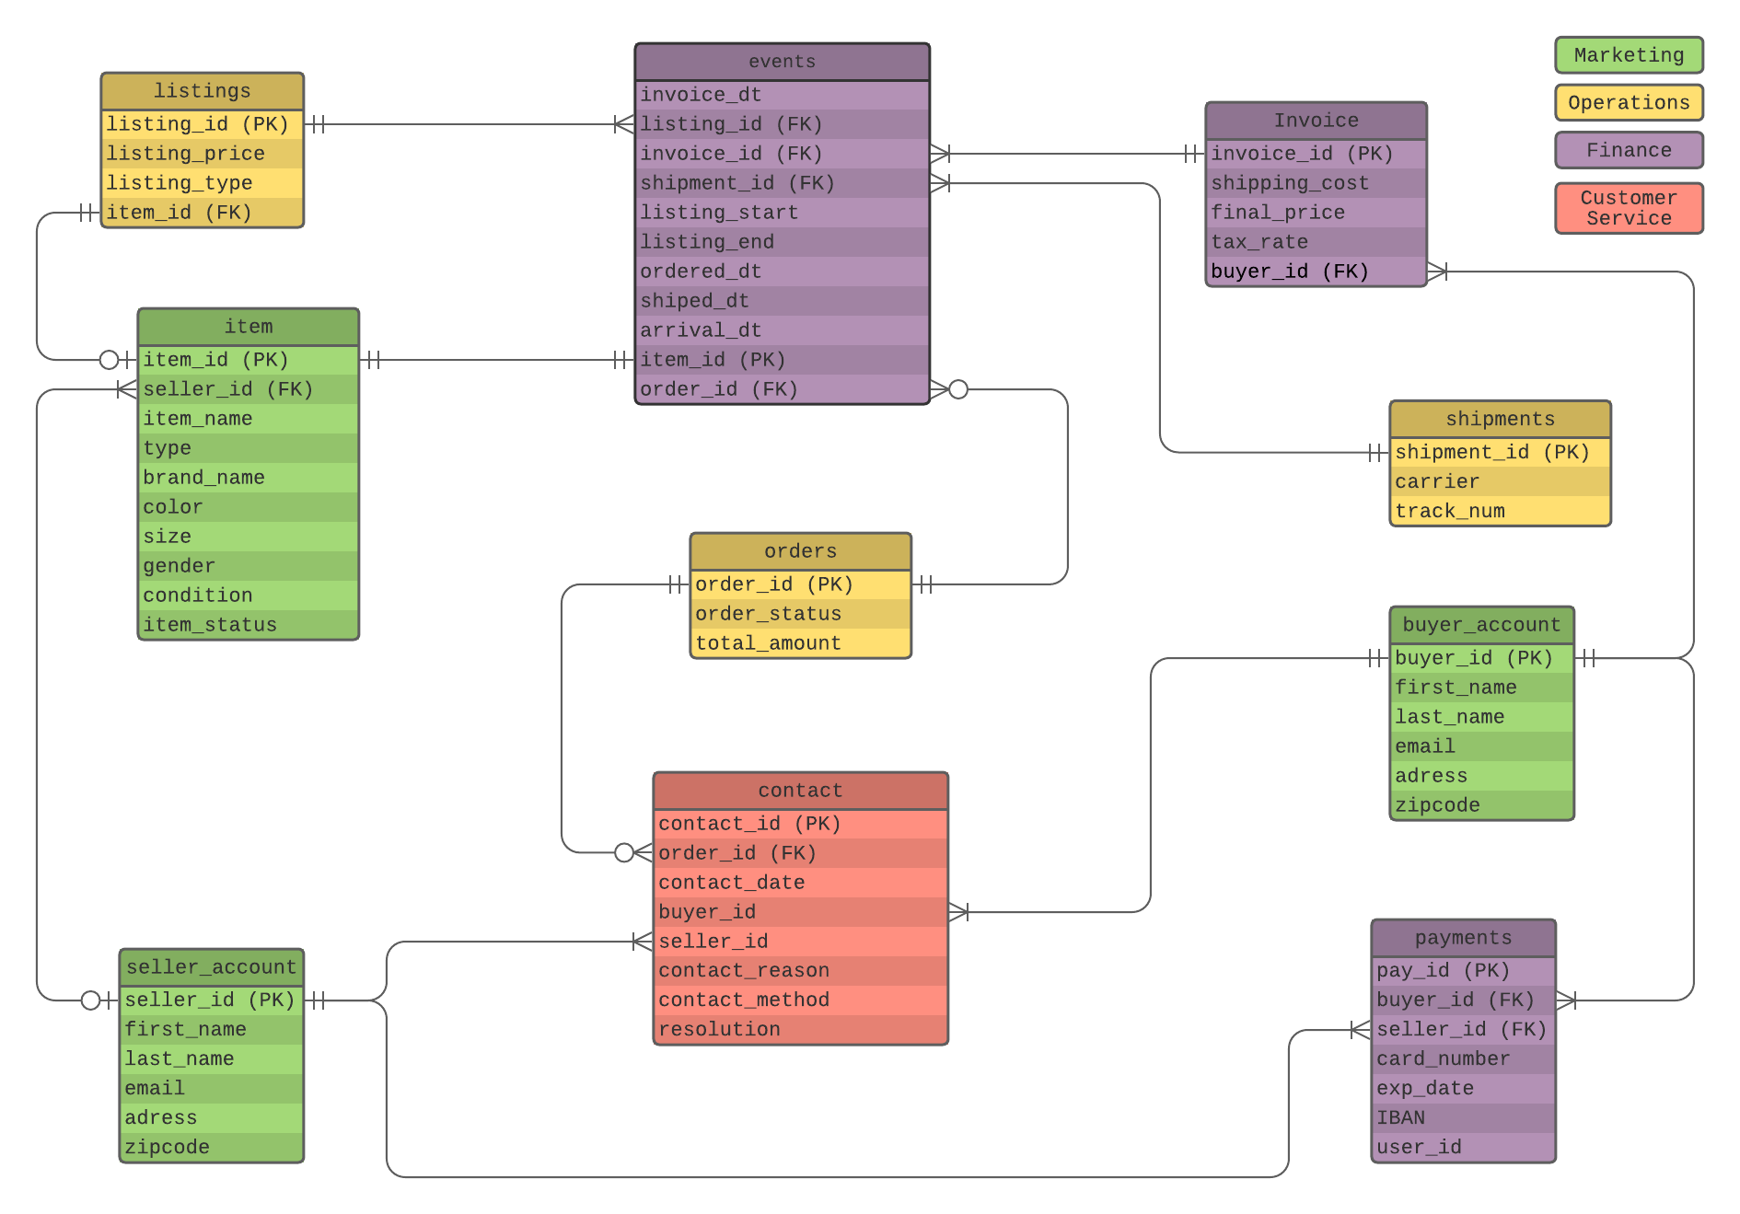
Revisited Logical Enterprise Data Model

Slide 12
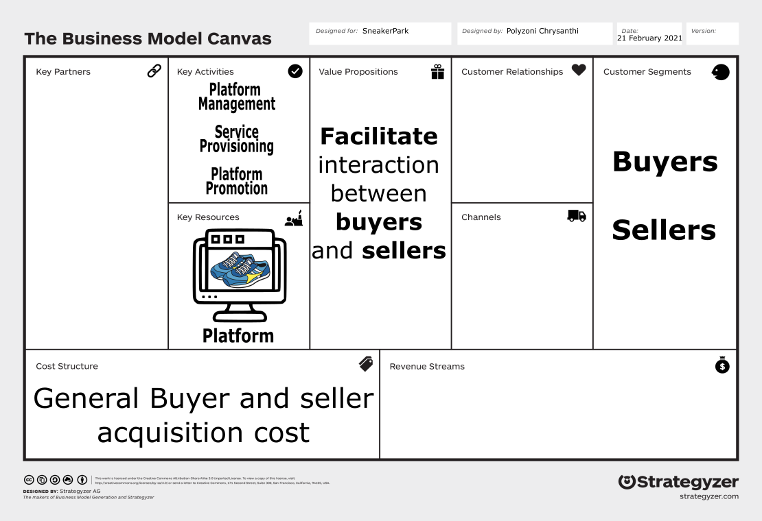
Why to introduce clearly a buyer account and a seller account?
Because Sneaker Park is a two-sided business model. It exists because these two exist
You need to have clear understanding about who is who.
And depict your business model in your data. Have a clear understanding of your existence.

Slide 13
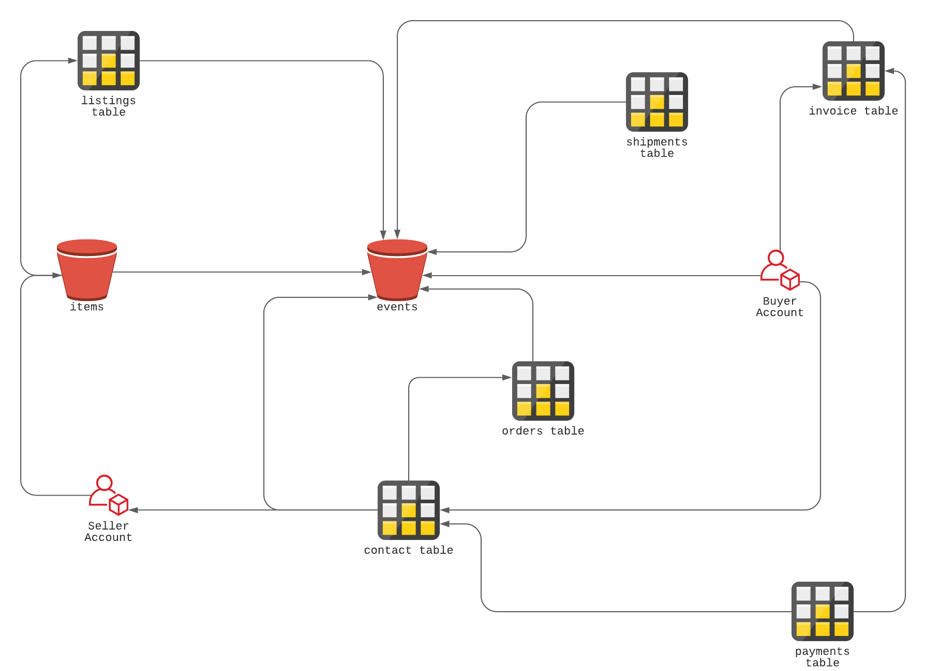
You can replace tables with buckets in a Data Lake architecture in the future where your innovation is more likely to happen: Item Table and Events Table as you move on with adding marketing information (ingest social media info for your marketing purposes) and different items (shoe types)
You need to have clear understanding about who is who.
And depict your business model in your data. Have a clear understanding of your existence.

Slide 14
Step 2
Enterprise Data Catalog Part 2: Metadata

Slide 15
The Metadata Catalog, documenting the metadata from all systems in the "Data Dictionary" and the “Enterprise Data Catalog” tabs of the provided Sheets template is attached

Slide 16
Step 3
Data Quality
Part 1: Profiling and Cleansing

Slide 17
Column | Table | Issue | Dimension | Description
item_status | item | Missing Data | Accuracy | Some records have NULL values for the item_status
total_amount | orders | Wrong Data | Consistency | Some records have data as 0.00
track_num | shipments | Wrong Data | Consistency | Some records have data as 0.00
final_price | invoice | Missing Data | Accuracy | Some records have NULL values for the final_price
contact_date | contact | Missing Data | Accuracy | All values are null
order_id | contact | Missing Data | Accuracy | Two values are null
arrival_dt | events | Missing Data | Accuracy | 40 values of not listed items have no arrival date
arrival_dt | events | Missing Data | consistency | 312 values of listed items have no arrival date
seller_id | seller_account | Ununiform Data | Uniformirty | seller_id, buyer_id should have the same number of digits

Slide 18
Step 4
Data Quality
Part 2: Monitoring

Slide 19
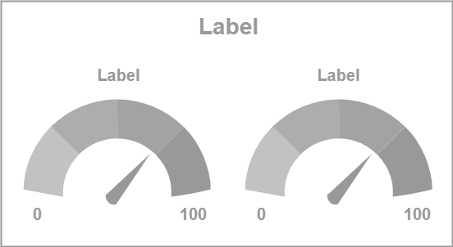
In an inventory company a data quality monitoring dashboard should include all possible date time information that is taking place in the warehouse. That will be used to monitor the data to ensure compliance with your data quality rules. Percentage of copleteness of the events table should be kept up to date to calculate Inventory turn ratios and have systems comunicating one another in terms of predictive analytics to be comunicating between operations and Marketing. Invertory turns will be making up overall company KPIs and will be driving Operations and marketing activities. They should all be controlled by the finace team.
Events Table
Monitoring
Arrival Date Completeness
Listing Dates Completeness

Slide 20

FUTURE ISSUE
N | contact_date | contact Missing Data| Completeness | All values are null all column Add contact date column | Add a NON NULL constraint | Percentage of NULL VALUES

Slide 21
Step 5
Master Data Management
Part 1: MDM Architecture

Slide 22
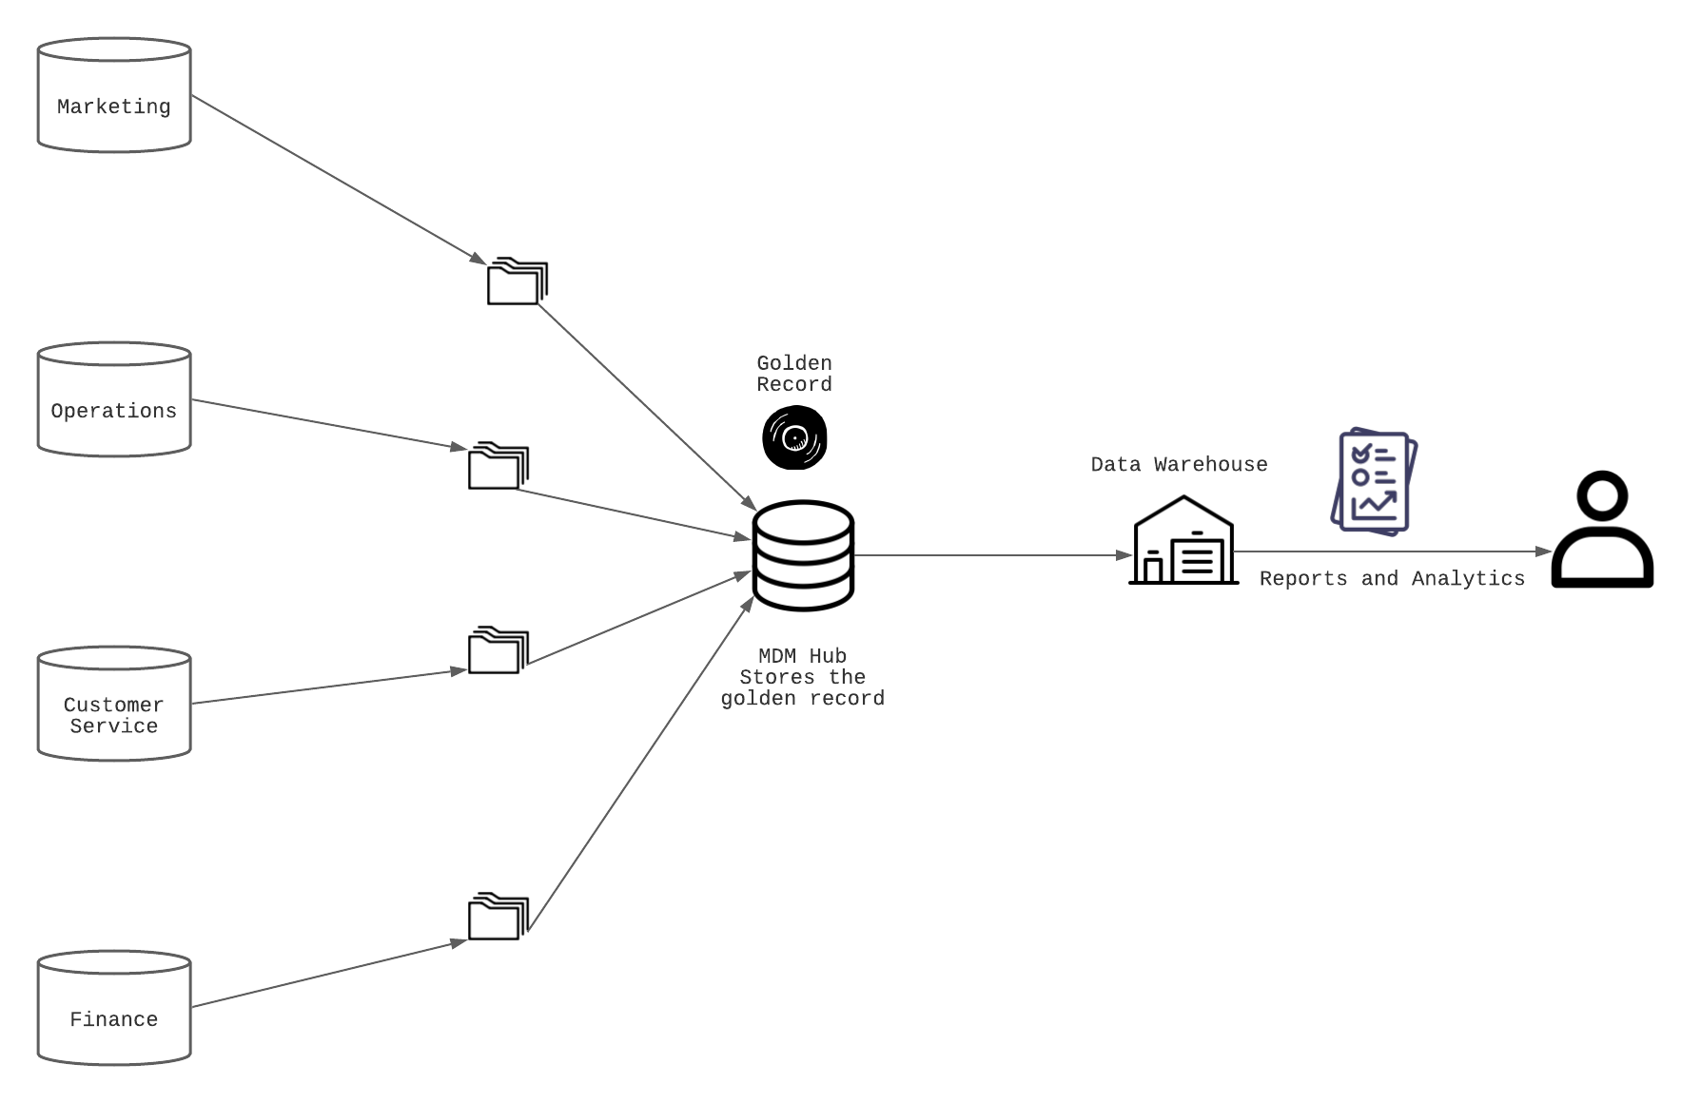
The proposed MDM implementation

Slide 23
Explanation:
For the time being we propose a Consolidated MDM (Master Data Management Architecture) as long as the system remains simple with only for different types of shoes : “Boots”, “Sandals”, “Dress”, and “Sneakers”. If you only trade shoes of a specific category things remain simple. The more the company gets larger and communications more critical and you might have to invest into more complicated DMD systems.
Consolidated MDM Master data from different source systems is physically consolidated, matched, cleansed, and stored in a central repository called the MDM hub.
This is typically done in batches at some regular intervals such as hourly, daily, weekly, etc. In the case of SneakerPark we suggest an interval of 12 hours. If this can cause disruption and can negatively influence inventory turnaround and KPIs set by the Finance team, we can consider moving to a consolidated MDM to save on time.
Unlike in Registry MDM, we are storing not just the keys and locations, but actual data. This consolidated master data constitutes what is called a “golden record” or the authoritative, most accurate record of that information that the organization has. The master data can then be ingested into an Enterprise Data Warehouse and used by downstream systems and users for analytics and reporting. That is why this style is also called Analytical MDM. In this style, the master data flows in one direction, more specifically from the source systems into the MDM Hub. The beauty of this architecture is that it’s still minimally intrusive to existing systems, but is more complex and expensive than Registry MDM.

Slide 24
Step 6
Master Data Management
Part 2: Master Record

Slide 25
Rules
seller_id matches userid
A seller must have created a seller account and created a buyer_id that would lead to the creation of an item_id and if the item passes the quality criteria a listing_id. The identification should be flawless. If we have one listing_id we should be having one and only one item_id that would lead to one and only one seller_id.
buyer_id matches userid
A buyer is not required to have a seller account, so a buyer is also a seller if and only if they have decided to sell their sneakers on the platform. A buyer account should match on the seller account not on the id but on the first name, last name adress which has to be the same only if this person wants to rade AND buy shoes in the platform.
item_id in item table matches item_id in events table
An item is identified by the unique item_id that may have similar characheristics with other items but all transactions and processes each item has had must be reported and registered on the events table and monitored by the finace team in terms of inventory turnaround. As soon as an item is accepted it gets an item_id and can have multiple listings which has to be reported in the events table. Many listings lead to just one order_id in case a buyer decides to buy the item.
seller_id in seller_account table matches seller_id in item table
The item’s characteristics may be similar, and the very same shoe can be traded from two different sellers. In that case these two identical but different items will have different item_id and two different seller_accounts.

Slide 26
Step 7
Data Governance:
Roles and Responsibilities

Slide 27
For each system a Data Owner has to be set:
One for the Marketing dapartment,
one for the finance deparment
one for the customer service department and
one for the operations department.
The finance department owner and administrator will be in posess of the events table. Data Quality Management, Metadata Management and MDM responsibilities will be set to the administrator of each system (Marketing, Finance, Operations and Customer service) respectivelly at this stage. KPIs will have to be set on the quality criteria each system and quality threasholds they have set. The most critical KPI and system to handle at the moment is the quality of the finacial system that will have to set inventory turnover ratios and threshols.

