Slide 1

KidKit

Slide 2

Problem
Families want to spend less possible time at the airports when they travel
People want to speed up all their activities in crowded places
People should be avoiding gathering and practice social distancing as much as possible, especially during vacation to avoid infections during holiday time.
Trust has been lost and uncertainty is very high
Households want to feel hygienically safe today more then ever

Slide 3
At the same time
The tourism industry has been hit in a non precedent manner
The aviation industry is facing huge loss
More and more companies are closing causing crisis and recession
Everyone is unhappy and can’t wait to get “back to normal”
Climate change is still imposing a high toll in our communities.

Slide 4
Solution
A clothing rental service for the holiday period so that people can be able to travel without having to prepare load and collect luggage at the airport.
A kit with all necessary items will be delivered at their destination and for the period they might need it, making it possible to visit different destinations easily without the luggage struggle.
In this way, it can be possible to successfully practice social distancing at the airport.

Slide 5
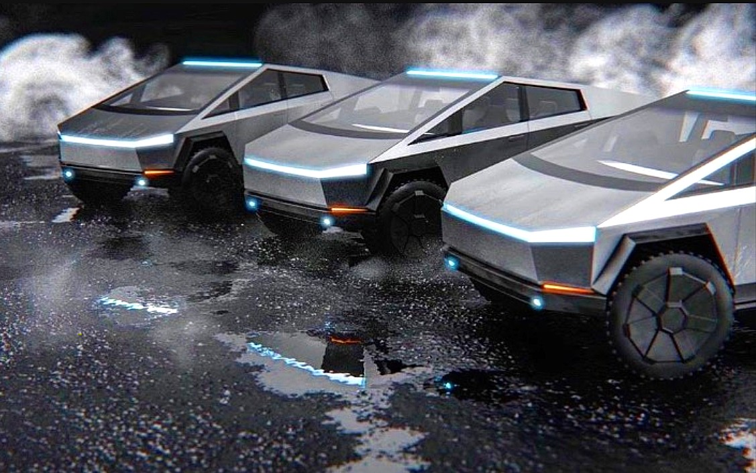
Solution A mobile laundry service fleet

Slide 6
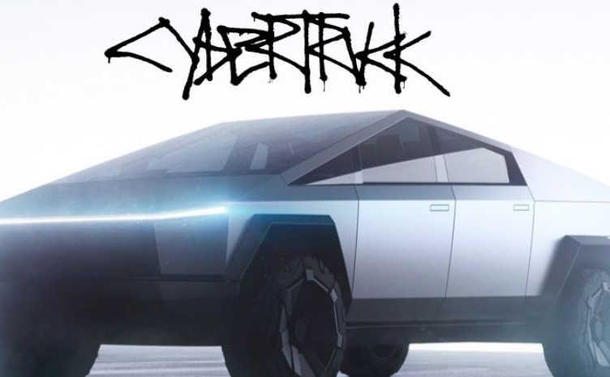
Made up of EV

Slide 7
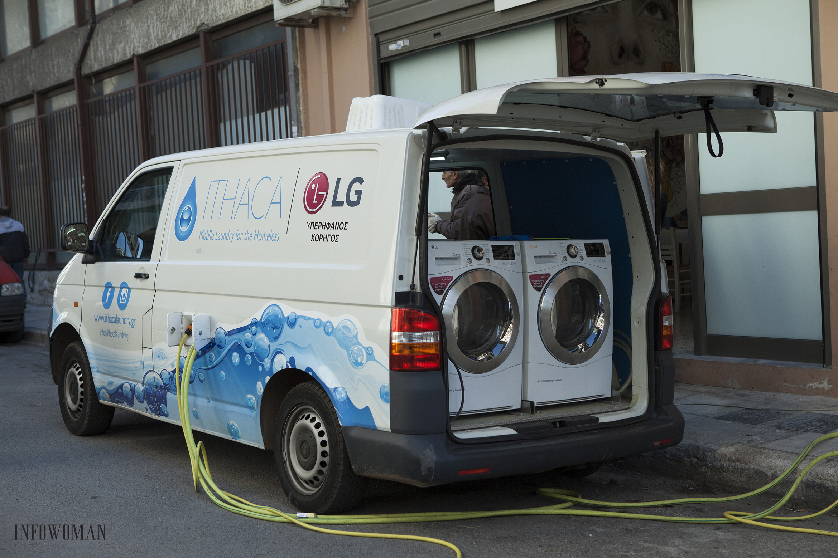
Serving smart cities of the future*
*with heart
https://ithacalaundry.gr/en/

Slide 8
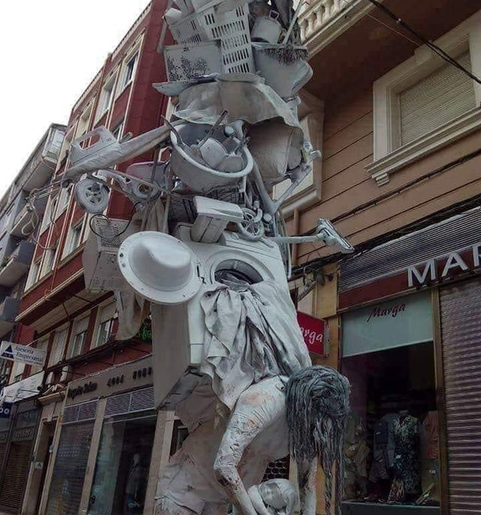

To avoid burnout and show to our children the attention they deserve

Slide 9
Global Online Clothing Market Size
The global online clothing rental market is anticipated to expand
at a compound annual growth rate (CAGR) of 10.76%
during the 2018-2023 period and will reach a value of USD 1.96 Bn by 2023,
up from USD 1.18 Bn in 2018*.
https://www.researchandmarkets.com/reports/4801592/global-online-clothing-rental-market-2018-2023

Slide 10








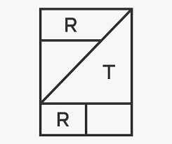



Competition

Slide 11

Market Size in Bay Area
Focusing on the family tourism market
we know that our clients are very likely to be visiting
The Walt Disney Family Museum
https://www.waltdisney.org/
During their visit

Slide 12
Market Size in Bay Area
With visitor attendance reaching 400,000 last year,
and the WDFM rated as the Bay Area’s
number one
museum by the Bay Area A-List and the Morey Group,
the management team has set a 10-year goal of increasing attendance to 600,000*.
*https://www.moppenheim.com/walt-disney-family-museum

Slide 13
Market Size in Bay Area
If we were to divide this number with 12 for the number of months per year,
and just focus on summertime,
We talk about approximately a market size of 67 000 people in the
Family demographic group

Slide 14
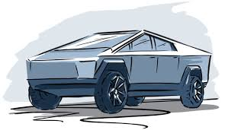
Market Size in Bay Area
It is now possible with AI to predict in detail how this market share is
the right initial fit to our business,
And develop resilient ways to adapt our strategy
to arrive to the expected results

Slide 15
Market Size in Bay Area
If we were to start for the first year and focus only on the 2% classic conversion
Rate based on digital marketing, that is 1340 conversions for the
First year, which makes 22 clients per day for two months to test
The Prototype laundry vehicle.

Slide 16
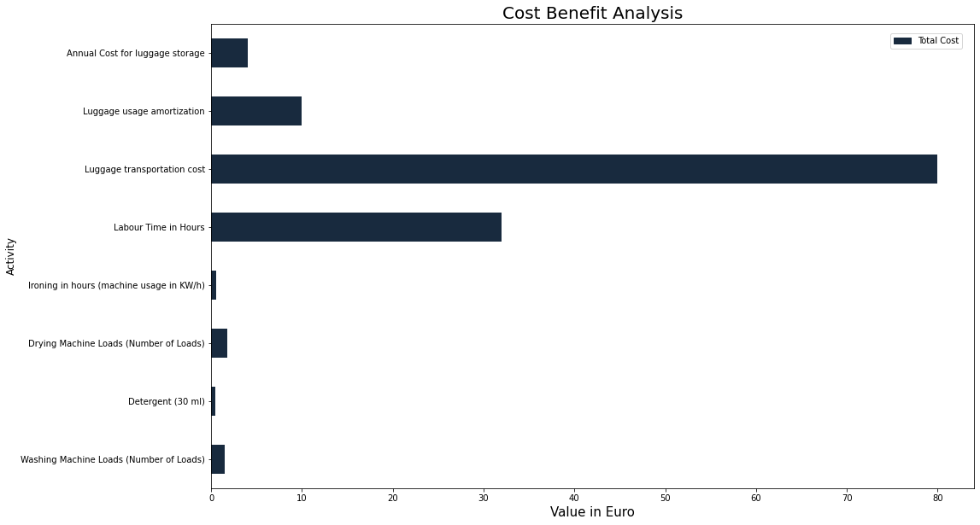

Slide 17
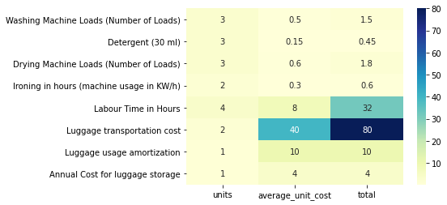
Total cost of luggage preparation: 130 euro \ round trip

Slide 18
Resources: vehicle laundry labor,
sealing methods,
luggage boxes
Resources: vehicle laundry labor
Resources: vehicle laundry labor
Quality
Control
Cleaning
Ironing,
Packing and sealing
WIP
WIP
RMI
FGI
Resources: #conscious H&M, Zara and other clothes, and/or partner branded clothes, The Truck
Resources: The Truck
Delivery to customer’s destination (airport or accommodation)
RMI
Operations
Process Flows
Delays: RMI (Raw Material Inventory), WIP (Work In Progress), FGI (Finished Good Inventory)

Slide 19
Market Penetration
The general idea is to make people literally dress up into
“innovation spirit” when they visit bay area.
This is thought to happen if we designed the collection
inspired by the pioneers of innovation like
Walt Disney (Disney Characters)
Steve Jobs (Pixar Characters)
Elon Musk (Star Wars characters)
Sebastian Thrun (Fancy Hawaiian shirts)
We would only invest a limited budget of $30 000 to identify
The right segments through the most popular digital tools
Google Ads
Facebook Ads
Twitter Ads
And carefully monitor word of digital mouth using the right
Channels and AI tools to be developed.

Slide 20



Milestones
5. Design distribution points and AI models to predict demand
3. Develop digital strategy
4. Monitor segments through digital channels, and AI tools to be developed.
In short AI for digital marketing
2. Create the collection given data we have collected about people interested in the service
1. Develop prototype vehicle
6. Create vehicle fleet
7. Test distribution network, charging network (energy, water, detergent) for mobile laundry business.

Slide 21
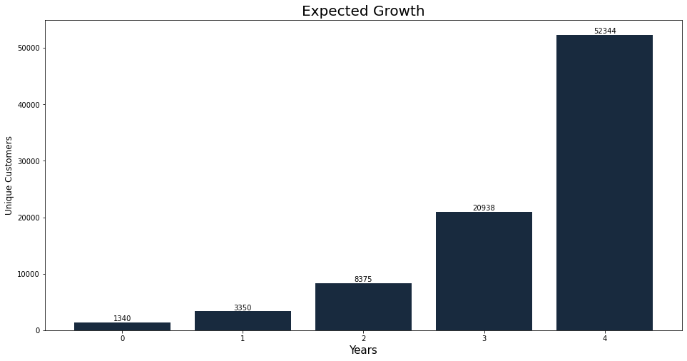
If this were to be successful, we expect exponential growth in the first five years of service

Slide 22
Expected Teamwork
An engineering team to redesign cyber truck to become the basic element of the mobile laundry system
A data science team to develop the digital marketing tools to feed data for the supply chain demand forecasting
A geo localization data science team to plan the distribution of the fleet spatially to minimize the use of energy, water and detergent supplies.
A fashion design team to create the concept and develop the collection focusing on the innovation spirit on bay area.

Slide 23
Expected Investment
The possibility to have the team created within the expertise of tesla labs, as a Cyber Truck
sub project, to develop the prototype, and build up the team for growth and expansion,
as a tesla project

Slide 24
Thank You

