Slide 1
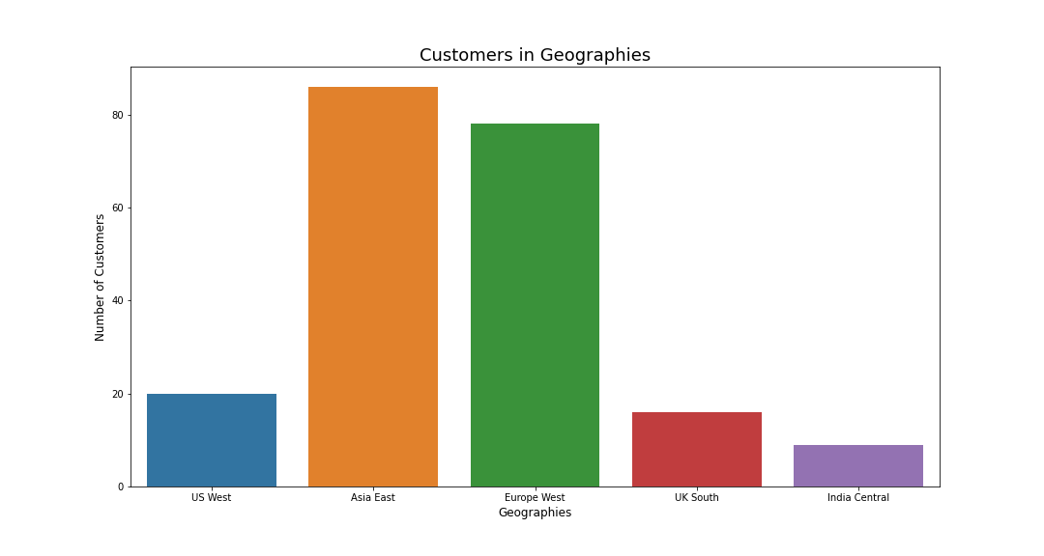
Create a module dedicated to challenging AI tasks in healthcare and the importance of the ‘Time to Insight’. Take advantage of the ‘Pledge to Americas workers’ initiative
Students hands on practice on challenging tasks over healthcare based on time restrictions for decision making.
Feed Customer Network with well trained professionals in the AI field of healthcare, taking advantage of the ‘Time to Insight Capabilities’
Create a module exposing the importance of ‘Time to insight’ for decision making in the Circular Economy context in collaboration with Ellen MacArthur Foundation
Hands on practice on successful circular economy strategies and the advantage of a rapid ‘Time to insight’ tools.
Join partners aiming to shift to Circular Economy and cut on high operational costs with the use of AI and big data.
Create a module exposing the importance of ‘Time to insight’ along with most important India partners and digital India Government Initiative.
Hands on practice using ‘Time to insight’ Azure Synapse tools.
Join workforce within Microsoft India Partners Network.

