Slide 1
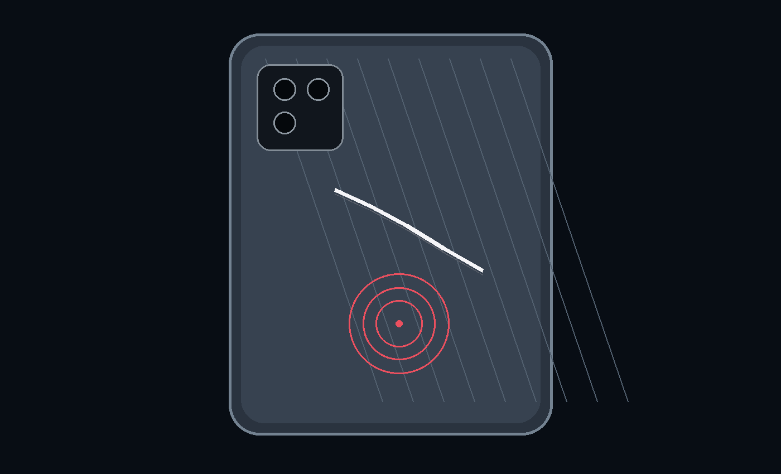
INDUSTRIAL COMPUTER VISION
Dent & Scratch Defect
Inspection — Back Glass
Traditional CV development + future Deep Learning / Hybrid roadmap
CURRENTLY UNDER TEST
Interpretable, tunable Traditional CV pipeline
Phone Back-Glass • Dent & Scratch Inspection
Computer Vision

Slide 2
Inspection Problem & Target
02
Detect small surface defects on reflective smartphone back glass while controlling glare, texture and temporal noise.
DEFECT TYPES
• Scratch: thin high-frequency structure / line
• Dent: localized surface deformation / intensity anomaly
• Both can be confused with glare, texture, dust or sensor noise
CORE CHALLENGES
• Reflective glass → illumination-sensitive response
• Micro-defects → very small spatial footprint
• Video inspection → false detections can flicker frame-to-frame
Phone Back-Glass • Dent & Scratch Inspection
Computer Vision

Slide 3
Current Inspection-Stations Architecture
03
The supplied application already provides a modular base for controlled image acquisition and pluggable detection.
CAMERA
LIGHTING
CAPTURE
DETECTION
UI / RESULT
Basler Camera 1/2
Exposure • Gain • FPS • Resolution
RGB recipes
Dual 4CH / Single 8CH
Light ON → settle → capture
→ Light OFF → save
RAW Laplacian • Canny
pluggable registry
Live view • parameters
Detection result
Modularity allows new CV or DL detectors to be added without redesigning camera / lighting / capture control.
Phone Back-Glass • Dent & Scratch Inspection
Computer Vision

Slide 4
Three-Path Development Strategy
04
A staged approach: exhaust interpretable CV improvements, then introduce learned representations where required.
01
02
03
TRADITIONAL CV
DEEP LEARNING
CV + DEEP LEARNING
Current testing
Deterministic + tunable
Future fallback
if handcrafted features are insufficient
Hybrid
CV-derived feature space → learned model
Decision point → compare detection stability, false-positive rate, minimum detectable defect size and production throughput.
Phone Back-Glass • Dent & Scratch Inspection
Computer Vision

Slide 5
Option 1 — Traditional CV: Phasewise Evolution
05
Each iteration addresses a specific failure mode observed in defect detection.
P1
P2
P3
P4
P5
Baseline
Noise reduction
ROI awareness
Spatial filtering
Temporal stability
Gray → Laplacian → threshold → contours
Gaussian smoothing → Laplacian → mean + k·σ
CLAHE → Canny / Adaptive Threshold → contour ROI → erosion
Candidate centroids → neighborhood radius → neighbor-count outlier logic
Local μ/σ via boxFilter → rolling mask buffer → persistence hits
Simple edge / micro-variation detector
Reduce high-frequency noise
Inspect relevant glass region; protect borders
Reject repetitive glare / texture clusters
Reduce frame-to-frame flicker
Phone Back-Glass • Dent & Scratch Inspection
Computer Vision

Slide 6
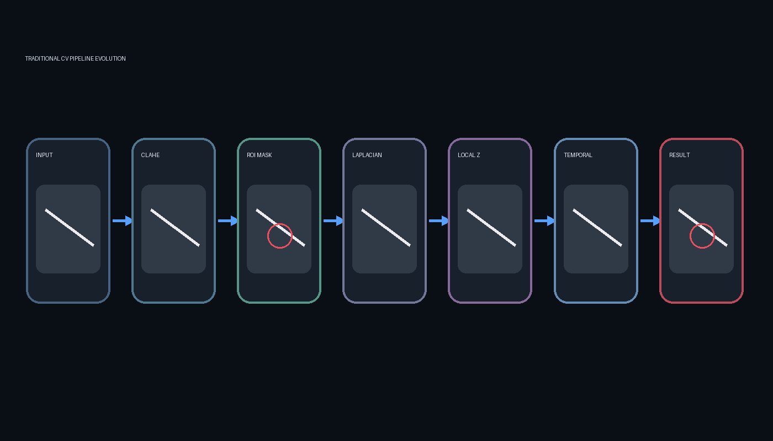
Traditional CV — Early Baseline: Laplacian + Dynamic Threshold
06
The first implementation converts local intensity curvature into a binary defect candidate map.
CORE OPERATION
• Convert BGR → grayscale
• Optional Gaussian smoothing to suppress sensor noise
• Laplacian: second spatial derivative / high-frequency response
• Threshold using mean + k × standard deviation
• Contours / bounding boxes group candidate pixels
Limitation: a single global threshold can move with illumination, texture and frame noise.
Phone Back-Glass • Dent & Scratch Inspection
Computer Vision

Slide 7
Traditional CV — ROI & Local Contrast Enhancement
07
Focus computation on the phone/glass region and make micro-contrast more visible before defect extraction.
1
2
3
CLAHE
ROI extraction
ROI erosion
Local histogram equalization
Enhances micro-contrast without relying only on global brightness
Gaussian blur → Canny / Adaptive Threshold → contours
Area filtering selects major structural region
5×5 morphology shrinks mask inward
Separates interior defect analysis from border structure
Result → defect detector sees the relevant surface rather than the entire camera frame.
Phone Back-Glass • Dent & Scratch Inspection
Computer Vision

Slide 8
Traditional CV — Spatial Density Outlier Logic
08
A candidate is evaluated against nearby candidates: isolated anomalies are retained; dense repeating patterns are treated as likely texture / glare.
SPATIAL MODEL
IMPLEMENTATION LOGIC
• Extract contour centroids (x, y)
• Compute Euclidean distance to other candidates
• Count neighbors within search radius
• If neighbor count ≤ max_allowed → retain as isolated anomaly
• Apply separately to interior and edge candidates
Virtual neighborhood radius
Purpose: suppress repeating reflection / texture hits.
Phone Back-Glass • Dent & Scratch Inspection
Computer Vision

Slide 9
Traditional CV — Local Statistics + Temporal Persistence
09
The latest detector directly targets the two observed sources of flicker: global threshold drift and single-frame noise.
LOCAL Z-SCORE STYLE THRESHOLD
WHY IT HELPS
T(x,y) = μ_local(x,y) + k · σ_local(x,y)
• Global threshold: sensitive to frame-wide drift
• Local threshold: adapts to nearby texture / illumination
• Rolling buffer: retains persistent hits
• Example: 3-frame buffer, require ≥2 hits
• μ and σ computed with cv2.boxFilter on |Laplacian|
• Pixel must stand out from its own neighborhood
TEMPORAL FILTER
Rolling mask buffer → persistent candidate = stable defect; one-frame blip = rejected.
Phone Back-Glass • Dent & Scratch Inspection
Computer Vision

Slide 10
Option 1 — Current Target Pipeline
10
The working direction combines the strongest elements developed across the supplied implementations.
Controlled capture → CLAHE → ROI / border separation → Laplacian → local threshold → spatial outlier filter → temporal persistence → PASS / FAIL
Phone Back-Glass • Dent & Scratch Inspection
Computer Vision

Slide 11
Traditional CV — Key Parameters to Tune
11
Parameters map directly to physical defect size, optical noise and camera behavior.
CLAHE grid / clip
Local contrast scale
Too local → texture amplification; too broad → micro-defect contrast lost
Laplacian ksize
Spatial derivative scale
1/3/5/7 trades micro-detail vs robustness
k × σ
Detection sensitivity
Higher k → fewer candidates; lower k → higher sensitivity + more noise
ROI erosion
Border exclusion
Protects structural edges from being interpreted as defects
Neighborhood radius
Physical inspection area
Should map to calibrated pixel/mm scale
Max neighbors
Outlier criterion
Reject dense repetitive candidates
Window size
Local statistics context
Controls what 'local background' means
Persistence frames / hits
Temporal stability
Suppresses transient sensor / illumination noise
Phone Back-Glass • Dent & Scratch Inspection
Computer Vision

Slide 12
Option 2 — Deep Learning (Future Fallback)
12
Use learned visual representations when rule-based features cannot achieve required robustness.
INPUT
SEGMENTATION
DETECTOR
CLASSIFY
Controlled images
Phone / glass ROI
YOLO / instance detector
Dent / Scratch / OK
• Training data: defect / non-defect images with bounding boxes or masks
• Segmentation can isolate glass surface before detection
• Augmentation should model realistic lighting, glare and small-defect variation
Phone Back-Glass • Dent & Scratch Inspection
Computer Vision

Slide 13
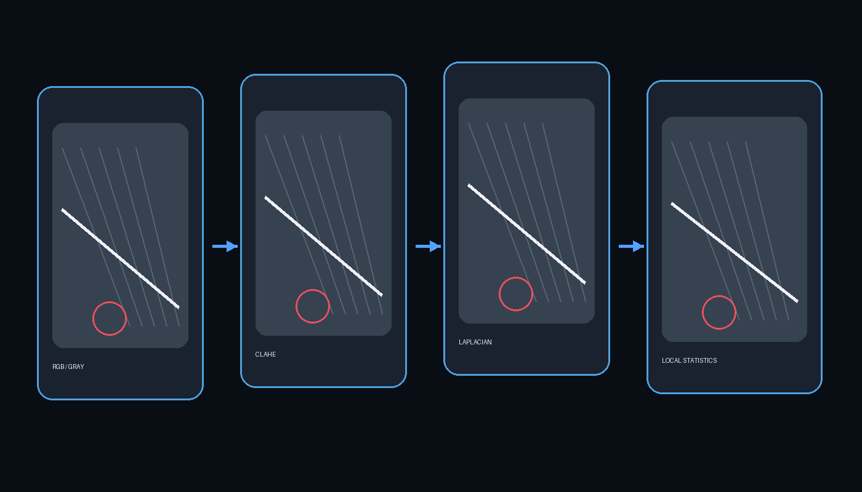
Option 3 — Traditional CV + Deep Learning Hybrid
13
Use classical vision to expose physically meaningful attributes, then let a model learn the final representation / decision.
ENHANCED FEATURE SPACE
• Original RGB / grayscale appearance
• CLAHE-enhanced image
• Laplacian / gradient response
• Local mean, standard deviation / Z-score
• ROI, edge distance and morphology-derived masks
• Spatial density / persistence attributes
[raw image + engineered channels / attributes] → CNN / segmentation / detector → defect probability
Phone Back-Glass • Dent & Scratch Inspection
Computer Vision

Slide 14
Approach Comparison — What Each Path Adds
14
Use measurable inspection criteria to select the production direction.
Traditional CV
Deep Learning
CV + Deep Learning
• Interpretable rules
• Fast to iterate
• Low data requirement
• Sensitive to imaging / thresholds
• Learns complex appearance
• Handles variation with enough data
• Requires labeling + training
• Needs validation for small defects
• Retains engineered physical cues
• Richer input representation
• Potentially more robust
• Higher system complexity
Phone Back-Glass • Dent & Scratch Inspection
Computer Vision

Slide 15
Validation Plan — From Prototype to Production
15
Evaluate the inspection system against the physical defect requirement, not only visual examples.
A
B
C
D
E
Build defect set
Optical repeatability
CV tuning
DL benchmark
Production test
Known dents + scratches
Different positions / sizes
Multiple captures per part
Lighting / exposure variation
Sensitivity vs false positives
Pixel/mm calibration
Train segmentation / detector
Compare on held-out set
Cycle time • stability
PASS/FAIL reliability
KPIs → Detection rate • False-positive rate • Minimum detectable defect • Processing time • Frame stability
Phone Back-Glass • Dent & Scratch Inspection
Computer Vision

Slide 16
Next Steps
16
Concrete work packages for the inspection development.
01
02
03
Optical setup
Traditional CV
Ground truth
Fix camera pose, focus, exposure and controlled RGB lighting recipes.
Tune CLAHE, ROI, Laplacian, local threshold, spatial + temporal filters.
Create labeled defect library with size / location / defect type metadata.
04
05
06
DL baseline
Hybrid experiment
Productionization
Train segmentation + detector on the same controlled capture protocol.
Compare raw-image input vs CV-enriched multi-channel feature input.
Integrate chosen detector into modular GUI and measure cycle-time / stability.
Phone Back-Glass • Dent & Scratch Inspection
Computer Vision

