Slide 1
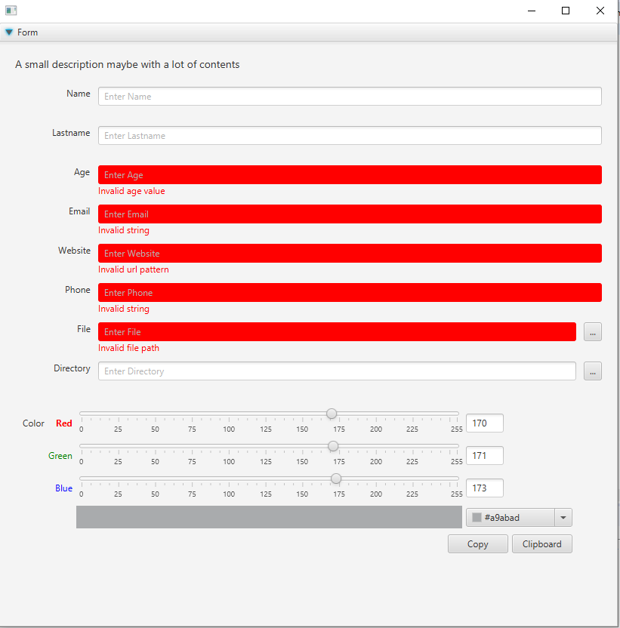
Tongue Framework
Tongue Renderer
Controller
Binding Model
Data Model
Code Generation
Tongue File
Project structure
JavaFX Application

