Slide 1
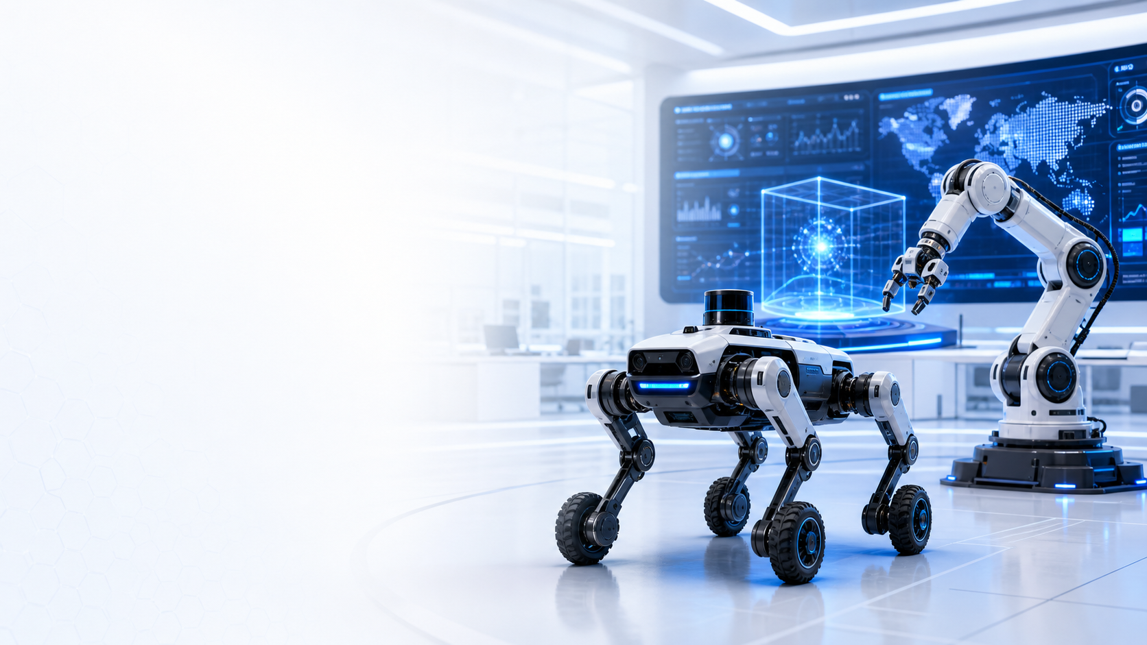

Physical AI · Security Robotics
Patrol & security
robotics in the AI era
Aiming for No. 1
Dr. 권성호 (QUAN CHENGHAO) | Dogu Robotics · Dogu X
Joined Dogu Robotics in 2020. Led software and R&D, served as CTO.
Leading Dogu X since early 2026.
Focus
Quadruped wheeled robots, arms and security fleets
Field
130 robots operating across Korea, deployment expertise
Learn
VLM/VLA, reinforcement learning and robot intelligence
Share
Field lessons and joint experiments in patrol security
Profile / Contact
Learning and experimenting to advance patrol and security robotics.
github.io/CHENGHAO-QUAN
Notes:
Hello, I am Dr. QUAN CHENGHAO, or 권성호. I worked at universities and research institutes before joining Dogu Robotics in 2020, driven by an interest in lidar. My roles have spanned software teams, R&D leadership, and CTO. Since early 2026, I have led Dogu X, an organization modeled on Google X.
I have led the development of wheeled patrol and security robots and fleet monitoring services, with experience operating 130 robots across Korea. Today, my focus includes quadruped robots with four wheels and robotic arms.
I believe AI is bringing major changes to both software development and physical security. To take an active part in that transition, I am exploring VLM/VLA, reinforcement learning, and robot intelligence, with a focus on applying new technologies to real operational challenges.
I would like to share lessons from deploying and operating robots, and work with people from different fields to discuss and test new patrol and security scenarios. My ambition is to become No. 1 in this field. Please scan the QR code and get in touch about robot operations or potential collaboration. Thank you.
Profile: https://chquandogong.github.io/CHENGHAO-QUAN/?lang=en
LinkedIn: https://www.linkedin.com/in/chenghao-quan/
Company: https://www.dogurobotics.com/
Biography and operating figures supplied by the presenter. Background: AI-generated concept illustration, not a product photograph.

