Slide 1
Information Environments and Asset Markets
Christoph Huber, Debrah Meloso, Michael Ungeheuer
Experimental Finance 2026
Toulouse
15 June, 2026

Slide 2

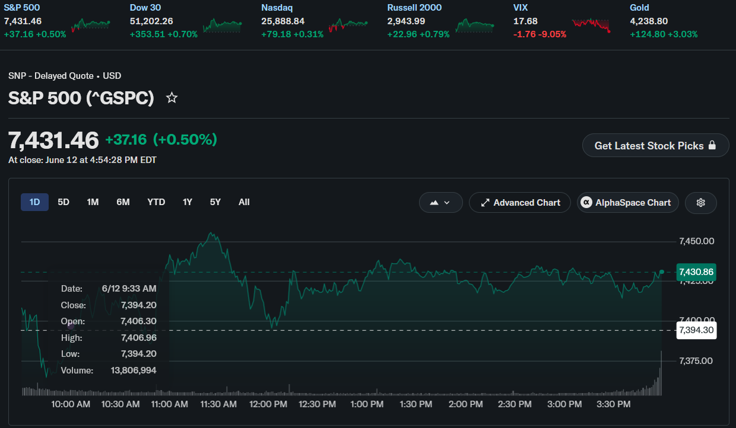
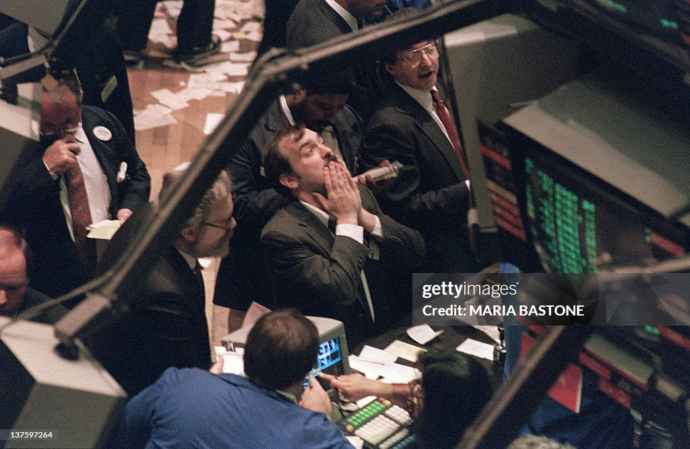
Motivation
Investors learn about security information in different ways
Sequential — historical charts, earnings announcements over time, etc.

Slide 3
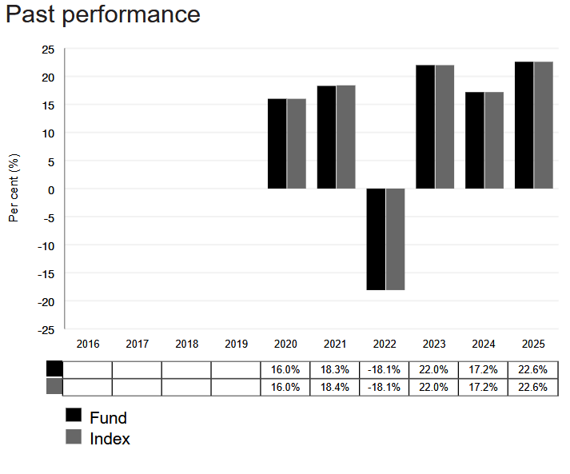
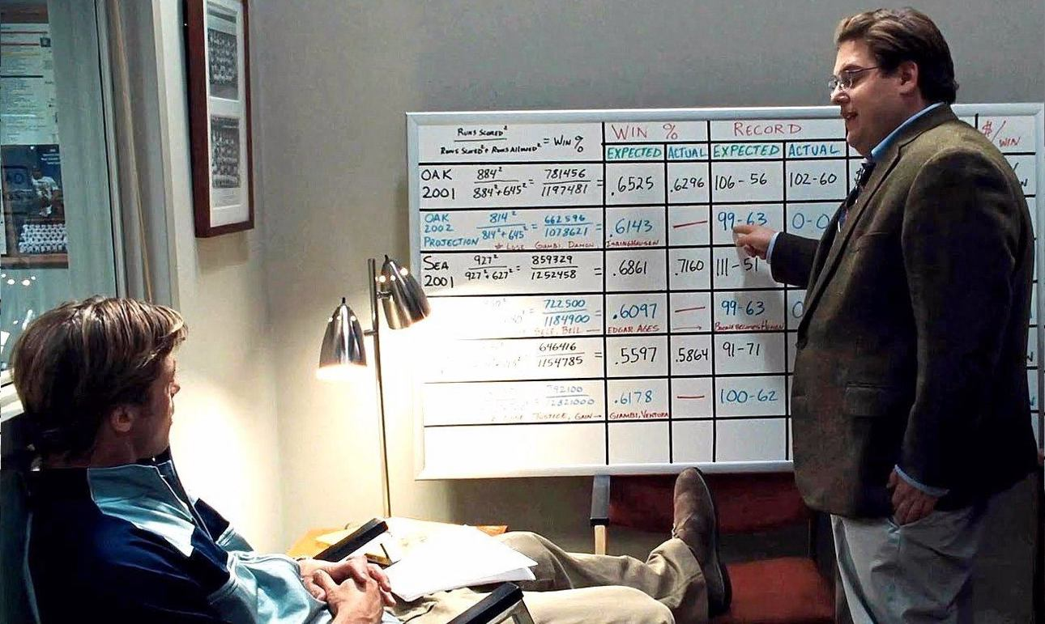
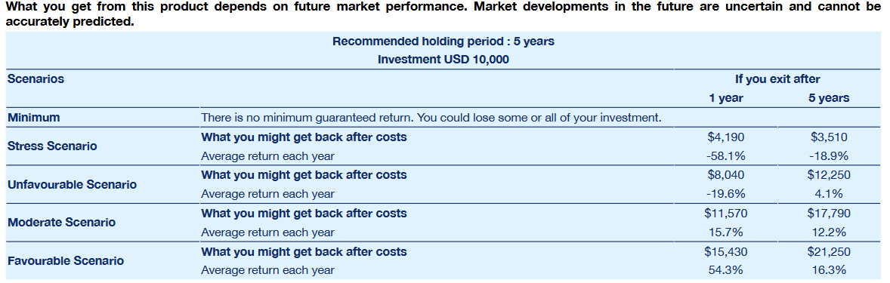
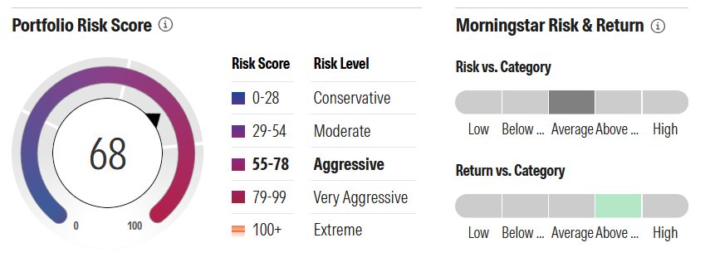
Motivation
Investors learn about returns in different ways
Simultaneous — distributional summaries, MiFID Key Information Docs, fact sheets, etc.

Slide 4
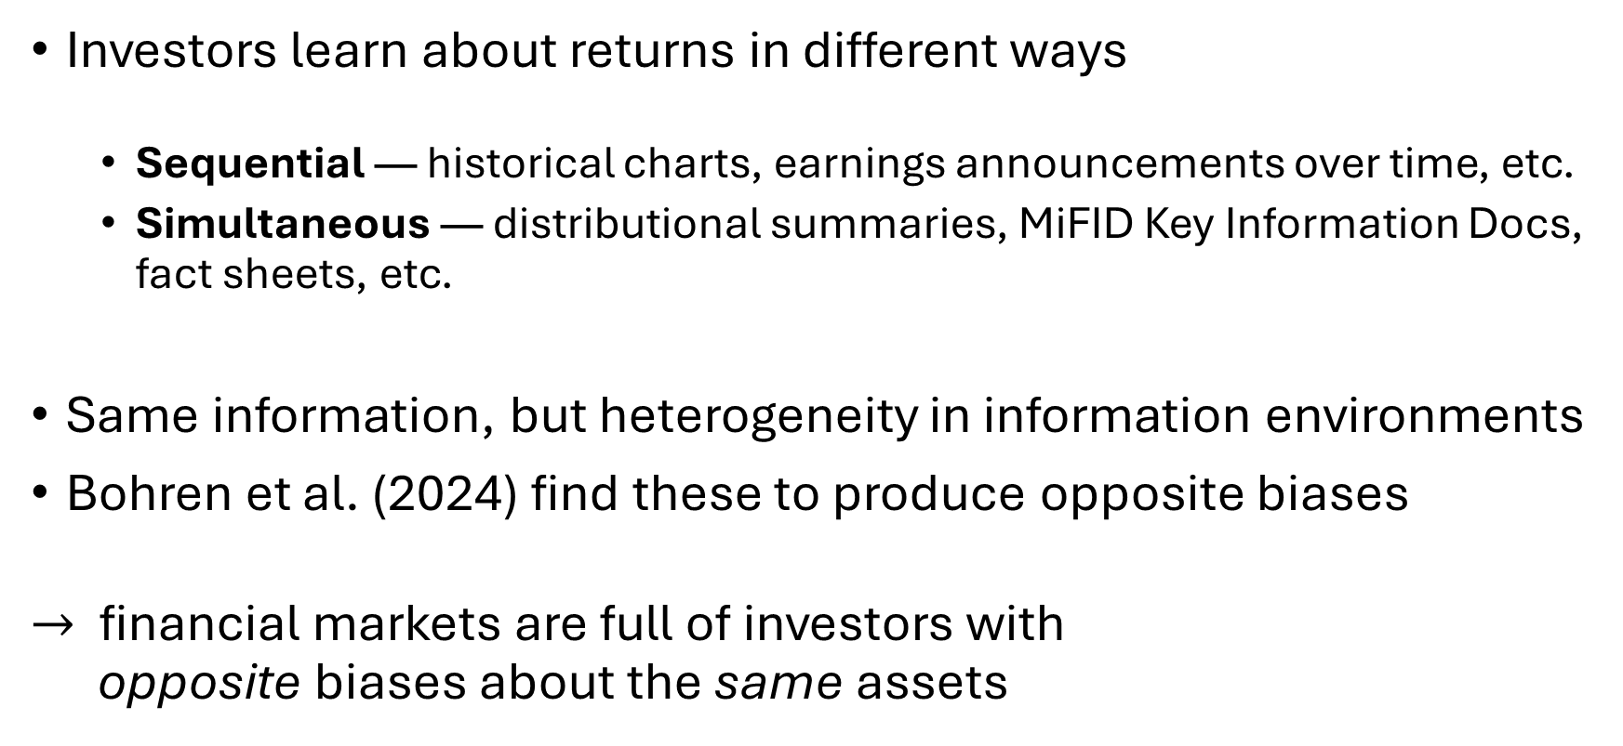
Motivation
Investors learn about returns in different ways
Sequential — historical charts, earnings announcements over time, etc.
Simultaneous — distributional summaries, MiFID Key Information Docs, fact sheets, etc.
Same information, but heterogeneity in information environments
Bohren et al. (2024) find these to produce opposite biases
$→$financial markets are full of investors with opposite biases about the same assets

Slide 5
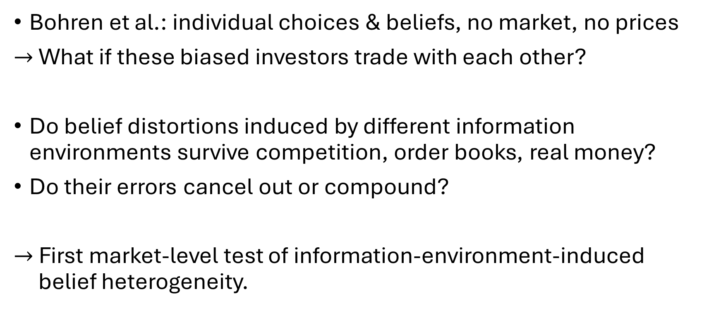
Research Questions
Bohren et al.: individual choices & beliefs, no market, no prices
$→$ What if these biased investors trade with each other?
Do belief distortions induced by different information environments survive competition, order books, real money?
Do their errors cancel out or compound?
$→$ First market-level test of information-environment-induced belief heterogeneity.

Slide 6
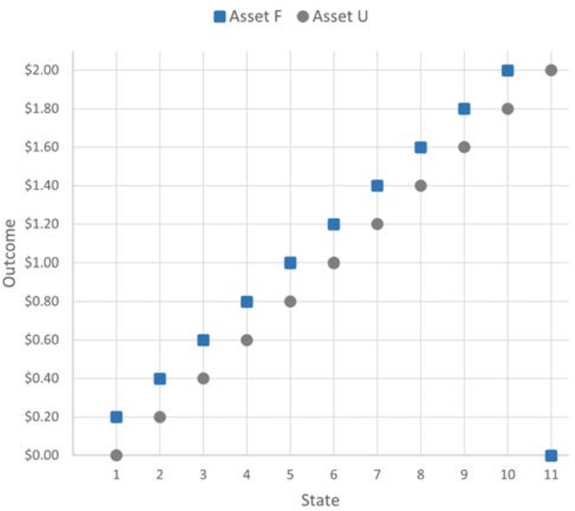
Two assets: Asset F and Asset U
Asset F
slightly ahead 10 out of 11 times
Frequent winner
Asset U
dramatically ahead 1 out of 11 times
Unlikely winner
Notes:
(say: this is the whole engine of the paper)

Slide 7
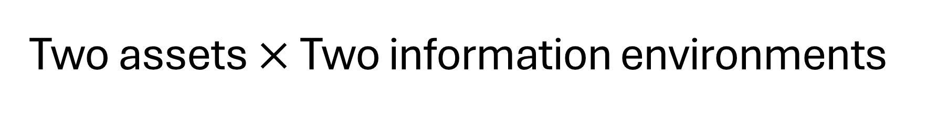
Two assets $×$ Two information environments
Asset F — slightly ahead in 10 of 11 states, Frequent winner
Asset U — dramatically ahead in 1 of 11 states, Unlikely winner
Sequential
imperfect memory recall → people misremember rare outperformance of U → 85% choose F
Simultaneous
limited attention → people overweight salient outperformance of U → 42% choose F
(Bohren, Hascher, Imas, Ungeheuer, Weber, 2024)
Notes:
both produce BIASED BELIEFS – but in OPPOSITE DIRECTIONS

Slide 8
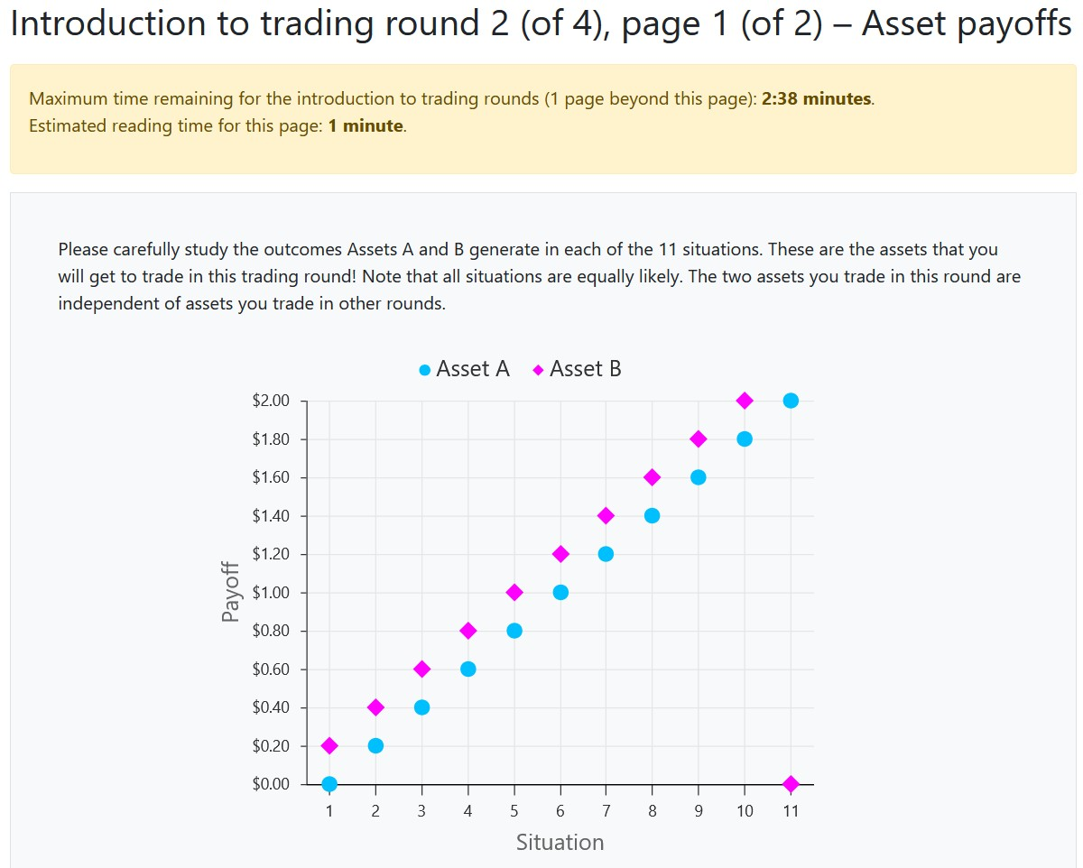
Simultaneous

Slide 9
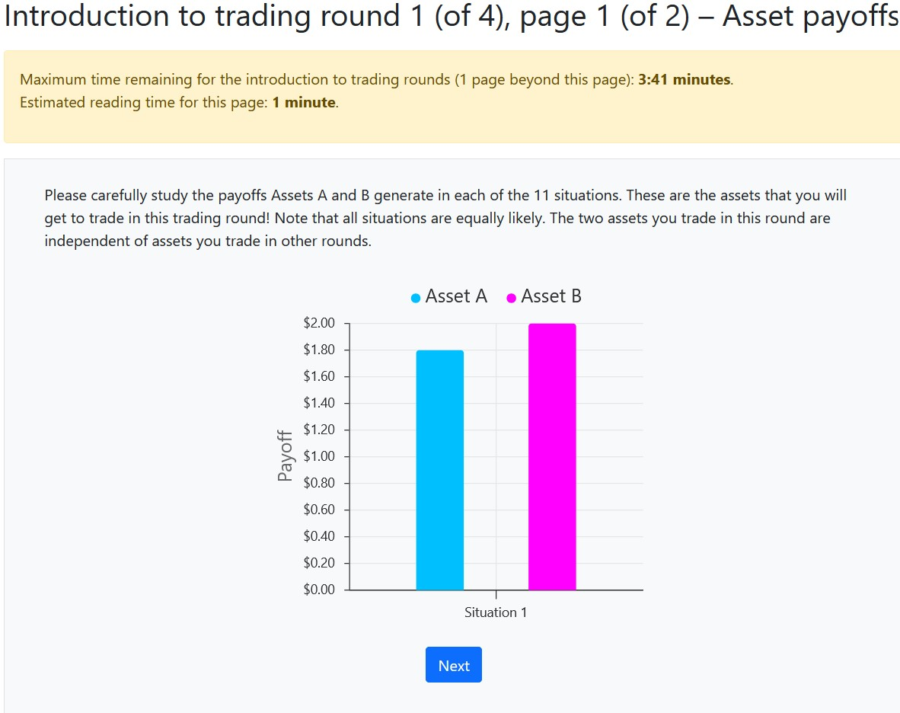
Sequential

Slide 10
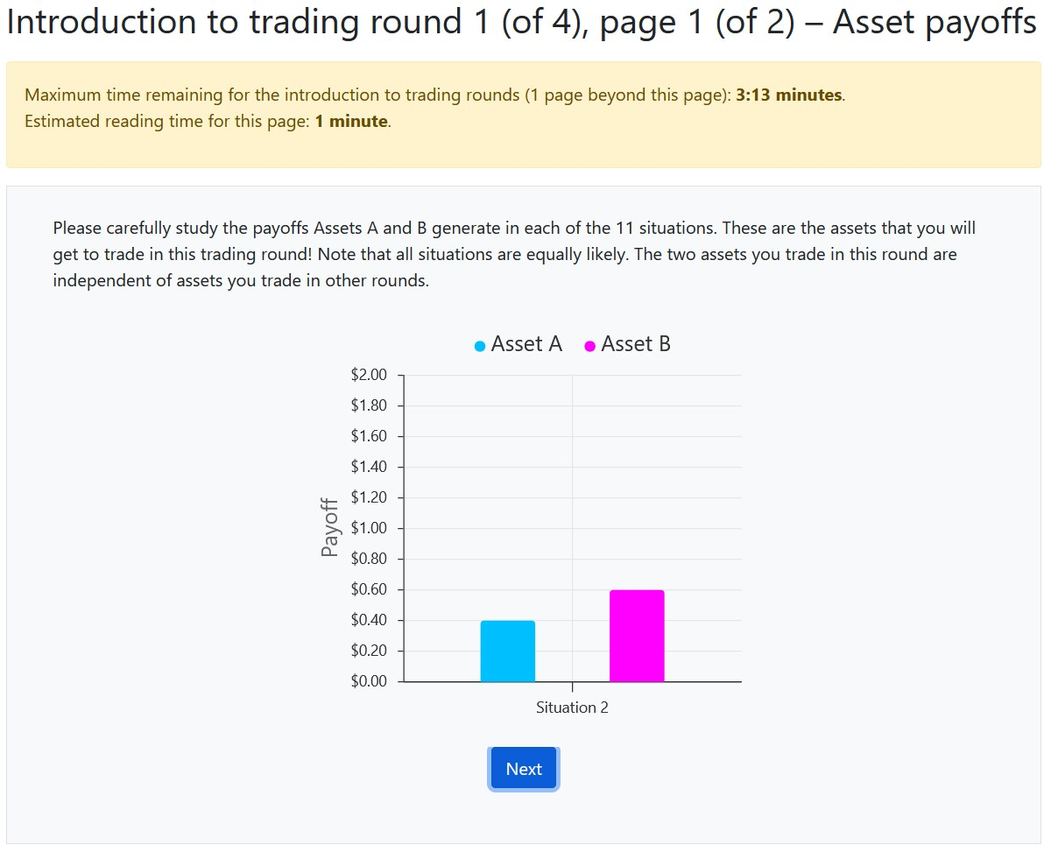
Sequential

Slide 11
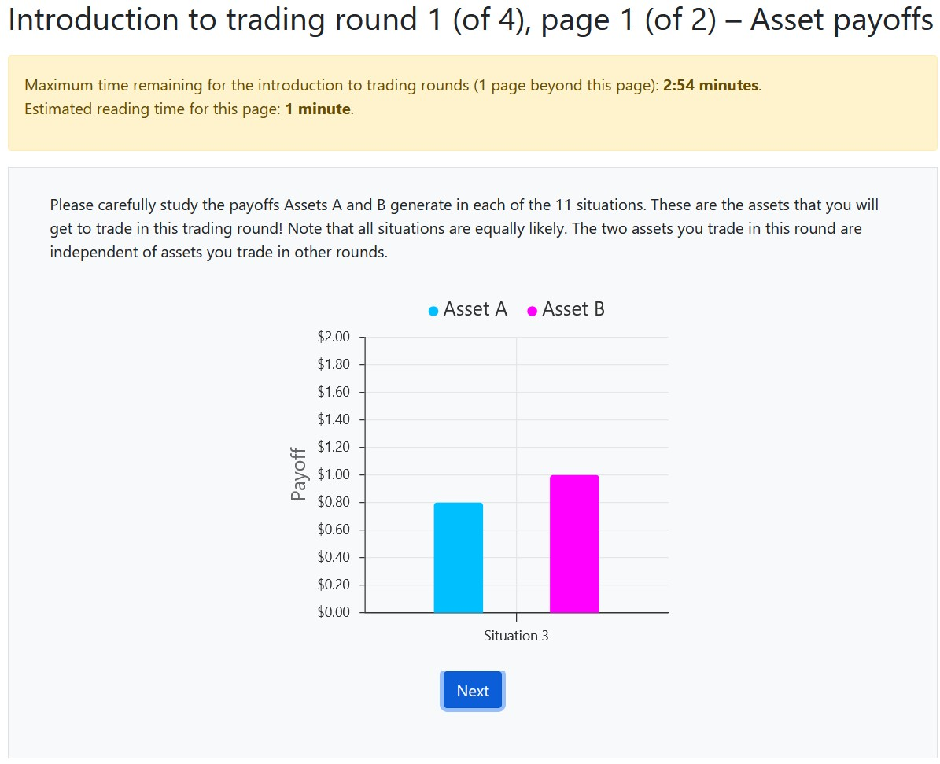
Sequential

Slide 12
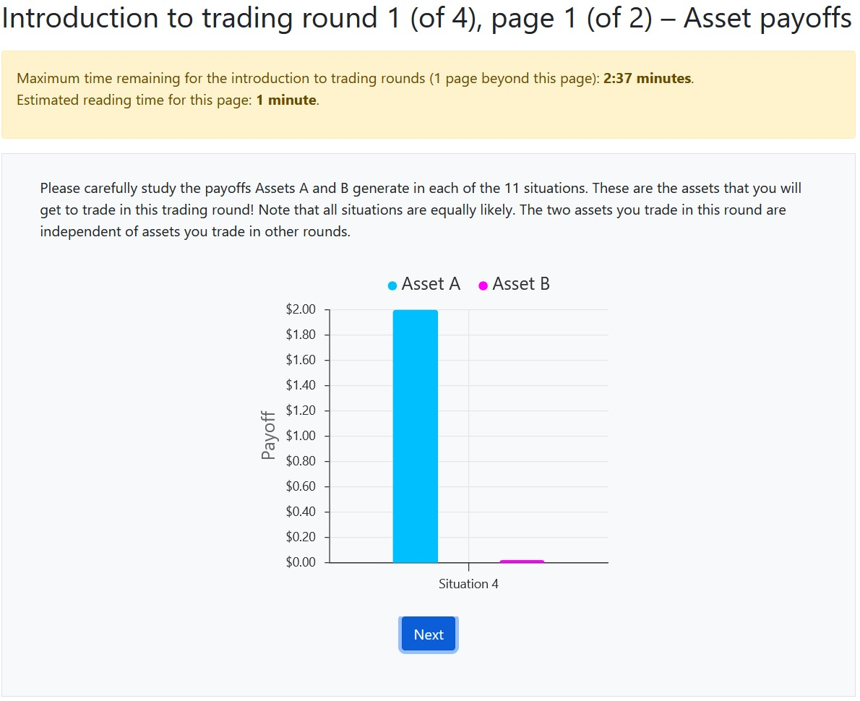
Sequential

Slide 13
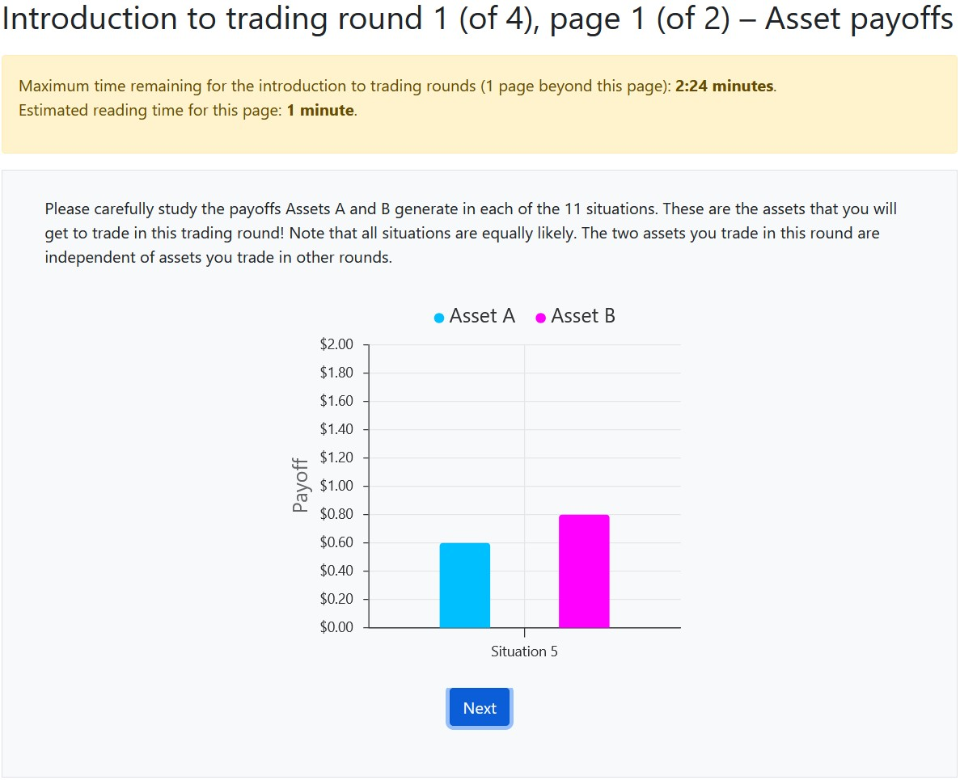
Sequential

Slide 14
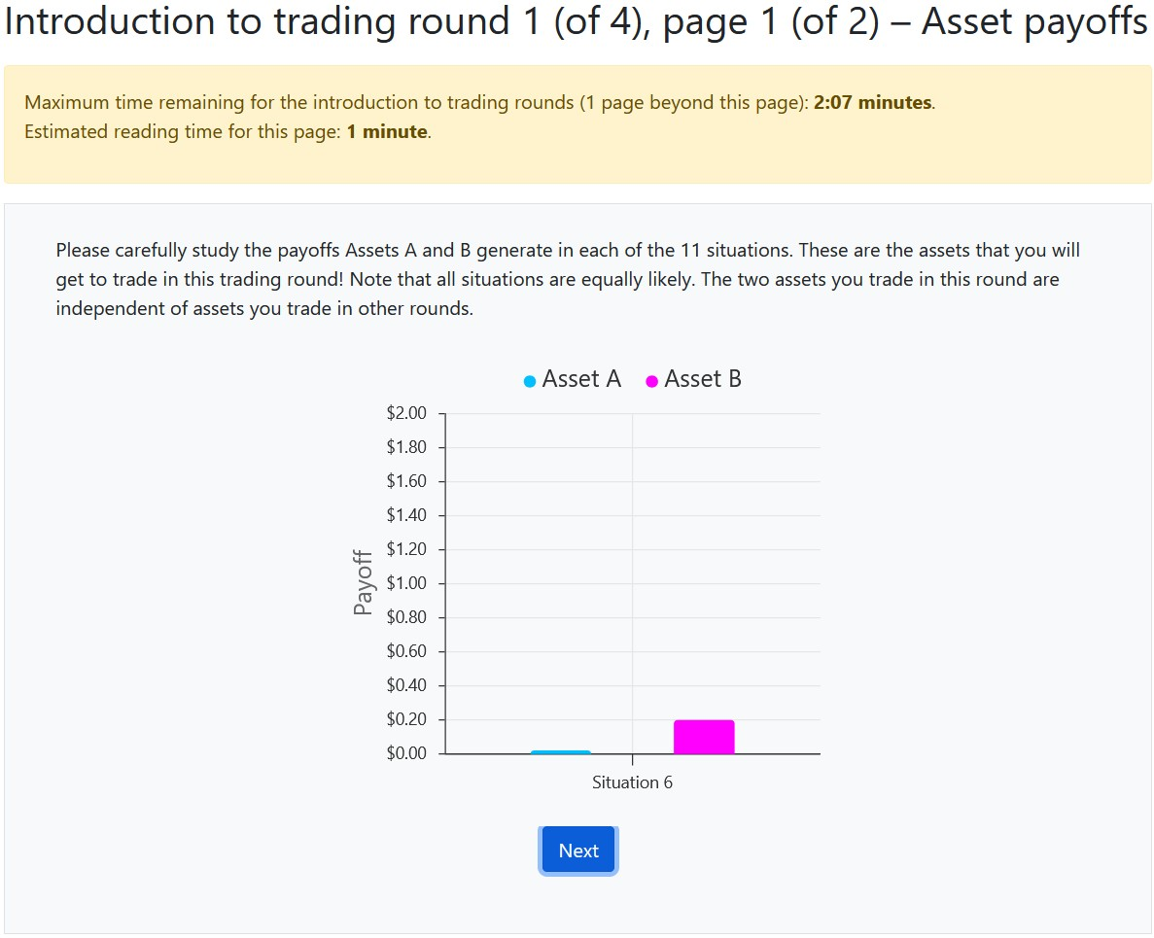
Sequential

Slide 15
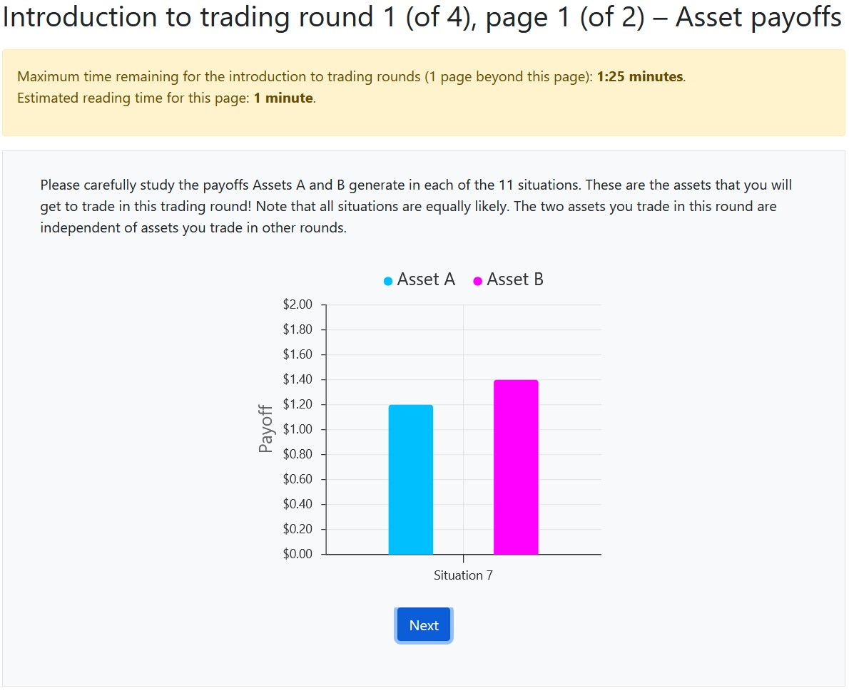
Sequential

Slide 16
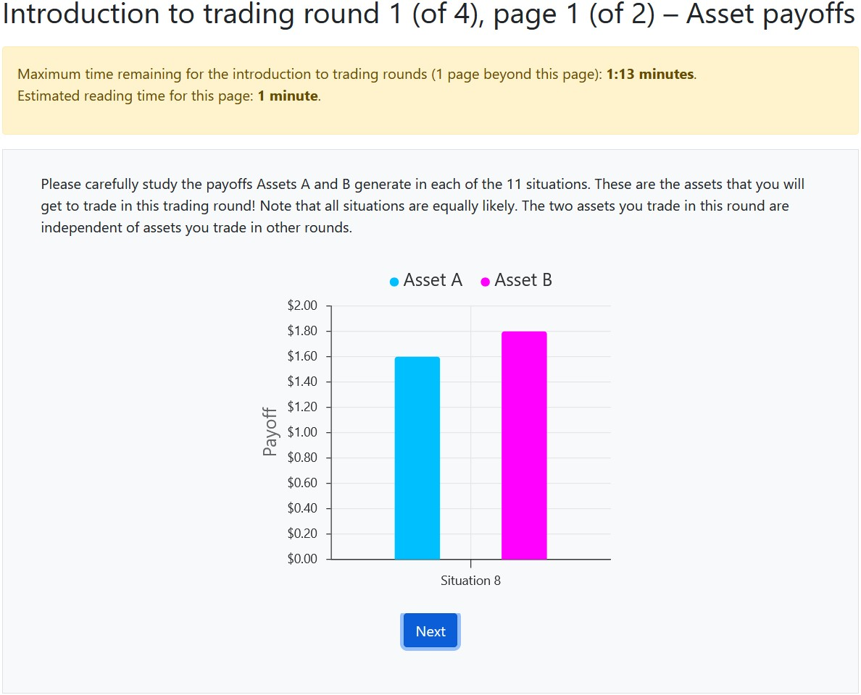
Sequential

Slide 17
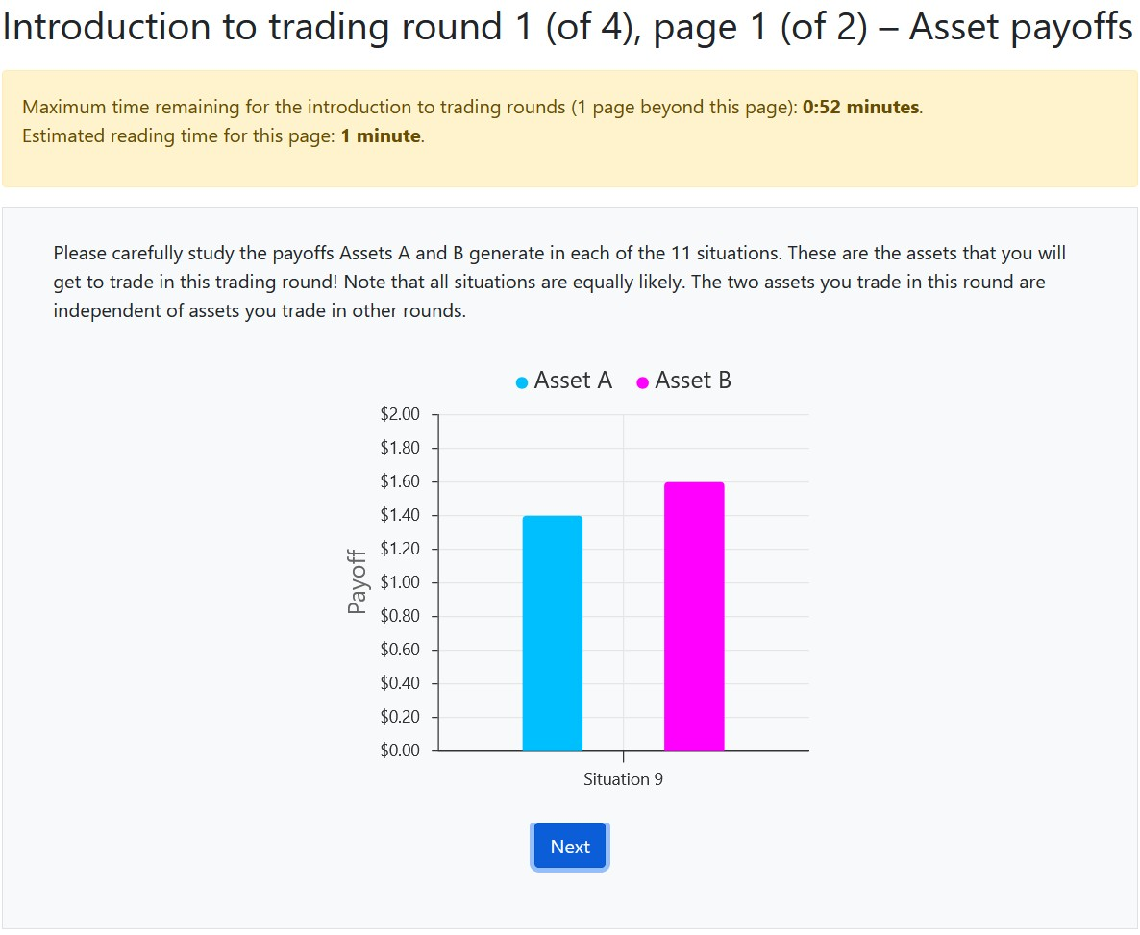
Sequential

Slide 18
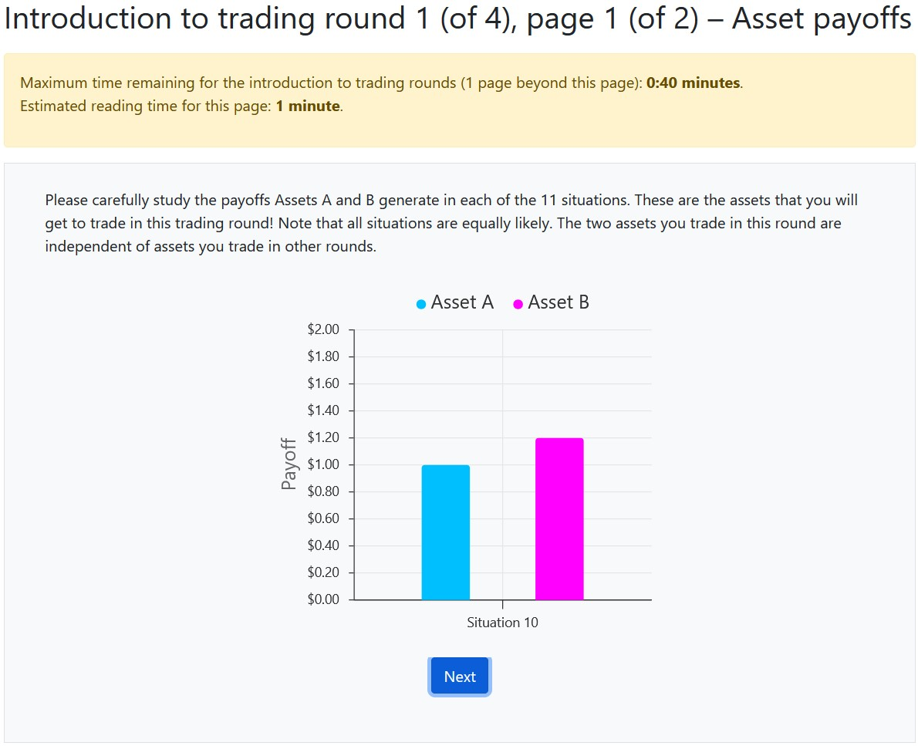
Sequential

Slide 19
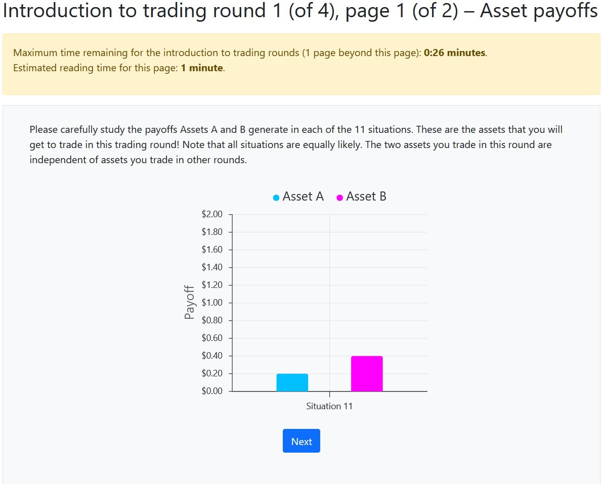
Sequential

Slide 20
Two assets $×$ Two information environments
Asset F — slightly ahead in 10 of 11 states, Frequent winner
Asset U — dramatically ahead in 1 of 11 states, Unlikely winner
Sequential
imperfect memory recall → people misremember rare outperformance of U → 85% choose F
Simultaneous
limited attention → people overweight salient outperformance of U → 42% choose F
(Bohren, Hascher, Imas, Ungeheuer, Weber, 2024)
Notes:
both produce BIASED BELIEFS – but in OPPOSITE DIRECTIONS

Slide 21
From choice gap to price gap
Asset F and Asset U: identical marginals
Asset F: {0.00, 0.20, 0.40, ..., 2.00} – 11 values, each equally likely
Asset U: {0.00, 0.20, 0.40, ..., 2.00} – the same 11 values, equally likely
In isolation, any rational investor should value them the same
If we find an F–U price gap = distorted interpretation of the joint distribution

Slide 22
Experimental design
Online Asset Market experiment
Participants trade Asset F and Asset U simultaneously
Continuous double auction (oTree <> Flex-E-Markets)
4 rounds of trading, 4 minutes per round
60 independent groups (each trading for 4 rounds)
Target: 20 traders per group (at least 12 traders per group)
up to about 1,200 online participants (Prolific)
Preregistered at OSF

Slide 23
Treatments
3 × 2 between-within experimental treatment design
Information Environment varied between groups:
Mixed / Sequential / Simultaneous
Endowments for trading varied within groups:
concentrated (Low Diversification (LD): 40/0 – 0/40)
diversified (High Diversification (HD) 20/20)
Notes:
Why cross them
- Belief heterogeneity → speculative trade
- Concentrated portfolios → rebalancing trade
- Cross the two → read off how much of volume is which
— and whether they interact

Slide 24
Hypotheses: Trading Volume
Highest Volume — LD.Mix:
traders disagree and need to rebalance
Middle Volume — LD.Seq, LD.Sim, HD.Mix:
exactly one motive each: either traders disagree or need to rebalance
Lowest Volume — HD.Seq, HD.Sim:
diversified endowments and traders agree
Notes:
[visual: the 3×2 grid, shaded dark→light by predicted volume]

Slide 25
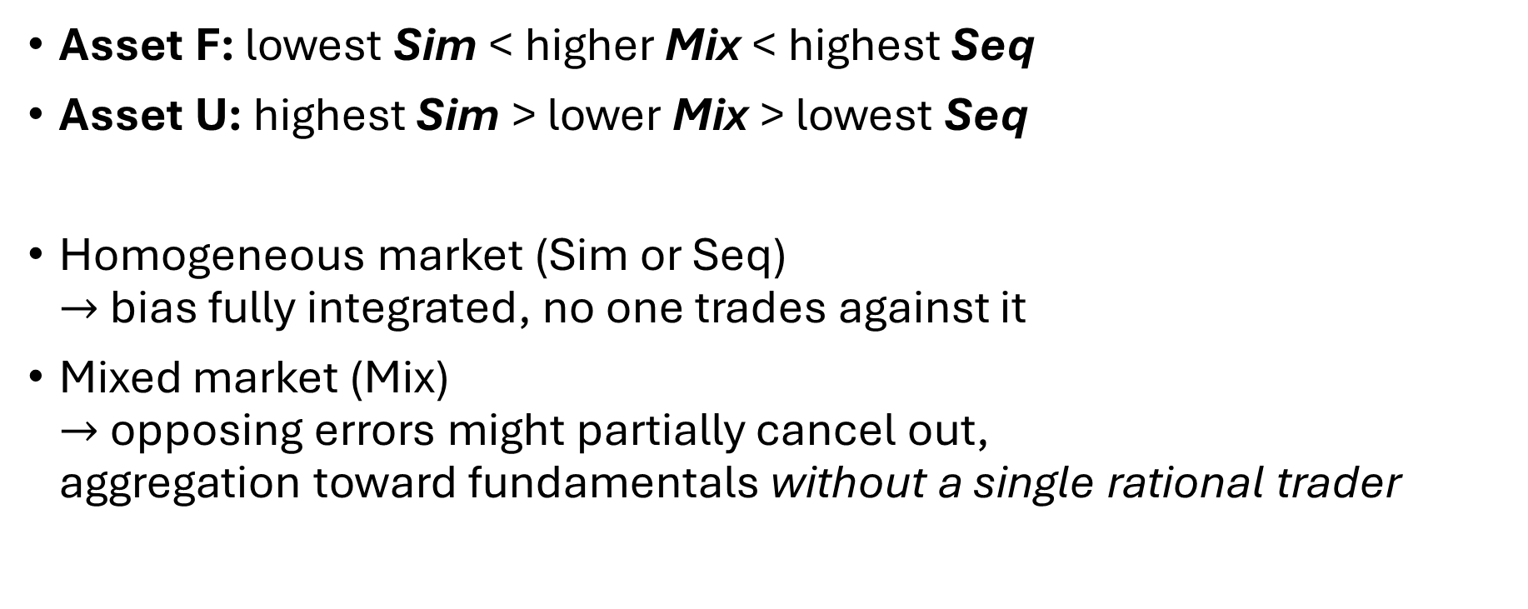
Hypotheses: Prices
Asset F: lowest Sim < higher Mix < highest Seq
Asset U: highest Sim > lower Mix > lowest Seq
Homogeneous market (Sim or Seq) $→$ bias fully integrated, no one trades against it
Mixed market (Mix) $→$ opposing errors might partially cancel out, aggregation toward fundamentals without a single rational trader

Slide 26
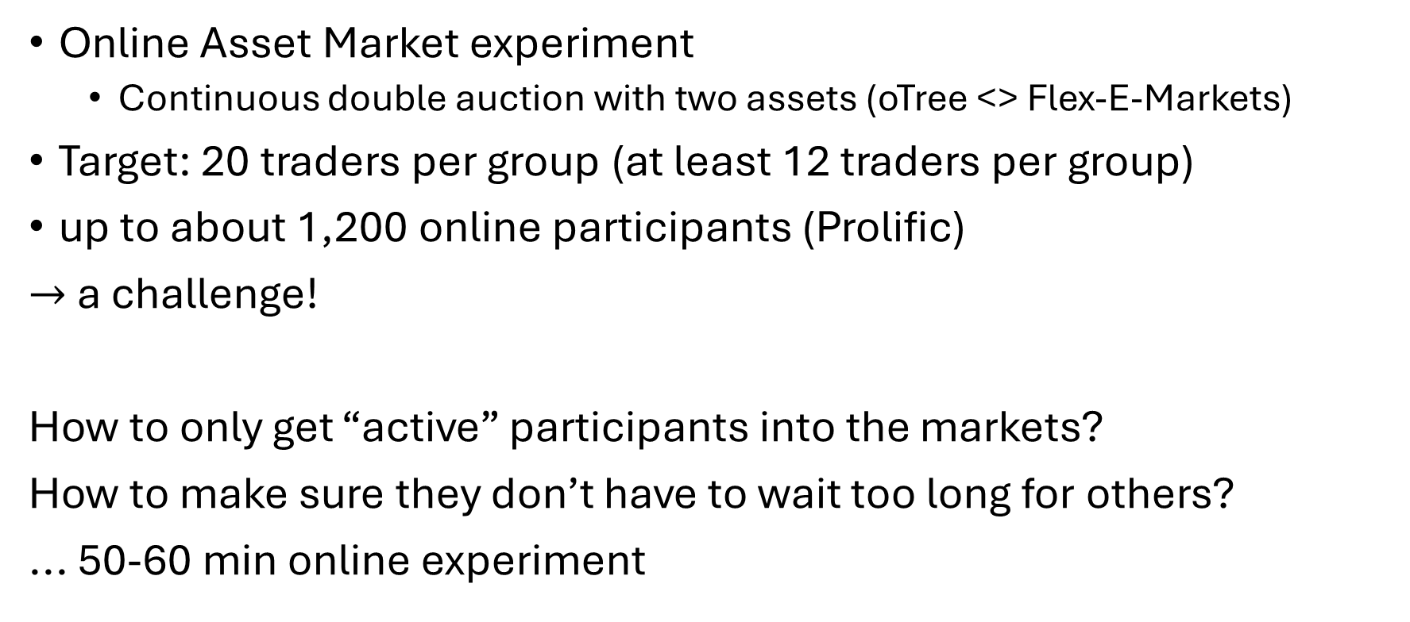
Experimental implementation
Online Asset Market experiment
Continuous double auction with two assets (oTree <> Flex-E-Markets)
Target: 20 traders per group (at least 12 traders per group)
up to about 1,200 online participants (Prolific)
$→$ a challenge!
How to only get “active” participants into the markets?
How to make sure they don’t have to wait too long for others?
... 50-60 min online experiment

Slide 27
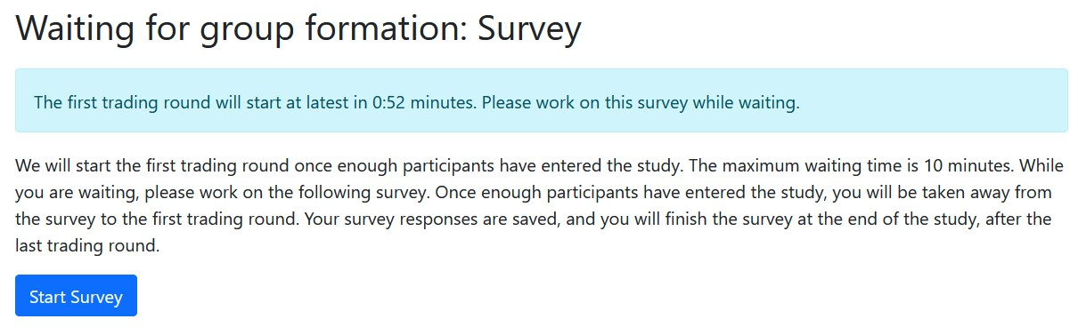

Experimental implementation
General Instructions + Attention Checks
Market Instructions + Practice Round
Survey with 7 pages $→$ 10:00 minute timer for each participant
If 20 participants arrived at the Survey $→$ group of 20 is formed
If timer runs out and 11-18 others are at the Survey $→$ group of 12-19
If timer runs out and < 11 others are at the Survey $→$ no group, payment
Market instructions + Market trading
After 4 rounds of trading, Survey continues where they left off

Slide 28
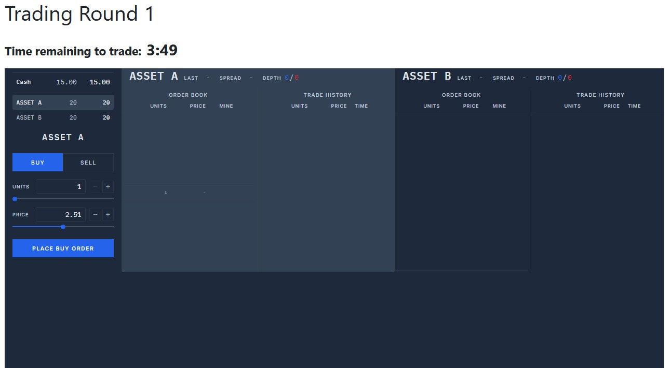
Experimental implementation
oTree <> Flex-E-Markets

Slide 29
Some first data
Implementation with Prolific, oTree, Flex-E-Markets and 20 participants per group in a 50min experiment is a massive challenge
So far only some first data from 2 groups with 4 rounds each (We will scale this up to 60 groups very soon!)
Notes:
[Drop your pilot result here — I don't have your numbers. Frame it honestly:]

Slide 30
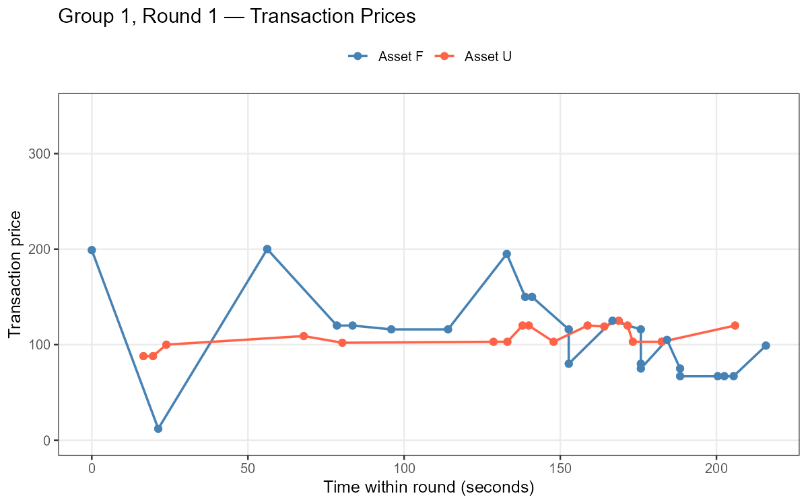
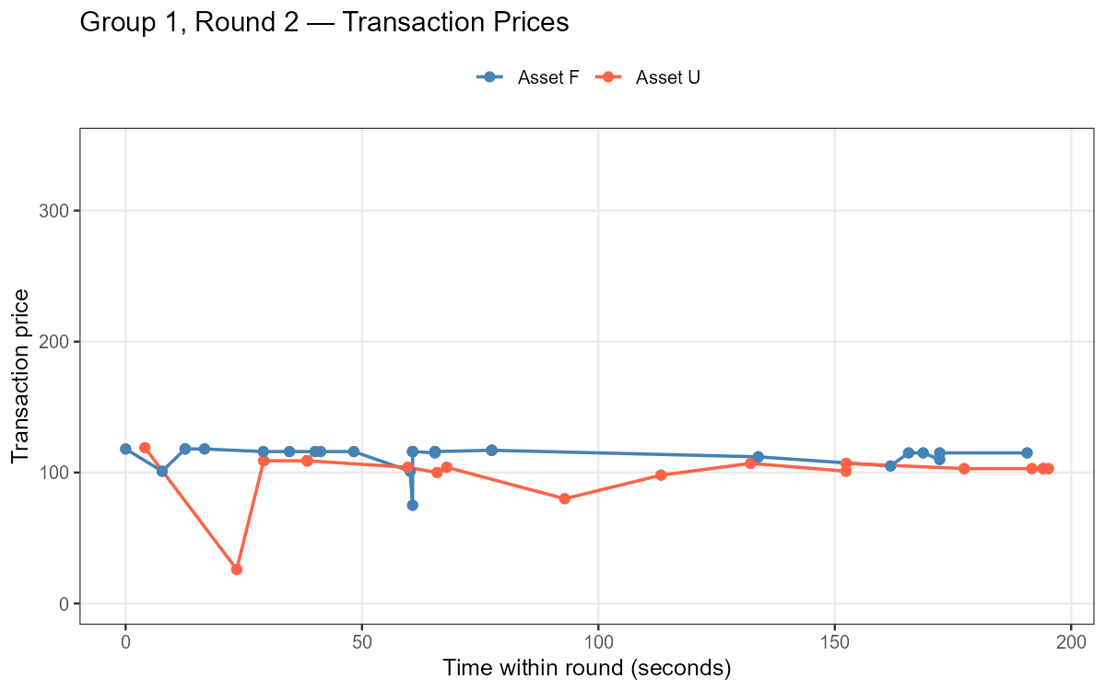
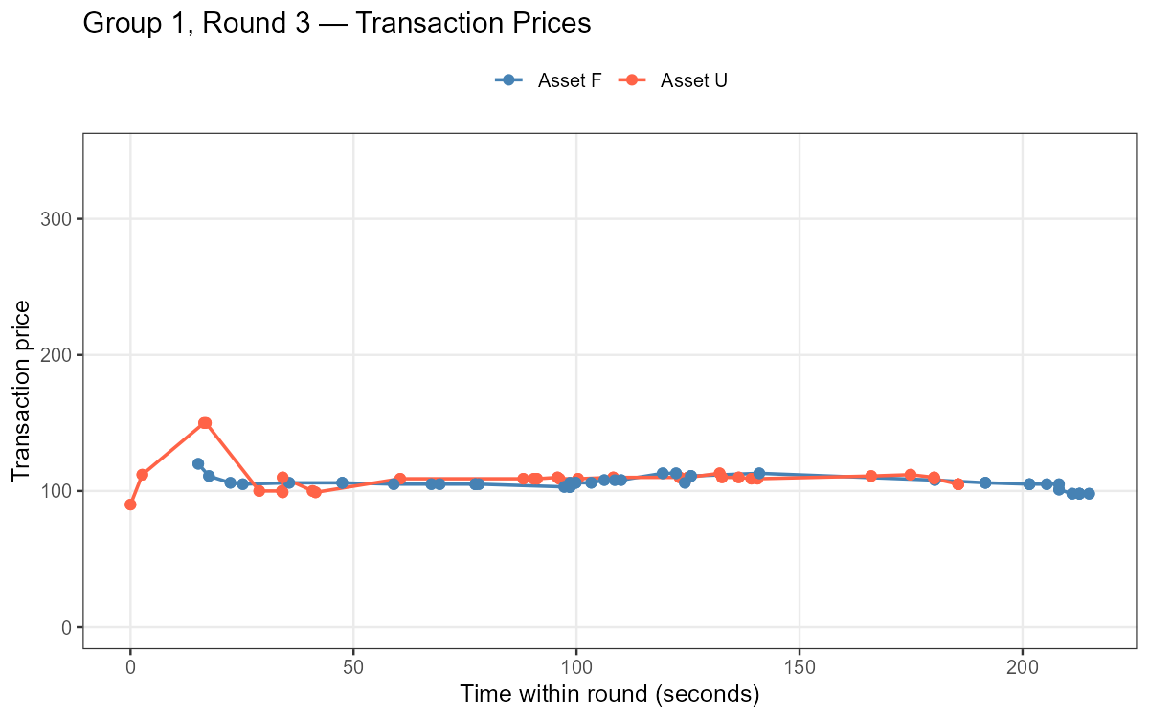
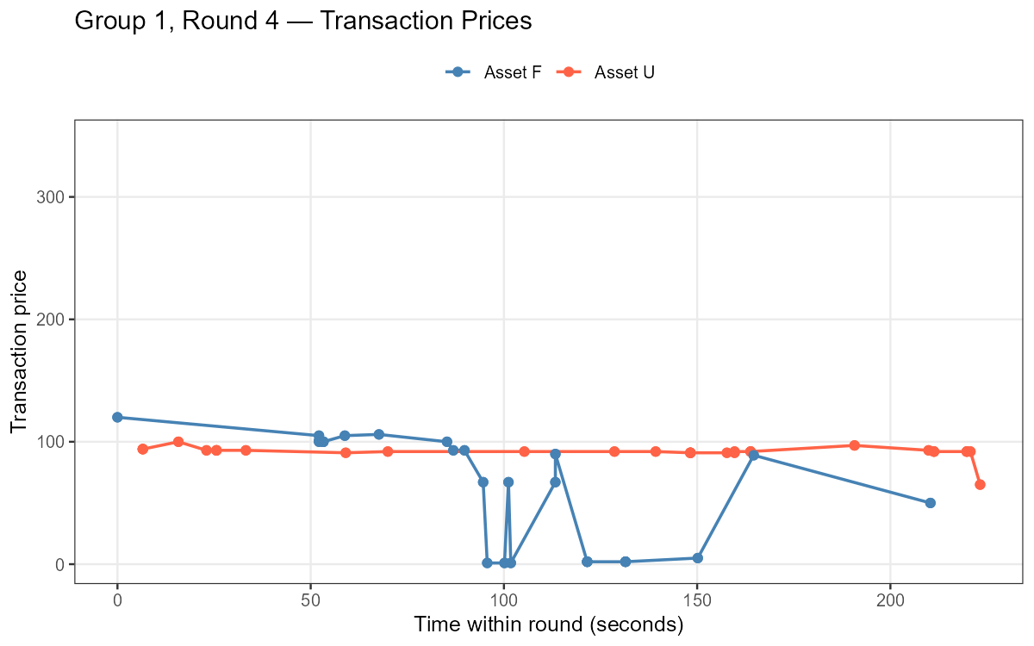
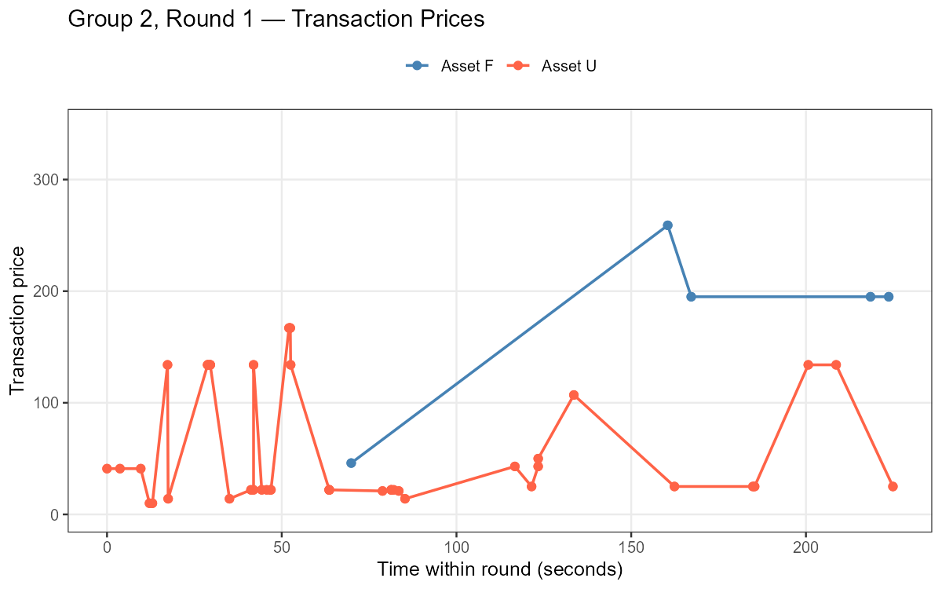
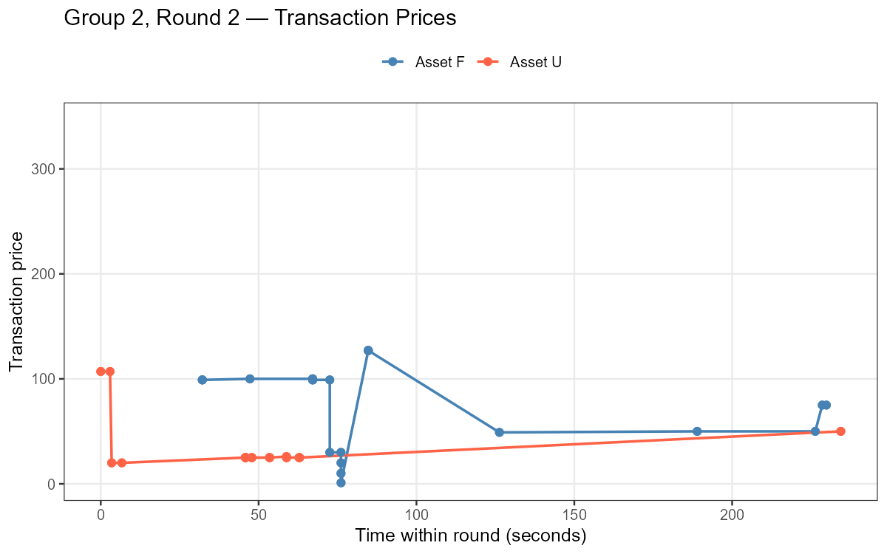
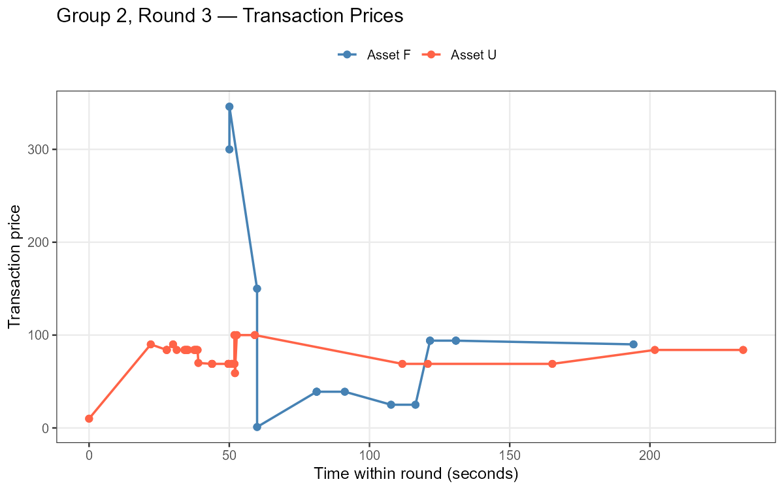
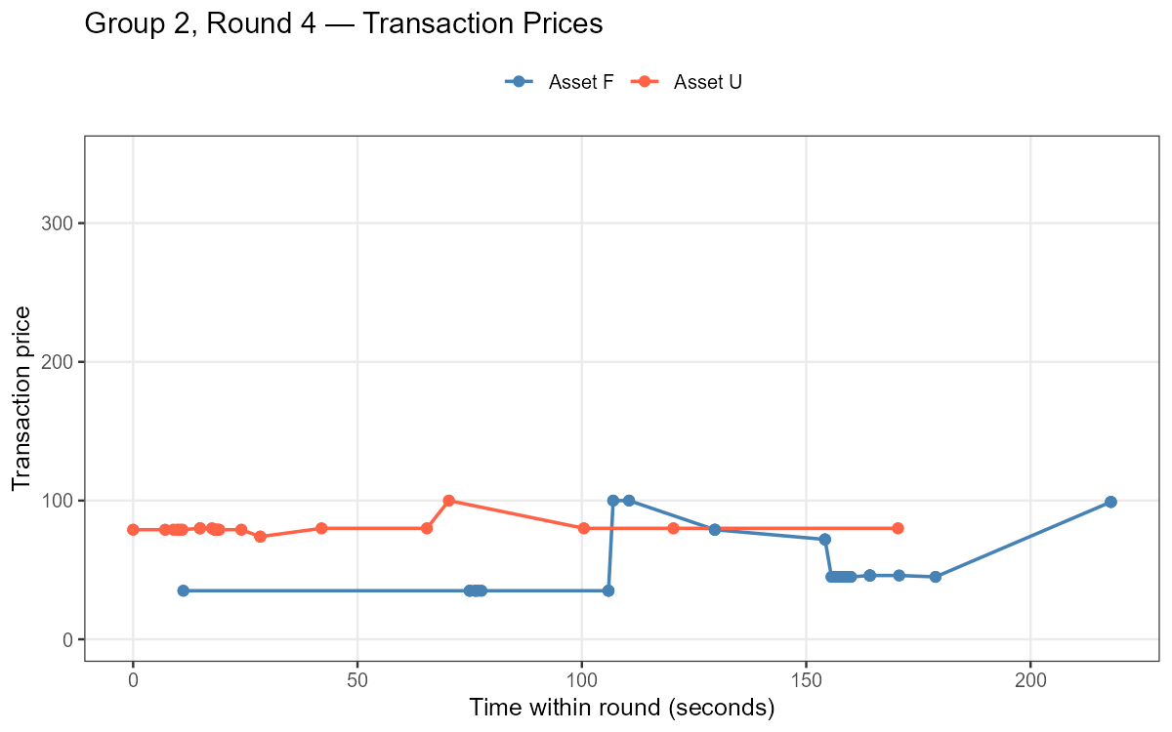
Some first data – Markets
G1/R1: LD.Mix
G1/R2: HD.Mix
G1/R3: LD.Mix
G1/R4: HD.Mix
G2/R1: LD.Sim
G2/R2: HD.Sim
G2/R3: LD.Sim
G2/R4: HD.Sim

Slide 31
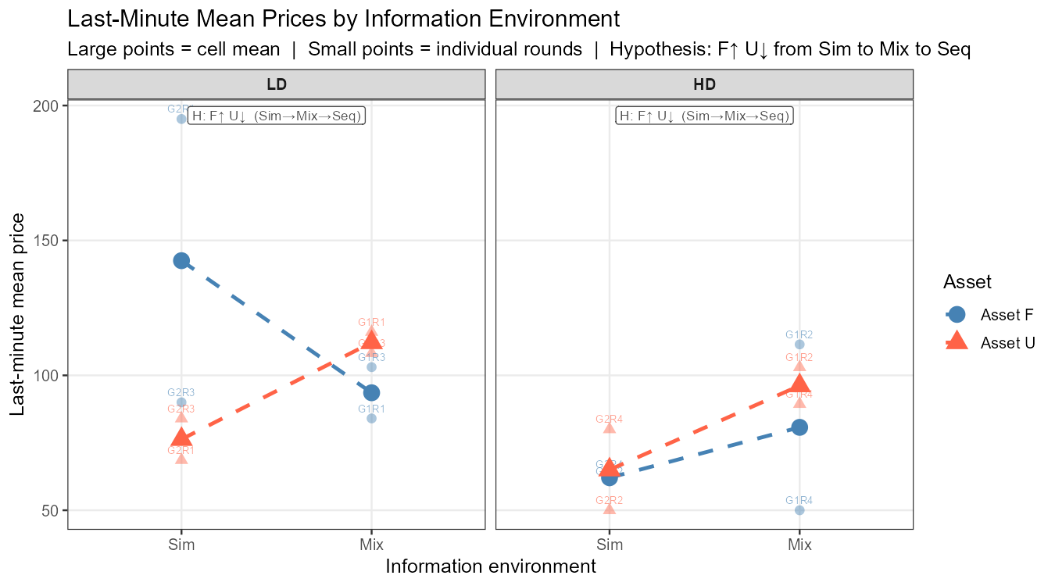
Some first data – Prices

Slide 32
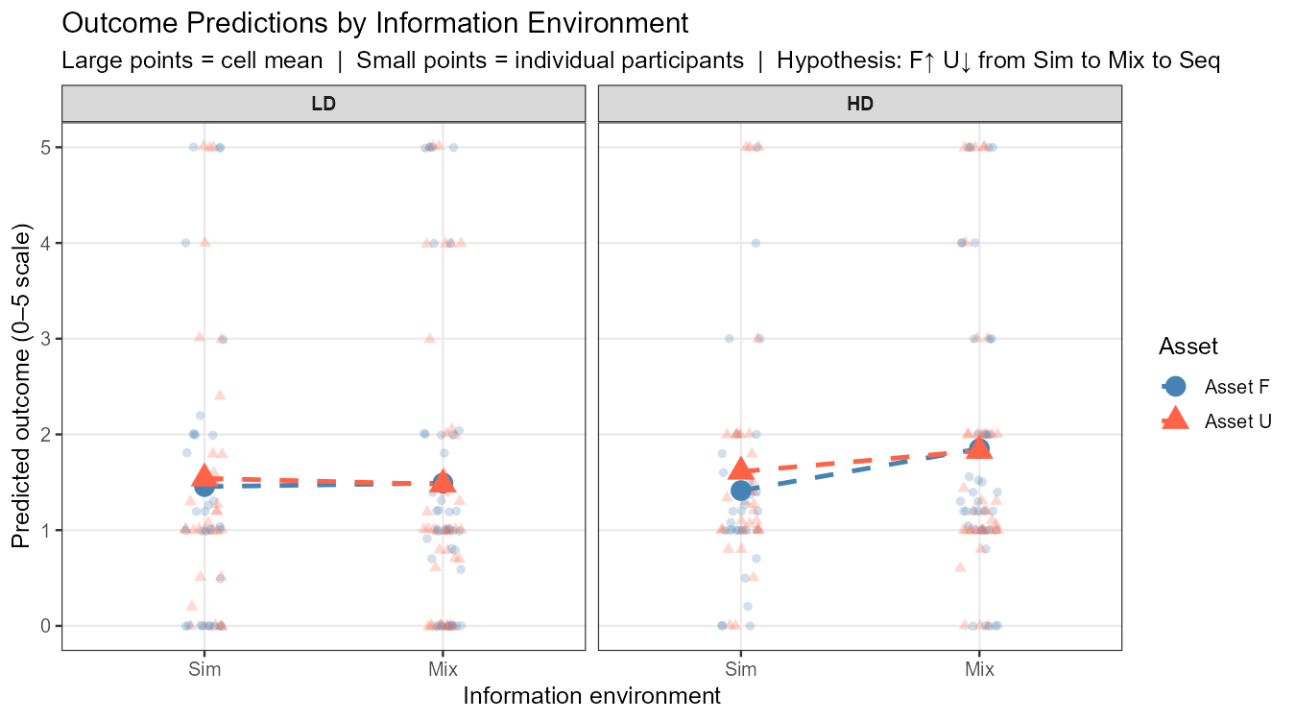
Some first data – Beliefs

Slide 33
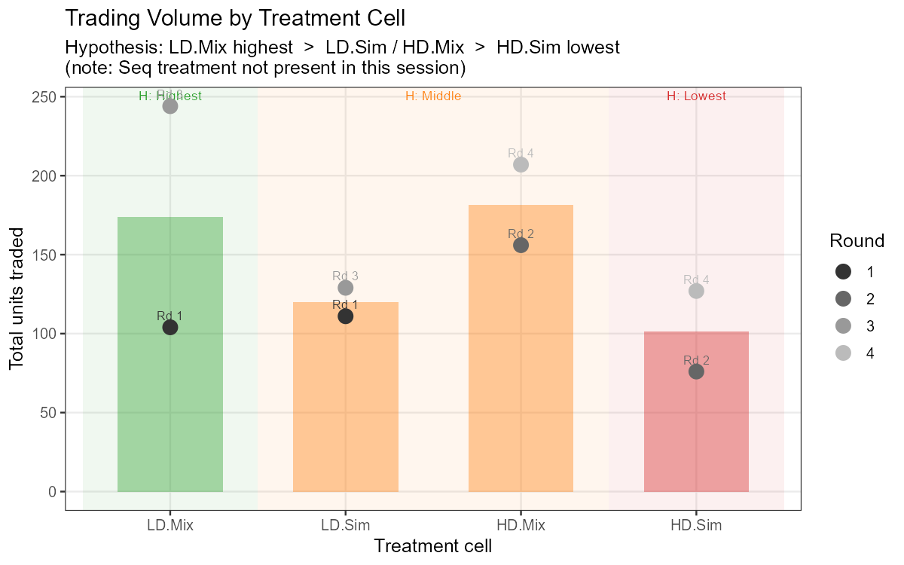
Some first data – Trading volume

Slide 34
Wrap up
First market test of belief heterogeneity induced by information environments
Different information environments pull biases in opposite directions
In markets, these biased beliefs are reflected in the same order book — discussed since Miller (1977) / Harrison–Kreps (1978)
Full data soon
Thank you chr-huber.com
christoph.huber@aalto.fi

Slide 35
Measures
Prices — final-minute transactions (≥20 trades; else last 20) → informationally mature
Volume — total shares per round
Secondary — limit vs. market orders, final holdings, volatility, payoff scale (max 2 vs. 5)
Moderators — financial literacy, experience, overconfidence, intuition

Slide 36
Information environments
between-subjects
IE1 — Mixed: half sequential, half simultaneous → heterogeneity in one market (the realistic one)
IE2 — Sequential: everyone forgets the blowout → market-wide tilt to F
IE3 — Simultaneous: everyone fixates on the blowout → market-wide tilt to U
→ IE1 is the novel cell: structurally opposing biases sharing one order book

Slide 37
Endowments
within-subjects
LD — Low diversification: concentrated holdings (all-U or all-F) → strong rebalancing pressure, belief-free
HD — High diversification: already balanced (20/20) → no mechanical motive → belief-driven trade only
Fully counterbalanced across 4 rounds
→ separates "I'm rebalancing" from "I disagree with you"

