Slide 1
Low-n Fine-Tuning
Similarity-Based Low-n Fine-Tuning on OpenFold3 for PDE10
FoldMaxxers
BioIncubate Catalyst Hackathon

Slide 2
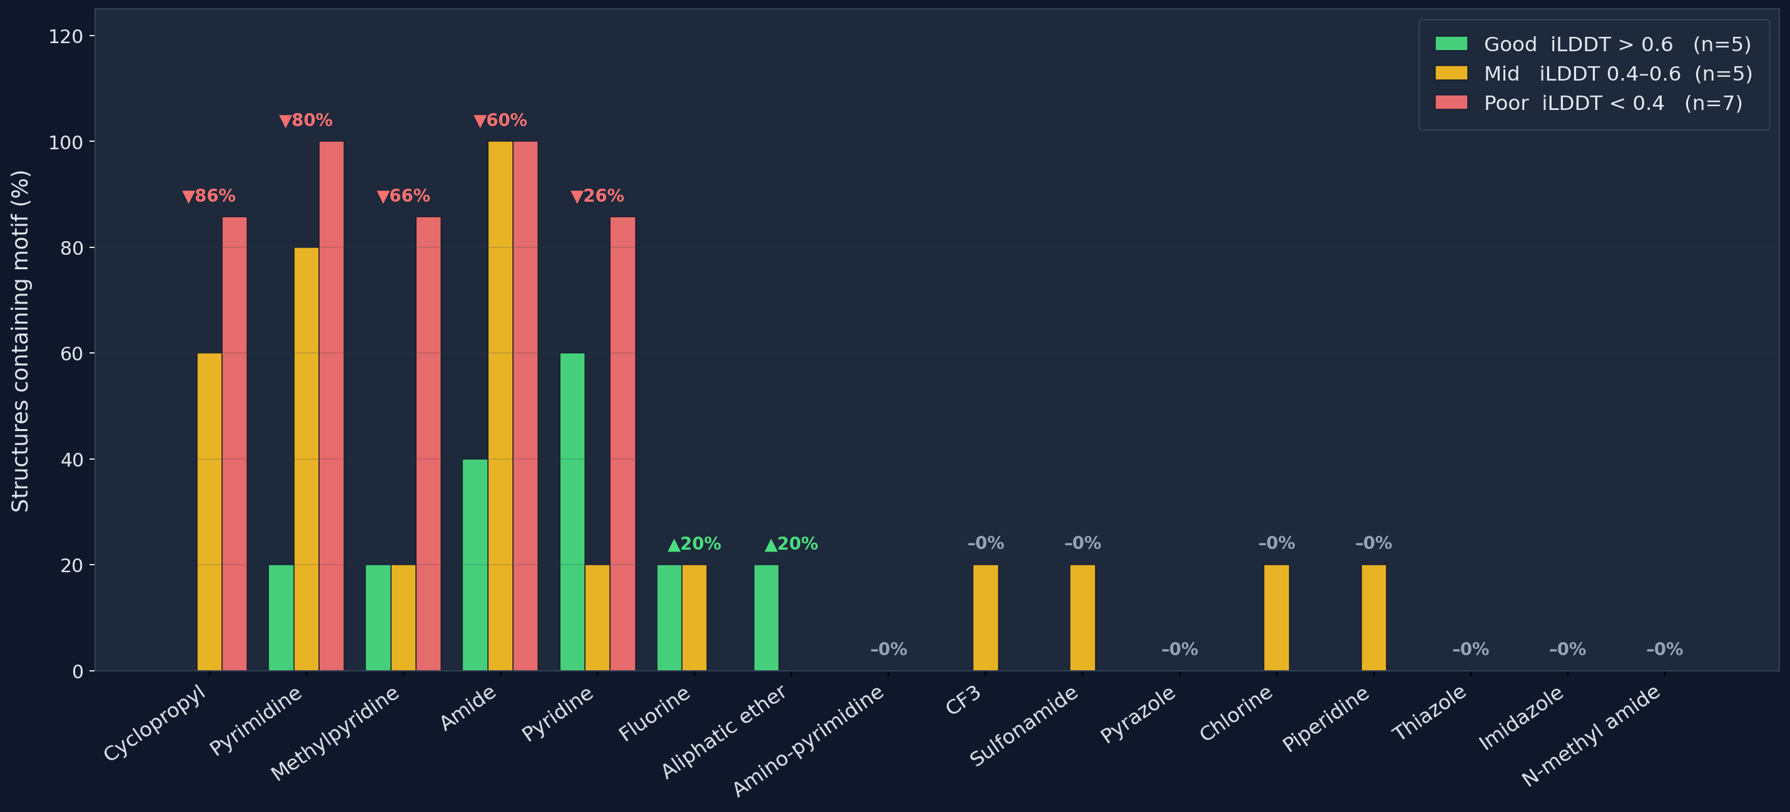
The Problem
aliphatic ethers and fluorine-containing ligands are the exception — where it actually works.
Failures are strongly systematic
cyclopropyl, pyrimidine, and methylpyridine ligands show −60 to −86% prevalence in good predictions

Slide 3
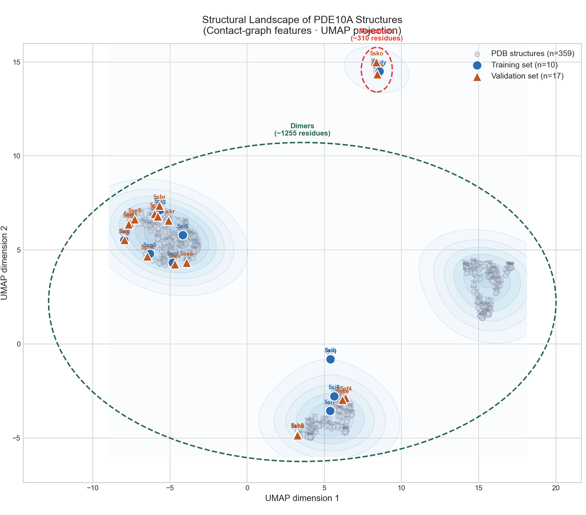


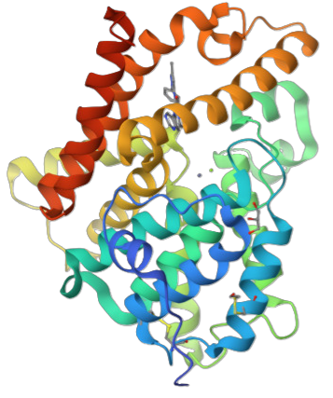
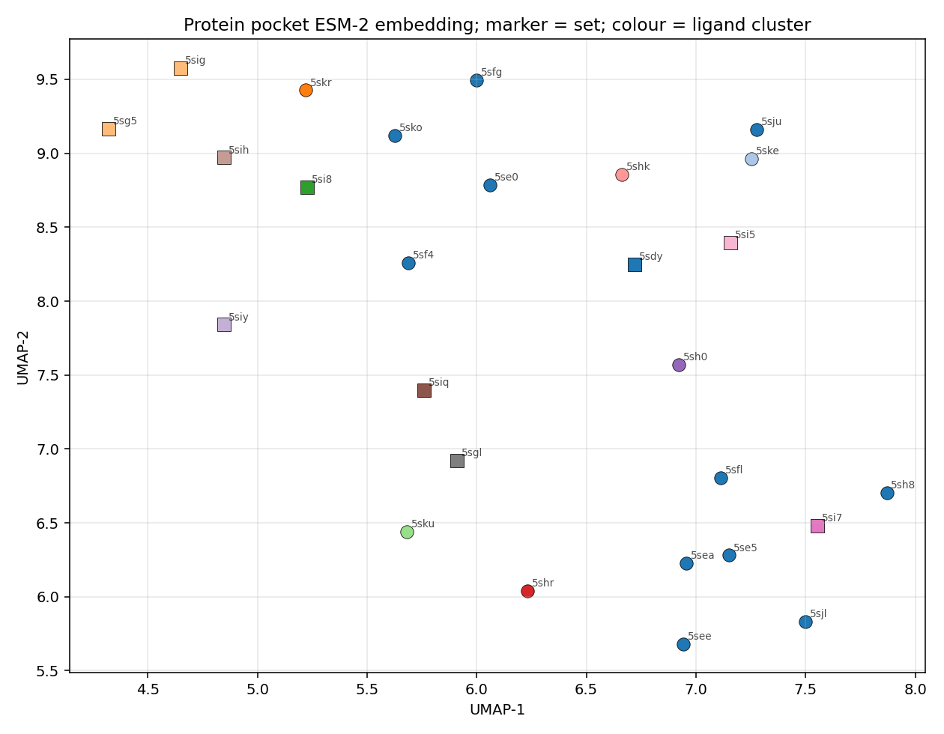
Our Solution
Joint similarity score
UMAP clustering of DB
ESM-2 embedding
-pocket only
-ligand
Subset of PDE10
35/8
Train/Val split
Fine-tuning

Slide 4
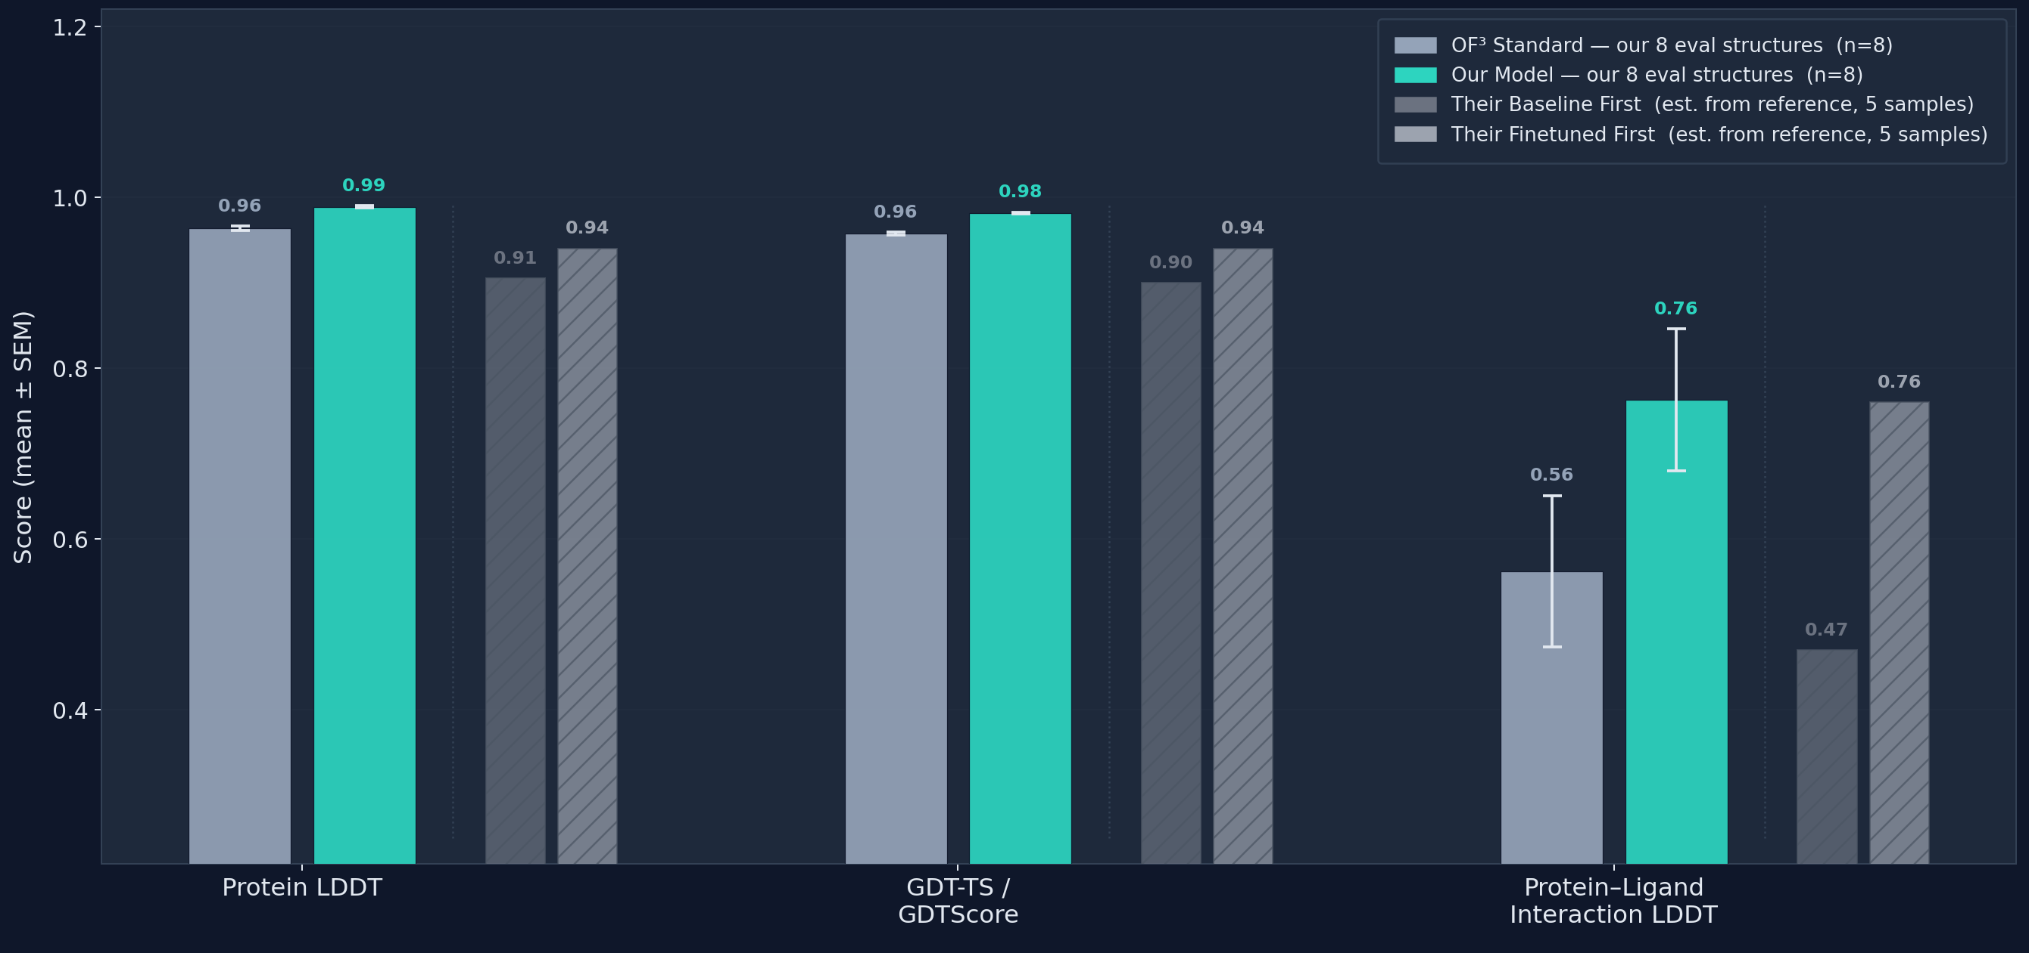
Our Model Performance

Slide 5
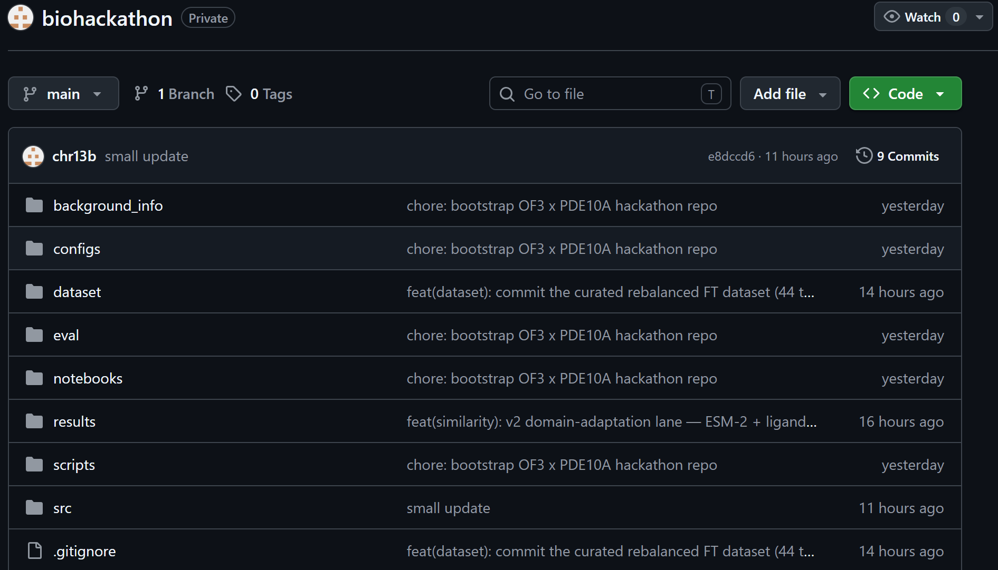
Our Codebase
github.com/chr13b/biohackathon.git

Slide 6
Questions?

Slide 7
The Problem
Motif | Good iLDDT (iLDDT >0.6) n=5 | Poor iLDDT (iLDDT <0.4) n=7 | Δ
Cyclopropyl | 0% | 86% | -86%
Pyrimidine | 20% | 100% | -80%
Methylpyridine | 20% | 86% | -66%
Amide | 40% | 100% | -60%
Failures are strongly systematic
cyclopropyl, pyrimidine, and methylpyridine ligands show −60 to −86% prevalence in good predictions
Aliphatic ethers and fluorine-containing ligands are the exception — where it actually works.

Slide 8
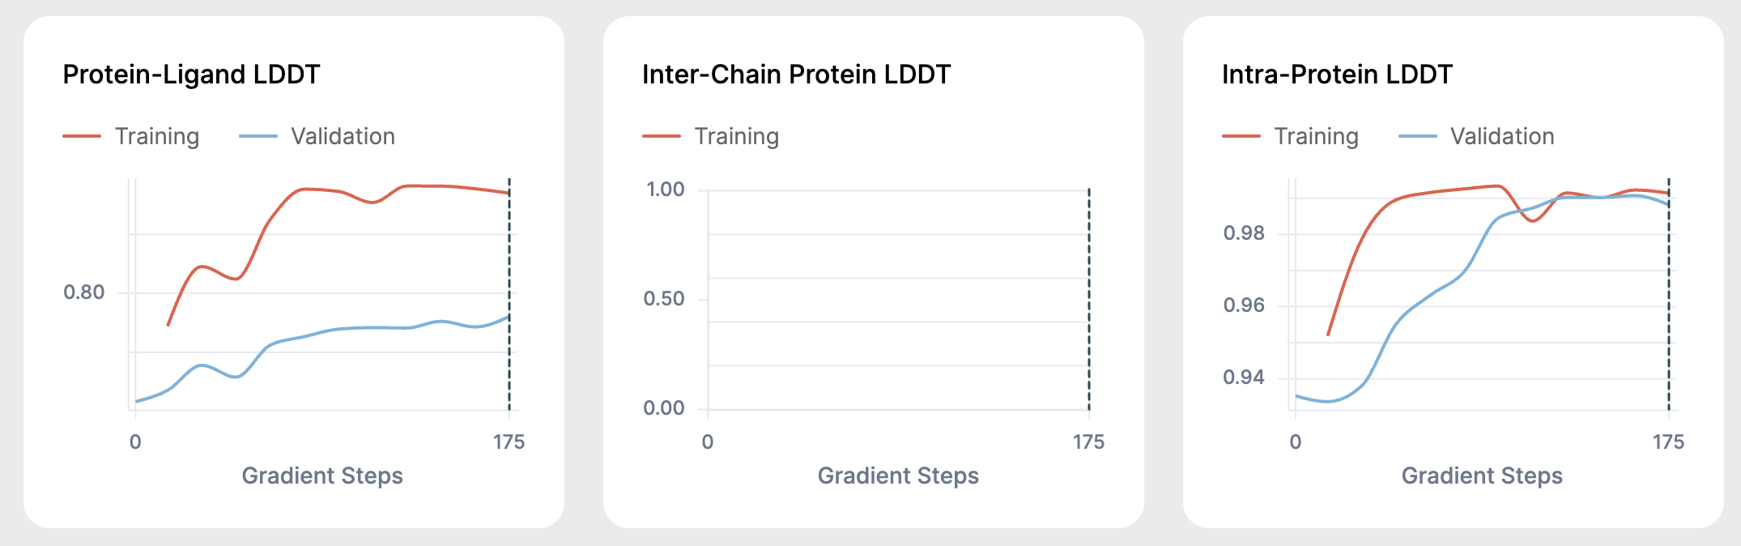
Performance & Benchmark Summary

Slide 9
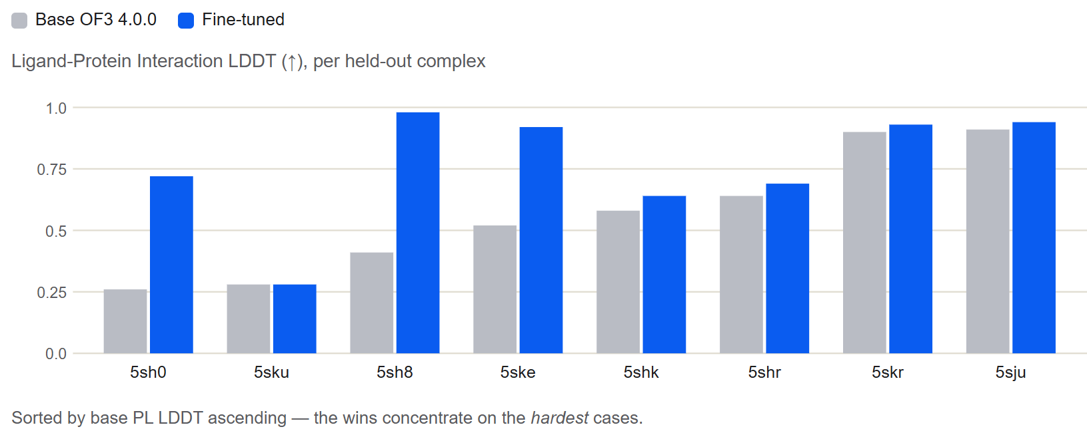
Ligand-Protein Interaction LDDT

Slide 10
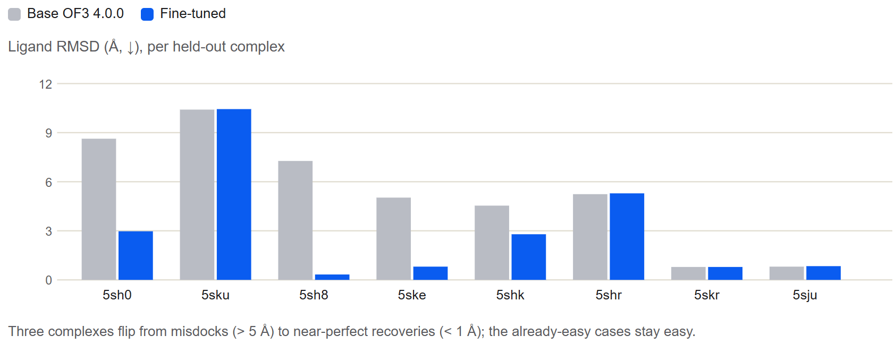
Ligand RMSD

Slide 11
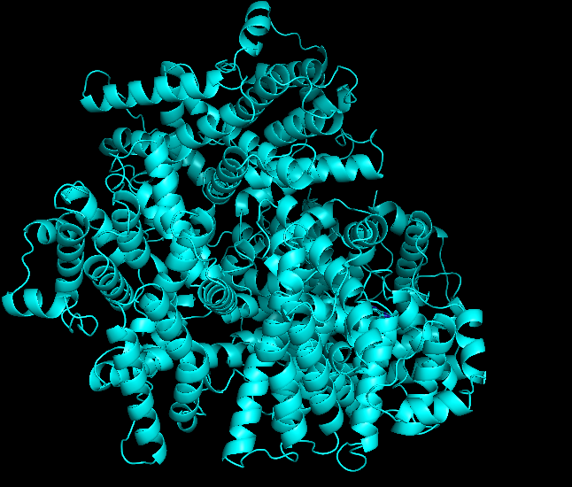
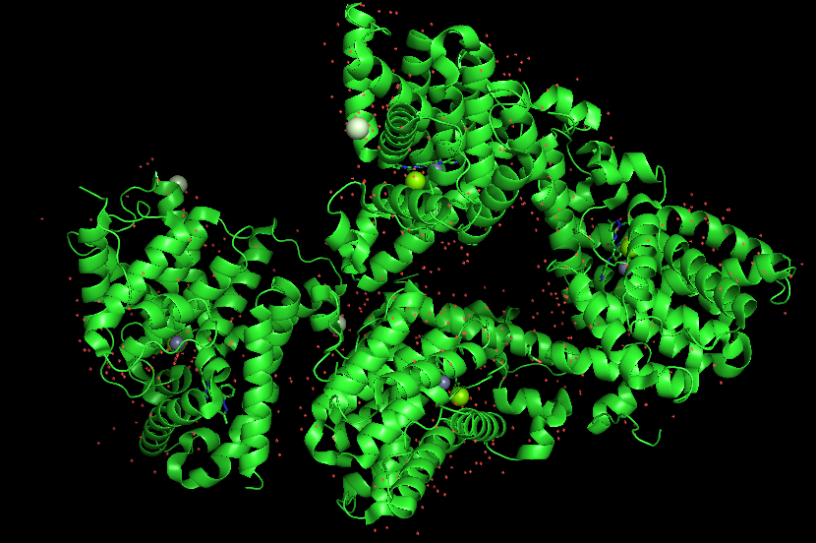
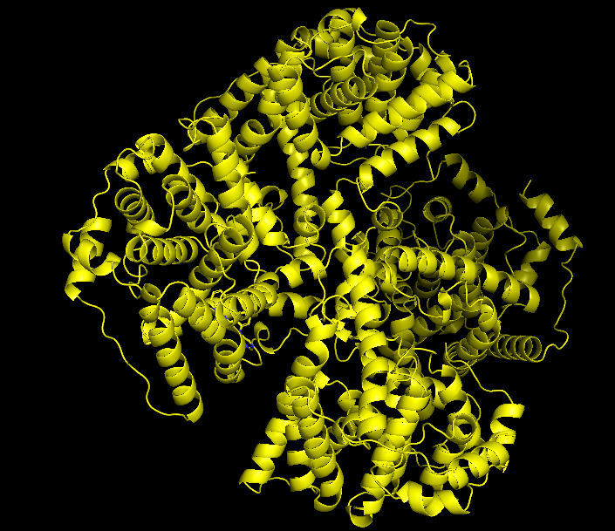
Our Model Performance: 5sh8

Slide 12
UMAP Clustering

Slide 13
Fine-Tuning Parameters
{
"batch_size": 4,
"crop_size": 384,
"data_seed": 42,
"ema_decay": 0.99,
"learning_rate": 0.0003,
"maximum_training_time": 36000,
"metric_to_monitor": "lddt_inter_protein_ligand",
"num_gradient_steps_per_epoch": 8,
"precision": "bf16",
"save_top_k": -1,
"training_seed": 42,
"warmup_steps": 50
}

