Slide 1
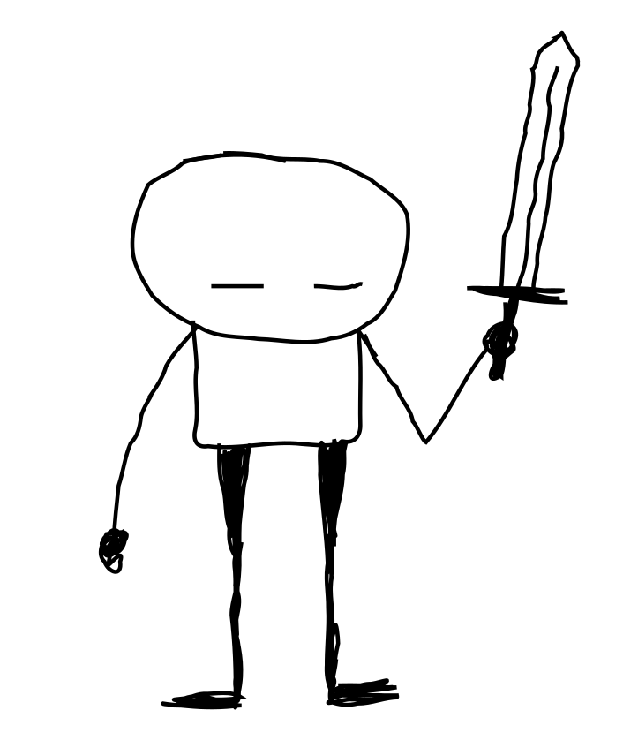
building juicy minimal roguelikes in the browser
Chris McCormick
@mccrmx https://mccormick.cx thepunkcollective.com
Notes:
Hi, my name is Chris and I’m here to talk to you about building juicy minimal roguelikes in the browser.
By the end of this talk I hope to have equipped your mental inventory with the tools to start your own browser based roguelike development adventure.

Slide 2
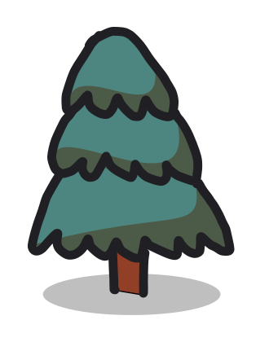
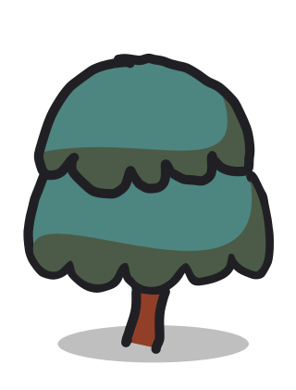
“juicy” and
“minimal”
Notes:
What do I mean by “juicy” and what do i mean by “minimal” in the context of roguelike games?

Slide 3
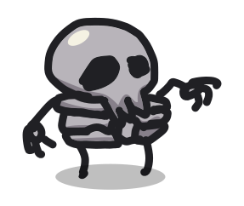

minimal roguelike
Notes:
Let’s talk about minimal roguelikes first. What does it mean to be minimal?
For me is means building a game with the barest essential gameplay elements.
They’re turn based and have permadeath. Entities in the game have various attributes.
You walk around and collect things and you fight baddies.
As you use things and fight baddies mathematical attributes are updated.
Interesting worlds arise as a result of the interaction of those various attributes.

Slide 4
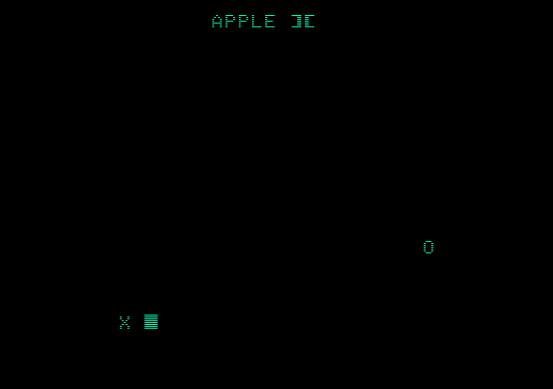
Notes:
Roguelikes have becomes these deep games with lots of emergent complexity.
I grew up playing Nethack and later the original Rogue.
I remember discovering Rogue after Nethack and finding it really refreshing.
For me Rogue represents minimalist perfection.
There is enough going on that it doesn’t get boring, but it leaves plenty of space for the player to make up their own narrative.
I wrote my first game on the Apple IIe at 8 years old.
It was a turn based tag game where you control the letter X and try not to get caught by the letter O.
This is basically an extremely minimal roguelike, but I think it’s an example of going too minimal to really call it a roguelike.

Slide 5
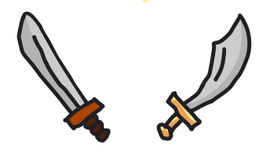
What “juicy” means
“Game feel”.
Notes:
So that’s what I mean by minimal here.
In the context of video games, “juicy” means the same thing as “game feel”.
It’s the combination of sound and animation that happens in response to some input that makes the game feel alive.

Slide 6
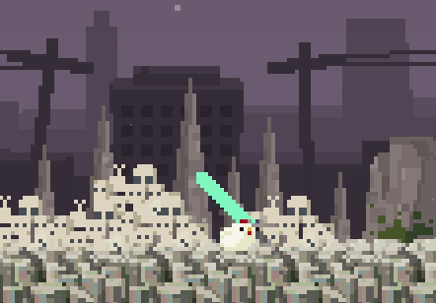
Notes:
Screen shake is an example of juice. This is an example of screen shake from a demo called “chicken sword”.
Notice how the screen literally shakes as the character lands.

Slide 7
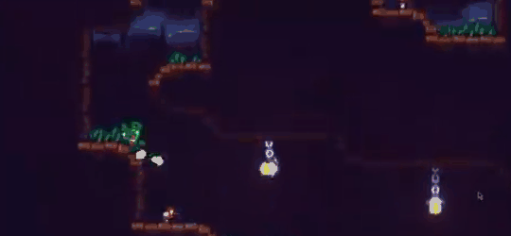
Notes:
This demo by game developer Ulon displays a ton of juice.
Notice:
* the dust trail as the character moves
* the movement of the grass
* the movement of the lamp as the player donks it
* the muzzle flash
* the way the character is pushed by back by firing
* the yellow ball of the shot
* and the smoke which results as the shot expires
All of this together adds a great deal of feeling to the game.

Slide 8
roguelikes i’ve made with browser tech
Notes:
So that’s what I mean by minimal juicy roguelikes.
The game play is minimal, and they are graphically rich.
The web browser is the perfect environment for making these types of games, because the web browser has batteries included.
I’m going to quickly show you the games I’ve made with browser tech to give you an idea of what you can do.

Slide 9
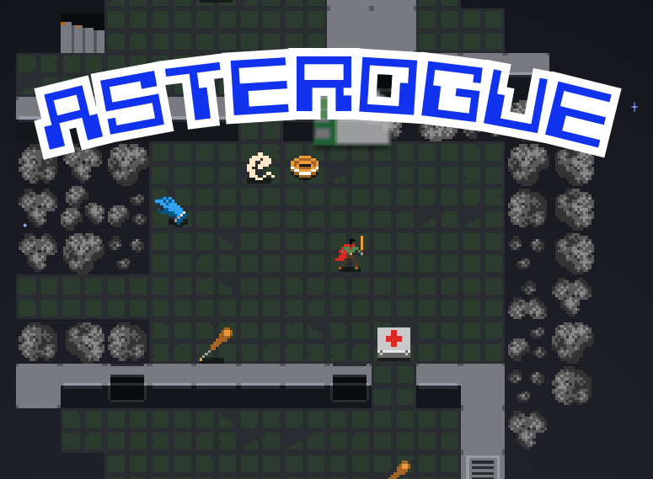
Notes:
Asterogue was my first solo developed commercial game.
In it you discover a hollow asteroid filled with procedurally generated mines, facilities, alien creatures, and space-loot.
The game play is minimal. It’s a smaller and simpler game even than Rogue, but it’s graphically richer.
In this gif you can see some of the juice i was talking about with screenshake, monster ghost, hit point indicator, and when collecting items.
I made this in a high intensity one and a half month development spurt in 2020. I built it for the browser and ported it to Android and Windows.
This was basically a result of having always wanted to make this game and finally just saying “if I dont do it now I never will.”
I’m currently in the process of updating Asterogue and porting it to Apple devices.

Slide 10
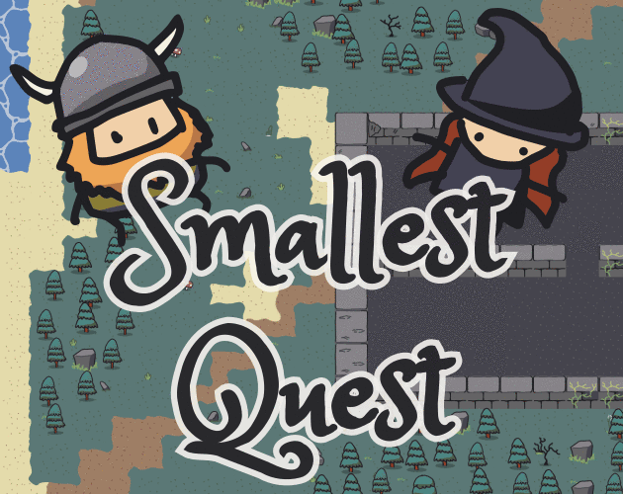
Notes:
My latest game is Smallest Quest.
The gameplay is even more minimal than Asterogue.
I noticed my kids really love turn based play and I wanted to make a game that appeals to kids.
You collect items as cards which is directly inspired by the game Patient Rogue.
In this game I really wanted to explore the idea of quests or missions, so the gameplay is roguelike with missions.
It’s a short game with gamepad play and simple graphics.
I hand drew all of the sprites and tiles which was a lot of fun.
In the end my kids gave it the thumbs up so that’s a win.

Slide 11
why use the browser? it’s already installed fast dev iteration graphics fonts point-and-click ui css animations live object inspection & tweaks portability
Notes:
That’s enough about my games.
Why use the browser as the runtime for your game?
You can find a browser on pretty much every modern computer. It’s a completely ubiquitous runtime environment.
Developing for browsers is fast. There’s no compilation step and with modern live-reloading technology you can see changes as soon as you make them.
Browsers support different types of graphics out of the box. Plain images, SVGs, and even Open GL rendering through WebGL.
Browsers have excellent support for different typefaces. Rendering text is as easy as changing an HTML tag.
There is built-in support for touch and mouse events if you need them.
CSS animations let you add all kinds of movement.
Live object inspection using the developer console means you can modify data structures in real time.
Developing for the browser makes your code highly portable. As long as there is a browser on a given platform, your game will run there. Also, it’s easier to reach players.

Slide 12

how to get started using rot.js and a web browser
Notes:
Now I’m going to show you how you can copy and paste together about 200 lines of code to make a basic functioning browser based roguelike.
It’s not a complete game but it’s enough for you to build something great off.
All you need to do this is a web browser and internet access so you can get hold of ROT.js.

Slide 13

rot.js
Notes:
ROT.js, short for “roguelike toolkit in JavaScript”, is a an excellent roguelike development library by Ondřej Žára. I hope I pronounced his name right.
You can use ROT.js with JavaScript, Typescript, ClojureScript or any other front-end browser language.
It takes care of console rendering, RNG, path finding, field of view, map generation, keyboard, tile maps, scheduling, and has support for hex tiles.
The only thing you need to do to start using it is put a single script tag in your HTML.

Slide 14
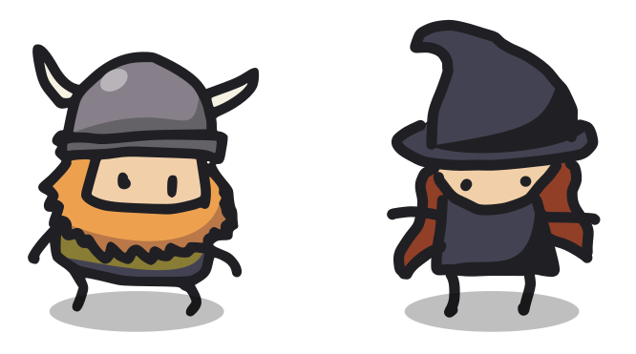
github.com/chr15m/roguelike-celebration-2021
Notes:
Ondřej has a great introductory tutorial on Rogue Basin, and a couple of useful jsfiddle demos.
I’ve made this GitHub repository with links to all that so you can find it after my talk.
**show the GitHub repo**
It also has the HTML script tag for loading the ROT.js library.

Slide 15
slingcode.net
Notes:
I said we only need a browser, but usually you need a text editor to write code.
Luckily these days there are a number of IDEs that run inside the browser so you don’t even need a text editor to get started.
I made a browser based text editor specifically for making web apps which you can find at slingcode.net.
I’m going to pull it up now and use it to create our first browser based roguelike.
All we’re going to do is take Ondras’s tutorial code from the jsfiddle (you can find it on the GitHub page) and paste the important bits into a fresh index.html file.
Add the script tag.
Copy and paste the code from jsfiddle.
Remove the body tag inner HTML.
canvas { border: 1px solid silver; }
This makes a nice little game where you run around looking for your lost banana and avoiding a monster character called Pedro, represented by the P character.
This is a great start if you want a console look game. You can dive right in and tweak it to your taste.

Slide 16
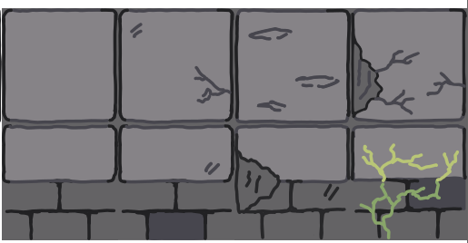
tile graphics
Notes:
In the GitHub README you’ll also find a link to another demo by Ondřej showing how to integrate graphical tilemaps.
Let’s take a quick look at it. You can see it’s only a handful of lines of code to add tilemap support.
We can use Slingcode to merge the graphical demo into our version.
Instead of these cute little graphics he has used I am going to use a tileset from kenney.nl called microrogue.

Slide 17
fonts
Notes:
So you can see straight away that getting a mini graphical roguelike going is trivial in HTML and JavaScript.
I’m going to show you some of the other cool features of using a web browser now.
The first one is fonts and text rendering in general.
Let’s say we want to add some text based UI to our game and display the number of hitpoints.
We can just overlay text easily over the top using an HTML tag.
We add a P tag, but the font looks no good. We can head over to Google Web fonts and choose a better font and add it to our game.
So the game is still the same, only now we can draw these extra UI elements on there.
And you can add all kinds of elements over the top of the game. The cards in Smallest Quest are done like that.
ROT.js also has support for different fonts when doing the console based rendering I showed you in the first part.

Slide 18
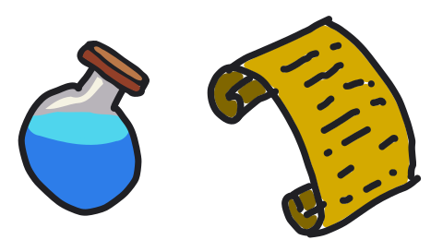
SVG
Notes:
Another cool property of using the browser is you get scalable vector graphics built in for free.
I didn’t use this for Asterogue but in Smallest Quest I used a lot of SVGs, including for the on-screen card elements.
What’s really nice about this is they scale smoothly as the name implies.
So you can draw something zoomed in or zoomed out and it still looks good.

Slide 19
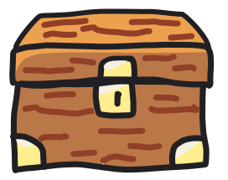
clickable rectangles
Notes:
By default ROT.js renders everything into a single canvas element.
If I inspect this element you can see this pretty clearly.
This works kind of like a giant image that ROT.js writes to.
If we want to use some of the cool built-in features of the web browser we need to overlay some HTML elements onto our game.
I’ll add a div tag with a red border on the screen and a onclick handler.
So I can move the character around and the red box follows them.
So what can we do with this box that’s overlaid? We can add juice like sparkles or dust effects or bounce, or we can render the character in there instead of on the canvas, and we can also use the box to detect clicks directly.
Let’s add a click handler. Because it is an HTML element with a click handle, when I click the red box it will display the position of the click.
This is the basis of the next couple of tricks I’m going to show you.

Slide 20

using css for juice
Notes:
In both of my games I used this trick of placing HTML elements over the canvas to accomplish various things.
I’m going to bring up my latest game Smallest Quest now so I can show you this.
I took this idea one step further in Smallest Quest.
I used ROT.js to draw all the backgrounds but I drew the characters and items inside the floating div tags on top.
All of the juice you can see in this game is created with CSS style sheet animations.
So for example when the characters bounce like this that is a stylesheet moving the div which contains the image of the character.
Same for the bobbing items. Same or the sword swipe that flashes up during combat.
If I inspect an item object you can see this in real time.

Slide 21
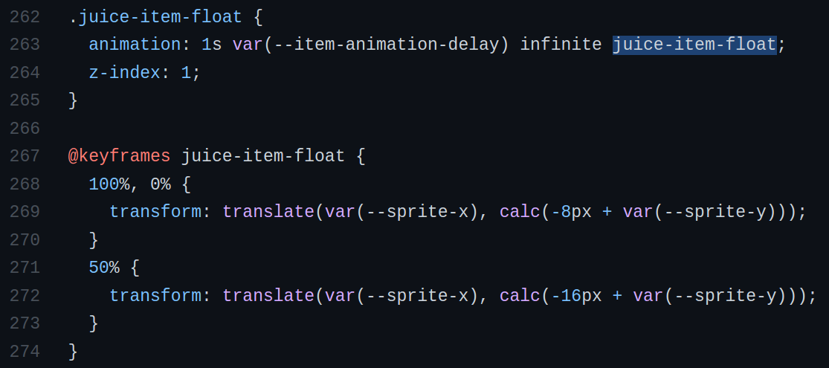
Notes:
What’s great about doing it this way is the code is so simple and declarative.
Here is the CSS code for adding that juicy bounce animation to the items.
At the top you can see a class declaration which is applied to the items that should bob up and down.
Again it is one line of JavaScript code to apply the class. You just say `element.classList.add(“classname”);`
Below that is the animation declaration.
You simply specify the relative position at different points in the animation.
Here I’ve got the start, the end, and half way through the animation.
You can see the vertical position of the translate is higher for half way through.
Because CSS animations use easing, the bob appears smooth.
So that’s how you can use CSS animations to add juice.

Slide 22

live object inspection and tweaking
Notes:
Finally I want to show you a cool trick you can use.
Because you can bind data and event handlers to on-screen elements you can do some nifty things.
In the Smallest Quest codebase I have an event handler on each item and monster which logs the properties of the thing to the console.
What’s cool about that is I can then edit them in real time.
Let me show you an example of modifying and item or monster.
As you can imagine this is very useful for balancing the game.

Slide 23
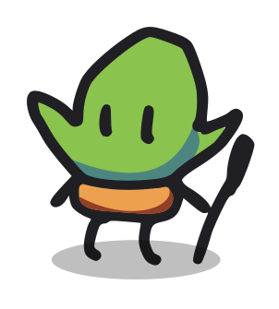
porting your game
Notes:
The final advantage I want to talk about is portability.
First of all, if you target the browser, anybody can run your game without any special device or hardware.
Also, because the web is such a popular platform there are all kinds of projects that let you run web based things in weird places.

Slide 24
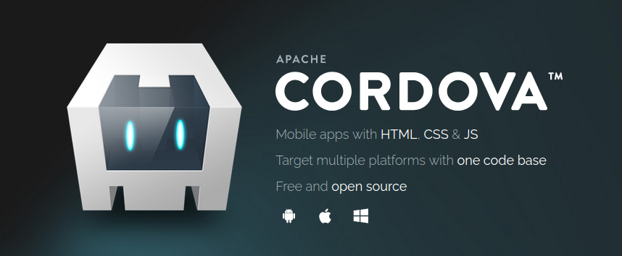
Notes:
For Asterogue I used the Apache Cordova framework to make native Android builds of my game.
This was fairly trivial to get working, maybe one day of work.
Basically all it does is wrap a web view up as a native app.
So the code I am using in the browser for debugging is exactly the same as the code running on the phone.

Slide 25
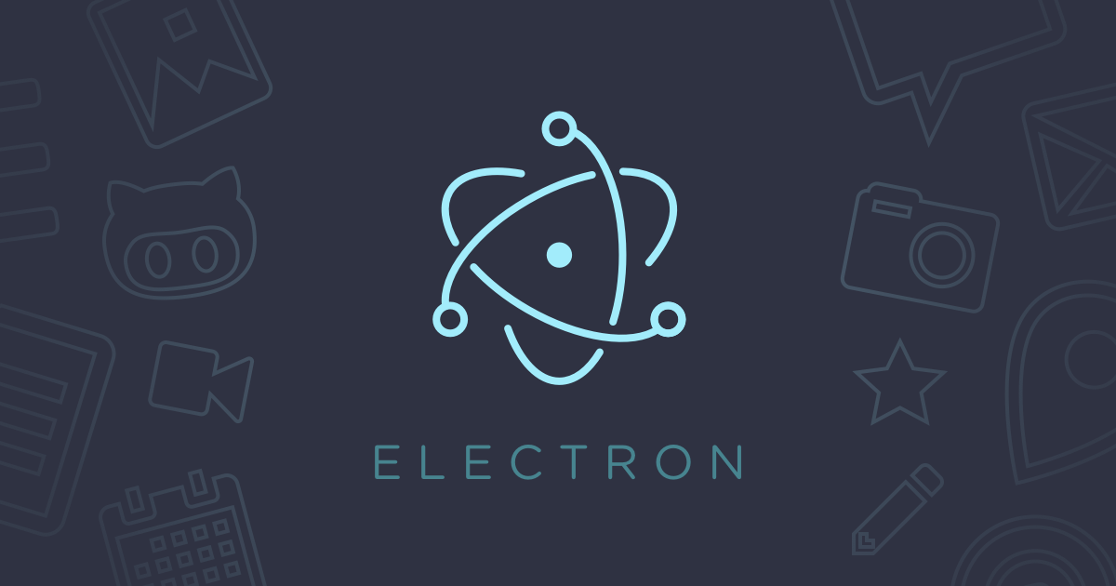
Notes:
For the desktop ports of both Asterogue and Smallest Quest I used Electron.
Similar to Cordova, it bundles a copy of Chrome browser and wraps it up to look like a native app.
Again it was super simple to do the port and only took a day or two of work.
Both Cordova and Electron give you access to the developer console too.
So you can do the same kind of live tweaking I was talking about before but on the native devices.
As you can imagine this is very useful for debugging.

Slide 26
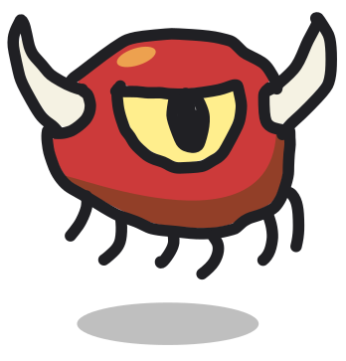
have fun!
Notes:
So that’s my talk.
I hope it’s given you some ideas about how you can use the web browser to make your next roguelike game in JavaScript.

Slide 27
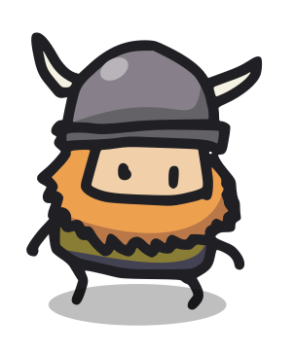
doodle rogue free tileset chr15m . itch . io
Notes:
By the way, I am releasing the graphical tiles from Smallest Quest as a standalone free tileset called Doodle Rogue.
That should be up soon on chr15m.itch.io which is my personal itch page. I’ll announce it on the Roguelike dev Reddit.

Slide 28
building juicy minimal roguelikes in the browser
Chris McCormick
@mccrmx https://mccormick.cx thepunkcollective.com
Notes:
Finally, you can find me on Twitter and my personal site mccormick.cx
The bottom link is The Punk Collective.
That’s me and some other friends releasing one game per month.
If you’re interested in finding out about our releases there is an email signup at the bottom of thepunkcollective.com
Thanks very much for having me, it’s a real honour to talk at Roguelike Celebration.

