Slide 1
Structured population models
Group: Amalia Bogri, Christian Berrig & Jonas Bolduan
General model parameters

Slide 2
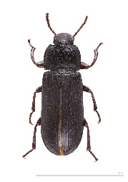
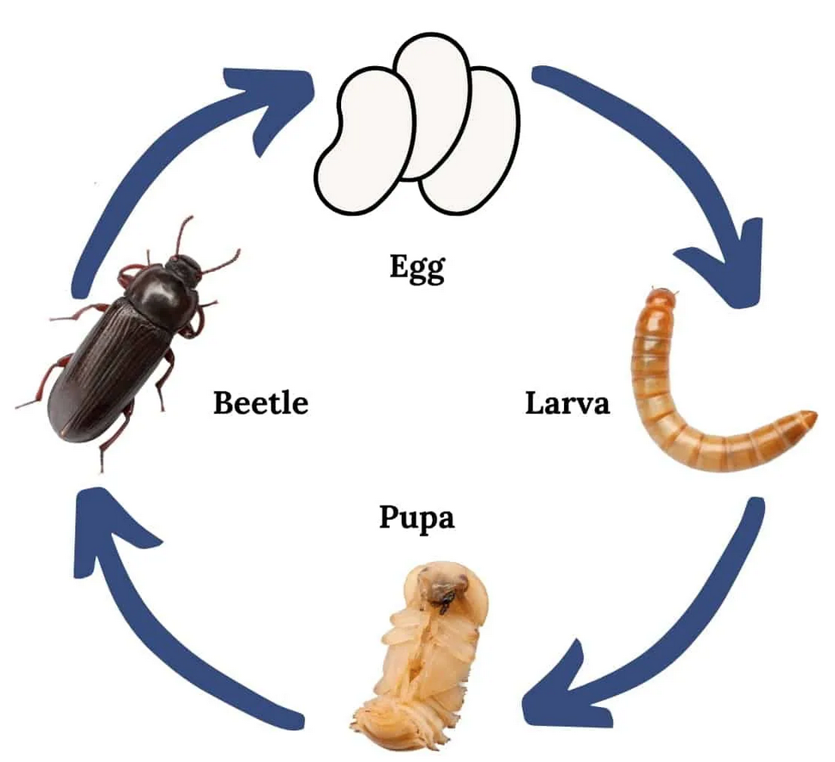




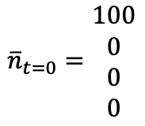
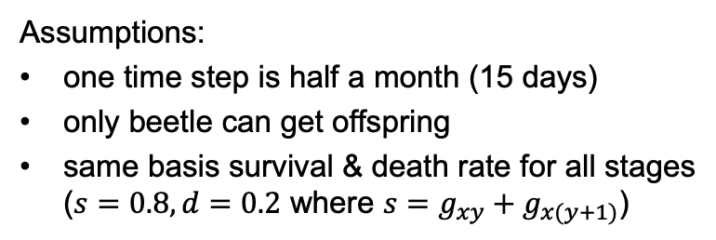

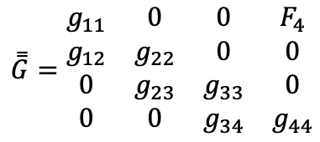



Stage-structured population: Beetles
4 stage structures:
Assumptions:
one time step is half a month (15 days)
only beetle can get offspring
same basis survival & death rate for all stages ($s=0.8, d=0.2$ where ${s=g}_{xy}+g_{x(y+1)}$)
$$g_{11}=0$$
$$F_{4}=25×\frac{1}{4}×0.8$$
$$g_{12}=0.8$$
$$\overset{̿}{G}=\begin{matrix}g_{11} & 0 & 0 & F_{4} \\ g_{12} & g_{22} & 0 & 0 \\ 0 & g_{23} & g_{33} & 0 \\ 0 & 0 & g_{34} & g_{44}\end{matrix}$$
$$g_{22}=\frac{5}{6}×0.8$$
$$g_{22}=\frac{3}{4}×0.8$$
$${\overline{n}}_{t=0}=\begin{matrix}100 \\ 0 \\ 0 \\ 0\end{matrix}$$
$$g_{23}=\frac{1}{6}×0.8$$
$$g_{34}=0.8$$
$$g_{33}=0$$
source: https://www.heritageacresmarket.com/mealworm-farm/

Slide 3
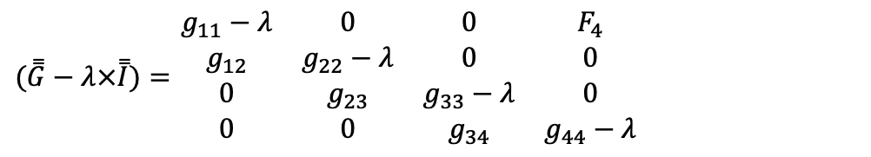


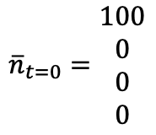
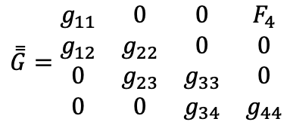
Analytical solution
$$\overset{̿}{G}=\begin{matrix}g_{11} & 0 & 0 & F_{4} \\ g_{12} & g_{22} & 0 & 0 \\ 0 & g_{23} & g_{33} & 0 \\ 0 & 0 & g_{34} & g_{44}\end{matrix}$$
$${\overline{n}}_{t=0}=\begin{matrix}100 \\ 0 \\ 0 \\ 0\end{matrix}$$
$$(\overset{̿}{G}−λ×\overset{̿}{I})\overline{x}=0$$
$$\det\left(\overset{̿}{G}−λ×\overset{̿}{I}\right)=0$$
$(\overset{̿}{G}−λ×\overset{̿}{I})=$ $\begin{matrix}g_{11}−λ & 0 & 0 & F_{4} \\ g_{12} & g_{22}−λ & 0 & 0 \\ 0 & g_{23} & g_{33}−λ & 0 \\ 0 & 0 & g_{34} & g_{44}−λ\end{matrix}$
→ Laplace expansion

Slide 4
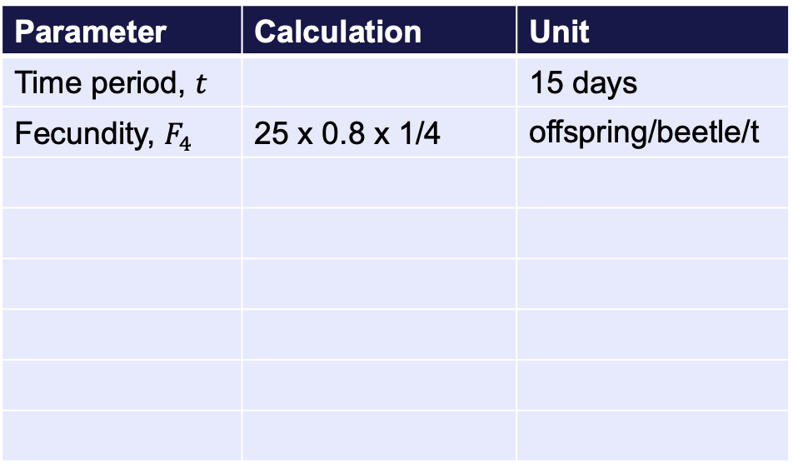
General model parameters
Parameter | Calculation | Unit
Time period, $t$ |  | 15 days
Fecundity, $F_{4}$ | 25 x 0.8 x 1/4 | offspring/beetle/t
Stage | Growth rate
Egg
Larva
Pupa
Beetle

Slide 5
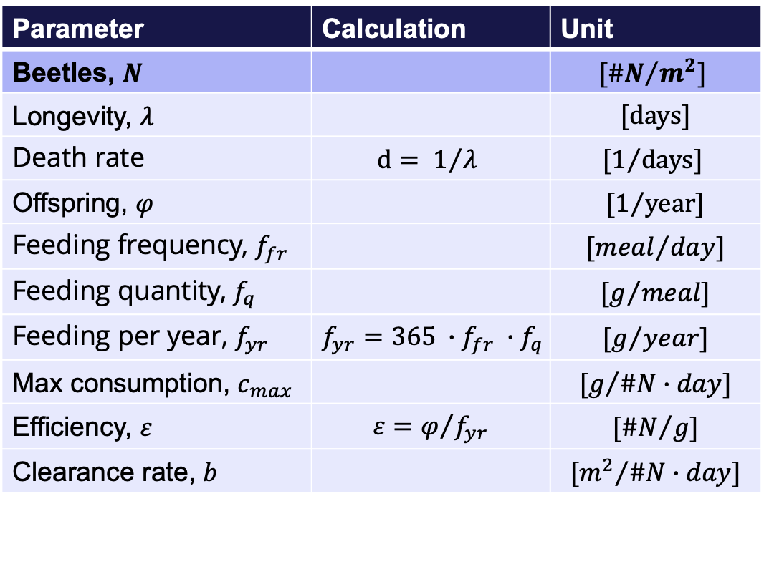
General model parameters
Parameter | Calculation | Unit
Beetles, $N$ |  | $${[\#N}/{m^{2}}]$$
Longevity, $λ$ |  | $$[days]$$
Death rate | $$d= 1/{λ }$$ | $${[1}/{days}]$$
Offspring, $φ$ |  | $${[1}/{year}]$$
Feeding frequency, $f_{fr}$ |  | $${[meal}/{day}]$$
Feeding quantity, $f_{q}$ |  | $${[g}/{meal}]$$
Feeding per year, $f_{yr}$ | $${{f_{yr}=365 ∙f}_{fr} ∙f}_{q}$$ | $${[g}/{year}]$$
Max consumption, $c_{max}$ |  | $${[g}/{\#N∙day}]$$
Efficiency, $ε$ | $$ε=φ/{f_{yr}}$$ | $${[\#N}/g]$$
Clearance rate, $b$ |  | $${[m^{2}}/{\#N∙day}]$$
Parameter | Calculation | Unit
Fecundity,

Slide 6

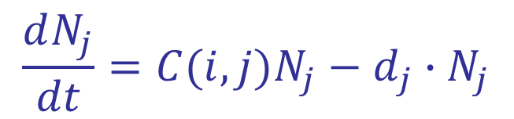
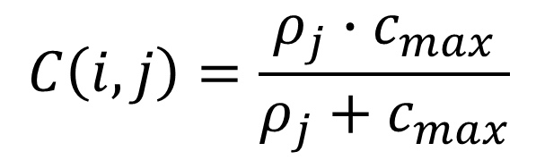

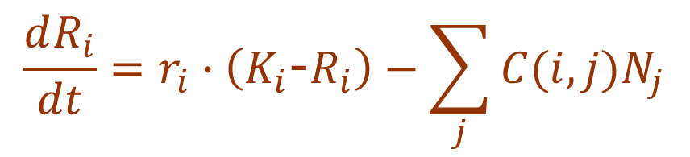
General model description:
CONSUMPTION:
Functional response for consumer j
RESOURCES i – Guano: R
$$\frac{dR_{i}}{dt}=r_{i}∙\left(K_{i}\text{−}R_{i}\right)−\sum_{j}{C(i,j)N_{j}}$$
$$C\left(i,j\right)=\frac{ρ_{j}∙c_{max}}{ρ_{j}+c_{max}}$$
For SUBSTITUTIONAL resources:
$$ρ_{j}=\sum_{i}{R_{i}}∙b_{ij}$$
CONSUMERS j –Beetles: N
$$\frac{dN_{j}}{dt}=C(i,j)N_{j}−d_{j}∙N_{j}$$
For ESSENTIAL resources:
$$ρ_{j}=min⁡(R_{j}{∙b}_{ij})$$
6

Slide 7
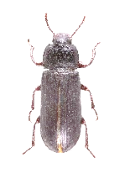


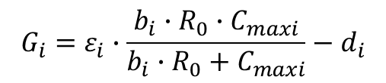


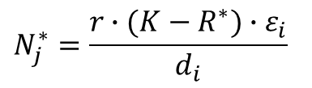
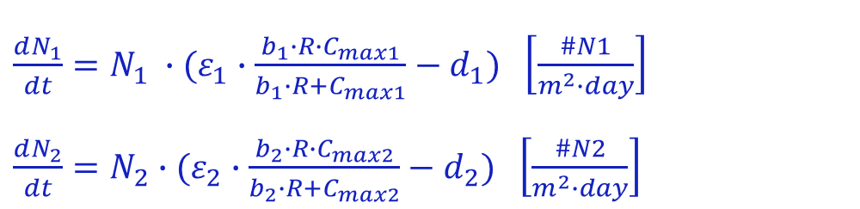



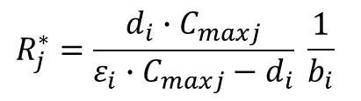

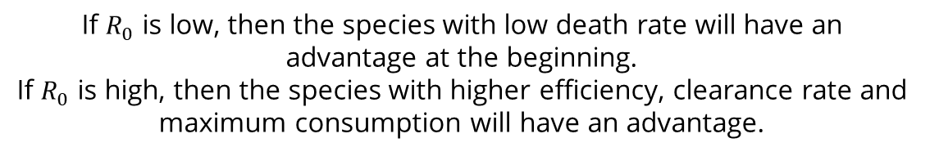
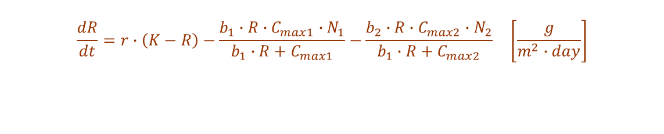


Case 1: Two consumers & One resource
$$\frac{dR}{dt}=r∙\left(K−R\right)−\frac{b_{1}∙R∙C_{max1}∙N_{1}}{b_{1}∙R+C_{max1}}−\frac{b_{2}∙R∙C_{max2}∙N_{2}}{b_{1}∙R+C_{max2}} \left[\frac{g}{m^{2}∙day}\right]$$
$$×ε_{1}$$
$$N_{1}$$
$$C_{1}{ N}_{1}$$
$$r K$$
R
$\frac{dN_{1}}{dt}=N_{1} ∙(ε_{1}∙\frac{b_{1}∙R∙C_{max1}}{b_{1}∙R+C_{max1}}−d_{1})$ $\left[\frac{\#N1}{m^{2}∙day}\right]$
$\frac{dN_{2}}{dt}=N_{2}∙(ε_{2}∙\frac{b_{2}∙R∙C_{max2}}{b_{2}∙R+C_{max2}}−d_{2})$ $\left[\frac{\#N2}{m^{2}∙day}\right]$
$$d_{1}{ N}_{1}$$
$$C_{2}{ N}_{2}$$
$$×ε_{2}$$
$$N_{2}$$
$r R$
Note: guano is coming into the islet system from the nesting birds, with rate r, and it is removed, with the same rate, as it dissolves to the soil and the sea.
$$d_{2}{ N}_{2}$$
Initial growth rate:
Equilibria:
$$G_{i}=ε_{i}∙\frac{b_{i}∙R_{0}∙C_{maxi}}{b_{i}∙R_{0}+C_{maxi}}−d_{i}$$
$$R_{j}^{∗}=\frac{d_{i}∙C_{maxj}}{ε_{i}∙C_{maxj}−d_{i}} \frac{1}{b_{i}}$$
If $R_{0}$ is low, then the species with low death rate will have an advantage at the beginning.
If $R_{0}$ is high, then the species with higher efficiency, clearance rate and maximum consumption will have an advantage.
$$N_{j}^{∗}=\frac{r∙(K−R^{∗})∙ε_{i}}{d_{i}}$$
7

Slide 8

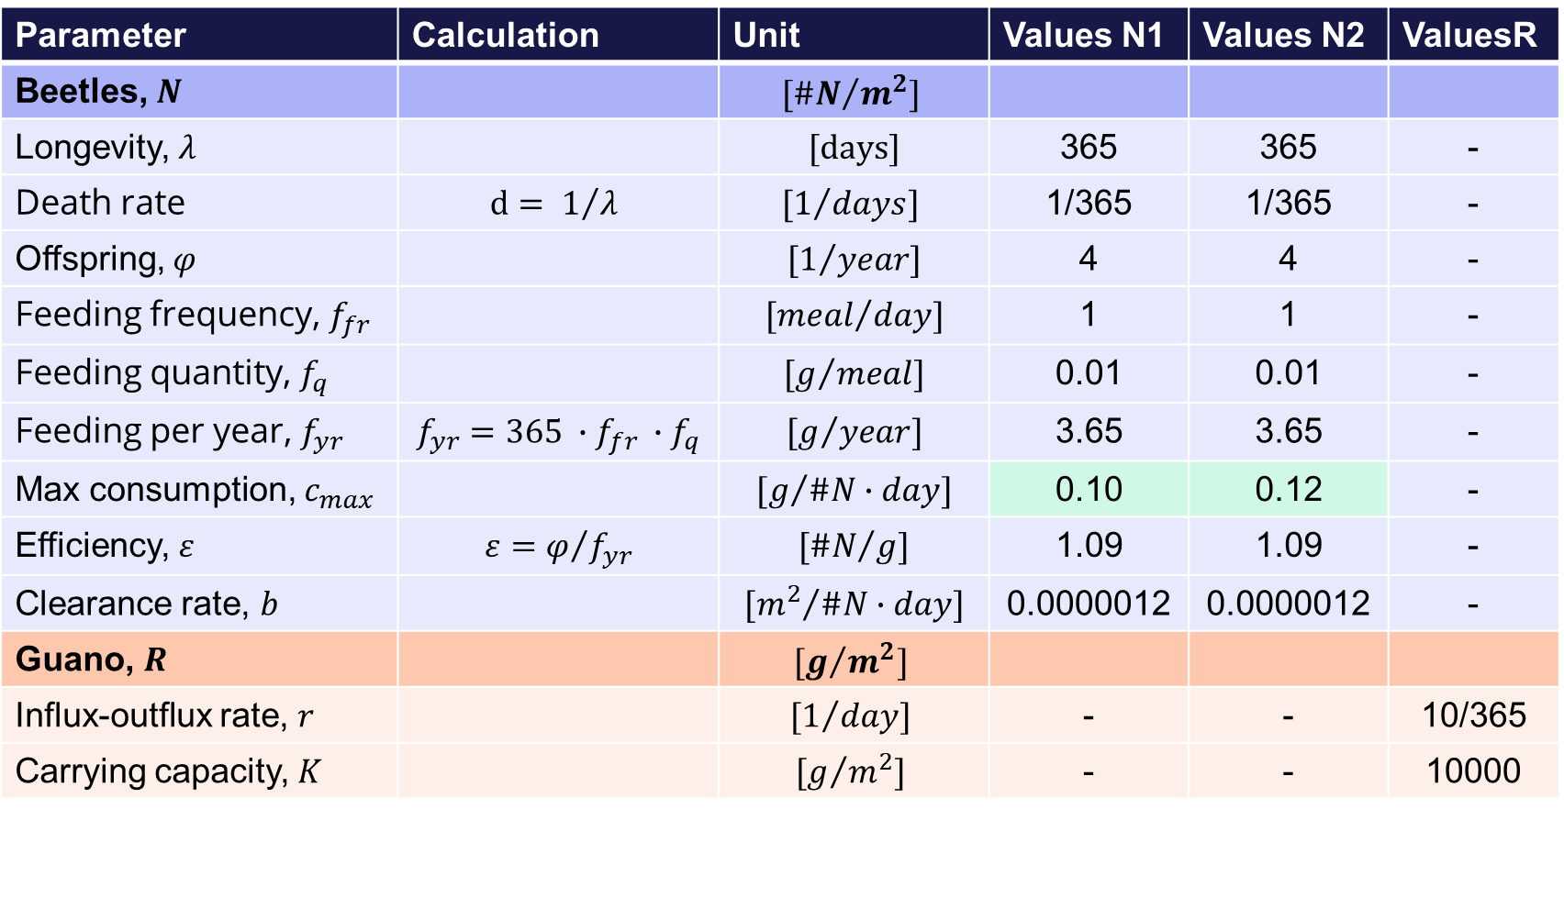
Case 1: Estimation of values
Parameter | Calculation | Unit | Values N1 | Values N2 | ValuesR
Beetles, $N$ |  | $${[\#N}/{m^{2}}]$$
Longevity, $λ$ |  | $$[days]$$ | 365 | 365 | -
Death rate | $$d= 1/{λ }$$ | $${[1}/{days}]$$ | 1/365 | 1/365 | -
Offspring, $φ$ |  | $${[1}/{year}]$$ | 4 | 4 | -
Feeding frequency, $f_{fr}$ |  | $${[meal}/{day}]$$ | 1 | 1 | -
Feeding quantity, $f_{q}$ |  | $${[g}/{meal}]$$ | 0.01 | 0.01 | -
Feeding per year, $f_{yr}$ | $${{f_{yr}=365 ∙f}_{fr} ∙f}_{q}$$ | $${[g}/{year}]$$ | 3.65 | 3.65 | -
Max consumption, $c_{max}$ |  | $${[g}/{\#N∙day}]$$ | 0.10 | 0.12 | -
Efficiency, $ε$ | $$ε=φ/{f_{yr}}$$ | $${[\#N}/g]$$ | 1.09 | 1.09 | -
Clearance rate, $b$ |  | $${[m^{2}}/{\#N∙day}]$$ | 0.0000012 | 0.0000012 | -
Guano, $R$ |  | $${[g}/{m^{2}}]$$
Influx-outflux rate, $r$ |  | $${[1}/{day}]$$ | - | - | 10/365
Carrying capacity, $K$ |  | $${[g}/{m^{2}}]$$ | - | - | 10000
We do realize that b looks very small, but it is the only way to produce a sensible graph.

Slide 9
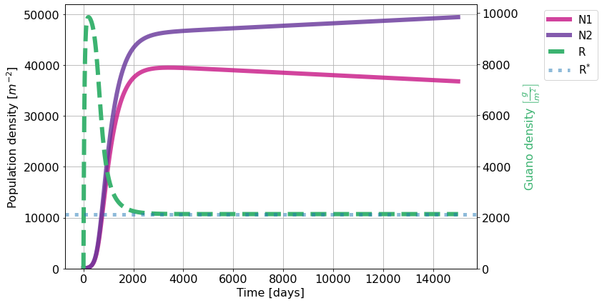
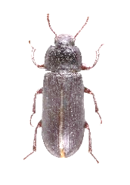
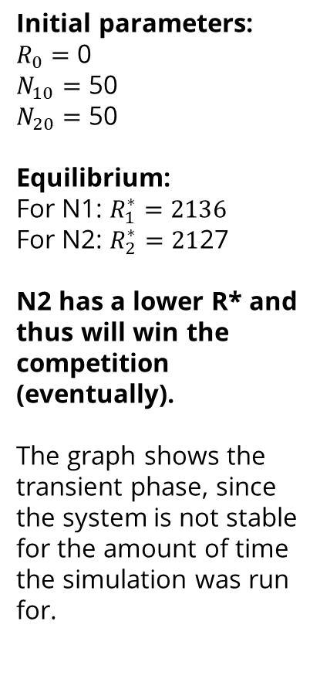
Case 1: Results
Note: N2 is also expected to ‘win’ at the start, as it has higher Cmax. However, since the system starts with 0 resources, the higher Cmax does not give an advantage at the first time step.
Initial parameters:
$R_{0}=$ 0
$N_{10}=$ 50
$N_{20}=$ 50
Equilibrium:
For N1: $R_{1}^{∗}=2136$
For N2: $R_{2}^{∗}=21$27
N2 has a lower R* and thus will win the competition (eventually).
The graph shows the transient phase, since the system is not stable for the amount of time the simulation was run for.

Slide 10
Case 1: Code in Python
yr = 365 # day/yr
feed_freq = 1 # 1/day (eats every day)
feed_quant = 0.01 # g (single meal quant)
feed_yr = feed_quant*feed_freq*yr # g/yr
offspring = 4 # offspr/(beetle*yr)
eps = [offspring/feed_yr]*2 # 1/g # Unit: [#N/g]
bs = [0.0000012, 0.0000012] # sqm /(day*beetle)
ds = [1/yr, 1/yr] # Unit: [1/day]
c_maxs = [0.1, 0.12] # g/(beetle*day)
r = 10/yr # Unit: [1/day]
K = 10000 # Unit: [g/sqm]
nR = 1 # number of distinct resources
V = 20 # Unit: [sqm]
init_state = [0, 50, 50]
t = np.linspace(0, 15000, 100000)
params = (eps, bs, ds, c_maxs, r, K, nR )
sol = odeint(deriv, init_state, t, params).T
R, N1, N2 = sol
print("Rstar:")
print(Rstar(0), Rstar(1))
fig, ax1 = plt.subplots(1,1, figsize=(12, 6), tight_layout=True)
ax2 = ax1.twinx()
ax1.grid()
ax2.plot(t, R, label="R", color='mediumseagreen', linestyle="--")
ax1.plot(t, N1, label="N1", color='mediumvioletred', alpha=0.8)
ax1.plot(t, N2, label="N2", color='rebeccapurple', alpha=0.8)
ax1.plot([], [], label="R", color='mediumseagreen', linestyle="--")
ax1.set_ylabel('Population density $\\left[m^{-2}\\right]$')
ax2.set_ylabel('Guano density $\\left[ \\frac{g}{m^{2}} \\right]$', color = 'mediumseagreen')
ax1.set_xlabel('Time [days]')
ax1.set_ylim(bottom=0)
ax2.set_ylim(bottom=0)
ax2.axhline(Rstar(1), linewidth=5, alpha=0.5, linestyle=":")
ax1.plot([], [], linewidth=5, alpha=0.5, linestyle=":", label="R$^{*}$")
ax1.legend(bbox_to_anchor=(1.15, 1), loc=2, borderaxespad=0.5, fontsize=15)
from scipy.integrate import odeint
import matplotlib.pyplot as plt
import numpy as np
# This is for reasonable fontsize universally defined:
fs_label = 16
parameters = {
'figure.titlesize': fs_label+6,
'axes.labelsize': fs_label,
'axes.titlesize': fs_label+4,
'xtick.labelsize': fs_label,
'ytick.labelsize': fs_label,
'legend.fontsize': fs_label,
'lines.linewidth': 6
}
plt.rcParams.update(parameters)
def deriv(state, t, *params):
eps, bs, ds, c_max, r, K, nR = params
Rs, Ns = state[:nR], state[nR:]
R = Rs[0]
C = lambda i: R*bs[i]*c_max[i]/(R*bs[i] + c_max[i])
dR_dt = r*K - r*R - sum(C(i)*Ns[i] for i in range(len(Ns)))
dN_dt = np.zeros(len(Ns))
for iN, N in enumerate(Ns):
dN_dt[iN] = eps[iN]*C(iN)*N - ds[iN]*N
return np.array([dR_dt, *dN_dt])

Slide 11







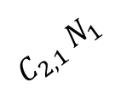




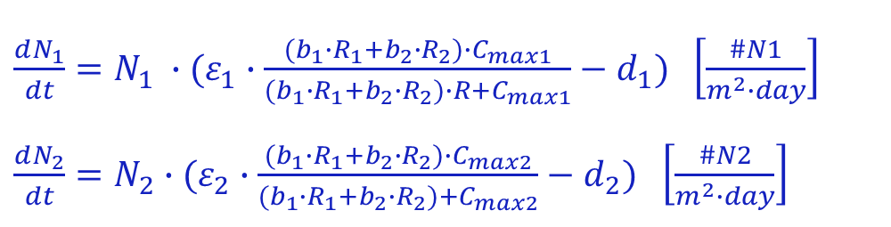



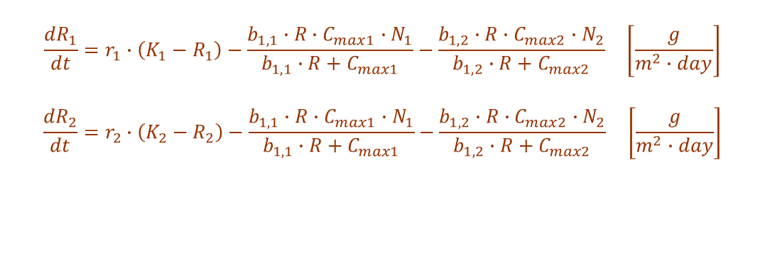
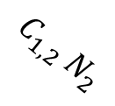


Case 2: Two consumers & Two substitutable resources
$$\frac{{dR}_{1}}{dt}=r_{1}∙\left(K_{1}−R_{1}\right)−\frac{b_{1,1}∙R∙C_{max1}∙N_{1}}{b_{1,1}∙R+C_{max1}}−\frac{b_{1,2}∙R∙C_{max2}∙N_{2}}{b_{1,2}∙R+C_{max2}} \left[\frac{g}{m^{2}∙day}\right]$$
$$\frac{{dR}_{2}}{dt}=r_{2}∙\left(K_{2}−R_{2}\right)−\frac{b_{1,1}∙R∙C_{max1}∙N_{1}}{b_{1,1}∙R+C_{max1}}−\frac{b_{1,2}∙R∙C_{max2}∙N_{2}}{b_{1,2}∙R+C_{max2}} \left[\frac{g}{m^{2}∙day}\right]$$
$${r_{1}R}_{1}$$
$$×ε_{1}$$
$$N_{1}$$
$$C_{1,1}{ N}_{1}$$
$${r_{1}K}_{1}$$
$$R_{1}$$
$$×ε_{1}$$
$$C_{1,2}{ N}_{2}$$
$$d_{1}{ N}_{1}$$
$\frac{dN_{1}}{dt}=N_{1} ∙(ε_{1}∙\frac{{(b}_{1}∙R_{1}+b_{2}∙R_{2})∙C_{max1}}{{(b}_{1}∙R_{1}+b_{2}∙R_{2})∙R+C_{max1}}−d_{1})$ $\left[\frac{\#N1}{m^{2}∙day}\right]$
$\frac{dN_{2}}{dt}=N_{2}∙(ε_{2}∙\frac{{(b}_{1}∙R_{1}+b_{2}∙R_{2})∙C_{max2}}{{(b}_{1}∙R_{1}+b_{2}∙R_{2})+C_{max2}}−d_{2})$ $\left[\frac{\#N2}{m^{2}∙day}\right]$
$$R_{2}$$
$$C_{2,1}{ N}_{1}$$
$$×ε_{2}$$
$${r_{2}K}_{2}$$
$$C_{2,2}{ N}_{2}$$
$$N_{2}$$
$$×ε_{2}$$
$${r_{2}R}_{2}$$
$$d_{2}{ N}_{2}$$
11

Slide 12

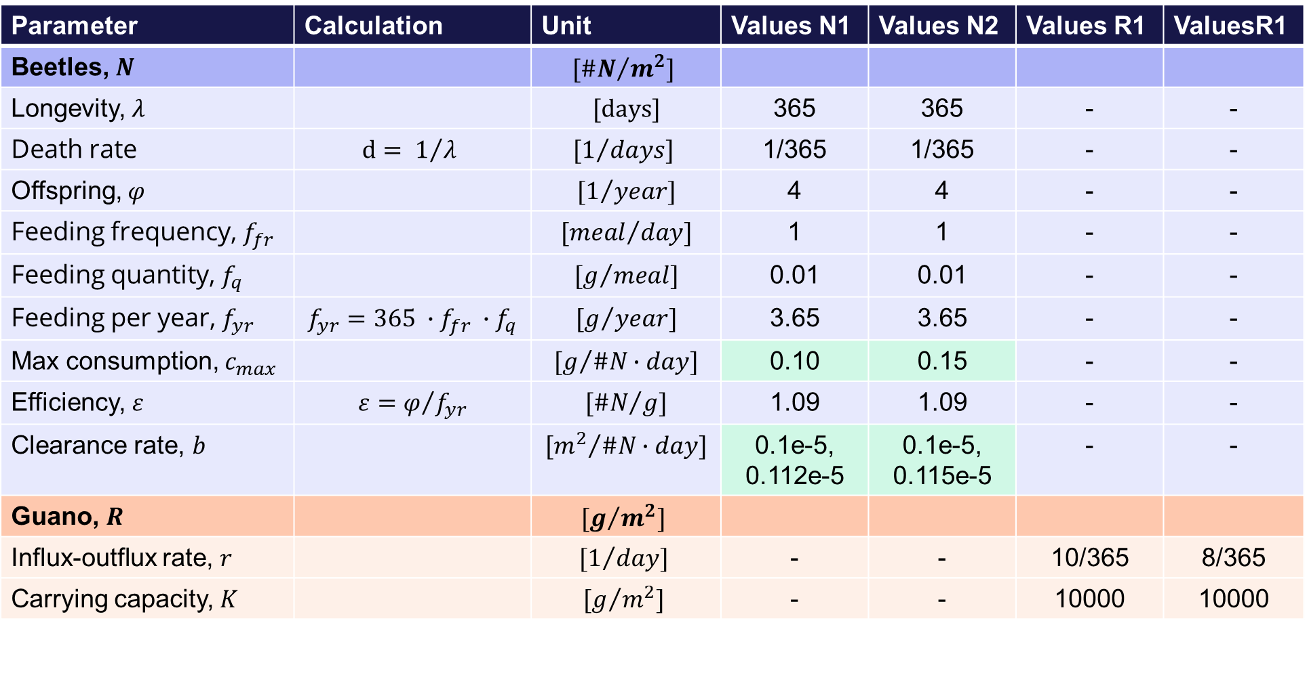
Case 2: Estimation of values
Parameter | Calculation | Unit | Values N1 | Values N2 | Values R1 | ValuesR1
Beetles, $N$ |  | $${[\#N}/{m^{2}}]$$
Longevity, $λ$ |  | $$[days]$$ | 365 | 365 | - | -
Death rate | $$d= 1/{λ }$$ | $${[1}/{days}]$$ | 1/365 | 1/365 | - | -
Offspring, $φ$ |  | $${[1}/{year}]$$ | 4 | 4 | - | -
Feeding frequency, $f_{fr}$ |  | $${[meal}/{day}]$$ | 1 | 1 | - | -
Feeding quantity, $f_{q}$ |  | $${[g}/{meal}]$$ | 0.01 | 0.01 | - | -
Feeding per year, $f_{yr}$ | $${{f_{yr}=365 ∙f}_{fr} ∙f}_{q}$$ | $${[g}/{year}]$$ | 3.65 | 3.65 | - | -
Max consumption, $c_{max}$ |  | $${[g}/{\#N∙day}]$$ | 0.10 | 0.15 | - | -
Efficiency, $ε$ | $$ε=φ/{f_{yr}}$$ | $${[\#N}/g]$$ | 1.09 | 1.09 | - | -
Clearance rate, $b$ |  | $${[m^{2}}/{\#N∙day}]$$ | 0.1e-5, 0.112e-5 | 0.1e-5, 0.115e-5 | - | -
Guano, $R$ |  | $${[g}/{m^{2}}]$$
Influx-outflux rate, $r$ |  | $${[1}/{day}]$$ | - | - | 10/365 | 8/365
Carrying capacity, $K$ |  | $${[g}/{m^{2}}]$$ | - | - | 10000 | 10000

Slide 13
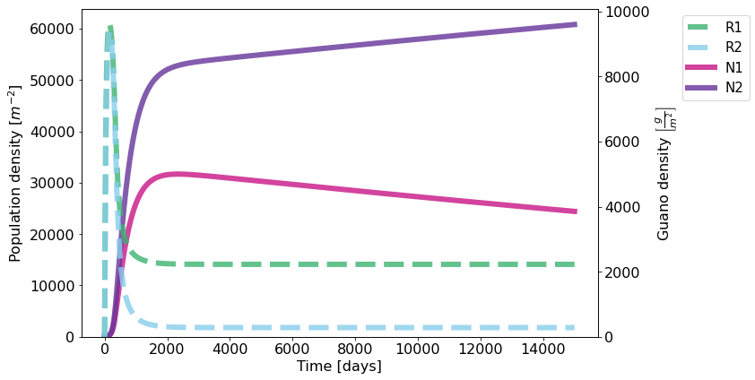
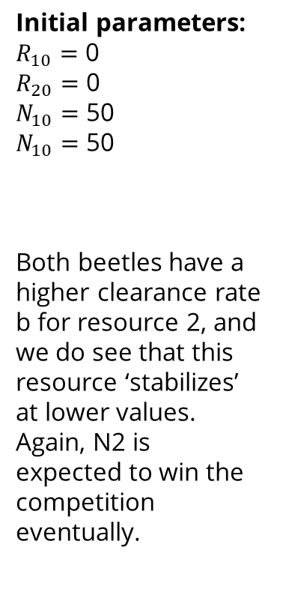
Case 2: Results
Initial parameters:
$R_{10}=$ 0
$R_{20}=$ 0
$N_{10}=$ 50
$N_{10}=$ 50
Both beetles have a higher clearance rate b for resource 2, and we do see that this resource ‘stabilizes’ at lower values. Again, N2 is expected to win the competition eventually.

Slide 14
Case 2: Code in Python
def deriv2(state, t, *params):
eps, bs, ds, c_max, rs, K, nR = params
Rs, Ns = state[:nR], state[nR:]
R_char = lambda j: np.sum([bs[j][i]*Rs[i] for i in range(len(Rs))])
C = lambda j: R_char(j)*c_max[j]/(R_char(j) + c_max[j])
dR_dt = np.zeros(len(Rs))
for iR, R in enumerate(Rs):
dR_dt[iR] = rs[iR]*(K - R) - sum(C(j)*Ns[j] for j in range(len(Ns)))
dN_dt = np.zeros(len(Ns))
for iN, N in enumerate(Ns):
dN_dt[iN] = (eps[iN]*C(iN) - ds[iN])*N
return np.array([*dR_dt, *dN_dt])
bs = np.array([[0.1, 0.112],[0.1, 0.115]]) # sqm /(day*beetle)
bs = np.multiply(bs, 1e-5)
c_maxs = [0.1, 0.15] # g/(beetle*day)
ds = [1/yr, 1/yr]
rs = [10/yr, 8/yr] # Unit: [1/day]
K = 10000 # Unit: [g/sqm]
t = np.linspace(0, 15000, 100000)
init_state = [0, 0, 50, 50]
nR = 2
params = (eps, bs, ds, c_maxs, rs, K, nR )
sol = odeint(deriv2, init_state, t, params).T
R1, R2, N1, N2 = sol
fig, ax = plt.subplots(1,1, figsize=(12, 6), tight_layout=True)
ax_twin = ax.twinx()
ax_twin.plot(t, R1 , label="R1", alpha=0.8, color='mediumseagreen', linestyle="--")
ax_twin.plot(t, R2 , label="R2", alpha=0.8, color = 'skyblue', linestyle="--")
ax.plot([], [] , label="R1", alpha=0.8, color='mediumseagreen', linestyle="--")
ax.plot([], [] , label="R2", alpha=0.8, color = 'skyblue', linestyle="--")
ax.plot(t, N1, label="N1", color='mediumvioletred', alpha=0.8)#, color = 'mediumseagreen', linestyle="--")
ax.plot(t, N2 , label="N2", color='rebeccapurple', alpha=0.8)#, color = 'mediumseagreen', linestyle="--")
ax.set_ylabel('Population density $\\left[ m^{-2} \\right]$')
ax_twin.set_ylabel('Guano density $\\left[ \\frac{g}{m^{2}} \\right]$')
ax.set_xlabel('Time [days]')
ax.set_ylim(bottom=0)
ax_twin.set_ylim(bottom=0)
ax.legend(bbox_to_anchor=(1.15, 1), loc=2, borderaxespad=0.5, fontsize=15)

