Slide 1
Evolution and optimization
Group: Amalia Bogri, Christian Berrig & Jonas Bolduan

Slide 2
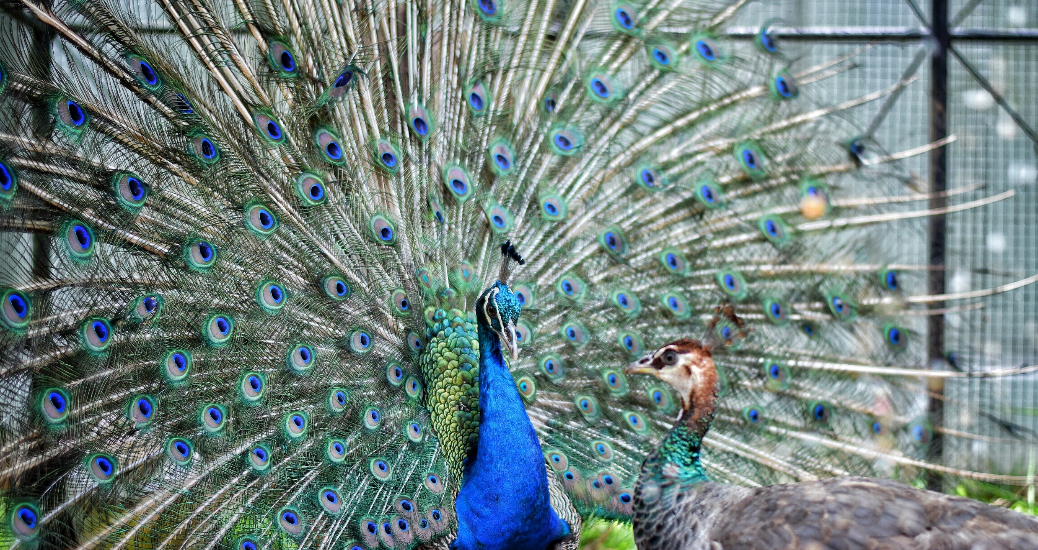
Evolution & optimization
Females (peahens) prefer to mate with males (peacocks) that have the most elaborate trails,
i.e. the trails with the most eye-spots.
Trails with more eye-spots are also larger in diameter.
Thus, more eye-spots signify greater mating success (gain).
The eye-spots are the trait we will use.
The costs of carrying an elaborate trail are still unknown.
In this model, we assume that there is a
metabolic cost (due to carrying the extra weight)
immune suppression cost that leads to excess mortality
(due to the increased testosterone)
with more eye-spots
References:
Petrie et al., 1991, Petrie & Halliday 1994, Gadagkar 2003, Ros et al., 2009

Slide 3
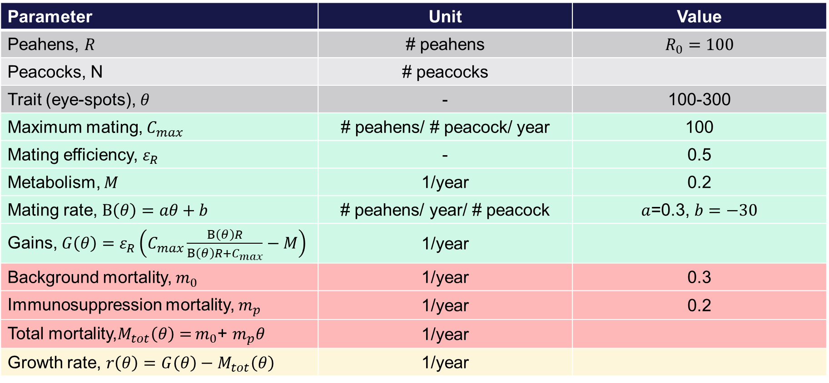
Evolution & optimization: model parameters
Parameter | Unit | Value
Peahens, $R$ | # peahens | $$R_{0}=100$$
Peacocks, N | # peacocks
Trait (eye-spots), $θ$ | - | 100-300
Maximum mating, $C_{max}$ | # peahens/ # peacock/ year | 100
Mating efficiency, $ε_{R}$ | - | 0.5
Metabolism, $M$ | 1/year | 0.2
Mating rate, $B\left(θ\right)=aθ+b$ | # peahens/ year/ # peacock | $a$=0.3, $b=−30$
Gains, $G\left(θ\right)=ε_{R}\left(C_{max}\frac{B\left(θ\right)R}{B\left(θ\right)R+C_{max}}−M\right)$ | 1/year
Background mortality, $m_{0}$ | 1/year | 0.3
Immunosuppression mortality, $m_{p}$ | 1/year | 0.2
Total mortality,$M_{tot}\left(θ\right)=$ $m_{0}$+ $m_{p}θ$ | 1/year
Growth rate, $r\left(θ\right)=$ $G\left(θ\right)−M_{tot}\left(θ\right)$ | 1/year

Slide 4
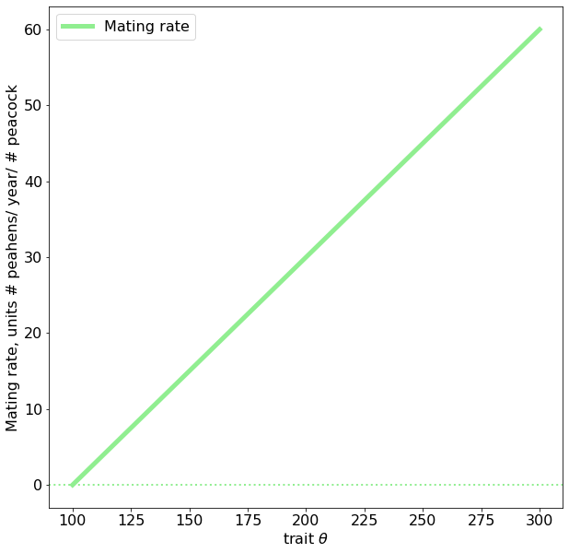

Evolution & optimization: plots
Mating rate* increases linearly with the number of eye-spots
*Similar to ‘clearance rate’
$$B\left(θ\right)=aθ+b$$

Slide 5
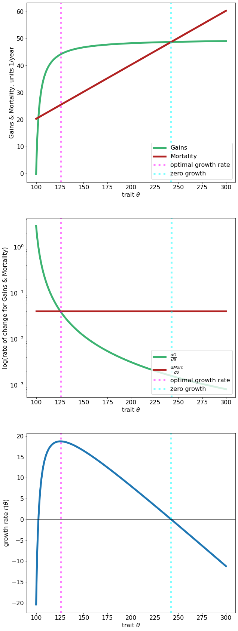
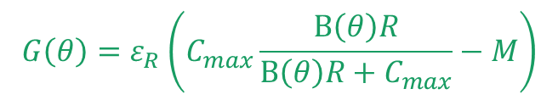

Evolution & optimization: plots
$$G\left(θ\right)=ε_{R}\left(C_{max}\frac{B\left(θ\right)R}{B\left(θ\right)R+C_{max}}−M\right)$$
$M_{tot}\left(θ\right)=$ $m_{0}$+ $m_{p}θ$
Total mortality increases with the number of eye-spots
Gains increase logistically up to a limit, at approximately 150 eye-spots.
(Optimal & zero growth calculated from growth rate r.)

Slide 6


Evolution & optimization: plots
$$G′\left(θ\right)$$
$$M_{tot}′\left(θ\right)$$
As expected, the rate of change of mortality is stable &
the rate of change of gains is decreasing (almost exponentially)
as the number of eye-spots increases

Slide 7
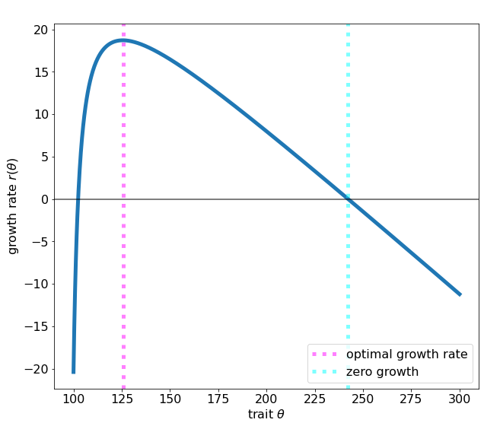
Evolution & optimization: plots
The growth rate of the peacocks reaches a maximum at ~125 eye-spots.
The growth rate becomes zero at ~240 eye-spots. This when the benefits of carrying the trait are equal to the costs.
At more than ~240 eye-spots, the metabolic & mortality costs of carrying the trait are greater than the mating benefit it confers.

Slide 8
Python code
fig, ax = plt.subplots(1, figsize=(10,10)) #, sharex=True
ax.plot(theta_list, B(theta_list), color = 'lightgreen', label = 'Mating rate')
ax.axhline(0, linewidth = 2, linestyle = ':', color = 'lightgreen')
ax.set_xlabel("trait $\\theta$")
ax.set_ylabel("Mating rate, units # peahens/ year/ # peacock")
ax.legend()
fig, ax = plt.subplots(3, 1, figsize=(10,30)) #, sharex=True
ax[0].plot(theta_list, G(theta_list), label="Gains", color = 'mediumseagreen')
ax[0].plot(theta_list, Mort(theta_list), label = 'Mortality', color = 'firebrick')
ax[0].axvline(theta_list[max_index], linestyle=":", alpha=0.5, color="magenta", label="optimal growth rate")
ax[0].axvline(root_r, linestyle=":", alpha=0.5, color="cyan", label="zero growth")
ax[0].set_xlabel("trait $\\theta$")
ax[0].set_ylabel("Gains & Mortality, units 1/year")
ax[0].legend(loc="lower right")
# Here we differentiate numerically to find the rate of change
# Basically we find the difference between each two points. So we end up with one point less. So we need one less theta.
ax[1].plot(theta_list[:-1], np.diff(G(theta_list)), label="$\\frac{d G}{d \\theta}$", color='mediumseagreen')
ax[1].plot(theta_list[:-1], np.diff(Mort(theta_list)), label="$\\frac{d Mort}{d \\theta}$",color='firebrick')
ax[1].axvline(theta_list[max_index], linestyle=":", alpha=0.5, color="magenta", label="optimal growth rate")
ax[1].axvline(root_r, linestyle=":", alpha=0.5, color="cyan", label="zero growth")
ax[1].set_xlabel("trait $\\theta$")
ax[1].set_ylabel("log(rate of change for Gains & Mortality)")
ax[1].legend(loc="lower right")
ax[1].set_yscale("log")
ax[2].plot(theta_list, r(theta_list))
ax[2].axhline (0, linewidth=2, color="k", alpha=0.5)
ax[2].set_xlabel("trait $\\theta$")
ax[2].set_ylabel("growth rate $r(\\theta)$")
ax[2].axvline(theta_list[max_index], linestyle=":", alpha=0.5, color="magenta", label="optimal growth rate")
ax[2].axvline(root_r, linestyle=":", alpha=0.5, color="cyan", label="zero growth")
ax[2].legend(loc="lower right")
# Import stuff:
from scipy.integrate import odeint
import matplotlib.pyplot as plt
import numpy as np
import scipy as sp
from sympy import Symbol
from sympy.solvers import solve
# This is for reasonable fontsize universally defined:
fs_label = 16
parameters = {
'figure.titlesize': fs_label+6,
'axes.labelsize': fs_label,
'axes.titlesize': fs_label+4,
'xtick.labelsize': fs_label,
'ytick.labelsize': fs_label,
'legend.fontsize': fs_label,
'lines.linewidth': 5
}
plt.rcParams.update(parameters)
# Parameters
# Case: Peacocks
R = 100 # 'resource': peahens
c_max = 100 # 'max consumption': maximum matings(females) per year per peacock
M = 0.2 # metabolism 0.2
eps = 0.5 # 'efficiency': successfull matings leading to offspring
m0 = 0.3 # backgrond mortality
mp = 0.2 # mortality due to "predation"/'immune supression'
theta_list = np.linspace(100, 300, 1000)
b = -30
a=0.3
B = lambda theta: a*theta + b # 'clearance rate': Dimension: females/time/peacock, Unit: sqkm/year/#peacocks
G = lambda theta: eps*(c_max*B(theta)*R/(c_max + B(theta)*R) - M) # gains
Mort = lambda theta: m0 + mp*theta #np.log(theta+1) # mortality
r = lambda theta: G(theta) - Mort(theta) # growth rate as function of trait theta
max_index = [i for i,v in enumerate(r(theta_list)) if v==max(r(theta_list))][0]
root_r = sp.optimize.root_scalar(r, bracket=[200, 400]).root
8

Slide 9
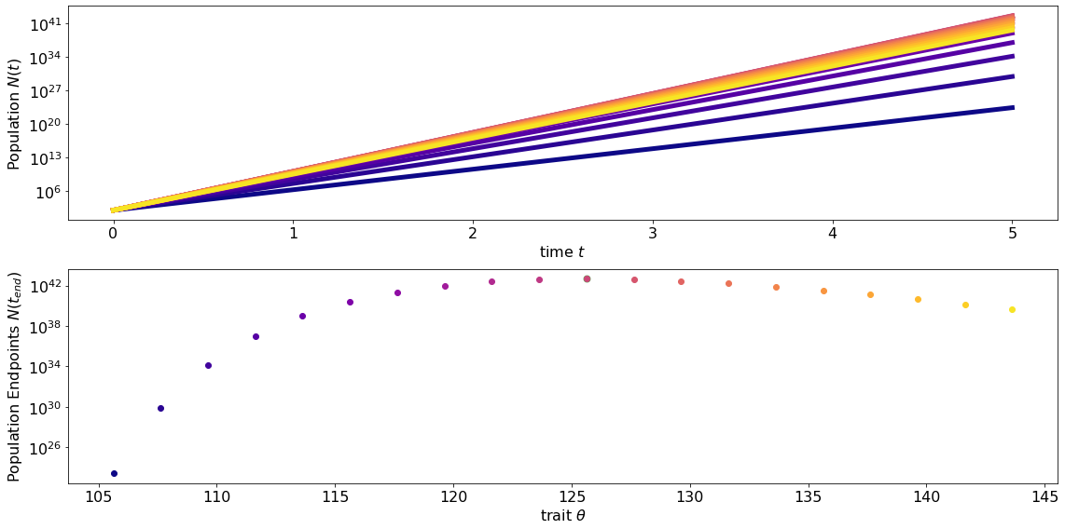
Evolution & optimization: solve the ODE
We solved the ODE for different peacock categories, that differ in the number of eye-spots.
As expected from the analysis beforehand, the peacocks with 125 eye-spots have a higher population at the end point of the simulation.
# peacocks
years
# peacocks

Slide 10
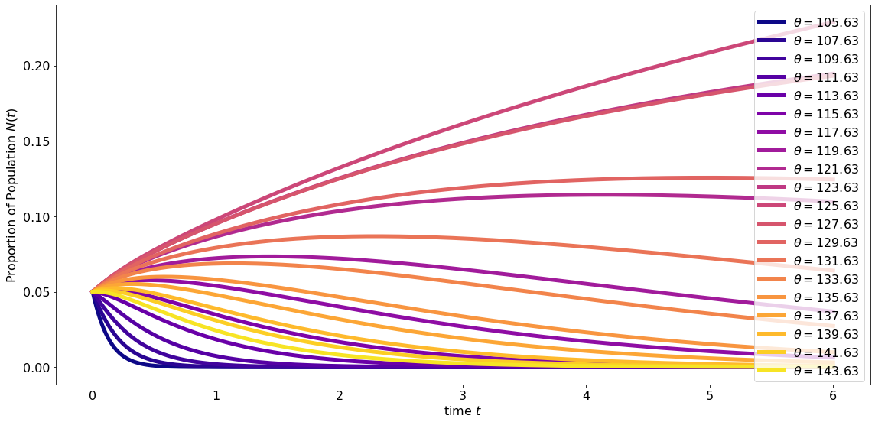
Evolution & optimization: solve the ODE
Here we are looking at the fractions of each category in the whole peafowl population.
Again, as expected from the analysis beforehand, the peacocks with 125 eye-spots comprise the highest percentage of the population at the end point of the simulation.
years

Slide 11
Python code
#Fractions
tmp_theta_list = [theta_list[max_index] + i*2 for i in range(-10, 10)]
state_init = [1/len(tmp_theta_list)]*len(tmp_theta_list)
params = tuple(tmp_theta_list)
def deriv_compare(state, t, *params):
s = lambda cur_theta: np.sum(np.array([(r(cur_theta) - r(theta))*state[i] for i, theta in enumerate(params)]))
pdots = np.array([state[i]*s(theta) for i, theta in enumerate(params)])
return pdots
# Long time scale:
t_list = np.linspace(0, 6, 1000)
ns = odeint(deriv_compare, state_init, t_list, args=params)
fig, ax = plt.subplots(figsize=(16,8), tight_layout=True)
for i, e in enumerate(zip(tmp_theta_list, ns.T)):
tmp_theta, sol = e
j = i/len(tmp_theta_list)
ax.plot(t_list, sol, color=plt.cm.plasma(j), label=f"$\\theta = {round(tmp_theta,2)}$")
ax.set_ylabel("Proportion of Population $N(t)$")
ax.set_xlabel("time $t$")
ax.legend()
# Peacocks numbers
tmp_theta_list = [theta_list[max_index] + i*2 for i in range(-10, 10)] # choose some thetas
state_init = [100]*len(tmp_theta_list) # make the same number of initial populations
params = tuple(tmp_theta_list)
def deriv(state, t, *params):
return np.array([r(theta)*state[i] for i, theta in enumerate(params)])
t_list = np.linspace(0, 5, 100)
ns = odeint(deriv, state_init, t_list, args=params)
fig, ax = plt.subplots(2, 1, figsize=(16,8), tight_layout=True)
for i, e in enumerate(zip(tmp_theta_list, ns.T)):
tmp_theta, sol = e
j = i/len(tmp_theta_list)
print(tmp_theta)
if tmp_theta == theta_list[max_index]:
ax[1].scatter(tmp_theta, sol[-1], s=50, color="green", alpha=0.5, label="optimal growth") # this dont plot for some reason...
ax[0].plot(t_list, sol, color=plt.cm.plasma(j), label=f"$\\theta = {round(tmp_theta,2)}$")
ax[1].scatter(tmp_theta, sol[-1], color=plt.cm.plasma(j), label=f"$\\theta = {round(tmp_theta,2)}$")
ax[0].set_ylabel("Population $N(t)$")
ax[0].set_xlabel("time $t$")
ax[0].set_yscale("log")
ax[1].set_ylabel("Population Endpoints $N(t_{end})$")
ax[1].set_xlabel("trait $\\theta$")
ax[1].set_yscale("log")
11

